Slide 1
CONVERTIAN
BY
SYNERGETIKS

Slide 2
TEAM SYNERGETIKS
ROLL NO | NAME
9362 | VINIT RAMAN DAVE
9377 | JONATHAN SURESH JOSEPH
9384 | AMEY JOTIBA MANAGUTE
9386 | JACOB SURESH MIRE
MENTOR: | MRS.PRAJKTA DHAMANSKAR

Slide 3
INDEX
SR.NO | NAME
1 | INTRODUCTION
2 | PROBLEM STATEMENT
3 | OBJECTIVE
4 | SCOPE
5 | COMPARISON
6 | UML DIAGRAMS
7 | TECHNOLOGIES REQUIRED
8 | REFERENCES

Slide 4
INTRODUCTION
IN TODAY'S ONLINE ERA WHERE EVERYONE IS WORKING AND STUDYING AT HOME ,THERE IS A CONSTANT NEED OF CONVERTING VARIOUS THINGS SUCH AS PDFS ,WORD FILES ,IMAGE FILES FROM ONE FORMAT TO ANOTHER.
AT THE SAME TIME, STUDENTS ALSO REQUIRE UNIT /MEASUREMENT CONVERTERS , CURRENCY CONVERTERS , WEIGHT CONVERTERS , AREA CONVERTERS ,VOLUME CONVERTERS ,FILE CONVERTERS AND MUCH MORE
WE AT SYNERGETIKS HAVE COME UP WITH A SOLUTION TO ALL THIS AND WE PRESENT TO YOU CONVERTIAN ,CONVERTIAN IS A WEBSITE THAT CONVERTS ALL UNITS; FROM TEMPERATURE TO CURRENCIES AND EVERYTHING IN BETWEEN.

Slide 5
PROBLEM STATEMENT
TO CREATE AN UPDATED AND ORGANIZED WEBSITE WHICH IS NOT SUBJECT LIMITED, PRESENTABLE , EASY AND CONVENIENT TO USE ALL IN ONE PLACE.
WE AIM AT MAKING AN USER-FRIENDLY WEBSITE, WITH AN EASY TO USE AND EASILY UNDERSTANDABLE INTERFACE. WE PLAN TO ACHIEVE THIS BY USING APPROPRIATE OPTIONS TO SELECT THROUGHOUT THE WEBSITE.

Slide 6
OBJECTIVE
TO MAKE A CONVENIENT WEBSITE THAT CONVERTS ALL TYPES OF QUANTITIES AND UNITS AT ONE PLACE.THE FOLLOWING ARE THE LIST OF ALL THE CONVERSIONS POSSIBLE THROUGH CONVERTIAN:-
LENGTH CONVERTER(MM,CM,M,KM,MILES,YARDS ,FT,INCHES, LIGHTYEARS)
WEIGHT CONVERTER(MG,G,KG,TONS,POUNDS,QUINTAL)
AREA CONVERTER(MM²,CM²,KM²,ACRES,HECTARES)
VOLUME CONVERTER(MM,CM,M,LITRES,KILO LITRES)
IMAGE TO PDF CONVERSION
PDF TO WORD DOC CONVERSION
TEMPERATURE CONVERTER(F°,C°,K)
PRESSURE(PSI,PA,KPA,BARR,ATM,TOR)
CURRENCY(RUPEES,DOLLARS,BRITISH POUNDS,DIRHAMS AND MANY MORE……)
NUMBER SYSTEM CONVERSION(BINARY,DECIMAL,OCTAL,HEXADECIMAL)
POWER CONVERSION(MW,WATTS,MW,GW,HP)
ANGLE CONVERSIONS(DEGREES,RADIANS)
IMAGE COMPRESSION

Slide 7

SCOPE
OUR WEBSITE COVERS ALL DOMAINS OF CONVERSIONS FROM FINANCIAL,SCIENTIFICAL,MATHEMATICAL ALL THE WAY TO DOCUMENT CONVERSIONS.

Slide 8
COMPARISON
NAME | UNIVERSALLY COMPATIBLE RESOLUTION | EASE OF USAGE | QUANTITY OF CONVERSIONS
https://www.onlineconversion.com/ | 🗶 | 🗶 | ✔
https://www.everythingconverter.com/ | ✔ | ✔ | 🗶
https://www.calculatorsoup.com/calculators/conversions/index.php | ✔ | 🗶 | subject limited
https://www.metric-conversions.org/time-conversion.htm | ✔ | 🗶 | 🗶
https://www.digikey.com/en/resources/online-conversion-calculators | ✔ | 🗶 | subject limited

Slide 9
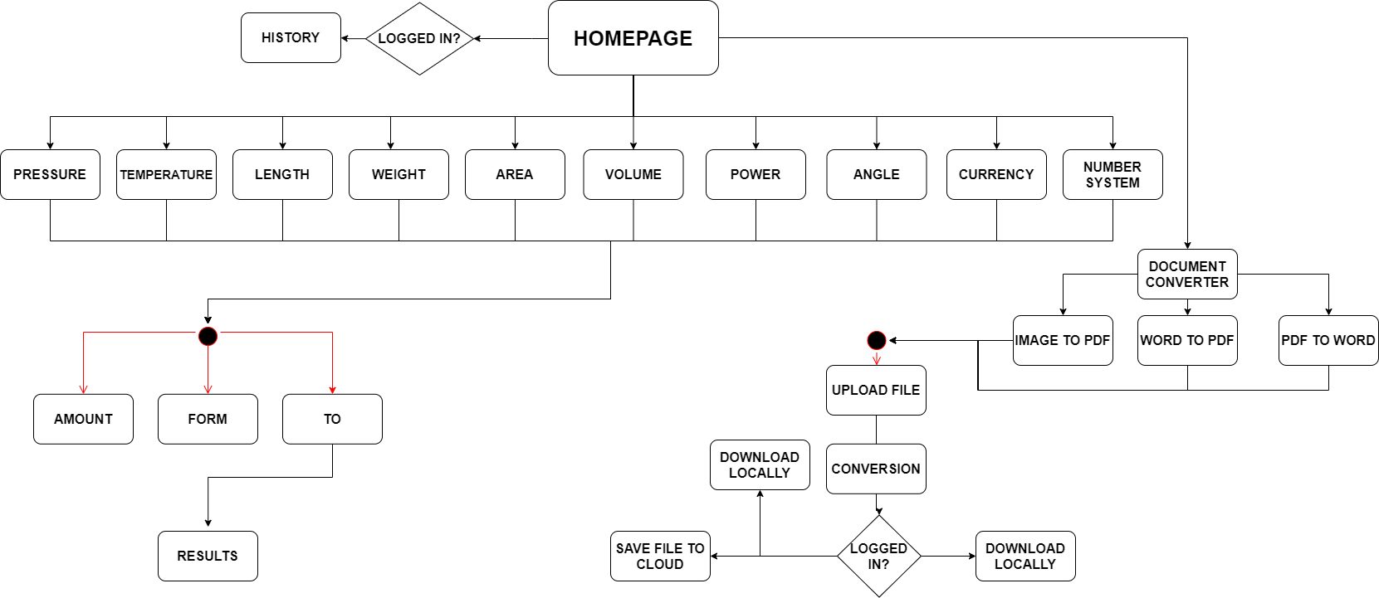
BLOCK DIAGRAM

Slide 10
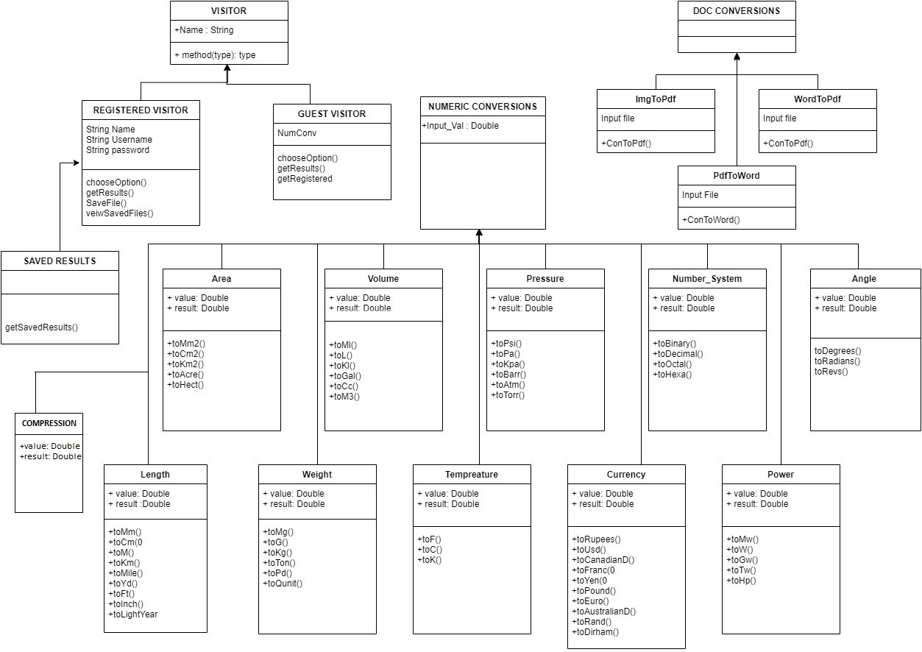
CLASS DIAGRAM

Slide 11
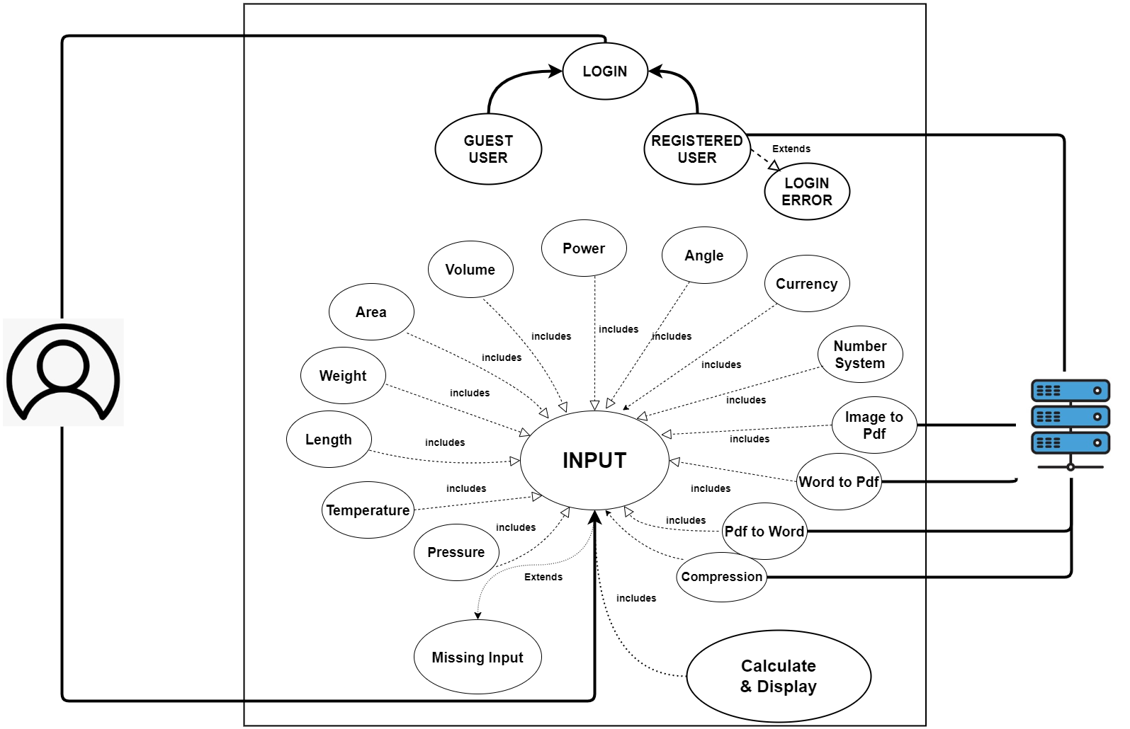
USE CASE DIAGRAM

Slide 12
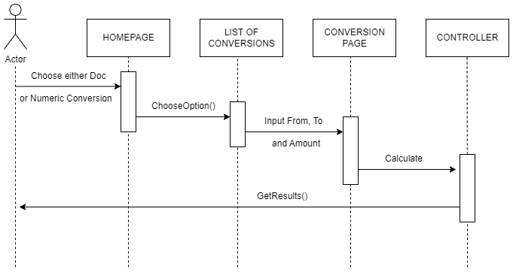
SEQUENCE DIAGRAM

Slide 13
TECHNOLOGIES REQUIRED
FRONTEND PROGRAMMING
HTML FOR DESCRIBING THE STRUCTURE OF WEB PAGES.
CSS FOR DEFINING THE STYLES FOR WEB PAGES.
BOOTSTRAP TO ADD DYNAMIC BEHAVIOR TO THE WEBPAGE AND ADD SPECIAL EFFECTS TO THE WEBPAGE.
BACKEND PROGRAMMING
PYTHON FOR WEB DEVELOPMENT, DATABASE CONNECTIVITY,
DJANGO AS FRAMEWORK
FIREBASE AS DATABASE
VSCODE AS AN IDE

Slide 14
IMPLEMENTATION DETAILS
• For image to pdf, we have used pillow library.Using this library we can convert image to pdf
• For currency conversions we have used forex-python which uses forex api (The Forex API is a free service for Current and historical foreign exchange rates built on top of data published by European Central Bank).
• For bitcoin price it uses coindesk api(coindesk is cryptocurrency exchange platfrom).
• For the scientific conversions such as(weight,temperature, volume,pressure,numbersystem,angle,length)we Are using simple formulas.
• The converted files and compressed images are stored on firebase cloud storage.
• We are using Python Imaging Library(Pillow) for image compression which takes compression parameter (1 from extreme image compression and 100 for lighter compression)

Slide 15
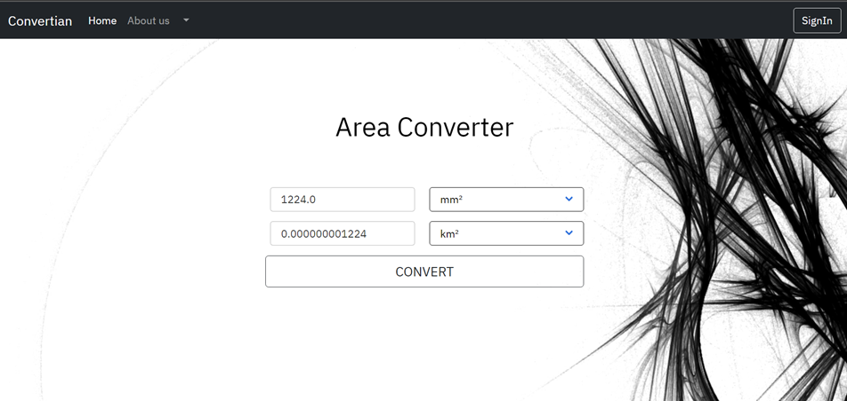
RESULTS

Slide 16
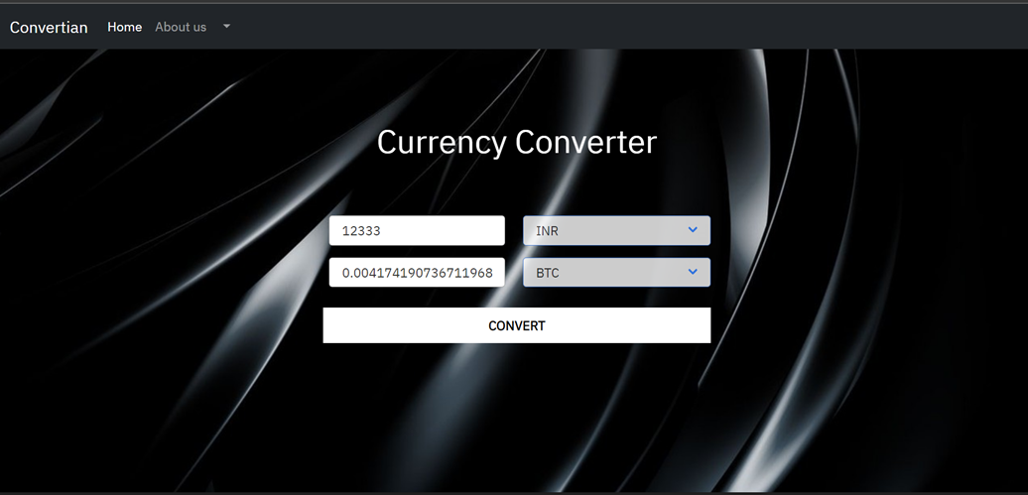

Slide 17
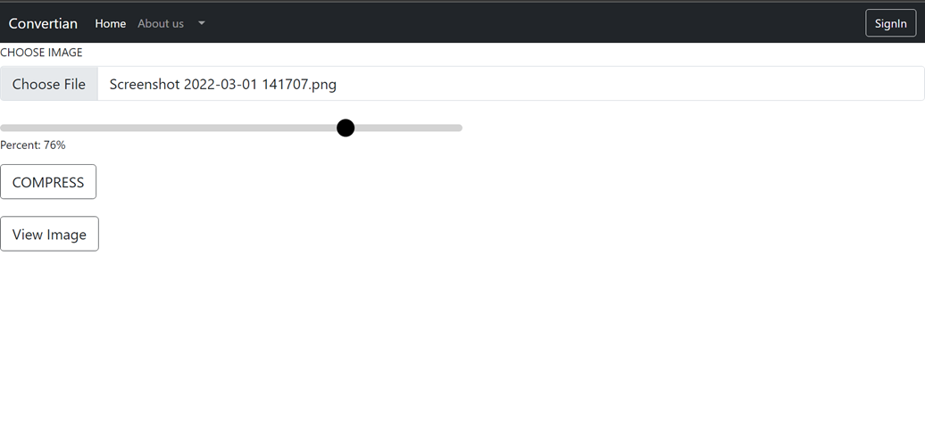

Slide 18
CONCLUSION
We aim to create website having priority as user’s comfort and easy to operate layout .By implementing the Web Development knowledge, we learnt throughout this process in creating absolutely simple design which makes operating self-explanatory.

Slide 19
Future Work
There is scope for future development of this project. To keep abstract of technical improvements, the system may be further refined.
So, enhancements can be made to improve the experience and usability of our website. We can improve the UI to improve our user experience. We can add more conversion if possible . We can improve user management show them their previous records of conversions which they have performed.
We can host this website if possible .

Slide 20
REFERENCES
Documentation :
https://getbootstrap.com/docs/5.1/getting-started/introduction
https://docs.djangoproject.com/en/4.0/
Videos:
https://www.youtube.com/watch?v=8wa4AHGKUJM
https://www.youtube.com/watch?v=HdoPg2e_m9s&list=PLu0W_9lII9ah7DDtYtflgwMwpT3xmjXY9&index=2
Websites:
https://forex-python.readthedocs.io/en/latest/usage.html
https://www.section.io/engineering-education/integrating-firebase-database-in-django/
https://www.geeksforgeeks.org/django-authentication-project-with-firebase/#:~:text=Grant%20Permissions%20on%20Firebase%20Dashboard,Project%20using%20MVT%20in%20Django%20%3F

Slide 21
THANK YOU!
FROM TEAM SYNERGETIKS

