Slide 1


INTERNATIONALDEBT STATISITCS
INTERNATIONAL DEBT STATISTICS
Presented By : Amey Pathare

Slide 2



PROJECT DETAILS
Domain: Finance
Tools Used : Excel, SQL, Power BI
Solution: Power BI & Github Link
INTERNATIONAL DEBT STATISTICS

Slide 3

PROBLEM STATEMENT
INTERNATIONAL DEBT STATISTICS
Majorly on Developing Countries they have to pay high price to service their debts and the cost is born by people with high poverty. They had to deal with the repayments that will be made in hard currencies.
Developing countries were hurt the most in the worldwide recession. The high cost of fuel, high interest rates, and declining exports made it increasingly difficult for them to repay their debts.

Slide 4

OBJECTIVE
INTERNATIONAL DEBT STATISTICS
The Objective is to minimise the interest cost of servicing the debt to the taxpayer and to employ it contra-cyclically as a stabilisation weapon to supplement monetary and fiscal policy. The dataset contains information about the amount of debt (in USD) owed by developing countries across several categories. You have to analyze international debt data collected by The World Bank.

Slide 5

BENEFITS
INTERNATIONAL DEBT STATISTICS
Overall International Debt Data
Total Debt Owed by Various Countries And Overall Countries
Average Amount By Different Countries Across Different Indicators
Highest Debt By Various Countries
Average Debt Across Indicators
Principal Repayments Across The Highest Average Debt
The Most Common Indicator

Slide 6
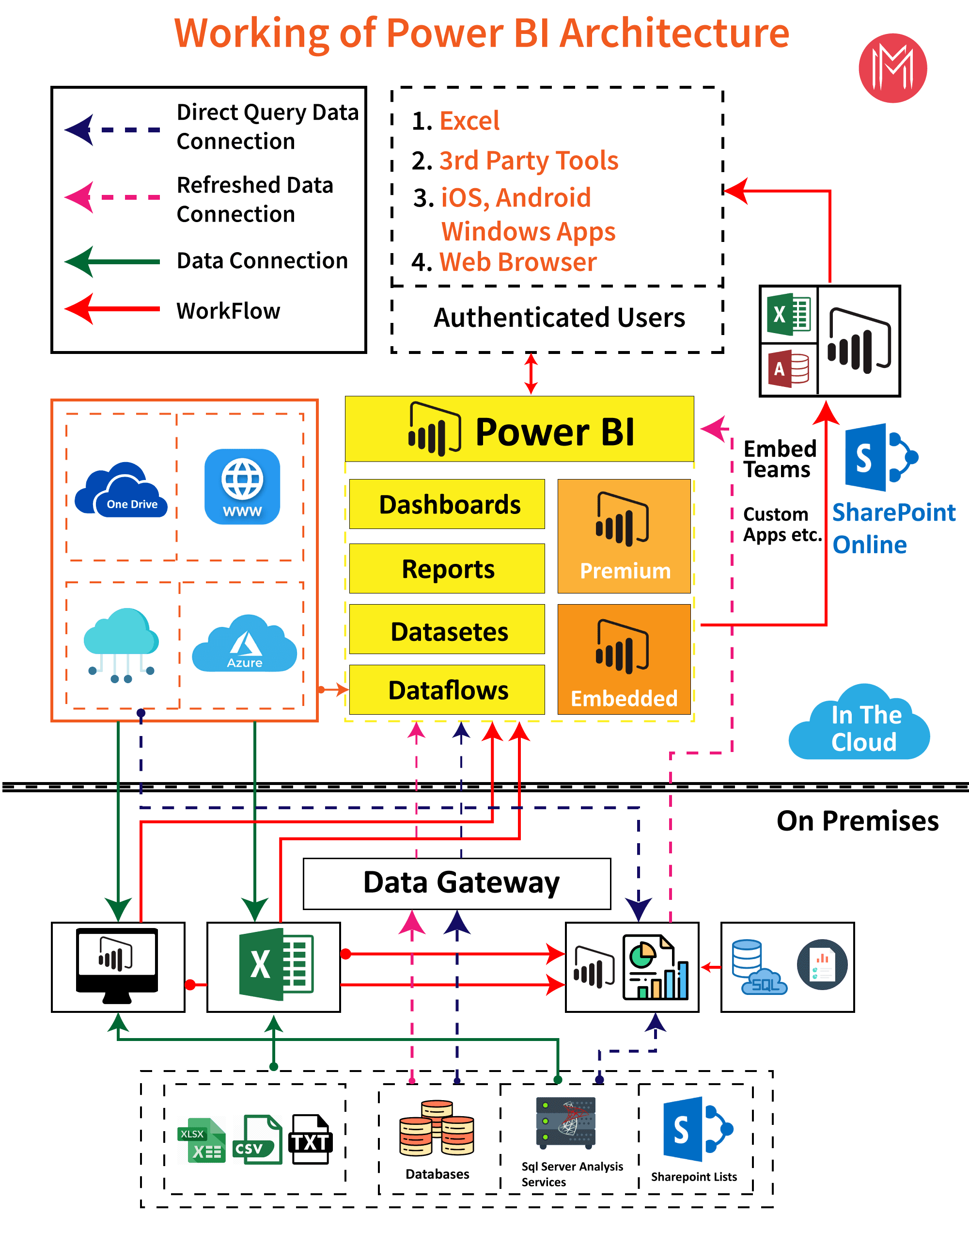
ARCHITECTURE
INTERNATIONAL DEBT STATISTICS

Slide 7
PROCESS FOR VISUALIZATION
Business Understanding:
While analyzing the data for the industry we should have clear overview and understanding of the industry what it does, what kind of decision they are going to make, for which purpose the data is being analyzed, this all data analyzing process is started with a question
INTERNATIONAL DEBT STATISTICS
2. Acquiring The Raw Data:
This is the step where after defining the question, data is collected from the different source such as data warehouse, logs, and data set to answer those question, row data is queried to answering the questions but this is not the raw data set, instead we need to call it raw data because it is not exactly in the form of where we want it to analyzing.

Slide 8
3. Extracting The Data :
This is the step where data is extracted to create a final data set. that will allow us to leads the further analyzing process this is a clean data set. SQL is used for extracting the data from the database. the database which is queried to extract the data having several rows exceed 1 Million. where database query languages like SQL enables an Analyst to analyze and transform data easily. SQL is the first thing you should learn as it enables you to work on the dataset.
INTERNATIONAL DEBT STATISTICS
4. Transforming The Data:
Data transformation is the process of converting the data or dataset from on state or structure to another state structure, it is the fundamental state of data integration where the data collected from different sources have been integrated into particular structured data in such manner that it can be used at a destination for analysis process this process is known as ETL(Extract Transform Load).

Slide 9
Analyzing the data:
There are many tools and languages available to carry out the data analysis, from the very advanced ones like SAS, SPSS, Tableau, Python, R to very basic and easy and most common ones like MS Excel.
One can use graphs, charts, and tables or pictures for Data Visualization to communicate the information in an effective way. Using Data Visualization techniques, a very complex data can be represented in a simplified and understandable manner.
INTERNATIONAL DEBT STATISTICS

Slide 10
Q & A
1. What is Power BI?
Power BI is a business analytics tool developed by Microsoft that helps you turn multiple unrelated data sources into valuable and interactive insights.
2. Why should we use Power BI?
Because Power BI provides an easy way for anyone, including non-technical people, to connect, change, and visualize their raw business data from many different sources and turn it into valuable data that makes it easy to make smart business decisions.
3. What is Power Pivot?
Power Pivot is an add-on provided by Microsoft for Excel since 2010. Power Pivot was designed to extend the analytical capabilities and services of Microsoft Excel.
4. What is Power Query?
Power Query is a business intelligence tool designed by Microsoft for Excel. Power Query allows you to import data from various data sources and will enable you to clean, transform and reshape your data as per the requirements. Power Query allows you to write your query once and then run it with a simple refresh.
5. What is DAX?
DAX stands for Data Analysis Expressions. It's a collection of functions, operators, and constants used in formulas to calculate and return values. In other words, it helps you create new info from data you already have.
INTERNATIONAL DEBT STATISTICS

Slide 11
6. Mention some advantages of Power BI.
It helps build an interactable data visualization in data centers
It allows users to transform data into visuals and share them with anyone
It establishes a connection for Excel queries and dashboards for fast analysis
It provides quick and accurate solutions
7. What are the different views available in Power BI Desktop?
There are three different views in Power BI, each of which serves another purpose:
Report View - In this view, users can add visualizations and additional report pages and publish the same on the portal.
Data View - In this view, data shaping can be performed using Query Editor tools.
Model View - In this view, users can manage relationships between complex datasets.
8. What is DBMS?
A Database Management System (DBMS) is a program that controls creation, maintenance and use of a database.
9. What is SQL?
SQL stands for Structured Query Language , and it is used to communicate with the Database. This is a standard language used to perform tasks such as retrieval, updation, insertion and deletion of data from a database.
INTERNATIONAL DEBT STATISTICS

Slide 12

INTERNATIONAL DEBT STATISTICS

