Slide 1

HOPE FOUNDATION’s International Institute of Information Technology
BE Project On
“ QR Code based Attendance System”
Class: BE IT SEM: VIII
Academic Year: 2021-22
Guide: Prof. Manjusha Amritkar
Students Name: Yash Jane, Amey Potnurwar, Siddhi Agarwal, Sneha Dixon

Slide 2
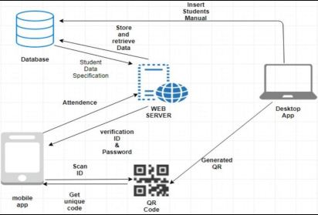
Problem Statement
“QR Code based Attendance System”

Slide 3
Purpose
To prevent any malpractices and unauthorized access to digital information.
Data collection, organization, report generation is exhausting process and is prone to cause errors.
By using this application users are not allowed to mark their proxy.
Attendance marking manually is tedious and long process for teachers as well as students.

Slide 4
Scope
A web application for the teachers to generate the QR code and maintain the attendance record.
A web application for students to scan the QR code displayed on the screen and mark their attendance.
A fully automated system to maintain the records.

Slide 5
Objectives
The idea of our project is to digitize the way attendance is taken in colleges and gives a more comfortable and easier experience while taking attendance. Tracking of attendance is entirely web-based so the data can be entered from anywhere you can access the internet.
This concept is viable, and it is a prerequisite among college and university professors. There is a need for a more robust and time-efficient way of attendance based on the current system. All colleges and universities that are eager to embrace digitization and make the work of taking attendance more convenient and efficient

Slide 6
Abstract
In order to track student engagement in the classroom, a student attendance system is necessary. Punch cards, log books, and fingerprint systems are among the manual presence-based attendance systems proposed. The administration demands careful attention, care, and strict devotion. In terms of processing time and accuracy, existing models are inefficient. So in our proposed system the student merely had to use his or her device to scan the QR code that the faculty would display. The flask API was used to design and executes the required tasks. This is an interesting way of automating the normal attendance system with authentication. The prior technique required manually entering student attendance in a register, which took time. As a result, the suggested project will make attendance tracking irrelevant.

Slide 7
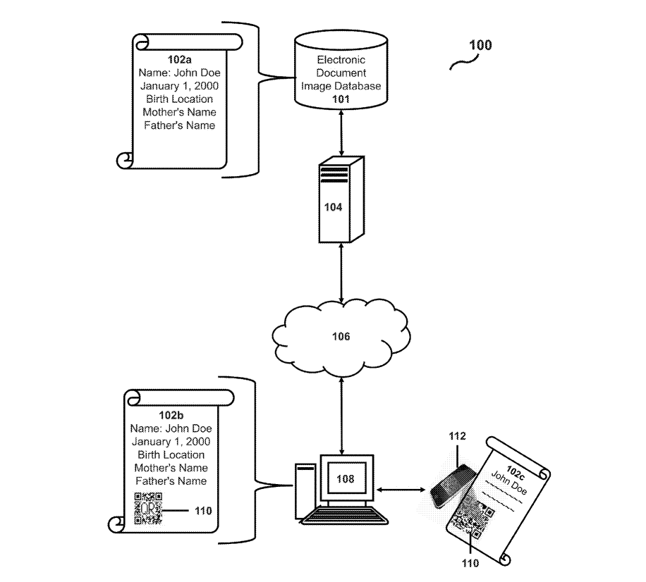
System Architecture
Introduction and System Overview

Slide 8
To achieve the above discussed objectives, a step-by-step methodology has been followed. The details of methodology are given below:
1]Generation a QR code
2]Scanning the QR code
Generation a QR code:
In the proposed system every QR code is embedded with a unique data for example (string). This is the specialty of the system also it generates a unique QR code every time for each and every student for every lecture in the class for a particular amount of time which is set by the server. The QR consist of a sting which has unique id and a time which will be valid for a given time these two attributes increase the authenticity of the QR and at the end the generated file will be saved as .png format for example <T18022.png>.By using smtp server we send unique QR code to student’s respective ID’s after generating in the form of png file.

Slide 9
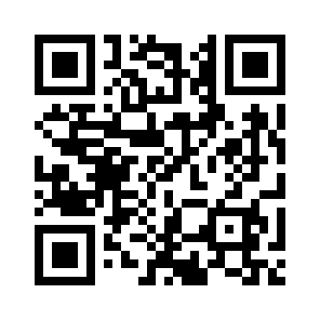
QR Architecture Formula For Generating the QR is a follow: QR= unique_id <space> generation_time e.g., t18063_43572886 Scanning the QR Code: The very first step is to open the application in student’s side and then open a scanner. after scanning the QR the scanner will get two attributes one will be student’s IRN string and other will be the time, Now the time which will the scanner give should be in the session time otherwise it will give be invalid. Also, a specific QR will be active for limited time only; after that it will be invalid also the system has master database table in which every record will be stored. Just after generating QR’s, in database table there is a status column in which every student will be marked as absent i.e. A, and after scanning the QR status will change to Present i.e., P.

Slide 10
Key Features
A web app for students, teachers and parents to operate, organize and monitor the attendance.
Proxy proof due to time + student’s unique id binded QR code (i.e., for e.g. a certain QR code is valid for only 35 min).
Unique QR code for every student for every lecture; sent to respective students via e-mail.
In-built QR code scanner in teacher dashboard for close monitoring of attendance marking procedure.
Facility to organize and maintain the attendance data in teacher's module.

Slide 11
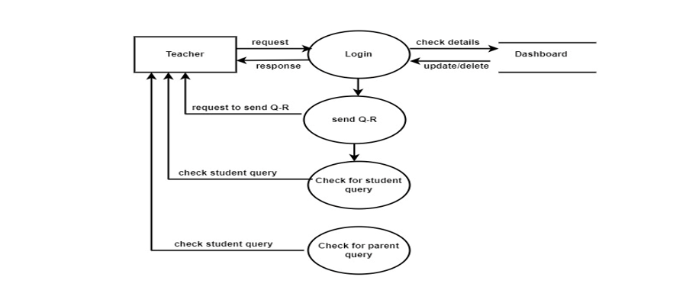
Teachers Dashboard

Slide 12
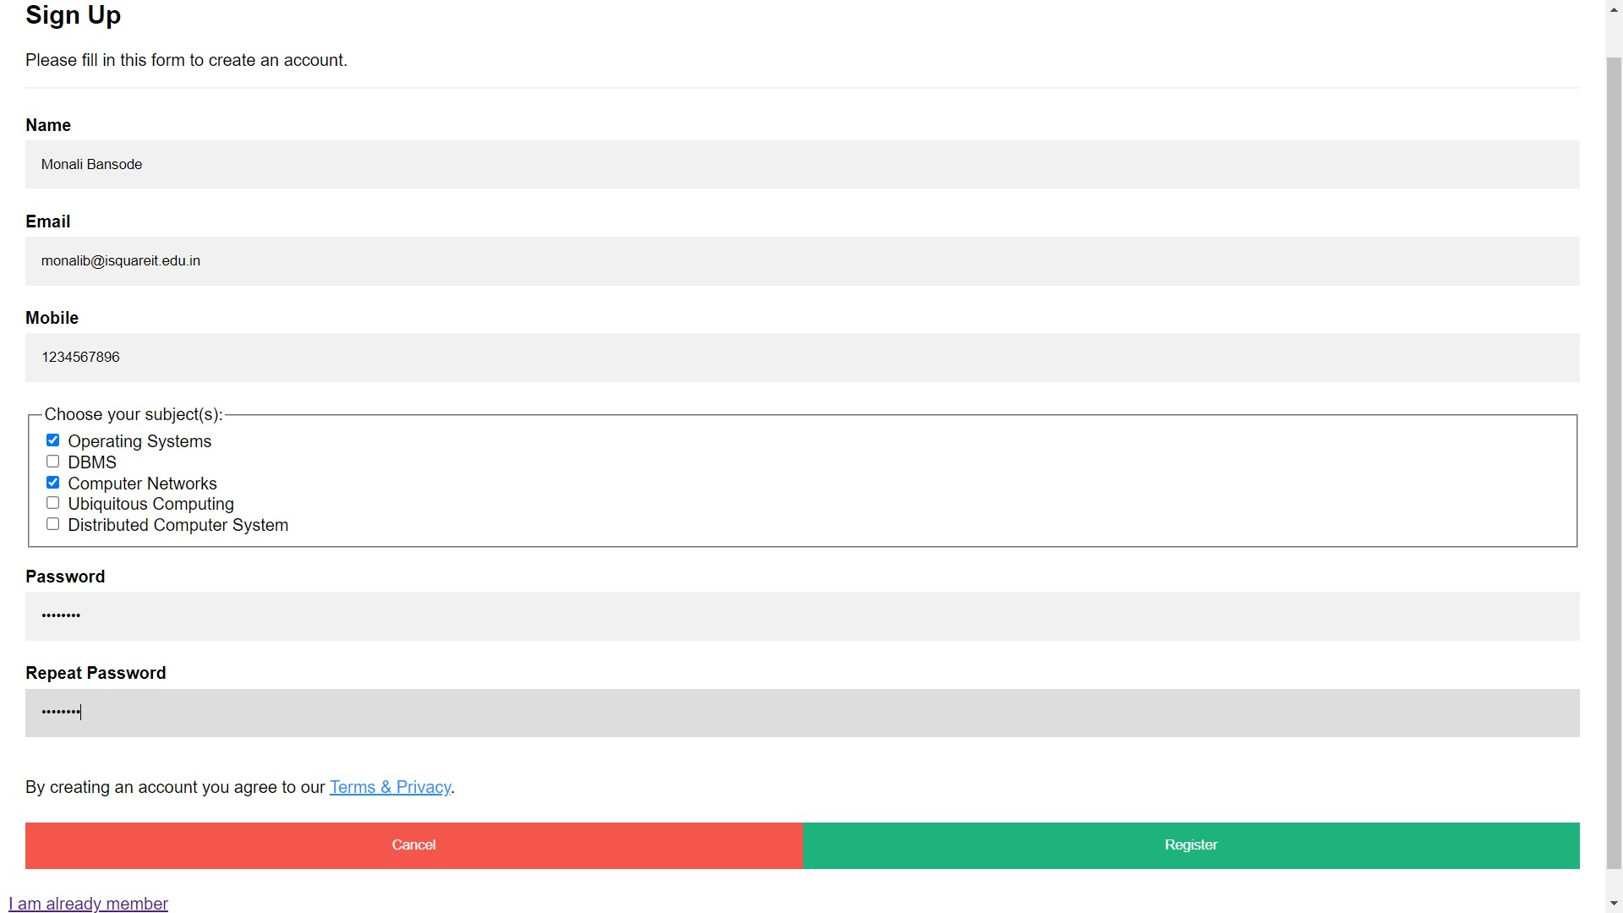
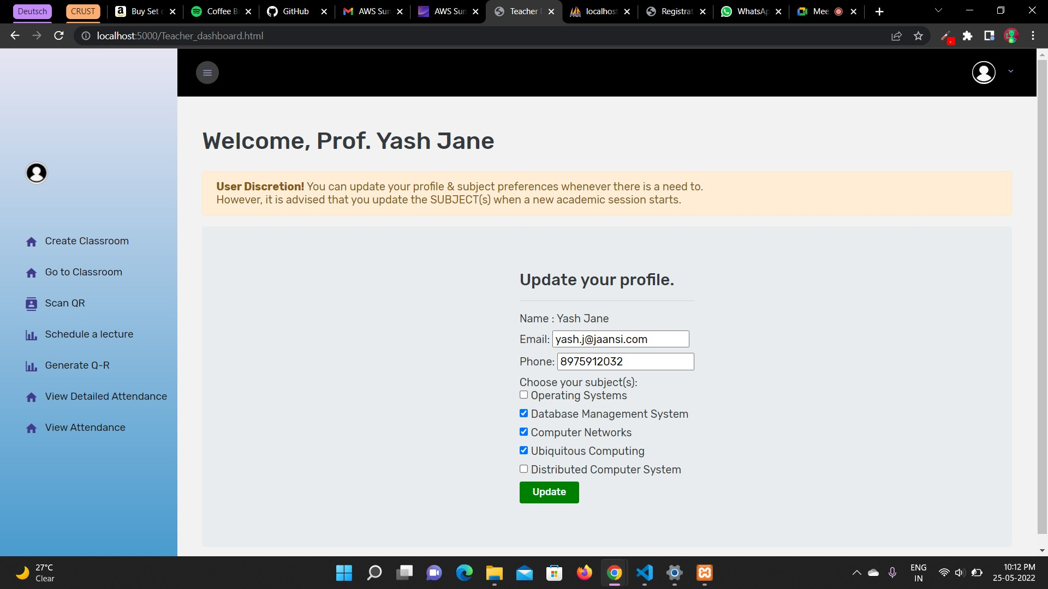
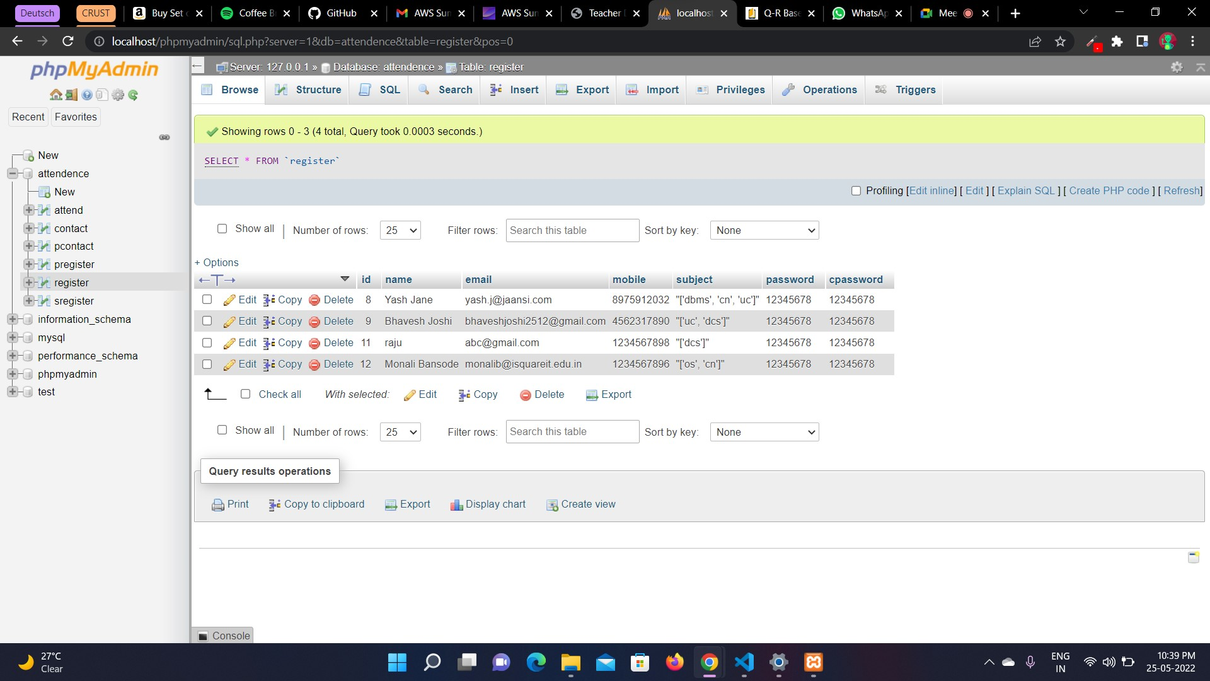
Teacher’s Portal UI and Database

Slide 13
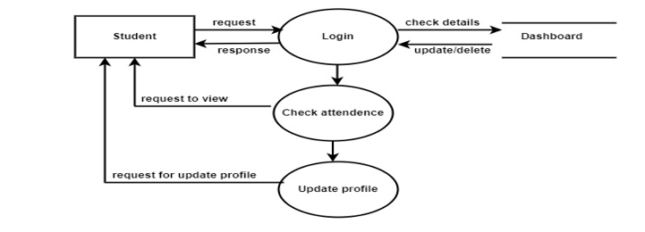
Students Dashboard

Slide 14
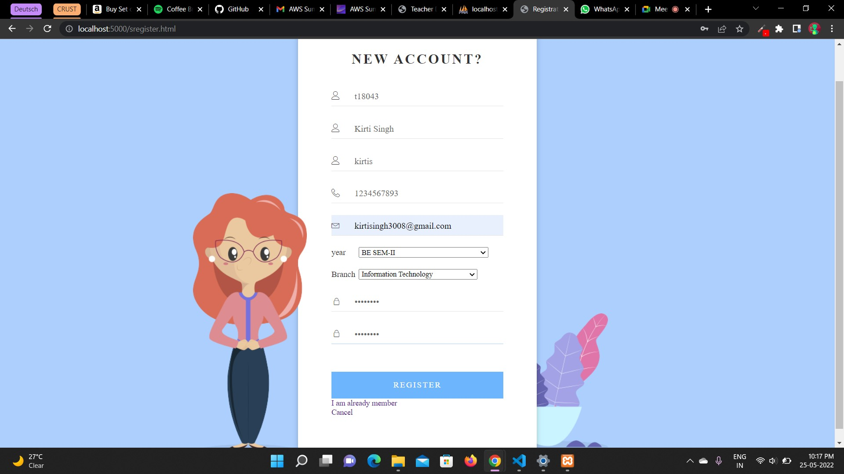
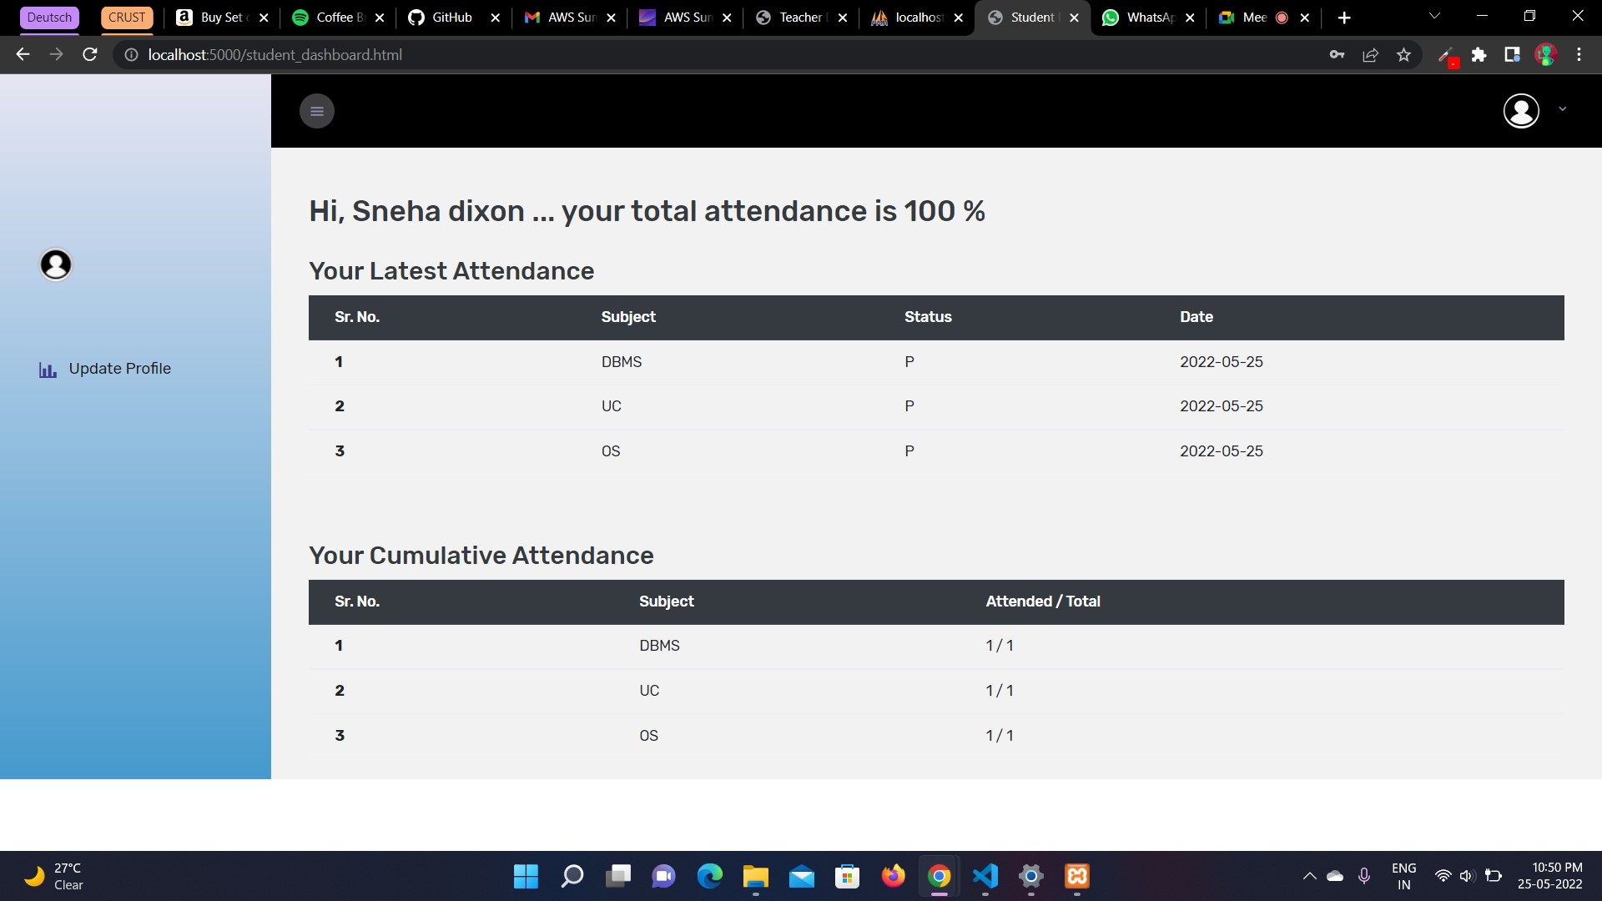
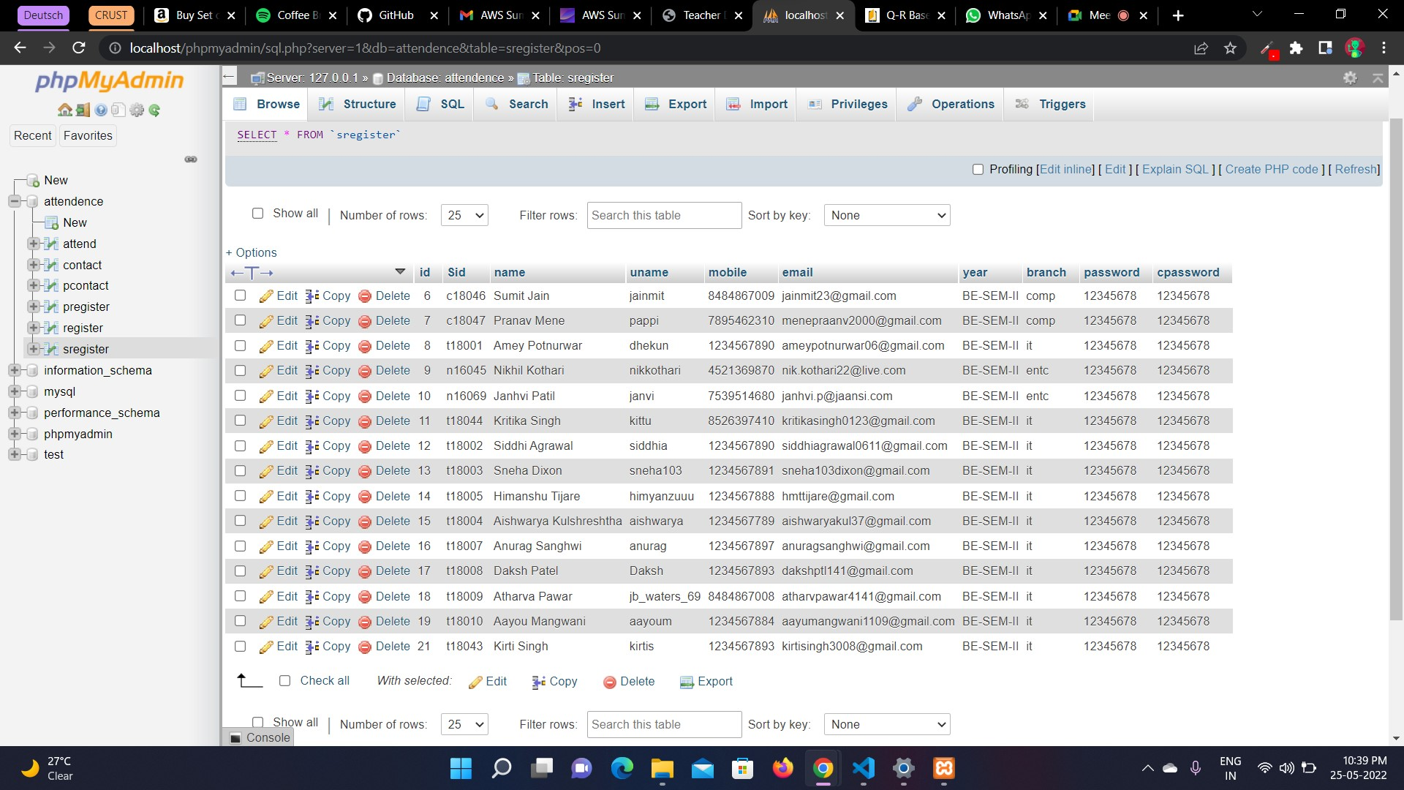
Student’s Portal UI and Database

Slide 15
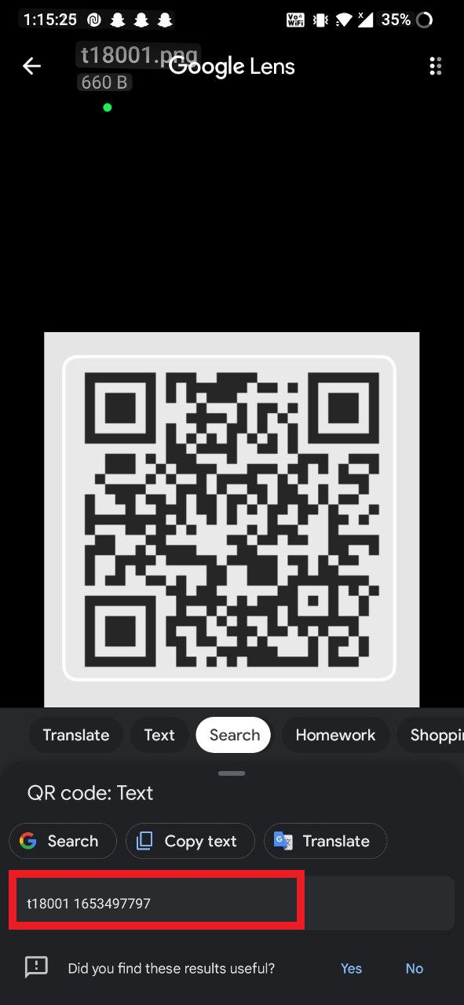
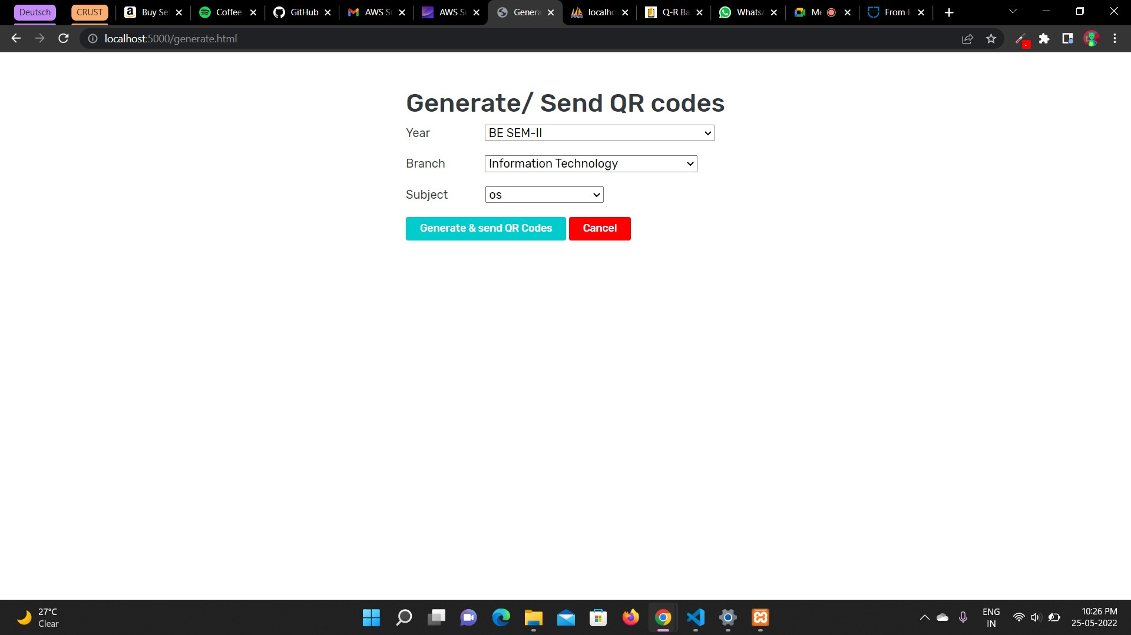
QR Code Generation

Slide 16
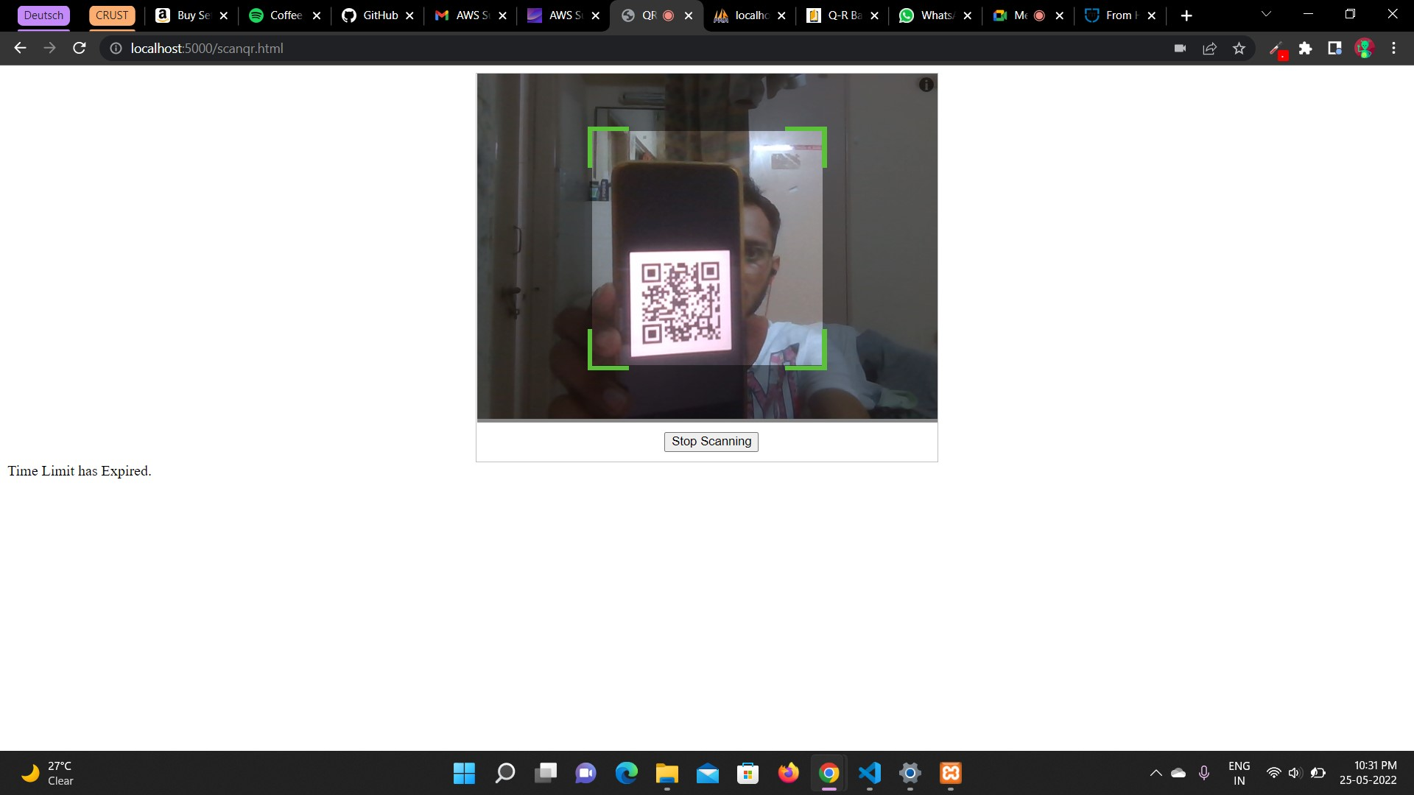
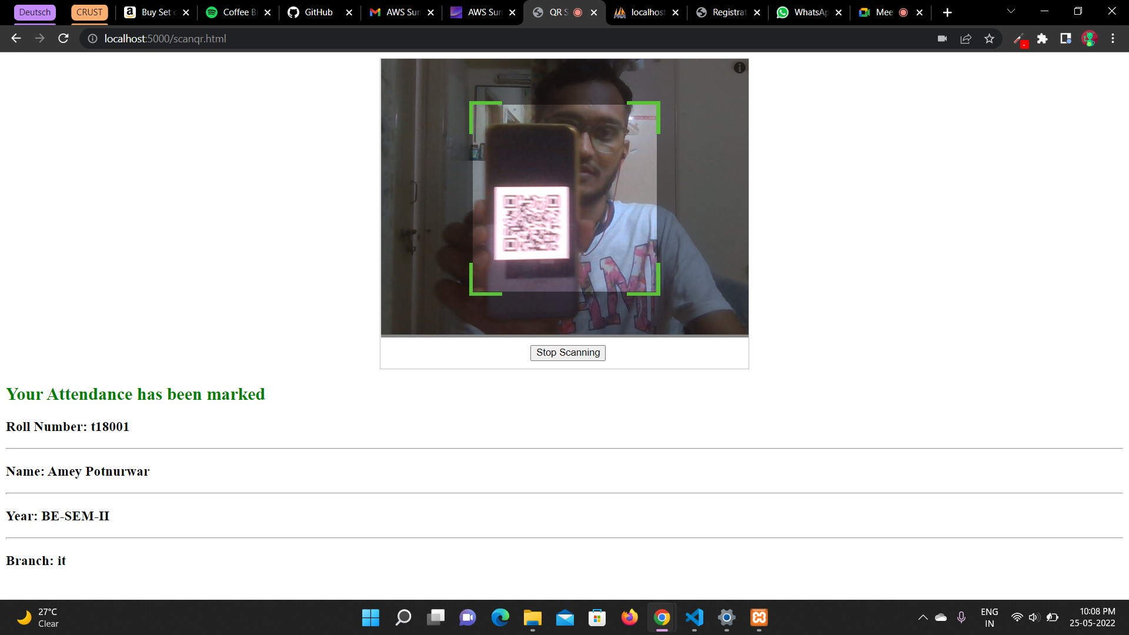
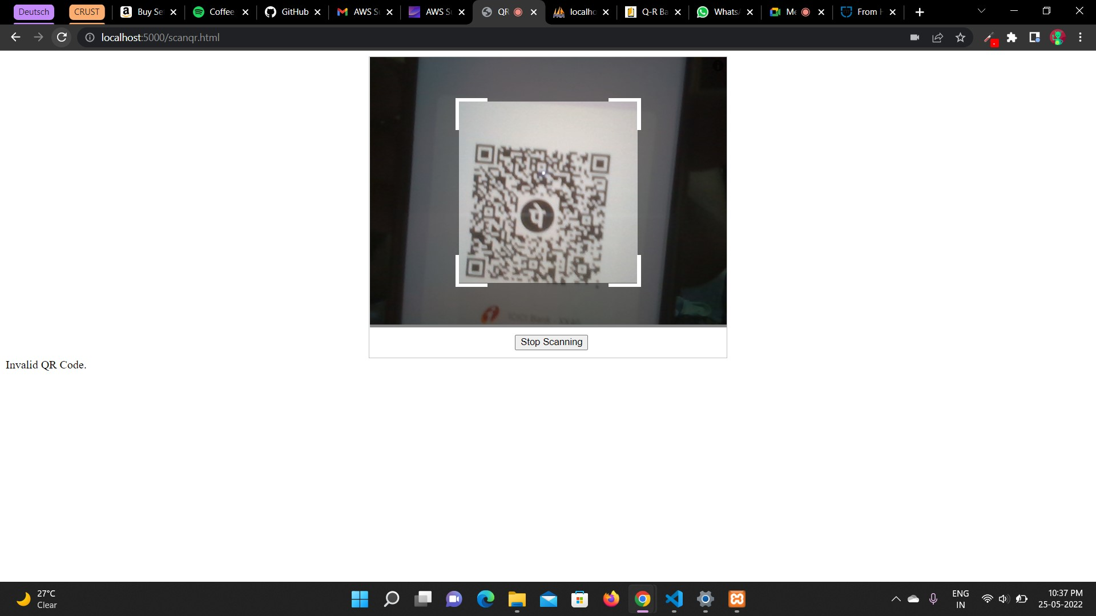
QR Code Scanning
Time limit Expired.
Attendance Marked Successfully
Invalid QR code (e.g.: PhonePe, Paytm, etc.)

Slide 17
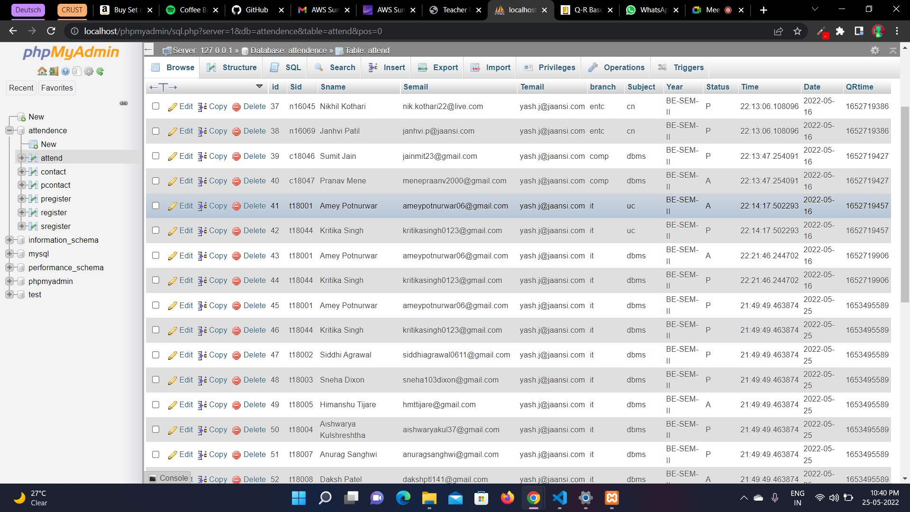
Attendance Database

Slide 18
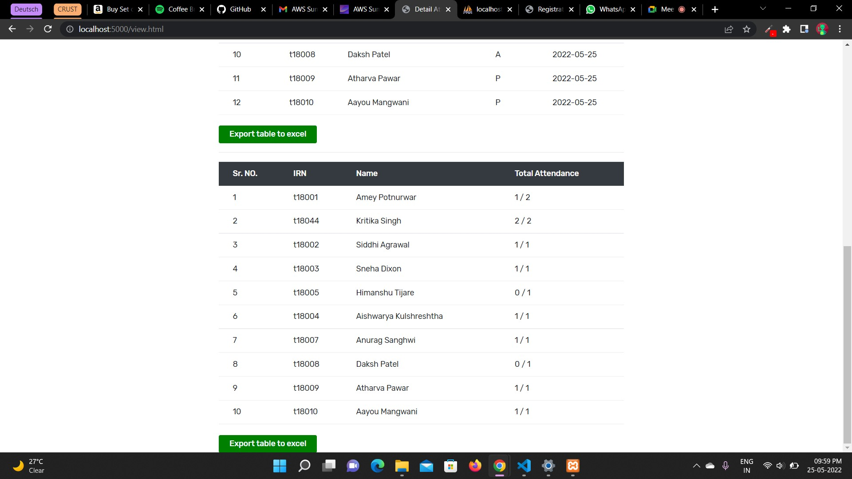
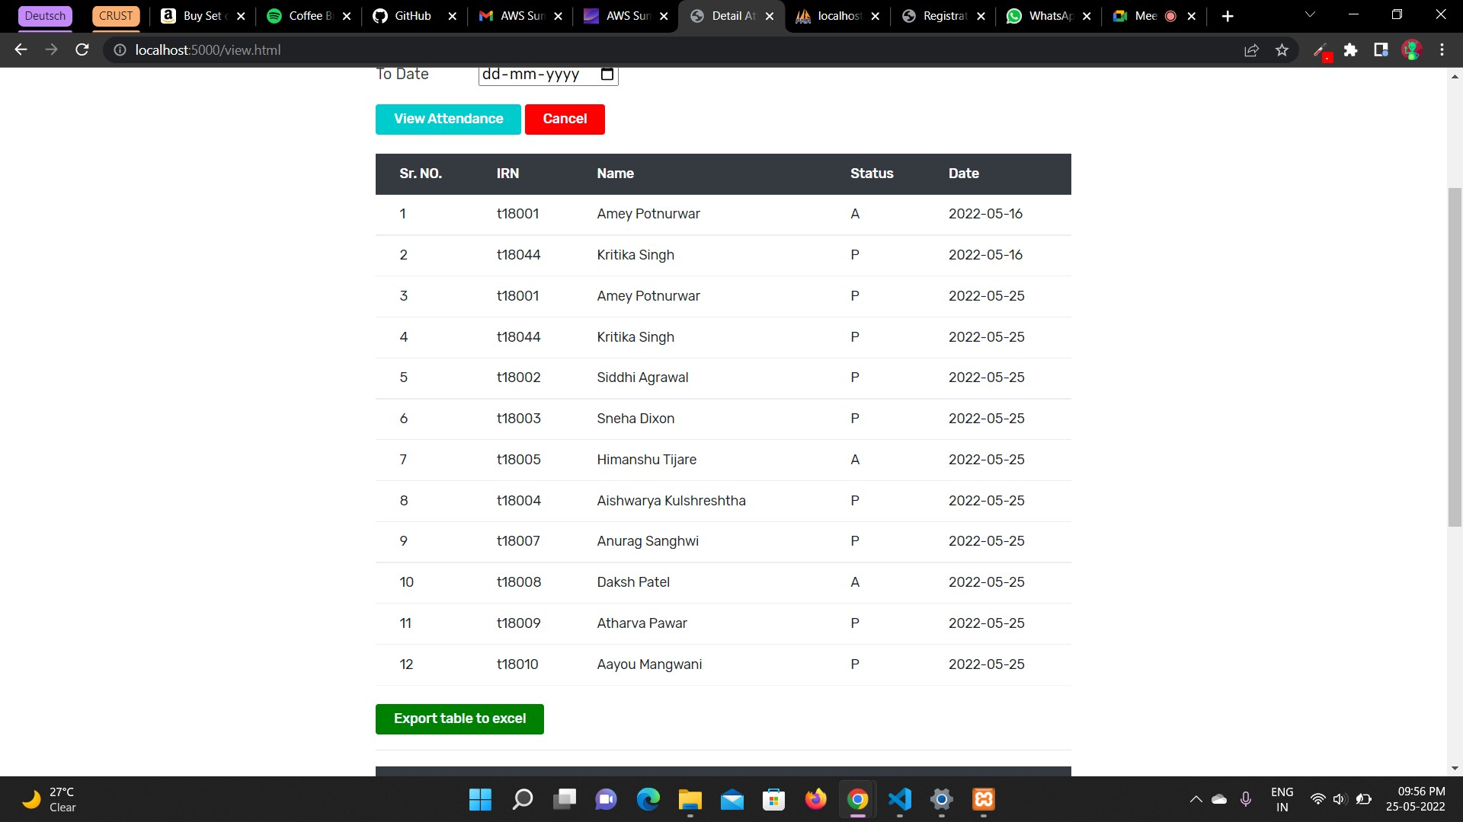
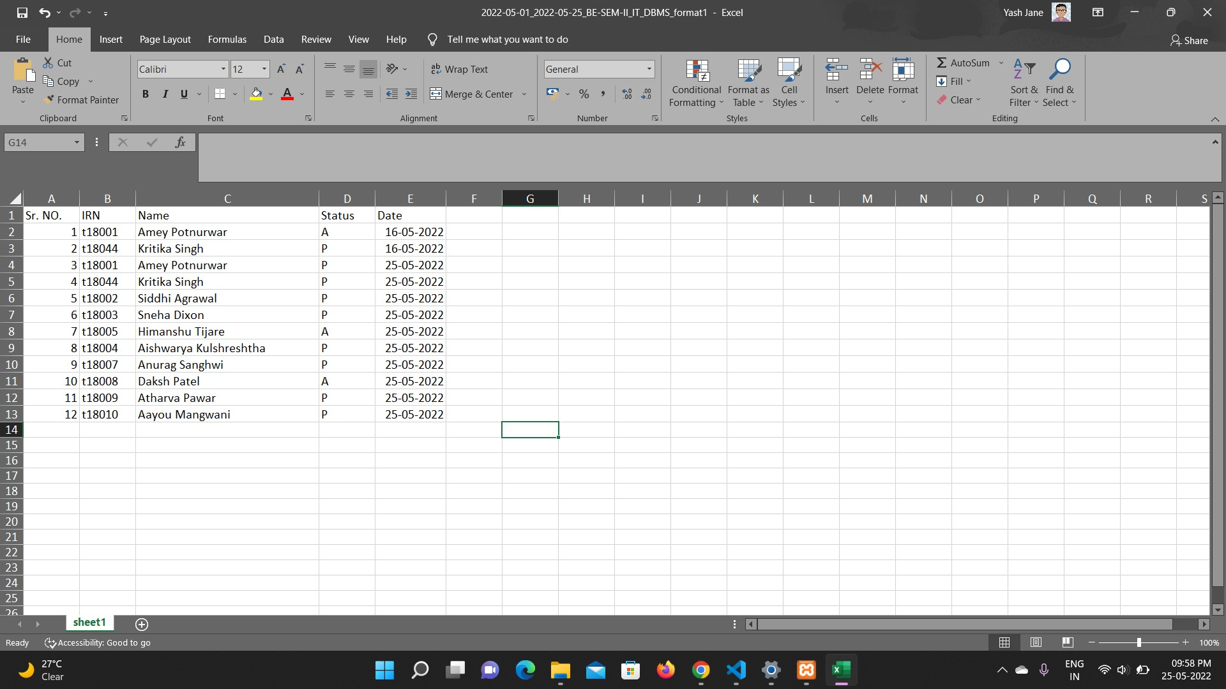
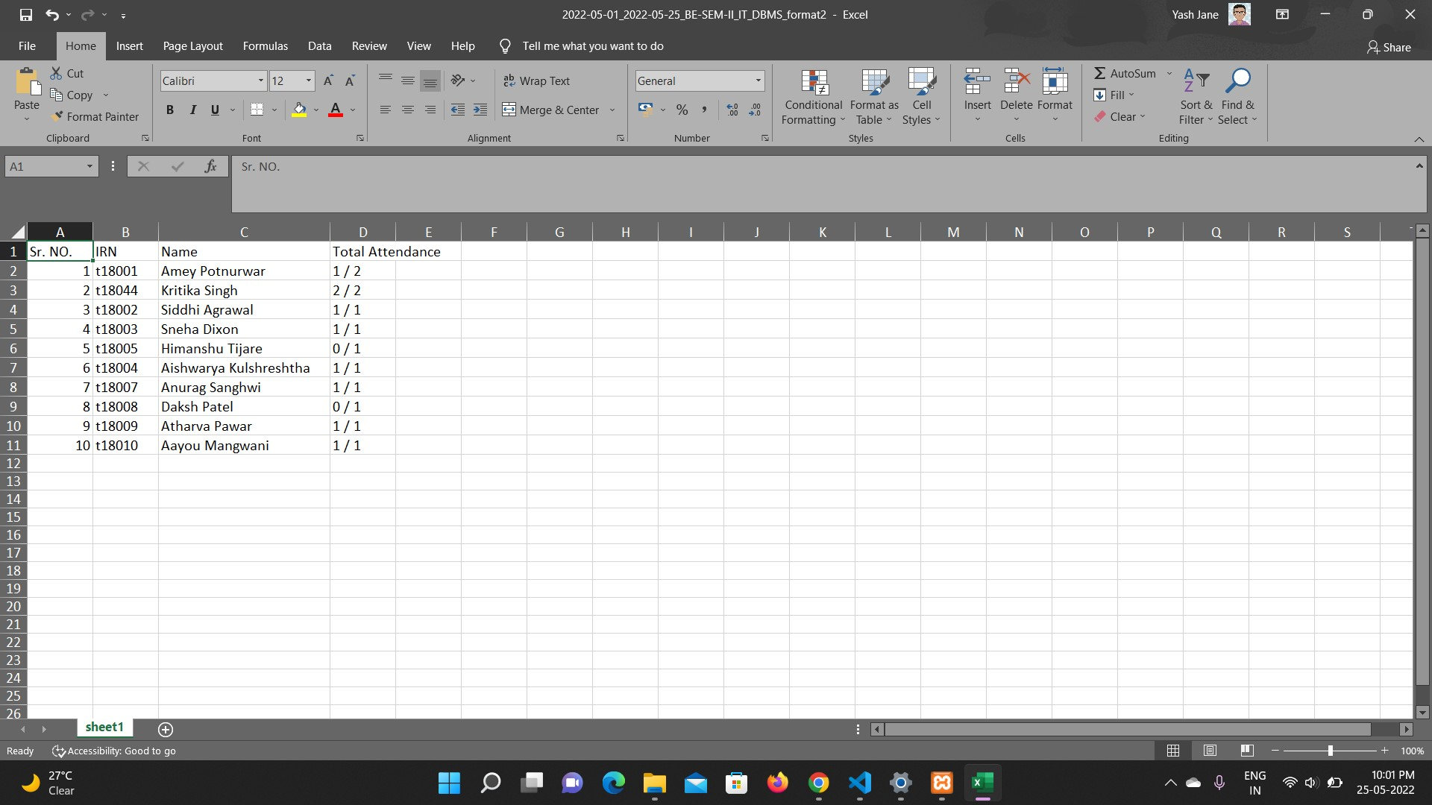
Attendance Report Generation

Slide 19
Applications
The light-weight design of the algorithm may enable it to pervade in many applications.
It can be used in the Web-apps and mobile apps that deals with sensitive information.
It will automate every problem related to attendance and make every process fast.
With the increasing IoT infrastructure it seems that this scheme will serve its purpose in IoT networks with some respective modifications.

Slide 20
Advantages
1. Students will be more punctual in attending class now that no signature on the attendance sheet is necessary.
2. Teachers do not have to squander 15 minutes of an hour of their time taking student attendance.
3. There is no need to keep track of attendance because it is saved electronically in a database.
4. The approach aids professors in quickly identifying defaulters.
5. A user can quickly obtain a student's attendance history.
6. It helps the institute save time, money, effort, and resources.

Slide 21
Literature Survey/ Related work
Wei, X., Manori, A., Devnath, N., Pasi, N., & Kumar, V. (2017). QR Code Based Smart Attendance System. International Journal of Smart Business and TechnologyAnkur Singhal, Sumedha Kaushik, “Network Security Using Cryptographic Techniques”, IJARCSSE - 2012, ISSN: 2277 128X, V2, Issue 12, PP 105 – 107.
] Masalha, F., & Hirzallah, N. (2014).A students attendance system using QR code. International Journal of Advanced Computer Science and Applications.

Slide 22
Conclusions
The potential application to eliminate the need for manual attendance taking at institutions across the country. This gives a low-cost automated alternative to the institution's current high-cost attendance management software. Scanning and taking attendance are considerably more enjoyable and user-friendly experiences for students and professors, enabling users save maximum effort and time while improving their experience. The overall structure of time value to the regular running of lectures will benefit users who scan and take attendance, as well as being identified as digital technology users. The project's future goals to incorporate it into a classroom platform and provide a full experience for the institution.

Slide 23
Thank you !
Questions & Answers

