Slide 1
Project Presentation

Slide 2
Introduction
Project Case Study
Project Walkthrough
Questions

Slide 3
Introduction to Hadoop Ecosystem
Big Data
Hadoop

Slide 4
Big Data
Big Data is a term that describes the large volume of data both structured and unstructured
Big Data can be analyzed for insights that lead to better decisions and strategic business moves

Slide 5
Hadoop
Hadoop is open-source software framework for storing data and running applications on clusters of commodity hardware
It provides massive storage for any kind of data, enormous processing power and ability to handle limitless concurrent tasks and jobs

Slide 6
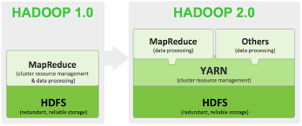
Hadoop

Slide 7
Hadoop advantage
Ability to store and process huge amounts of any kind of data quickly
Computing power
Fault tolerance
Flexibility
Low cost
Scalability

Slide 8
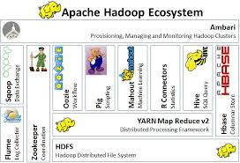
Hadoop Ecosystem

Slide 9
Hadoop Ecosystem
Hadoop Common
HDFS
YARN
MapReduce
Hive
Pig
Sqoop

Slide 10
Hadoop Ecosystem
Flume
Spark
HBase
Zookeeper
Oozie

Slide 11
Hadoop Common
Libraries and utilities used by Hadoop modules

Slide 12
Hadoop Distributed File System (HDFS)
Java-based scalable system that stores data across multiple machines

Slide 13
YARN (Yet Another Resource Negotiator)
YARN provides resource management for the processes running on Hadoop

Slide 14
MapReduce
A parallel processing software framework
It is comprised of two steps
Map step is a master node that takes inputs and partitions them into smaller sub-problems and then distributes them to worker nodes
Reducer step master node takes all answers to all sub-problems and combines them to produce output

Slide 15
Hive
A data warehousing and SQL-like language that presents data in the form of tables

Slide 16
Pig
A platform for manipulating data stored in HDFS that includes a compiler for MapReduce programs and a high-level language called Pig Latin
It provides a way to perform data extractions, transformations and loading and basic analysis without writing MapReduce programs

Slide 17
Sqoop
A connection and transfer mechanism that moves data between Hadoop and relational databases

Slide 18
Flume
Software that collects and aggregates and moves large amount of streaming data into HDFS

Slide 19
Spark
An open-source cluster computing framework with in-memory analytics

Slide 20
HBase
A non-relational distributed database that runs on top of Hadoop
HBase tables can serve as input and output for MapReduce jobs

Slide 21
Zookeeper
An application that coordinates distributed processing

Slide 22
Oozie
A Hadoop job scheduler

Slide 23
Project Case Study H1-B Case Study
The H1B is an employment-based, non-immigrant visa category for temporary foreign workers in the United States
For a foreign national to apply for H1B visa, an US employer must offer a job and petition for H1B visa with the US immigration department.
This is the most common visa status applied for and held by international students once they complete college/ higher education (Masters, Ph.D.) and work in a full-time position
Analysis on the H1B visa applicants between the years 2011-2016

Slide 24
Project Walkthrough
Demonstration of Executing Shell script
Technologies used during analysis
MapReduce
Hive
Pig
Sqoop

Slide 25
Questions

Slide 26
Thank You

