Slide 1
Image scraping and classification
Classification

Slide 2
requirements
Scrape Imgaes
Train a DL model to classify images

Slide 3
Phases
Data Scraping
Classification

Slide 4
Scraping
Step 1 : Scrape urls of product results
Step 2 : Scrape each url for the image source
Step 3 : Take screenshot of each driver window post loading the image source url
Step 4: Save images in local directory

Slide 5
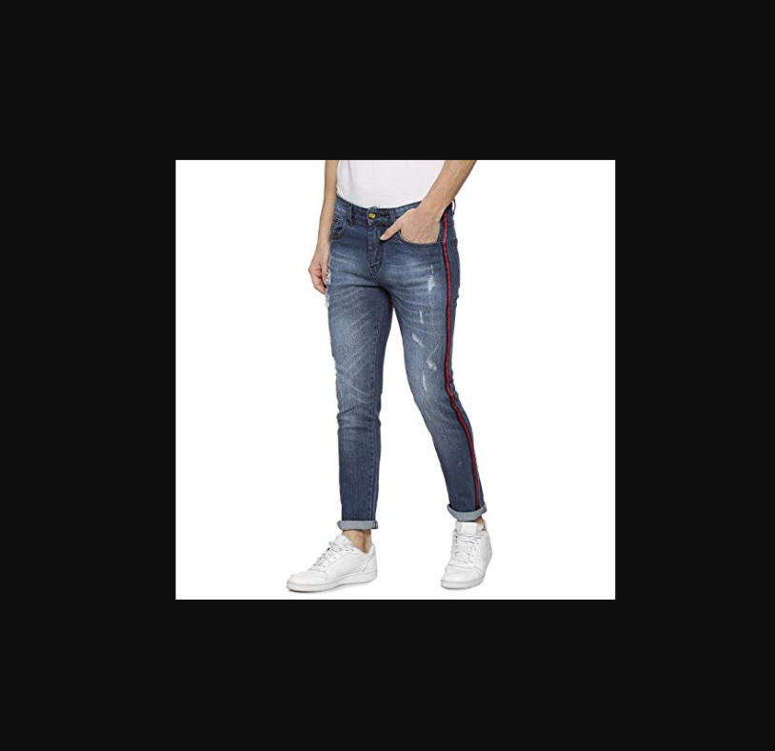
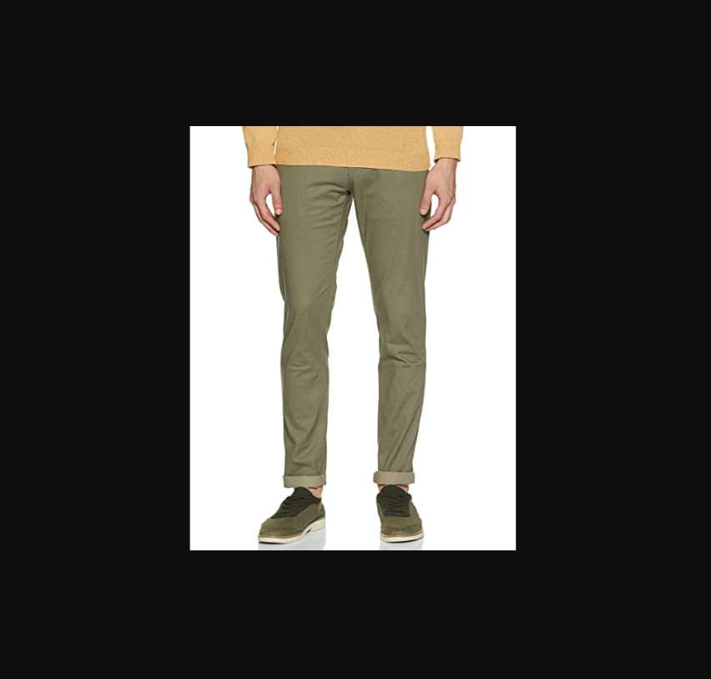
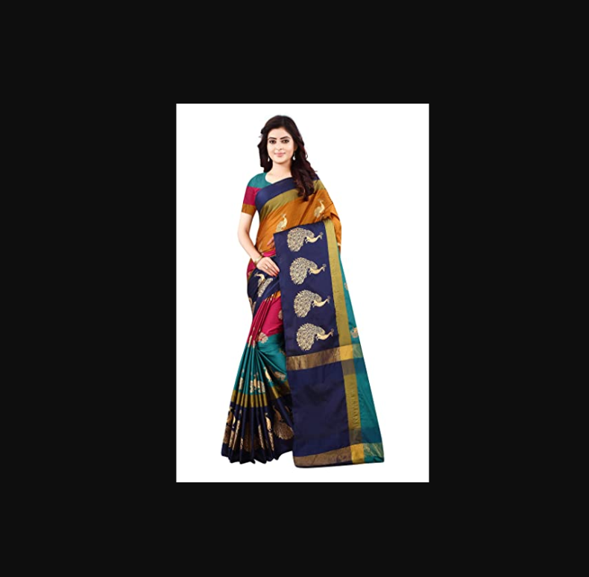
Images
Jeans
Trousers
Sarees

Slide 6
Pre-processing and cleaning
Each image was reshaped to a size of 224*224
The numpy arrays representation was scaled down for reducing computational complexity.

Slide 7
MODELS
ANN (10 epochs, SGD optimizer)
CNN (10 epochs, Adam optimizer)

Slide 8
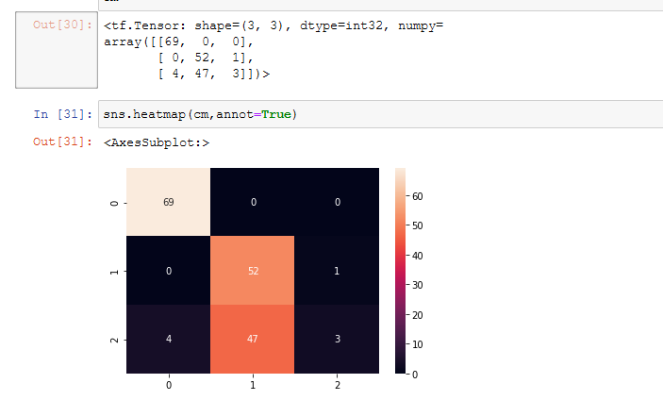
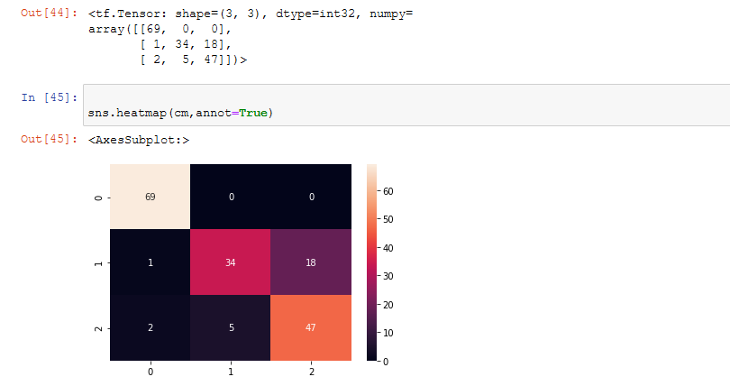
Test data results
CNN results
ANN results

Slide 9
Observations
Accuracy increases as epochs progress
Loss decreases as epochs progress
CNN performs better for image data
Scaling is important to reduce computational complexity

Slide 10
Conclusions

