Slide 1
ADS Final Project
Amey Utturkar
Dhaval Bhinde

Slide 2
Text Analytics

Slide 3
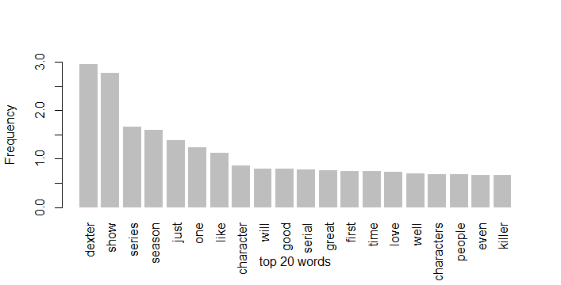
Output

Slide 4
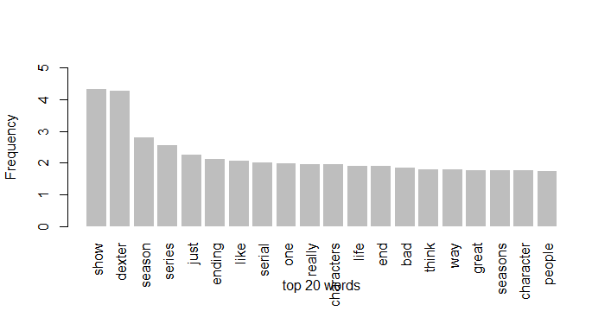
Output

Slide 5
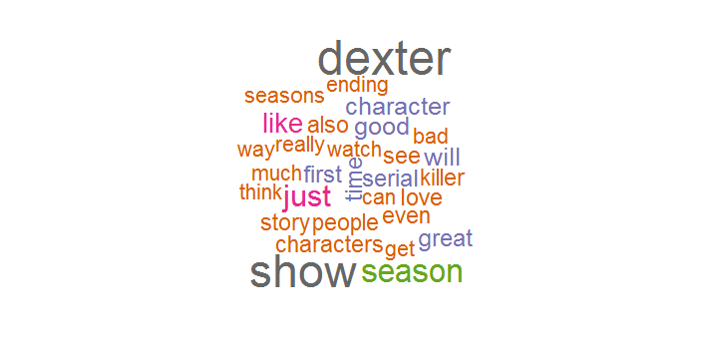
Output

Slide 6
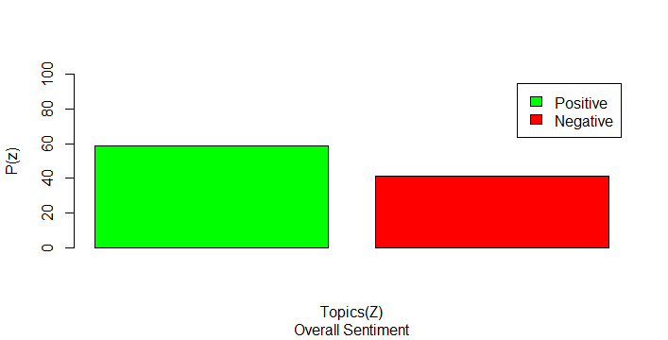
Output

Slide 7
Naïve Bayes Classification
Overview
Naïve Bayes Classifier is based on the Bayesian Theorem with independent assumptions between predictors.
Bayesian model is easy to build, with no complicated iterative parameters making it very useful for large datasets.
It is suitable when the dimensionality of the input is high.
Despite its simplicity, Naïve Bayes can often outperform more sophisticated classification methods.

Slide 8
Algorithm
Bayes Theorem provides a way to calculate posterior probability P(c|x), from P(c), P(x), and P(x|c).
It assume that the effect of the value of a predictor (x) on a given class (c) is independent of the values of other predictors.
The above assumption is called class conditional independence

Slide 9
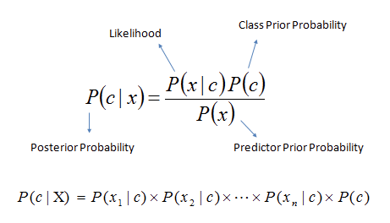
Formula

Slide 10
Formula
Where,
P(c|x) is the posterior probability of class (target) given predictor (attribute).
P(c) is the prior probability of class.
P(x|c) is the likelihood which is the probability of predictor given class.
P(x) is the prior probability of predictor.

Slide 11
Data Processing
Transformed continuous variables to categorical variables
For age, if value is greater than 50 then assigned “Aged” else assigned “Young”.
Also transformed other variables such as Time_at_add, Time_employed, Time_bank, Home_Expn, Balance to three categories depending on the data in each column.
After data processing partitioned the original training dataset in 80:20 to form two datasets for training and testing

Slide 12
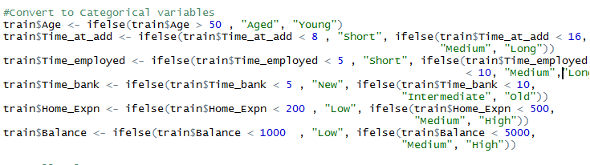
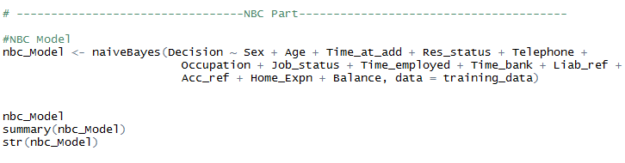
Code

Slide 13
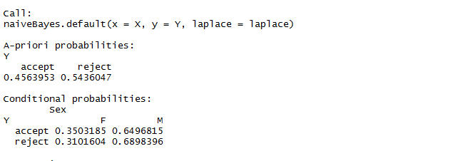
Output

Slide 14
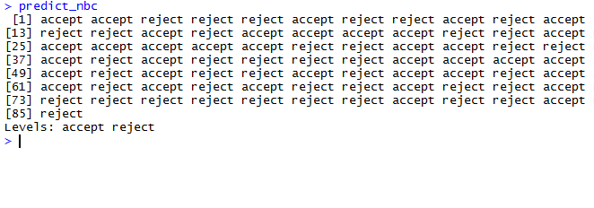
Output

Slide 15
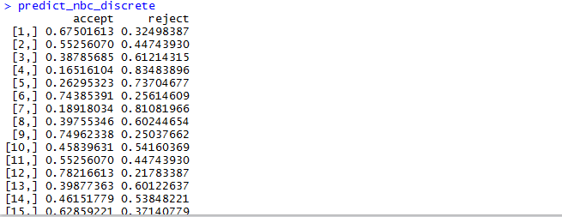
Output

Slide 16
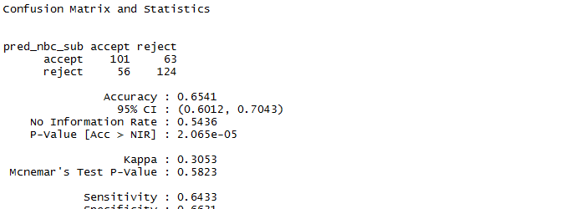
Output

Slide 17
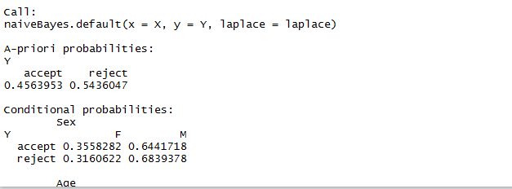
Output - Laplace

Slide 18
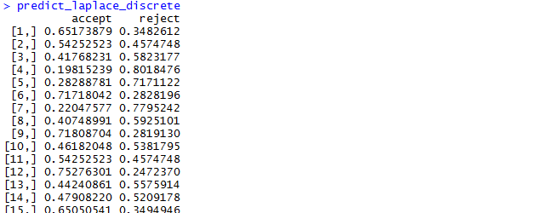
Output

Slide 19
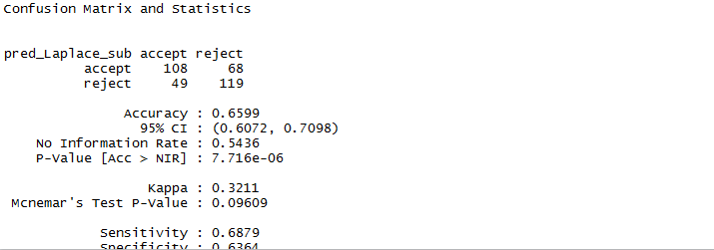
Output

Slide 20
Neural Networks
Overview
Neural network is a machine learning framework that attempts to mimic the learning pattern of natural biological neural network.
Each neural unit is connected with many others, and links can be enforcing or inhibitory in their effect on the activation state of connected neural units.
Each individual neural unit may have a summation function which combines the values of all its inputs together.
There may be a threshold function or limiting function on each connection and on the unit itself such that it must surpass it before it can propagate to other neurons.
These systems are self-learning and trained rather than explicitly programmed and excel in areas where the solution or feature detection is difficult to express in a traditional computer program.

Slide 21
Data Processing
Transformed categorical variables to the numeric variables
For Sex, if value is M then assigned “0” else assigned “1” and so on.
Also transformed other categorical variables such as Res_status, Telephone, Liab_ref, Acc_ref, Decision.
For columns such as Occupation, Job_status which are having multiple categories, performed 1 to N Transformation
After data processing partitioned the original training dataset in 80:20 to form two datasets for training and testing

Slide 22
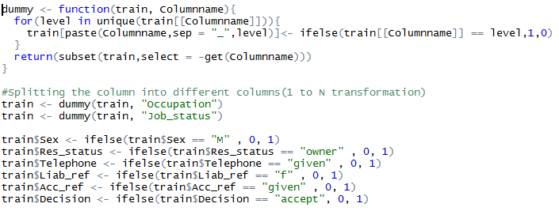
Code

Slide 23
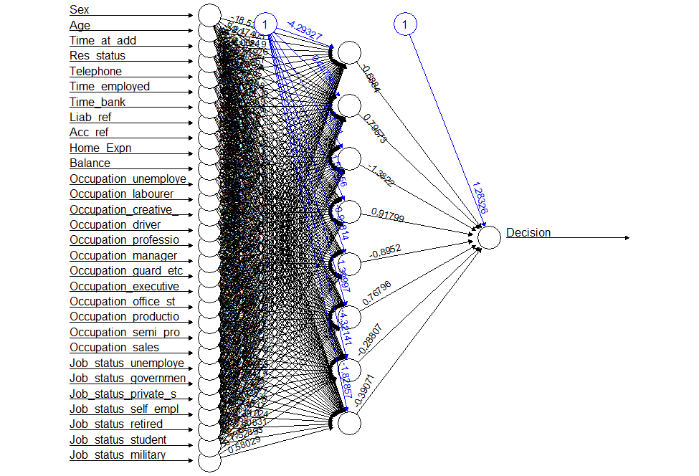
Plot

Slide 24
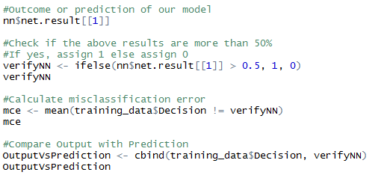
Code

Slide 25
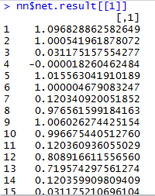
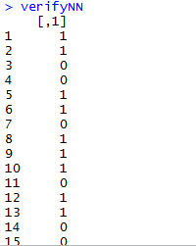
Output

Slide 26
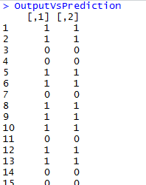
Output

Slide 27
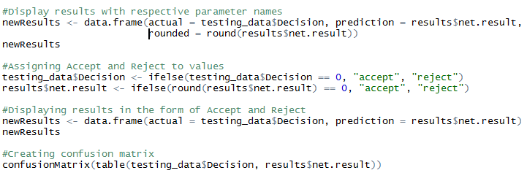
Output

Slide 28
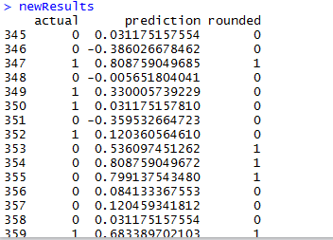
Output

Slide 29
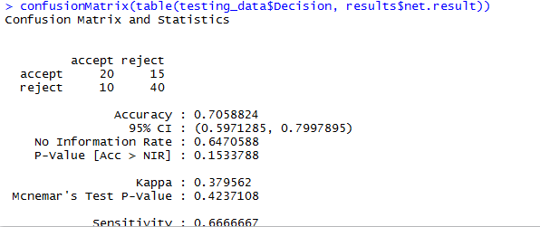
Output

Slide 30
Thank You!

