Slide 1

YMCA
Post-campaign Report
Ateyeh Pedram
Zeinab Zangeneh Madar
Harshit Sidhwani
Amey Vanmali
Sahar Moshtaghiaragh

Slide 2
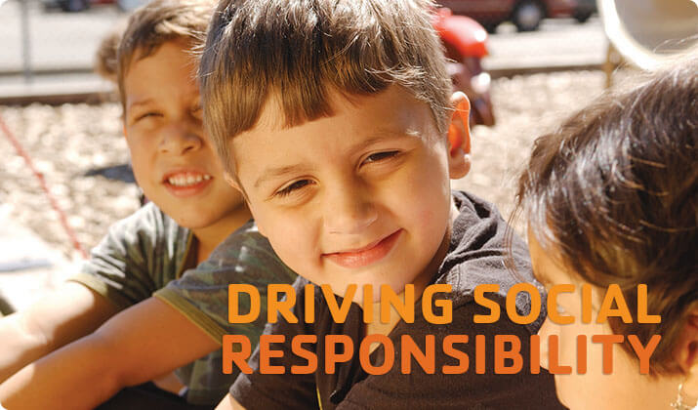
YMCA - Bristol
•YMCA - Young Men’s Christian Association
https://www.bristolymca.net/
•YMCA, also known as Y, is the nation's leading nonprofit working towards empowering communities through youth development, healthy living and social responsibility. Y is a spirit, a movement and a cause who promote values such as care, honesty, respect, responsibility, and faith.
•YMCA Bristol is located in Bristol, Tennessee.
•The size of the organization within the range of 50 - 100 employees.

Slide 3

Table of Contents
1 | Campaign Overviews
2 | Core performance metrics
3 | Online marketing strategy analysis
4 | Marketing goals and social impact
5 | Conclusion and next steps

Slide 4
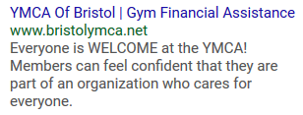
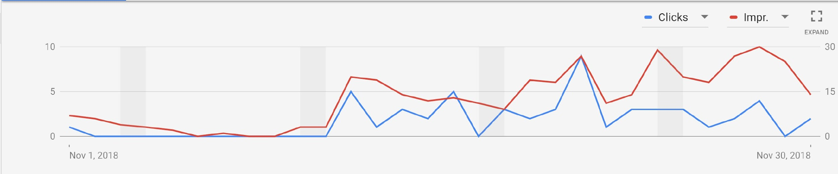
Awareness Campaign Overview
Awareness
53 clicks out of 379 impressions.
Average CPC: $1.14
Total Budget: $45/day
Cost: $60.67
Ad groups:
Service-Financial assistance: most successful ad group with CTR of 30% (3 clicks out of 10 impressions)
Programs-After School Sports: CTR of 15.38% (2 clicks out of 13 impressions)
Program-Healthy living: most impressions with CTR of 13.52% (48 clicks out of 355 impressions)
Program- Youth Development: Just 1 impression and no clicks

Slide 5
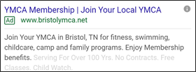
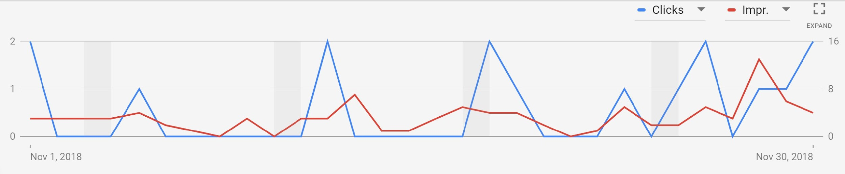
Membership Campaign Overview
Membership
16 clicks out of 96 impressions.
Average CPC: $1.73
Total Budget: $156/day
Cost: $27.73
Ad groups:
Senior Members: most successful ad group with CTR of 42.86% (3 clicks out of 7 impressions)
Join YMCA: most number of clicks compared to other ad groups with CTR of 15.52% (9 clicks out of 58 impressions)
Volunteers: CTR of 12.90% (4 clicks out of 31 impressions)

Slide 6

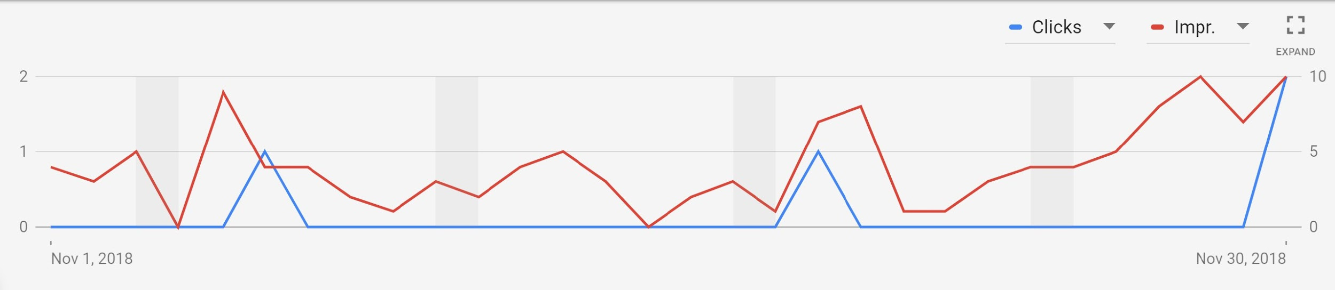
Contribution Campaign Overview
Contribution
4 clicks out of 123 impressions.
Average CPC: $0.93
Total Budget: $45/day
Cost: $3.72
Ad groups:
Make Donations: CTR of 3.25% (4 clicks out of 123 impressions)

Slide 7
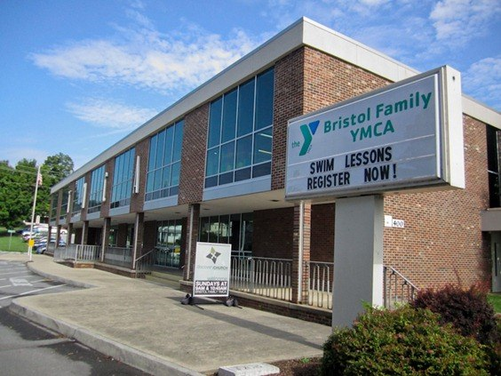
Core Performance Metrics
Proprietary + Confidential
The results of Awareness and Membership campaigns are satisfying.
Contribution campaign needs to be improved.
Getting high impressions but very few clicks for Contribution.
Possible reasons for low clicks on contribution campaigns:
Ads are not appealing and not attracting users to click on it.
Users who don’t trust ads and immediately scroll past them for finding familiar organizations.
It could have been better if we didn’t include the name of organization in ad title.
Awareness
Membership
Contribution
CLICKS/TRAFFIC
53/379
16/96
4/123
CLICK THROUGH Rate
%
13.98%
16.67%
3.25%
CPC
$1.14
$1.73
$0.93
$60.67
$27.73
$3.72
Cost
Notes:
Your ads are not appealing and not attracting online users to click on it. For that you need to focus on compelling ads with good call to actions defining the product/service you are targeting.
Donations need trust of people. If people don’t know your brand and name, they won’t trust you to make contributions to your organization. As a result they don’t click on the ad.

Slide 8




Online Marketing Strategy
We aimed to earn donations, raising awareness and reach out to people who need help. We ran an Awareness Campaign to achieve this goal. The campaign was a success and we were able to increase awareness for YMCA Bristol. The impressions for the campaign were 379. CTR for the campaign was 13.98%.
Educate Mission/ Awareness
Cultivate
Donors
Our second goal was to attract more number of donors, for which we had the Contribution Campaign to help YMCA achieve their fundraising goals which total up to $500,000 annually. With this campaign we were able to have 123 impressions and 4 clicks.
YMCA Bristol has 30 volunteers currently and faces a primary issue of recruiting more volunteers. We ran a Membership Campaign to add to their volunteer pool, and it was a success seeing the numbers for our campaign. We had 96 impressions and 16 clicks with a CTR of 16.67% which is better than our primary Awareness Campaign.
Recruit Volunteers
Promote Events
We intended to promote events inside our Awareness Campaign and use event related keywords to create AdWords campaigns. We also used Geotargeting to raise awareness about their events. But the related keywords were not our best choice and they couldn’t deliver the intended results as the CTR was 11.11% for them.

Slide 9
Marketing Goal Achievement and Social Impact
Social Impact: building healthy, confident, connected and secure children, adults, families and communities. Individuals making healthy choices, inspiring children and community coming together for the common good are all examples of social impact of YMCA.
Priority of YMCA Goals:
Recruit members/volunteers
Raise awareness
Reach people who need help
Earn donations
Promote events
We recommend the nonprofit organization to keep running campaigns, but it’s possible to improve the outcome by improving Keywords and ads content.
Notes:
Social impact:
The Y is, and always will be, dedicated to building healthy, confident, connected and secure children, adults, families and communities. Every day our impact is felt when an individual makes a healthy choice, when a mentor inspires a child and when a community comes together for the common good.
Their social impact is assisting people overcome the challenges they face in body, mind and spirit. Through forming partnerships in the community, YMCA Social Impact is able to connect with the people who are really doing it tough.
Based on what we discussed with the organization, the priority of their goals was as follow. (1 to 5) . by running 3 campaign ads we significantly achieved the first 3 most important goal. Last 2 goals needs further improvements. Also regarding last goal(promote events) , the organization had only one event to promote during this period.

Slide 10
Recommended Next Steps
Promoting event can be highly improved on their website. They can hold and promote special events like halloween and thanksgiving on their website and advertise for it using an appropriate landing page.
Work on their mobile view and run campaigns for it as well, since most of parents don’t have time to use personal computer.
Mobile View
Promote Events
Improve donations landing page on their website and make it more clear and user friendly.
They can raise awareness about their brand specifically for donation purposes to attract people’s trust, by running display network campaigns.
Landing Page
Donors Awareness
Notes:
D: Donations are highly related to campaign. They can raise awareness by using banner ads , running campaigns in display network and other networking channels like tv,...

Slide 11
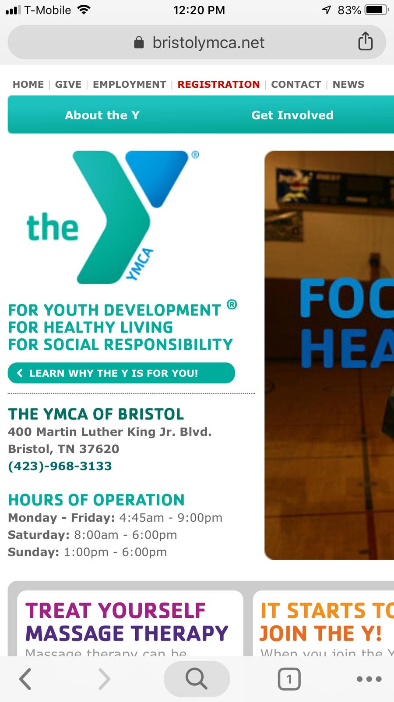
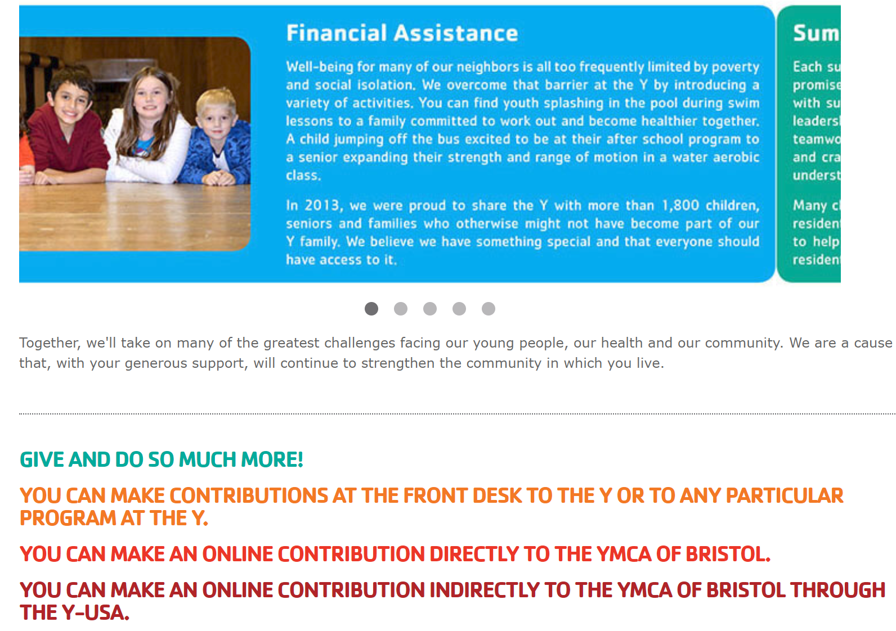
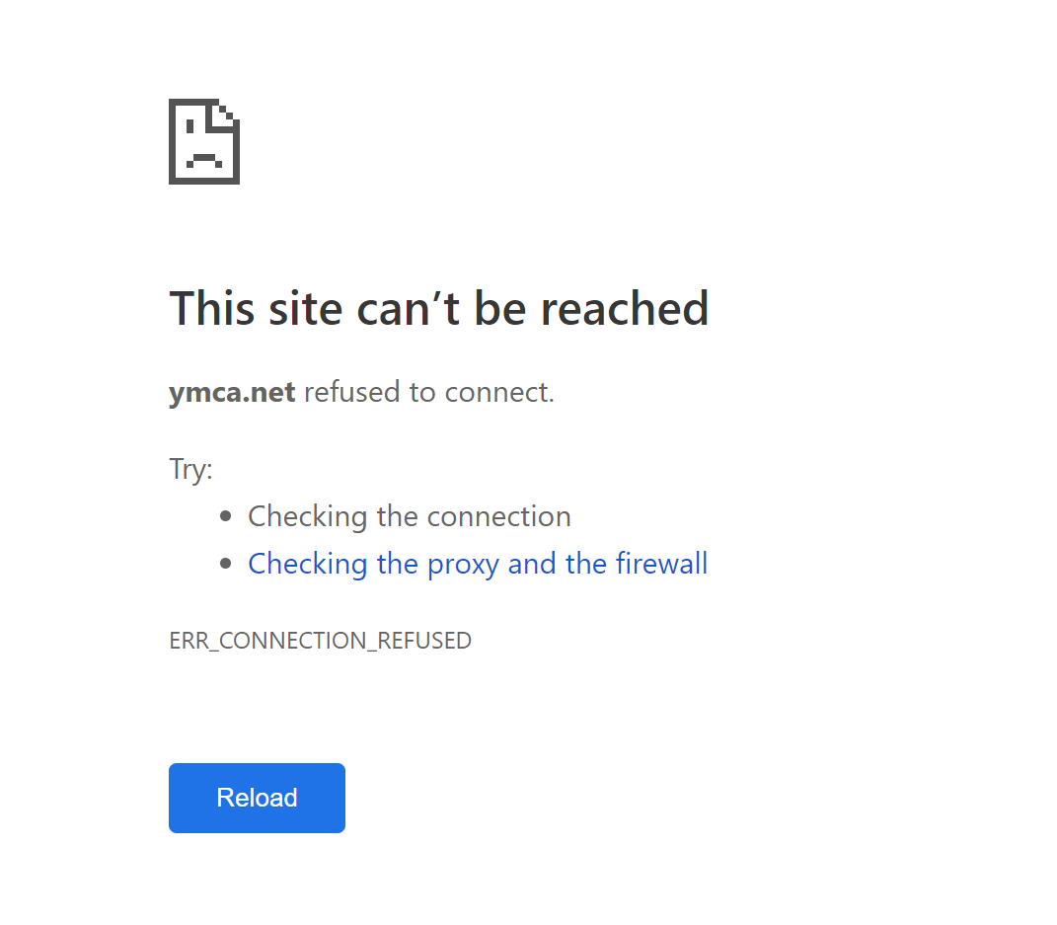
Website Issues and Mobile View

Slide 12
Learning Component
Learned how to promote the current standing of a brand (YMCA) and increase the impact of its products or services. The purpose is to save time and improve the quality of campaigns.
Learning Objectives
Our client was very helpful and responsive during the whole project. They helped us prioritize objectives and goals of this project and made requested changes in a very short period of time.
Client Dynamics
We defined certain roles and responsibilities for each member of the group. Our group was able to tackle problems quickly with good feedback.
Group Dynamics
We improved impressions and CTR for each campaign by creating proper keywords and ad copies. Although Contribution campaign can be further improved, other campaigns can be continued to run.
Outcome

Slide 13

THANK YOU

