Slide 1
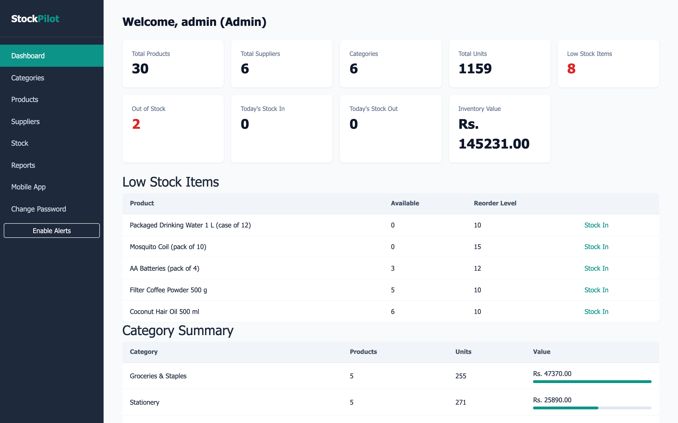
COLLEGE MINI PROJECT
StockPilot
Inventory Management System
Console Application, ASP.NET Core MVC Web App & Progressive Web App
[Team Member 1] — [Roll No. 1]
[Team Member 2] — [Roll No. 2]
[Team Member 3] — [Roll No. 3]
[Team Member 4] — [Roll No. 4]
[Course / Programme Name] · [Department Name]
[College / Institute Name]
Guide: [Guide / Project Mentor Name] | [Academic Year, e.g. 2025-26]
Notes:
Good morning everyone. We're presenting StockPilot, an Inventory Management System built for small retail businesses. It spans a console app, a full ASP.NET Core MVC web application, and a Progressive Web App for mobile stock lookups. Over the next few slides we'll walk through the problem, the architecture, the database, and a live walkthrough of the working system.

Slide 2
Agenda
01
Problem Statement & Objectives
06
Web App — Login, Dashboard & Master Data
02
System Architecture & Tech Stack
07
Stock Transactions & Reports
03
Phase 1 — Console Application (OOP)
08
Progressive Web App (PWA)
04
Database Design (ERD)
09
Testing & Results
05
Use Cases & Data Flow
10
Conclusion & Future Scope
01 / 17
Notes:
Here's the roadmap for today's presentation: starting from the problem we set out to solve, through the architecture and database design, a walkthrough of the working web app and mobile PWA, and finishing with our testing results and future scope.

Slide 3
Problem Statement & Objectives
The Problem
Our Objectives
• Small retailers still track stock on paper or in ad-hoc spreadsheets.
• No single source of truth for stock levels across staff.
• Stock-outs and overstocking both go unnoticed until it's too late.
• No easy way to check inventory from the shop floor or on the move.
• Build a centralised, role-based system for products, stock & suppliers.
• Enforce validation: no negative stock, no selling past availability.
• Give managers live dashboards and printable reports.
• Ship a mobile-friendly PWA for quick, offline-capable stock lookups.
02 / 17
Notes:
The problem is a familiar one for small shops: inventory tracked on paper or scattered spreadsheets, with no real-time visibility into what's in stock. Our objectives were to centralise that data, enforce real validation rules like blocking stock-outs, and give staff both a full web dashboard and a lightweight mobile PWA for quick lookups.

Slide 4
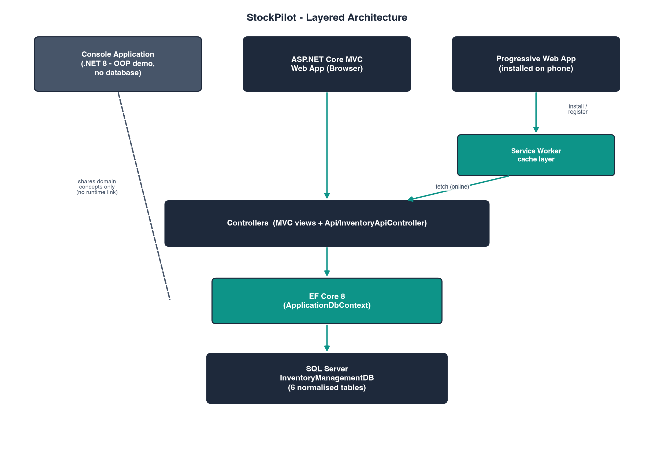
System Architecture
03 / 17
Notes:
StockPilot follows a clean layered architecture. Three client surfaces — the console app, the MVC web views, and the PWA — all talk to the same application layer, which enforces business rules like stock validation. That layer sits on EF Core 8 for data access, backed by a normalised SQL Server database.

Slide 5
Technology Stack
C#
.NET
EF
C# / .NET 8
ASP.NET Core MVC
EF Core 8
Modern, strongly-typed runtime across all three apps
Server-rendered web app with Razor views
Code-first ORM, migrations & LINQ queries
SQL
BS5
PWA
SQL Server
Bootstrap 5
Progressive Web App
Relational store — 6 tables, FKs, CHECK constraints
Responsive, accessible UI components
Installable, offline-capable mobile experience
04 / 17
Notes:
On the technology side we're running the full Microsoft web stack: C# and .NET 8, ASP.NET Core MVC for the web app, EF Core for data access, and SQL Server as the database. Bootstrap 5 handles responsive styling, and the whole experience is wrapped as an installable, offline-capable PWA.

Slide 6
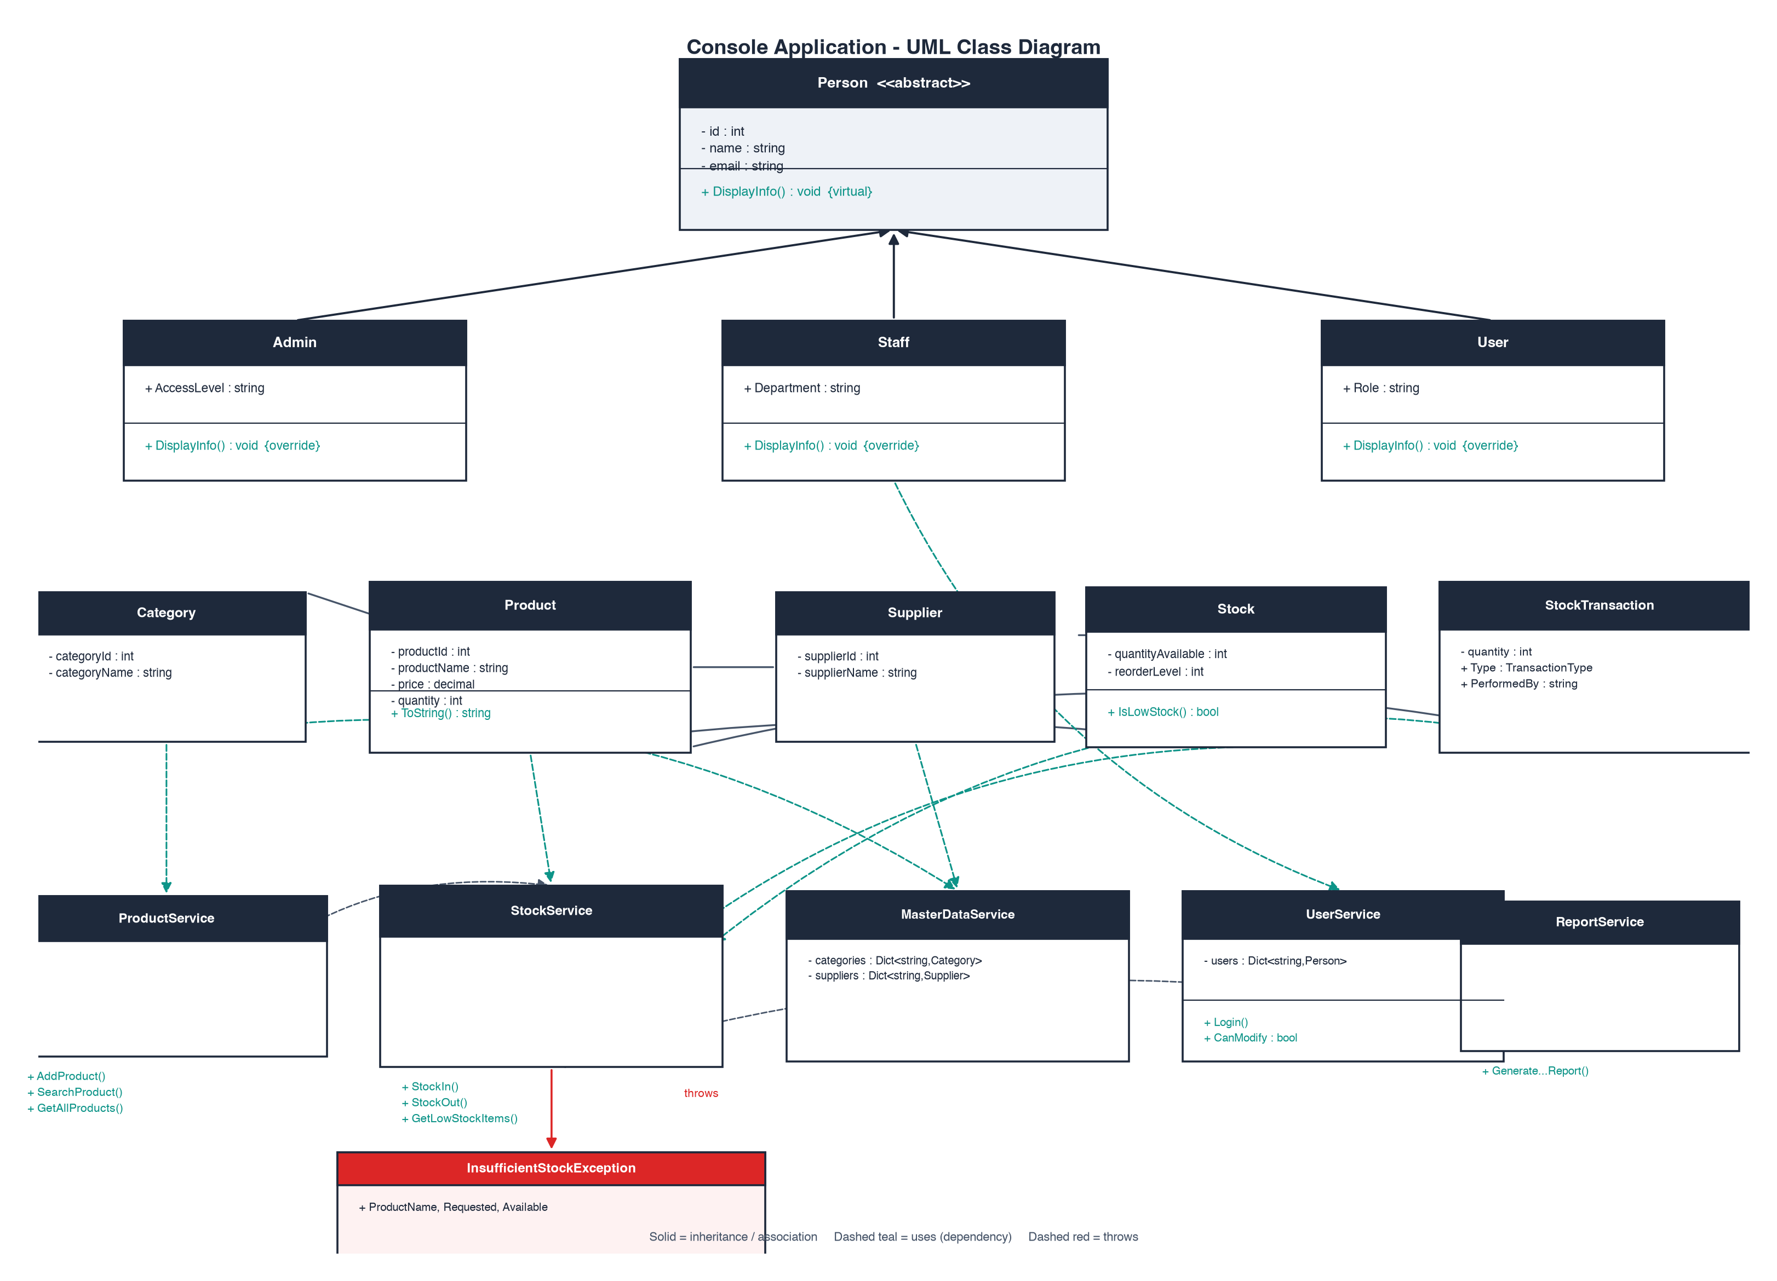
Phase 1 — Console Application
Core OOP Concepts Applied
1
Inheritance
Product & report types share a common base class hierarchy.
2
Encapsulation
Private fields exposed only through validated properties.
3
Polymorphism
Overridden methods drive role-specific menu behaviour.
4
Exceptions
Custom InsufficientStockException guards every stock-out.
5
Collections
Generic List<T> / Dictionary<> power in-memory lookups.
05 / 17
Notes:
Phase one of the project was a menu-driven console application, used to prove out the core OOP design before building the web layer. It demonstrates inheritance, encapsulation, polymorphism, custom exceptions for stock validation, and generic collections for in-memory data handling.

Slide 7
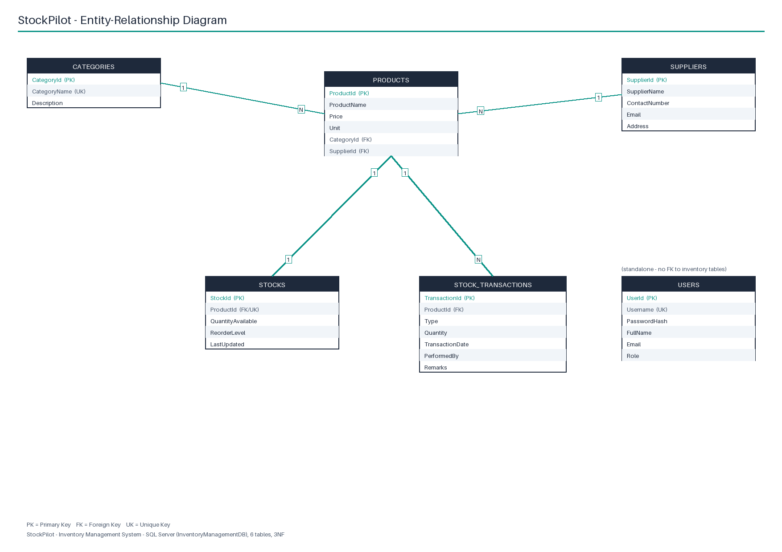
Database Design
Key Facts
• 6 core tables: Categories, Suppliers, Products, Stocks, StockTransactions, Users.
• Primary/foreign keys enforce referential integrity across the schema.
• CHECK constraints guard price, quantity & reorder-level ranges.
• Normalised to 3NF — no repeating or derivable groups.
• Unique indexes on category name, username & product-stock mapping.
06 / 17
Notes:
The database is a normalised, third-normal-form SQL Server schema with six core tables. Foreign keys tie products to their category and supplier, stock levels are tracked per product, and every stock movement is logged in a StockTransactions table. Check constraints stop invalid data — like negative prices or quantities — from ever being written.

Slide 8
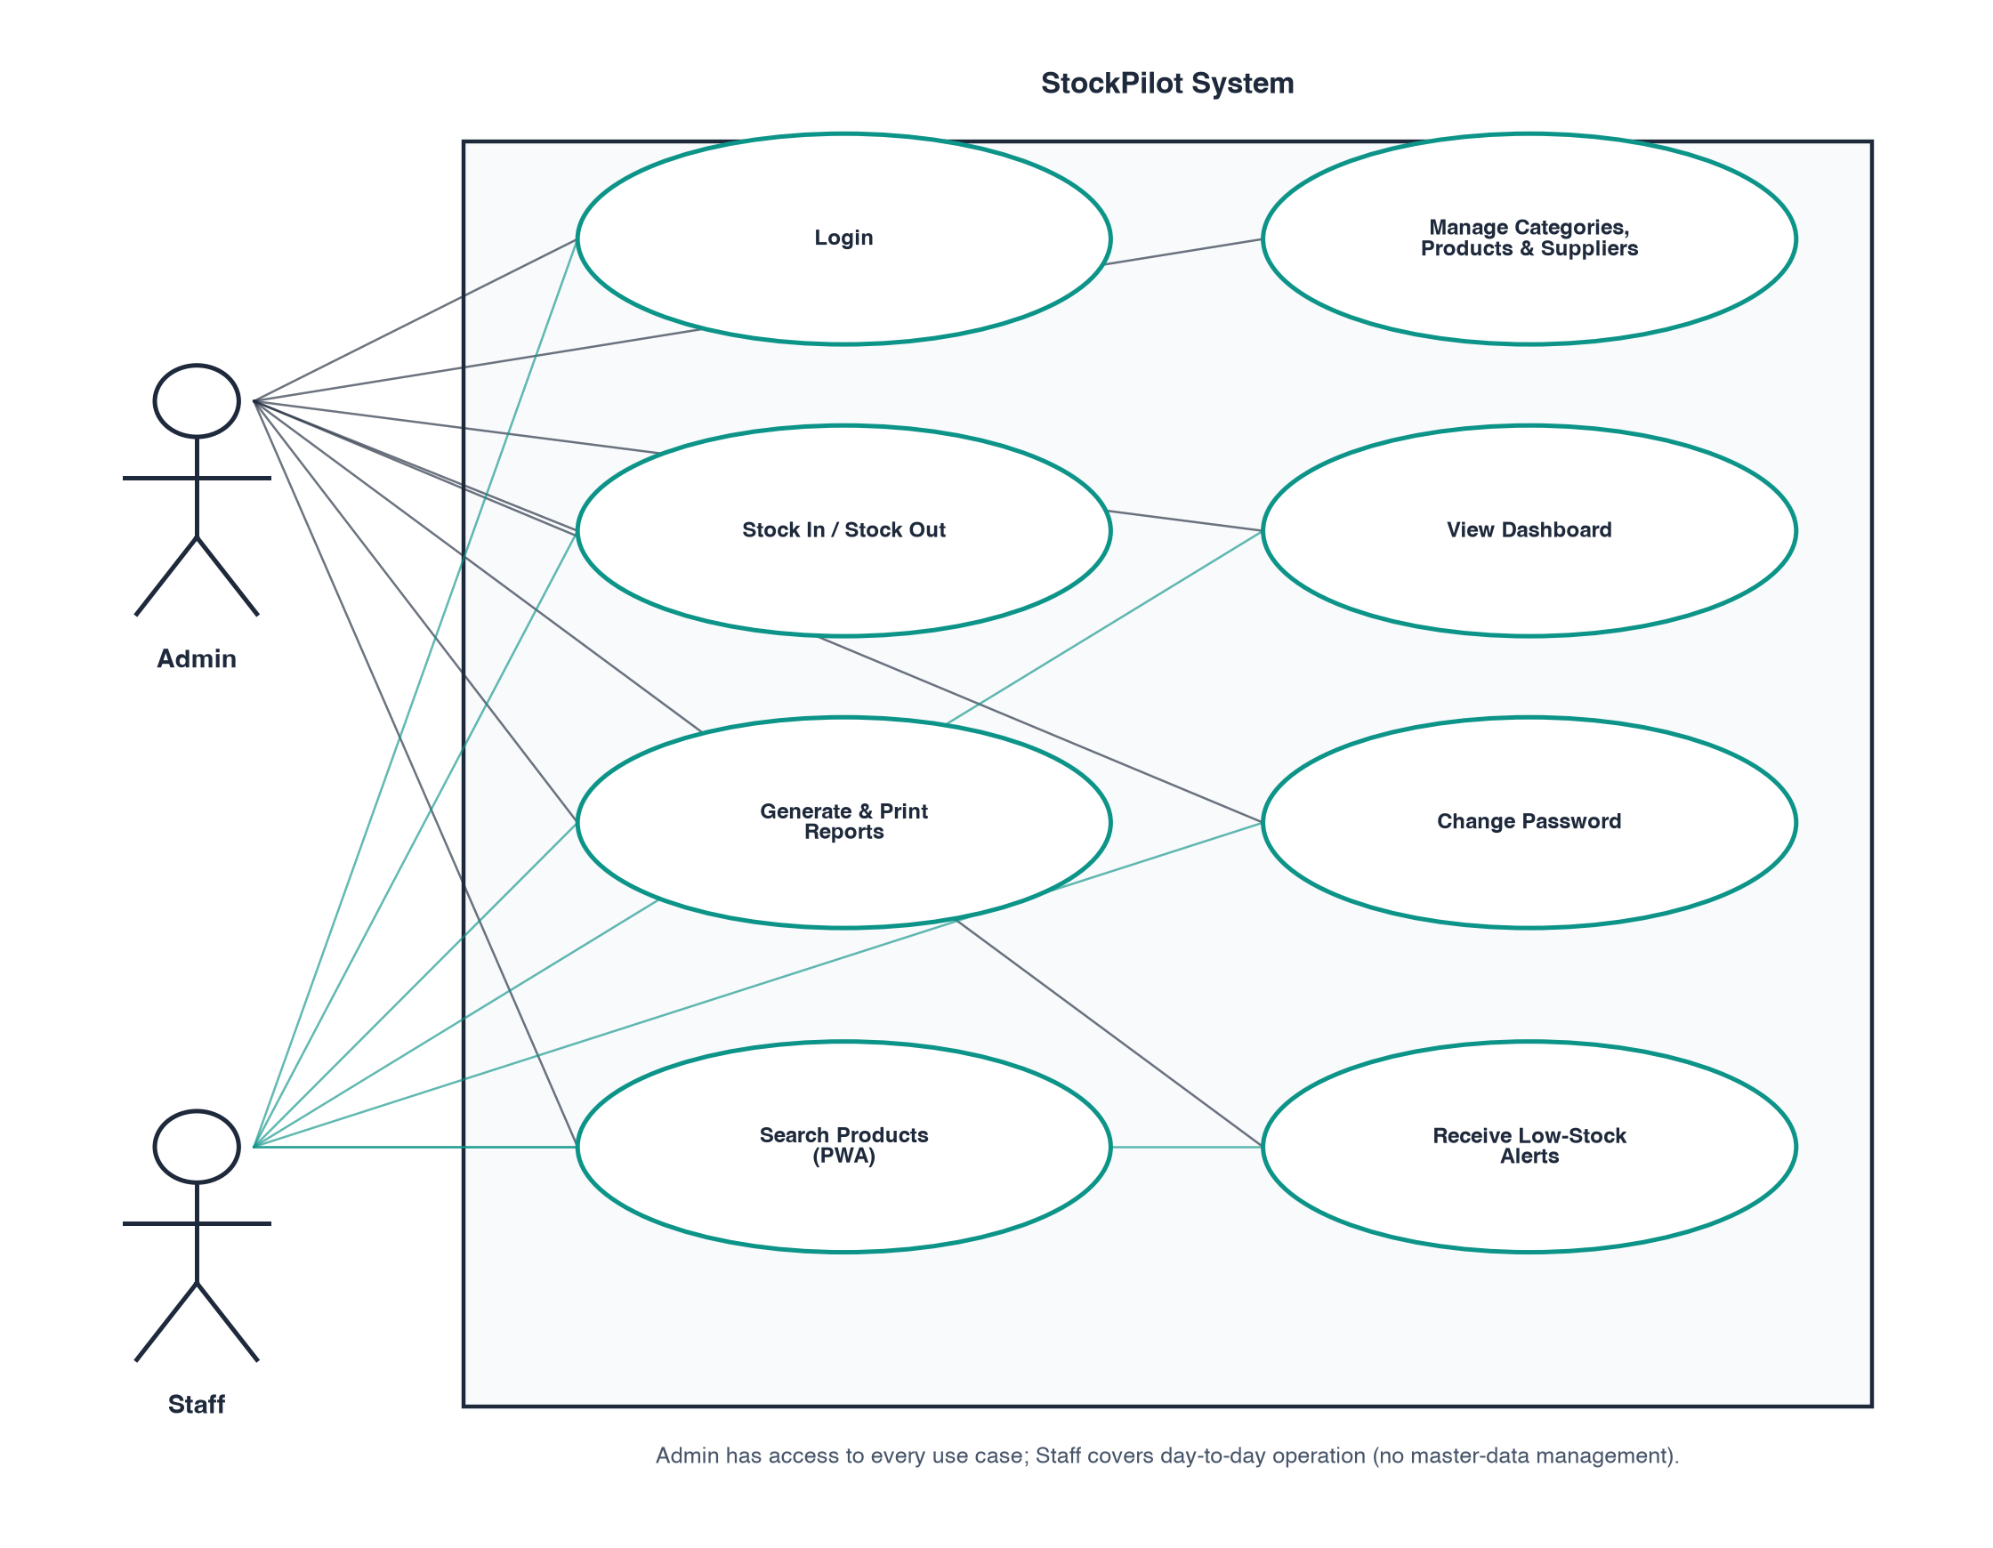
Use Cases & Data Flow
07 / 17
Notes:
This use-case view shows the two main actors — administrators and staff or viewer-level users — and how they interact with the system's core capabilities: managing products and categories, recording stock movements, viewing reports, and authenticating securely.

Slide 9
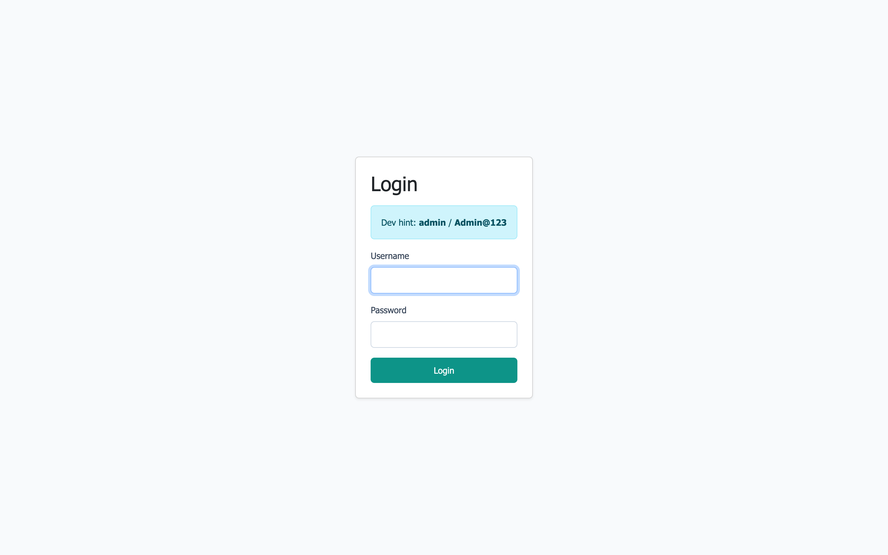
Web App — Login & Security
Security Highlights
• Passwords hashed with ASP.NET Core Identity's PasswordHasher — never stored in plain text.
• A session authentication filter redirects every unauthenticated request to /Account/Login.
• Role-based access — Admin vs. Viewer — restricts who can modify data.
• Self-service Change Password flow, verified against the current hash.
• PWA API endpoints return 401 JSON (not a redirect) when the session is missing.
Login screen
08 / 17
Notes:
Security starts at login. Passwords are hashed with ASP.NET Core Identity's PasswordHasher, never stored in plain text, and a custom session filter redirects any unauthenticated request straight back to the login page. Role based access separates admin and viewer permissions, and users can change their own password from within the app.

Slide 10
Web App — Dashboard
Rs. 145,231
Total value
Live dashboard
09 / 17
Notes:
The dashboard gives an at-a-glance summary: total products, suppliers, low and out-of-stock counts, and total inventory value, alongside a live low-stock table. This doughnut chart breaks that inventory value down by category — Groceries and Stationery carry the largest share of value in our seed data.

Slide 11
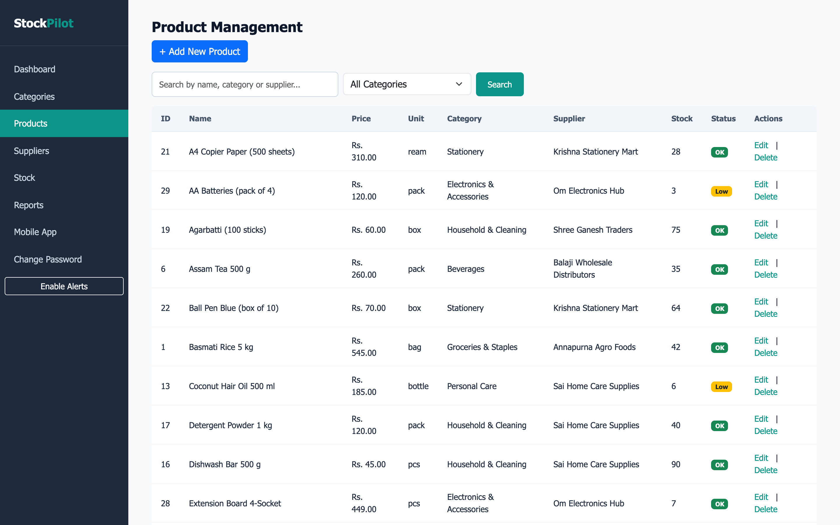
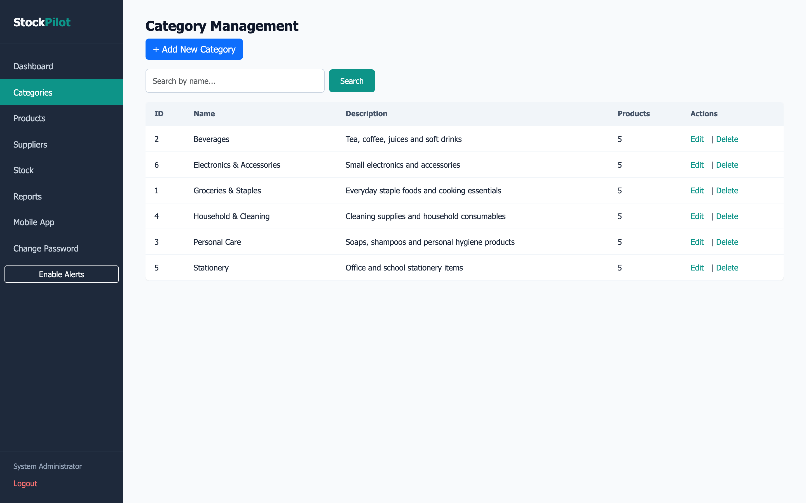
Master Data Management
Products
Categories
• Full CRUD for products, categories & suppliers, with server-side validation.
• Live search and category/supplier filters across every list view.
• Category delete is blocked while products still reference it — no orphaned data.
• Every product links to exactly one category and one supplier via foreign keys.
10 / 17
Notes:
Master data — products, categories and suppliers — all get full create, read, update and delete screens with live search and filtering. We also guard data integrity: you can't delete a category that's still in use by a product.

Slide 12
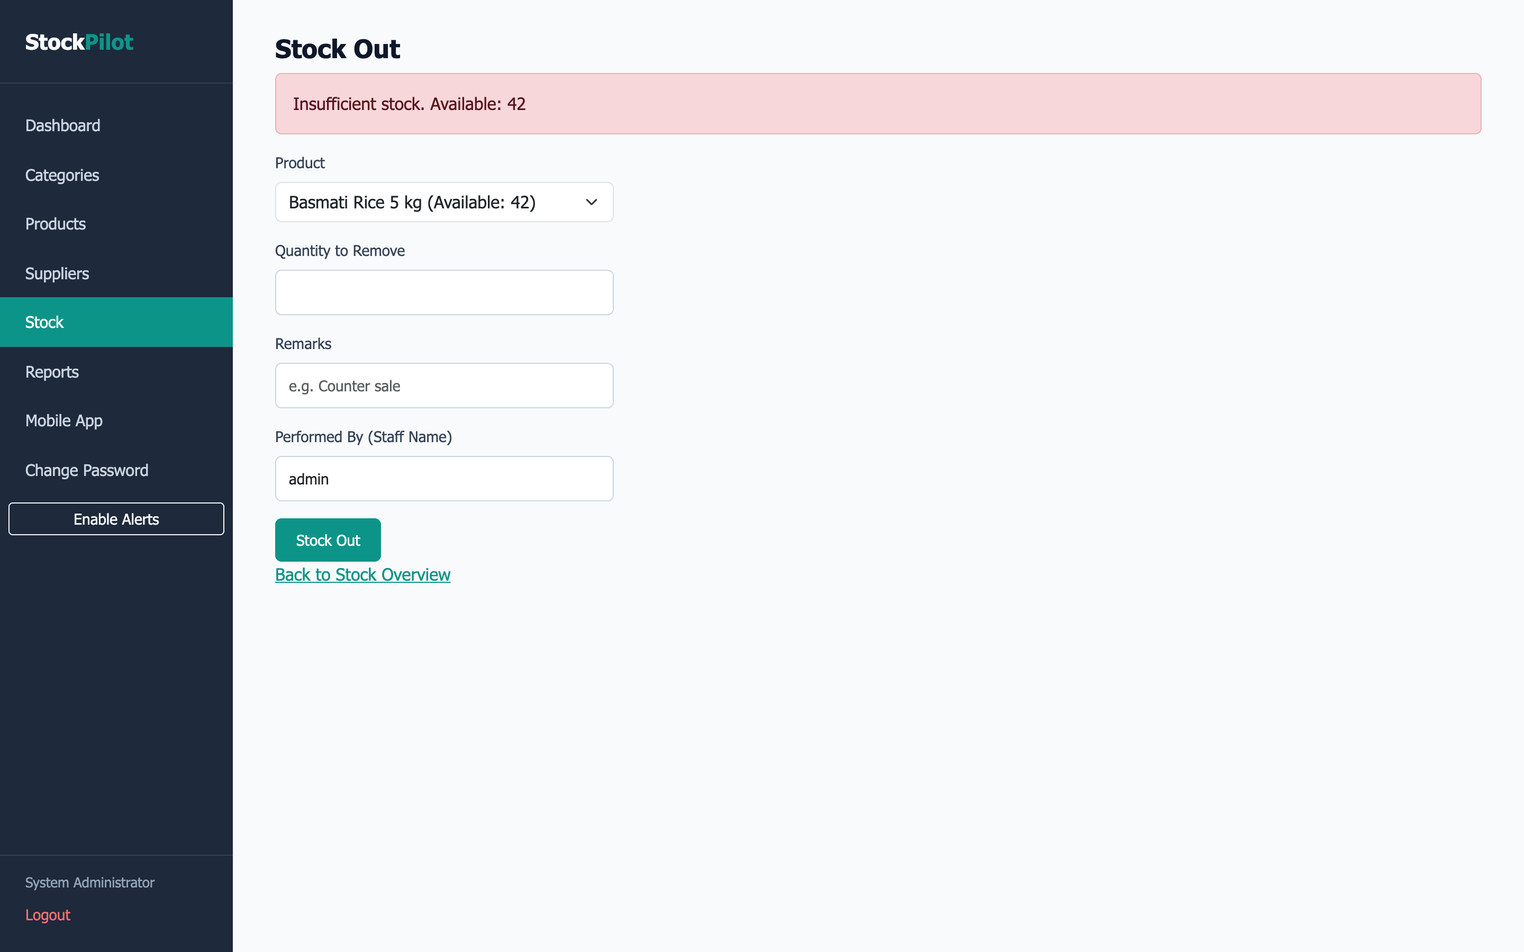
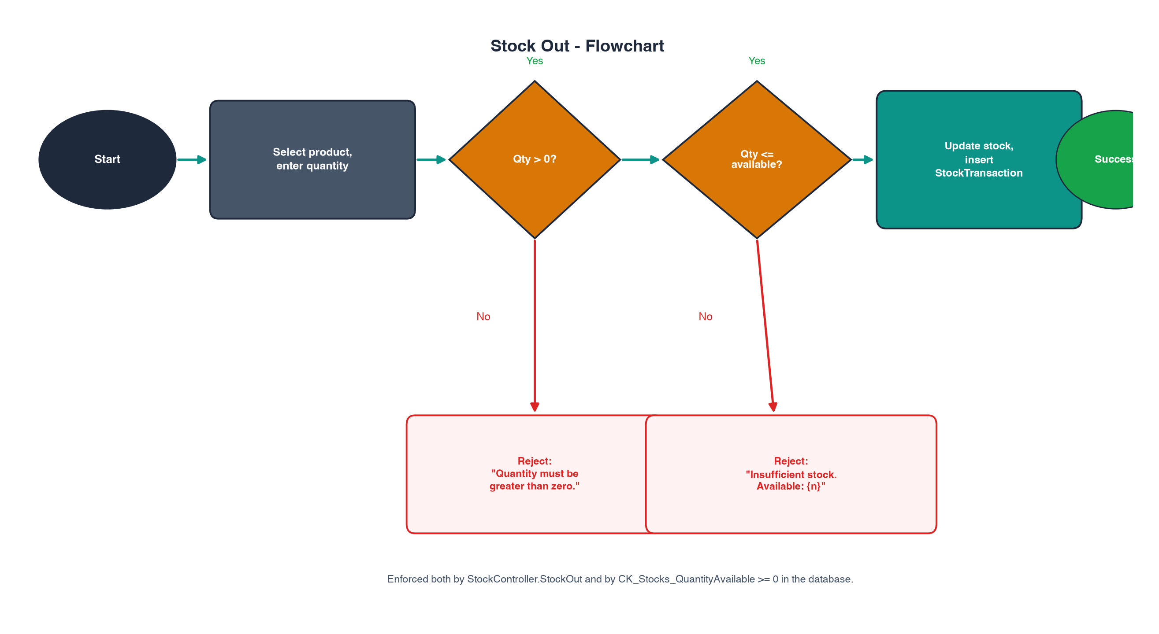
Stock Transactions
Stock Out — validation in action
11 / 17
Notes:
Every stock movement runs through validation before it's committed. Here we tried to remove ninety-nine thousand units of a product that only has forty-two available — the system rejects it immediately with a clear 'Insufficient stock' message and the stock level stays untouched. Every accepted Stock In or Stock Out is also logged as a transaction for full audit history.

Slide 13
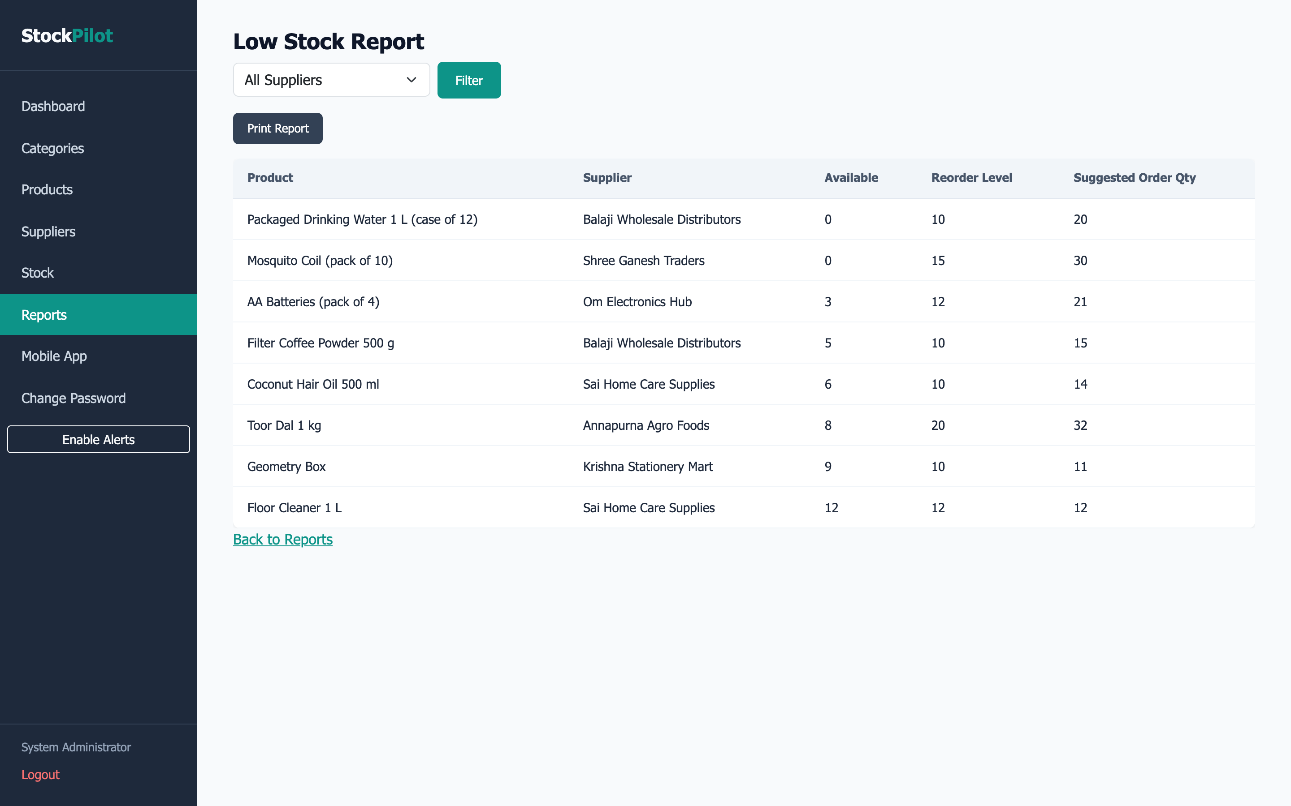
Reports & Analytics
Low Stock report
12 / 17
Notes:
Beyond the dashboard, StockPilot ships five dedicated reports — product catalogue, stock summary, low stock, transaction history and inventory value — each filterable and print-friendly. On the right, units in stock by category and the overall stock health: most products sit at a healthy OK level, with six running low and two fully out of stock.

Slide 14
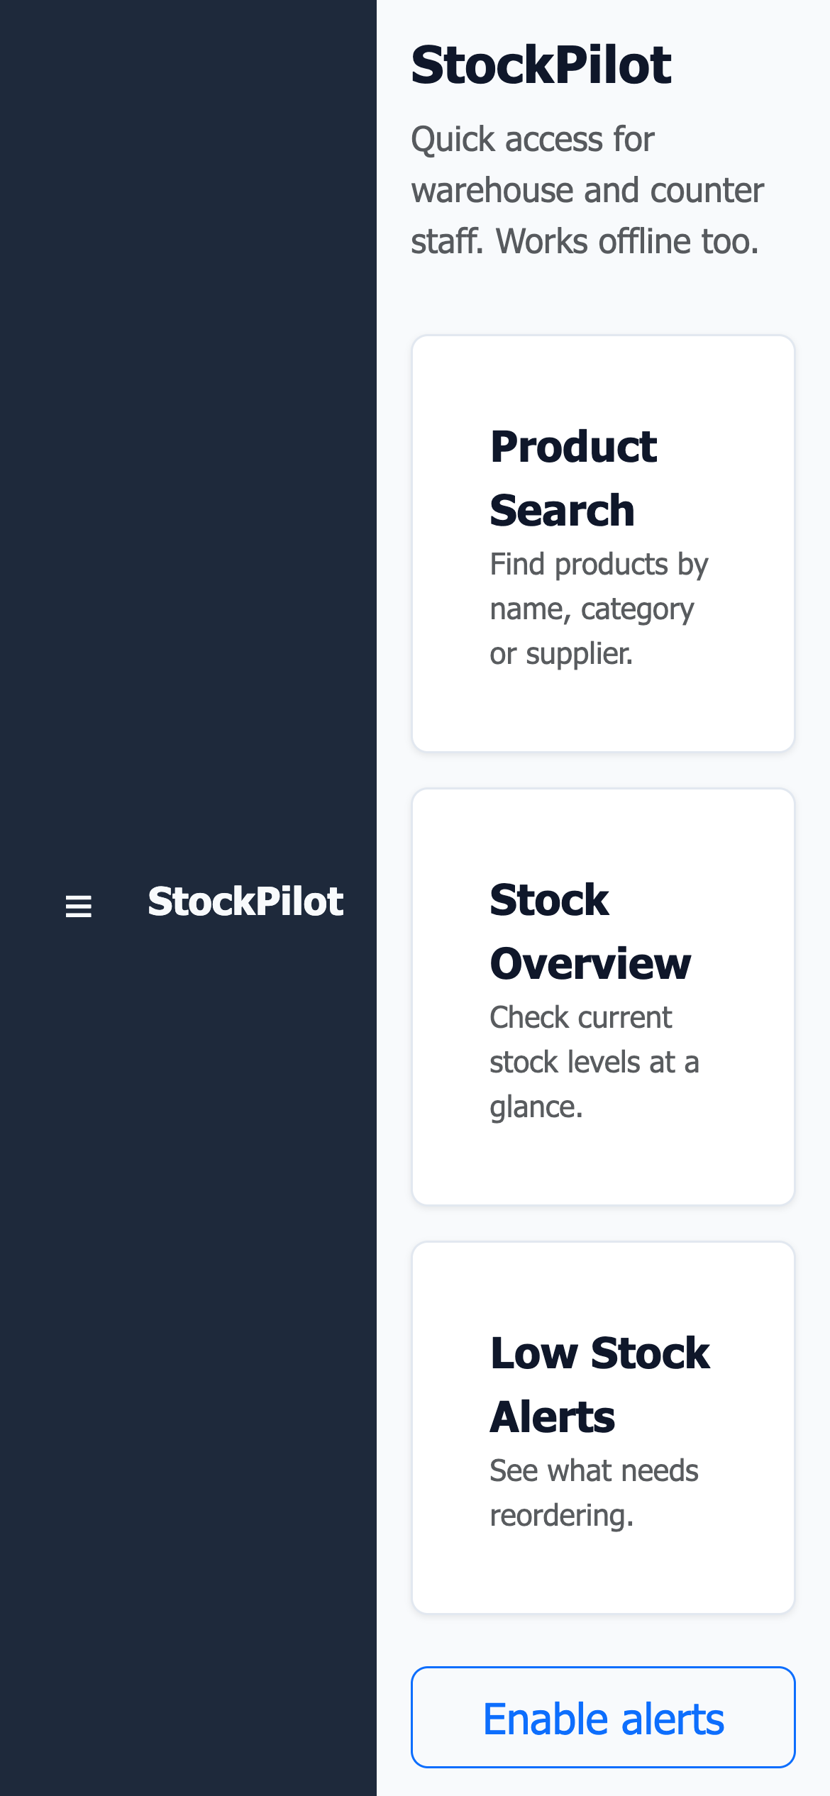
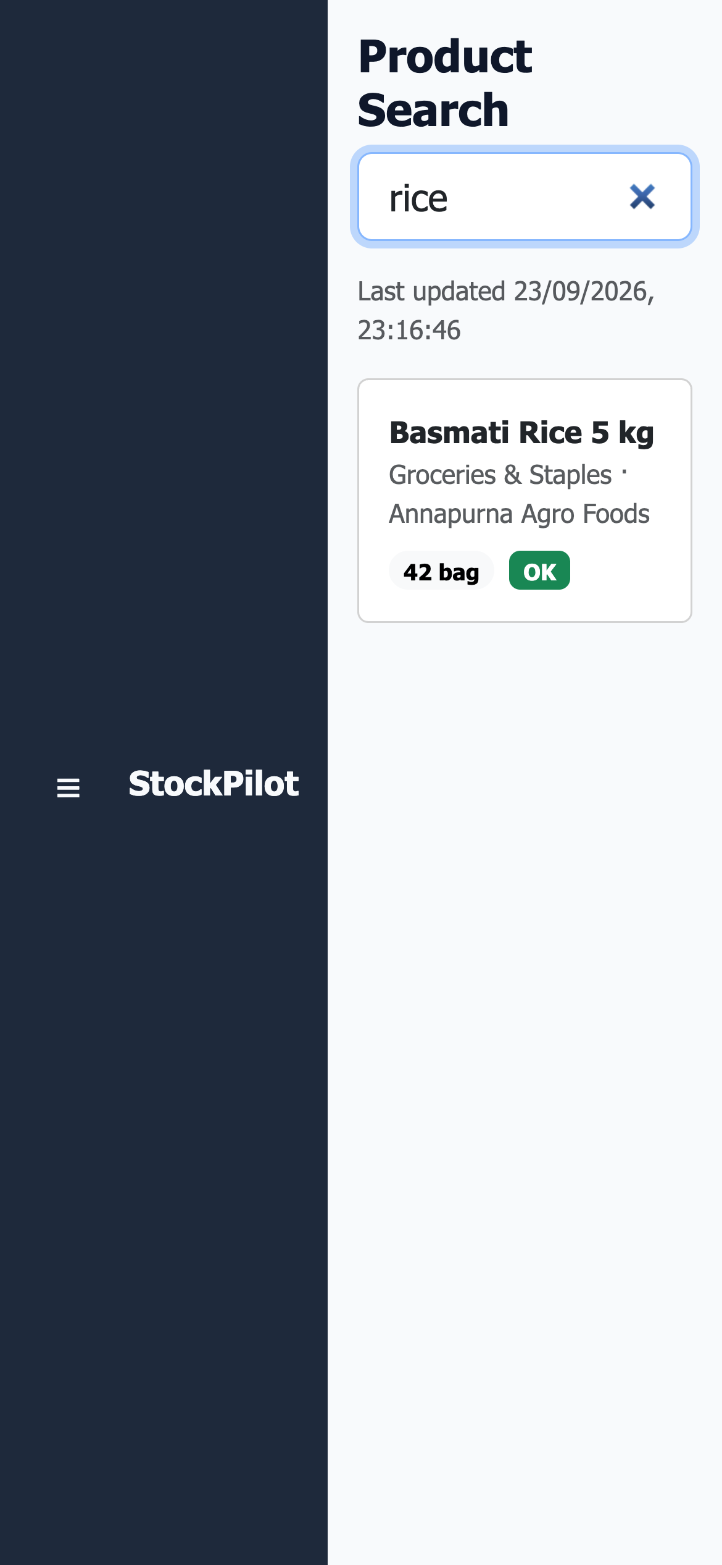
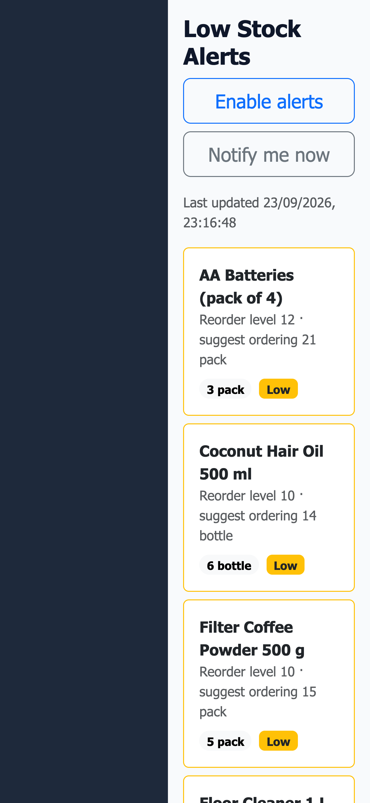
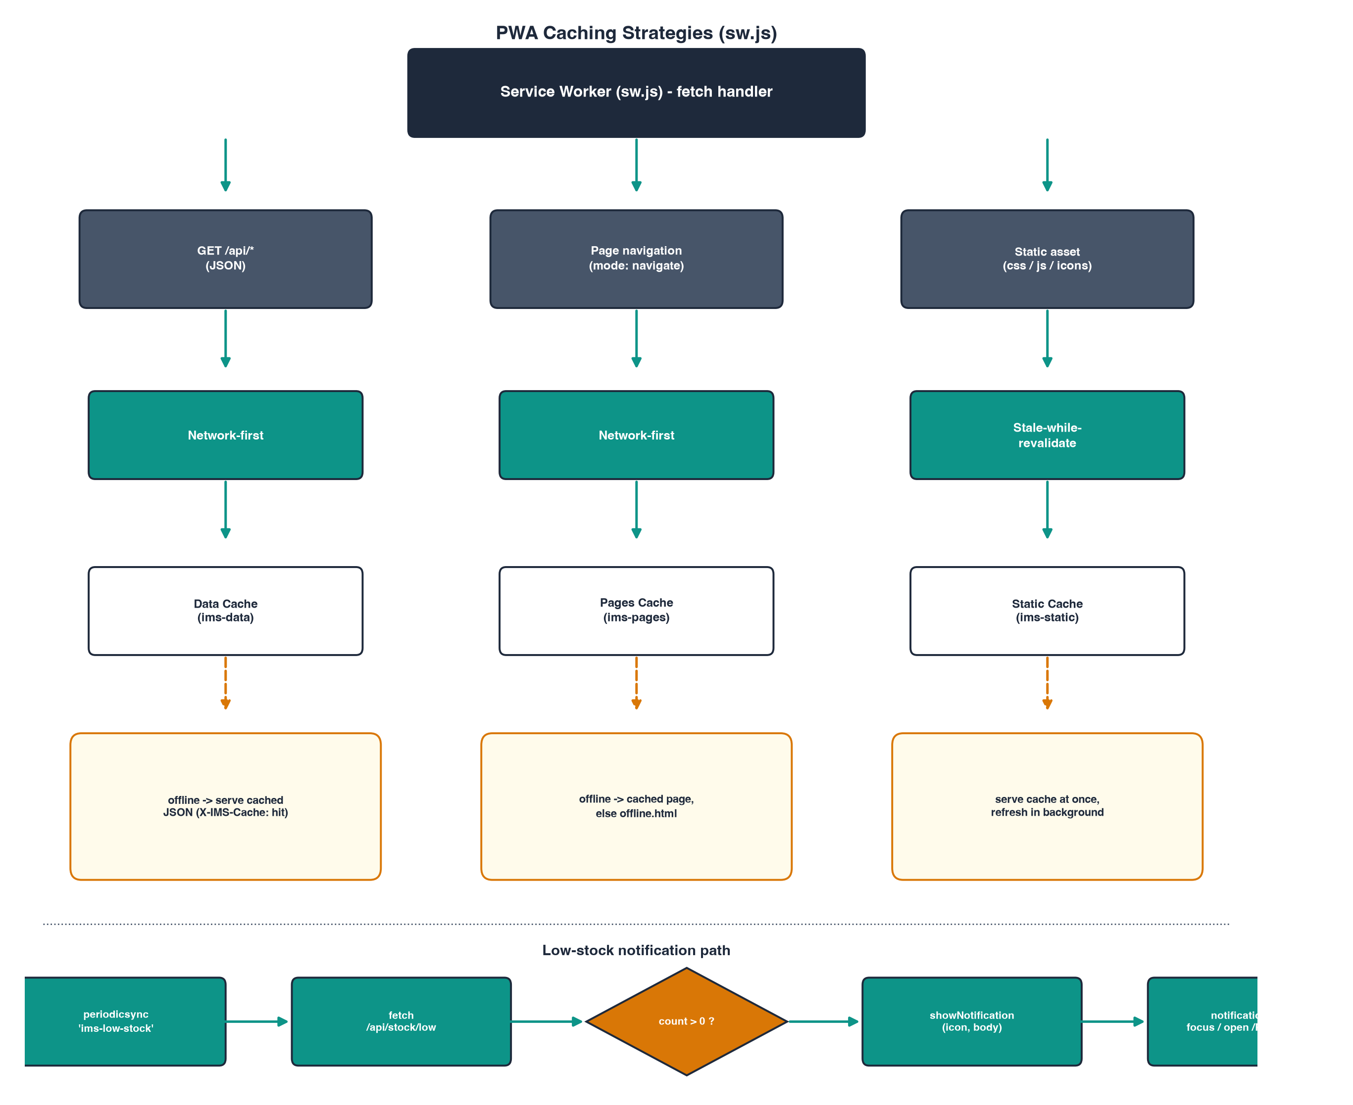
Progressive Web App
Mobile-First Features
• Installable — Add to Home Screen on Android & iOS.
• Offline-capable via a service worker cache for the last-viewed data.
• Low-stock browser notifications when alerts are enabled.
• Same live product & stock data as the desktop dashboard.
Home
Search
Low Stock
13 / 17
Notes:
For staff on the move, StockPilot ships as an installable Progressive Web App. It's add-to-home-screen ready, caches the last-viewed data through a service worker so it still works offline, and can raise a browser notification when stock runs low — all backed by the same live data as the desktop app.

Slide 15
Testing & Results
Key Test Cases
ID | Test | Status
TC-04 | POST /Account/Login with admin/Admin@123 and a valid antiforgery token | Pass
TC-07 | POST /Stock/StockOut with quantity=99999 on a product with 42 in stock | Pass
TC-09 | POST /Category/Delete/1 for a category with products assigned to it | Pass
TC-13 | GET /api/products without a session | Pass
TC-14 | Authenticated GET /api/stock/low | Pass
TC-17 | Run ResetDatabase.sql, then CreateTables.sql, then SeedData.sql via sqlcmd against Docker SQL Server (script path, not the app) | Pass
18/22
automated pass
14 / 17
Notes:
We ran 22 test cases covering build, authentication, stock validation, reporting and the PWA API layer. 18 passed automated verification via curl and sqlcmd checks against the live app and database; the remainder are flagged for manual browser-based verification, like the install prompt and offline reload. This table highlights six of the most important cases, including the insufficient-stock guard we just demonstrated.

Slide 16
Conclusion & Future Scope
What We Built
Future Scope
• A working 3-tier system: Console app, ASP.NET Core MVC web app, and a PWA.
• Validated stock workflows with full transaction history and audit trail.
• Role-based security, live dashboards and five printable reports.
• A normalised SQL Server schema seeded with realistic demo data.
• Barcode / QR scanning for faster Stock In & Stock Out.
• Purchase-order workflow tying supplier orders to Stock In.
• Multi-branch / multi-warehouse inventory support.
• Push notifications and richer analytics on the PWA.
15 / 17
Notes:
To sum up, StockPilot delivers a complete, validated inventory workflow across three client surfaces, backed by a properly normalised database and real security. Looking ahead, barcode scanning, supplier purchase orders, and multi-branch support are the natural next steps.

Slide 17
Thank You
Questions?
StockPilot — Inventory Management System
Notes:
Thank you for your time. We're happy to take any questions — whether about the architecture, the validation rules, the database design, or a live demo of any part of the app.

