Slide 1
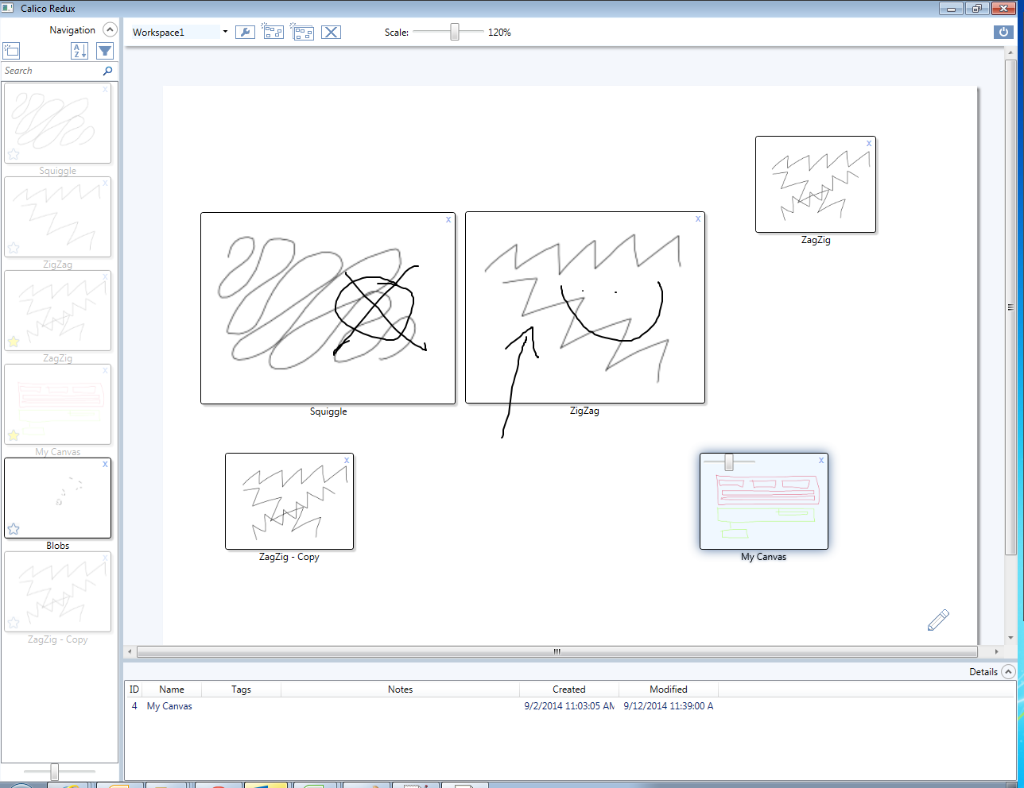
Workspace
selector
Workspace controls:
details, new, clone, delete
Global scale slider
Sort
Filter
Quit
New canvas
Workspace
Double-click to edit canvas
All Canvases
Favorite
Annotation mode
Navigation
Navigation
scale
slider
Double-click to edit details
Details

Slide 2
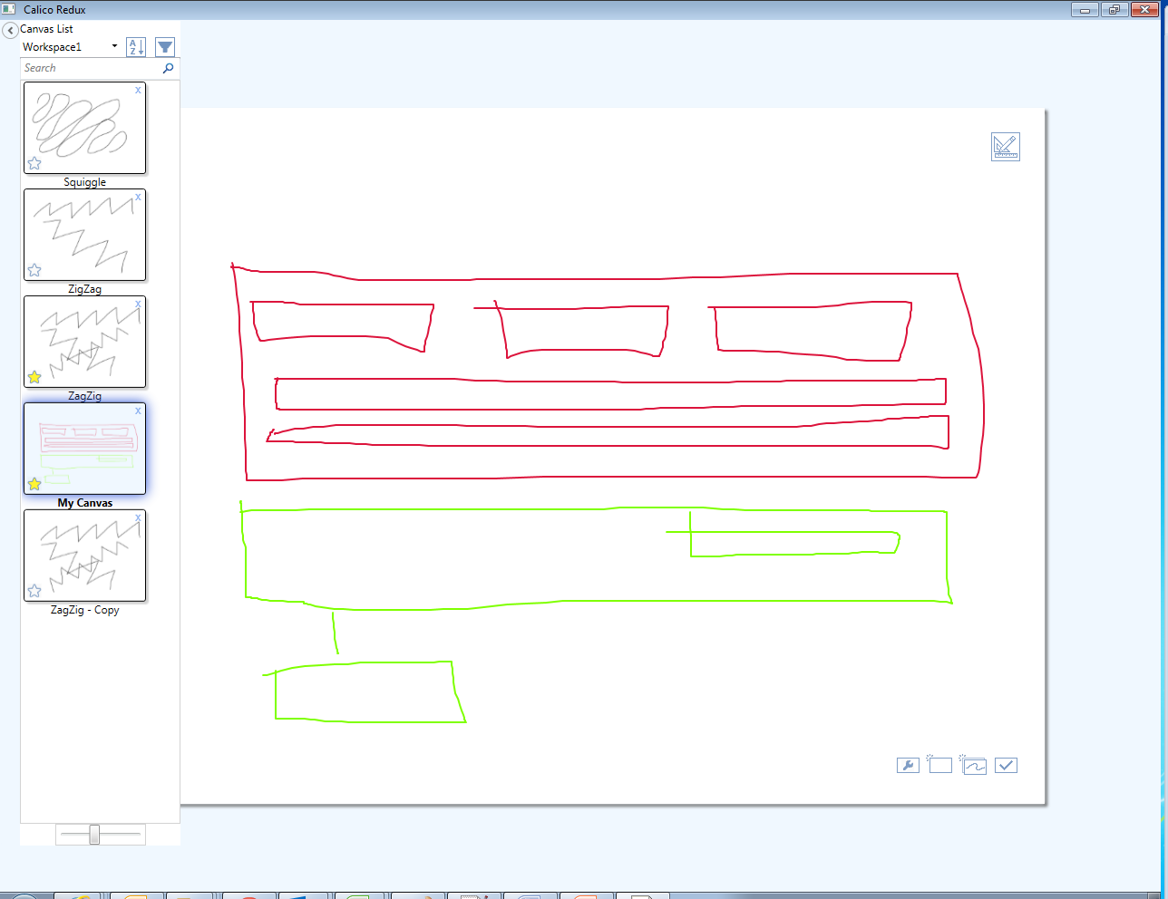
Workspace
selector
Click to switch to canvas
Show toolbox
Canvases in selected workspace
Canvas controls:
details, new, clone, done
Navigation
Navigation
scale
slider

Slide 3
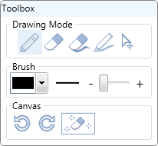
Erase stroke
Erase
Highlighter
Draw
Select
Pen color
Pen size
Undo/Redo
Clear canvas

