Slide 1
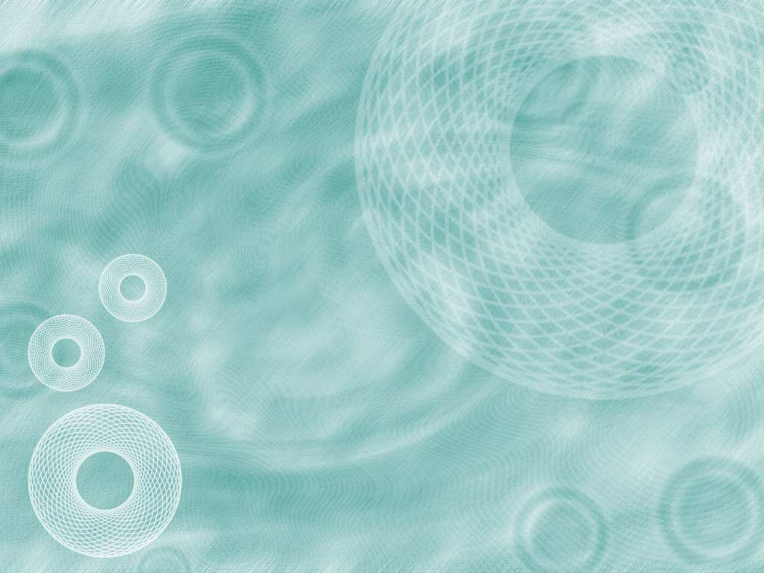
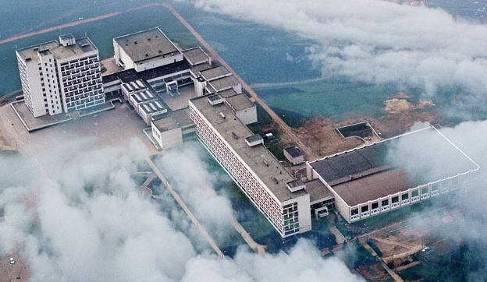
Chuvash State University
Department of Applied Physics and Nanotechnology
Knowledge Base is a Future of Nanomaterials World
Victor Abrukov and
ChSU team
abrukov@yandex.ru
3rd International Conference on Nanotek and Expo
OMICS Group Conferences
The work is partially supported by the Russian Foundation for Basic Research (grant 13-02-97071) and the Organizing Committee of Nanotek 2013 .

Slide 2

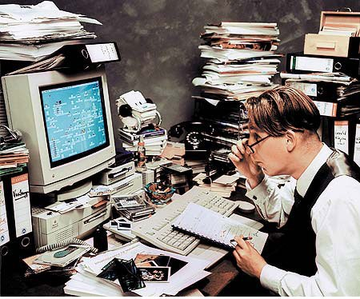
Global Problem
Currently a lot of experimental
data on properties and characteristics
of various nanomaterials
are obtained in all of the world
Big Data problem?!
What we can do? What we can make with Data?

Slide 3
Questions to Experiment
What does it mean that you have done an experiment? This means that you have tables and graphs.
The main question that we want to put here is how could we increase the significance (profit, price) of tables and graphs?
For example:
How could we generalize all of them?
How could we use them to solve an inverse problem?
Could we look beyond the experiment and to imagine (predict) results of experiments that we were not being able to execute?
etc?

Slide 4
Main Question
Is it possible to present the results of experimental research as Knowledge Base?
Under Knowledge Base, we mean an information tool, containing all relationships between all variables of object, allowing to calculate a value of one variable through others as well as solving both direct and inverse problems, predicting characteristics of object which have not been investigated yet as well as predicting a technology parameters that provide the required characteristics of object

Slide 5
Goal of Presentation
To depict the first examples of the ARTIFICIAL NEURAL NETWORKS usage for solution of these questions and problems

Slide 6
Artificial Neural Networks (ANN)
ANN is the only tool of approximation of experimental function of many variables.
The Kolmogorov-Arnold theorem, which deals with the capability of representation of a function of several variables by means of superposition of functions of a smaller number of variables, is the first basis of ANN applications.
The real computer emulators of ANN are like the usual computer programs. The difference is that their creation is based on the use of a training procedure which executes by means of a set of examples (a data base of examples).
ANN use principles of human brain working. They are like children and need in training.

Slide 7
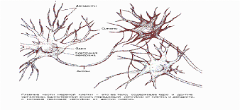
A part of human neural networks

Slide 8
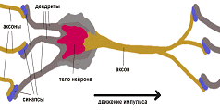
Scheme of human neuron

Slide 9
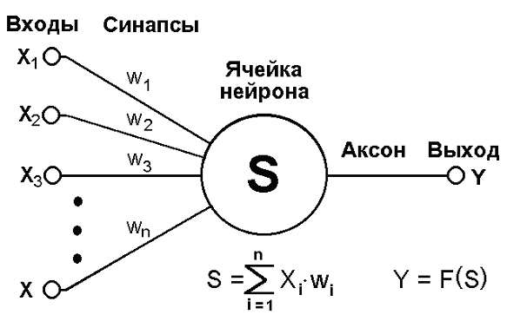
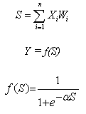
Scheme of artificial neuron
Artificial neuron consist of inputs, synapses, summator and non-linear converter. It executes the following operations:
W i is the weight of a synapse (i = 1..., n); S is the result of summation; Xi is the component of input vector (input signals) (i = 1..., n); Y is the output signal of a neuron; n is the number of inputs of a neuron; and f is the non-linear transforming (function of activation or transfer function)
Operations which provides an artificial neuron like operation which carries the human neuron

Slide 10
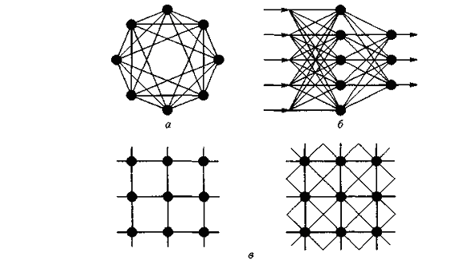
Kinds of Artificial Neural Networks.
ANN represent some quantity of artificial “neurons” and can be presented often as “neurons” formed in layers (б)

Slide 11
Multifactor computational models (CM) of the characteristics of nano films of linear-chain carbon (LCC) (carbene) with embedded into LCC various atoms (LCCA)
(Russian Foundation for Basic Research, project no 13-02-97071)
Models are based on experimental results for the electrical and optical characteristics of nano films of LCCA.
For the first time LCCA were manufactured in the Chuvash State University, using unique technology protected by a patent, and using a variety of know-how.
The direction of work can be of great interest for active and passive elements of solid-state electronics, photovoltaic elements, sensors, medical applications, etc.

Slide 12
The electronic structure of the linear-chain carbon molecule
σ-bond
π-bond
A fragment of the molecule of LCC

Slide 13

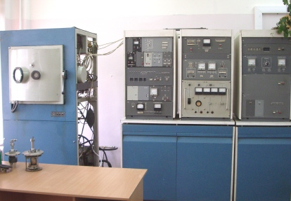
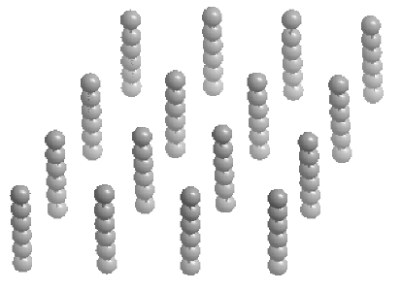
The film of line-chain carbon
У
Z
5Å
Х

Slide 14
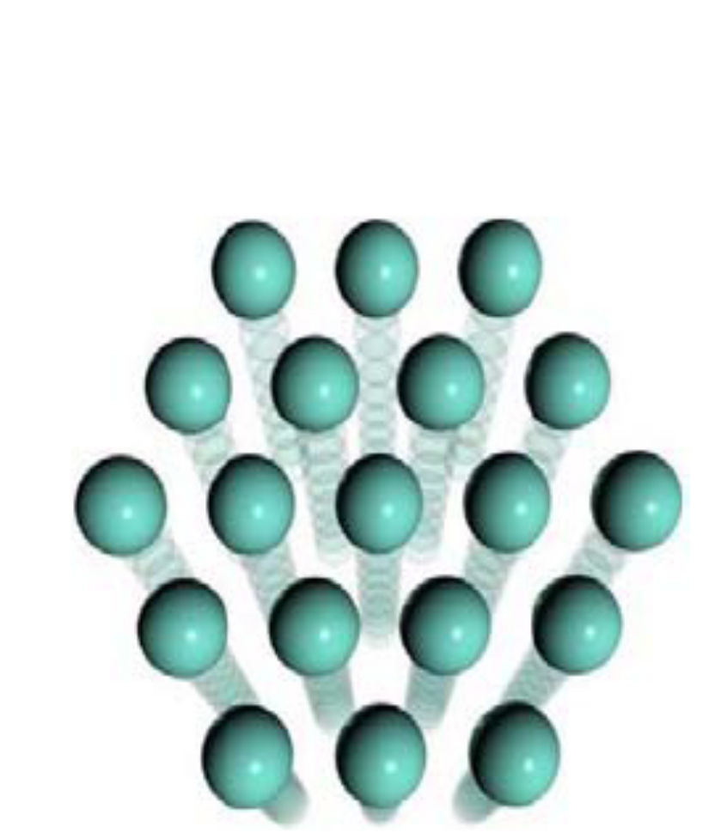
The film of line-chain carbon with embedded into LCC Ag atom (on the right)
0,67 Å
углерод
2,1Å
атом
серебра
1,45Å
Модель линейно-цепочечного углерода
5Å
расстояние между
цепочками углерода

Slide 15
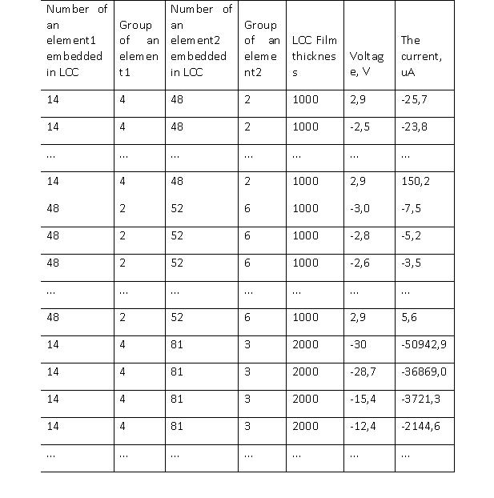
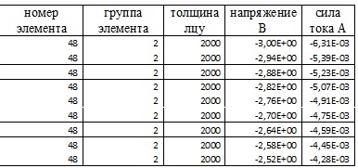
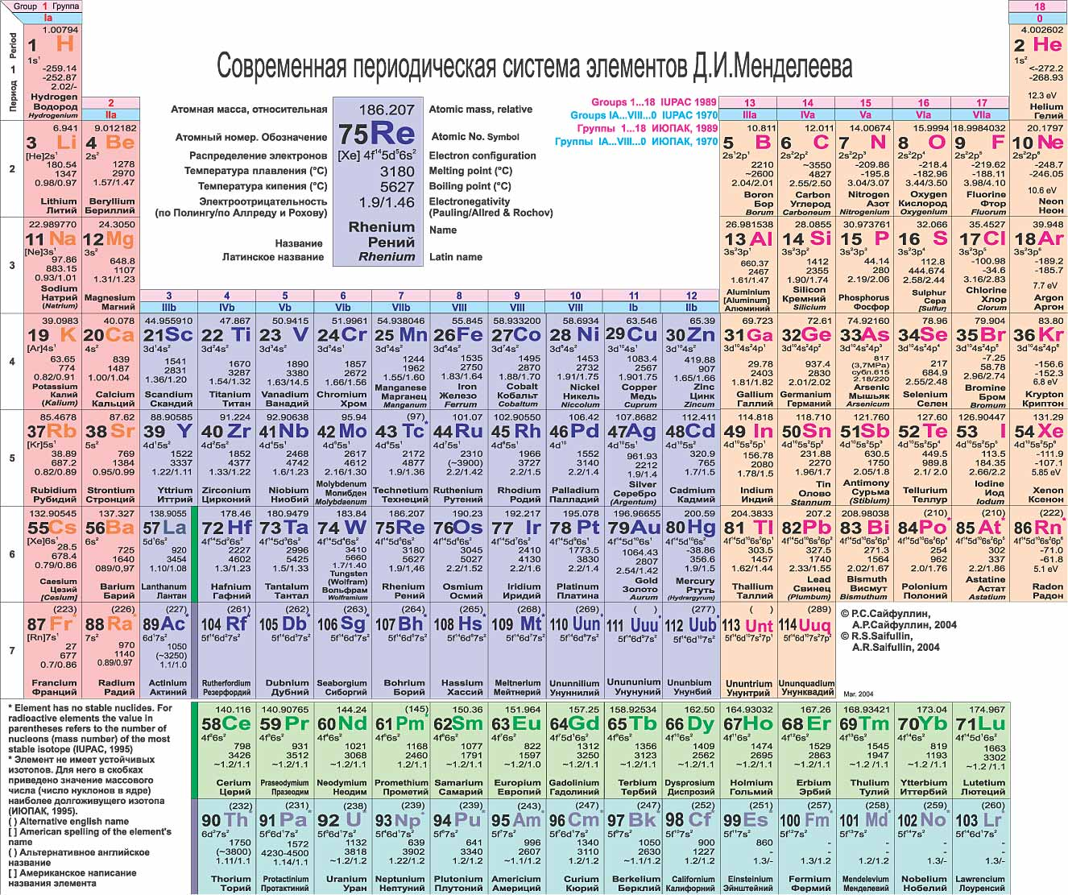
The scheme of construction of the CM
1. We have taken experimental data of the various type of LCCA

Slide 16
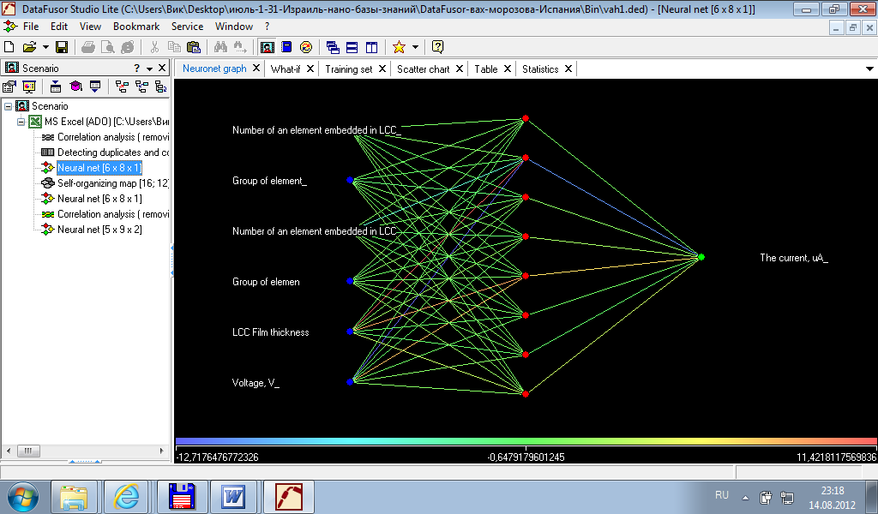
The structure of ANN
2. Then we have chosen the structure of ANN in accordance with dimension of experimental data and have trained the ANN

Slide 17
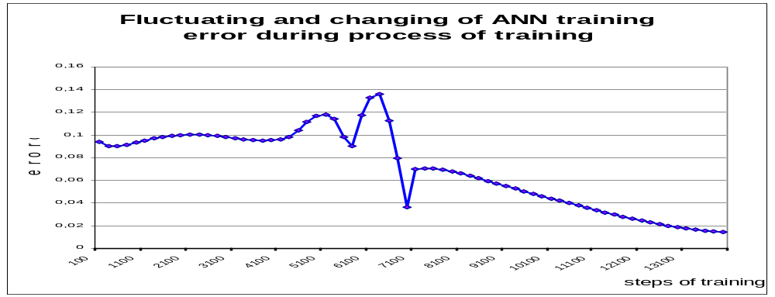
Training of Artificial Neural Networks
The task of ANN training consists of finding such synaptic weights by means of which input information (input signals) will be correctly transformed into output information (output signal).
During ANN training, a training tool (usually method of “back propagation of errors”) compares the output signals to known target values, calculates the error, modifies the weights of synapse that give the largest contribution to error and repeats the training cycle many times until an acceptable output signal is achieved.
A usual number of training cycles is 1000 …10,000.

Slide 18
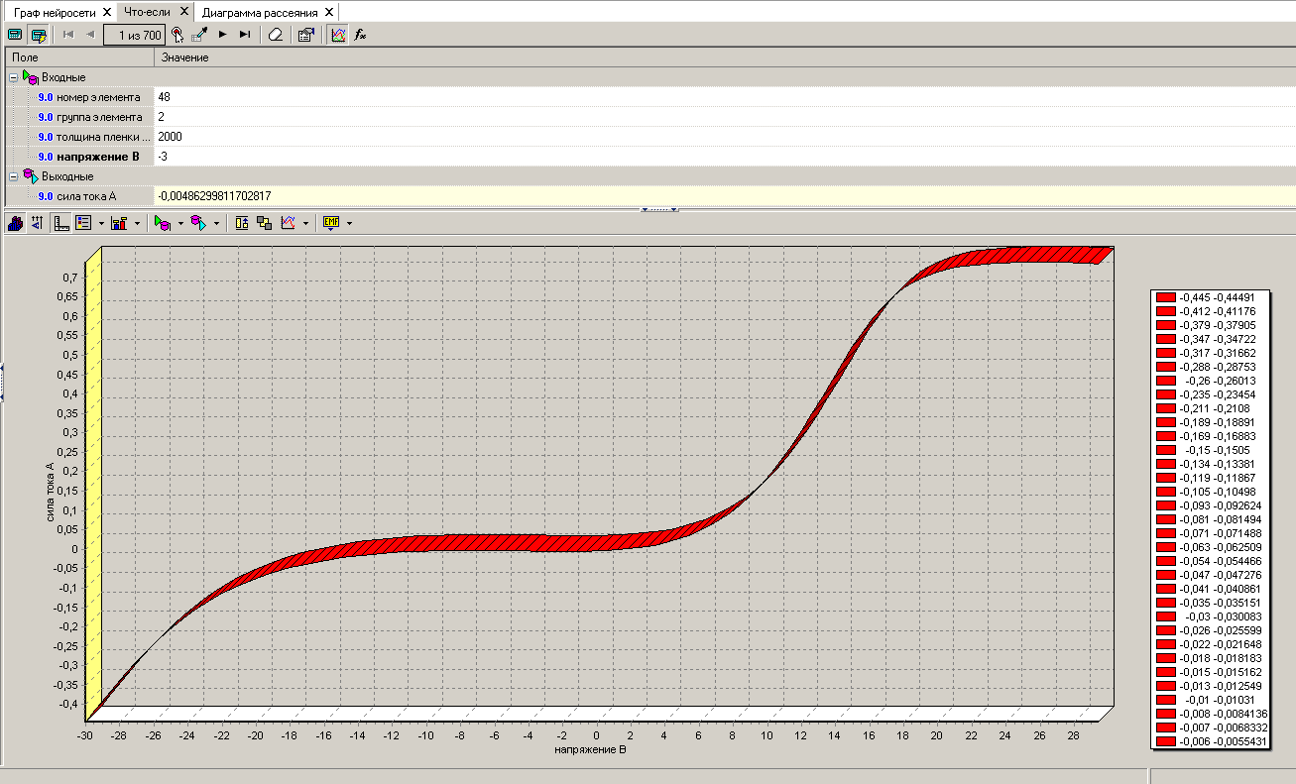
The illustration of dependence revealed by CM (one element was embedded into LCCA)

Slide 19
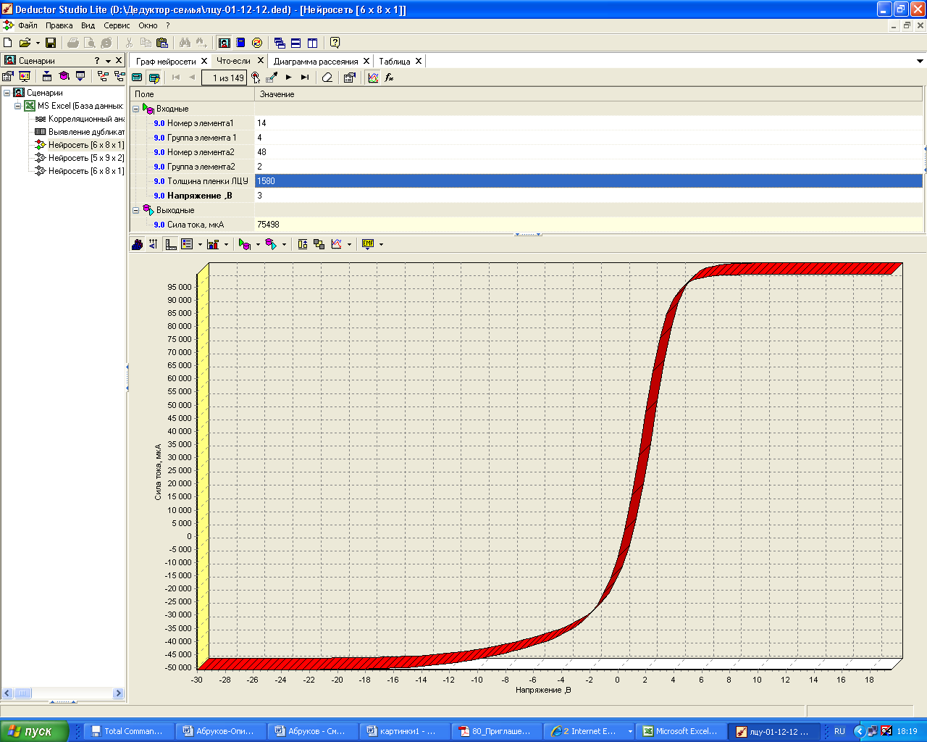
The illustration of dependence revealed by CM (two elements were embedded into LCCA)

Slide 20
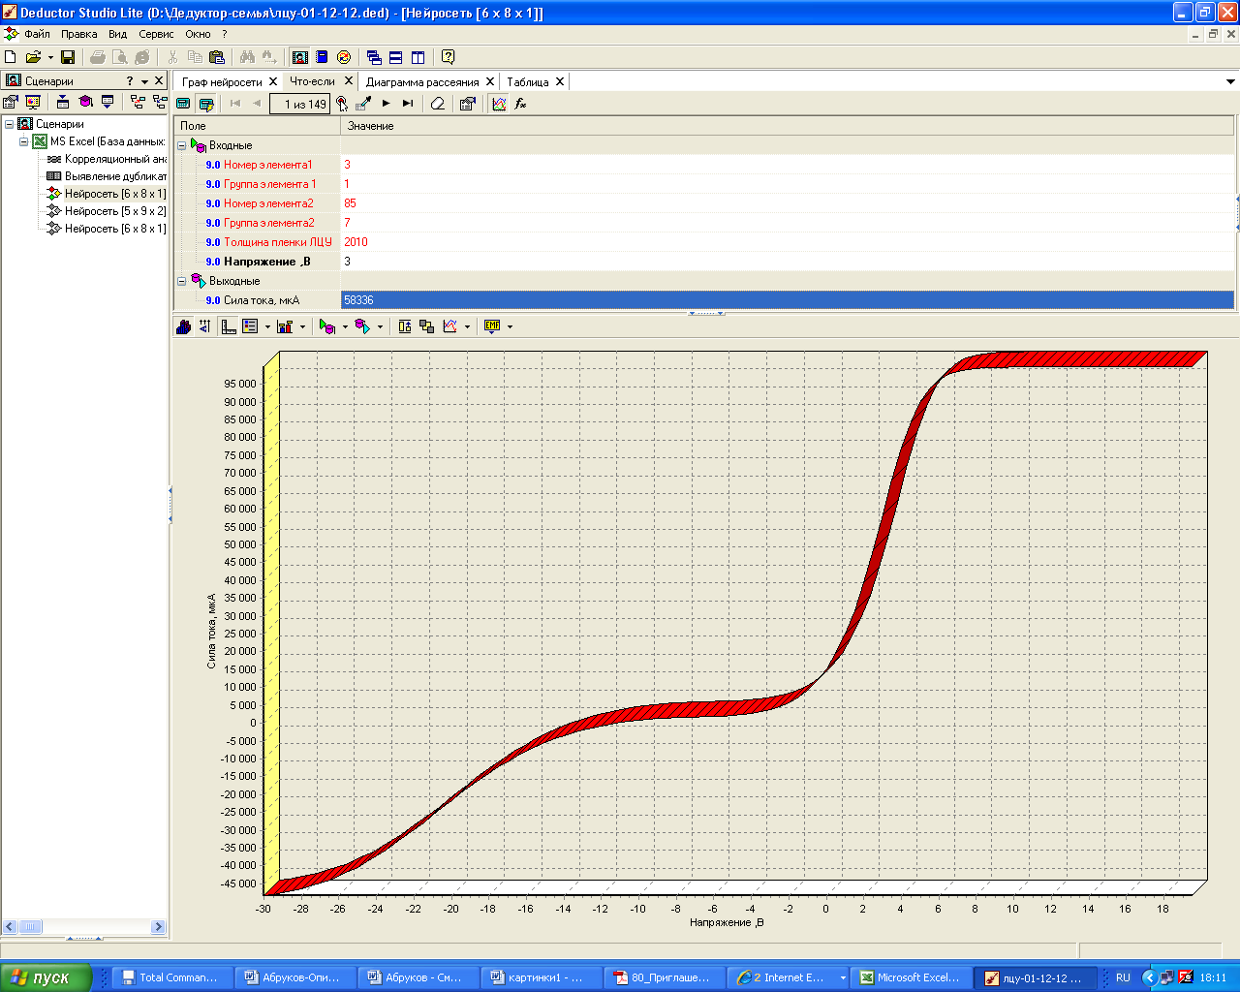
The illustration of dependence revealed by CM (a hypothetical sort of LCCA, a “new experimental” results which was obtained without an experiment)

Slide 21
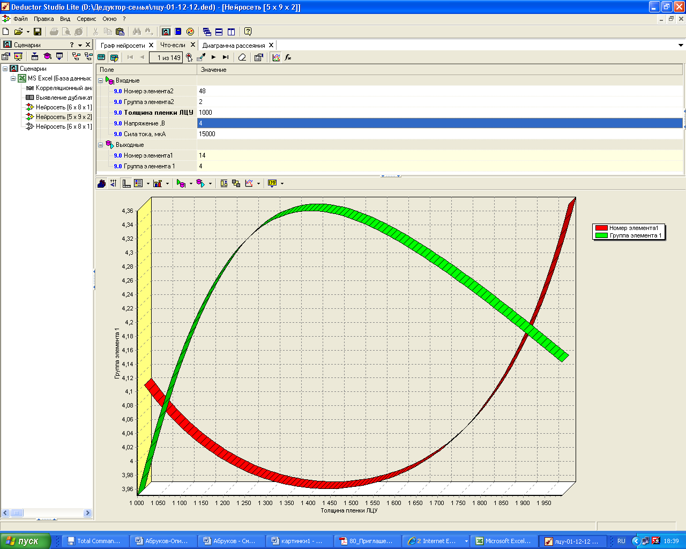
A solution of an inverse task: determination of the kind of element 1 and its group for the various thickness of the LCCA that provide a required current-voltage characteristics (value of electrical current 15 mA for voltage 4 V)

Slide 22
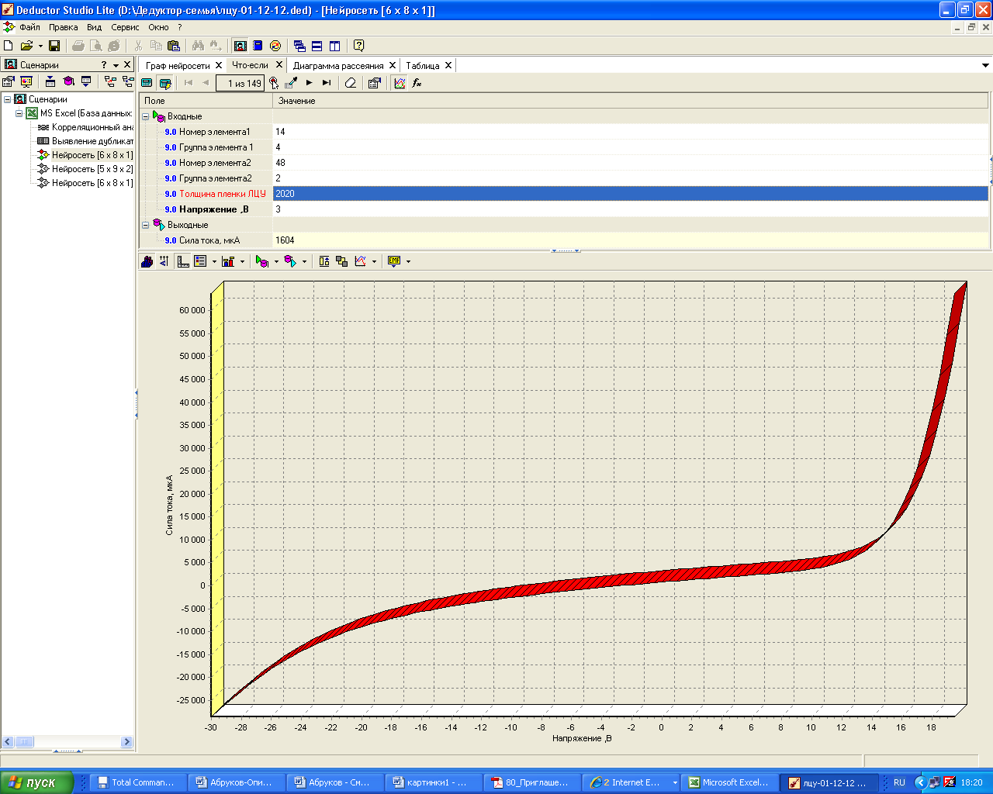
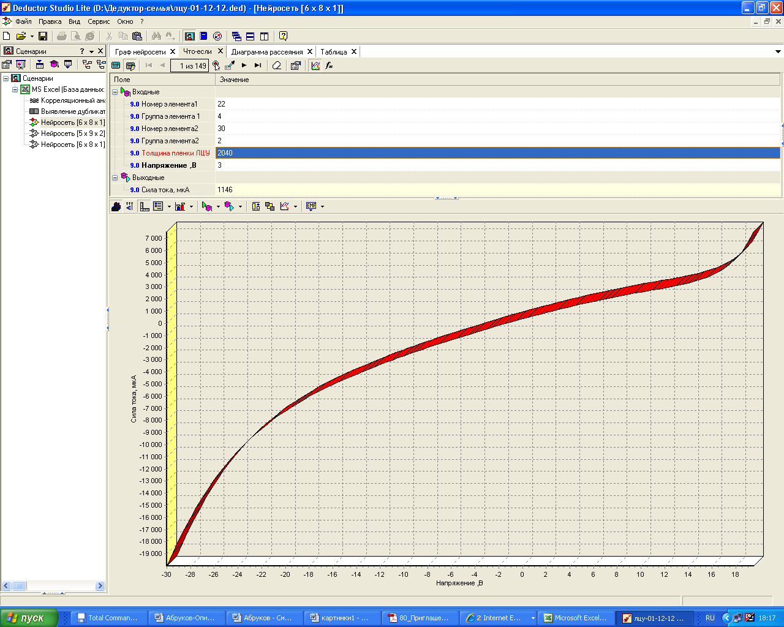
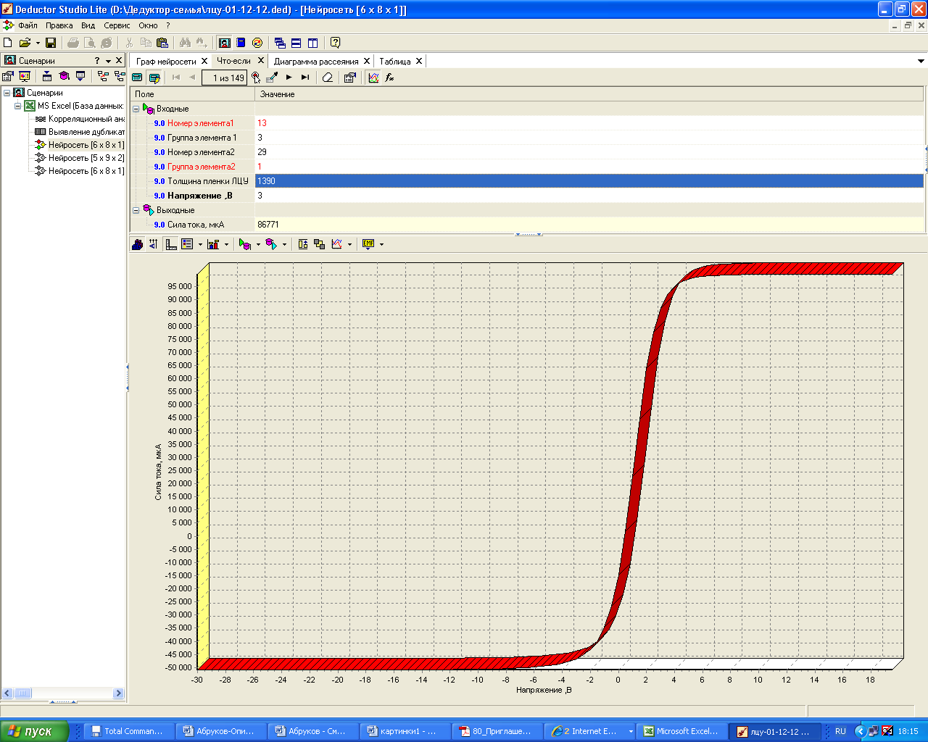
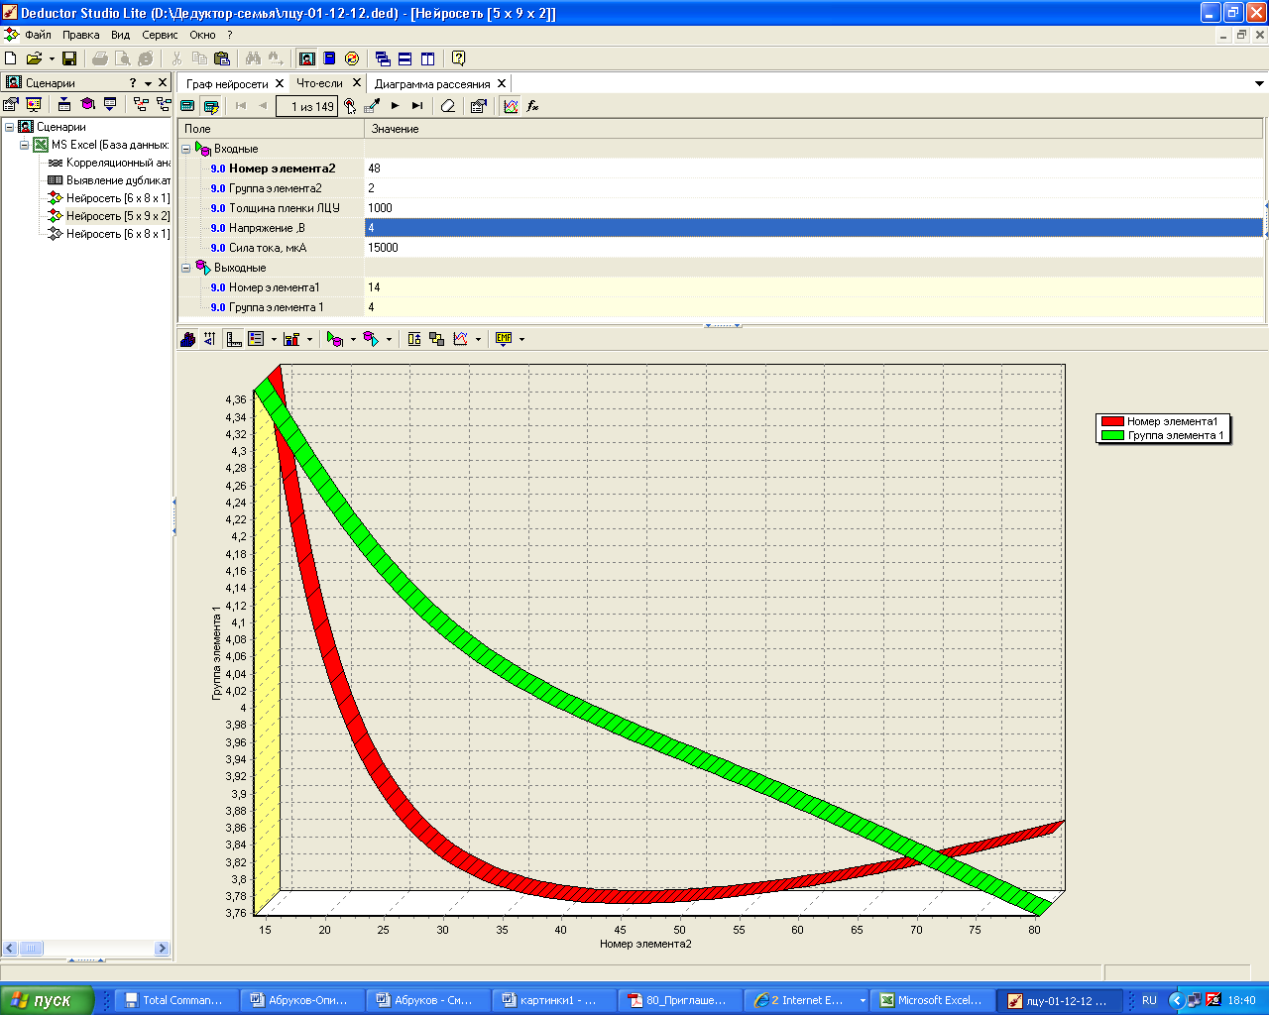
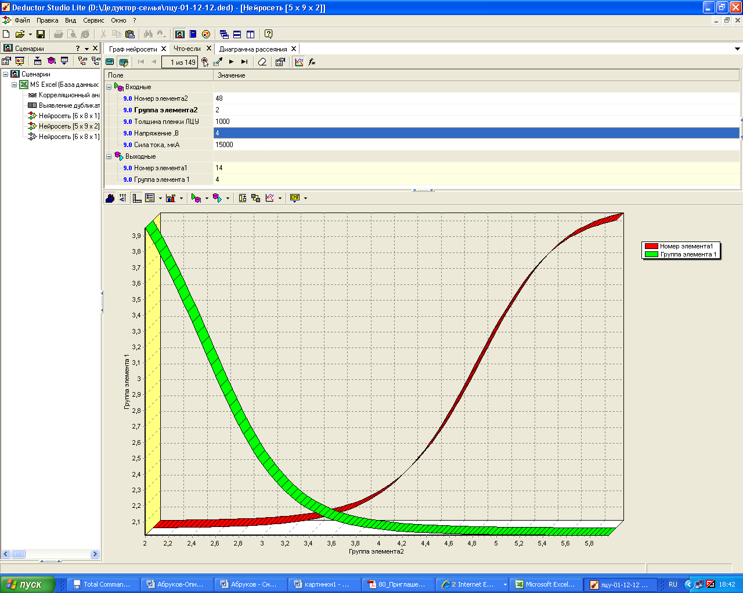
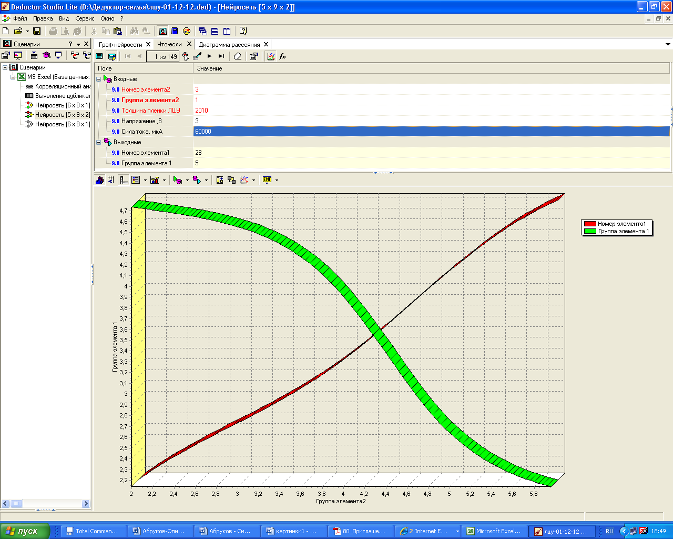
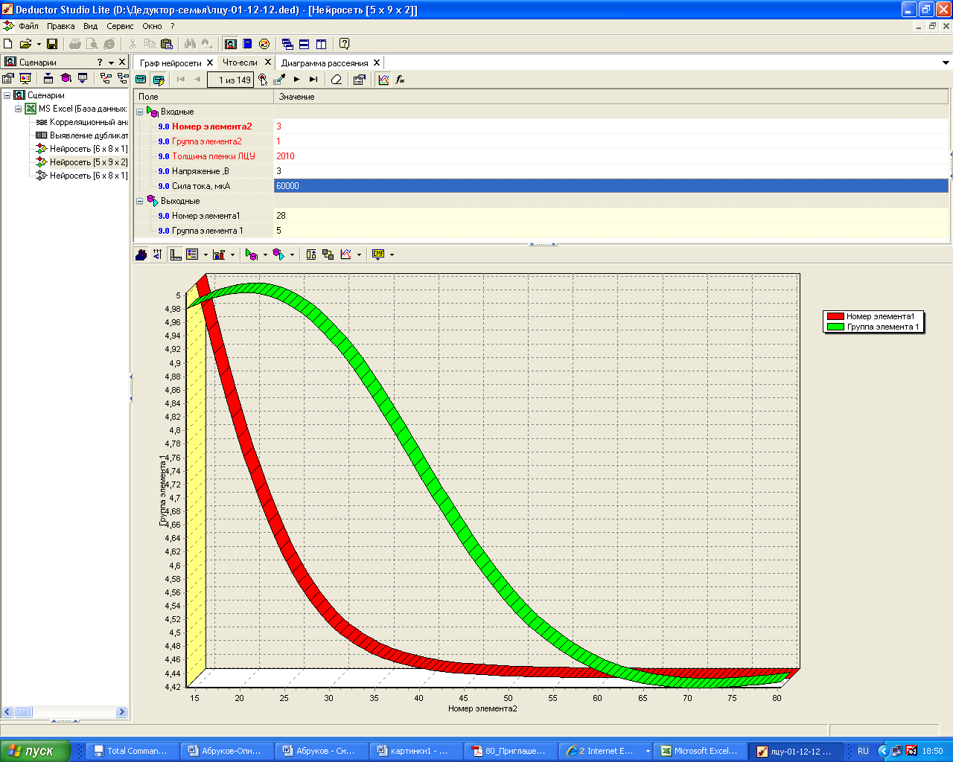
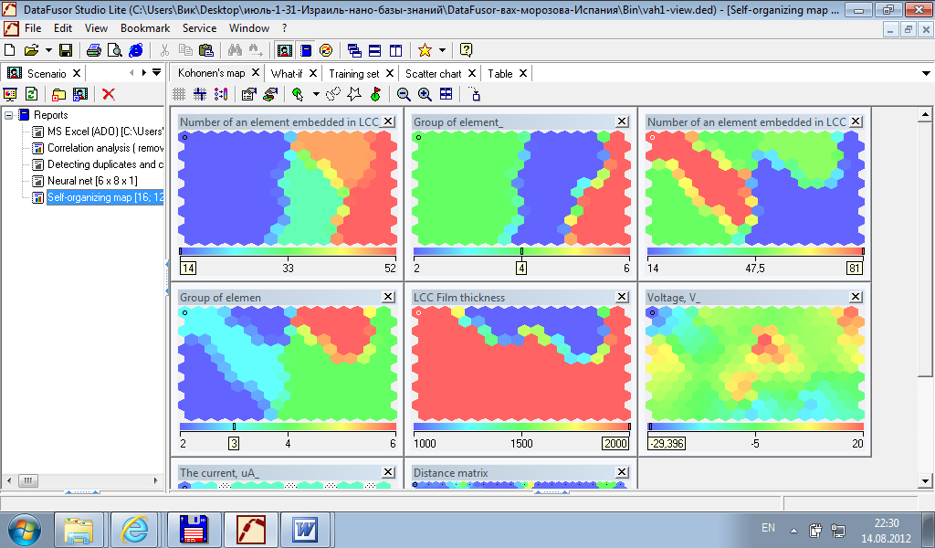
Only a little part of knowledge that there are in CM and can be obtained and illustrated instantly:
The CM (Knowledge Base ?) allow us to generalize current-voltage characteristics, to predict the current-voltage characteristic of any new sort of LCCA as well as to solve an inverse tasks

Slide 23
Conclusion 1
Outputs
1. CM correctly “determine” the Current-Voltage Characteristics of LCCA and it is the good approximation tool of multidimensional experimental functions
2. CM correctly reveal all dependences of the current on other parameters and it is the good tool for generalization.
3. CM instantly calculate a values of the necessary characteristics and it is the fast engineering calculator specialized to LCCA
4. CM get any characteristics of a hypothetical sort of LCCA and it is the most cheap way for receiving of “new” “experimental” results without an experiment
5. We could consider CM which we have obtained as the first example of Knowledge Base in field of nanomaterial's science.

Slide 24
Conclusion 2
A lot of experimental data is obtained in nanomaterial’s science nowadays and it grows every day.
It is time “to collect stones” and to develop an information tool for generalization of experimental results obtained. It is time to create a Nanomaterial’s Computational Tool like the Human Genome or the Materials Genome (https://www.materialsproject.org) in order to solve the problem of future “Nanomaterials Genome”.
We consider a creation of Knowledge Base as the first step for solution this problem and we invite participants of Nanotek-2013 who are interested in the creation of the multifactor computational models in area of nanomaterial’s science to collaborate with our team.
We think the Knowledge Base will be a future of the nanomaterial’s world.

Slide 25
One reference – we had been started with it
Neural Networks for Instrumentation, Measurement and Related Industrial Applications (2003). Proceedings of the NATO Advanced Study Institute on Neural Networks for Instrumentation, Measurement, and Related Industrial Applications (9-20 October 2001, Crema, Italy)/ ed. by Sergey Ablameyko, Liviu Goras, Marco Gori and Vincenzo Piuri, IOS Press, Series 3: Computer and Systems Sciences – Vol. 185, Amsterdam.

Slide 26
Contacts
Chuvash State University, Bldg. 1, Department of Applied Physics and Nanotechnology
University Str., 38, office 225
Tel. +7352-455600 add.3602
Fax: +7352-452403
E-mail: abrukov@yandex.ru
Thank you!

Slide 27
Conclusion
All you need in your life is love
All you need in your scientific life is neural networks
It can be artificial neural networks

