Slide 1

The 4-Color Theorem
Exploring Graph Theory and Map Coloring Created by: Alex Frear

Slide 2
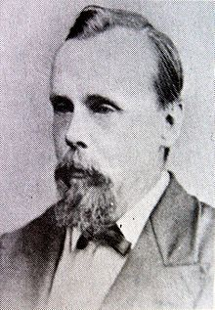
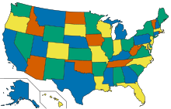
Introduction
The 4-Color Theorem states: "Any map in a plane can be colored using at most four colors, such that no two adjacent regions share the same color.“
First proposed in 1852 by Francis Guthrie
It remained unproven for over a century!
The challenge: Ensuring adjacent regions (sharing a border) do not have the same color.

Slide 3
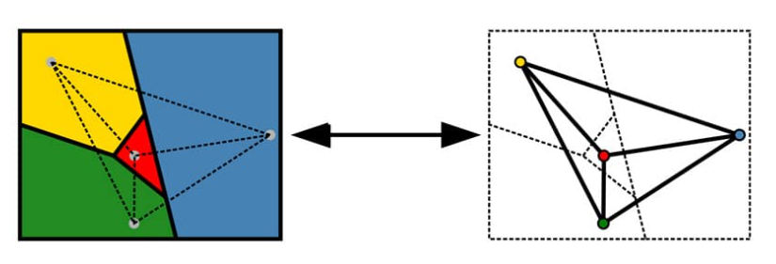
Graph Theory Basics
Graph Theory is a branch of mathematics that studies nodes (vertices) and connections (edges).
Planar Graphs are graphs that can be drawn without edges crossing.
A map can be represented as a graph:
Regions → Nodes (Vertices)
Borders → Edges (Connections between nodes)

Slide 4
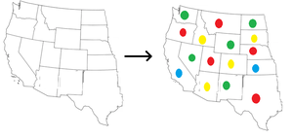
Understanding the 4-Color Theorem
The goal: Color any map using only 4 colors so that no two adjacent regions share a color.
Key Observations:
Some maps can be colored with fewer than 4 colors.
However, no planar map requires more than 4 colors.

Slide 5
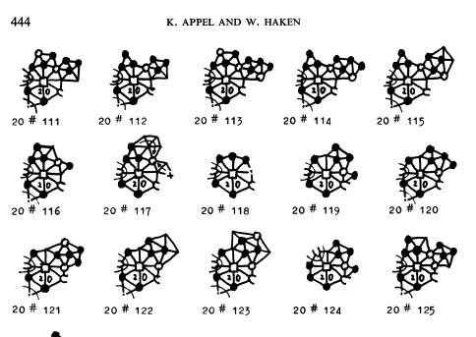
Proof and Computational Verification
Early Attempts: Mathematicians tried proving it with logic but failed.
Breakthrough (1976): Appel & Haken provided the first proof.
The proof used a computer to check 1,936 cases.
This was the first major theorem proven using a computer!

Slide 6
Applications of the 4-Color Theorem
Maps & Geography: Political maps (countries, states)
Scheduling Problems: Avoiding time conflicts in scheduling (e.g., exams)
Wireless Networks: Assigning frequencies to avoid interference
Puzzles & Games: Used in Sudoku and other logic puzzles

Slide 7

Visual Graph Theory Example
Coloring a simple graph with 4 colors
Steps:
Convert a map into a graph.
Start coloring with one node.
Assign different colors to connected nodes.
Complete the graph with at most 4 colors.

Slide 8
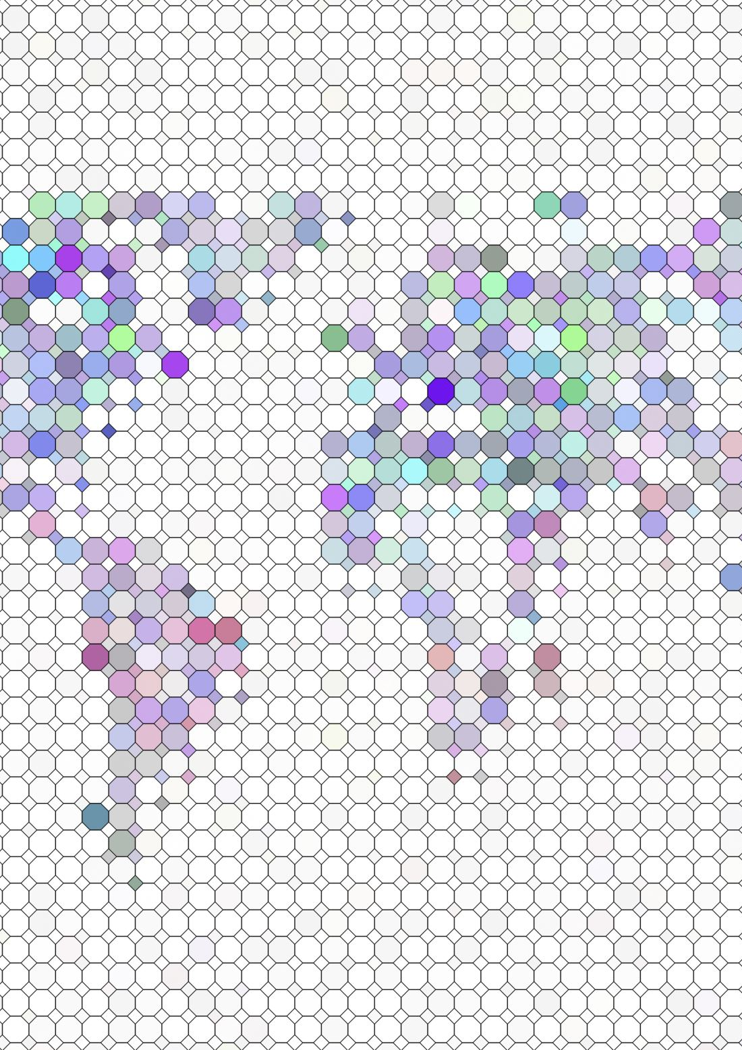
Conclusion
The 4-Color Theorem is a fundamental result in graph theory.
It has real-world applications beyond map coloring.
The theorem was first proven using a computer!

