Slide 1
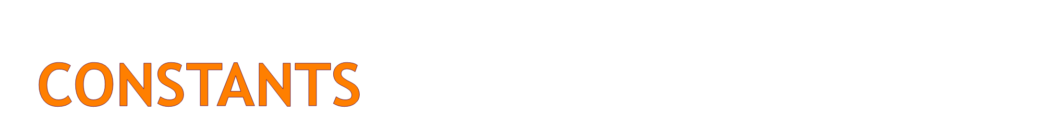
Fixed values such as numbers, letters, and strings are called “constants” - because their value does not change
Numeric constants are as you expect
String constants use single-quotes (')
or double-quotes (")
>>> print 123
123
>>> print 98.6
98.6
>>> print 'Hello world'
Hello world

Slide 2
Variables
A variable is a named place in the memory where a programmer can store data and later retrieve the data using the variable “name”
Programmers get to choose the names of the variables
You can change the contents of a variable in a later statement
x = 12.2
y = 14
12.2
x
100
x = 100
14
y

Slide 3
Python Variable Name Rules
Must start with a letter or underscore _
Must consist of letters and numbers and underscores
Case Sensitive
Good: spam eggs spam23 _speed
Bad: 23spam #sign var.12
Different: spam Spam SPAM

Slide 4
Reserved Words
You can not use reserved words as variable names / identifiers
and del for is raise
assert elif from lambda return
break else global not try
class except if or while
continue exec import pass yield
def ﬁnally in print
Notes:
Like a dog .... food ... food ...

Slide 5
Sentences or Lines
x = 2
x = x + 2
print x
Assignment Statement
Assignment with expression
Print statement
Variable
Operator
Constant
Reserved Word

Slide 6
Assignment Statements
We assign a value to a variable using the assignment statement (=)
An assignment statement consists of an expression on the right hand side and a variable to store the result
x = 3.9 * x * ( 1 - x )

Slide 7
0.6
A variable is a memory location used to store a value (0.6).
x
0.6
0.6
x = 3.9 * x * ( 1 - x )
0.4
Right side is an expression. Once expression is evaluated, the result is placed in (assigned to) x.
0.93

Slide 8
A variable is a memory location used to store a value. The value stored in a variable can be updated by replacing the old value (0.6) with a new value (0.93).
0.6 0.93
x
x = 3.9 * x * ( 1 - x )
Right side is an expression. Once expression is evaluated, the result is placed in (assigned to) the variable on the left side (i.e. x).
0.93

Slide 9
Numeric Expressions
Because of the lack of mathematical symbols on computer keyboards - we use “computer-speak” to express the classic math operations
Asterisk is multiplication
Exponentiation (raise to a power) looks different from in math.
Operator | Operation
+ | Addition
- | Subtraction
* | Multiplication
/ | Division
** | Power
% | Remainder

Slide 10
Numeric Expressions
>>> jj = 23
>>> kk = jj % 5
>>> print kk
3
>>> print 4 ** 3
64
Operator | Operation
+ | Addition
- | Subtraction
* | Multiplication
/ | Division
** | Power
% | Remainder
>>> xx = 2
>>> xx = xx + 2
>>> print xx
4
>>> yy = 440 * 12
>>> print yy
5280
>>> zz = yy / 1000
>>> print zz
5
4 R 3
5
23
20
3

Slide 11
Order of Evaluation
When we string operators together - Python must know which one to do first
This is called “operator precedence”
Which operator “takes precedence” over the others
x = 1 + 2 * 3 - 4 / 5 ** 6

Slide 12
Operator Precedence Rules
Highest precedence rule to lowest precedence rule
  Parenthesis are always respected
  Exponentiation (raise to a power)
  Multiplication, Division, and Remainder
  Addition and Subtraction
  Left to right
Parenthesis
Power
Multiplication
Addition
Left to Right

Slide 13
1 + 2 ** 3 / 4 * 5
>>> x = 1 + 2 ** 3 / 4 * 5
>>> print x
11
>>>
1 + 8 / 4 * 5
1 + 2 * 5
Parenthesis
Power
Multiplication
Addition
Left to Right
1 + 10
11

Slide 14
1 + 2 ** 3 / 4 * 5
>>> x = 1 + 2 ** 3 / 4 * 5
>>> print x
11
>>>
1 + 8 / 4 * 5
Note 8/4 goes before 4*5 because of the left-right rule.
1 + 2 * 5
1 + 10
Parenthesis
Power
Multiplication
Addition
Left to Right
11

Slide 15
Operator Precedence
Parenthesis
Power
Multiplication
Addition
Left to Right
Remember the rules top to bottom
When writing code - use parenthesis
When writing code - keep mathematical expressions simple enough that they are easy to understand
Break long series of mathematical operations up to make them more clear
Exam Question: x = 1 + 2 * 3 - 4 / 5

Slide 16
Python Integer Division is Weird!
Integer division truncates
Floating point division produces floating point numbers
>>> print 10 / 2
5
>>> print 9 / 2
4
>>> print 99 / 100
0
>>> print 10.0 / 2.0
5.0
>>> print 99.0 / 100.0
0.99
This changes in Python 3.0

Slide 17
Mixing Integer and Floating
When you perform an operation where one operand is an integer and the other operand is a floating point the result is a floating point
The integer is converted to a floating point before the operation
>>> print 99 / 100
0
>>> print 99 / 100.0
0.99
>>> print 99.0 / 100
0.99
>>> print 1 + 2 * 3 / 4.0 - 5
-2.5
>>>

Slide 18
What does “Type” Mean?
In Python variables, literals, and constants have a “type”
Python knows the difference between an integer number and a string
For example “+” means “addition” if something is a number and “concatenate” if something is a string
>>> ddd = 1 + 4
>>> print ddd
5
>>> eee = 'hello ' + 'there'
>>> print eee
hello there
concatenate = put together

Slide 19
Type Matters
>>> eee = 'hello ' + 'there'
>>> eee = eee + 1
Traceback (most recent call last):
File "<stdin>", line 1, in <module>
TypeError: cannot concatenate 'str' and 'int' objects
>>> type(eee)
<type 'str'>
>>> type('hello')
<type 'str'>
>>> type(1)
<type 'int'>
>>>
Python knows what “type” everything is
Some operations are prohibited
You cannot “add 1” to a string
We can ask Python what type something is by using the type() function.

Slide 20
Several Types of Numbers
Numbers have two main types
  Integers are whole numbers: -14, -2, 0, 1, 100, 401233
  Floating Point Numbers have decimal parts: -2.5 , 0.0, 98.6, 14.0
There are other number types - they are variations on float and integer
>>> xx = 1
>>> type (xx)
<type 'int'>
>>> temp = 98.6
>>> type(temp)
<type 'float'>
>>> type(1)
<type 'int'>
>>> type(1.0)
<type 'float'>
>>>

Slide 21
Type Conversions
>>> print float(99) / 100
0.99
>>> i = 42
>>> type(i)
<type 'int'>
>>> f = float(i)
>>> print f
42.0
>>> type(f)
<type 'float'>
>>> print 1 + 2 * float(3) / 4 - 5
-2.5
>>>
When you put an integer and floating point in an expression the integer is implicitly converted to a float
You can control this with the built in functions int() and float()

Slide 22
String Conversions
>>> sval = '123'
>>> type(sval)
<type 'str'>
>>> print sval + 1
Traceback (most recent call last):
File "<stdin>", line 1, in <module>
TypeError: cannot concatenate 'str' and 'int'
>>> ival = int(sval)
>>> type(ival)
<type 'int'>
>>> print ival + 1
124
>>> nsv = 'hello bob'
>>> niv = int(nsv)
Traceback (most recent call last):
File "<stdin>", line 1, in <module>
ValueError: invalid literal for int()
You can also use int() and float() to convert between strings and integers
You will get an error if the string does not contain numeric characters

Slide 23
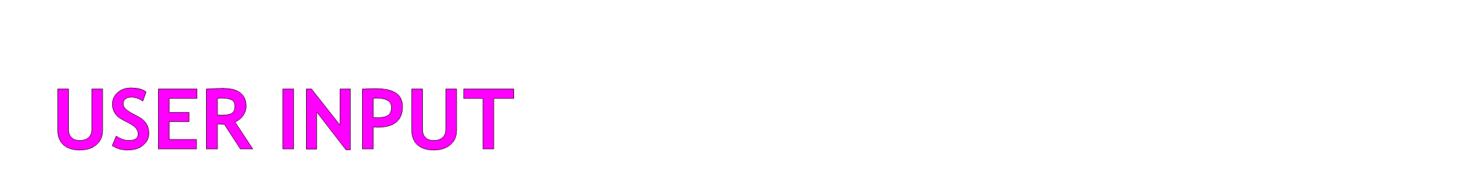
We can instruct Python to pause and read data from the user using the raw_input function
The raw_input function returns a string
nam = raw_input(‘Who are you?’)
print 'Welcome', nam
Who are you? Chuck
Welcome Chuck

Slide 24
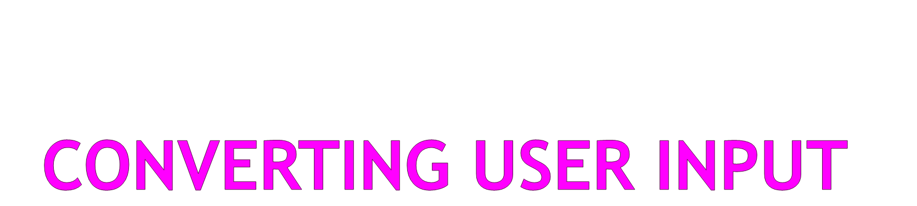
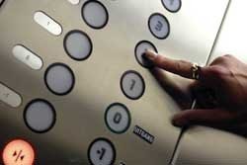
If we want to read a number from the user, we must convert it from a string to a number using a type conversion function
Later we will deal with bad input data
inp = raw_input(‘Europe floor?’)
usf = int(inp) + 1
print 'US floor', usf
Europe floor? 0
US floor 1

Slide 25
Comments in Python
Anything after a # is ignored by Python
Why comment?
  Describe what is going to happen in a sequence of code
  Document who wrote the code or other ancillary information
  Turn off a line of code - perhaps temporarily

Slide 26
# Get the name of the file and open it
name = raw_input('Enter file:')
handle = open(name, 'r')
text = handle.read()
words = text.split()
# Count word frequency
counts = dict()
for word in words:
counts[word] = counts.get(word,0) + 1
# Find the most common word
bigcount = None
bigword = None
for word,count in counts.items():
if bigcount is None or count > bigcount:
bigword = word
bigcount = count
# All done
print bigword, bigcount

Slide 27
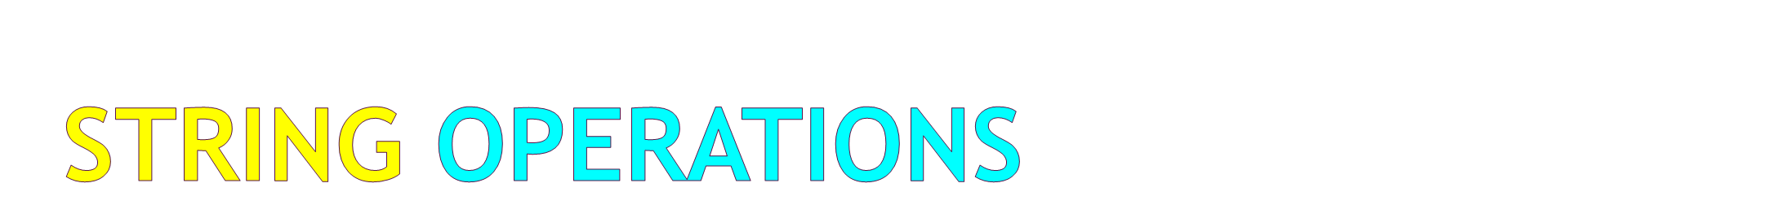
Some operators apply to strings
  + implies “concatenation”
  * implies “multiple concatenation”
Python knows when it is dealing with a string or a number and behaves appropriately
>>> print 'abc' + '123’
Abc123
>>> print 'Hi' * 5
HiHiHiHiHi
>>>

Slide 28
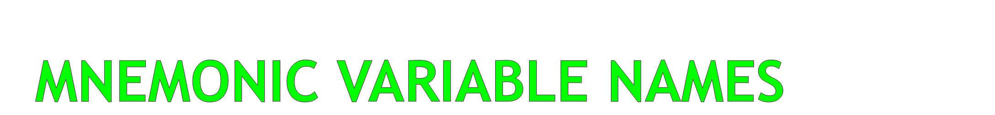
Since we programmers are given a choice in how we choose our variable names, there is a bit of “best practice”
We name variables to help us remember what we intend to store in them (“mnemonic” = “memory aid”)
This can confuse beginning students because well named variables often “sound” so good that they must be keywords
http://en.wikipedia.org/wiki/Mnemonic

Slide 29
x1q3z9ocd = 35.0
x1q3z9afd = 12.50
x1q3p9afd = x1q3z9ocd * x1q3z9afd
print x1q3p9afd
a = 35.0
b = 12.50
c = a * b
print c
hours = 35.0
rate = 12.50
pay = hours * rate
print pay
What is this code doing?

Slide 30
Exercise
Write a program to prompt the user for hours and rate per hour to compute gross pay.
Enter Hours: 35
Enter Rate: 2.75
Pay: 96.25

Slide 31
Summary
Type
Resrved words
Variables (mnemonic)
Operators
Operator precedence
Integer Division
Conversion between types
User input
Comments (#)

