Slide 1
Big data project
Telecome Company Churn Prediction

Slide 2

Description
Nowadays, telecom industry faces fierce com-petition in satisfying its customers. The role of churn prediction system is not only restricted to accurately predict churners but also to interpret customer churn behavior.
Our project aim is to basically Analyzing customer churn behavior and get insights about the relation between why they decide to churn and the other factors.
Creating a model able to predict the customers that will churn.

Slide 3

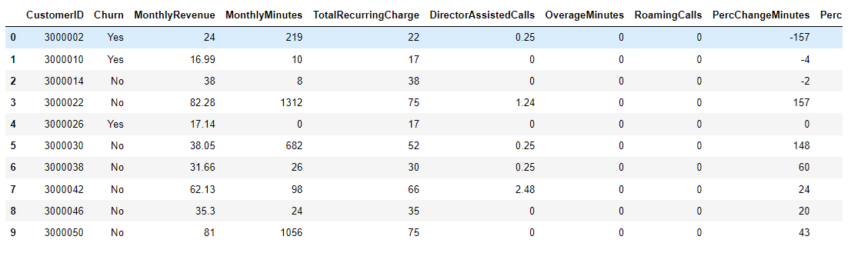
Data
We are using Cell2Cell dataset from Kaggle.
Cell2Cell dataset is preprocessed and a balanced version provided for analyzing Process. consists of 71,047 instances and 58 attributes.

Slide 4
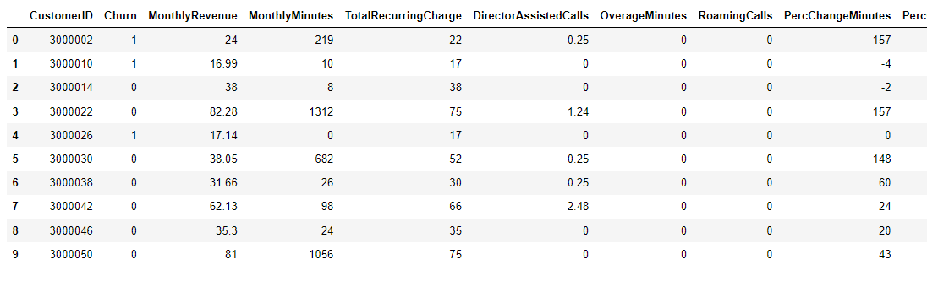
Data Cleaning
The first thing we done in the cleaning process is converting the label data to numeric , machine learning models doesn't work with string so we had to convert label data using a built in function in the sklearn library called label_encoder , it searches for the unique strings and label it , example we had in the label column churn : yes or no , so it will be yes: 1 and no : 0.
Data after the process :

Slide 5
Data Cleaning
The second step is to check for null data in the training and the test .
Null data will give the model a misleading information , so we searched for null data and delete the rows if it has any null values.

Slide 6
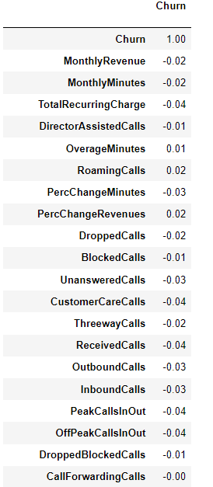
Feature selection
We plotted a correlation with the label data and the all our features then we give away the features which has zero correlation with the label as when the feature number increase the model training time increase and the accuracy will decrease as huge number of features with no correlation at all will affect the model badly.

Slide 7
Model Used: Random Forest
The random forest is a classification algorithm consisting of many decisions trees. It uses bagging and feature randomness when building each individual tree to try to create an uncorrelated forest of trees whose prediction by committee is more accurate than that of any individual tree.
Each individual tree in the random forest spits out a class prediction and the class with the most votes becomes our model’s prediction.
We implemented the random forest model using pyspark .
pySpark is the Python API for Apache Spark, an open source, distributed computing framework and set of libraries for real-time, large-scale data processing.

Slide 8
challenges
One of the challenges was the preprocessing of the data and the good understanding through the exploratory analysis.
We analyzed the features of the data to get insights about the relation between the target variable and the other feature, after this process we were able to know the relation between the Churn of the customers and the other variables

Slide 9
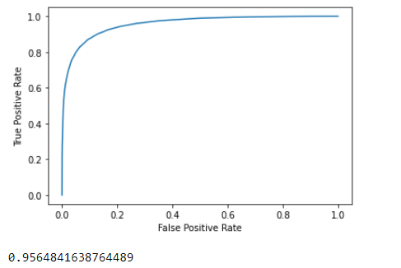
Results
We are able to get a 95 % accuracy in the evaluation of the model using AUC metric as shown in the figure, we separated the data into train and test and we used the test data to predict and evaluate the correctness of our model

