Slide 1



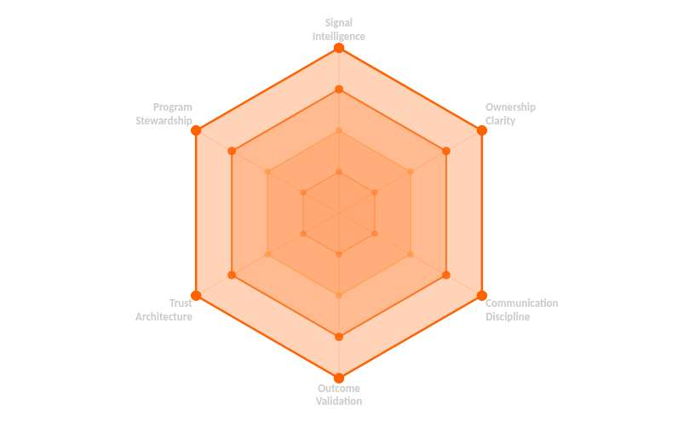


The Six-Dimension Skills Rubric
EEP Behavioral Framework — 6 Dimensions · 4 Proficiency Levels · Observable Evidence Required
COMPETENCY PROFILE — PROFICIENCY LEVEL VISUALIZATION
6 RUBRIC DIMENSIONS
Below Standard
Developing
At Standard
Above Standard
Signal Intelligence
L1+
Detecting & interpreting engagement signals
Ownership Clarity
L1+
Defining & maintaining outcome ownership
Communication Discipline
L1+
Structured, precise delivery communication
Outcome Validation
L1+
Verifying results against defined outcomes
Trust Architecture
L1+
CE Framework application in practice
Program Stewardship
L2+
Program integrity & practitioner development
EVIDENCE STANDARD
Ratings must be supported by observable, verifiable evidence. Self-report ("I always do this") is not sufficient — documented logs, session records, and independent confirmation are required.

