Slide 1


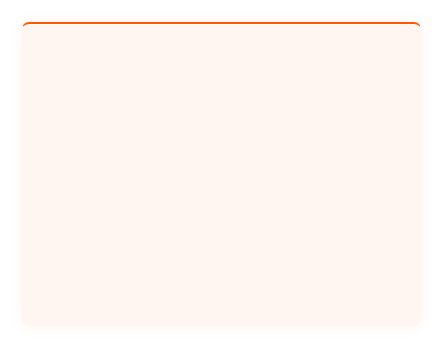





CEEDS in Practice — Scenario Exercise
CEES SCENARIO 4
THE SIGNAL REVIEW
TRAINING DELIVERY GUIDE · SECTION 5
SCENARIO PROMPT
During a Weekly Signal Review, a team member says: "The client seems happy — no complaints this week, the calls have been going well, and they seemed positive in the last meeting." How do you respond as the Engagement Lead facilitating the review?
A
Accept & Move On
B
Redirect to Signals — CORRECT
Name the pattern: "That's status language — not a signal."
Accept the update — positive sentiment is treated as a valid signal
Redirect to three-stream model: friction, clarity, and follow-through
No follow-up questions — move on to the next agenda item
VS
Ask the signal question: "What did the client do or say that you're reading as positive?"
Status language accepted — "seems happy" logged as engagement health indicator
Observable behavior only: specific client actions = signals; general impressions = status
Missed learning opportunity — team never develops signal observation skills
FACILITATOR SCRIPT
"What specific signals did you observe this week across the three streams — friction, clarity, and follow-through?"
STATUS LANGUAGE
"The client seems happy" — impression, not evidence
SIGNAL LANGUAGE
"What did the client do or say?" — specific, observable, actionable
KEY RULE
If you can't point to a behavior, it's not a signal —it's a feeling

