Slide 1



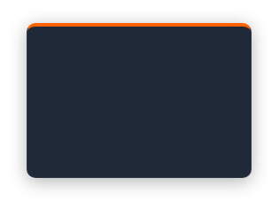
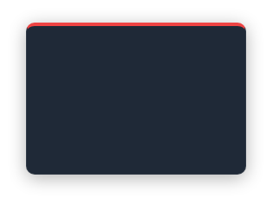
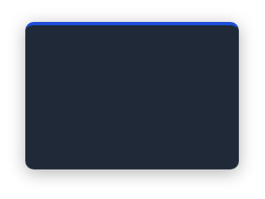
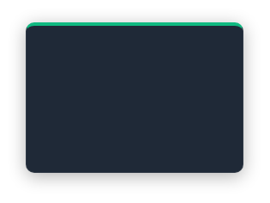
The Premise — Identity Is the New Perimeter
SECURITY MODERNIZATION
“
Identity is the new perimeter — over 80% of breaches involve compromised credentials , making identity the single highest-leverage investment in any security modernization effort.
”
Security Modernization Implementation Framework · Mike Garcia · v1.0, June 2026
80%+
$4.88M
4-Layer
Day 1
BREACHES VIA CREDENTIALS
AVG. BREACH COST
CORRECT SEQUENCING
RISK REDUCTION BEGINS
Compromised identity is the leading attack vector across enterprise environments
IBM Cost of a Data Breach Report 2024— highest recorded average to date
Identity → Data Protection →Governance → AI Enablement
Every layer reinforces the one beneath it— risk reduced from day one of deployment
Source: IBM Cost of a Data Breach Report 2024
Security Modernization Framework v1.0
Classification: Internal / Delivery Confidential

