Slide 1
Debugging
(Java programs in Eclipse)

Slide 2
Debugging
Types of problems
obviously incorrect results
exceptions and other run-time errors
less obvious mis-behaviors
Typical causes
incorrect or misunderstood code
code we forgot to write
cases we forgot to handle
unexpected interactions

Slide 3
Sometimes the problem is clear
a straight forward calculation or algorithm yields an unexpected result
an operation fails because of incorrect/invalid parameters
e.g. an out-of-bounds, conversion or zero-divide exception in your own code
the exception trace will indicate the offending line of code
an error returned or exception thrown by an invoked method
follow the stack trace down to the causing caller
ignore earlier methods that were just start-up
ignore later methods that merely passed on a bad parameter they received
look at the suspected offending call
should be obvious which calculation/variable/parameter caused problem
you must recognize why or how the value was invalid
you must figure out where that invalid/incorrect value came from

Slide 4
Simple Run-Time Exceptions: out of bounds
Exception in thread "main" java.lang.ArrayIndexOutOfBoundsException: 12
at silverdollar.TextCoinStrip.gameIsOver(TextCoinStrip.java:122)
at silverdollar.TextCoinStrip.play(TextCoinStrip.java:144)
at silverdollar.TextCoinStrip.main(TextCoinStrip.java:165)
the exception was thrown at the offending line of code
Eclipse provides you with direct links to:
the description of the exception
the offending line of source code

Slide 5
Down-stream Exceptions from invalid parameters
Exception in thread "main" java.lang.IndexOutOfBoundsException: Index: 12, Size: 12
at java.util.ArrayList.rangeCheck(ArrayList.java:653)
at java.util.ArrayList.get(ArrayList.java:429)
at silverdollar.TextCoinStrip.gameIsOver(TextCoinStrip.java:119)
at silverdollar.TextCoinStrip.play(TextCoinStrip.java:141)
at silverdollar.TextCoinStrip.main(TextCoinStrip.java:162)
the exception was thrown down-stream from the bug
we must infer which method most likely contains the bug
Eclipse provides you with direct links to:
the description of the exception
each line of code in the call-stack at the time of fault

Slide 6


Deeper analysis of a stack trace
Faults and incorrect results often well down-stream of the bug
A had an incorrectly initialized/computed value
A passed that value as a parameter to B
B used that value to request service C
C threw an exception
Much of the evidence may still be in memory
the parameters to and locals in each called method are still on the stack
the most recent values for objects on which they operate are still in memory
Eclipse Debug Mode (use the rather than the icon:
the Debug pane allows you to select any desired stack frame
the Variables pane displays all locals and instance variables and their values
the (optional) Expressions pane enables you to display functions of program data

Slide 7
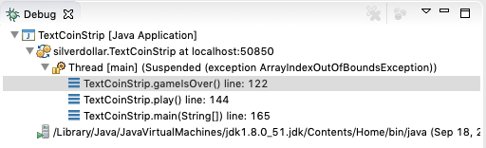
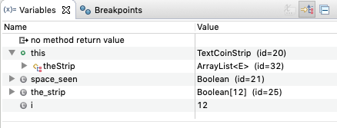
Eclipse Debug Perspective

Slide 8
Often the cause is not so clear
it may be clear what value caused the error or exception
value may not be intrinsically invalid, but merely inconsistent w/other data
two pieces of related data - one may have changed but the other didn’t
data from or used with a service that we do not fully understand
it may not be clear how offending value came to be there at that time
it was initialized/calculated long ago, and its inputs are no longer known
it has been changed by many subsequent operations
changes may come from other (parallel/external) sources
approaching such problems:
make sure that we understand how to use service and interpret its results
understand when and how incorrect/inconsistent values came into existence
there may not even be an exception … merely unexpected results

Slide 9
The Scientific Method (of Debugging)
NO
data confirms
examine data
formulate hypothesis
design experiment
YES
SOLVE PROBLEM
new tests & instrumentation
NO
(inadequate data)

Slide 10
Gathering more data
The bug may have been exercised long before the exception
How can we we know what calls were made 10,000,000 instructions ago?
How can we know what object states and locals were present a that time?
Key event logging: if we aren’t sure what happened, and how far we got
print a message whenever we reach an important piece of code
we will know what did (and did not) happen, and the order of these events
Breakpoints: if suspected code is seldom called
tell a debugger to stop program execution whenever we reach a certain instruction
when it stops, we can examine the stack and in-memory objects
we can do single-step and other limited executions to observe step-by-step results
Key data logging: if the calls are too frequent for break points
log every important operation, parameters, and results … “the Truth will be in there”

Slide 11
Event and Data Logging
What events and data to log
too little … not capturing enough key events (or associated data) to shed light on problem
think about what the key events are
think about what other data you would need to follow the processing
too much … the important information is buried beneath 100K lines of garbage
can you do the logging under only certain conditions
are there post-processing tools you can use to find the interesting information
How to log it
small amounts of data to console (i.e. System.out or System.err)
large amounts of data to a file (less clutter, enables post-processing)
huge amounts of short-term data to in-memory circular buffers
important software often uses (run-time controllable) logging frameworks

Slide 12
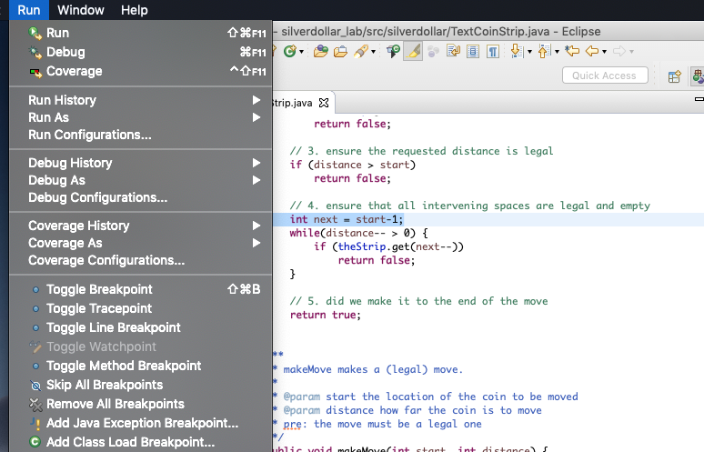
Eclipse Break-Points and Single Stepping

