Slide 1
Predicting Employee Performance Ratings
Data Science Project by Amged Alamari

Slide 2
Objective
To analyze employee data and uncover factors that drive performance ratings.
Build a predictive model to support HR in recognizing high-performing employees.

Slide 3
Dataset Summary
- IBM HR Analytics dataset with 1470 employees
- Target: PerformanceRating (1–4 scale)
- 35 features across job, salary, and personal dimensions

Slide 4
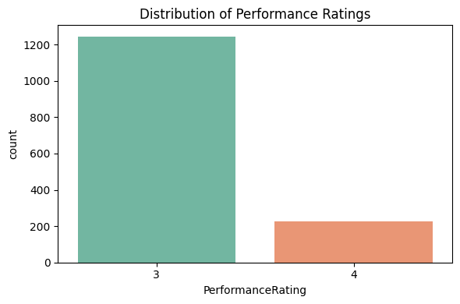
Performance Rating Distribution

Slide 5
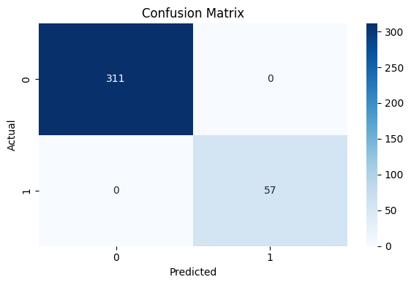
Model Performance: Confusion Matrix

Slide 6
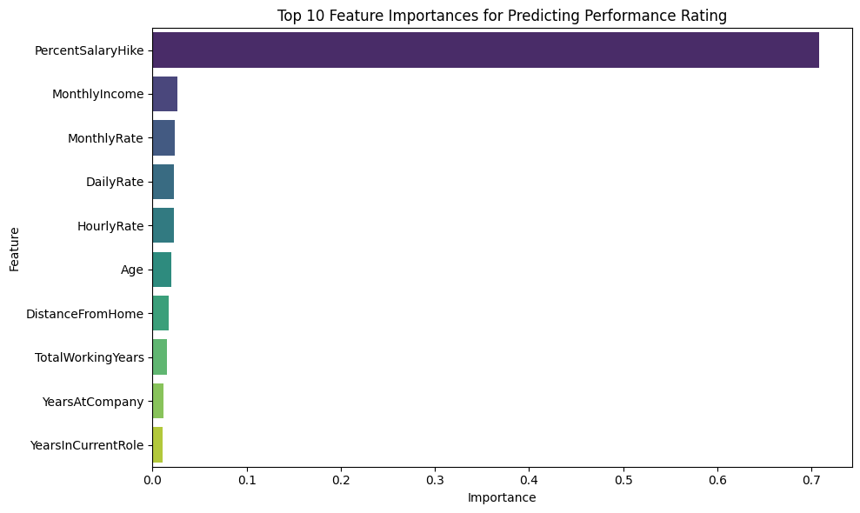
Top Predictive Features

Slide 7
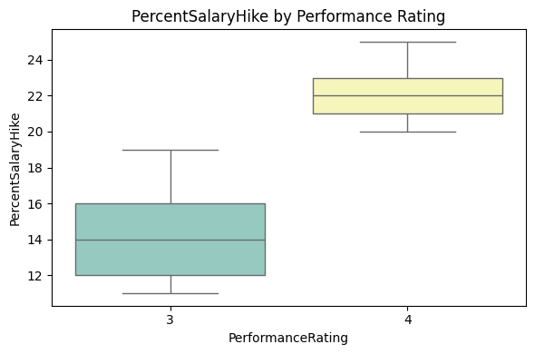
PercentSalaryHike by Performance Rating

Slide 8
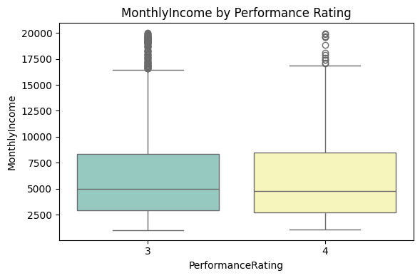
MonthlyIncome by Performance Rating

Slide 9
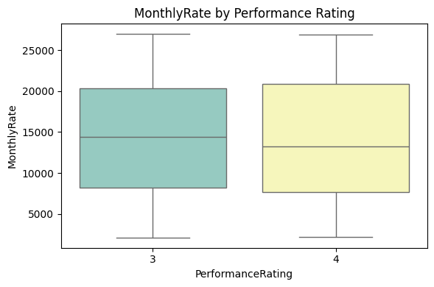
MonthlyRate by Performance Rating

Slide 10
Key Insights
- Performance rating is imbalanced (majority = 3)
- PercentSalaryHike is the strongest predictor
- Most misclassifications are minor (no false positives)
- Monetary features outweigh job characteristics in prediction

