Slide 1
Predicting Employee Performance Ratings
Data Science Project by Amged Alamari

Slide 2
Objective
To analyze employee data and uncover factors that drive performance ratings.
Build a predictive model to support HR in recognizing high-performing employees.

Slide 3
Dataset Summary
- IBM HR Analytics dataset with 1470 employees
- Target: PerformanceRating (1–4 scale)
- 35 features across job, salary, and personal dimensions

Slide 4
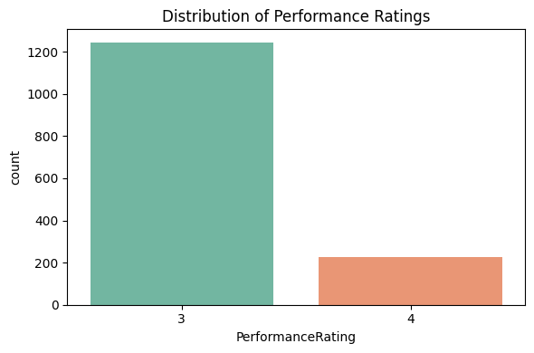
Performance Rating Distribution
“A significant majority of employees (~84%) have a performance rating of 3.”
“Only ~2% receive the highest rating (4), highlighting class imbalance.”
“This skew impacts modeling and requires stratified sampling or class balancing techniques.”

Slide 5
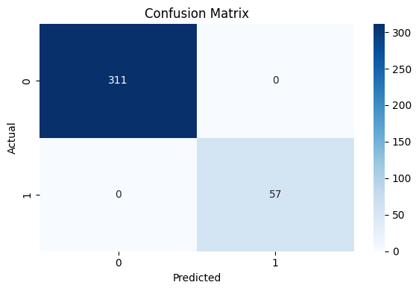
Model Performance: Confusion Matrix
“The model achieved near-perfect accuracy, especially on the dominant class (rating 3).”
“No misclassifications between classes 3 and 4 — indicating high precision.”
“Balanced accuracy should still be considered due to skewed class distribution.”

Slide 6
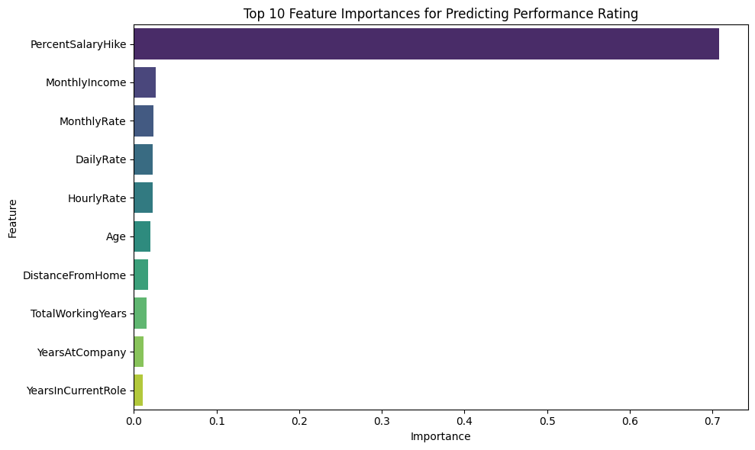
Top Predictive Features
“PercentSalaryHike alone contributes over 70% of the predictive power.”
“This strong signal suggests compensation policies heavily influence performance appraisals.”
“Other features like MonthlyIncome and DailyRate play a minor role.”

Slide 7
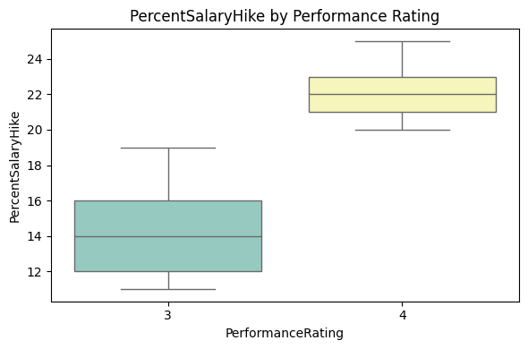
PercentSalaryHike by Performance Rating
“Employees rated 4 receive noticeably higher salary hikes than those rated 3.”
“Clear separation of medians shows why this feature dominates the model’s decision-making.”
“Potential HR implication: Performance ratings might be used to justify raises.”

Slide 8
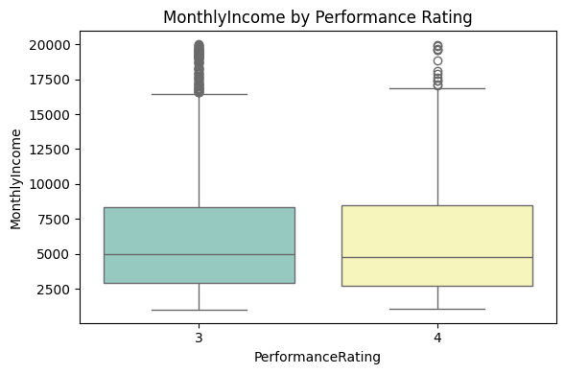
MonthlyIncome by Performance Rating
“Some upward trend visible, but not as distinct as salary hikes.”
“Higher income doesn’t consistently translate to higher performance ratings.”
“Could indicate salary is more reflective of tenure or job level than performance.”

Slide 9
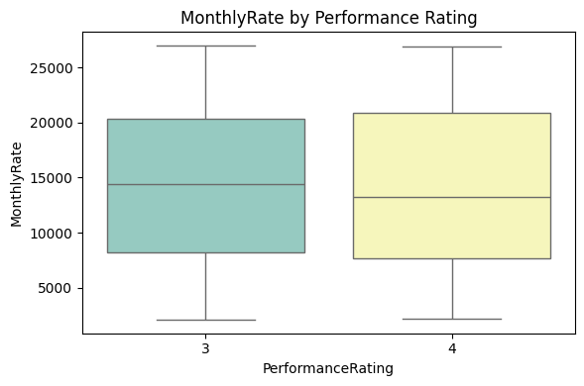
MonthlyRate by Performance Rating
“No strong visible pattern between monthly rate and performance.”
“Adds weight to the idea that performance ratings are tied more to dynamic changes (like salary hikes) than base compensation.”

Slide 10
Key Insights
- Performance rating is imbalanced (majority = 3)
- PercentSalaryHike is the strongest predictor
- Most misclassifications are minor (no false positives)
- Monetary features outweigh job characteristics in prediction

