Slide 1
CST Project: Quiz Site
Submitted By:- Submitted To:-
1.Ambika 1710991079 Mrs. Rabina
2.Ankita 1710991111

Slide 2
Table Content
Introduction
Purpose of project
Home Page
Login Page
Quiz Page
Future Scope

Slide 3
Introduction
The website is a quiz site which is based on various programming languages.
The website serves you the knowledge of the languages in the form of MCQ questions.
The user is supposed to choose his language and attempt the test and later will get the result as well.
The site is a great source of information and knowledge to those keen in this field.

Slide 4
Purpose Of Project
The purpose of the project is to check the knowledge of the user in technical field.
The user gets to know about his thinking capacity.
The quiz provides a source of recreation in an interactive and attractive way.

Slide 5

HOME PAGE

Slide 6
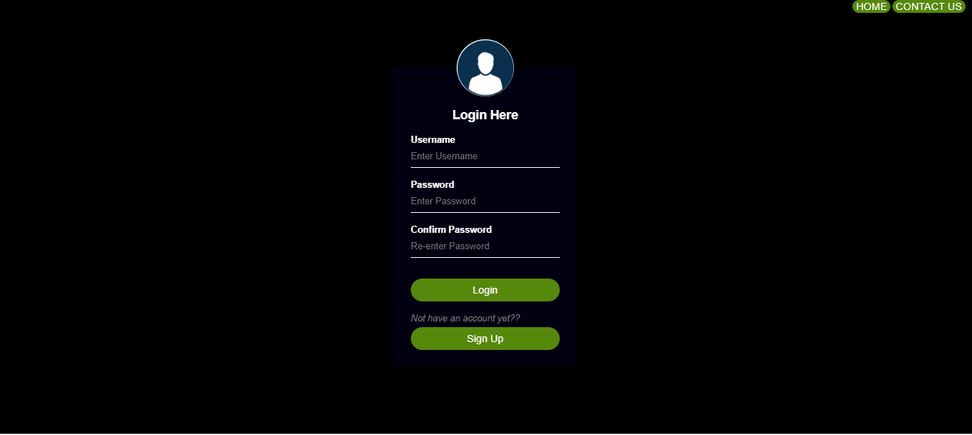
LOGIN PAGE

Slide 7
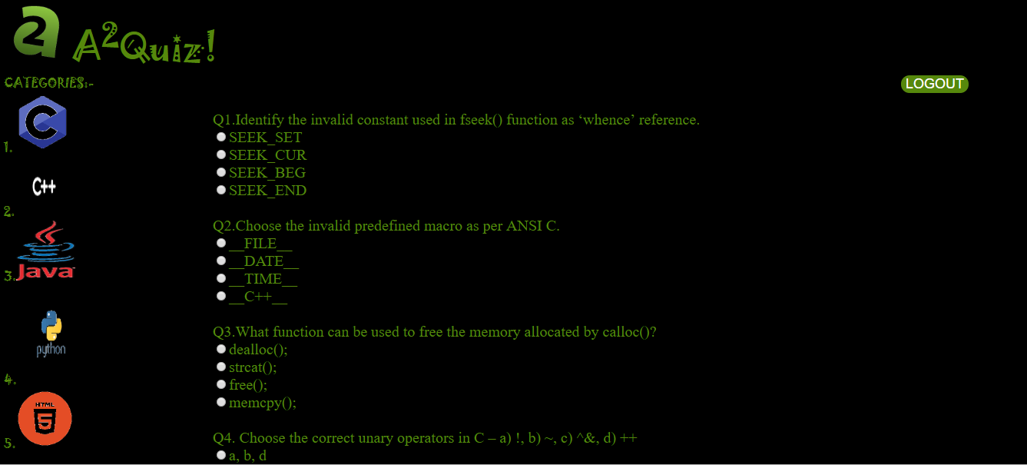
QUIZ PAGE

Slide 8
Future Scope
In future more language can be added which further adds information to the user.

