Slide 1
CIS 721 - Real-Time Systems
Quiz #1 Review
Mitch Neilsen
neilsen@ksu.edu

Slide 2
Outline
Quiz #1: Fri., Oct. 16, in class
Topics
  Real-Time Scheduling Theory and Algorithms
  Ch. 1-7
Open book, open notes

Slide 3
Terms and Concepts
A real-time system is a system with performance deadlines on computations and actions; that is, system correctness depends on the timeliness of the results.
An embedded system is a system that exists within a larger system.
A job is a unit of work that is scheduled and executed by the system (J_{i,k} ).
A task is a set of related jobs that provide some system function τ_{i} = { J_{i,1}, J_{i,2}, ... , J_{i,n} }.; e.g., the reception of a data frame could be a job that is part of a task that provides time service.
The deadline of a job is the time at which a job must be completed.

Slide 4
Deadlines
The release time (or arrival time) of a job is the time at which the job becomes available for execution ( r_{i} or R_{i} ).
The response time of a job is the length of time between the release time of the job and the time instant when it completes.
The relative deadline of a job is the maximum allowable response time of a job ( D_{i} ).
The absolute deadline of a job is the time at which a job must be completed ( d_{i} = r_{i} + D_{i} ).
Failure to meet a hard deadline is considered a fatal fault, whereas a soft deadline can be missed as long as the average performance is optimized.

Slide 5
Event-Driven Task
Arrival Time
Deadline
Execution Time
Slack Time
Minimum Interarrival Time
Actual Interarrival Time

Slide 6
Time-Driven Task
Scheduled Start Time
Scheduled Start Time
Deadline
Execution Time
Slack Time
Period

Slide 7
Scheduler
A scheduler assigns jobs to processors.
A schedule is an assignment of all jobs in the system on available processors (produced by scheduler).
The execution time (or run-time) of a job is the amount of time required to complete the execution of a job once it has been scheduled ( e_{i} or C_{i} ).
A constraint imposed on the timing behavior of a job is called a timing constraint.

Slide 8
Assumptions
The scheduler works correctly; e.g., it only produces valid schedules that satisfy the following conditions:
  each processor is assigned to at most one job at a time,
  each job is assigned to at most one processor,
  no job is scheduled before its release time, and
  all precedence constraints and resource usage constraints are satisfied.

Slide 9
Feasible Schedule
A valid schedule is a feasible schedule if every job meets its timing constraints; e.g., completes executing by its deadline.
A set of jobs is schedulable according to a scheduling algorithm if (when) using the algorithm (the scheduler) always produces a feasible schedule.

Slide 10
Common Approaches
For Real-Time Scheduling
Clock-Driven (Time-Driven) Approach – scheduling decisions are made at specific time instants.
Weighted Round-Robin Approach - every job joins a FIFO queue; when a job reaches the front of the queue, its weight refers to the fraction of processor time (number of time slices) allocated to the job.
Priority-Driven (Event-Driven) Approach - ready jobs with highest priorities are scheduled for execution first.
  Scheduling decisions are made when particular events occur; e.g., a job is released or a processor becomes idle. A work-conserving processor is busy whenever there is work to be done.

Slide 11
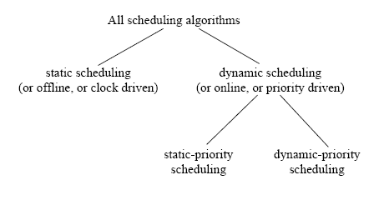
Classification of Scheduling Algorithms
Static Cyclic
EDF
EDF is optimal for scheduling preemptive tasks on a single processor.

Slide 12
EDF Algorithm
Earliest-Deadline-First (EDF) algorithm:
  At any time, execute the available job with the earliest deadline.
Theorem: (Optimality of EDF): In a system with one processor and preemption allowed, EDF is optimal; that is, EDF can produce a feasible schedule for a given job set J with arbitrary release times and deadlines, if a feasible schedule exists.
Proof: Apply schedule transformations and remove idle time.

Slide 13
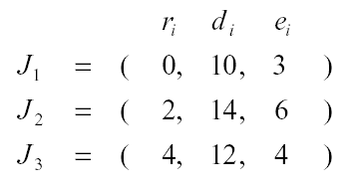
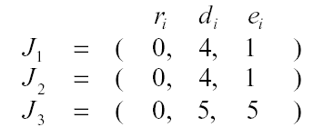
EDF may not be optimal
When preemption is not allowed:
When more than one processor is used:

Slide 14
Periodic Task Model
Tasks: T₁, ….., T_{n}
Each consists of a set of jobs: T_{i} = {J_{i1}, J_{i2}, …….}
φ_{i}: phase of task T_{i} = time when its first job is released
p_{i}: period of T_{i} = minimum inter-release time
H: hyperperiod H = lcm(p₁, ….., p_{n})
e_{i}: execution time of T_{i}
u_{i}: utilization of task T_{i} is given by u_{i} = e_{i} / p_{i}
D_{i}: (relative) deadline of T_{i}, typically D_{i} = p_{i}

Slide 15
Periodic Task
We refer to a periodic task T_{i} with phase φ_{i} , period p_{i} , execution time e_{i} , and relative deadline D_{i} by the 4-tuple (φ_{i} , p_{i} , e_{i} , D_{i} ).
Example: ( 1, 10, 3, 6 )
By default, the phase of each task is 0, and its relative deadline is equal to its period.
Example: ( 0, 10, 3, 10 ) = ( 10, 3 ).

Slide 16
Static Cyclic Scheduling
Periodic Task 1: (12, 3)
Periodic Task 2: (6, 3)
Periodic Task 3: (12, 2)
Hyperperiod H = lcm(12, 6, 12) = 12
Potential frame sizes? 3 or 6

Slide 17
Clock-Driven Example
$ hi_pr < cyclic2.input > cyclic2.output
OUTPUT:
max flow:11
c flow values
f 1 2 3
f 1 4 3
f 1 3 3
f 1 5 2
f 2 6 3
f 2 7 0
f 3 6 3
f 4 7 3
f 5 7 2
f 5 6 0
f 6 8 6
f 7 8 5
c
INPUT:
p max 8 12
n 1 s
n 8 t
a 1 2 3
a 1 3 3
a 1 4 3
a 1 5 2
a 2 6 6
a 2 7 6
a 3 6 6
a 4 7 6
a 5 6 6
a 5 7 6
a 6 8 6
a 7 8 6
Jobs
2
J₁
Minor
Cycles
3
6
6
Source
(s)
J_{2,1}
3
6
3
8
J_{2,2}
4
1
3
6
(t)
Terminal
2
5
7
J₃
minor cycle
2
J₁
J_{2,1}
J_{2,2}
J₃
major cycle

Slide 18
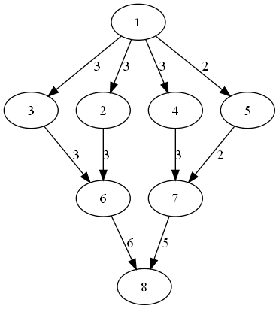
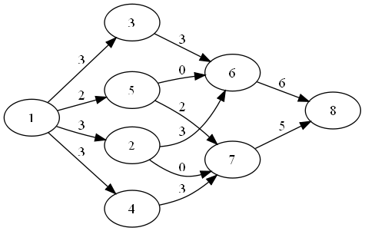
Resulting Graphics File
digraph g {
1 -> 2 [label=3]
1 -> 4 [label=3]
1 -> 3 [label=3]
1 -> 5 [label=2]
2 -> 6 [label=3]
3 -> 6 [label=3]
4 -> 7 [label=3]
5 -> 7 [label=2]
6 -> 8 [label=6]
7 -> 8 [label=5]
{ rank=same; 2; 3; 4; 5;}
{ rank=same; 6; 7;}
}
dot -Tpng fn.gr -o fn.png

Slide 19
Output generated
Jobs
Frames

Slide 20
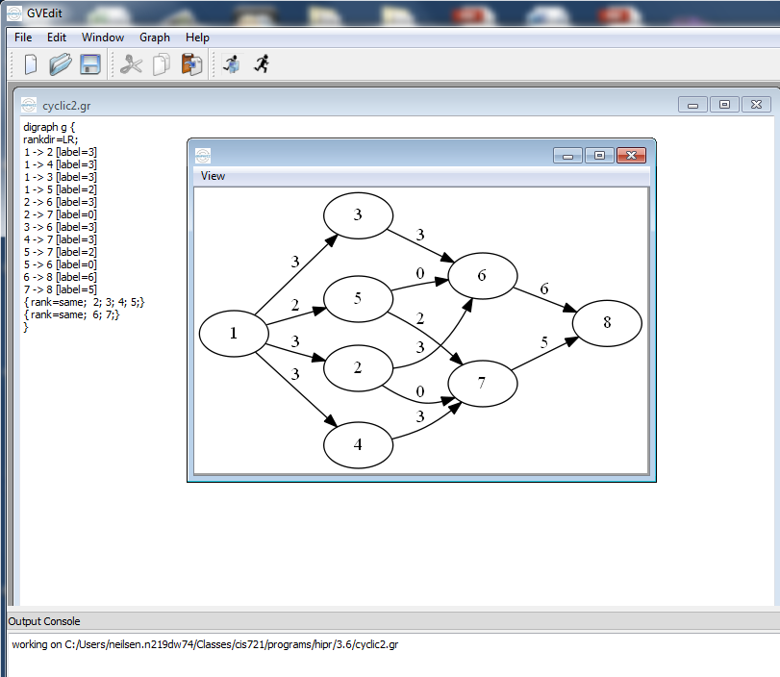

GraphViz Editor: GVEdit
rankdir = LR;

Slide 21
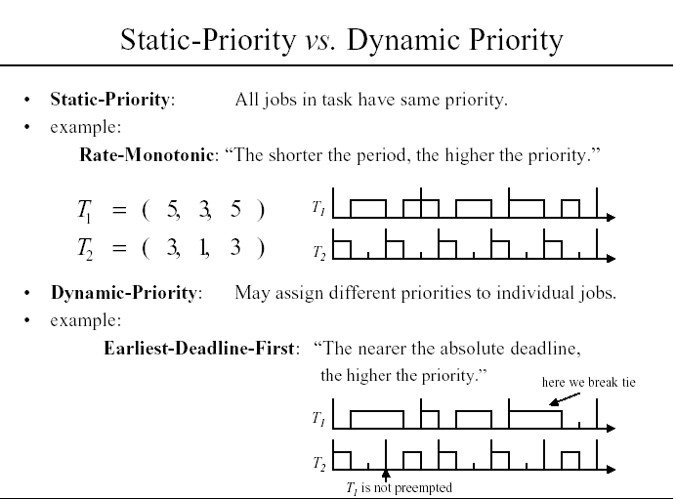

Slide 22
Rate-Monotonic Algorithm (RM)
The rate of a task is the inverse of its period ( f_{i} = 1 / p_{i} ).
Tasks with higher rates (shorter periods) are assigned higher priorities.
C. L. Liu and J. W. Layland, “Scheduling Algorithms for Multiprogramming in a Hard Real-Time Environment”, JACM, Vol. 20, No. 1, pages 46-61, 1973.

Slide 23
Deadline-Monotonic Algorithm (DM)
Tasks with shorter relative deadlines are assigned higher priorities.
When tasks have relative deadlines ( D_{i} ) equal to their periods ( p_{i} ), the rate-monotonic algorithm is the same as the deadline-monotonic algorithm.

Slide 24
Optimal Priority Assignment
A given priority assignment algorithm is optimal if whenever a task set can be scheduled by some fixed priority assignment, it can also be scheduled by the given algorithm.
Liu and Layland show that the rate-monotonic (RM) algorithm is optimal, for preemptive, periodic task sets, with phase 0 and relative deadlines equal to their periods.

Slide 25
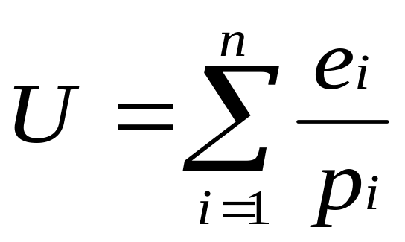
Processor Utilization
Given a periodic task T_{i} , the ratio u_{i} = e_{i} / p_{i} is called the utilization of task T_{i} .
The total utilization U of all tasks in a system is the sum of the utilizations of all individual tasks:

Slide 26
Maximum Achievable Utilization
A task set is fully utilized if any increase in
run-time would result in a missed deadline.
Total
Utilization
(U)
unschedulable
task sets
100 %
schedulable
task sets
0 %

Slide 27
Example #1
Task Period Deadline Run-Time Phase
T_{i} p_{i} D_{i} e_{i} φ_{i}
---------------------------------------------------------------------
A 2 2 1 0
B 2 2 1 0
(High Priority)
(Low Priority)
U = 1/2 + 1/2 = 1.0 = 100 %
The task set is fully utilized.
A
...
B
0
2
4
6
8
10

Slide 28
Example #2
Task Period Deadline Run-Time Phase
T_{i} p_{i} D_{i} e_{i} φ_{i}
---------------------------------------------------------------------
A 2 2 1 0
B 3 3 1 0
(High Priority)
(Low Priority)
U = 1/2 + 1/3 = 0.8333
The task set is fully utilized,
even though U < 1.0.
A
...
B
0
2
4
6
8
10

Slide 29
Fully utilized task sets
A task set is fully utilized if any increase in
run-time would result in a missed deadline.
Total
Utilization
(U)
100 %
#1
fully utilized
task sets
schedulable
task sets
unschedulable
#2
Q: What is the worst-case
achievable utilization that
still ensures schedulability?
0 %
A: U_{RM} = n ( 2 ^{(1/n)} - 1 )

Slide 30
Utilization-Based Test
A sufficient, but not necessary, test that can be used to test the schedulability of a task set that is assigned priorities using the rate-monotonic algorithm, with deadlines equal to periods.
Compute total task utilization U(n) = U.
Compare with worst-case utilization bound (also called schedulable utilization) U_{RM}(n) = U_{RM}:
  If U > 1, then the task set is not schedulable.
  If U ≤ U_{RM}, then the task set is schedulable.
  Otherwise, no conclusion can be made.

Slide 31
Schedulability Analysis
Utilization-Based Tests
  Not exact (sufficient, but not necessary).
  Not applicable to more general task models.
Time-Based Tests (Response Time Analysis)
  Use analytic approach to predict worst-case response time of each task.
  Compare computed worst-case response times with deadlines.
  Exact (sufficient and necessary)

Slide 32
Example
Task Period Deadline Run-Time Phase
τ_{i} T_{i} D_{i} C_{i} φ_{i}
---------------------------------------------------------------------
A 7 7 3 0
B 12 12 3 0
C 20 20 5 0
(High Priority)
(Low Priority)
U = 3/7 + 3/12 + 5/20 = 13/14 ≈ 0.93
U_{RM} = 3 (2 ^{1/3} - 1) ≈ 0.78
Since U_{RM} < U ≤ 1.0, no conclusion can be drawn using the Utilization-Based Test.

Slide 33
Response Time
The response time (R_{i}) for task T_{i} is given by R_{i} = e_{i} + I_{i} where:
  e_{i} is the execution time of each job in T_{i} , and
  I_{i} is the maximum interference caused by higher priority tasks in any interval [ t, t + R_{i} ).

Slide 34
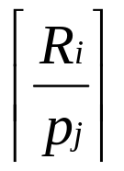
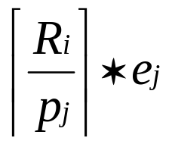
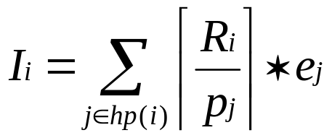
Maximum Interference (I_{i})
The number of releases of task T_{j} in [ t, t + R_{i} ) is given by
The interference caused by task T_{j} is
The maximum interference caused by all higher priority tasks is given by
where hp(i) = set of all tasks with priority greater than task T_{j} .

Slide 35
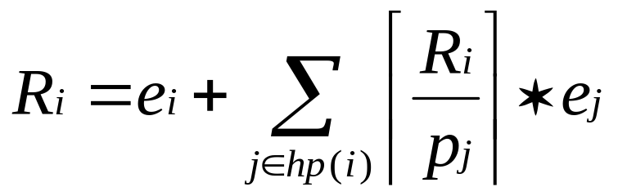
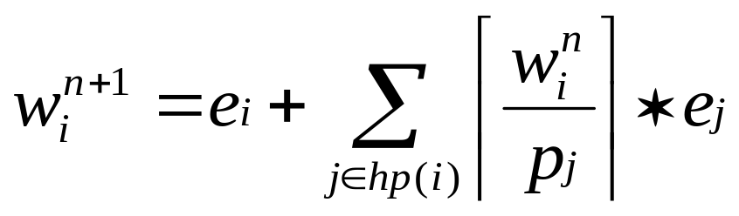
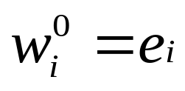
Response Time Analysis
The (worst-case) response time (w_{i}) for task T_{i} is given by the implicit equation:
Solve by forming a recurrence relation:

Slide 36
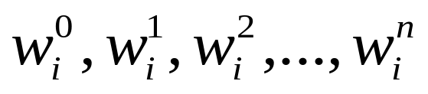
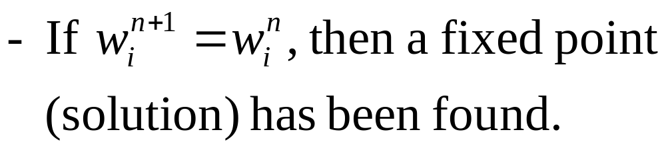
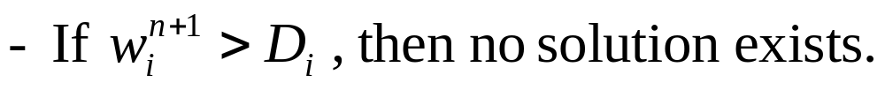
Solving Recurrence
The sequence
is non-decreasing:

Slide 37
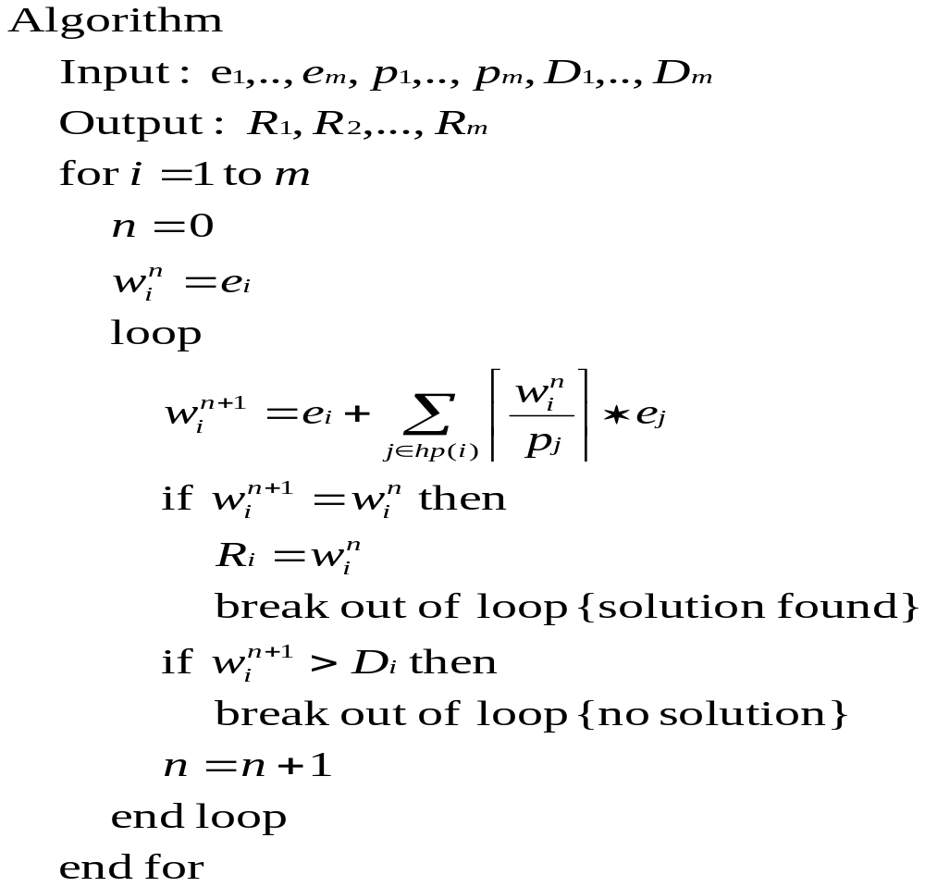

Slide 38
Response Time Analysis
For each task, T_{i} , compute worst-case response time ( R_{i} ).
If ( R_{i} ≤ D_{i} ) for each task T_{i} , then the task set is feasible (schedulable).
Response Time Analysis is both necessary and sufficient, and works for task sets with deadlines different than periods. If deadlines are greater than periods, then need to test jobs in task T_{i} over a level-i busy period and assign priorities from lowest to highest.

Slide 39
Preemption Thresholds
Task Model
Task Set Γ = {τ₁, τ₂, τ₃, ... , τ_{n} }
  Each task τ_{i} is characterized by ( C_{i}, T_{i}, D_{i} ), denoted τ_{i} ∼ ( C_{i}, T_{i}, D_{i} ).
  Each task τ_{i} is assigned a priority π_{i} ∈ {1,2,..,n}
  and a preemption threshold γ_{i} ∈ {π_{i} , π_{i} + 1,..,n}.
Notes:
  1 = lowest priority, n = highest priority.
  π_{i} = static priority.
  γ_{i} = dynamic priority.

Slide 40
Run-Time Model
Modified fixed-priority, preemptive scheduling.
When task τ_{i} is released, it is scheduled using its static priority π_{i} .
After task τ_{i} starts executing, another task τ_{j} can preempt τ_{i} only if π_{j} > γ_{i} ≥ π_{i} .

Slide 41
Extremes
If γ_{i} = π_{i} for each i, then the result is preemptive, priority-based scheduling.
If γ_{i} = n (max. priority) for each i, then the result is non-preemptive, priority-based scheduling.

Slide 42
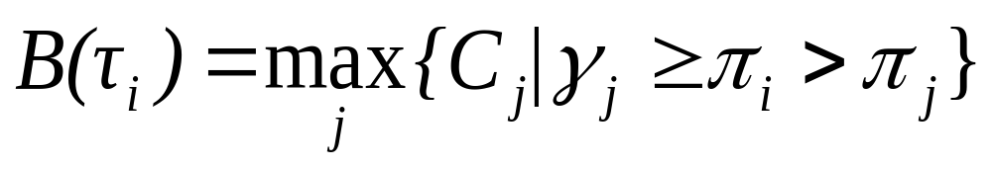
Response Time Analysis
The blocking time of task τ_{i} is denoted B(τ_{i}). Blocking occurs if a lower priority task is running and task τ_{i} cannot preempt it.
τ_{i}
τ_{j}

Slide 43
Busy Period Analysis
A critical instant occurs when all higher priority tasks arrive at the same time, and the task that contributes to the maximum blocking arrives at the critical instant - ε.
τ_{k}
interference
τ_{i}
τ_{j}
blocking

Slide 44
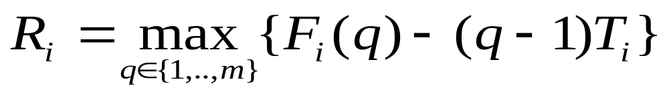
Divide Busy Period
Divide the busy period for τ_{i} into two parts:
  the length of time from the critical instant (time 0) to the point when τ_{i} starts executing its q^{th} job ( S_{i}(q) ).
  the length of time from the time τ_{i} starts executing its q^{th} job until it finishes executing its q^{th} job (F_{i}(q)-S_{i}(q) ).
Let q = 1, 2, ... , m until we reach q = m s.t. F_{i}(m) ≤ m T_{i} that is, the m^{th} job completes before the next job is released.
Then,

Slide 45
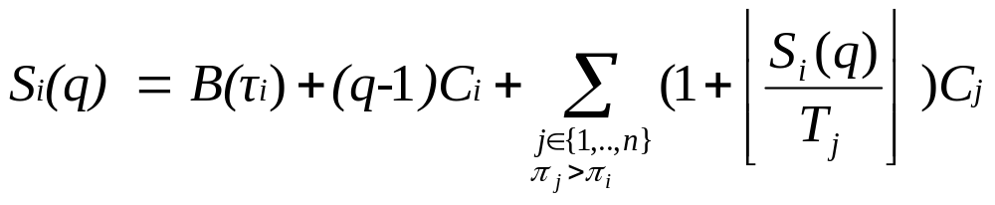
Worst-Case Start Time ( S_{i}(q) )

Slide 46
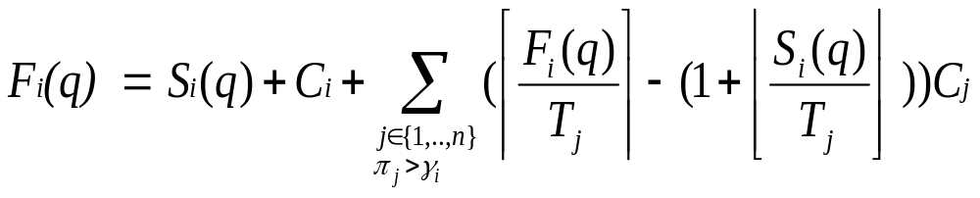
Worst-Case Finish Time ( F_{i}(q) )

Slide 47
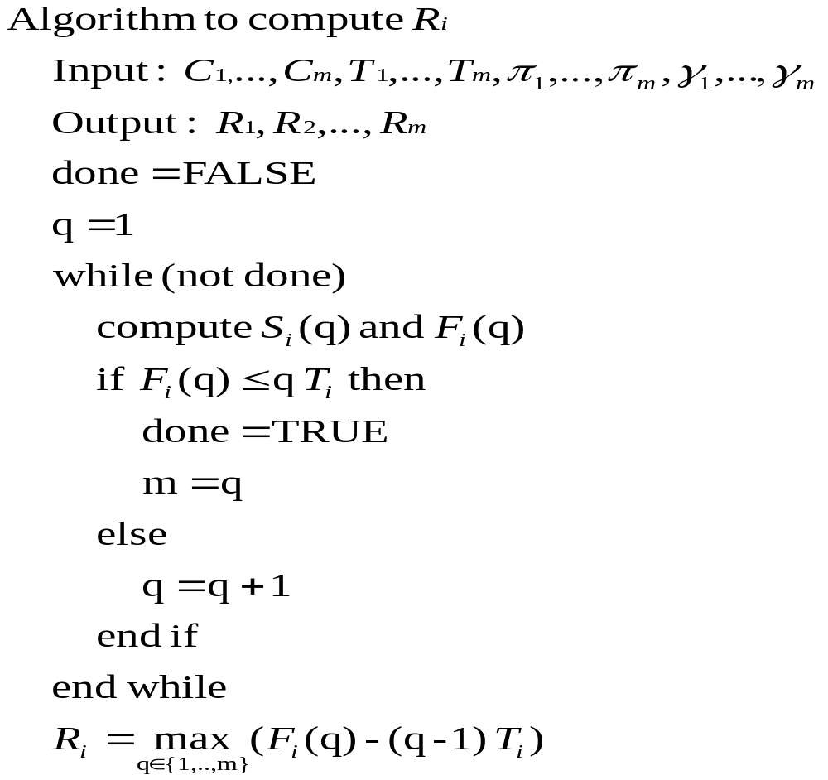

Slide 48
Preemption Threshold Assignment
Assign preemption thresholds from lowest priority to highest priority.
Only elevate preemption threshold as much as needed to make a given task feasible.

Slide 49
Summary
Quiz #1
  Fri., Oct. 16, in class
  Open book, open notes
  50 minutes

