Slide 1
Vending Machine
Informal Specification

Slide 2
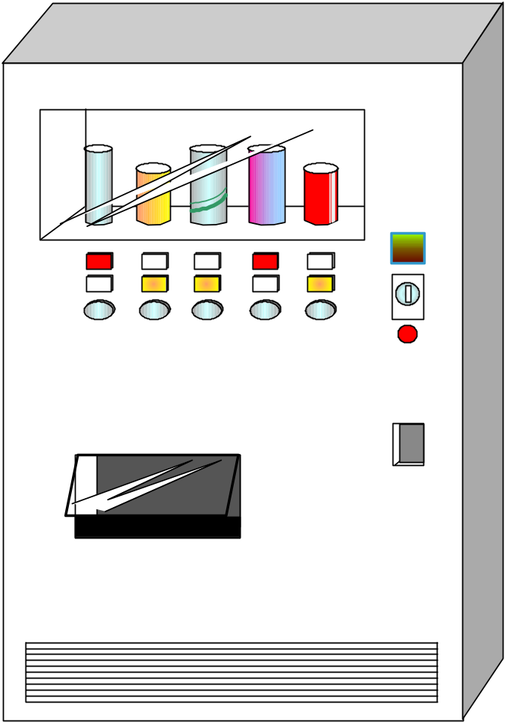
Appearance of the Vending Machine
Merchandize Display
Sold Out Light
Amount Display
Purchasable Light
Coin Inserter
Purchase Button
No Change Light
Coin Return Button
Coin Return
Can Delivery Bin

Slide 3
Specification of the Vending Machine
Actors: Customer and Maintenance Person
Specification 1 (for customers)
  It can provide customers with N kinds of drinks
    Your control program should scale well
  A customer can use 10, 50, 100, or 500 Japanese yen coins
  When a customer presses a purchase button for a can whose purchasable light is on,
    if it can return change, it dispenses a can and returns change
    if it cannot return change, it turns on the No Change Light for 3 seconds and does not dispense a can
      Then the customer selects another can, adds more coins, or presses the Coin Return Button to get the money (change) back
  When a customer presses the Coin Return Button, if the Amount Display shows amount greater than 0, it returns coins for the amount

Slide 4
Specification of the Vending Machine
Specification 2 (for Maintenance Personnel)
  When the front panel is opened, there are
    a button to list the sales record
    a button to clear the sales record
    a printer
  When the List Sales Record Button is pressed, the printer prints out the list of sales records since last time the machine is initialized (booted) or the sales records are cleared
    Each print-out line consists of “type of can, price, date and time”
  When the Clear Sales Record Button is pressed, the Vending Machine clears the sales records

