Slide 1
Virtualization-optimized architectures
Yu-Shen Ng
Group Product Manager
ESX Server
VMware

Slide 2
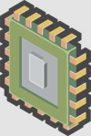





Agenda: Virtualization-optimized architectures
CPU-optimizations
Memory-optimizations
OS-optimizations

Slide 3

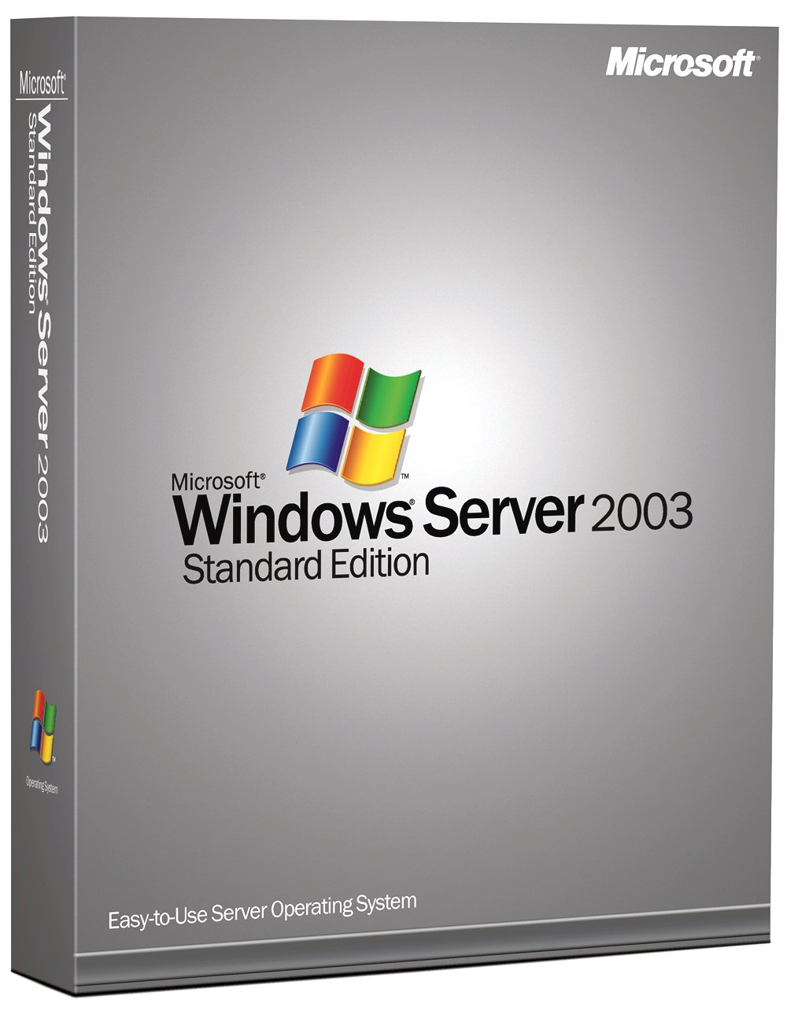
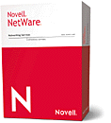



Background context: the full virtualization software stack
Management
and
Distributed
Virtualization
Services
Third-party Solutions
Third-
Party
Agents
SDK / VirtualCenter Agent
VMX
VMX
VMX
VMX
VM
VM
VM
VM
I/O Stack
Virtual Machine
Monitor
Service
Console
VMM
VMM
VMM
VMM
VMotion
Device Drivers
Provisioning
Distributed
Virtual Machine
File System
Virtual NIC
and
Switch
Enterprise
Class
Virtualization
Functionality
Backup
Resource
Management
CPU Scheduling
Memory Scheduling
Storage Bandwidth
Network Bandwidth
VirtualCenter
DRS
Storage Stack
Network Stack
DAS
Distributed
Services
Device Drivers
ESX Server
VMkernel Hardware Interface
Hardware
Notes:
2 minutes
This is what the core ESX Server architecture looks like today.
The VMM provides the abstraction of a virtual machine to a guest operating system. It allows a guest to think it is running on real hardware.
The VMkernel manages the hardware and drives storage and network I/O.
The Service Console is a privileged VM running Linux. It hosts these VMX processes that assist the VMM in
virtualizing and driving non-performance critical I/O devices. Each VMM is associated with a VMX process.
ESX Server enhances core virtualization with enterprise class functionality.
The resource management subsystem provides efficient allocation of the hardware resources to the running
VMs. It enhances consolidation ratios by allowing many VMs to run with tight resource guarantees
on a single server box.
The storage subsystem contains a file system for efficient storage of large virtual disk files. It is a distributed
filesystem that allows multiple ESX Servers to mount the same filesystem volumes. It supports clustering and
backup functionality. The storage subsystems also supports SAN multipathing for high-availability.
The network subsystem contains a virtual switch that supports NIC teaming for high-availability and VLANs for
enterprise class network management.
Hardware vendors run their system management agents, such as IBM Director and HP Insight Manager in the
Service Console. We provide the necessary interfaces for these agents to access the underlying hardware.
Finally, to support management of a cluster of ESX Server computers, the Service Console hosts an SDK and a
VirtualCenter Agent that allows VirtualCenter and third-party solutions to provide distributed virtualization services.
The SDK is a system management API.
The rest of the talk will consider how this system organization will evolve in the future.

Slide 4

Virtualization Software Technology
VMM
VMM
VMM
Enhanced
Functionality
Base Functionality (e.g. scheduling)
Hypervisor
Virtual Machine Monitor (VMM)
  SW component that implements virtual machine hardware abstraction
  Responsible for running the guest OS
Hypervisor
  Software responsible for hosting and managing virtual machines
  Run directly on the hardware
  Functionality varies greatly with architecture and implementation

Slide 5
Agenda: Virtualization-optimized architectures
CPU-optimizations
Memory-optimizations
OS-optimizations

Slide 6
Background: virtualizing the whole system
Three components to classical virtualization techniques
Many virtualization technologies focus on handling privileged instructions
Privileged instruction virtualization | Handling privileged instructions by de-privileging or ring compression
Memory virtualization | Memory partitioning and allocation of physical memory
Device and I/O virtualization | Routing I/O requests between virtual devices and physical hardware

Slide 7
CPU Virtualization
Three components to classical virtualization techniques
Many virtualization technologies focus on handling privileged instructions
Privileged instruction virtualization | Handling privileged instructions by de-privileging or ring compression
Memory virtualization | Memory partitioning and allocation of physical memory
Device and I/O virtualization | Routing I/O requests between virtual devices and physical hardware

Slide 8
What are privileged instructions and how are they traditionally handled?
In traditional OS’s (e.g. Windows)
  OS runs in privileged mode
  OS exclusively “owns” the CPU hardware & can use privileged instructions to access the CPU hardware
  Application code has less privilege
In mainframes/traditional VMM’s
  VMM needs highest privilege level for isolation and performance
  Use either “ring compression” or “de-privileging” technique
    Run privileged guest OS code at user-level
    Privileged instructions trap, and are emulated by VMM
  This way, the guest OS does NOT directly access the underlying hardware
Apps
Ring 3
Guest OS
Ring 0
Apps
Ring 3
Guest OS
VMM
Ring 0

Slide 9
Handling Privileged Instructions for x86
De-privileging not possible with x86!
  Some privileged instructions have different semantics at user-level: “non-virtualizable instructions”
VMware uses direct execution and binary translation (BT)
  BT for handling privileged code
  Direct execution of user-level code for performance
  Any unmodified x86 OS can run in virtual machine
Virtual machine monitor lives in the guest address space

Slide 10
Protecting the VMM (since it lives in guest’s address for BT perf.)
Need to protect VMM and ensure isolation
  Protect virtual machines from each other
  Protect VMM from virtual machines
VMware traditionally relies on memory segmentation hardware to protect the VMM
  VMM lives at top of guest address space
  Segment limit checks catch writes to VMM area
VMM
0
4GB
Summary: since the VMM is in the same address space as guests (for BT performance benefits), segment limit checks protect the VMM

Slide 11
CPU assists: Intel VT-x / AMD-V
CPU vendors are embracing virtualization
  Intel Virtualization Technology (VT-x)
  AMD-V
Key feature is new CPU execution mode (root mode)
  VMM executes in
  root mode
  Allows x86 virtualization
  without binary translation
  or paravirtualization
Non-root mode
Apps
Apps
Ring 3
Guest OS
Guest OS
Ring 0
VM
exit
VM
enter
Root mode
Virtual Machine Monitor (VMM)

Slide 12
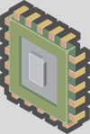
1st Generation CPU Assist
  Initial VT-x/AMD-V hardware targets privileged instructions
    HW is an enabling technology that makes it easier to write a functional VMM
    Alternative to using binary translation
  Initial hardware does not guarantee highest performance virtualization
    VMware binary translation outperforms VT-x/AMD-V
 | Current VT-x/AMD-V
Privileged instructions | Yes
Memory virtualization | No
Device and I/O virtualization | No

Slide 13
Challenges of Virtualizing x86-64
Older AMD64 and Intel EM64T architectures did not include segmentation in 64-bit mode
How do we protect the VMM?
64-bit guest support requires additional hardware assistance
  Segment limit checks available in 64-bit mode on newer AMD processors
  VT-x can be used to protect the VMM on EM64T
    Requires trap-and-emulate approach instead of BT

Slide 14
Agenda: Virtualization-optimized architectures
CPU-optimizations
Memory-optimizations
OS-optimizations

Slide 15
Memory Virtualization
One of the most challenging technical problems in virtualizing the x86 architecture
Privileged instruction virtualization | Handling privileged instructions by de-privileging or ring compression
Memory virtualization | Memory partitioning and allocation of physical memory
Device and I/O virtualization | Routing I/O requests between virtual devices and physical hardware

Slide 16
Review of the “Virtual Memory” concept
Process 1
Process 2
0 4GB
0 4GB
Virtual
Memory
VA
Physical
Memory
PA
Modern operating systems provide virtual memory support
  Applications see a contiguous address space that is not necessarily tied to underlying physical memory in the system
  OS keeps mappings of virtual page numbers to physical page numbers
  Mappings are stored in page tables
CPU includes memory management unit (MMU) and translation lookaside buffer (TLB) for virtual memory support

Slide 17
Virtualizing Virtual Memory
VM 1
VM 2
Process 1
Process 2
Process 1
Process 2
Virtual
Memory
VA
Physical
Memory
PA
Machine
Memory
MA
In order to run multiple virtual machines on a single system, another level of memory virtualization must be done
  Guest OS still controls mapping of virtual address to physical address: VA -> PA
  In virtualized world, guest OS cannot have direct access to machine memory
  Each guest’s physical memory is no longer the actual machine memory in system
VMM maps guest physical memory to the actual machine memory: PA -> MA

Slide 18
Virtualizing Virtual Memory: Shadow Page Tables
VM 1
VM 2
Process 1
Process 2
Process 1
Process 2
Virtual
Memory
VA
Physical
Memory
PA
Machine
Memory
MA
VMM uses “shadow page tables” to accelerate the mappings
  Directly map VA -> MA
  Can avoid the two levels of translation on every access
  Leverage TLB hardware for this VA -> MA mapping
  When guest OS changes VA -> PA, the VMM updates the shadow page tables

Slide 19
Future Hardware Assist at the Memory level
Both AMD and Intel have announced roadmap of additional hardware support
  Memory virtualization (Nested paging, Extended Page Tables)
  Device and I/O virtualization (VT-d, IOMMU)
 | HW Solution
Privileged instructions | VT-X / AMD-V
Memory virtualization | EPT / NPT
Device and I/O virtualization | Intelligent devices, IOMMU / VT-d

Slide 20
Nested Paging / Extended Page Tables
VM 1
VM 2
Process 1
Process 2
Process 1
Process 2
Virtual
Memory
VA
Physical
Memory
PA
Machine
Memory
MA
Hardware support for memory virtualization is on the way
  AMD: Nested Paging / Nested Page Tables (NPT)
  Intel: Extended Page Tables (EPT)
Conceptually, NPT and EPT are identical
  Two sets of page tables exist: VA -> PA and PA -> MA
  Processor HW does page walk for both VA -> PA and PA -> MA

Slide 21
Benefits of NPT/EPT
Performance
  Compute-intensive workloads already run well with binary translation/direct execution
  NPT/EPT will provide noticeable performance improvement for workloads with MMU overheads
  Hardware addresses the performance overheads due to virtualizing the page tables
  With NPT/EPT, even more workloads become candidates for virtualization
Reducing memory consumption
  Shadow page tables consume additional system memory
  Use of NPT/EPT will reduce “overhead memory”
Today, VMware uses HW assist in very limited cases
  NPT/EPT provide motivation to use HW assist much more broadly
  NPT/EPT require usage of AMD-V/VT-x

Slide 22
Flexible VMM Architecture
Flexible “multi-mode” VMM architecture
  Separate VMM per virtual machine
Select mode that achieves best
workload-specific performance
based on CPU support
Today
  32-bit: BT
  64-bit: BT or VT-x
Tomorrow
  32-bit: BT or AMD-V/NPT
  or VT-x/EPT
  64-bit: BT or VT-x or AMD-V /NPT
  or VT-x/EPT
Same VMM architecture for ESX Server, Player,
Server, Workstation and ACE
. . .
VM
VM
VM
VM
BT/VT
VMM64
BT
VMM32
BT/VT
VMM64
. . .
BT
VMM32

Slide 23
Agenda: Virtualization-optimized architectures
CPU-optimizations
Memory-optimizations
OS-optimizations

Slide 24
CPU Virtualization Alternatives: OS Assist
Three alternatives for virtualizing CPU (handling those troublesome “privileged instructions”)
  Binary translation
  Hardware assist (first generation)
  OS assist or paravirtualization
 | Binary Translation | Current HW Assist | Paravirtualization
Compatibility | Excellent | Excellent
Performance | Good | Average
VMM sophistication | High | Average

Slide 25
Paravirtualization
Paravirtualization can also address CPU virtualization
  Modify the guest OS to remove the troublesome “privileged instructions”
  Export a simpler architecture to OS
 | Binary Translation | Current HW Assist | Paravirtualization
Compatibility | Excellent | Excellent
Performance | Good | Average
VMM sophistication | High | Average

Slide 26
Paravirtualization’s compatibility rating: poor
Paravirtualization can also address CPU virtualization
  Modify the guest OS to remove non-virtualizable instructions
  Export a simpler architecture to OS
  Cannot support unmodified guest OSes (e.g., Windows 2000/XP)
 | Binary Translation | Current HW Assist | Paravirtualization
Compatibility | Excellent | Excellent | Poor
Performance | Good | Average
VMM sophistication | High | Average

Slide 27
Paravirtualization’s performance rating: excellent
Paravirtualization can also address CPU virtualization
  Modify the guest OS to remove non-virtualizable instructions
  Export a simpler architecture to OS
  Cannot support unmodified guest OSes (e.g., Windows 2000/XP)
  Higher performance possible
  Paravirtualization not limited to CPU virtualization
 | Binary Translation | Current HW Assist | Paravirtualization
Compatibility | Excellent | Excellent | Poor
Performance | Good | Average | Excellent
VMM sophistication | High | Average

Slide 28
Paravirtualization’s VMM sophistication: average
Paravirtualization can also address CPU virtualization
  Modify the guest OS to remove non-virtualizable instructions
  Export a simpler architecture to OS
  Cannot support unmodified guest OSes (e.g., Windows 2000/XP)
  Higher performance possible
  Paravirtualization not limited to CPU virtualization
  Relatively easy to add paravirtualization support; very difficult to add binary translation
 | Binary Translation | Current HW Assist | Paravirtualization
Compatibility | Excellent | Excellent | Poor
Performance | Good | Average | Excellent
VMM sophistication | High | Average | Average

Slide 29
Paravirtualization Challenges
XenLinux paravirtualization approach unsuitable for enterprise use
  Relies on separate kernel for native and in virtual machine
  Guest OS and hypervisor tightly coupled (data structure dependencies)
  Tight coupling inhibits compatibility
  Changes to the guest OS are invasive
VMware’s proposal: Virtual Machine Interface API (VMI)
  Proof-of-concept that high-performance paravirtualization possible with a maintainable interface
  VMI provides maintainability & stability
  API supports low-level and higher-level interfaces
  Allows same kernel to run natively and in a paravirtualized virtual machine: “transparent paravirtualization”
  Allows for replacement of hypervisors without a guest recompile
  Preserve key virtualization functionality: page sharing, VMotion, etc.

Slide 30
Improved Paravirtualization
Great progress is happening in the Linux kernel community
  paravirt-ops infrastructure in Linux kernel 2.6.20
  VMI-backed (to paravirt-ops) is on track for 2.6.21.
  Ubuntu has will be shipping a VMI-enabled kernel in their Feisty release.
Paravirt ops
  Developers from VMware, IBM LTC, XenSource, Red Hat
  http://ozlabs.org/~rusty/paravirt/
  Improves compatibility: transparent paravirtualization & hypervisor interoperability`
 | Binary Translation | Current HW Assist | Paravirtualization
Compatibility | Excellent | Excellent | Good
Performance | Good | Average | Excellent
VMM sophistication | High | Average | Average

Slide 31
The future impact of NPT/EPT
Role of paravirtualization changes when NPT/EPT is available
  NPT/EPT addresses MMU virtualization overheads
  Paravirtualization will become more I/O-focused
 | Binary Translation | Hardware Assist | Paravirtualization
Compatibility | Excellent | Excellent | Good
Performance | Good | Excellent | Excellent
VMM sophistication | High | Average | Average

Slide 32
Summary & Review
CPU-optimizations
Memory-optimizations
OS-optimizations

Slide 33
Summary
Hardware assist technology will continue to mature
  Continue to broaden the set of workloads that can be virtualized
  NPT/EPT HW will bring a substantial performance boost
VMware provides flexible architecture to support emerging virtualization technologies
  Multi-mode VMM utilizes binary translation, hardware assist and paravirtualization
  Select best operating mode based on:
    HW available in the processor
    The workload being executed

