Slide 1
CIS 751/CIS 551: Computer and Information Security
Instructor: Xinming (Simon) Ou
TA: Xiaolong (Daniel) Wang
Class time: TTh 3:55-5:10

Slide 2
Logistics
Course website
http://people.cis.ksu.edu/~xou/cybersec13/
where you can find
  Lecture slides and videos
  Programming assignments and homework
  Reading materials
Remote students
  Lecture video will be made available the day following the lecture
  Deadlines will be a day after the posted deadline

Slide 3
Logistics - continued
Communications
  A facebook group will be created and you will be invited to join it. Feel free to post your questions/comments/ideas attendant to the course.
  Course announcements will be made through emails. Questions to instructor and TA must be sent through emails.

Slide 4
Logistics - continued
Tools needed
  Get VMware Software
    CIS department has academic licenses for students and faculty/staff.
  Practice Linux if you are not familiar with it

Slide 5
What is this course about?
Provide a comprehensive treatment of computer and information security
  Security breaks at the weakest link
  Attackers do not play by any rules
  Everything can be a security problem
  Root causes of the current cybersecurity problem
Cover both defense and offense aspects
Cover both theory and practice

Slide 6
Topics
Common attacks on software
Application of cryptography in security
Authentication and authorization
Network security
Web/cloud security
Smart-phone security

Slide 7
Tasks
Lectures
Readings
Assignments (about one per week)
  Programming projects
  Homework
Final report
  You decide your own topic and get it approved by me

Slide 8
Grades
Homework and projects: 40%
Exams: 30%
Final report: 20%
Class participation: 10%
CIS551 and CIS751 graded separately

Slide 9
Collaboration Policy
Exams: no collaboration
Homework and programming assignments: discussion with other students OK, but must indicate who you discussed with in your submission
Final report: discussion encouraged, but the report must be your own work

Slide 10
Class Participation (on campus)
Everyone must present one reading assignment (5 pts).
  Order will be sent through email
  One week to finish reading and prepare for a 20-min presentation in class
Students not presenting participate in the discussion (e.g., asking questions) (5 pts).
  We will also ask you questions during the presentation

Slide 11
Class Participation (remote)
Remote students must submit an essay on one reading assignment (5 pts).
  One week to finish reading, prepare for a short essay, and email it to us
  We will distribute the essay to the whole class
Off-campus students ask questions on any presented paper through facebook (5 pts).

Slide 12
Student Self Introduction

Slide 13
What is Security?
Classical definition:
  Confidentiality
  Integrity
  Availability
Security is the prevention of threats from causing undesired effects
  Threat model is important: who are your adversaries? What is at stake?

Slide 14
Can we have absolute security?
Security is always a trade off between cost and risks
Threat model:
  Who are the adversaries?
  What are their motivations?
  How capable are they?
  How much risk can they afford?
Effectiveness of countermeasures:
  How much risk is reduced for users?
  How much inconvenience is incurred on users?
  How much risk is increased for adversaries?

Slide 15
Example1: Spam Emails
Which one of C,I,A does this problem fall into?
What is the threat model?
What are possible counter measures?_x000e_

Slide 16
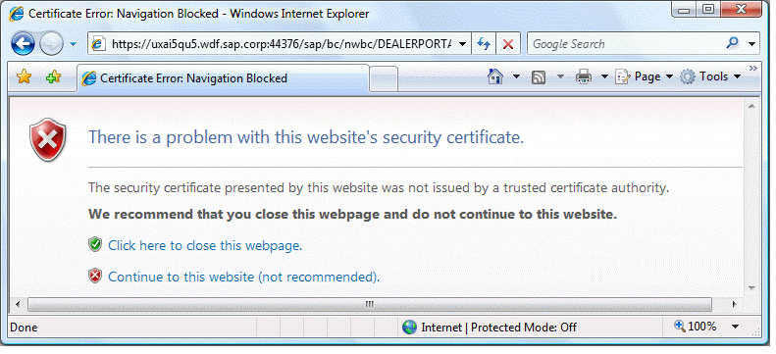
Example 2

