Slide 1

Independent Range Sampling on Interval Data
Daichi Amagata Osaka University

Slide 2
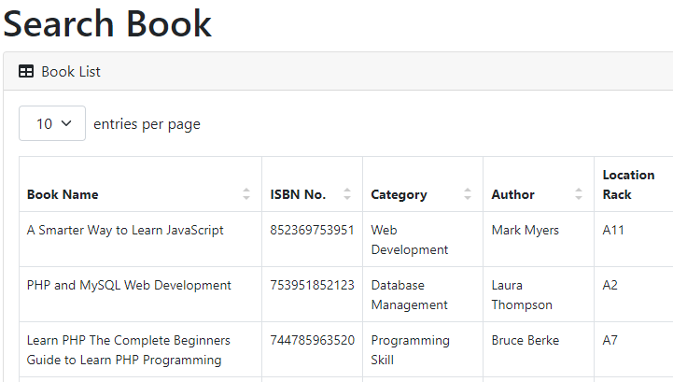
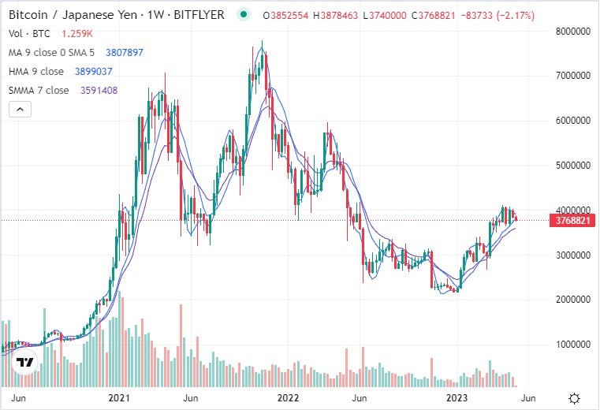

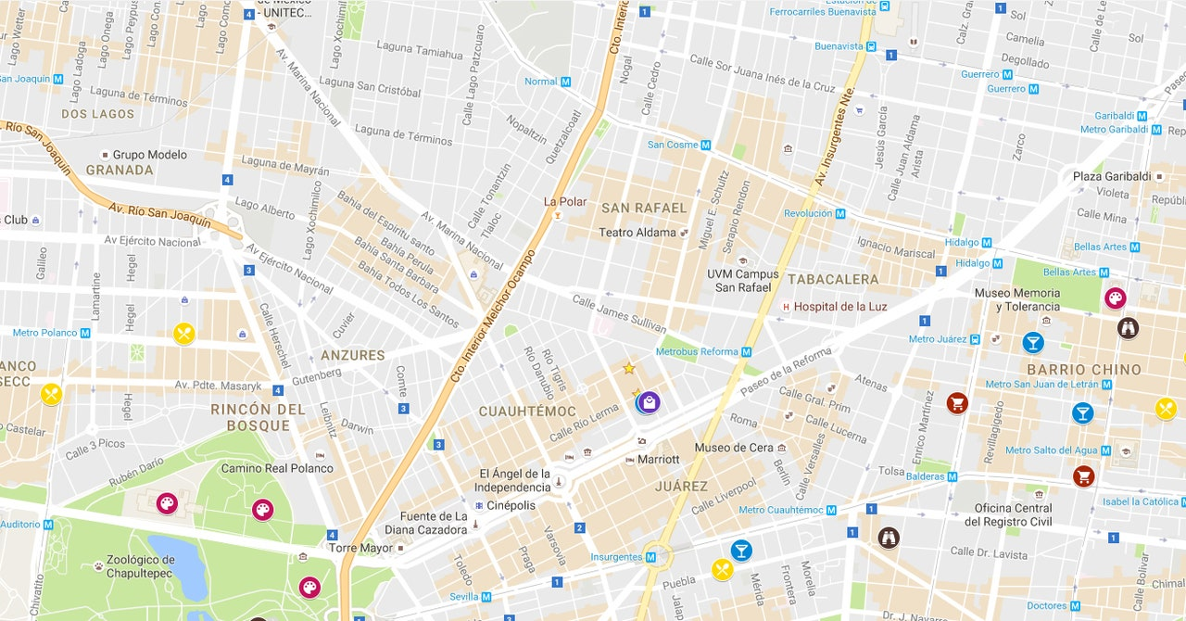
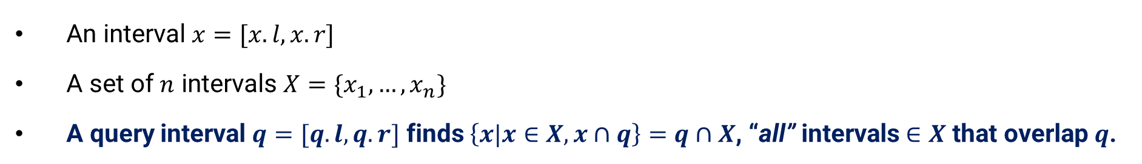
Background: Range Search on Interval Data
An interval $x=[x.l,x.r]$
A set of $n$ intervals $X=\{x_{1},…,x_{n}\}$
A query interval $q=[q.l,q.r]$ finds $\left\{x|x∈X,x∩q\right\}=q∩X$, “all” intervals $∈X$ that overlap $q$.
Ex.1) Vehicle management systems: Show vehicles that were active between 17:00 and 22:00 a week ago.
Ex.2) Book management systems:
Collect books that were borrowed
in the last month.
Ex.3) Historical cryptocurrency databases:
Show when the price of Bitcoin (BTC) falls in [30,000, 40,000] dollars.
Notes:
This work addresses the problem of range search on interval data.
An interval is a pair of the left- and right-endpoints.
Given a query interval and a set of intervals, this problem finds all intervals overlapping q.
This problem is important for some real-world applications, like car management systems, book management systems, and cryptocurrency databases.
For instance, when we want to analyze how the price of bitcoin updates within a range of dollars, we can issue a range query to do so.

Slide 3


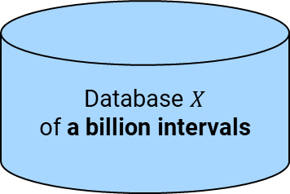
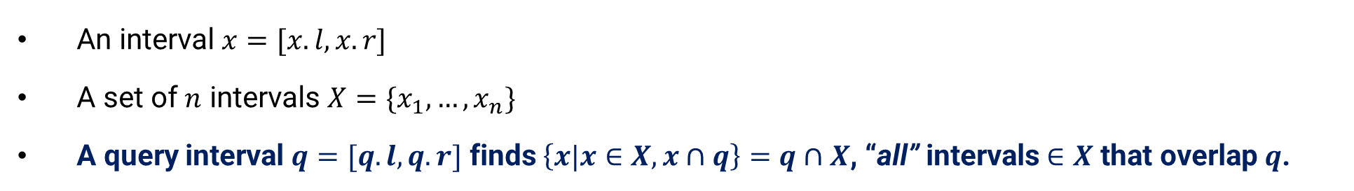
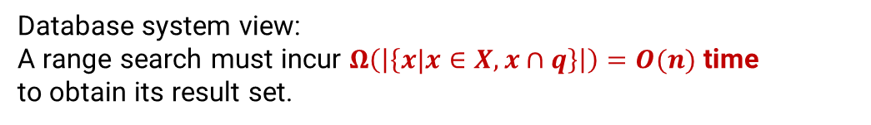
Background: Issues Due to “Too Large Result Set”
An interval $x=[x.l,x.r]$
A set of $n$ intervals $X=\{x_{1},…,x_{n}\}$
A query interval $q=[q.l,q.r]$ finds $\left\{x|x∈X,x∩q\right\}=q∩X$, “all” intervals $∈X$ that overlap $q$.
Ex.1) Vehicle management systems: Show vehicles that were active between 17:00 and 22:00 a week ago.
Database system view:
A range search must incur $Ω\left(\left|\left\{x|x∈X,x∩q\right\}\right|\right)=O(n)$ time
to obtain its result set.
Database $X$ of a billion intervals
Still 10,000,000 intervals!
query interval $q$
$$\left\{x | x∈X, x∩q\right\}$$
Issue 1: not easy to analyze/visualize
Issue 2: slow response
Notes:
However, simple range searches may not be friendly for users, because the result size is not controllable.
This means (that) the result size can be too much, like in the left figure.
If we want to visualize the result of a range query but its result size is very large, it takes too long time to visualize and it is hard to get knowledge from the visualized result.
More specifically, let’s assume that a database contains a billion intervals.
Even if the query selectivity is only 1%, the result contains 10 million intervals.
Any range search algorithms must access 10 million intervals, so its search time is also still too long.

Slide 4
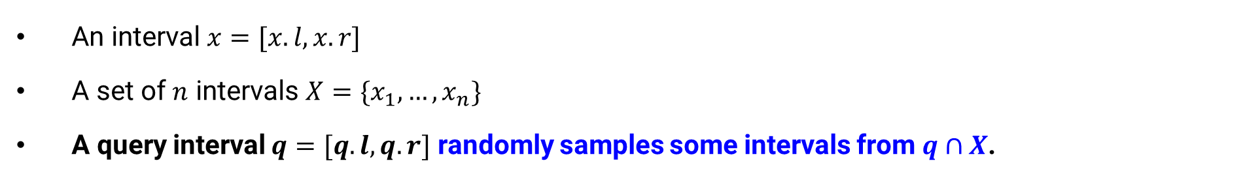
Background: Range Sampling
An interval $x=[x.l,x.r]$
A set of $n$ intervals $X=\{x_{1},…,x_{n}\}$
A query interval $q=[q.l,q.r]$ randomly samples some intervals from $q∩X$.
Ex.1) Vehicle management systems: Show vehicles that were active between 17:00 and 22:00 a week ago.
Ex.1) Vehicle management systems:
Show randomly sampled vehicles that were active between 17:00 and 22:00 a week ago.
Issue 1: not easy to analyze/visualize
easy to analyze/visualize & accelerated efficiency
(if only samples are obtained)
Notes:
To solve these issues, range sampling is a promising approach.
This query randomly samples some intervals from the set of intervals overlapping the query.
For instance, if we apply this range sampling query, only sampled intervals are returned, so the visualization can be easier without losing the distribution.
And, if only samples are obtained, search efficiency can be accelerated.

Slide 5


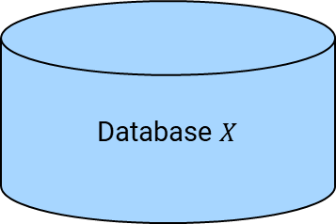

Preliminary
Problem Definition: IRS (Independent Range Sampling) on interval data
Input: $X$ (a set of $n$ intervals), $q$ (query interval), and $s$ (#samples)
Output: $S$ (a set of $s$ intervals, each of which is picked from $q∩X$ uniformly at random)
First attempt: How about
(1) running a search algorithm (e.g., [1])
(2) and then do random sampling?
Database $X$
query interval $q$
(1) Range search
(2) Random sampling
$$\left\{x | x∈X, x∩q\right\}$$
$$S$$
Claim (no merit)
The above algorithm incurs $Ω\left(\left|q∩X\right|\right)=O(n)$ time.
[1] “Hint: A hierarchical index for intervals in main memory,” In SIGMOD, 2022.
Notes:
Let’s formally define this problem.
Given a set of intervals, a query interval, and the number of samples s, this problem outputs a set of s intervals, each of which is picked from the search result set uniformly at random.
This problem seems easy to be solved.
An intuitive approach is to run a search algorithm first, and the do random sampling from the search result.
This is indeed meaningless, because it ignores the issue of slow response time of range search.
Because the worst time of any range search is O(n), this approach does not provide efficiency merit.

Slide 6

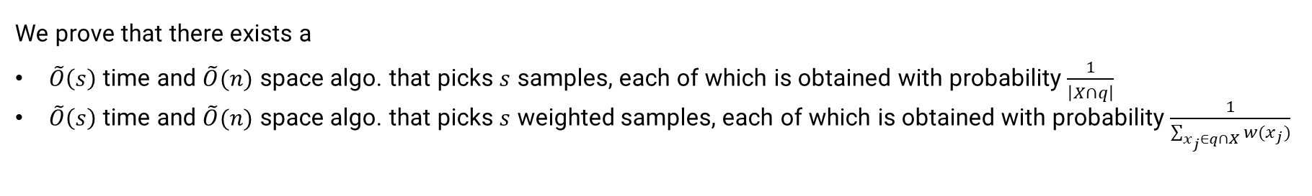
Contributions
Challenge
How to obtain $s$ random samples without running a search algorithm?
Findings
We prove that there exists a
$\tilde{O}\left(s\right)$ time and $\tilde{O}(n)$ space algo. that picks $s$ samples, each of which is obtained with probability $\frac{1}{\left|X∩q\right|}$
$\tilde{O}\left(s\right)$ time and $\tilde{O}(n)$ space algo. that picks $s$ weighted samples, each of which is obtained with probability $\frac{1}{\sum_{x_{j}∈q∩X}{w(x_{j})}}$
$\tilde{O}\left(⋅\right)$ hides any polylog factors.
Experiments
We demonstrate that our algorithms are much faster than baseline algorithms.
Our implementation is available at https://github.com/amgt-d1/IRS-interval.
Notes:
So, we need to overcome that challenge: how to obtain s random samples without running a search algorithm.
This work finds some theoretical results.
There exists a soft-order(s) time and soft-order(n) space algorithm that solves this problem correctly.
We have a similar result even when intervals have weights.
We experimentally show that our algorithms are much faster than baseline algorithms.
Our codes are available at this GitHub repository.

Slide 7




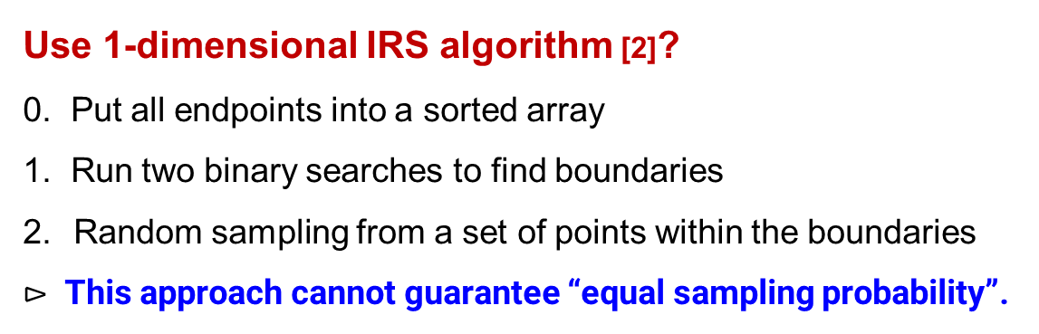









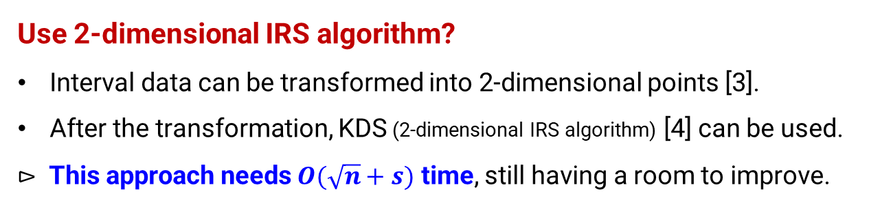


Why Existing Techniques are NOT Sufficient?
Use 1-dimensional IRS algorithm [2]?
0. Put all endpoints into a sorted array
1. Run two binary searches to find boundaries
Random sampling from a set of points within the boundaries
$⊳$ This approach cannot guarantee “equal sampling probability”.
$$x_{1}$$
$$x_{2}$$
$$x_{3}$$
$$x_{5}$$
$$x_{4}$$
$$x_{6}$$
$$x_{7}$$
$$x_{8}$$
$$x_{9}$$
$$x_{10}$$
$$x_{11}$$
$$q$$
$$x_{8}.l$$ | $$x_{2}.l$$ | $$x_{4}.l$$ | $$x_{8}.r$$ | $$x_{1}.l$$ | $$x_{9}.l$$ | $$x_{2}.r$$ | $$x_{4}.r$$ | $$⋯$$ | $$x_{7}.r$$
2 points: $x_{2}, x_{4}$ whereas 1 point: $x_{8}, x_{1}, x_{9}$
Use 2-dimensional IRS algorithm?
Interval data can be transformed into 2-dimensional points [3].
After the transformation, KDS (2-dimensional IRS algorithm) [4] can be used.
$⊳$ This approach needs $O(\sqrt{n}+s)$ time, still having a room to improve.
We reduce this
time complexity.
[2] “Independent range sampling,” In PODS, 2014.
[3] “A general technique for top-k geometric intersection query problems,” TKDE, 2014.
[4] “Spatial independent range sampling,” In SIGMOD, 2021.
Notes:
Now, let’s review the existing algorithms for independent range sampling.
One straightforward idea is to use 1-dimensional independent range sampling algorithm, because intervals are pairs of 1-dimensional points.
In an offline step, we put all endpoints into a sorted array.
Given a query, we run two binary searches to find overlapping boundaries.
Then, we do random sampling from a set of points within the boundaries.
Actually, this approach cannot guarantee equal sampling probability, because some intervals are fully covered by the query while some intervals are partially covered by the query.
Another idea is to use 2-dimensional independent range sampling algorithm, because intervals can be converted to 2-dimensional points.
If we employ the state-of-the-art algorithm, we can solve our problem in O(sqrt(n)+s) time, but this is still sensitive to n.
Our work reduces this time complexity.

Slide 8


























Building Block of Our Technique
Interval tree: a balanced binary tree for interval data
Structure
Each interval is maintained at the firstly stabbed node (e.g., $x_{1}$ at $u_{root}$, $x_{3}$ at $u_{2}$)
Each node $u_{i}$ maintains
a value $c_{i}$ (centroid)
$L_{i}^{l}$ and $L_{i}^{r}$ which respectively are lists of intervals sorted in ascending order of left-endpoint and right-endpoint
Range search
Traverse overlapping nodes from $u_{root}$ in the following way:
Case 1: If ${q.r<c}_{i}$, traverse only left child node (e.g., $q_{1}$ at $u_{root}$)
Case 2: If $c_{i} <q.l$, traverse only right child node (e.g., $q_{1}$ at $u_{1}$)
Case 3: If $q.l≤c_{i}≤q.r$, traverse both left and right child nodes (e.g., $q_{2}$ at $u_{2}$)
$⊳$ This approach needs $O(n)$ time, because of no bounds for case 3.
$$L_{1}^{l}=\left[x_{2},x_{4}\right]$$
$$L_{1}^{r}=[x_{2},x_{4}]$$
$$L_{root}^{l}=\left[x_{1},x_{6}\right]$$
$$L_{root}^{r}=[x_{6},x_{1}]$$
$$u_{root}$$
$$u_{1}$$
$$u_{2}$$
$$u_{3}$$
$$u_{4}$$
$$u_{5}$$
$$u_{6}$$
$$c_{3}$$
$$c_{1}$$
$$c_{4}$$
$$c_{root}$$
$$c_{5}$$
$$c_{2}$$
$$c_{6}$$
$$x_{1}$$
$$x_{2}$$
$$x_{3}$$
$$x_{5}$$
$$x_{4}$$
$$x_{6}$$
$$x_{7}$$
$$x_{8}$$
$$x_{9}$$
$$x_{10}$$
$$x_{11}$$
$$q_{1}$$
$$q_{2}$$
Notes:
Before I explain our technique, I introduce the interval tree, because it is a building block of our technique.
This is essentially a balanced binary tree for interval data.
Each interval is maintained at the firstly stabbed node.
Each node maintains a centroid value, tow lists of intervals sorted by left- and right-endpoints.
Given a query, we traverse all nodes that may overlap the query based on the centroids.
Unfortunately, simply using this interval tree needs O(n) time, because we cannot bound the number of nodes accessed.
This is easy to see: if a query overlaps all intervals, all nodes have to be traversed.

Slide 9
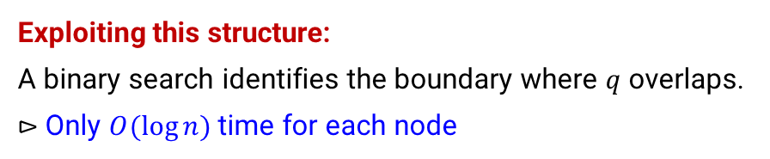

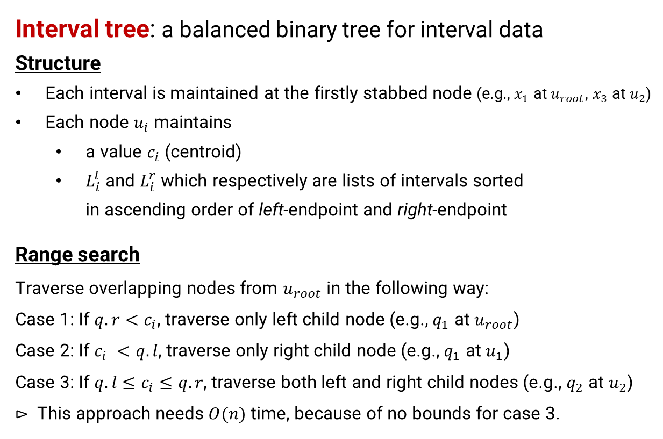
Main Idea 1
Interval tree: a balanced binary tree for interval data
Structure
Each interval is maintained at the firstly stabbed node (e.g., $x_{1}$ at $u_{root}$, $x_{3}$ at $u_{2}$)
Each node $u_{i}$ maintains
a value $c_{i}$ (centroid)
$L_{i}^{l}$ and $L_{i}^{r}$ which respectively are lists of intervals sorted in ascending order of left-endpoint and right-endpoint
Range search
Traverse overlapping nodes from $u_{root}$ in the following way:
Case 1: If ${q.r<c}_{i}$, traverse only left child node (e.g., $q_{1}$ at $u_{root}$)
Case 2: If $c_{i} <q.l$, traverse only right child node (e.g., $q_{1}$ at $u_{1}$)
Case 3: If $q.l≤c_{i}≤q.r$, traverse both left and right child nodes (e.g., $q_{2}$ at $u_{2}$)
$⊳$ This approach needs $O(n)$ time, because of no bounds for case 3.
$$L_{i}^{l}=\left[x_{1},x_{2},x_{3},x_{4},x_{5},x_{6}\right]$$
Exploiting this structure: A binary search identifies the boundary where $q$ overlaps. $⊳$ Only $O(\log{n})$ time for each node
Notes:
From now, we explain how to solve our problem efficiently.
The first idea is to exploit the interval tree structure.
Recall that each node has two lists of intervals, and they are sorted based on left- and right-endpoints.
For instance, one list of this node has six intervals, and they are sorted based on left-endpoint.
This structure is useful to identify the boundary where a given query overlaps.
In the right figure, the boundary is x4, and we need only O(logn) time to find it.

Slide 10





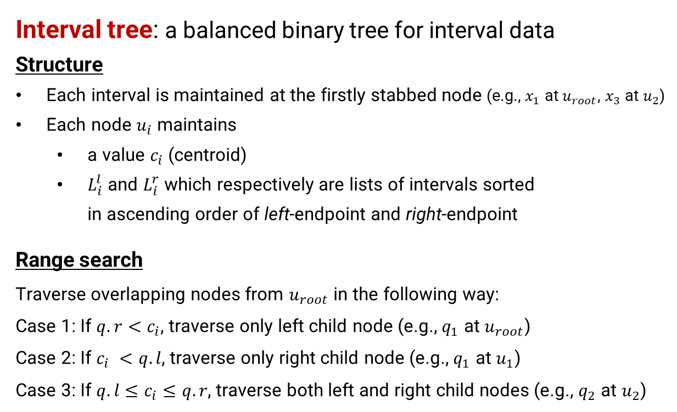


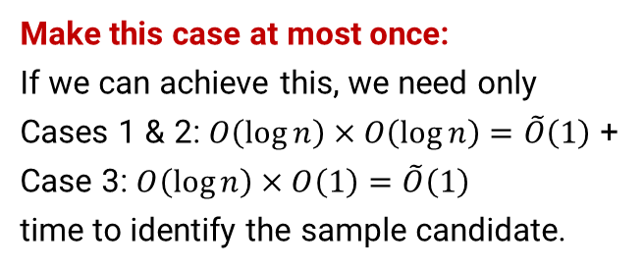
Main Idea 2
Interval tree: a balanced binary tree for interval data
Structure
Each interval is maintained at the firstly stabbed node (e.g., $x_{1}$ at $u_{root}$, $x_{3}$ at $u_{2}$)
Each node $u_{i}$ maintains
a value $c_{i}$ (centroid)
$L_{i}^{l}$ and $L_{i}^{r}$ which respectively are lists of intervals sorted in ascending order of left-endpoint and right-endpoint
Range search
Traverse overlapping nodes from $u_{root}$ in the following way:
Case 1: If ${q.r<c}_{i}$, traverse only left child node (e.g., $q_{1}$ at $u_{root}$)
Case 2: If $c_{i} <q.l$, traverse only right child node (e.g., $q_{1}$ at $u_{1}$)
Case 3: If $q.l≤c_{i}≤q.r$, traverse both left and right child nodes (e.g., $q_{2}$ at $u_{2}$)
Make this case at most once:
If we can achieve this, we need only
Cases 1 & 2: $O\left(\log{n}\right)×O\left(\log{n}\right)=\tilde{O}\left(1\right)$ +
Case 3: $O\left(\log{n}\right)×O\left(1\right)=\tilde{O}\left(1\right)$ time to identify the sample candidate.
$$L_{1}^{l}=\left[x_{2},x_{4}\right]$$
$$L_{1}^{r}=[x_{2},x_{4}]$$
$$L_{root}^{l}=\left[x_{1},x_{6}\right]$$
$$L_{root}^{r}=[x_{6},x_{1}]$$
$$u_{root}$$
$$u_{1}$$
$$u_{2}$$
$$u_{3}$$
$$u_{4}$$
$$u_{5}$$
$$u_{6}$$
$$c_{3}$$
$$c_{1}$$
$$c_{4}$$
$$c_{root}$$
$$c_{5}$$
$$c_{2}$$
$$c_{6}$$
$$x_{1}$$
$$x_{2}$$
$$x_{3}$$
$$x_{5}$$
$$x_{4}$$
$$x_{6}$$
$$x_{7}$$
$$x_{8}$$
$$x_{9}$$
$$x_{10}$$
$$x_{11}$$
$$q$$
How to access $x_{9}$ and $x_{10}$ without incurring $O\left(n\right)$ node accesses?
Notes:
The main problem of interval tree is the case 3 here: if a query overlaps the centroid, we have to traverse its left and right child nodes.
Because of this observation, we must traverse all nodes in the worst case.
If we have this case at most once, we need to traverse only O(logn) nodes.
Then, we need to identify the boundaries of the O(logn) nodes, resulting in soft-order(1) time to identify the sample candidate.

Slide 11
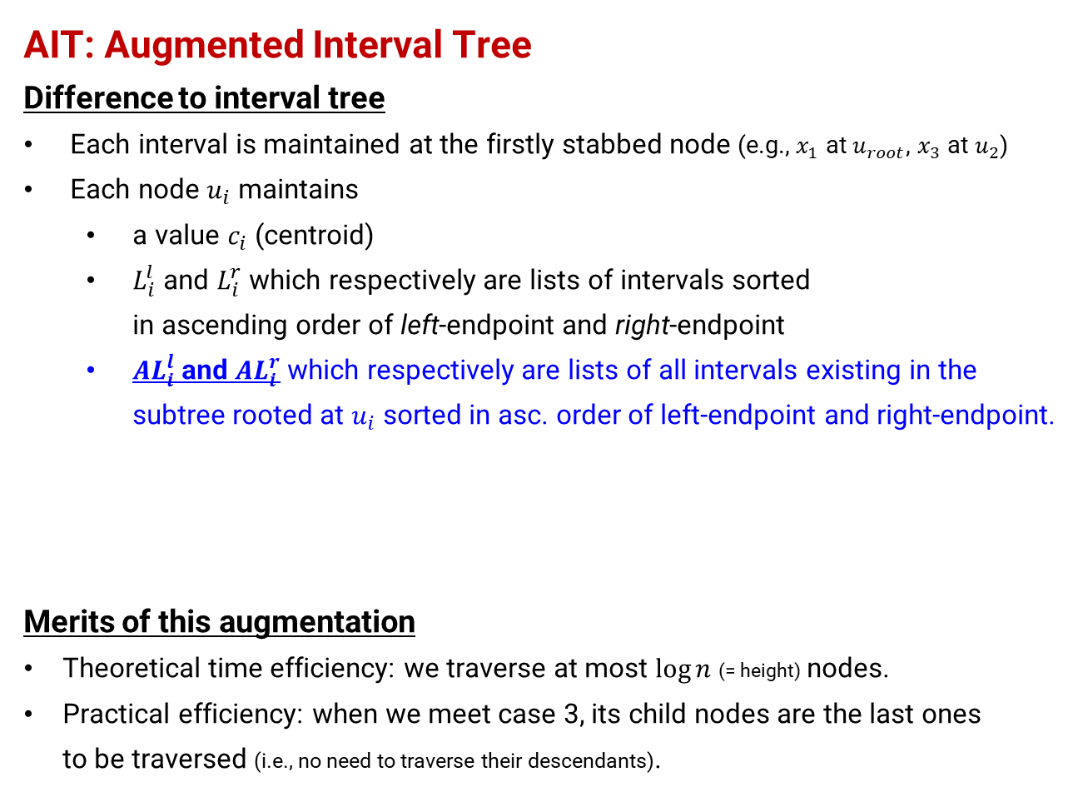

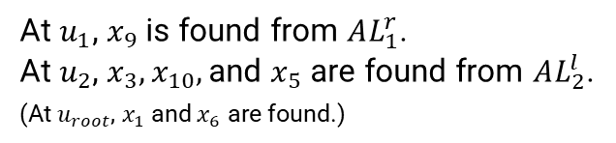


New Data Structure
AIT: Augmented Interval Tree
Difference to interval tree
Each interval is maintained at the firstly stabbed node (e.g., $x_{1}$ at $u_{root}$, $x_{3}$ at $u_{2}$)
Each node $u_{i}$ maintains
a value $c_{i}$ (centroid)
$L_{i}^{l}$ and $L_{i}^{r}$ which respectively are lists of intervals sorted in ascending order of left-endpoint and right-endpoint
${AL}_{i}^{l}$ and ${AL}_{i}^{r}$ which respectively are lists of all intervals existing in the subtree rooted at $u_{i}$ sorted in asc. order of left-endpoint and right-endpoint.
Merits of this augmentation
Theoretical time efficiency: we traverse at most $\log{n}$ (= height) nodes.
Practical efficiency: when we meet case 3, its child nodes are the last ones to be traversed (i.e., no need to traverse their descendants).
$L_{1}^{l}=[x_{2},x_{4}]$, $L_{1}^{r}=[x_{2},x_{4}]$
$${AL}_{1}^{l}=[x_{8},x_{2},x_{4},x_{9}]$$
$${AL}_{1}^{r}=[x_{8},x_{2},x_{4},x_{9}]$$
$L_{2}^{l}=[x_{3},x_{5}]$, $L_{2}^{r}=[x_{5},x_{3}]$
$${AL}_{2}^{l}=[x_{3},x_{10},x_{5},x_{7},x_{11}]$$
$${AL}_{2}^{r}=[x_{10},x_{5},x_{3},x_{11},x_{7}]$$
$$u_{root}$$
$$u_{1}$$
$$u_{2}$$
$$u_{3}$$
$$u_{4}$$
$$u_{5}$$
$$u_{6}$$
At $u_{1}$, $x_{9}$ is found from $AL_{1}^{r}$.
At $u_{2}$, ${x_{3}, x}_{10},$and $x_{5}$ are found from $AL_{2}^{l}$.
(At $u_{root}$, $x_{1}$ and $x_{6}$ are found.)
$$c_{3}$$
$$c_{1}$$
$$c_{4}$$
$$c_{root}$$
$$c_{5}$$
$$c_{2}$$
$$c_{6}$$
$$x_{1}$$
$$x_{2}$$
$$x_{3}$$
$$x_{5}$$
$$x_{4}$$
$$x_{6}$$
$$x_{7}$$
$$x_{8}$$
$$x_{9}$$
$$x_{10}$$
$$x_{11}$$
$$q$$
How to access $x_{9}$ and $x_{10}$ without incurring $O\left(n\right)$ node accesses?
Notes:
To implement these ideas, we extend the interval tree structure and propose augmented interval tree.
The main difference is two additional lists, which maintains the intervals existing in the subtree rooted at the node.
This augmentation may be fairly simple, it has two important merits.
The first merit is theoretical efficiency: we traverse at most logn nodes.
The other is practical efficiency: when we meet the case, its child nodes are the last ones toe be traversed, which corresponds to so-called early termination.

Slide 12



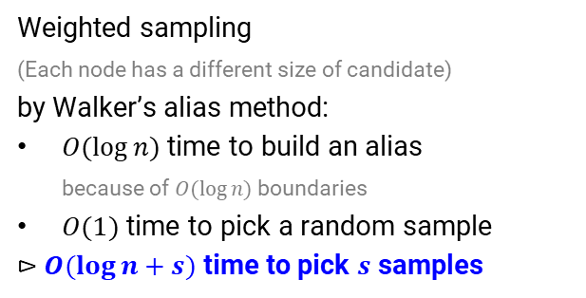

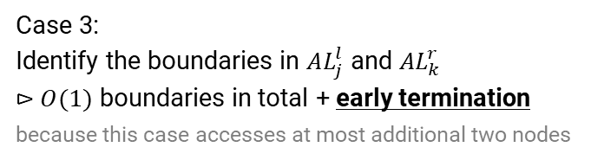

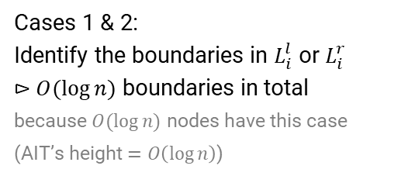
Our IRS Algorithm
Case 1
Case 2
Cases 1 & 2:
Identify the boundaries in $L_{i}^{l}$ or $L_{i}^{r}$ $⊳$ $O(\log{n})$ boundaries in total because $O(\log{n})$ nodes have this case
(AIT’s height $=O\left(\log{n}\right)$)
$$L_{root}^{l}=\left[x_{1},x_{6}\right]$$
$$L_{root}^{r}=[x_{6},x_{1}]$$
Case 3
Case 3:
Identify the boundaries in $AL_{j}^{l}$ and $AL_{k}^{r}$ $⊳$ $O(1)$ boundaries in total + early termination because this case accesses at most additional two nodes
$L_{1}^{l}=[x_{2},x_{4}]$, $L_{1}^{r}=[x_{2},x_{4}]$
$${AL}_{1}^{l}=[x_{8},x_{2},x_{4},x_{9}]$$
$${AL}_{1}^{r}=[x_{8},x_{2},x_{4},x_{9}]$$
$L_{2}^{l}=[x_{3},x_{5}]$, $L_{2}^{r}=[x_{5},x_{3}]$
$${AL}_{2}^{l}=[x_{3},x_{10},x_{5},x_{7},x_{11}]$$
$${AL}_{2}^{r}=[x_{10},x_{5},x_{3},x_{11},x_{7}]$$
$$u_{root}$$
$$u_{1}$$
$$u_{2}$$
$$u_{3}$$
$$u_{4}$$
$$u_{5}$$
$$u_{6}$$
$⊳$ $\tilde{O}\left(1\right)$ time to identify the candidate
$$c_{3}$$
$$c_{1}$$
$$c_{4}$$
$$c_{root}$$
$$c_{5}$$
$$c_{2}$$
$$c_{6}$$
Weighted sampling (Each node has a different size of candidate) by Walker’s alias method:
$O(\log{n})$ time to build an alias because of $O(\log{n})$ boundaries
$O(1)$ time to pick a random sample
$⊳$ $O(\log{n}+s)$ time to pick $s$ samples
$$x_{1}$$
$$x_{2}$$
$$x_{3}$$
$$x_{5}$$
$$x_{4}$$
$$x_{6}$$
$$x_{7}$$
$$x_{8}$$
$$x_{9}$$
$$x_{10}$$
$$x_{11}$$
$$q$$
This query accesses only $u_{root}, u_{1},$ and $u_{2}$.
Notes:
I briefly introduce our algorithm.
When the query does not overlap the centroid of a given node, which is case 1 or 2, we identify the boundaries of the corresponding list and go to its left or right child.
On the other hand, when the query overlaps the centroid, we identify the boundaries of the augmented lists, and the search step is over.
Because the number of intervals overlapping the query is different for each node, we employ weighted sampling.
We can build its structure in O(logn) time, because we access at most logn nodes.
By using the structure, a sample can be picked in O(1) time.

Slide 13


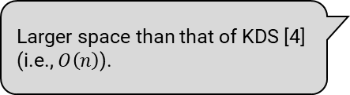
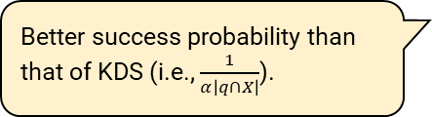
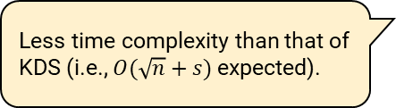
Theoretical Analysis
Theorem 1 (Space complexity)
Larger space than that of KDS [4] (i.e., $O\left(n\right)$).
The space complexity of our algorithm (or an AIT) is $O(n\log{n})$.
Theorem 2 (Time complexity)
Less time complexity than that of KDS (i.e., $O(\sqrt{n}+s)$ expected).
Our algorithm picks $s$ random samples in $O(\log^{2}{n}+s)$ time.
Theorem 3 (Correctness)
Better success probability than that of KDS (i.e., $\frac{1}{α\left|q∩X\right|}$).
Our algorithm picks a random samples with probability $1/|q∩X|$.
[4] “Spatial independent range sampling,” In SIGMOD, 2021.
Notes:
From our data structure and algorithm, we have three important theorems.
First, the space complexity of our data structure is O(nlogn), which is still reasonable for large n.
Second, our algorithm picks s random samples in O((logn)^2 + s) time, which is faster than the state-of-the-art for large n.
Last, our algorithm does not yield biased samples, so samples are absolutely random.

Slide 14

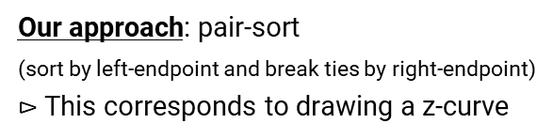
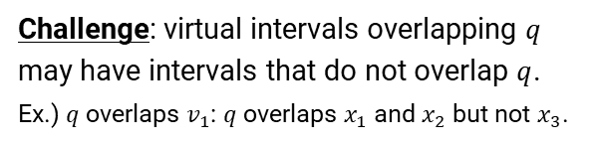




How to Reduce Space Complexity?
Definition 1 (virtual interval)
Given a subset $X_{i}$ of $X$, the virtual interval of $X_{i}$, $v_{i}$, is defined as $v_{i}.l=\min_{x∈X_{i}}{x.l}$ and $v_{i}.r=\max_{x∈X_{i}}{x.r}$
Corollary 1
Given a set $V$ of virtual intervals such that $\left|V\right|=Θ\left(\frac{n}{\log{n}}\right)$, the space complexity of the AIT on $V$ is $O\left(n\right)$.
How to partition $X$ (or how to alleviate false positives)
Challenge: virtual intervals overlapping $q$ may have intervals that do not overlap $q$.
Ex.) $q$ overlaps $v_{1}$: $q$ overlaps $x_{1}$ and $x_{2}$ but not $x_{3}$.
Our approach: pair-sort (sort by left-endpoint and break ties by right-endpoint) $⊳$ This corresponds to drawing a z-curve
Our partition: disjoint and uniform partition based on the sort order
$$x_{1}$$
$$x_{2}$$
$$x_{3}$$
$$v_{1}$$
$$q$$
Notes:
One may want a data structure that is linear to n.
This can be achieved by merging logn intervals into a single virtual interval.
The main challenge here is how to merge logn intervals, because virtual intervals incur false positives.
We solve this challenge by using pair-sort, meaning that sort by left-endpoints and break ties by right-endpoint.
Actually, this approach corresponds to drawing a z-curve, so similar intervals are merged.
Then, we partition the dataset based this sort order so that one subset consists of logn intervals.

Slide 15
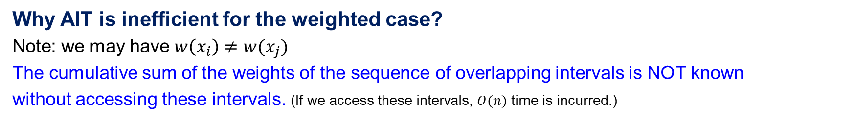
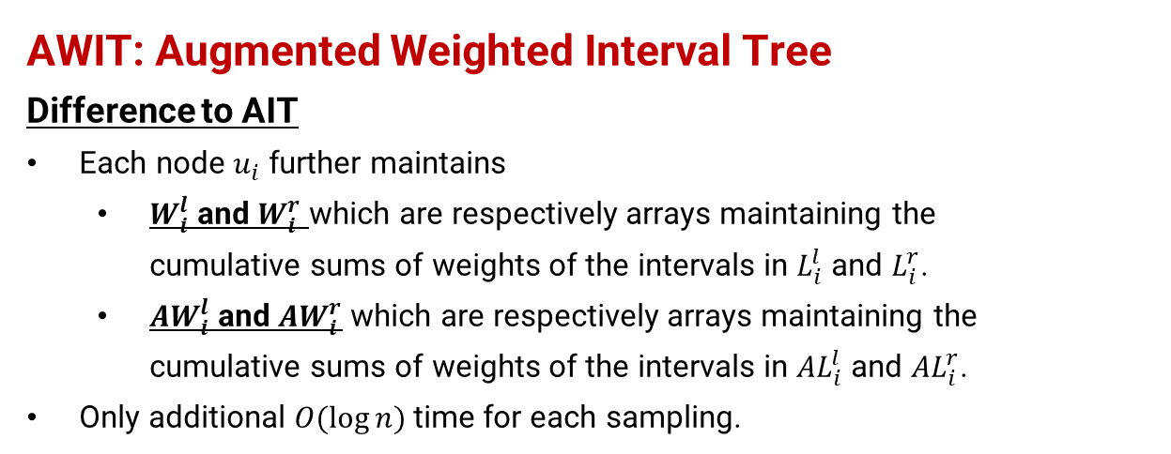
How to Handle Weighted Intervals?
Why AIT is inefficient for the weighted case?
Note: we may have $w\left(x_{i}\right)≠w(x_{j})$
The cumulative sum of the weights of the sequence of overlapping intervals is NOT known without accessing these intervals. (If we access these intervals, $O(n)$ time is incurred.)
AWIT: Augmented Weighted Interval Tree
Difference to AIT
Each node $u_{i}$ further maintains
$W_{i}^{l}$ and $W_{i}^{r}$ which are respectively arrays maintaining the cumulative sums of weights of the intervals in $L_{i}^{l}$ and $L_{i}^{r}$.
${AW}_{i}^{l}$ and ${AW}_{i}^{r}$ which are respectively arrays maintaining the cumulative sums of weights of the intervals in ${AL}_{i}^{l}$ and ${AL}_{i}^{r}$.
Only additional $O(\log{n})$ time for each sampling.
$L_{1}^{l}=[x_{2},x_{4}]$, $L_{1}^{r}=[x_{2},x_{4}]$
$${AL}_{1}^{l}=[x_{8},x_{2},x_{4},x_{9}]$$
$${AL}_{1}^{r}=[x_{8},x_{2},x_{4},x_{9}]$$
$L_{2}^{l}=[x_{3},x_{5}]$, $L_{2}^{r}=[x_{5},x_{3}]$
$${AL}_{2}^{l}=[x_{3},x_{10},x_{5},x_{7},x_{11}]$$
$${AL}_{2}^{r}=[x_{10},x_{5},x_{3},x_{11},x_{7}]$$
$$u_{root}$$
$$u_{1}$$
$$u_{2}$$
$$u_{3}$$
$$u_{4}$$
$$u_{5}$$
$$u_{6}$$
$$c_{3}$$
$$c_{1}$$
$$c_{4}$$
$$c_{root}$$
$$c_{5}$$
$$c_{2}$$
$$c_{6}$$
$$x_{1}$$
$$x_{2}$$
$$x_{3}$$
$$x_{5}$$
$$x_{4}$$
$$x_{6}$$
$$x_{7}$$
$$x_{8}$$
$$x_{9}$$
$$x_{10}$$
$$x_{11}$$
$$q$$
$${AW}_{2}^{l}=\left[{w(x}_{3}\right),w\left(x_{3}\right)+{w(x}_{10}),{w\left(x_{3}\right)+{w(x}_{10})+w(x}_{5}),⋯]$$
Notes:
When intervals have weights, AIT loses its efficiency, because we do not know the total weight of the intervals exist in the boundary.
To deal with this case, we further extend the AIT structure so that we can compute such total weight without accessing all intervals exist in the boundary.
Our idea is to maintain the cumulative sum of the weights, since the overlapping intervals appear in a sequence manner.
Although we omit the detail, this approach needs only O(logn) additional costs for sampling an intervals.

Slide 16
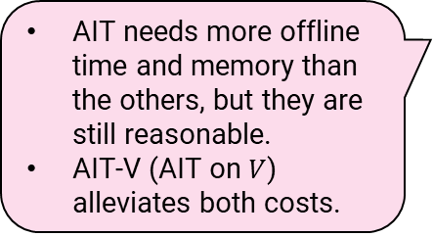
Experiments: Dataset, Pre-processing Time, and Memory Usage
Diverse applications:
Book management
Bitcoin
Vehicles (train & taxi)
AIT needs more offline time and memory than the others, but they are still reasonable.
AIT-V (AIT on $V$) alleviates both costs.
Notes:
We investigated the practical performances of our algorithms.
As for pre-processing time, AIT is the longest but still reasonable.
As for memory usage, AIT needs about 30GB for 100 million intervals, so again it is reasonable.
We see that AIT-V, which maintains virtual intervals, alleviates pre-processing time and memory usage.

Slide 17
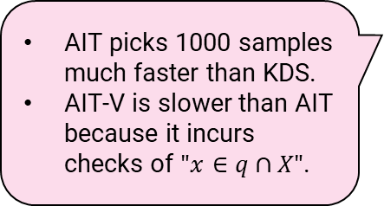
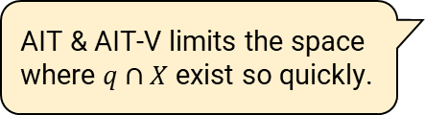
Experiments: Query Processing Time (Decomposed Time)
AIT & AIT-V limits the space where $q∩X$ exist so quickly.
AIT picks 1000 samples much faster than KDS.
AIT-V is slower than AIT because it incurs checks of $"x∈q∩X"$.
Notes:
Next, query processing time.
Our algorithms can identify sample candidate so quickly: at most a few microseconds.
Sampling time has a similar result: AIT needs only 20 to 40 microseconds to pick 1,000 random samples.
The running time of each algorithm is the sum of candidate computation and sampling times.
Then, we see that our algorithms are much faster than the competitors.

Slide 18
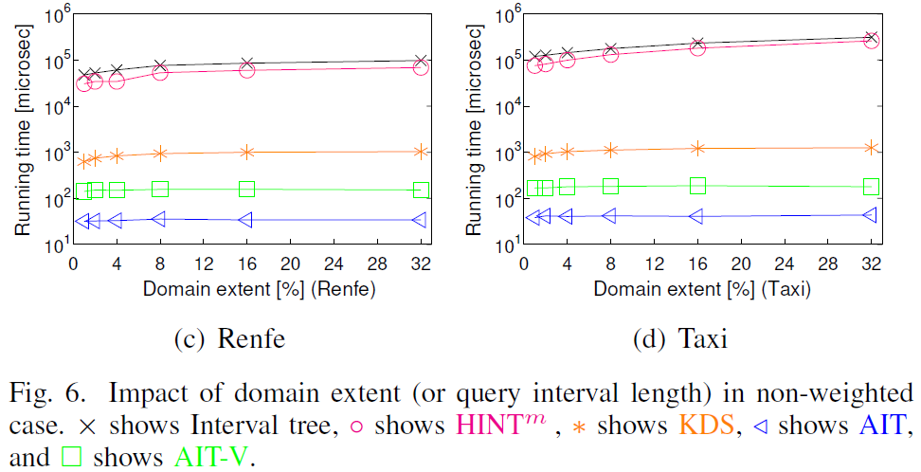
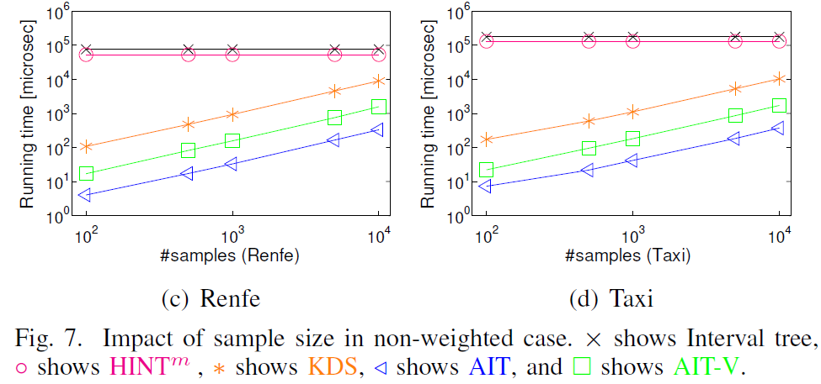
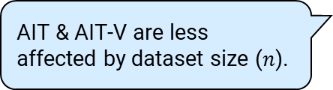
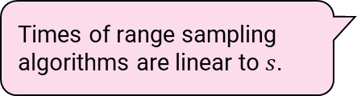
Experiments: Query Processing Time (Impact of Parameters)
AIT & AIT-V are not affected by range size.
AIT & AIT-V are less affected by dataset size ($n$).
Times of range sampling algorithms are linear to $s$.
Notes:
- We studied the impacts of range size, sample size, and dataset size.
- To summarize, our algorithms are always better than the competitors and run according to the theorem.

Slide 19
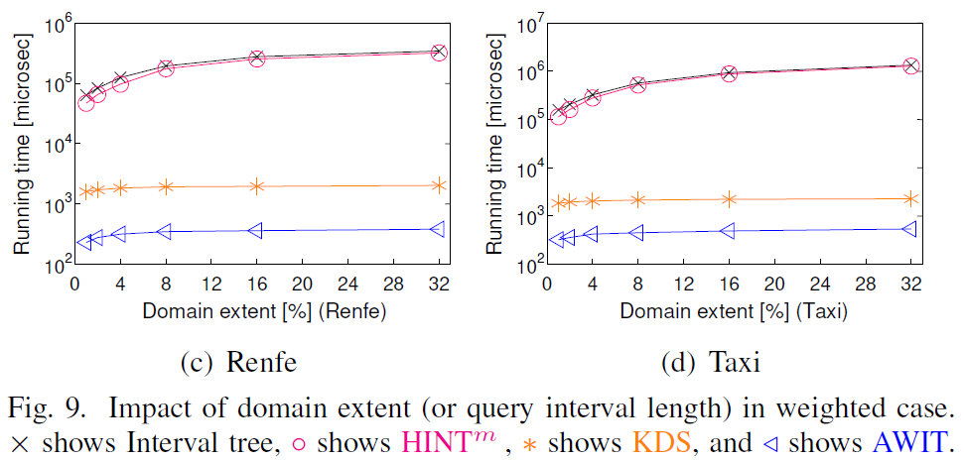
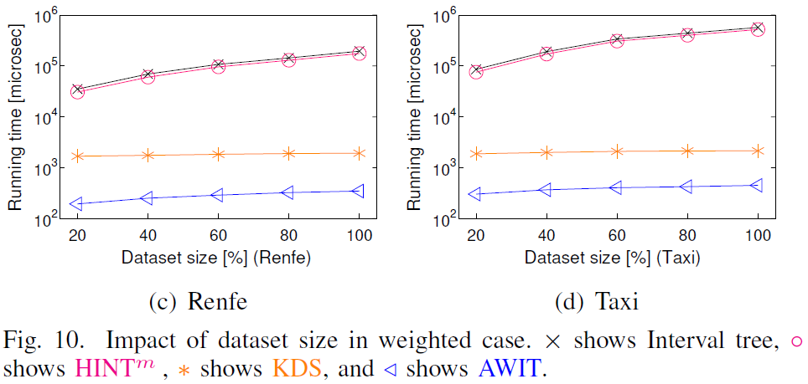
Experiments: Query Processing Time (Weighted Interval Case)
AIT is less affected by range size.
AWIT always outperforms the others.
AWIT has a superior sampling efficiency.
Notes:
- Even when intervals have weights, our algorithm is much better than the competitors.

Slide 20
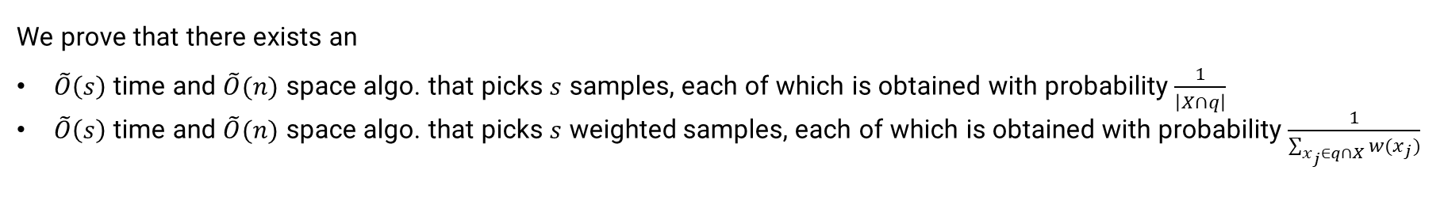
Summary
Problem
Independent range sampling on interval data that returns $s$ intervals, each of which is picked from $q∩X$ uniformly at random
Findings
We prove that there exists an
$\tilde{O}\left(s\right)$ time and $\tilde{O}(n)$ space algo. that picks $s$ samples, each of which is obtained with probability $\frac{1}{\left|X∩q\right|}$
$\tilde{O}\left(s\right)$ time and $\tilde{O}(n)$ space algo. that picks $s$ weighted samples, each of which is obtained with probability $\frac{1}{\sum_{x_{j}∈q∩X}{w(x_{j})}}$
Experiments
We demonstrate that our algorithms are much faster than a baseline algorithm.
Our implementation is available at https://github.com/amgt-d1/IRS-interval.
Notes:
To conclude, we addressed the problem of independent range sampling on intervals data.
We proved that there exists an efficient algorithm that correctly solves this problem.
Our experiments confirm that this theory works practically.
That’s all, thank you.

Slide 21
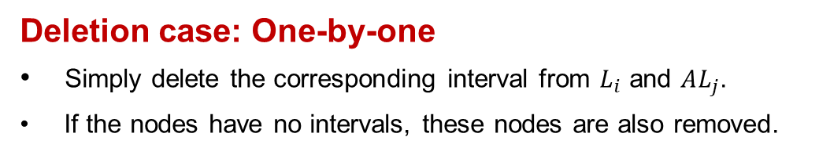
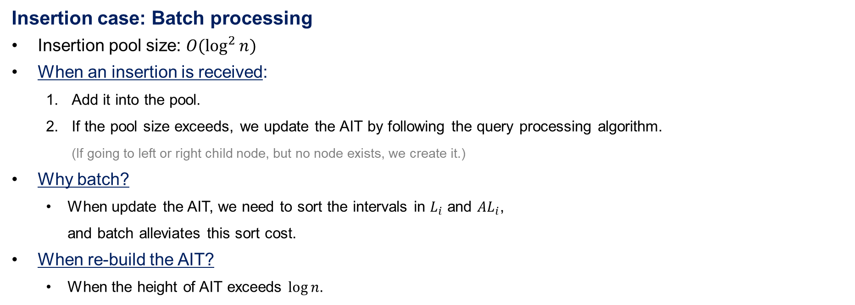

How to Deal With Updates?
Insertion case: Batch processing
Insertion pool size: $O(\log^{2}{n})$
When an insertion is received:
Add it into the pool.
If the pool size exceeds, we update the AIT by following the query processing algorithm. (If going to left or right child node, but no node exists, we create it.)
Why batch?
When update the AIT, we need to sort the intervals in $L_{i}$ and $AL_{i}$, and batch alleviates this sort cost.
When re-build the AIT?
When the height of AIT exceeds $\log{n}$.
$$u_{root}$$
$$u_{1}$$
$$u_{2}$$
$$u_{3}$$
$$u_{4}$$
$$u_{5}$$
$$u_{6}$$
$$c_{3}$$
$$c_{1}$$
$$c_{4}$$
$$c_{root}$$
$$c_{5}$$
$$c_{2}$$
$$c_{6}$$
$$x_{1}$$
$$x_{2}$$
$$x_{3}$$
$$x_{5}$$
Deletion case: One-by-one
Simply delete the corresponding interval from $L_{i}$ and $AL_{j}$.
If the nodes have no intervals, these nodes are also removed.
$$x_{4}$$
$$x_{6}$$
$$x_{7}$$
$$x_{8}$$
$$x_{9}$$
$$x_{10}$$
$$x_{11}$$
New interval (added to $L_{root}$)

