Slide 1


FAST DENSITY-PEAKS CLUSTERING: MULTICORE-BASED PARALLELIZATION APPROACH
Daichi Amagata^{1,2} and Takahiro Hara¹
1. Osaka University
2. JST PRESTO
Notes:
My name is Daichi Amagata, assistance professor at Osaka University, Japan.
I’d like to talk about density-peaks clustering.

Slide 2
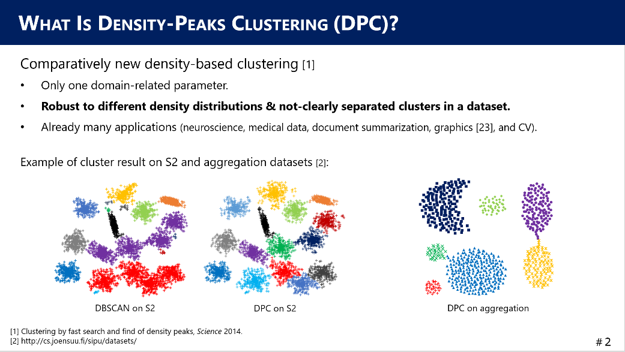
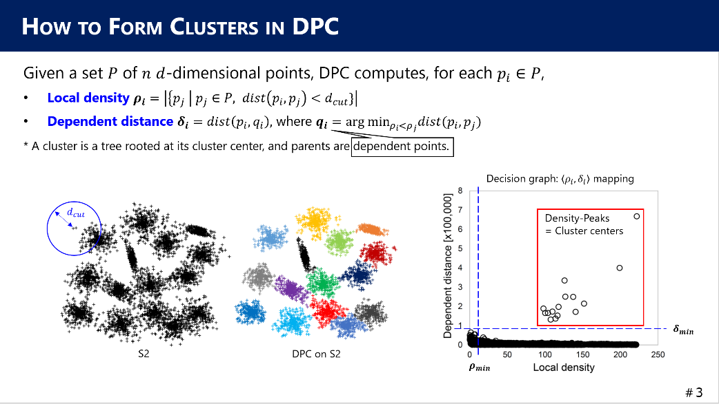
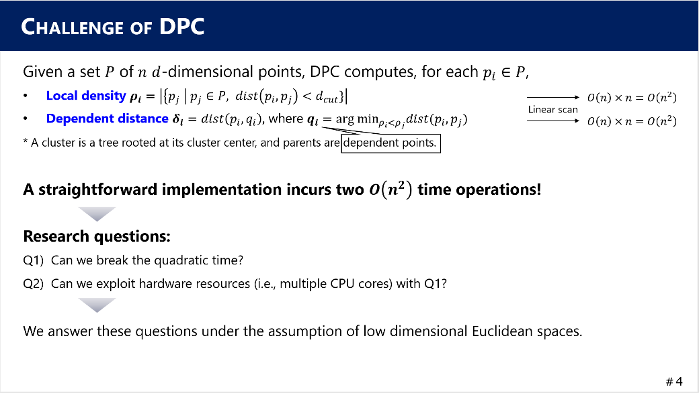
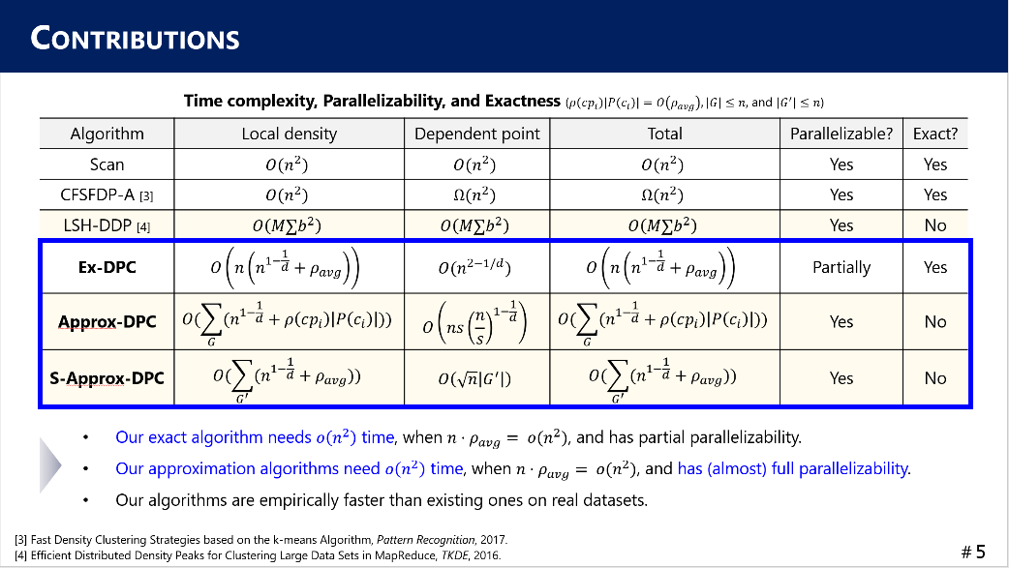
ROADMAP
Background:
What is Density-Peaks Clustering?
How to form clusters
Challenge & Our contributions
Our techniques:
Ex-DPC
Approx-DPC
S-Approx-DPC
Experimental results:
Effectiveness (accuracy)
Efficiency
Conclusion
Notes:
First, I introduce the background of this study.

Slide 3
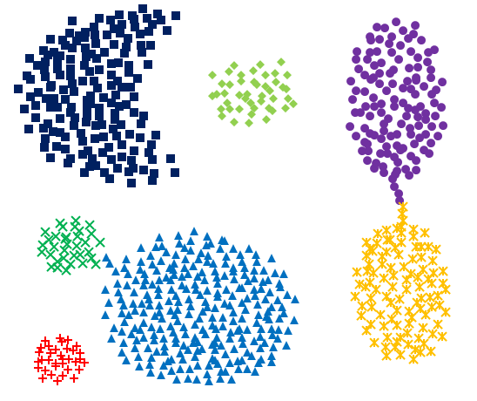
WHAT IS DENSITY-PEAKS CLUSTERING (DPC)?
Comparatively new density-based clustering [1]
Only one domain-related parameter.
Robust to different density distributions & not-clearly separated clusters in a dataset.
Already many applications (neuroscience, medical data, document summarization, graphics, and CV).
Example of cluster result on S2 and aggregation datasets [2]:
DBSCAN on S2
DPC on S2
DPC on aggregation
[1] Clustering by fast search and find of density peaks, Science 2014.
[2] http://cs.joensuu.fi/sipu/datasets/
Notes:
Let’s start with a question: what is density-peaks clustering, DPC. This is one of density-based clustering.
Essentially, it needs only one domain-specific parameter, but it is robust to different density distributions and not-clearly separated clusters in a dataset.
Thanks to this nice advantage, DPC has applications in many domains such as neuroscience, graphics, and computer vision.
Let’s compare the clustering results of DBSCAN and DPC on dataset S2 which has 15 Gaussian clusters.
You can see that the clusters are not clearly separated. So, DBSCAN does not function well. On the other hand, DPC provides an intuitive result. This is one merit of DPC.
Even if a border between clusters is ambiguous, DPC can successfully deal with it, as shown in the right figure.
Now we have a question: why DPC can form such clusters.

Slide 4
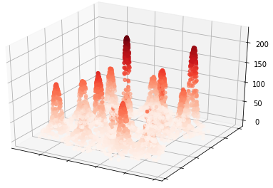


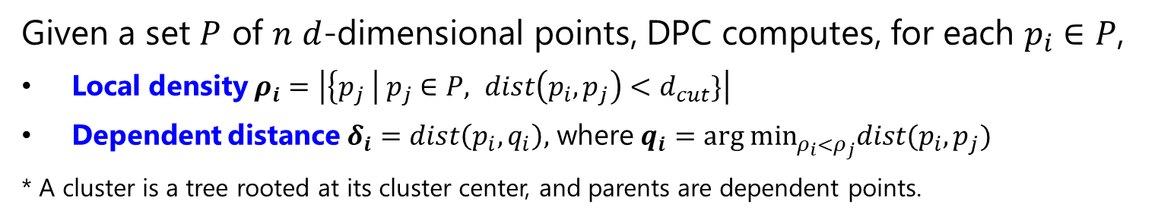

HOW TO FORM CLUSTERS IN DPC
Given a set $P$ of $n$ $d$-dimensional points, DPC computes, for each $p_{i}∈P$,
Local density $ρ_{i}=\left|\left\{p_{j} \right| p_{j}∈P, dist\left(p_{i},p_{j}\right)<d_{cut}\}\right|$
Dependent distance $δ_{i}=dist\left(p_{i},q_{i}\right),$ where $q_{i}=arg min_{ρ_{i}<ρ_{j}}dist(p_{i},p_{j})$
* A cluster is a tree rooted at its cluster center, and parents are dependent points.
Decision graph: $\left\langle ρ_{i},δ_{i}\right\rangle$ mapping
$$d_{cut}$$
Density-Peaks = Cluster centers
$$δ_{min}$$
S2
DPC on S2
$$ρ_{min}$$
Notes:
Let’s see the definition of DPC. Here, assume that we have n d-dimensional points. DPC forms clusters based on two criteria, local density and dependent distance.
The local density of a point p_i is the number of other points with distance less than d_cut. d_cut is a domain-specific distance threshold.
The dependent point of p_i is the nearest neighbor point among the points with higher local density than its local density, \rho_i.
The dependent distance of p_i is the distance between p_i and its dependent point.
The pair of local density and dependent distance can be viewed in a 2-dimensional space. It is called a decision graph, the right figure. From this figure, we see 15 points with large dependent distance.
If a point has large dependent distance, it means that there are no points with larger local density in that local space, so this point is density-peak.
Density-peaks are regarded as cluster centers. They can be decided by setting \delta_min. Besides, we can remove noises that have small local density by setting \rho_min.
Then, a cluster in DPC is a tree structure rooted at its cluster center and the parent of each point is its dependent point.

Slide 5
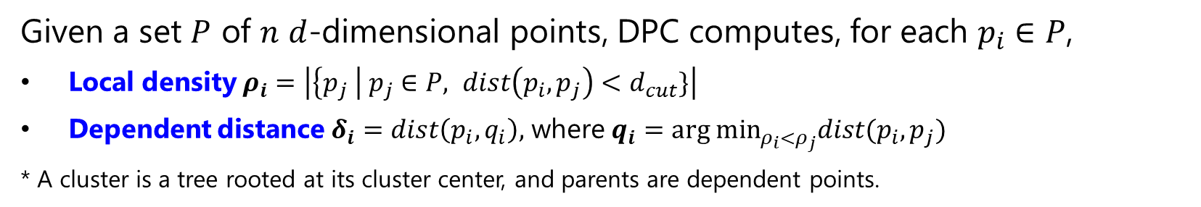


CHALLENGE OF DPC
Given a set $P$ of $n$ $d$-dimensional points, DPC computes, for each $p_{i}∈P$,
Local density $ρ_{i}=\left|\left\{p_{j} \right| p_{j}∈P, dist\left(p_{i},p_{j}\right)<d_{cut}\}\right|$
Dependent distance $δ_{i}=dist\left(p_{i},q_{i}\right),$ where $q_{i}=arg min_{ρ_{i}<ρ_{j}}dist(p_{i},p_{j})$
* A cluster is a tree rooted at its cluster center, and parents are dependent points.
$$O\left(n\right)×n=O\left(n^{2}\right)$$
Linear scan
$$O\left(n\right)×n=O\left(n^{2}\right)$$
A straightforward implementation incurs two $O\left(n^{2}\right)$ time operations!
Research questions:
Q1) Can we break the quadratic time?
Q2) Can we exploit hardware resources (i.e., multiple CPU cores) with Q1?
We answer these questions under the assumption of low dimensional Euclidean spaces.
Notes:
The cluster definition of DPC is simple and intuitive, but it has a computational challenge.
A straightforward implementation of DPC is to compute the local density and dependent distance of each point by linear scan.
This needs quadratic time to the data size, so does not scale to large datasets.
Now we have two questions. Can we break the quadratic time? And can we exploit CPU cores to reduce practical computation time while breaking the quadratic time?
In this study, we answer these questions under the assumption of low dimensional Euclidean spaces.

Slide 6
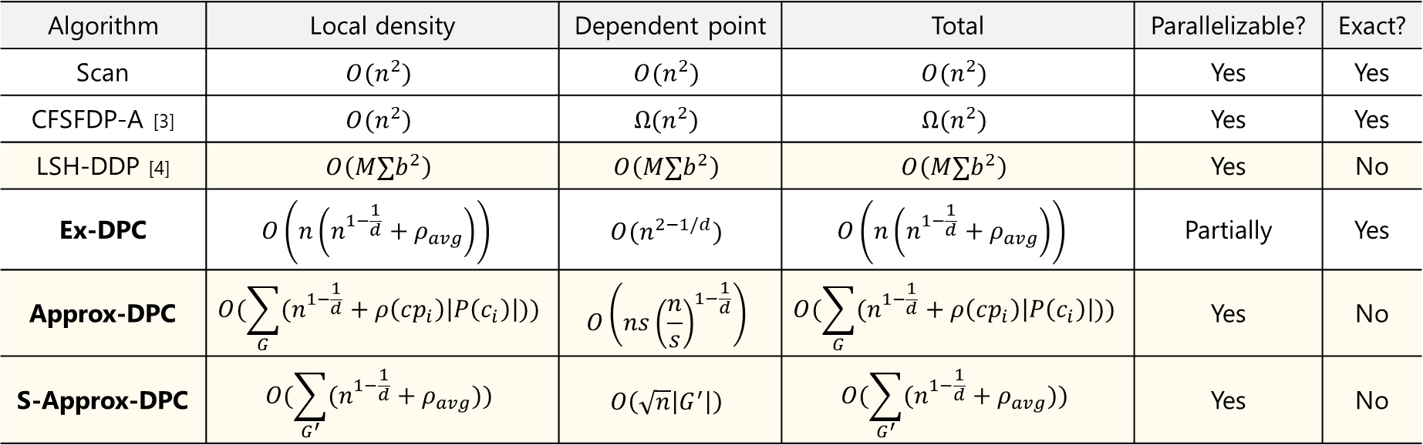

CONTRIBUTIONS
Time complexity, Parallelizability, and Exactness ($ρ\left(cp_{i}\right)\left|P\left(c_{i}\right)\right|=O\left(ρ_{avg}\right),\left|G\right|≤n,$ and $\left|G^{′}\right|≤n$)
Algorithm | Local density | Dependent point | Total | Parallelizable? | Exact?
Scan | $$O(n^{2})$$ | $$O(n^{2})$$ | $$O(n^{2})$$ | Yes | Yes
CFSFDP-A [3] | $$O(n^{2})$$ | $$Ω(n^{2})$$ | $$Ω(n^{2})$$ | Yes | Yes
LSH-DDP [4] | $$O\left(M∑b^{2}\right)$$ | $$O\left(M∑b^{2}\right)$$ | $$O\left(M∑b^{2}\right)$$ | Yes | No
Ex-DPC | $$O\left(n\left(n^{1−\frac{1}{d}}+ρ_{avg}\right)\right)$$ | $$O(n^{2−1/d})$$ | $$O\left(n\left(n^{1−\frac{1}{d}}+ρ_{avg}\right)\right)$$ | Partially | Yes
Approx-DPC | $$O(\sum_{G}{(n^{1−\frac{1}{d}}+ρ\left(cp_{i}\right)\left|P\left(c_{i}\right)\right|))}$$ | $$O\left(ns{\left(\frac{n}{s}\right)}^{1−\frac{1}{d}}\right)$$ | $$O(\sum_{G}{(n^{1−\frac{1}{d}}+ρ\left(cp_{i}\right)\left|P\left(c_{i}\right)\right|))}$$ | Yes | No
S-Approx-DPC | $$O(\sum_{G^{′}}{(n^{1−\frac{1}{d}}+ρ_{avg}))}$$ | $$O\left(\sqrt{n}\left|G^{′}\right|\right)$$ | $$O(\sum_{G^{′}}{(n^{1−\frac{1}{d}}+ρ_{avg}))}$$ | Yes | No
Our exact algorithm needs $o\left(n^{2}\right)$ time, when $n⋅ρ_{avg}= o(n^{2})$, and has partial parallelizability.
Our approximation algorithms need $o\left(n^{2}\right)$ time, when $n⋅ρ_{avg}= o(n^{2})$, and have (almost) full parallelizability.
Our algorithms are empirically faster than existing ones on real datasets.
[3] Fast Density Clustering Strategies based on the k-means Algorithm, Pattern Recognition, 2017.
[4] Efficient Distributed Density Peaks for Clustering Large Data Sets in MapReduce, TKDE, 2016.
Notes:
This is a summary of our result. We propose one exact algorithm and two approximation algorithms.
They need sub-quadratic time to the data size.
Our exact algorithm has partial parallelizability, and our approximation algorithms have almost full parallelizability.

Slide 7
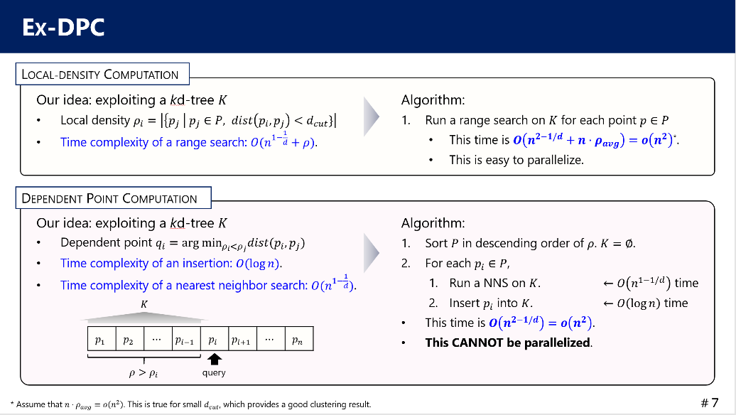
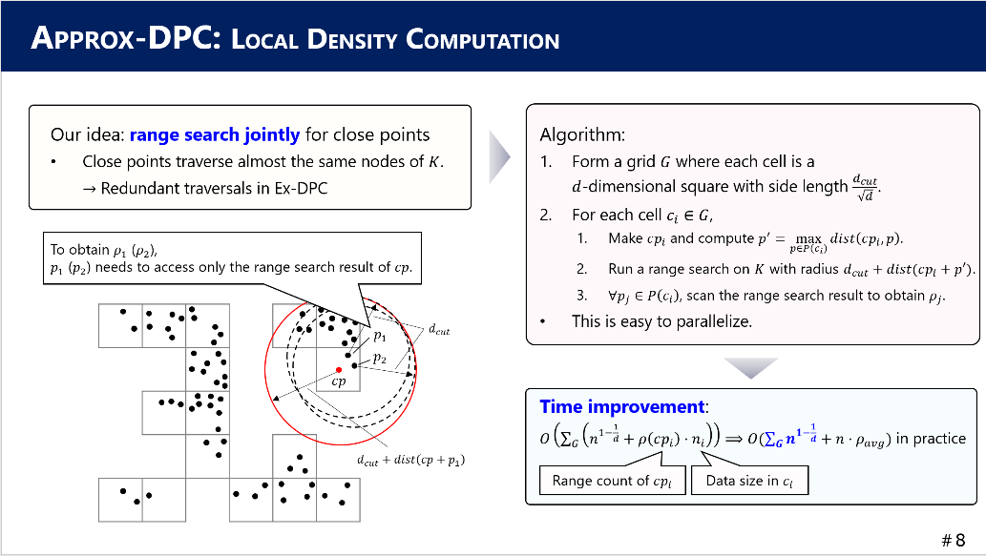
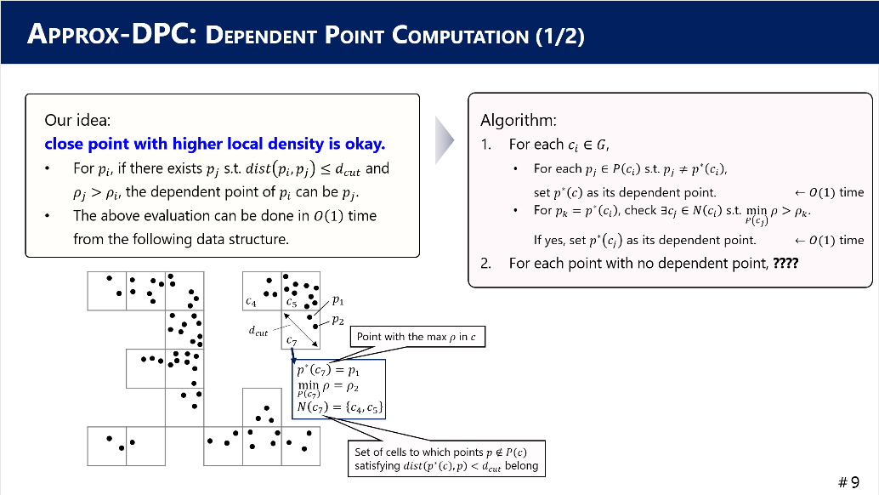
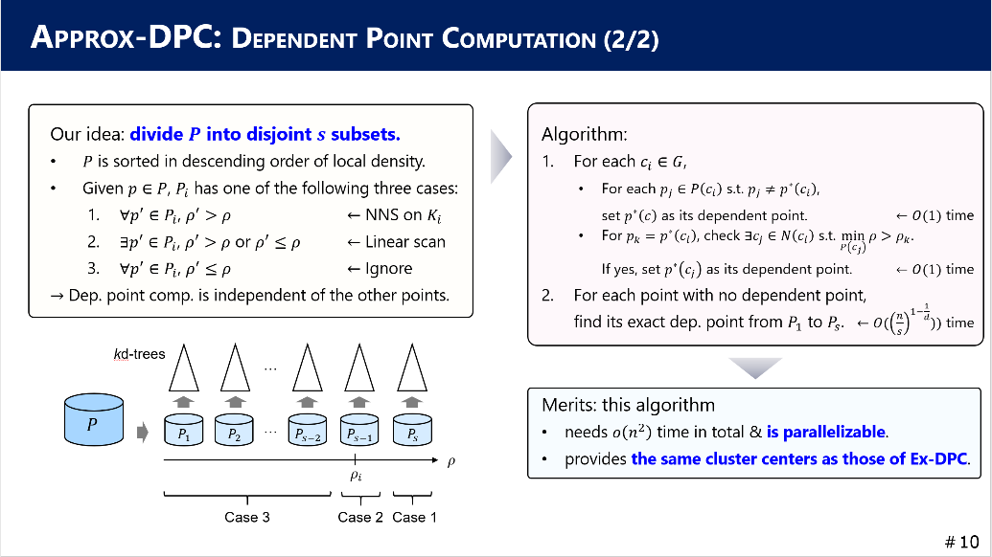
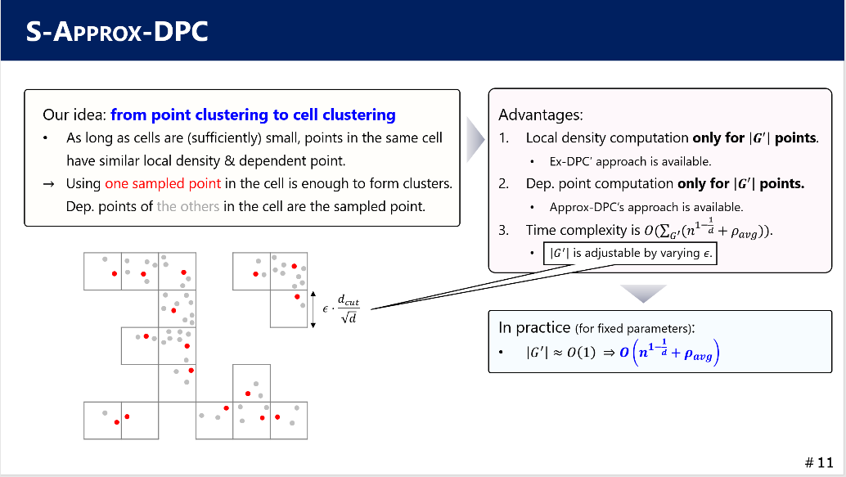
ROADMAP
Background:
What is Density-Peaks Clustering?
How to form clusters
Our contributions
Our techniques:
Ex-DPC
Approx-DPC
S-Approx-DPC
Experimental results:
Effectiveness (accuracy)
Efficiency
Conclusion
Notes:
- Let’s turn our attention into the techniques that achieve DPC in sub-quadratic time.

Slide 8

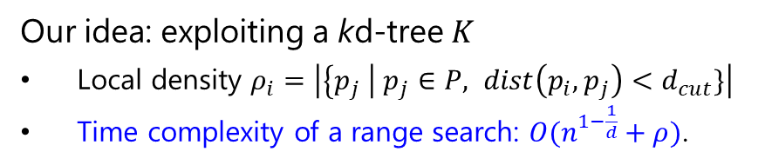


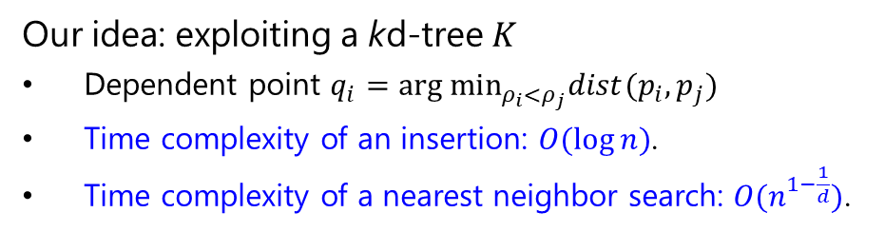
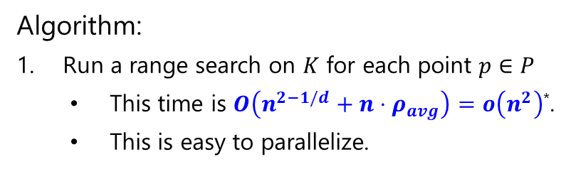

EX-DPC
LOCAL-DENSITY COMPUTATION
Our idea: exploiting a kd-tree $K$
Local density $ρ_{i}=\left|\left\{p_{j} \right| p_{j}∈P, dist\left(p_{i},p_{j}\right)<d_{cut}\}\right|$
Time complexity of a range search: $O(n^{1−\frac{1}{d}}+ρ)$.
Algorithm:
Run a range search on $K$ for each point $p∈P$
This time is $O\left(n^{2−1/d}+n⋅ρ_{avg}\right)=o\left(n^{2}\right)$*.
This is easy to parallelize.
DEPENDENT POINT COMPUTATION
Our idea: exploiting a kd-tree $K$
Dependent point $q_{i}=arg min_{ρ_{i}<ρ_{j}}dist(p_{i},p_{j})$
Time complexity of an insertion: $O(\log{n})$.
Time complexity of a nearest neighbor search: $O(n^{1−\frac{1}{d}})$.
Algorithm:
Sort $P$ in descending order of $ρ$. $K=∅$.
For each $p_{i}∈P$,
Run a NNS on $K$. $←O\left(n^{1−1/d}\right)$ time
Insert $p_{i}$ into $K$. $←O\left(\log{n}\right)$ time
This time is $O\left(n^{2−1/d}\right)=o\left(n^{2}\right)$.
This CANNOT be parallelized.
$$K$$
$$p_{1}$$ | $$p_{2}$$ | $$⋯$$ | $$p_{i−1}$$ | $$p_{i}$$ | $$p_{i+1}$$ | $$⋯$$ | $$p_{n}$$
$$ρ>ρ_{i}$$
query
* Assume that $n⋅ρ_{avg}=o\left(n^{2}\right)$. This is true for small $d_{cut}$, which provides a good clustering result.
Notes:
I first introduce our exact algorithm, Ex-DPC. Our idea is simple. Exploiting a kd-tree.
Let’s see the definition of local density, again. It corresponds to the size of range search where query is each point and the radius is d_cut.
We use a property of kd-tree. A range search on a kd-tree needs sublinear time to the data size.
Then our algorithm is super-simple, run a range search on the kd-tree for each point. This time is sub-quadratic. Clearly, this algorithm is easy to parallelize.
Next, dependent point computation. Dependent point is not simple nearest neighbor, and it has a constraint of local density. How to find it exactly in sub-linear time?
Let’s assume that the dataset is sorted in descending order of local density. In this figure, p_1 has the largest local density and p_n has the smallest.
Now we wanna compute the dependent point of p_i. We know that p_1 to p_i-1 have larger local density than \rho_i, so its dependent point exists in this subset.
If this subset is indexed by a kd-tree, a nearest neighbor search on this kd-tree can find its dependent point in sub-linear time.
After that, if p_i is inserted into the kd-tree, it is ready for computing the dependent point of p_i+1.
This is our algorithm that achieves sub-quadratic time. However, this approach cannot be parallelized, because the kd-tree is updated incrementally.

Slide 9

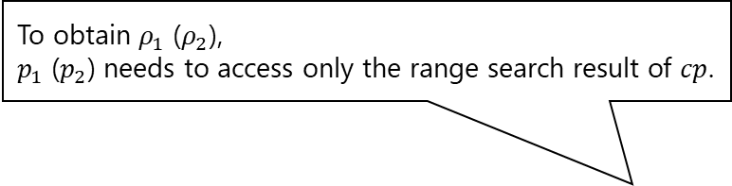
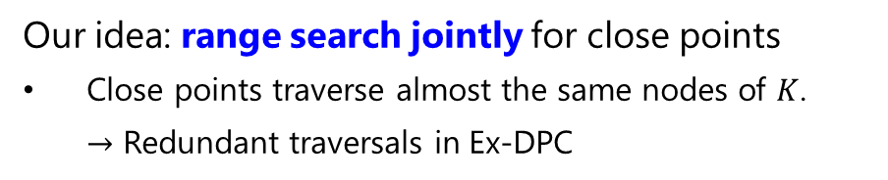





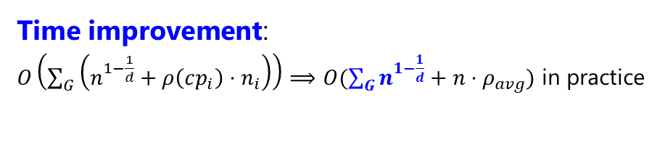


APPROX-DPC: LOCAL DENSITY COMPUTATION
Our idea: range search jointly for close points
Close points traverse almost the same nodes of $K$. $→$ Redundant traversals in Ex-DPC
Algorithm:
Form a grid $G$ where each cell is a $d$-dimensional square with side length $\frac{d_{cut}}{\sqrt{d}}$.
For each cell $c_{i}∈G$,
Make $cp_{i}$ and compute $p^{′}=\max_{p∈P\left(c_{i}\right)}{dist\left(cp_{i},p\right)}$.
Run a range search on $K$ with radius $d_{cut}+dist(cp_{i}+p′)$.
$∀p_{j}∈P\left(c_{i}\right)$, scan the range search result to obtain $ρ_{j}$.
This is easy to parallelize.
To obtain $ρ_{1}$ ($ρ_{2}$), $p_{1}$ ($p_{2}$) needs to access only the range search result of $cp$.
$$p_{1}$$
$$d_{cut}$$
$$p_{2}$$
$$cp$$
Time improvement:
$O\left(\sum_{G}{\left(n^{1−\frac{1}{d}}+ρ\left(cp_{i}\right)⋅n_{i}\right)}\right)⟹O(\sum_{G}{n^{1−\frac{1}{d}}}+n⋅ρ_{avg})$ in practice
$$d_{cut}+dist\left(cp+p_{1}\right)$$
Range count of $cp_{i}$
Data size in $c_{i}$
Notes:
Next, our first approximation algorithm, Approx-DPC. Approx-DPC computes the local density of each point exactly but in an optimized way.
The idea is to run range search jointly for close points. It is easy to imagine that Ex-DPC traverses almost the same nodes of the kd-tree for close points, and it is redundant.
Let’s see this figure, and assume the range search of the red circle. The circle centered at p_1 or p_2 is covered by the red circle.
So, to obtain the local density of p_1 and p_2, we need to access only the range search result of the red circle.
This grid structure can reduce the number of range searches on kd-tree. It is no more n times.
The theoretical time of this approach is sensitive to the output size of the range search with the extended radius.
But, if we put a reasonable assumption, this approach improves the time of local density computation against that of Ex-DPC.

Slide 10




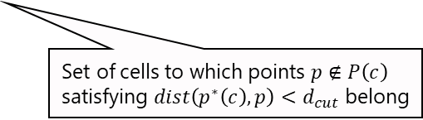





APPROX-DPC: DEPENDENT POINT COMPUTATION (1/2)
Our idea: close point with higher local density is okay.
For $p_{i}$, if there exists $p_{j}$ s.t. $dist\left(p_{i},p_{j}\right)≤d_{cut}$ and $ρ_{j}>ρ_{i}$, the dependent point of $p_{i}$ can be $p_{j}$.
The above evaluation can be done in $O\left(1\right)$ time from the following data structure.
Algorithm:
For each $c_{i}∈G$,
For each $p_{j}∈P\left(c_{i}\right)$ s.t. $p_{j}≠p^{∗}\left(c_{i}\right)$, set $p^{∗}\left(c\right)$ as its dependent point.
For ${p_{k}=p}^{∗}\left(c_{i}\right)$, check $∃c_{j}∈N\left(c_{i}\right)$ s.t. $\min_{P\left(c_{j}\right)}{ρ}>ρ_{k}$. If yes, set $p^{∗}\left(c_{j}\right)$ as its dependent point.
For each point with no dependent point, ????
$←O(1)$ time
$←O(1)$ time
$$c_{4}$$
$$c_{5}$$
$$p_{1}$$
$$p_{2}$$
$$d_{cut}$$
$$c_{7}$$
Point with the max $ρ$ in $c$
$$p^{∗}\left(c_{7}\right)=p_{1}$$
$$\min_{P\left(c_{7}\right)}{ρ}=ρ_{2}$$
$$N\left(c_{7}\right)=\left\{c_{4},c_{5}\right\}$$
Set of cells to which points $p∉P\left(c\right)$ satisfying $dist\left(p^{∗}\left(c\right),p\right)<d_{cut}$ belong
Notes:
Recall that Ex-DPC cannot parallelize its dependent point computation. Our challenge here is how to parallelize it while keeping sub-quadratic time.
Our first idea here is that, for each point p_i, if it has a close point with higher local density than \rho_i, it can be its dependent point even if it is not the nearest neighbor.
The close points are defined based on d_cut. What does this idea bring? For many points, their approximate dependent points can be obtained in constant time.
Actually, this data structure maintains the point p* with the maximum local density in each cell. Then, approximate dependent points of the other points in the cell is p*.
For instance, approximate dependent point of p_2 is p_1, and it needs a constant time.
Moreover, each cell maintains the minimum local density in this cell and a set of cells to which points not in this cell satisfying distance less than d_cut belong.
For p*, if there exists a cell whose minimum local density is higher than the local density of p*, its dependent point can be obtained in a constant time.
For instance, the minimum local density in c_5 is higher than \rho_1, approximate dependent point of p_1 is p* of c_5.
We now have a new question. For points with no dependent point from these operations, what we have to do? This is the remaining task.

Slide 11












APPROX-DPC: DEPENDENT POINT COMPUTATION (2/2)
Our idea: divide $P$ into disjoint $s$ subsets.
$P$ is sorted in descending order of local density.
Given $p∈P$, $P_{i}$ has one of the following three cases:
$∀p^{′}∈P_{i}$, $ρ^{′}>ρ$ $←$ NNS on $K_{i}$
$∃p^{′}∈P_{i}$, $ρ^{′}>ρ$ or $ρ^{′}≤ρ$ $←$ Linear scan
$∀p^{′}∈P_{i}$, $ρ^{′}≤ρ$ $←$ Ignore
$→$ Dep. point comp. is independent of the other points.
Algorithm:
For each $c_{i}∈G$,
For each $p_{j}∈P\left(c_{i}\right)$ s.t. $p_{j}≠p^{∗}\left(c_{i}\right)$, set $p^{∗}\left(c\right)$ as its dependent point.
For ${p_{k}=p}^{∗}\left(c_{i}\right)$, check $∃c_{j}∈N\left(c_{i}\right)$ s.t. $\min_{P\left(c_{j}\right)}{ρ}>ρ_{k}$. If yes, set $p^{∗}\left(c_{j}\right)$ as its dependent point.
For each point with no dependent point, find its exact dep. point from $P_{1}$ to $P_{s}$.
$←O(1)$ time
$←O(1)$ time
$←O({\left(\frac{n}{s}\right)}^{1−\frac{1}{d}}))$ time
kd-trees
…
Merits: this algorithm
needs $o\left(n^{2}\right)$ time in total & is parallelizable.
provides the same cluster centers as those of Ex-DPC.
$$P$$
…
$$P_{1}$$
$$P_{2}$$
$$P_{s−2}$$
$$P_{s−1}$$
$$P_{s}$$
$$ρ$$
$$ρ_{i}$$
Case 3
Case 2
Case 1
Notes:
We solve this question by dividing the sorted point set into disjoint subsets. Given a point, a subset P_i has one of three cases.
Case 1: All points in this subset have higher local density. Case 2: local densities are higher or not higher. Case 3: all smaller.
Now let’s assume that each subset is indexed by a kd-tree, as shown in this figure, and we wanna compute the dependent point of p_i.
The local density of p_i is here. ‘cause the points in the subsets P_1 to P_s-2 have less local densities than \rho_i, we ignore them.
For P_s-1, we find the nearest point with higher local density by a linear scan, ‘cause it falls into the case 2.
For P_s, all points have higher local density, so we run a nearest neighbor search on its kd-tree. By merging the results of case 1 and case 2, we obtain its exact dependent point.
By carefully setting the number of subsets, we have three merits:
This algorithm needs sub-quadratic time, this algorithm is parallelizable ‘case each point is evaluated independently, and this algorithm returns the same cluster centers as those of Ex-DPC. This provides an accurate clustering result.

Slide 12
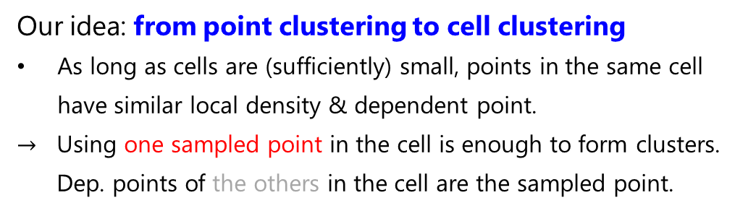
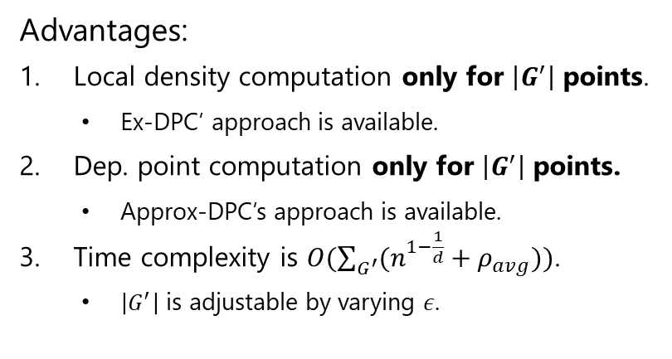
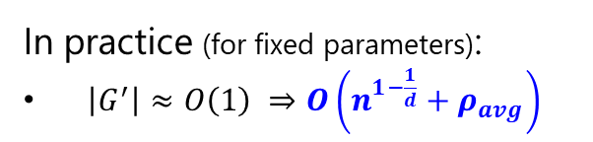

S-APPROX-DPC
Our idea: from point clustering to cell clustering
As long as cells are (sufficiently) small, points in the same cell have similar local density & dependent point.
$→$ Using one sampled point in the cell is enough to form clusters. Dep. points of the others in the cell are the sampled point.
Advantages:
Local density computation only for $\left|G^{′}\right|$ points.
Ex-DPC’ approach is available.
Dep. point computation only for $\left|G^{′}\right|$ points.
Approx-DPC’s approach is available.
Time complexity is $O(\sum_{G^{′}}{(n^{1−\frac{1}{d}}+ρ_{avg}))}$.
$\left|G^{′}\right|$ is adjustable by varying $ε$.
$$ε⋅\frac{d_{cut}}{\sqrt{d}}$$
In practice (for fixed parameters):
$\left|G^{′}\right|≈O\left(1\right) ⇒O\left(n^{1−\frac{1}{d}}+ρ_{avg}\right)$
Notes:
Our second approximation algorithm S-Approx-DPC further improves the efficiency by converting point clustering into cell clustering.
From the grid structure, it is easy to see that points in the same cell have similar local density and dependent points.
From this observation, even if we use only one sampled point in each cell, the clustering result does not change much.
Dependent points of not sampled points are the sampled point in the same cell.
Then we need to compute the local density and dependent point only for sampled points.
For local density, the approach of Ex-DPC is fine. For dependent point, the approach of Approx-DPC is fine.
The time complexity of S-Approx-DPC is related to the grid size and data size. And, the grid size is adjustable by varying a parameter epsilon.
In practice, the data distribution does not change much even if data size becomes larger, meaning that the grid size can be regarded as a constant.
Then, its time complexity can be almost linear to the data size. This is the main result of S-Approx-DPC.

Slide 13
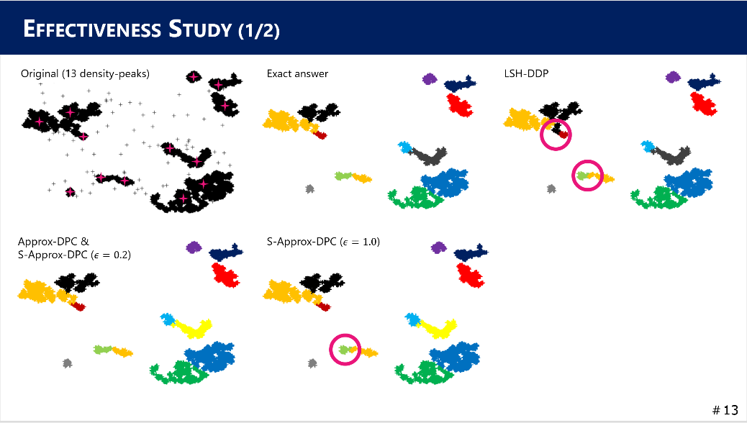
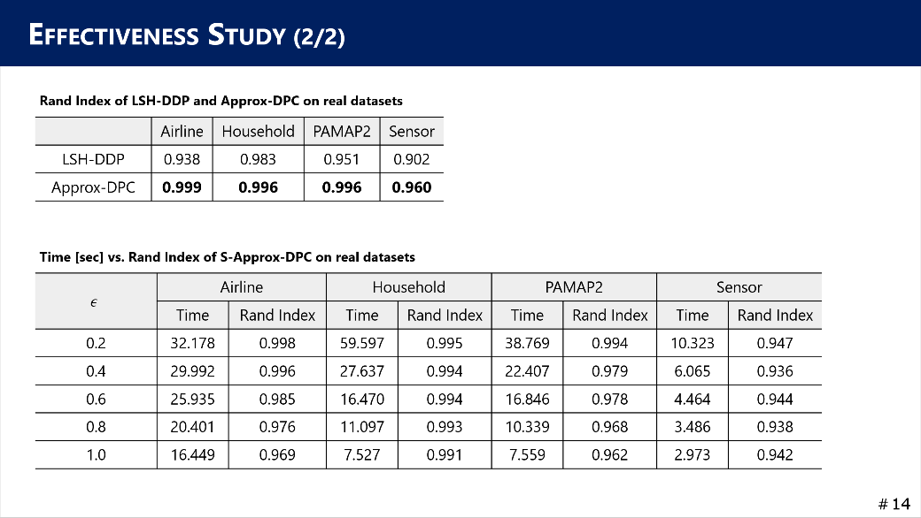
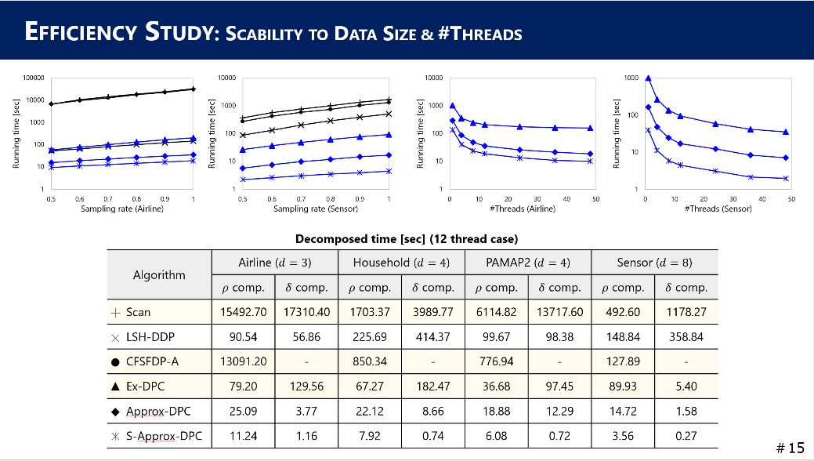
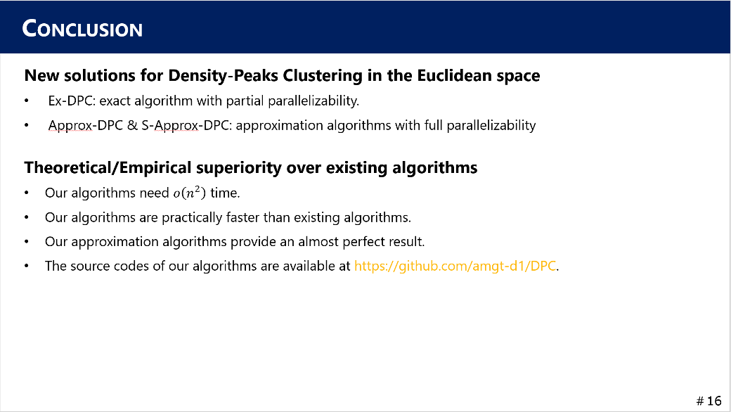
ROADMAP
Background:
What is Density-Peaks Clustering?
How to form clusters
Our contributions
Our techniques:
Ex-DPC
Approx-DPC
S-Approx-DPC
Experimental results:
Effectiveness (accuracy)
Efficiency
Conclusion
Notes:
Last, I introduce our experimental results.

Slide 14


EFFECTIVENESS STUDY (1/2)
Original (13 density-peaks)
Exact answer
LSH-DDP
Approx-DPC & S-Approx-DPC ($ε=0.2$)
S-Approx-DPC ($ε=1.0$)
Notes:
We confirmed the accuracy of approximation algorithms by visualization.
This dataset has 13 density-peaks, so it has 13 clusters. This is the exact answer, and this is the result of state-of-the-art approximation algorithm. This has one big difference and one small difference.
On the other hand, Approx-DPC and S-Approx-DPC with a small epsilon provide the perfect result. Even if we enlarge epsilon, S-Approx-DPC provides only a small error.

Slide 15
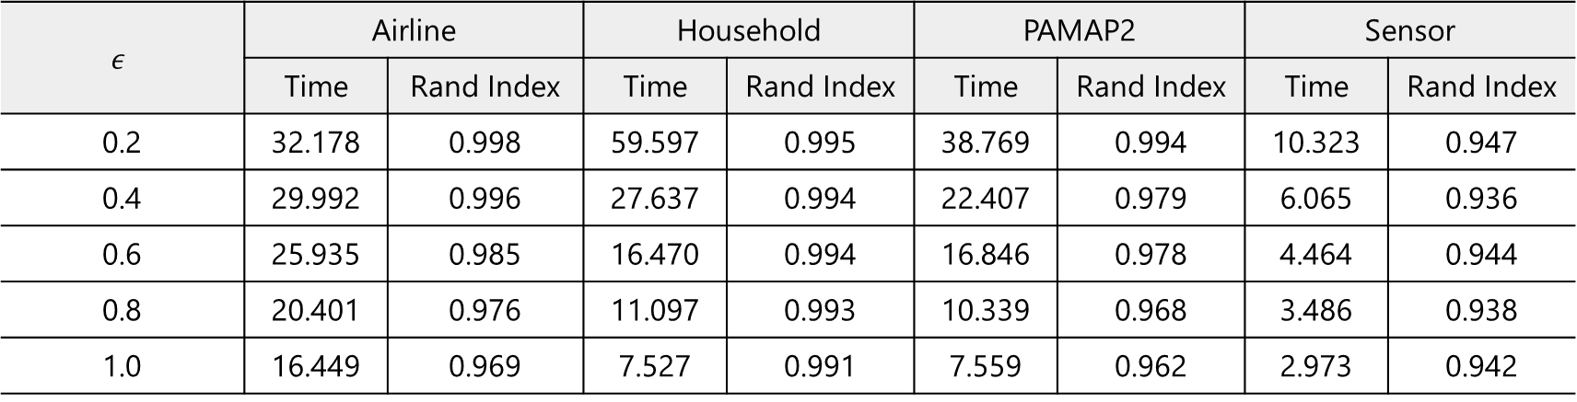
EFFECTIVENESS STUDY (2/2)
Rand Index of LSH-DDP and Approx-DPC on real datasets
 | Airline | Household | PAMAP2 | Sensor
LSH-DDP | 0.938 | 0.983 | 0.951 | 0.902
Approx-DPC | 0.999 | 0.996 | 0.996 | 0.960
Time [sec] vs. Rand Index of S-Approx-DPC on real datasets
$$ε$$ | Airline |  | Household |  | PAMAP2 |  | Sensor
 | Time | Rand Index | Time | Rand Index | Time | Rand Index | Time | Rand Index
0.2 | 32.178 | 0.998 | 59.597 | 0.995 | 38.769 | 0.994 | 10.323 | 0.947
0.4 | 29.992 | 0.996 | 27.637 | 0.994 | 22.407 | 0.979 | 6.065 | 0.936
0.6 | 25.935 | 0.985 | 16.470 | 0.994 | 16.846 | 0.978 | 4.464 | 0.944
0.8 | 20.401 | 0.976 | 11.097 | 0.993 | 10.339 | 0.968 | 3.486 | 0.938
1.0 | 16.449 | 0.969 | 7.527 | 0.991 | 7.559 | 0.962 | 2.973 | 0.942
Notes:
Next, Rand Index on real datasets. Again, Approx-DPC provides almost perfect result.
The bottom table shows the tradeoff between time and accuracy of S-Approx-DPC with different epsilon.
When epsilon is small, it is accurate but long time. When epsilon is large, its Rand Index decreases a bit, but short time.

Slide 16
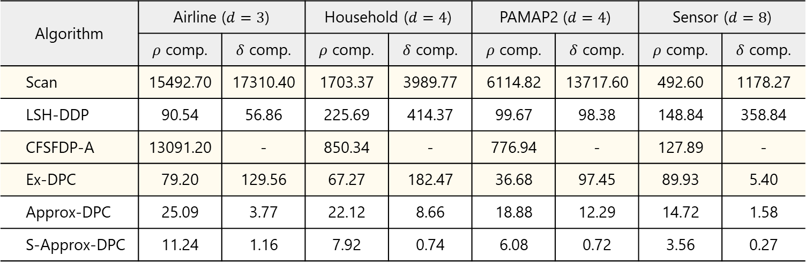
EFFICIENCY STUDY: SCABILITY TO DATA SIZE & #THREADS
Decomposed time [sec] (12 thread case)
Algorithm | Airline ($d=3$) |  | Household ($d=4$) |  | PAMAP2 ($d=4$) |  | Sensor ($d=8$)
 | $ρ$ comp. | $δ$ comp. | $ρ$ comp. | $δ$ comp. | $ρ$ comp. | $δ$ comp. | $ρ$ comp. | $δ$ comp.
Scan | 15492.70 | 17310.40 | 1703.37 | 3989.77 | 6114.82 | 13717.60 | 492.60 | 1178.27
LSH-DDP | 90.54 | 56.86 | 225.69 | 414.37 | 99.67 | 98.38 | 148.84 | 358.84
CFSFDP-A | 13091.20 | - | 850.34 | - | 776.94 | - | 127.89 | -
Ex-DPC | 79.20 | 129.56 | 67.27 | 182.47 | 36.68 | 97.45 | 89.93 | 5.40
Approx-DPC | 25.09 | 3.77 | 22.12 | 8.66 | 18.88 | 12.29 | 14.72 | 1.58
S-Approx-DPC | 11.24 | 1.16 | 7.92 | 0.74 | 6.08 | 0.72 | 3.56 | 0.27
Notes:
Last, running time. The left figures show the scalability to data size. The right figures show the scalability to the number of threads. The blue lines show the results of our algorithms.
Ex-DPC is quite faster than existing exact algorithms Scan and CFSFDP-A. Also, Approx-DPC and S-Approx-DPC are faster than LSH-DDP and scale well to many threads.

Slide 17
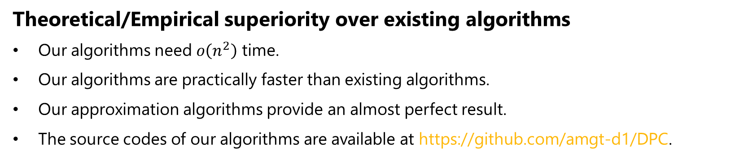
CONCLUSION
New solutions for Density-Peaks Clustering in the Euclidean spaces
Ex-DPC: exact algorithm with partial parallelizability.
Approx-DPC & S-Approx-DPC: approximation algorithms with full parallelizability
Theoretical/Empirical superiority over existing algorithms
Our algorithms need $o\left(n^{2}\right)$ time.
Our algorithms are practically faster than existing algorithms.
Our approximation algorithms provide an almost perfect result.
The source codes of our algorithms are available at https://github.com/amgt-d1/DPC.
Notes:
To conclude, we proposed new solutions for Density-Peaks Clustering in the Euclidean spaces.
We analyzed their performances theoretically and empirically, and they are better than those of existing solutions.

