Slide 1


Fast and Exact Outlier Detection in Metric Spaces: A Proximity Graph-based Approach
Daichi Amagata^{1,2}, Makoto Onizuka¹, Takahiro Hara¹
1. Osaka University
2. JST PRESTO

Slide 2



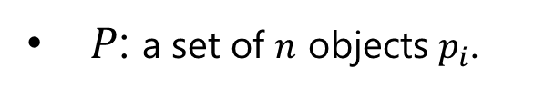
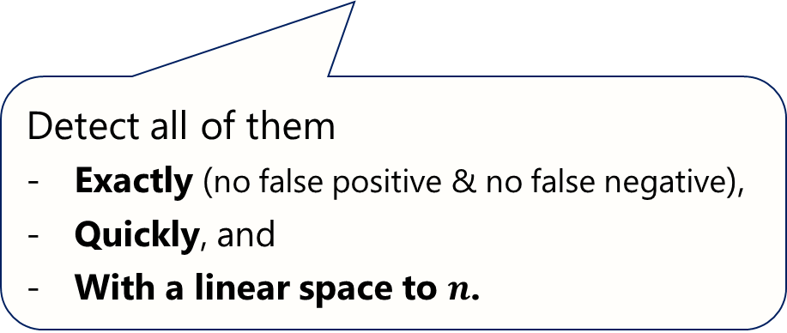
PROPBLEM DEFINITION: DOD (DISTANCE-BASED OUTLIER DETECTION)
$P$: a set of $n$ objects $p_{i}$.
NEIGHBORS OF $p_{i}$: objects $p_{j}∈P s.t. dist\left(p_{i},p_{j}\right)≤r$, where $dist(⋅,⋅)$ is a metric function.
DISTANCE-BASED OUTLIERS: objects with less than $k$ neighrbors.
Detect all of them
Exactly (no false positive & no false negative),
Quickly, and
With a linear space to $n$.
Example) $k=5$ & Euclidean space:
$$r$$
$$r$$

Slide 3


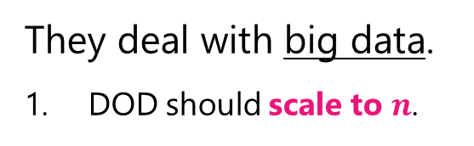
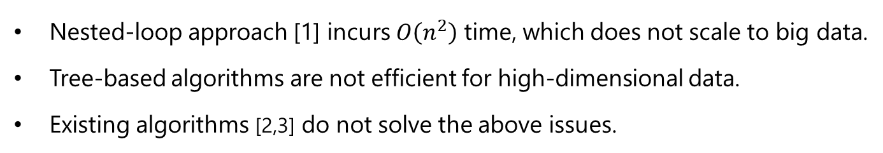
MOTIVATION
Application View
They deal with big data.
DOD should scale to $n$.
Noise Removal
Data cleaning, Machine learning, and etc.
They deal with variety type of data.
DOD should deal with metric spaces.
DOD should be robust to dimensionality.
Abnormal phenomena detection
Security check, Medical diagnosis, and etc.
Technical View
Nested-loop approach [1] incurs $O\left(n^{2}\right)$ time, which does not scale to big data.
Tree-based algorithms are not efficient for high-dimensional data.
Existing algorithms [2,3] do not solve the above issues.
[1] Mining Distance-based Outliers in Near Linear Time with Randomization and a Simple Pruning Rule, In KDD, 2003.
[2] Mining Distance-based Outliers from Large Datasets in any Metric Space, In KDD, 2006.
[3] Dolphin: An Efficient Algorithm for Mining Distance-based Outliers in Very Large Datasets, TKDD, 2009.

Slide 4
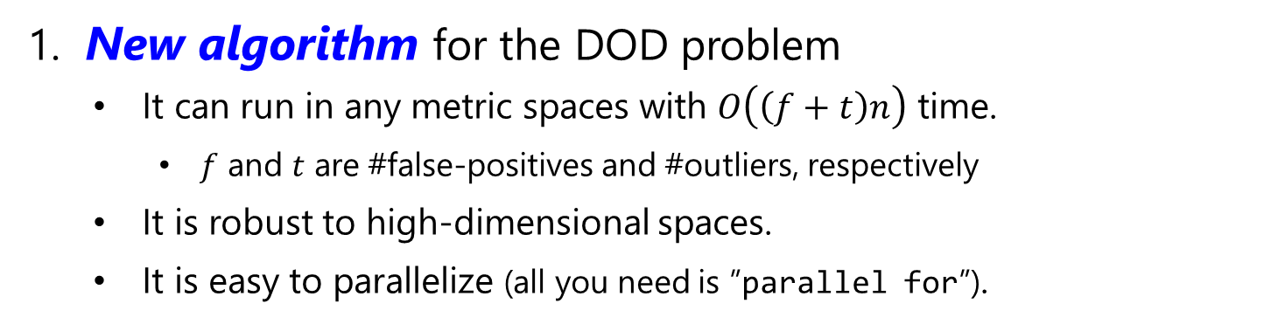
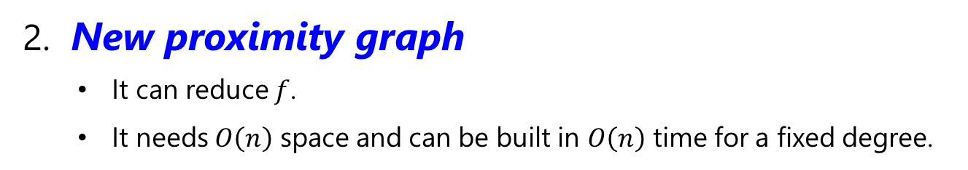
CONTRIBUTION
1. New algorithm for the DOD problem
It can run in any metric spaces with $O\left(\left(f+t\right)n\right)$ time.
$f$ and $t$ are #false-positives and #outliers, respectively
It is robust to high-dimensional spaces.
It is easy to parallelize (all you need is ”parallel for”).
2. New proximity graph
It can reduce $f$.
It needs $O\left(n\right)$ space and can be built in $O\left(n\right)$ time for a fixed degree.
3. Empirical evaluation
7 real datasets with some distance functions.
Our algorithm is quite faster than any others.
Table 1: Running time [sec] (some examples)
Dataset | SNIF [2] | DOLPHIN [3] | Ours
Glove | 1222.43 | 9277.89 | 2.63
HEPMASS | 20360.80 | NA | 38.40

Slide 5
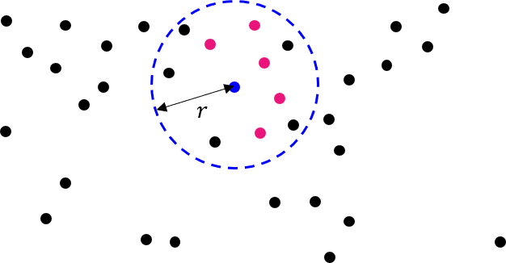

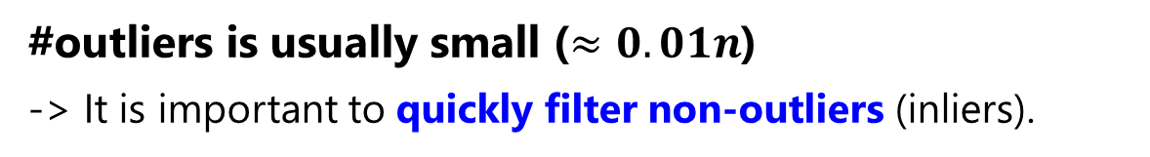

MAIN IDEA 1
Solving the RANGE COUNTING PROBLEM* quickly
*The problem that returns the number of objects $p′$ s.t. $dist\left(q,p^{′}\right)≤r$, where $q$ is a query.
NEIGHBORS OF $p_{i}$: objects $p_{j}∈P s.t. dist\left(p_{i},p_{j}\right)≤r$.
OUTLIERS: objects with less than $k$ neighrbors.
We just need to know whether “$k$ objects in this space?” or not.
#outliers is usually small ($≈0.01n$)
-> It is important to quickly filter non-outliers (inliers).

Slide 6
MAIN IDEA 2
Solving the RANGE COUNTING PROBLEM* quickly
*The problem that returns the number of objects $p′$ s.t. $dist\left(q,p^{′}\right)≤r$, where $q$ is a query.
We want to access only neighbors for each $p∈P$.
We need a data structure that can prune far objects.
A proximity graph is built offline.
Any metric space is available.
Being robust to dimensionality.

Slide 7

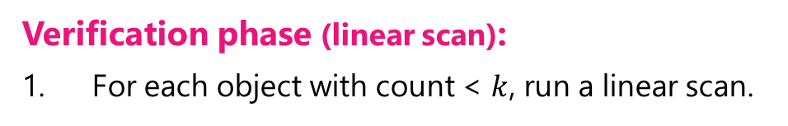
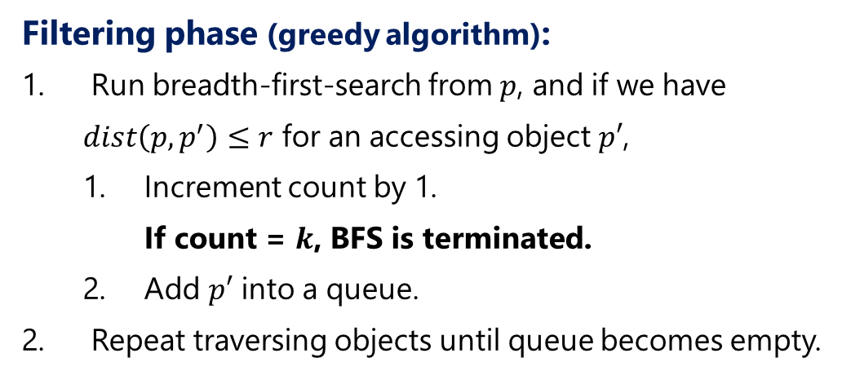
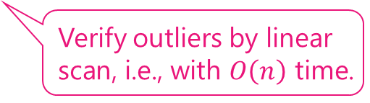
OVERVIEW OF OUR DOD ALGORITHM
Filter-and-Verification framework is employed.
Filter inliers with $O\left(k\right)$ time.
Verify outliers by linear scan, i.e., with $O\left(n\right)$ time.
Filtering phase (greedy algorithm):
Run breadth-first-search from $p$, and if we have $dist\left(p,p^{′}\right)≤r$ for an accessing object $p′$,
Increment count by 1. If count = $k$, BFS is terminated.
Add $p′$ into a queue.
Repeat traversing objects until queue becomes empty.
Each object is evaluated independently.
-> It is parallelizable.
Verification phase (linear scan):
For each object with count < $k$, run a linear scan.

Slide 8
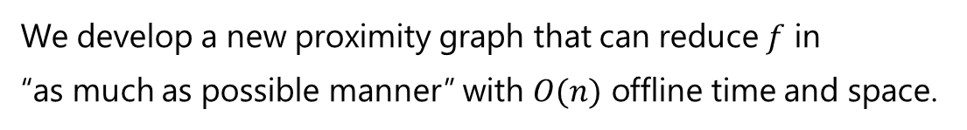
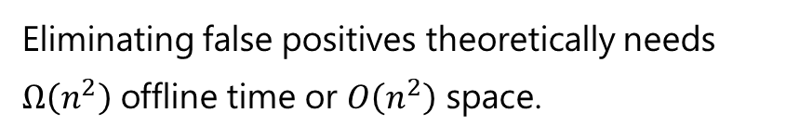
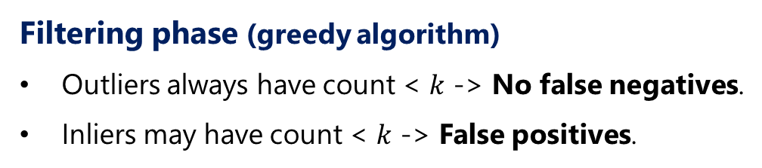
CHALLENGE OF OUR ALGORITHM
Time complexity of our algorithm: $O\left(\left(f+t\right)n\right)$
$f$: #false positives, $t$: #outliers
Verification incurs the main cost.
Filtering phase (greedy algorithm)
Outliers always have count < $k$ -> No false negatives.
Inliers may have count < $k$ -> False positives.
Eliminating false positives theoretically needs $Ω\left(n^{2}\right)$ offline time or $O\left(n^{2}\right)$ space.
There are neighbors that are not reachable from a given object.
We develop a new proximity graph that can reduce $f$ in “as much as possible manner” with $O(n)$ offline time and space.

Slide 9
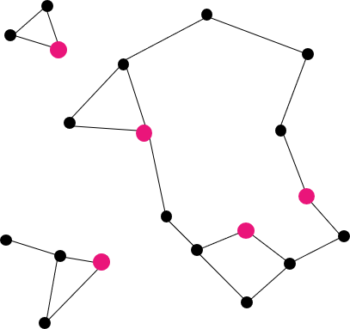
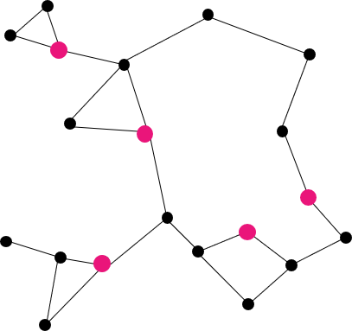

MRPG: METRIC RANDOMIZED PRPXIMITY GRAPH
AKNNG: Approximate KNN Graph (red nodes are pivots.)
SC-AKNNG: Strongly-connected AKNNG
SC-AKNNG + Monotonic paths from random objects
SC-AKNNG + Monotonic paths from random objects + removing unnecessary links
MRPG
Monotonic path: sequence of nodes $p, p_{i},p_{i+1}, …p_{i+j}$ such that $dist\left(p,p_{i}\right)≤dist(p,p_{i+j })$ for $j∈\left[1,m\right]$
MSG: graph with at least a monotonic path between arbitrary two nodes <- $O(n^{2}(K+\log{n}))$ time to build
MRPG: approximation of MSG -> $O\left(nK^{2}\log{K^{3}}\right)=O(n)$ time for a fixed $K$ (= initial degree)

Slide 10

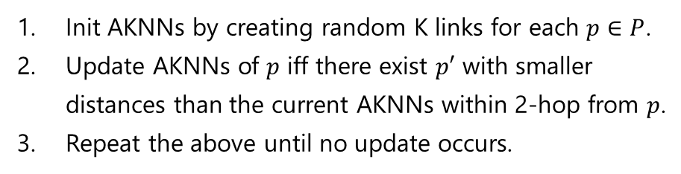
STEP 1: NNDESCENT+
AKNNG: Approximate KNN Graph (red nodes are pivots.)
SC-AKNNG: Strongly-connected AKNNG
SC-AKNNG + Monotonic paths from random objects
SC-AKNNG + Monotonic paths from random objects + removing unnecessary links
-> Creating links between the most similar objects -> high reachability to neighbors
NNDESCENT [WWW’11]
NNDESCENT+: $O(nK^{2}\log{K})$ time AKNNG building
Init AKNNs by creating random K links for each $p∈P$.
Update AKNNs of $p$ iff there exist $p′$ with smaller distances than the current AKNNs within 2-hop from $p$.
Repeat the above until no update occurs.
Init AKNNs by a VP-tree to cluster similar objects.
Do the same as NNDESCENT while ignoring non-update nodes.
After convergence, retrieve the exact K’NN (K’ > K) for nodes with large distances to their AKNNs.

Slide 11


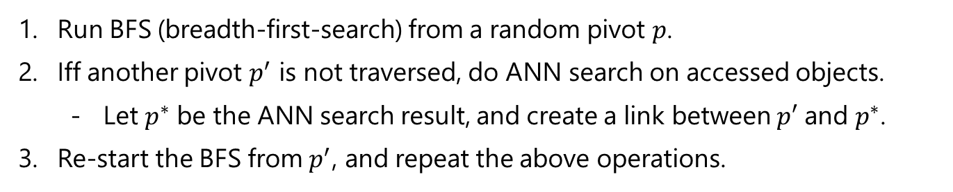



STEP 2: CONNECT-SUBGRAPHS
AKNNG: Approximate KNN Graph (red nodes are pivots.)
SC-AKNNG: Strongly-connected AKNNG
SC-AKNNG + Monotonic paths from random objects
SC-AKNNG + Monotonic paths from random objects + removing unnecessary links
-> Improving connectivity to achieve high reachability to neighbors
$$p$$
Run BFS (breadth-first-search) from a random pivot $p$.
Iff another pivot $p^{′}$ is not traversed, do ANN search on accessed objects.
Let $p^{∗}$ be the ANN search result, and create a link between $p′$ and $p^{∗}$.
Re-start the BFS from $p^{′}$, and repeat the above operations.
<- $O(nK)$ time
<- $O\left(K\right)$ time
$O\left(nK\right)$ time
<- $O\left(1\right)$ time

Slide 12


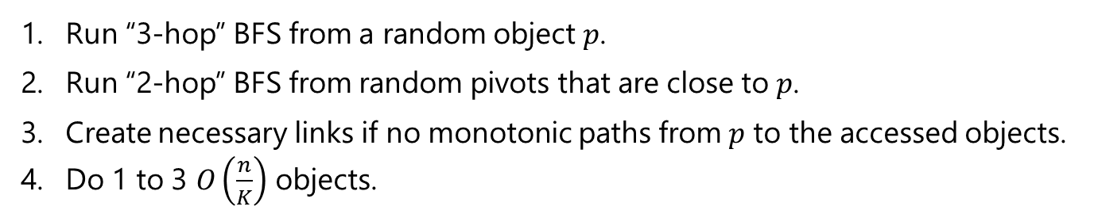


STEP 3: REMOVE-DETOURS
AKNNG: Approximate KNN Graph (red nodes are pivots.)
SC-AKNNG: Strongly-connected AKNNG
SC-AKNNG + Monotonic paths from random objects
SC-AKNNG + Monotonic paths from random objects + removing unnecessary links
-> Improving high reachability to neighbors
Run “3-hop” BFS from a random object $p$.
Run “2-hop” BFS from random pivots that are close to $p$.
Create necessary links if no monotonic paths from $p$ to the accessed objects.
Do 1 to 3 $O\left(\frac{n}{K}\right)$ objects.
<- $O\left(K^{3}\log{K^{3}}\right)×O(n/K)$ time
<- $O\left(K^{2}\log{K^{2}}\right)×O\left(K\right)$ time
<- $O\left(nK\right)$ time
$O\left(nK^{2}\log{K^{3}}\right)$ time

Slide 13
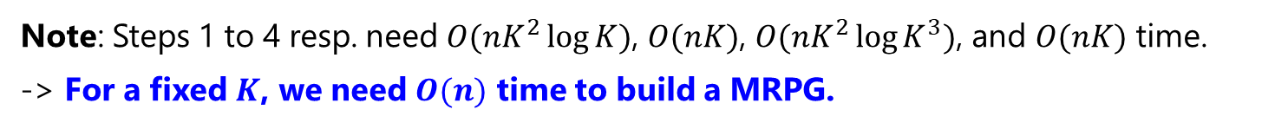

STEP 4: REMOVE-LINKS
AKNNG: Approximate KNN Graph (red nodes are pivots.)
SC-AKNNG: Strongly-connected AKNNG
SC-AKNNG + Monotonic paths from random objects
SC-AKNNG + Monotonic paths from random objects + removing unnecessary links
MRPG
If objects $p_{i}$ and $p_{j}$ s.t. $\left(p_{i},p_{j}\right)∈E$ have links to a common pivot $p$, remove $\left(p_{i},p_{j}\right)$.
← $O(nK)$ time
Note: Steps 1 to 4 resp. need $O(nK^{2}\log{K})$, $O(nK)$, $O(nK^{2}\log{K^{3}})$, and $O(nK)$ time.
-> For a fixed $K$, we need $O(n)$ time to build a MRPG.

Slide 14
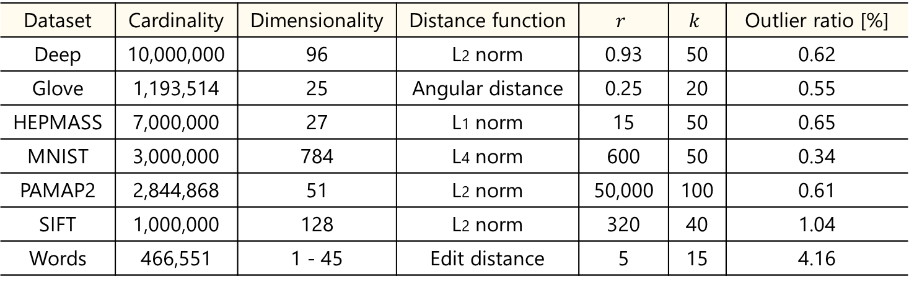
EXPERIMENTAL SETTING
Evaluated algorithms:
State-of-the-art: Nested-loop [KDD’03], SNIF [KDD’06], DOLPHIN [TKDD’09], and VP-tree [SODA’93].
Our algorithm with proximity graphs: NSW [IS’14], KGraph [WWW’11], MRPG.
For MPRG, our algorithm is optimized to it.
Table 2: Dataset, statistics, and default parameters
Dataset | Cardinality | Dimensionality | Distance function | $$r$$ | $$k$$ | Outlier ratio [%]
Deep | 10,000,000 | 96 | L2 norm | 0.93 | 50 | 0.62
Glove | 1,193,514 | 25 | Angular distance | 0.25 | 20 | 0.55
HEPMASS | 7,000,000 | 27 | L1 norm | 15 | 50 | 0.65
MNIST | 3,000,000 | 784 | L4 norm | 600 | 50 | 0.34
PAMAP2 | 2,844,868 | 51 | L2 norm | 50,000 | 100 | 0.61
SIFT | 1,000,000 | 128 | L2 norm | 320 | 40 | 1.04
Words | 466,551 | 1 - 45 | Edit distance | 5 | 15 | 4.16

Slide 15
EXPERIMENTAL RESULT OF OFFLINE TIME & INDEX SIZE
Table 3: Offline time [sec] with 48 threads
Table 4: Index size [MB]
Dataset | NSW | KGraph | MRPG
Deep | NA | 20079.80 | 17230.30
Glove | 2333.47 | 923.83 | 791.53
HEPMASS | NA | 7935.25 | 5221.86
MNIST | NA | 7217.84 | 6850.54
PAMAP2 | 4522.14 | 1325.40 | 888.61
SIFT | 4910.94 | 929.48 | 817.33
Words | 871.27 | 455.15 | 868.62
Dataset | SNIF | DOLPHIN | VP-tree | NSW | KGraph | MRPG
Deep | NA | NA | 324.35 | NA | 5516.58 | 7350.83
Glove | 13.26 | 69.14 | 54.86 | 186.62 | 460.48 | 438.76
HEPMASS | 61.04 | NA | 265.39 | NA | 2188.65 | 2450.84
MNIST | NA | NA | 117.80 | NA | 589.08 | 591.27
PAMAP2 | 18.36 | 65.12 | 128.00 | 819.17 | 553.87 | 760.69
SIFT | 8.10 | 47.00 | 39.99 | 157.58 | 433.48 | 489.14
Words | 4.41 | 26.86 | 27.79 | 102.20 | 191.73 | 178.74

Slide 16
EXPERIMENTAL RESULT OF ONLINE TIME (OVERVIEW)
Table 5: Online time [sec]. 48 (resp. 12) threads on Deep and MNIST (resp. the others)
Dataset | Nested-loop | SNIF | DOLPHIN | VP-tree | NSW | KGraph | MRPG
Deep | NA | NA | NA | NA | NA | 8616.10 | 1966.17
Glove | 1045.47 | 1222.43 | 9277.89 | 1398.92 | 147.00 | 83.32 | 2.63
HEPMASS | 17925.40 | 20360.80 | NA | 8597.23 | NA | 780.19 | 38.40
MNIST | NA | NA | NA | NA | NA | 4983.33 | 3435.29
PAMAP2 | 422.40 | 1213.56 | 1819.90 | 208.55 | 22.16 | 23.77 | 10.55
SIFT | 1427.74 | 1507.58 | 8684.08 | 2005.27 | 200.89 | 175.88 | 11.32
Words | 1844.65 | 2086.50 | 7061.50 | 1021.39 | 498.34 | 393.95 | 2.67
Winner is our algorithm + MRPG:
x21~ (Deep), x398 (Glove), x224 (HEPMASS), x13~ (MNIST), x20 (PAMAP2), x126 (SIFT), and x383 (Words) times faster than state-of-the-art.
Our approach “filter-and-verification” is faster than the state-of-the-art:
NSW and KGraph are also faster than the state-of-the-art.

Slide 17


EXPERIMENTAL RESULT OF ONLINE TIME (IMPACT OF PARAMETERS)
Scalability to $n$:
Robustness to outlier rate by varying $k$:

Slide 18
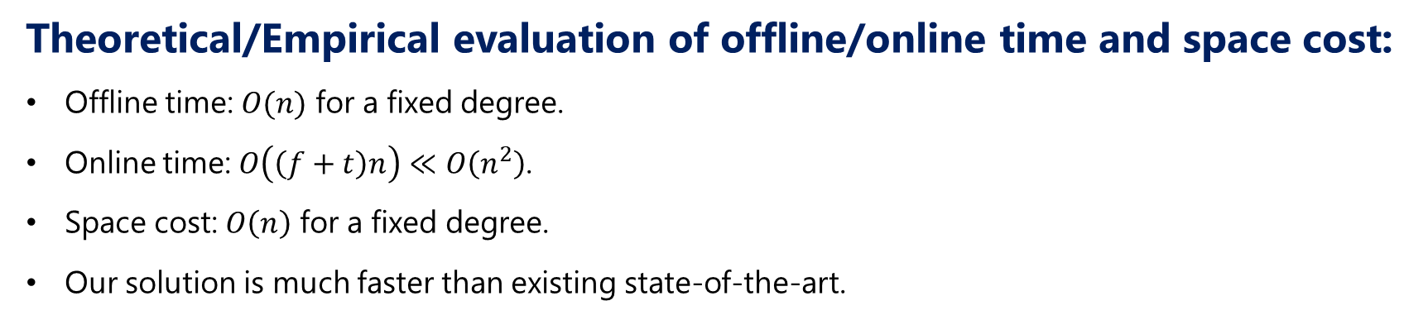
CONCLUSION
New solution for the distance-based outlier detection problem:
A filter-and-verification framework on a proximity graph.
MRPG: Metric Randomized Proximity Graph.
Theoretical/Empirical evaluation of offline/online time and space cost:
Offline time: $O(n)$ for a fixed degree.
Online time: $O\left(\left(f+t\right)n\right)≪O\left(n^{2}\right)$.
Space cost: $O\left(n\right)$ for a fixed degree.
Our solution is much faster than existing state-of-the-art.

