Slide 1

DIVERSITY MAXIMIZATION IN THE PRESENCE OF OUTLIERS
Daichi Amagata
Osaka University
Notes:
Hi, I’m Daichi Amagata from Osaka University, Japan.
I’d like to talk about diversity maximization in the presence of outliers.

Slide 2






BACKGROUND: MAKING A SUMMARY OF A DATASET
This dataset ($X$) is too large for my application (or resource)… I wanna reduce the size to $k$.
$X$: a set of $n$ points
$$S$$
$S$: a set of $k (≪n)$ points
Sampling: Quite easy & the best if the data distribution should be preserved (but may be skewed).
Submodular maximization: Users must specify an appropriate function (which may not be trivial).
Diversity maximization: Easy to specify & the summary can avoid skewness.
Notes:
Let’s suppose a situation where we have a dataset X, and it is too large for our application or our resource cannot afford to use X.
Then, we wanna reduce the dataset size from n to k, and k is much smaller than n.
This is to make a summary of X.
So, how to make a summary?
An intuitive approach is sampling: it’s easy and probably the best approach if the data distribution should be preserved.
However, it may provide a skewed result.
If we wanna avoid such a skewness, we can use the problem of submodular maximization.
It’s a nice approach, but we have to specify an appropriate function which may not be trivial.
So, we consider diversity maximization, which is easy to specify and its summary can avoid skewness.

Slide 3

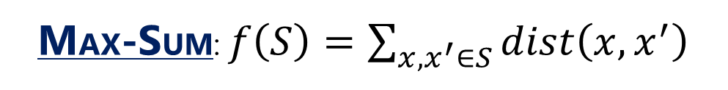
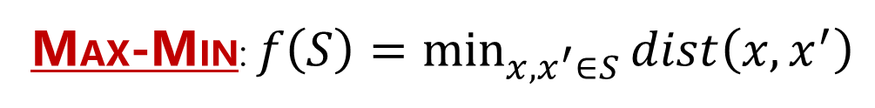
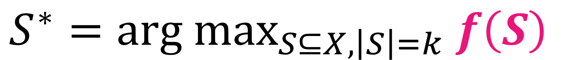
BACKGROUND: DIVERSITY MAXMIZATION
$$S^{∗}=arg max_{S⊆X, \left|S\right|=k} f\left(S\right)$$
MAX-MIN: $f\left(S\right)=\min_{x,x^{′}∈S}{dist\left(x,x^{′}\right)}$
MAX-SUM: $f\left(S\right)=\sum_{x,x^{′}∈S}{dist\left(x,x^{′}\right)}$
It’s diverse!
It’s skewed…
Notes:
This equation formally defines the diversity maximization problem, which is to select k points from X so that the function f is maximized.
We have two famous functions.
One is the function that evaluates the minimum pairwise distance among all pairs in S.
The other is the function that evaluates the sum of all pairwise distances.
The triangles show 10 points obtained by each objective function.
We can see (that) Max-Min diversification provides a diverse result, but Max-Sum does not.
So, we use Max-Min diversification in this study.

Slide 4
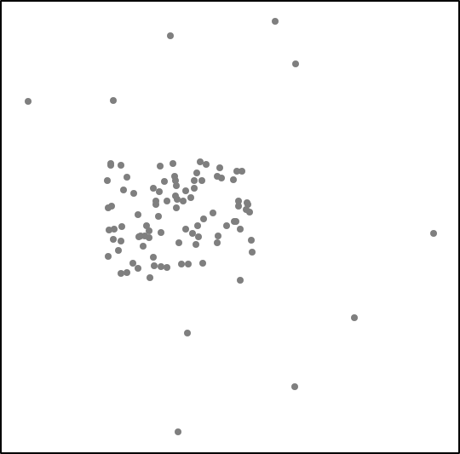
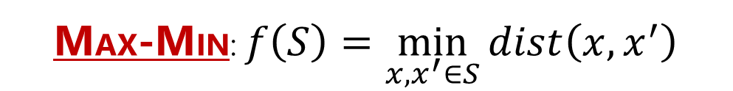
BACKGROUND: DIVERSITY MAXMIZATION + OUTLIERS
$$S^{∗}=arg max_{S⊆X, \left|S\right|=k} f\left(S\right)$$
MAX-MIN: $f\left(S\right)=\min_{x,x^{′}∈S}{dist\left(x,x^{′}\right)}$
It’s diverse!
Notes:
We assume (that) X has outliers, such as blue points in the right figure, and this is a standard setting for real-world data.
To make a good summary of X, we should avoid the outliers and get the red triangles in the left figure.
However, past studies of Max-Min diversification did not consider this setting.
So, we formally define the problem of Max-Min diversification with outliers.

Slide 5
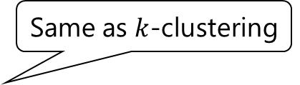
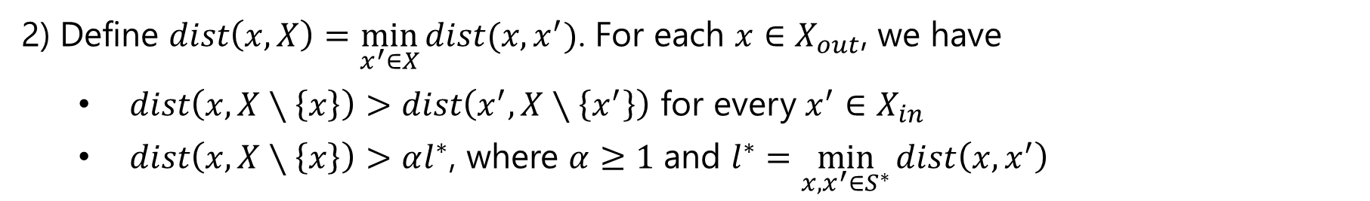

PRELIMINARY
Problem Definition
Input: $X=X_{in}∪X_{out}$ (a set of $n$ points in a metric space) and $k≥2$ (output size)
Output: $S^{∗}=arg max_{S⊆X∖X_{out}, \left|S\right|=k}\min_{x,x^{′}∈S}{dist\left(x,x^{′}\right)}$ ▷ NP-hard
Assumptions
Same as $k$-clustering
Outliers are far from the other points.
1) $\left|X_{out}\right|=z$
2) Define $dist\left(x,X\right)=\min_{x^{′}∈X}{dist(x,x^{′})}$. For each $x∈X_{out}$, we have
$dist\left(x,X∖\left\{x\right\}\right)>dist\left(x^{′},X∖\left\{x^{′}\right\}\right)$ for every $x^{′}∈X_{in}$
$dist\left(x,X∖\left\{x\right\}\right)>αl^{∗}$, where $α≥1$ and $l^{∗}=\min_{x,x^{′}∈S^{∗}}{dist\left(x,x^{′}\right)}$
Notes:
Its input is X and the output size k.
X consists of two sets X_in and X_out, where X_in is a set of inliers and X_out is a set of outliers.
The output is a set S* of k points that maximizes the minimum pairwise distance in S, and S is a subset of X_in, meaning (that) S must not contain outliers.
The Max-Min diversification is an NP-hard problem, so this problem is NP-hard as well.
This problem definition is actually too general, so we put two assumptions about outliers to make it solvable.
First, the number of outliers is z, and this is the same setting as k-clustering.
Second, for each outlier, the distance to its nearest neighbor is further than that of every inlier.
Plus, the distance is further than alpha times l*.
Alpha is a constant and l* is the minimum pairwise distance in the optimal solution S*.

Slide 6
SOTA ALGO. FOR MAX-MIN DIV. W/O OUTLIERS IS NOT EFFECTIVE
GMM [1]: A state-of-the-art $O(nk)$ time ½-approximation algorithm if $X_{out}=∅$
1) Add a random point in $X$ into $S$ ▷ $O\left(1\right)$ time
2 to $k$) Add $x^{∗}=arg max_{x∈X∖S} dist\left(x,S\right)$ into $S$ ▷ $O\left(n(k−1)\right)$ time
4
7
3
It’s diverse!
It’s dirty…
10
1
8
6
9
2
5
[1] Ravi, S. S.; Rosenkrantz, D. J.; and Tayi, G. K. 1994. Heuristic and Special Case Algorithms for Dispersion Problems. Operations Research, 42(2): 299–310.
Notes:
One simple question is: can we use a state-of-the-art algorithm for Max-Min diversification even if X has outliers.
The answer is no.
The state-of-the-art algorithm is called GMM.
It first picks a random point of X and adds it into a solution S (animation).
Next, it adds the point that has the maximum distance to S (animation), and this is repeated until the size of S becomes k (animation).
The time complexity of this algorithm is O(nk), which is efficient.
However, since it is based on the furthest point retrieval, the solution tends to contain many outliers, as the right figure illustrates.
This observation motivates a new technique for Max-Min diversification with outliers.

Slide 7
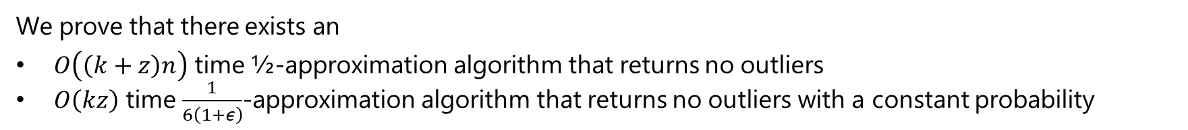
CONTRIBUTION TO THE PROBLEM OF MAX-MIN DIV. w/ OUTLIERS
Challenge
Does there exist an algorithm that can return $S$ containing no outliers in time proportional to $n, k,$ and $z$?
Findings
We prove that there exists an
$O\left(\left(k+z\right)n\right)$ time ½-approximation algorithm that returns no outliers
$O\left(kz\right)$ time $\frac{1}{6\left(1+ε\right)}$-approximation algorithm that returns no outliers with a constant probability
Experiments
We demonstrate that
Existing Max-Min diversification algorithms’ solutions contain most outliers.
Our algorithms are much (e.g., four orders of magnitude) faster than a baseline algorithm.
Notes:
We answer the question: does there exist an algorithm that can return a solution containing no outliers in time proportional to data-size, output-size, and outlier-size.
Our findings are two algorithms.
One algorithm runs in time proportional to n, k, and z, guarantees the error bound, and returns no outliers.
The other runs in time independent of data-size, guarantees the error bound, and returns no outliers with a constant probability.
We run experiments using real-world datasets and got two main results.
Existing algorithms don’t work well, and our algorithms are much faster than a baseline algorithm that returns no outliers.

Slide 8
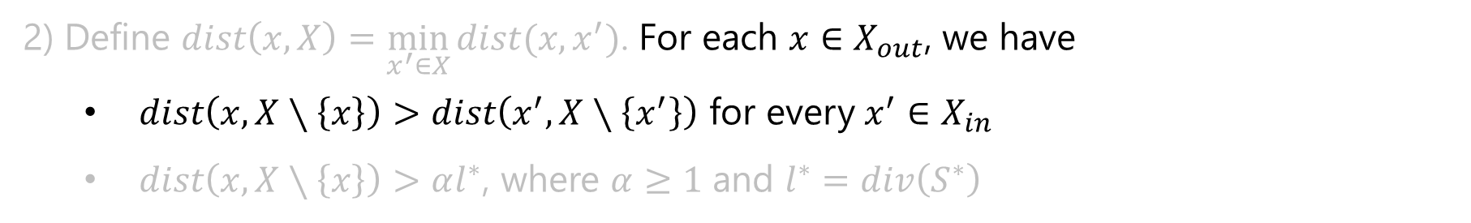

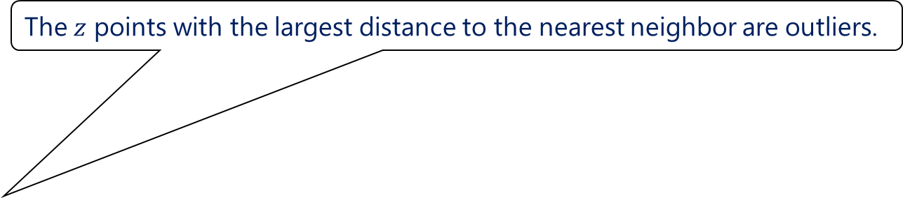
BASELINE ALGORITHM: $O(n^{2})$ TIME, ½ -APPROX., & NO OUTLIERS
Operations
1) Compute the NN (nearest neighbor) of each $x∈X$. ▷ $O\left(n^{2}\right)$ time
2) Remove $z$ points with the largest NN distance. ▷ $O\left(z\right)$ time
3) Run GMM on the remaining points. ▷ $O\left(\left(n−z\right)k\right)$ time
Assumptions
The $z$ points with the largest distance to the nearest neighbor are outliers.
1) $\left|X_{out}\right|=z$
2) Define $dist\left(x,X\right)=\min_{x^{′}∈X}{dist(x,x^{′})}$. For each $x∈X_{out}$, we have
$dist\left(x,X∖\left\{x\right\}\right)>dist\left(x^{′},X∖\left\{x^{′}\right\}\right)$ for every $x^{′}∈X_{in}$
$dist\left(x,X∖\left\{x\right\}\right)>αl^{∗}$, where $α≥1$ and $l^{∗}=div\left(S^{∗}\right)$
Notes:
I introduce this baseline algorithm.
This algorithm uses a property of outliers.
The outliers have larger distances to their nearest neighbor than inliers.
So, by computing the nearest neighbor of each point in X, we can identify the outliers, the z points with the largest nearest neighbor distance.
Based on this fact, the baseline algorithm computes the nearest neighbor of each point, removes the z points, and runs GMM on the remaining points.
As it exactly removes the outliers, it obtains the approximation guarantee.
However, because of the first operation, it incurs O(n^2) time, and this does not scale well to large n.
So, a more efficient algorithm is required.

Slide 9


OUTLIER-AWARE GREEDY ALGORITHM
Lemma 1
$S^{′}←$ GMM$\left(X,k+z\right)$ contains the $z$ outliers.
Operations
1) $S^{′}←$ GMM$\left(X,k+z\right)$ ▷ $O\left(n(k+z)\right)$ time
2) Compute the NN of each $x∈S′$ ▷ $O\left(n(k+z)\right)$ time
3) $Z←$ $z$ points with the largest NN dist. ▷ $O\left(z\right)$ time
4) $S←$ GMM$(X∖Z,k)$ ▷ $O\left(\left(n−z\right)k\right)$ time
Result of GMM$\left(X,k+z\right)$
Theorem 1
GREEDY returns a ½-approx. solution with no outliers in $O(n(k+z))$ time.
Notes:
To remove the quadratic factor, we took a different approach for identifying the outliers.
Specifically, we proved lemma 1: the k+z points retrieved by GMM must contain the z outliers.
The idea behind this lemma is to exploit the GMM’s sensitivity to the outliers like the right figure shows.
Thanks to this lemma, we do not need the quadratic time anymore, since the GMM’s time is proportional to the output size, k+z in this case.
The overall operations of our greedy algorithm are almost the same as those of the baseline algorithm.
The difference is only the first step.
To identify the outliers, we use GMM, where the output size is k+z.
Then, we have the first result, theorem 1.
We can obtain a one-half-approximate solution with no outliers in O(n(k+z)) time.
This is a good result, but we find a faster algorithm with performance guarantee.
Let’s see this algorithm next.

Slide 10
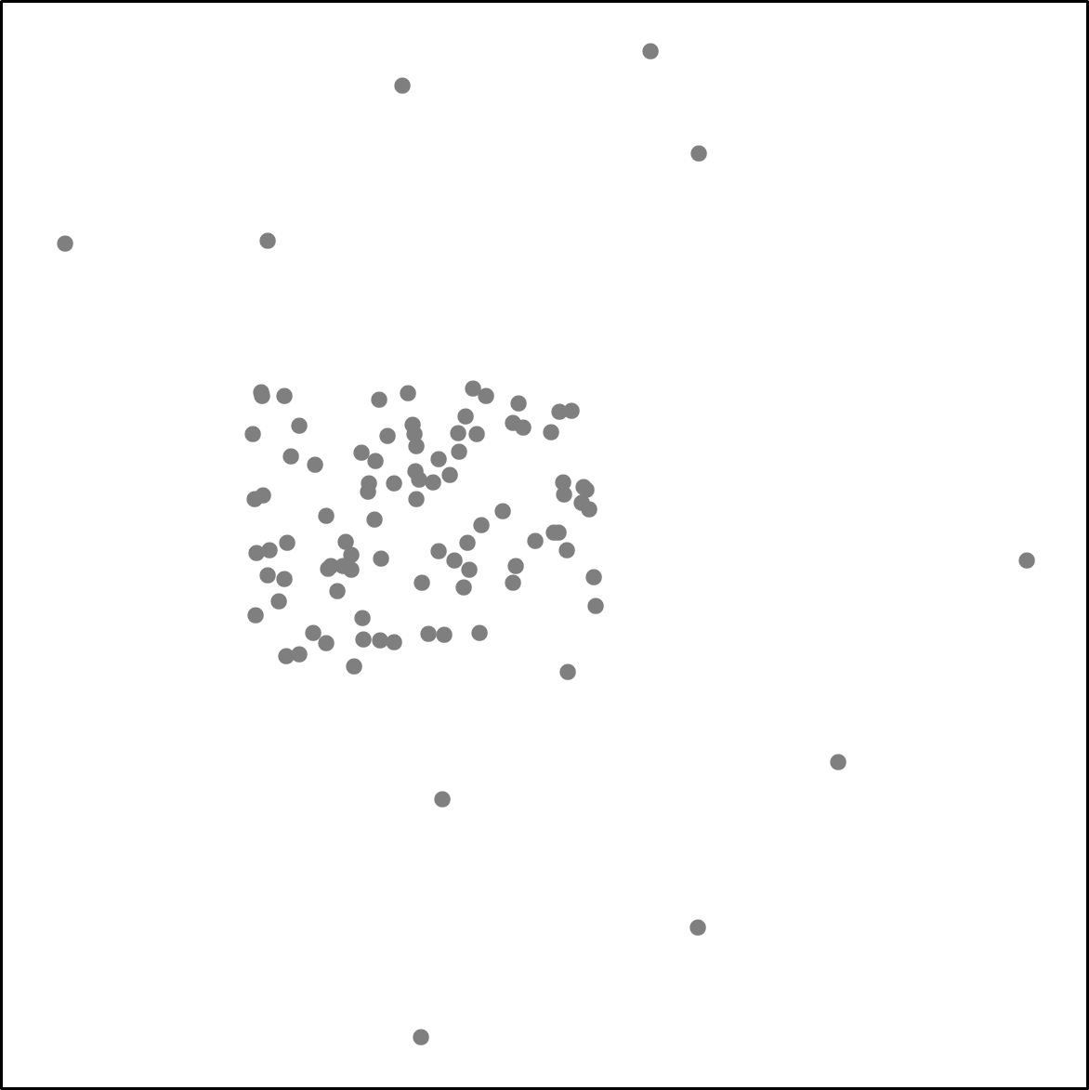
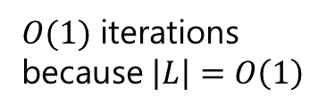

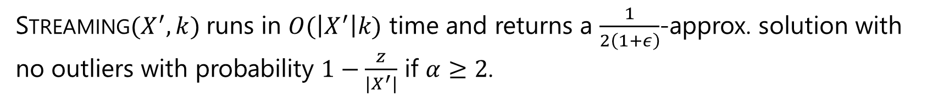

STREAMING ALGORITHM
$$\hat{l}/2$$
$O(\left|X^{′}\right|k)$ time
$O(1)$ iterations because $\left|L\right|=O\left(1\right)$
Lemma 2
STREAMING$(X^{′},k)$ runs in $O(\left|X^{′}\right|k)$ time and returns a $\frac{1}{2\left(1+ε\right)}$-approx. solution with no outliers with probability $1−\frac{z}{\left|X^{′}\right|}$ if $α≥2$.
* $l^{∗}=f\left(S^{∗}\right)=\min_{x,x^{′}∈S^{∗}}{dist\left(x,x^{′}\right)}$
Notes:
We designed a streaming algorithm.
Its inputs are a subset of X, k, and a guess of l* which is the minimum pairwise distance of the optimal solution.
First, this algorithm also picks a random point.
Then, it selects a point that satisfies the distance constraint of l.
The idea here is like not too close to the current solution and not too far from the current solution.
This operation is repeated until we have k points.
We proved the number of iterations to obtain a good guess of l* is constant.
Then, we obtain lemma 2: this algorithm runs in O(k times the input data size) and returns an error-bounded solution with no outliers with high probability if z is constant.
This is because, as long as the first point is an inlier, the other points in our solution should be inliers if alpha is not less 2.
Please check our paper for a detailed proof.
We combine this lemma with the technique in the next page.

Slide 11

CORESET FOR MAX-MIN DIVERSIFICATION WITH OUTLIERS
Definition of Coreset
$C⊆X$ is a $β$-coreset, if, for $S⊆C$, we have $div\left(S\right)≥\frac{div\left(S^{∗}\right)}{β}$.
Lemma 3
$C←$ GMM$\left(X,k+z\right)$ is a 3-coreset (it yields the anti-cover property even in the presence of outliers).
Theorem 2 (main result)
Built in an offline phase
STREAMING$(C,k)$, where $\left|C\right|=O\left(z\right)≥k+z$, runs in $O(kz)$ time and returns a $\frac{1}{6\left(1+ε\right)}$-approx. solution with no outliers with a constant probability if $α≥2$ ($1−\frac{z}{\left|C\right|}=O\left(1\right)⟺\left|C\right|=\frac{z}{1−O\left(1\right)}$).
We can make a summary $S$ of $X$ with online time independent of $n$.
Notes:
Now, we want to use a coreset for our streaming algorithm, and a coreset is a subset of X.
Formally, a subset C is a beta-coreset, if a subset of C satisfies this error bound against the optimal solution.
We proved (that) the output of GMM, where the output size is k+z, is a 3-coreset.
Again, please check our paper for the proof.
From lemmas 2 and 3, we have the main result.
Let’s assume we offline build a coreset C of O(z) points so that it is larger than k+z.
Our streaming algorithm on the coreset runs in O(kz) time and returns an error-bounded solution with no outliers with a constant probability.
Now we can make a summary of X with online time independent of n.

Slide 12
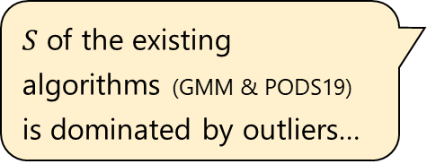


EXPERIMENT: COMPARISON WITH COMPETITORS ($k=100$, $z=200$)
Table 1: Average number of outliers in $S$
$S$ of the existing algorithms (GMM & PODS19) is dominated by outliers…
Table 2: Average $div\left(S\right)=\min_{x,x^{′}∈S}{dist\left(x,x^{′}\right)}$ and running time [sec] (no outliers are returned)
Our algorithms are faster than BASELINE. Especially, CORESET is super fast.
Table 3: Average time to identify $z$ outliers [sec]
GREEDY identifies the outliers much faster than BASELINE.
* FCT: 10-dim & $n=580,812$, Household: 7-dim & $n=2,049,280$, KDD99: 16-dim & $n=311,029$, Mirai: 115-dim & $n=764,137$
Notes:
We ran experiments on real-world datasets.
Table 1 shows the average number of outliers in a solution obtained by existing algorithms that do not consider outliers.
More than 80% are outliers, so they are not useful for datasets with outliers.
Table 2 shows the average diversity and running time.
The algorithms in this table did not return outliers.
These algorithms return competitive diversity, but the running time is totally different: our algorithms are much faster than the baseline one.
Especially, coreset is super fast.
Table 3 shows the average time to identify z outliers.
As greedy reduces the number of points that need to compute the nearest neighbor from n to only k+z, it is much faster than the baseline.
The all results validate the efficiency of our theoretical results.

Slide 13
EXPERIMENT: IMPACTS OF $k$ & $z$
Notes:
Also, we studied the impacts of the output size k and the number of outliers z.
These experimental results simply show (that) the behavior of each algorithm follows its theoretical performance.
For instance, the running times of Greedy, Streaming, and Coreset are theoretically proportional to k, so they need longer time for larger k.
As for z, Greedy and Coreset have the same results.
On the other hand, if the input of Streaming is X, its time is theoretically independent of z, so it is robust against z.

Slide 14
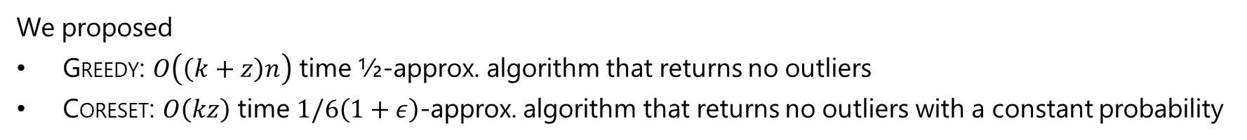
CONCLUSION
Problem:
First study on Max-Min diversification with outliers
Technical Contribution:
We proposed
GREEDY: $O\left(\left(k+z\right)n\right)$ time ½-approx. algorithm that returns no outliers
CORESET: $O\left(kz\right)$ time $1/6\left(1+ε\right)$-approx. algorithm that returns no outliers with a constant probability
Experiments:
We demonstrated that
Existing Max-Min diversification algorithms’ solutions contain most outliers.
Our algorithms are much (e.g., four orders of magnitude) faster than a baseline algorithm.
Source code available at https://github.com/amgt-d1/Max-Min-w-Outliers
Notes:
To conclude, we addressed the first study of Max-Min Diversification with outliers.
We proposed two algorithms that are theoretically sound and empirically efficient and effective.
This is conformed by experiments on real-world datasets.
The source codes of our algorithms are available at my GitHub repository.
That’s all, thank you.

