Slide 1

Identifying the Most Interactive Object in Spatial Databases
Osaka University
Daichi Amagata, Takahiro Hara

Slide 2
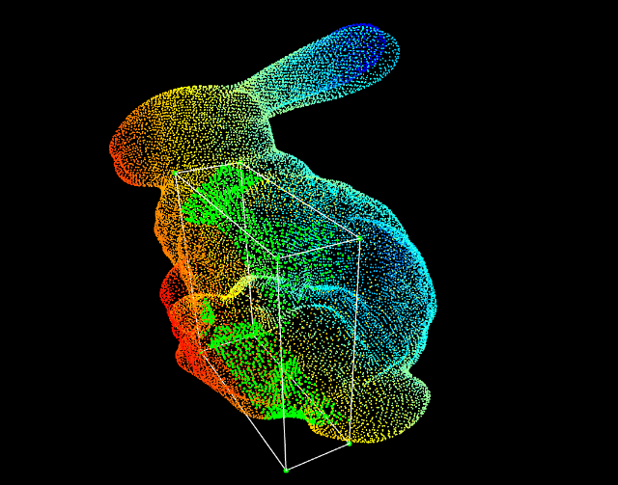
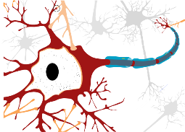
Background: Prevalence of “an object is a set of points”
Examples
Neuron data (neuroscience)
Animal trajectory (databases and GIS)
Point cloud (CV, ML, and GIS)
Analysis of synaptic connections between neurons based on distance
Similarity search and clustering based on distance and shape
Object recognition (by clustering) based on distance and density
Why representation by point set?
Applications want to use spatial queries to mine useful information from object set.
Notes:
Some recent applications have represented an object as a set of points. Examples are neuroscience, trajectory databases, and point cloud. These applications conduct distance-based simulation, similarity search, clustering, and object recognition. That is, these applications use a set of points as an object, because they want to use spatial queries.

Slide 3
Background: Spatial query processing
Representative examples
Range query: reports all points within a radius from a query point
kNN query: retrieves the most nearest k points from a query point
Their importance for…
The case of “an object is a point” → Yes, they are primitive operators!
The case of “an object is a set of points” → ???
Notes:
Well-known spatial queries are range queries and kNN queries. They are important if one object is one point. However, if one object is a set of points, we cannot evaluate their importance. In this work, we propose an analysis tool for objects which are represented by sets of points.

Slide 4
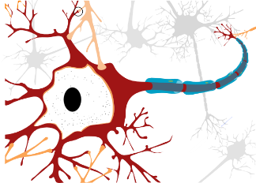
Background: Analysis tool for point set objects
There are interactions between objects.
Many objects follow the pattern of red trajectory.
-> leader-follower relationships?
Synapse
Neurons: Synaptic connections (for signal processing between neurons)
Animal (bird) trajectories: Social relationships (e.g., flying patterns)
Interactions:
Occur when distances are small = There are pairs of points with small distance
Important object:
An object with many interactions
Design an operator that retrieves this object.
Notes:
We focus on the fact (that) in these applications, there are interactions between objects. For example, neurons interact with each other through synaptic connections which are used for signal processing. Also, the right figure illustrates bird trajectories, and we see (that) many trajectories follow the red trajectory. Birds also have social relationships, and the figurer suggests leader-follower relationships. From these examples, we can see (that) object interactions occur when their distances are small. In other words, they have pairs of points with small distance. Now we define an object with many interactions as important object, and design an operator which retrieves the object.

Slide 5
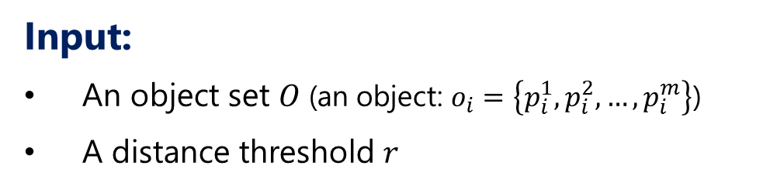

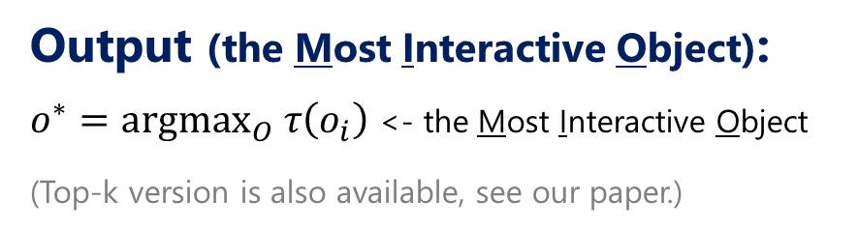
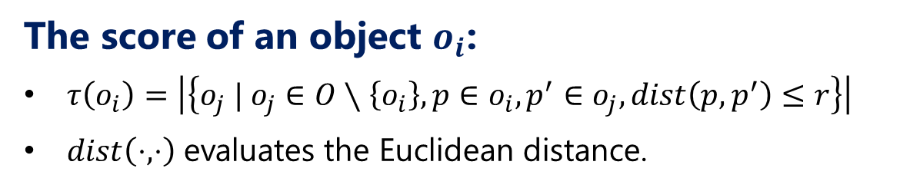
Problem definition: MIO query processing
Input:
An object set $O$ (an object: $o_{i}=\left\{p_{i}^{1},p_{i}^{2},…,p_{i}^{m}\right\}$)
A distance threshold $r$
The score of an object $o_{i}$:
$τ\left(o_{i}\right)=\left|\left\{o_{j} | o_{j}∈O∖\left\{o_{i}\right\}, p∈o_{i},p^{′}∈o_{j}, dist\left(p,p^{′}\right)≤r\right\}\right|$
$dist\left(⋅,⋅\right)$ evaluates the Euclidean distance.
$$r$$
Output (the Most Interactive Object):
$o^{∗}=argmax_{O} τ\left(o_{i}\right)$ <- the Most Interactive Object
(Top-k version is also available, see our paper.)
Notes:
This slide describes our problem definition. Given an object set and a user-specified distance parameter r, the score of an object is calculated by this equation. Specifically, if an object o_i has a pair of points with distance within r for an object o_j, they interact with each other. Let’s assume (that) the navy object is o_i and the red object is o_j. Because they have a pair of points whose distance is within r, they interact with each other. The score of object o_i is the number of objects which interact with o_i. The output is the object with the maximum score.

Slide 6



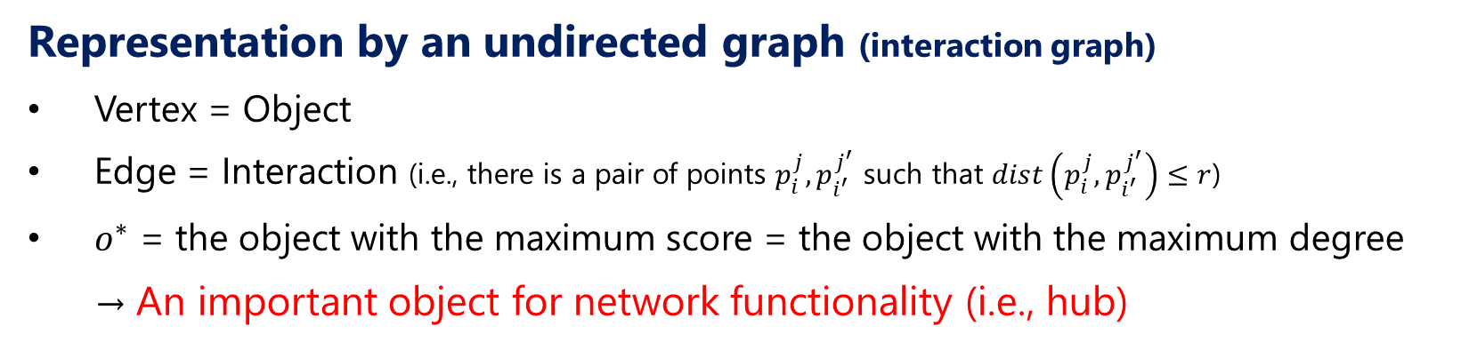












Problem definition: Interpretation by discrete math
Representation by an undirected graph (interaction graph)
Vertex = Object
Edge = Interaction (i.e., there is a pair of points $p_{i}^{j}, p_{i^{′}}^{j^{′}}$ such that $dist\left(p_{i}^{j},p_{i^{′}}^{j^{′}}\right)≤r$)
$o^{∗}$ = the object with the maximum score = the object with the maximum degree → An important object for network functionality (i.e., hub)
$$o_{9}$$
$$o_{14}$$
$$o_{1}$$
$$o_{10}$$
$$o_{5}$$
$$o_{13}$$
$$o_{8}$$
$$o_{12}$$
$$o_{4}$$
$$o_{15}$$
$$o_{11}$$
$$o_{3}$$
$$o_{7}$$
$$o_{2}$$
$$o_{6}$$
Notes:
Actually, the semantic of our problem can be understood by using discrete math. We represent interactions by an undirected graph. In this case, a vertex is an object. If two objects interact with each other, there is an edge between them. Then, the object, with the maximum score, has the maximum degree. In other words, it is an important object for network functionality, or hub, from the view of degree centrality.

Slide 7
Contributions
Problem definition
MIO query processing in spatial databases
Interpretation by discrete math
Algorithm design
Prove a brute-force algorithm is not efficient.
Prove a theoretical algorithm is not practical.
Propose an efficient and practical algorithm.
Experiment
Investigate the efficiency of the proposed algorithm.
Notes:
We have three main contributions. First, we define a new problem, MIO query processing in spatial databases. Second, we prove a brute-force algorithm is not efficient, a theoretical algorithm is not practical, and propose an efficient and practical algorithm. Last, we investigate the efficiency of the proposed algorithm.

Slide 8
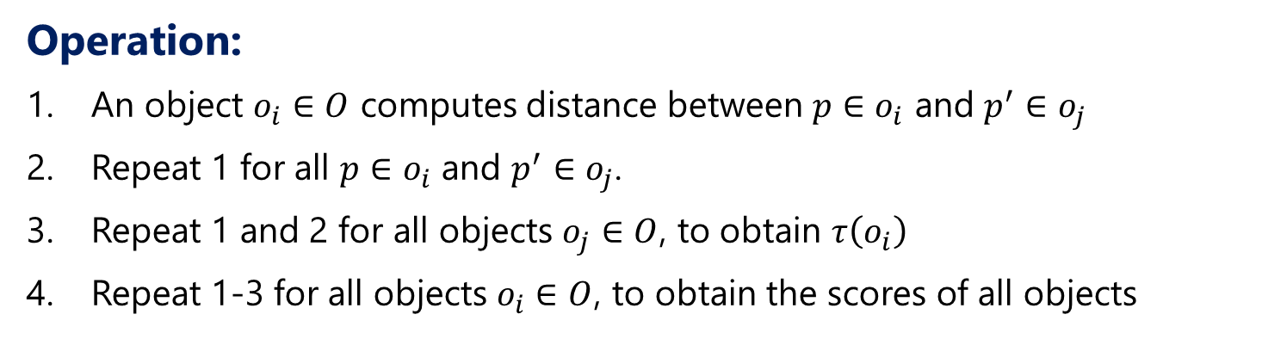
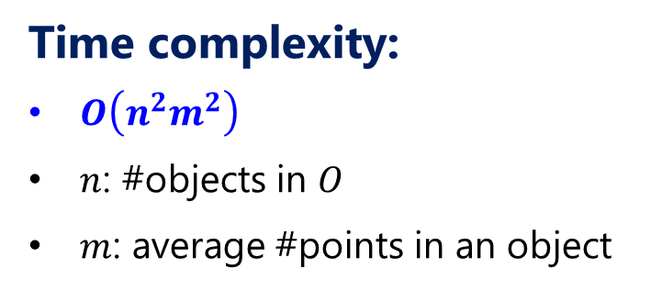
Nested loop algorithm
Operation:
An object $o_{i}∈O$ computes distance between $p∈o_{i}$ and $p^{′}∈o_{j}$
Repeat 1 for all $p∈o_{i}$ and $p^{′}∈o_{j}$.
Repeat 1 and 2 for all objects $o_{j}∈O$, to obtain $τ\left(o_{i}\right)$
Repeat 1-3 for all objects $o_{i}∈O$, to obtain the scores of all objects
Time complexity:
$O\left(n^{2}m^{2}\right)$
$n$: #objects in $O$
$m$: average #points in an object
Notes:
First, we show a brute-force or nested-loop algorithm incurs an expensive cost. To obtain the score of an object o_i, we do pairwise distance computation between its points and points of another object, and repeat this for all the other objects. Now we have the score of o_i. Then, we do the same computation for all objects. This algorithm incurs O(n2m2) time where n is the number of objects and m is the average number of points in an object. You know (that) this algorithm does not scale to large datasets.

Slide 9



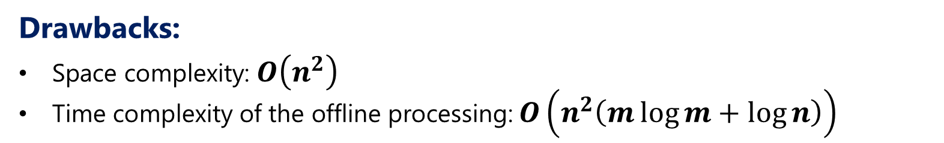
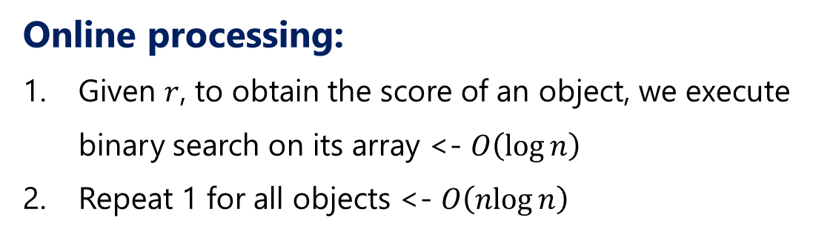
Theorem: There is an $O\left(n\log{n}\right)$ online time algorithm
Offline processing:
All objects compute the closest point pairs with the other objects.
All objects store the distances of the closest pairs in their arrays by ascending order.
Online processing:
Given $r$, to obtain the score of an object, we execute binary search on its array <- $O\left(\log{n}\right)$
Repeat 1 for all objects <- $O\left(\operatorname{nlog}{n}\right)$
$$o_{i}$$
$$o_{j}$$
Drawbacks:
Space complexity: $O\left(n^{2}\right)$
Time complexity of the offline processing: $O\left(n^{2}\left(m\log{m}+\log{n}\right)\right)$
0.1 | 0.3 | 0.6 | … | 1.5
Array for $o_{i}$
Notes:
Next, we show there is an O(nlogn) online time algorithm. In offline processing, all objects compute the closest point pairs with the other objects. Then, all objects store the distances of the closest pairs in their arrays by ascending order. For example, the closest pair of this navy and red objects is this, and the distance is stored in this array. This operation is repeated for all the other objects, then we have this array. In online processing, given r, to obtain the score of an object, we need to count the elements which are smaller than or equal to r. This can be done by binary search, so required O(logn) time. By repeating this operation for all objects, we can obtain the exact answer, so the time complexity is O(nlogn) time. This algorithm seems fast, but has two big drawbacks. First, its memory cost is huge. Second, its pre-processing cost is also huge. We can conclude this theoretical algorithm is not practical.

Slide 10

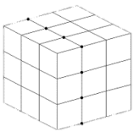
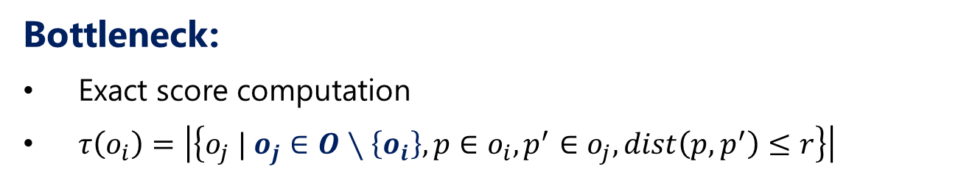
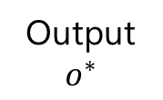

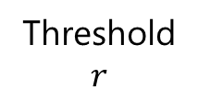
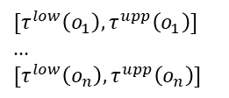

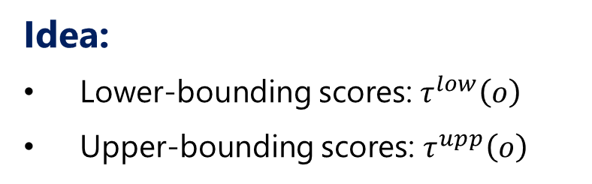
Proposed algorithm: Challenge & approach
Bottleneck:
Exact score computation
$τ\left(o_{i}\right)=\left|\left\{o_{j} | o_{j}∈O∖\left\{o_{i}\right\}, p∈o_{i},p^{′}∈o_{j}, dist\left(p,p^{′}\right)≤r\right\}\right|$
Reduce #objects whose exact scores need to be computed
Idea:
Lower-bounding scores: $τ^{low}\left(o\right)$
Upper-bounding scores: $τ^{upp}\left(o\right)$
If $max τ^{low}\left(o\right)≥τ^{upp}\left(o^{′}\right)$, $o^{′}≠o^{∗}$.
Flow of the solution:
Step-1
Step-2
Step-3
Threshold
$$r$$
Building index (online processing)
Bounding scores (Lower- & Upper-bounding)
Verification (by exact score comp.)
Output
$$o^{∗}$$
$$[τ^{low}\left(o_{1}\right),τ^{upp}\left(o_{1}\right)]$$
…
$$[τ^{low}\left(o_{n}\right),τ^{upp}\left(o_{n}\right)]$$
$$τ\left(o_{i}\right)≥…≥τ\left(o_{j}\right)$$
Notes:
I proceed to explanation of our algorithm. The bottleneck of this problem is exact score computation, because, to obtain the score of an object, we basically need to compare it with the other objects. So, to obtain the answer quickly, we have to reduce the number of objects whose scores need to be computed. To achieve this, we bound the score of each object with a reasonable cost. More specifically, we compute a lower- and upper-bound score for each object. By doing so, we can obtain the maximum lower-bound score. Given an object, if its upper-bound is less than the lower-bound, it cannot be the answer, meaning we can prune its exact score computation. Our algorithm implements this idea. First, we build an index online, compute lower- and upper-bound scores based on the index, prune unnecessary objects, and then compute the exact scores of necessary objects.

Slide 11
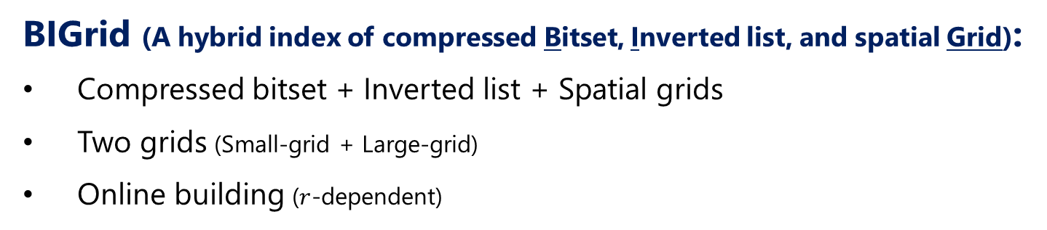



Proposed algorithm: Data structure
BIGrid (A hybrid index of compressed Bitset, Inverted list, and spatial Grid):
Compressed bitset + Inverted list + Spatial grids
Two grids (Small-grid + Large-grid)
Online building ($r$-dependent)
Compressed bitset
Compressed bitset + Inverted list
Small-grid
Large-grid
$$r$$
$$\left\lceil r\right\rceil$$
$$\left\lceil r\right\rceil$$
Notes:
We propose a new index which integrates compressed bitsets, inverted list, and spatial grids, namely BIGrid. BIGrid has two grids, small-grid and large-grid, which are built online. In the small-grid, the diagonal length of each cell is r. In the large-grid, each side length of each cell is r. Besides, each cell has a compressed bitset and inverted list.

Slide 12
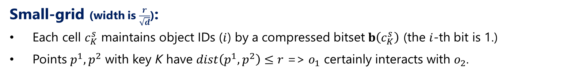
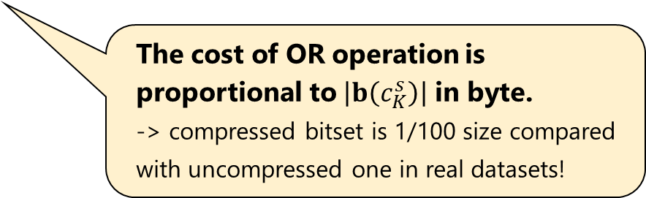
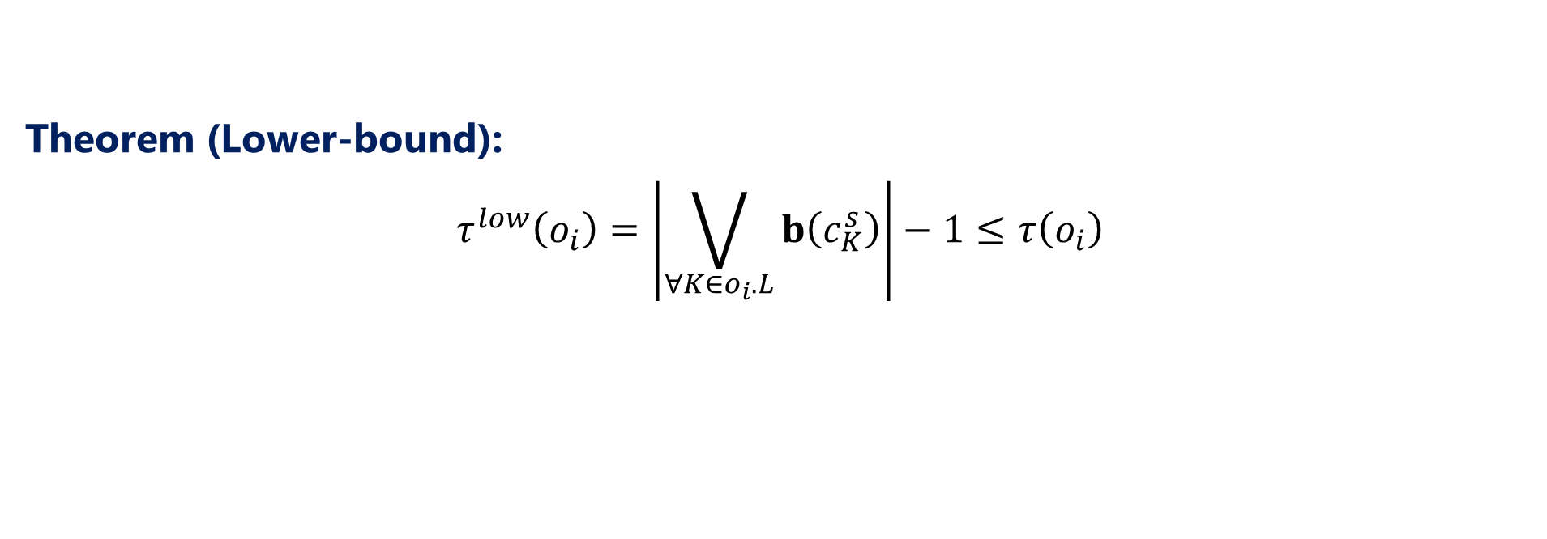
Proposed algorithm: Data structure & Lower-bounding
Small-grid (width is $\frac{r}{\sqrt{d}}$):
Each cell $c_{K}^{s}$ maintains object IDs ($i$) by a compressed bitset $b\left(c_{K}^{s}\right)$ (the $i$-th bit is 1.)
Points $p^{1},p^{2}$ with key K have $dist\left(p^{1},p^{2}\right)≤r$ => $o_{1}$ certainly interacts with $o_{2}$.
Theorem (Lower-bound):
$$τ^{low}\left(o_{i}\right)=\left|\bigvee_{∀K∈o_{i}.L}{b\left(c_{K}^{s}\right)}\right|−1≤τ\left(o_{i}\right)$$
The cost of OR operation is proportional to $\left|b\left(c_{K}^{s}\right)\right|$ in byte.
-> compressed bitset is 1/100 size compared with uncompressed one in real datasets!
$$r$$
Notes:
We use the small-grid to compute lower-bound scores. The compressed bitset in a cell maintains object IDs. If points of the object with ID i are mapped to a cell, the i-th bit of its compressed bitset is 1. We see distances of points in the same cell are definitely within r. Therefore, if the i-th and the j-th bits are 1, objects o_i and o_j definitely interact with each other. From this fact, we can compute a lower-bound score of an object by using bitwise OR operations on compressed bitsets. Actually, the cost of OR operation on compressed bitsets is proportional to byte size of bitsets. Because distributions of real datasets are very skewed, there are long sequences of 1 or 0 in compressed bitsets. They can be very compressed. High compression rate provides a small OR operation cost.

Slide 13
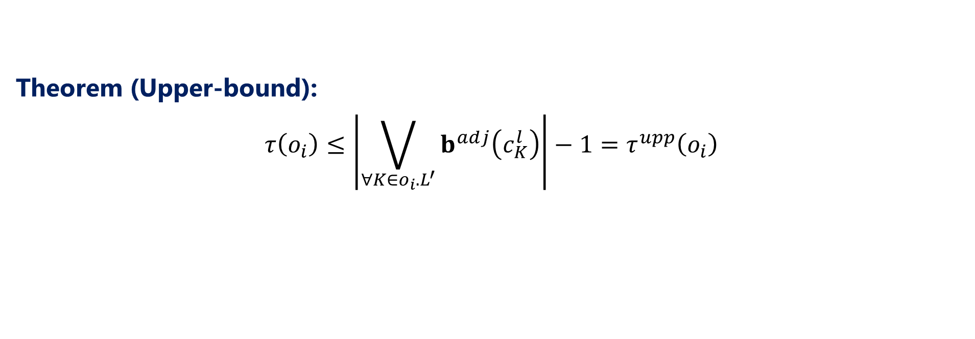
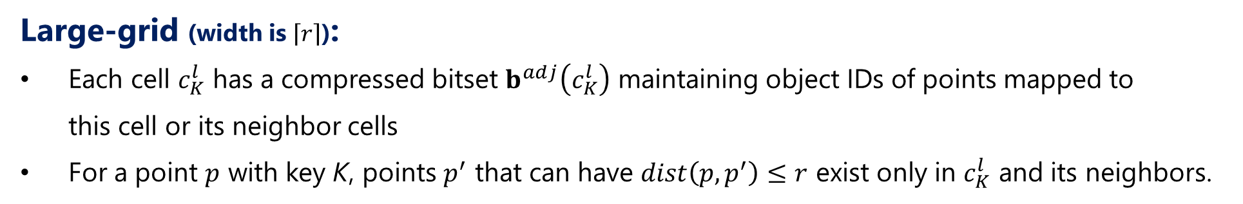
Proposed algorithm: Data structure & Upper-bounding
Large-grid (width is $\left\lceil r\right\rceil$):
Each cell $c_{K}^{l}$ has a compressed bitset $b^{adj}\left(c_{K}^{l}\right)$ maintaining object IDs of points mapped to this cell or its neighbor cells
For a point $p$ with key K, points $p^{′}$ that can have $dist\left(p,p^{′}\right)≤r$ exist only in $c_{K}^{l}$ and its neighbors.
Theorem (Upper-bound):
$$τ\left(o_{i}\right)≤\left|\bigvee_{∀K∈o_{i}.L^{′}}{b^{adj}\left(c_{K}^{l}\right)}\right|−1=τ^{upp}\left(o_{i}\right)$$
$$\left\lceil r\right\rceil$$
$$\left\lceil r\right\rceil$$
Notes:
Next, the large-grid is used to compute upper-bound scores. The approach is almost the same to the lower-bounding. The difference is to access neighbor cells, because for a point, its cell and neighbor cells have points that can have distance within r. We therefore maintain the IDs of objects whose points are mapped to its cell or neighbor cells by a compressed bitset. Then, we can compute an upper-bound score by this equation.

Slide 14

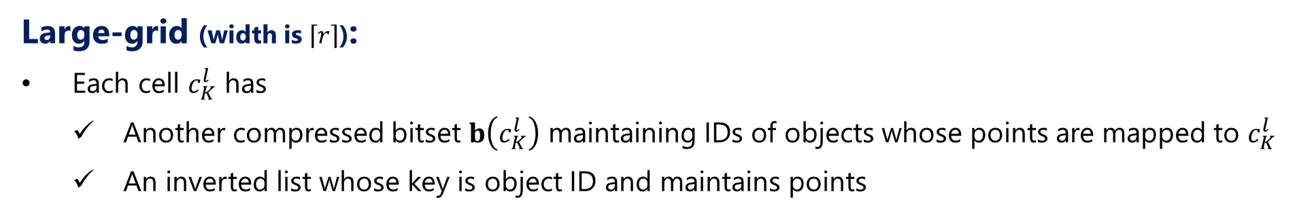



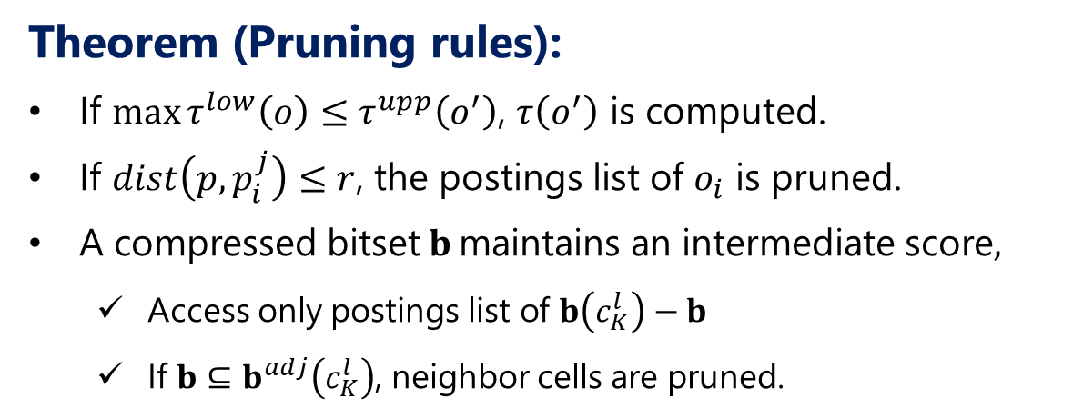


Proposed algorithm: Data structure & Exact score comp.
Large-grid (width is $\left\lceil r\right\rceil$):
Each cell $c_{K}^{l}$ has
Another compressed bitset $b\left(c_{K}^{l}\right)$ maintaining IDs of objects whose points are mapped to $c_{K}^{l}$
An inverted list whose key is object ID and maintains points
Inverted list
Theorem (Pruning rules):
If $\max{τ^{low}\left(o\right)≤τ^{upp}\left(o^{′}\right)}$, $τ\left(o^{′}\right)$ is computed.
If $dist\left(p,p_{i}^{j}\right)≤r$, the postings list of $o_{i}$ is pruned.
A compressed bitset$b$ maintains an intermediate score,
Access only postings list of $b\left(c_{K}^{l}\right)−b$
If $b⊆b^{adj}\left(c_{K}^{l}\right)$, neighbor cells are pruned.
$$o_{1}$$
$$p_{1}^{1},p_{1}^{3},…$$
$$o_{2}$$
$$p_{2}^{4},p_{2}^{6},…$$
$$r$$
$$r$$
Notes:
Now, I introduce how to compute the exact score of an object. For a point p, we need to retrieve points that can have distance within r from p. Such points exist in the same cell and its neighbor cells. We retrieve points from these cells, and repeat this for each point of the object to obtain its exact score. Actually, we can accelerate this processing by using inverted list and compressed bitsets. For example, we retrieve points with distance within r from this point in this cell. Now let’s assume these points have distance within r. You may remind that this cell already knows the objects that exist in the neighbor cells from its compressed bitset. We refer to it and now know (that) there are no more objects that can interact with the object in the neighbor cells, so we can skip accessing the neighbor cells.

Slide 15
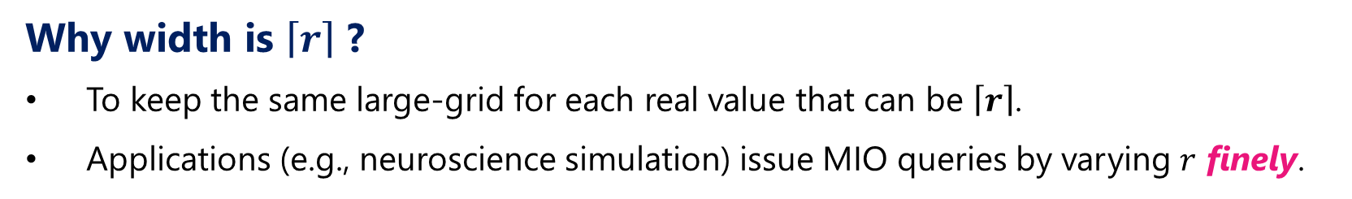
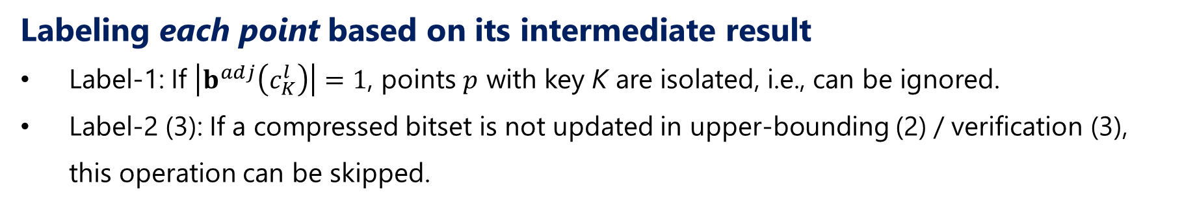
Proposed algorithm: +Labeling approach
Why width is $\left\lceil r\right\rceil$ ?
To keep the same large-grid for each real value that can be $\left\lceil r\right\rceil$.
Applications (e.g., neuroscience simulation) issue MIO queries by varying $r$ finely.
Labeling each point based on its intermediate result
Label-1: If $\left|b^{adj}\left(c_{K}^{l}\right)\right|=1$, points $p$ with key K are isolated, i.e., can be ignored.
Label-2 (3): If a compressed bitset is not updated in upper-bounding (2) / verification (3), this operation can be skipped.
$$\left\lceil r\right\rceil$$
$$\left\lceil r\right\rceil$$
Label-1
Label-3
Label-2
Notes:
We can furthermore improve query processing efficiency by utilizing the intermediate results of previous queries. To achieve this, we use floor function for the cell length. Then, for all r that has the same value, the large-grid becomes the same. This is practical, because target applications of MIO queries require fine-grained r. We label each point so that we can know whether the point is necessary or not. We have three labels. First, if a point is isolated, we can ignore it for future queries. In addition, if the compressed bitset, which corresponds to a point, is not updated during query processing, we do not need to do OR operation on the compressed bitset for future queries. We attach label 2 or 3 to that point.

Slide 16
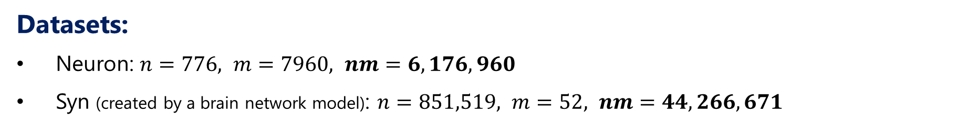
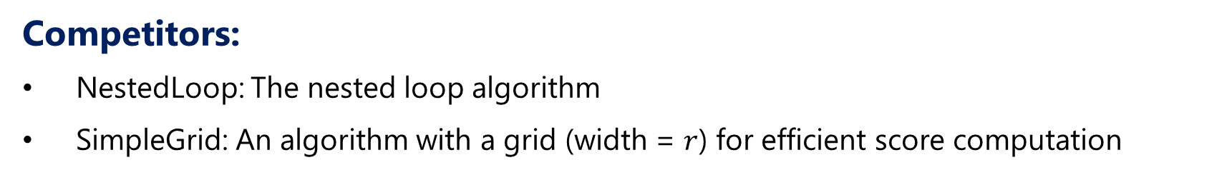
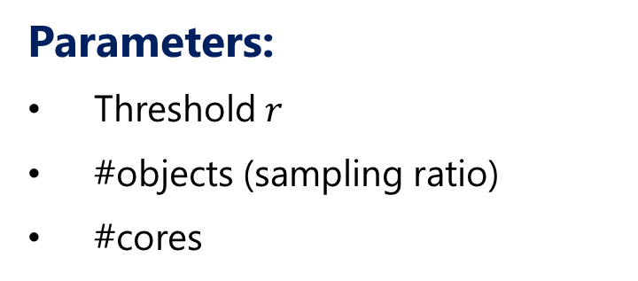
Experiment: setting
Datasets:
Neuron: $n=776, m=7960, nm=6,176,960$
Syn (created by a brain network model): $n=851,519, m=52, nm=44,266,671$
Parameters:
Threshold $r$
#objects (sampling ratio)
#cores
Competitors:
NestedLoop: The nested loop algorithm
SimpleGrid: An algorithm with a grid (width = $r$) for efficient score computation
Notes:
For experiments, we used some real datasets and a synthetic dataset. In this presentation, I show the results on Neuron and Synthetic datasets. As competitors, we used the nested loop algorithm and a simple grid algorithm. This algorithm also computes the scores of all objects, but uses a grid to efficiently compute scores similar to our algorithm.

Slide 17
Experiment: Time vs. threshold $r$
Prune exact score computation by lower- and upper-bonding
Notes:
These figures illustrate run time results on neuron and synthetic datasets. We see our algorithms are significantly faster than the competitors. As r increases, the run time of nested-loop decreases. The number of point pairs whose distances are smaller than r increases, which accelerates early termination in nested-loop. On the other hand, the run time of simple-grid increases. This is because the number of points in a cell increases, which increases the number of distance computations. Our algorithms are not sensitive to the distance threshold.

Slide 18
Experiment: Decomposed time [sec] ($r=4$)
Dataset | Neuron |  |  | Syn
Algorithm | SimpleGrid | BIGrid | BIGrid-Label | SimpleGrid | BIGrid | BIGrid-Label
Label-Input | 0 | 0 | 0.4012 | 0 | 0 | 4.959
Grid-Mapping | 4.029 | 17.122 | 15.4517 | 16.449 | 59.927 | 59.059
Lower-bounding | 0 | 2.677 | 2.8949 | 0 | 44.036 | 41.96
Upper-bounding | 0 | 25.061 | 1.2858 | 0 | 156.697 | 90.181
Verification | 146.039 | 2.291 | 0.5657 | 4245.15 | 10.792 | 2.958
Notes:
This table shows the decomposed time of each algorithm. We see that the verification cost of simple-grid is large. On the other hand, our lower- and upper-bounding costs are small but prune many objects. This results in small verification cost. In addition, the labeling approach reduces bounding and verification costs.

Slide 19
Experiment: Time vs. number of objects (sampling ratio)
Notes:
I show the scalability of each algorithm. Nested-loop and simple-grid are super-linear to the number of objects, so they are not scalable. On the other hand, our algorithms have linear scalability. Especially, our algorithms can run on large datasets, but the competitors cannot do it.

Slide 20
Conclusion
Our focus: “an object is a set of points”
Existing operators do not consider this situation.
MIO query processing problem:
The most interactive object is retrieved.
BIGrid supports efficient query processing.
Multi-core processing is also available (see our paper).
Experiments on real datasets verify the efficiency.
Notes:
I conclude my presentation. We considered a model where an object is a set of points. We proposed MIO query and its processing algorithms. Our experiments show (that) our algorithms are efficient.

Slide 21
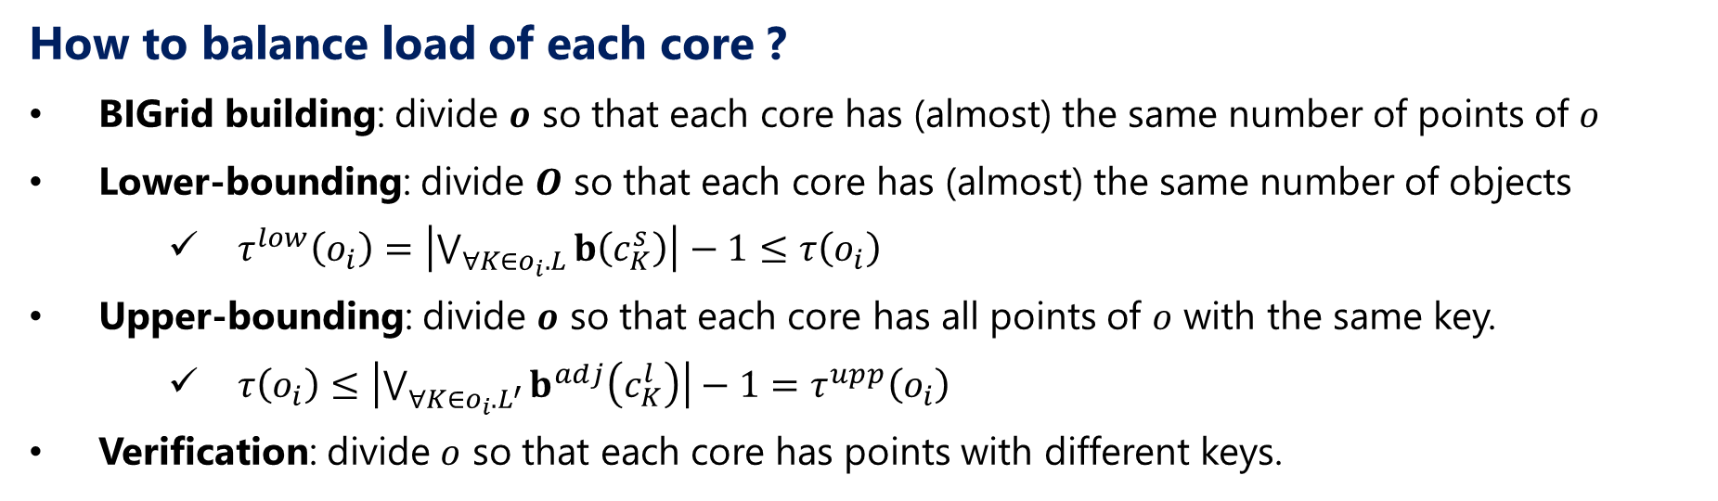
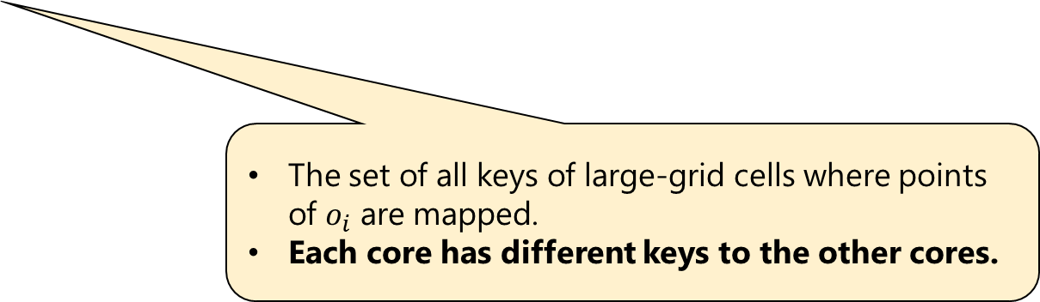
Proposed algorithm: Multi-core processing
How to balance load of each core ?
BIGrid building: divide $o$ so that each core has (almost) the same number of points of $o$
Lower-bounding: divide $O$ so that each core has (almost) the same number of objects
$τ^{low}\left(o_{i}\right)=\left|\bigvee_{∀K∈o_{i}.L}{b\left(c_{K}^{s}\right)}\right|−1≤τ\left(o_{i}\right)$
Upper-bounding: divide $o$ so that each core has all points of $o$ with the same key.
$τ\left(o_{i}\right)≤\left|\bigvee_{∀K∈o_{i}.L^{′}}{b^{adj}\left(c_{K}^{l}\right)}\right|−1=τ^{upp}\left(o_{i}\right)$
Verification: divide $o$ so that each core has points with different keys.
The set of keys where their cells have multiple object IDs.
The set size is small in practice.
The set of all keys of large-grid cells where points of $o_{i}$ are mapped.
Each core has different keys to the other cores.
Notes:
Next, I’d like to introduce how to extend our algorithm. The most important thing for parallel processing is load balancing. Our single core algorithm has 4 steps, BIGrid building, lower-bounding, upper-bounding, and verification. As for BIGrid building, we divide an object so that each core has almost the same number of points of the object. For lower-bounding, we divide the object set so that each more has the same number of objects. o_i.L is a set of keys where their cells have multiple IDs, and in practice, its size is small. So the simple approach is enough. On the other hand, in parallel upper-bounding, we divide an object so that each core has all points of the object with the same key. By doing so, each core can have different keys to the other cores. For parallel verification, we divide an object so that each core has points with different keys.

Slide 22
Proposed algorithm: Data structure & Exact score comp.
Pruning based on an intermediate result.
Each core has similar keys, intermediate results can be similar. -> pruning rate can be similar.
Inverted list
Theorem (Pruning rules):
If $\max{τ^{low}\left(o\right)≤τ^{upp}\left(o^{′}\right)}$, $τ\left(o^{′}\right)$ is computed.
If $dist\left(p,p_{i}^{j}\right)≤r$, the postings list of $o_{i}$ is pruned.
A compressed bitset$b$ maintains an intermediate score,
Access only postings list of $b\left(c_{K}^{l}\right)−b$
If $b⊆b^{adj}\left(c_{K}^{l}\right)$, neighbor cells are pruned.
$$o_{1}$$
$$p_{1}^{1},p_{1}^{3},…$$
$$o_{2}$$
$$p_{2}^{4},p_{2}^{6},…$$
$$r$$
$$r$$
Notes:
In the verification, we prune unnecessary cell accesses based on intermediate results. So to keep load balancing, each core should have a similar intermediate result. If we divide an object so that each subset of points has similar keys, each core is likely to have similar keys.

Slide 23
Experiment: Memory vs. threshold $r$
Impact of compressed bitsets and inverted lists
Notes:
These graphs illustrate memory results. Due to rich information on the index, our algorithm incurs more memory than simple-grid. However, its memory cost is cheap for recent main-memory systems. Besides, as r increases, the memory cost decreases. This is because the number of cells decreases.

Slide 24
Experiment: Memory vs. number of objects (sampling ratio)
Notes:
Memory cost is similar to the previous result. Our algorithms require linear memory cost.

Slide 25
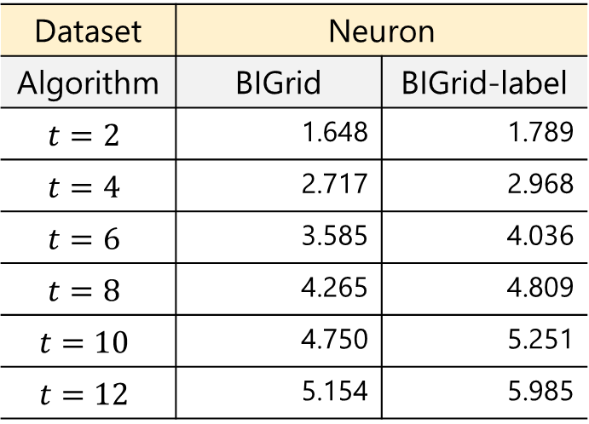
Experiment: Time vs. #cores
Speed-up ratio against single core case
Dataset | Neuron
Algorithm | BIGrid | BIGrid-label
$$t=2$$ | 1.648 | 1.789
$$t=4$$ | 2.717 | 2.968
$$t=6$$ | 3.585 | 4.036
$$t=8$$ | 4.265 | 4.809
$$t=10$$ | 4.750 | 5.251
$$t=12$$ | 5.154 | 5.985
Notes:
Last, I show the result of multi-core processing. Nested-loop and simple-grid employed hash-partition for multi-core processing, but their run time does not decrease. On the other hand, our algorithms decrease their run time with increase of cores.

