Slide 1

Dynamic Set kNN Self-Join
Daichi Amagata, Takahiro Hara, Chuan Xiao Osaka University, Japan

Slide 2



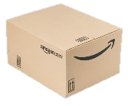
Background: Data model
Many web applications deal with sets of elements:
Video on-demand services: A user = A set of movies
E-commerce: A user = A set of products
Social network services: A user = A set of users (or groups)
Sets are dynamic:
Each set is updated (i.e., elements are added or removed) over time.
Notes:
Nowadays, we have many web applications which deal with sets of elements, such as video on-demand services, e-commerce, and social network services. For example, in Netflix, users may be represented by sets of movies, and we can observe (that) the sets are dynamic, because sets are updated when users take some actions. For instance, if we watch some movies or buy some products, sets have new elements.

Slide 3
Background: Set similarity join
An important operator, e.g., for collaborative and social filtering:
Video on-demand services: Recommendation for each user
E-commerce: Recommendation for each customer
Social network services: Network analysis (e.g., clustering)
Requirement:
Each set wants its answer (e.g., recommendation).
The answer is continuously updated.
← We provide the k most similar sets for each. = kNN self-join
← We monitor the join result. = Dynamic kNN self-join
Notes:
For applications which deal with sets, set similarity join is an important operator to enable collaborative and social filtering. They are utilized for recommendation and network analysis. You know (that) they have two important requirements. First, each set wants its answer. To satisfy this, we provide the k most similar sets for each set. This is kNN self-join. Second, the answer is continuously updated, since sets are dynamic. So, we need to monitor the join result. This is actually the problem of dynamic kNN self-join.

Slide 4

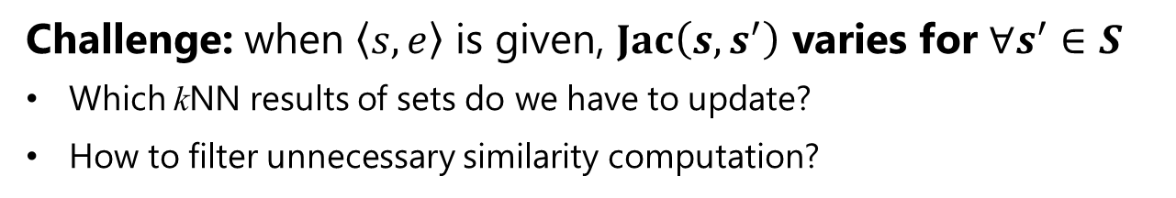
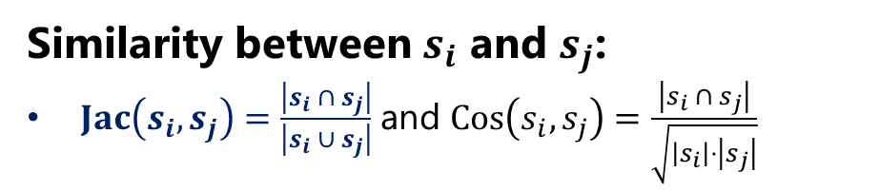
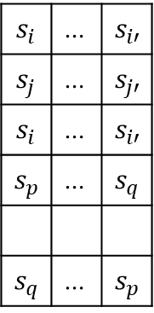


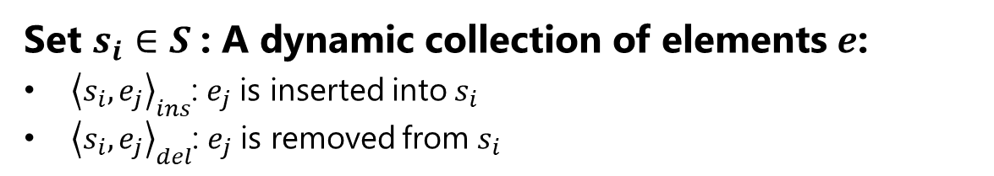
Problem definition
Problem:
Given a collection $S$ of sets and k, we monitor the kNN sets for each set $s∈S$.
Set $s_{i}∈S$: A dynamic collection of elements $e$:
${\left\langle s_{i},e_{j}\right\rangle }_{ins}$: $e_{j}$ is inserted into $s_{i}$
${\left\langle s_{i},e_{j}\right\rangle }_{del}$: $e_{j}$ is removed from $s_{i}$
set
kNN results
$$e$$
$$s_{1}$$
$$s_{2}$$
$$s_{3}$$
$$s_{4}$$
$$s_{n}$$
$$s_{i}$$ | … | $$s_{i′}$$
$$s_{j}$$ | … | $$s_{j′}$$
$$s_{i}$$ | … | $$s_{i′}$$
$$s_{p}$$ | … | $$s_{q}$$
$$s_{q}$$ | … | $$s_{p}$$
Similarity between $s_{i}$ and $s_{j}$:
$Jac\left(s_{i},s_{j}\right)=\frac{\left|s_{i} ∩ s_{j}\right|}{\left|s_{i} ∪ s_{j}\right|}$ and $Cos\left(s_{i},s_{j}\right)=\frac{\left|s_{i} ∩ s_{j}\right|}{\sqrt{\left|s_{i}\right|⋅\left|s_{j}\right|}}$
…
…
…
…
Challenge: when $\left\langle s,e\right\rangle$ is given, $Jac\left(s,s^{′}\right)$ varies for $∀s^{′}∈S$
Which kNN results of sets do we have to update?
How to filter unnecessary similarity computation?
Notes:
Here I define the problem. Given a collection S of sets and k, we monitor the kNN records for each set in the collection. A set is a dynamic collection of elements. I use these notations to represent the insertion of an element e_j into a set s_i, and removal of e_j from s_i. To measure similarity between two sets, we use Jaccard and cosine similarities. In this presentation, I use Jaccard one. Besides, I consider only insertion case in this presentation. This problem is computationally challenging, because, when a set has a new element, the similarity between the set and the other sets vary. Hence, which kNN results of sets do we have to update? How to filter unnecessary similarity computation? We have to consider these concerns.

Slide 5
Contribution
Problem definition
Dynamic set kNN self-join
First time to address this problem
Algorithm design
Find fundamental properties of this problem
Develop an algorithm that enables incremental update
Analyze its advantage
Experiment
Investigate the efficiency of the proposed algorithm on real datasets
Notes:
We have three main contributions. First, we address a new problem: dynamic set kNN self-join. Second, we develop an efficient algorithm for the problem. Last, we investigate its efficiency by using real datasets.

Slide 6
Summary of concrete challenges
Solve?
1. Identifying sets whose kNN results may change
2. Quick update of kNN results of the above sets
3. Quick similarity computation between two sets
Notes:
I summarize our concrete challenges. First, we have to identify sets whose kNN results may change to avoid unnecessary computation. Second, we have to update the kNN results of the corresponding sets quickly. Last, we need to compute similarity between two sets quickly. I’m going to overcome these challenges from now.

Slide 7

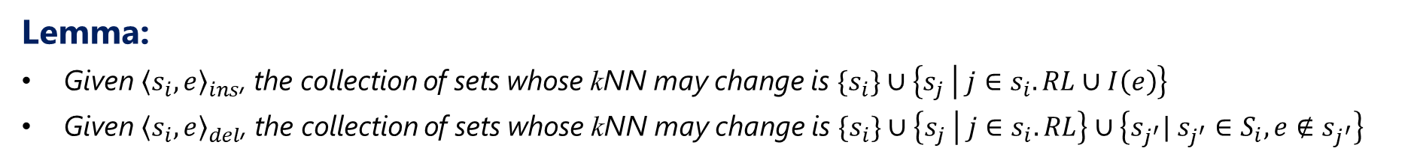

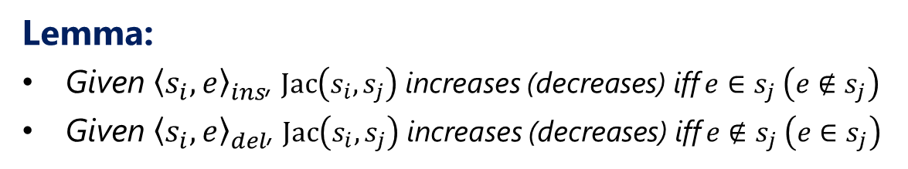

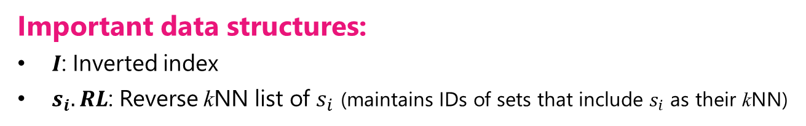










Fundamental property
Questions: When a set has a new element,
Which sets can newly become its kNN result?
Whose kNN results do we have to update?
$$s_{i}$$
$$s_{j}$$
$$e_{1}$$
$$e_{1}$$
$$e_{2}$$
$$e$$
Lemma:
Given ${\left\langle s_{i},e\right\rangle }_{ins}$, $Jac\left(s_{i},s_{j}\right)$ increases (decreases) iff $e∈s_{j} \left(e∉s_{j}\right)$
Given ${\left\langle s_{i},e\right\rangle }_{del}$, $Jac\left(s_{i},s_{j}\right)$ increases (decreases) iff $e∉s_{j} \left(e∈s_{j}\right)$
$$e_{3}$$
$$e_{3}$$
Important data structures:
$I$: Inverted index
$s_{i}.RL$: Reverse kNN list of $s_{i}$ (maintains IDs of sets that include $s_{i}$ as their kNN)
Inverted index $I$
$$e_{i}$$
$$s_{1},s_{3},…$$
$$e_{j}$$
$$s_{2},s_{3},…$$
Lemma:
Given ${\left\langle s_{i},e\right\rangle }_{ins}$, the collection of sets whose kNN may change is $\{s_{i}\}∪\left\{s_{j} | j∈s_{i}.RL∪I\left(e\right)\right\}$
Given ${\left\langle s_{i},e\right\rangle }_{del}$, the collection of sets whose kNN may change is $\{s_{i}\}∪\left\{s_{j} | j∈s_{i}.RL\right\}∪\left\{s_{j^{′}}| s_{j^{′}}∈S_{i},e∉s_{j^{′}}\right\}$
Notes:
We provide some fundamental properties to solve the first challenge. They are derived from questions, when a set has a new element, which sets can newly become its kNN result? And, whose kNN results do we have to update? This lemma answers to the first question. If a set s_i has a new element e, the Jaccard similarity between s_i and s_j increases if and only if s_j has e. We can understand this lemma from this Venn diagram. So, to efficiently access such sets, we employ two data structures, inverted index and reverse kNN lists. The reverse kNN list of a set s_i maintains identifiers of sets that include s_i as their kNN. Now we can see the answer to the second question from this lemma. We can reduce the search space from all sets to only a single reverse kNN list and a single postings list.

Slide 8


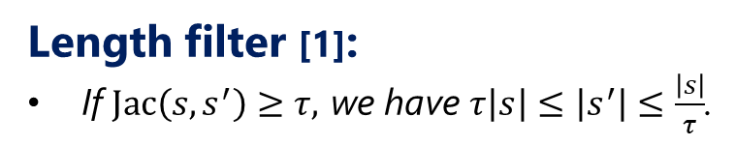




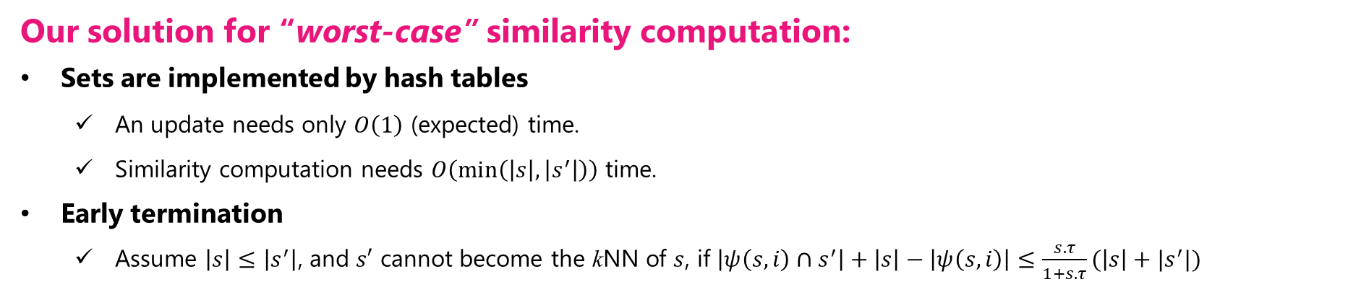

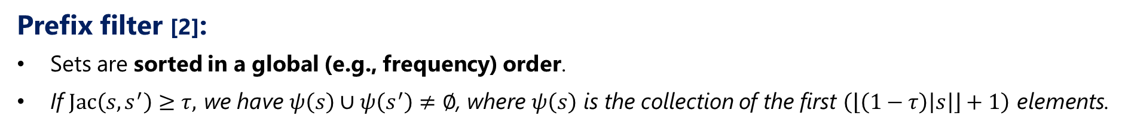

Set similarity computation
Length filter [1]:
If $Jac\left(s,s^{′}\right)≥τ,$ we have $τ\left|s\right|≤\left|s^{′}\right|≤\frac{\left|s\right|}{τ}$.
$$s$$
$$e_{1}$$ | $$e_{2}$$ | $$e_{3}$$ | ? | ?
$$s^{′}$$
$$e_{4}$$ | $$e_{8}$$ | ? | ?
Prefix filter when intersection size needs to be $≥3$.
Prefix filter [2]:
Sets are sorted in a global (e.g., frequency) order.
If $Jac\left(s,s^{′}\right)≥τ,$ we have $ψ\left(s\right)∪ψ\left(s^{′}\right)≠∅$, where $ψ\left(s\right)$ is the collection of the first $\left(\left\lfloor \left(1−τ\right)\left|s\right|\right\rfloor +1\right)$ elements.
Our solution for “worst-case” similarity computation:
Sets are implemented by hash tables
An update needs only $O\left(1\right)$ (expected) time.
Similarity computation needs $O\left(\min\left(\left|s\right|,\left|s^{′}\right|\right)\right)$ time.
Early termination
Assume $\left|s\right|≤\left|s^{′}\right|$, and $s′$ cannot become the kNN of $s$, if $\left|ψ\left(s,i\right)∩s^{′}\right|+\left|s\right|−\left|ψ\left(s,i\right)\right|≤\frac{s.τ}{1+s.τ}(\left|s\right|+|s^{′}|)$
$$s$$
$$e_{1}$$ | $$e_{8}$$ | … | … | … | … | … | … | $$e_{2}$$
$$s^{′}$$
$$e_{7}$$ | $$e_{3}$$ | $$e_{2}$$ | $$e_{1}$$ | $$e_{4}$$
[1] A primitive operator for similarity joins in data cleaning, In ICDE 2006.
[2] Scaling up all pairs similarity search, In WWW 2007.
Notes:
Next, how to filter unnecessary similarity computation. Existing studies have proposed length filter and prefix filter. The length filter uses the idea, to be similar, the set size also should be similar. The prefix filter assumes sets are sorted in a frequency order, and uses the idea (that) to be similar, two sets must have at least one common element in their prefix. We see (that) the prefix filter is not suitable for dynamic sets, because we need many sorting operations for each set update. To avoid this, we use two techniques. First, we implement sets by using hash tables, because update and similarity computation costs are both reasonable. Also, we can use an early termination based on a similar approach to the prefix filter, without sorting.

Slide 9

Summary of concrete challenges
Solve?
1. Identifying sets whose kNN results may change
2. Quick update of kNN results of the above sets
3. Quick similarity computation between two sets
Notes:
We have solved the first and the last challenges. The remaining challenge is the main one of our problem, meaning (that) our main contribution is to solve it.

Slide 10
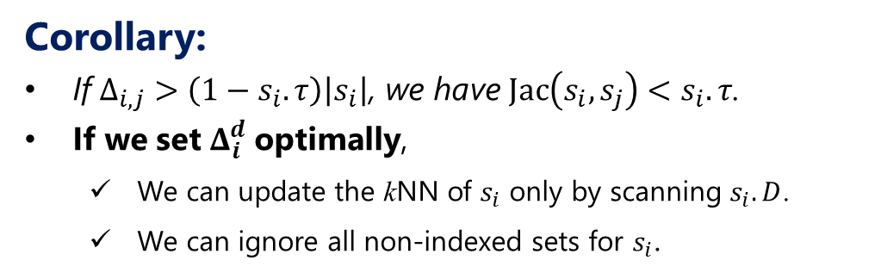
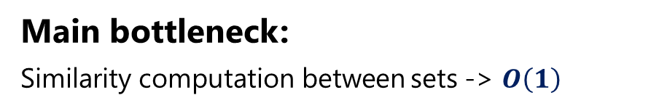


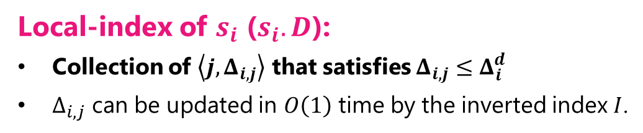
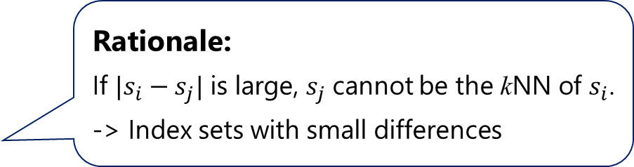
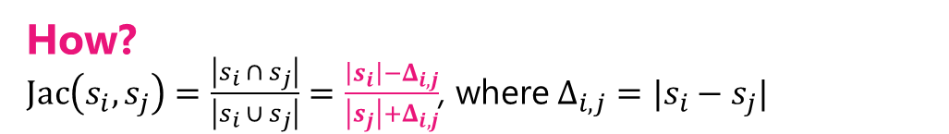

LI-DSN-Join: Local-index (main idea)
Main bottleneck:
Similarity computation between sets -> $O\left(1\right)$
How?
$Jac\left(s_{i},s_{j}\right)=\frac{\left|s_{i} ∩ s_{j}\right|}{\left|s_{i} ∪ s_{j}\right|}=\frac{\left|s_{i}\right|−Δ_{i,j}}{\left|s_{j}\right|+Δ_{i,j}}$, where $Δ_{i,j}=|s_{i}−s_{j}|$
Local-index of $s_{i}$ ($s_{i}.D$):
Collection of $\left\langle j,Δ_{i,j}\right\rangle$ that satisfies $Δ_{i,j}≤Δ_{i}^{d}$
$Δ_{i,j}$ can be updated in $O\left(1\right)$ time by the inverted index $I$.
Rationale:
If $|s_{i}−s_{j}|$ is large, $s_{j}$ cannot be the kNN of $s_{i}$.
-> Index sets with small differences
Corollary:
If $Δ_{i,j}>\left(1−s_{i}.τ\right)\left|s_{i}\right|$, we have $Jac\left(s_{i},s_{j}\right)<s_{i}.τ$.
If we set $Δ_{i}^{d}$ optimally,
We can update the kNN of $s_{i}$ only by scanning $s_{i}.D$.
We can ignore all non-indexed sets for $s_{i}$.
$$s_{i}.D$$
$$\left\langle 1,3\right\rangle$$ | $$\left\langle 3,2\right\rangle$$ | … | $$\left\langle 5,1\right\rangle$$
The operation of kNN update for $s_{i}$
Notes:
Our algorithm LI-DSN-Join incrementally updates the join result basically. The main bottleneck of our problem is similarity computation between sets. If this cost becomes a constant, the update time becomes fast, but how to do it? We can see (that) the Jaccard similarity can be obtained in a constant time if we have the difference size between two sets. So, we maintain it in a local-index. It is a collection of pairs of ID and a difference size, and the size has not to be larger than a threshold. The rationale of this index is (that) if the difference between s_i and s_j is large, s_j cannot be the kNN of s_i. So if s_i has an index that maintains sets with small differences, we can update its kNN only by scanning its local-index. I later introduce how to set the threshold.

Slide 11



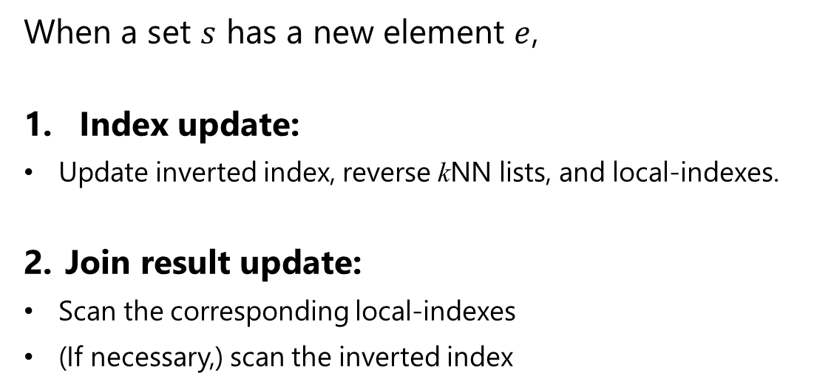







LI-DSN-Join: overview
When a set $s$ has a new element $e$,
Index update:
Update inverted index, reverse kNN lists, and local-indexes.
Join result update:
Scan the corresponding local-indexes
(If necessary,) scan the inverted index
Postings list $I\left(e\right)$
$$s.D$$
$$e$$
$$s_{1},s_{3},…,s$$
$$\left\langle 1,3\right\rangle$$ | $$\left\langle 3,2\right\rangle$$ | …
$$s.D$$
…
$$s_{i}.D$$
$$\left\langle 1,3\right\rangle$$ | $$\left\langle 3,2\right\rangle$$ | …
$$\left\langle 2,1\right\rangle$$ | $$\left\langle 3,1\right\rangle$$ | …
Notes:
This is the flow of LI-DSN-Join when a set has a new element. It is quite simple, update our index, then update the join result.

Slide 12

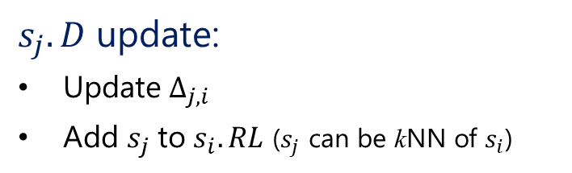
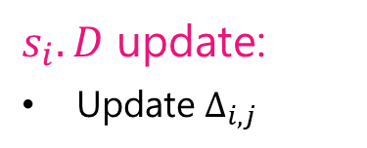
LI-DSN-Join: Index update (insertion case)
Scan only the postings list $I(e)$!
$s_{i}.D$ update:
Update $Δ_{i,j}$
$s_{j}.D$ update:
Update $Δ_{j,i}$
Add $s_{j}$ to $s_{i}.RL$ ($s_{j}$ can be kNN of $s_{i}$)
Notes:
This algorithm describes how to update our data structures including the inverted index, reverse kNN lists, and local-indexes, when a set has a new element. I don’t explain the detail, but I wanna say (that) the index update can be done by scanning only a single postings list. So this is done very quickly.

Slide 13

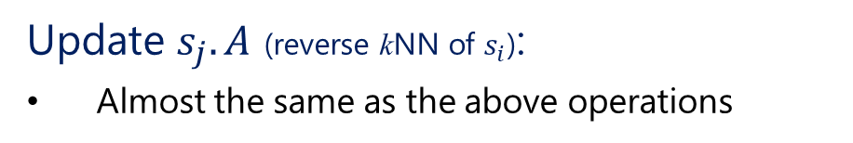
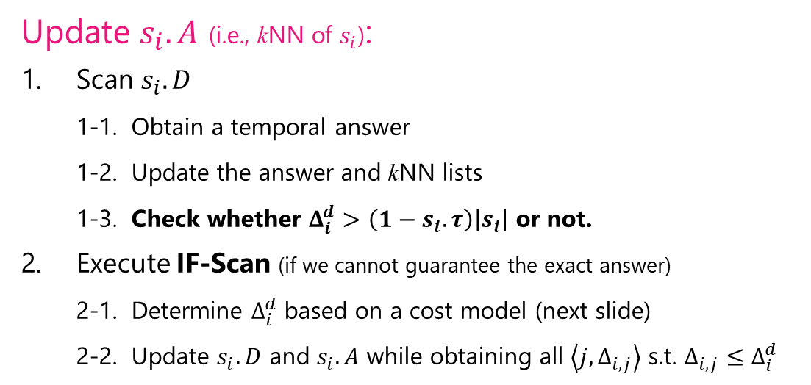
LI-DSN-Join: $Δ$-Scan & IF-Scan
Update $s_{i}.A$ (i.e., kNN of $s_{i}$):
Scan $s_{i}.D$
1-1. Obtain a temporal answer
1-2. Update the answer and kNN lists
1-3. Check whether $Δ_{i}^{d}>\left(1−s_{i}.τ\right)\left|s_{i}\right|$ or not.
Execute IF-Scan (if we cannot guarantee the exact answer)
2-1. Determine $Δ_{i}^{d}$ based on a cost model (next slide)
2-2. Update $s_{i}.D$ and $s_{i}.A$ while obtaining all $\left\langle j,Δ_{i,j}\right\rangle$ s.t. $Δ_{i,j}≤Δ_{i}^{d}$
$$\left\langle 1,3\right\rangle$$ | $$\left\langle 3,2\right\rangle$$ | … | $$\left\langle 5,1\right\rangle$$
Update $s_{j}.A$ (reverse kNN of $s_{i}$):
Almost the same as the above operations
Notes:
Then, we update the join result by delta-Scan which scans local-indexes. Basically, delta-Scan is sufficient for the join result update. However, because thresholds, which are the k-th highest similarities, are dynamic, the threshold of the local-index may not guarantee the correctness. In this case, we execute IF-Scan to determine the threshold and update the local-index as well as the join result.

Slide 14
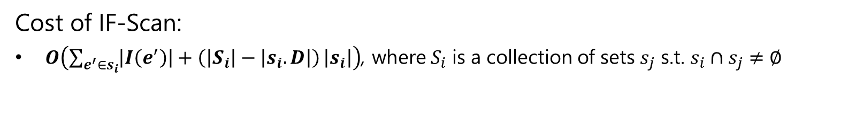
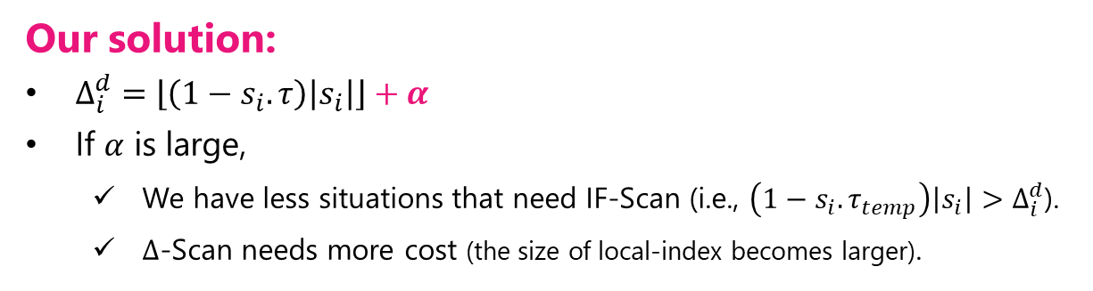
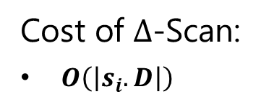

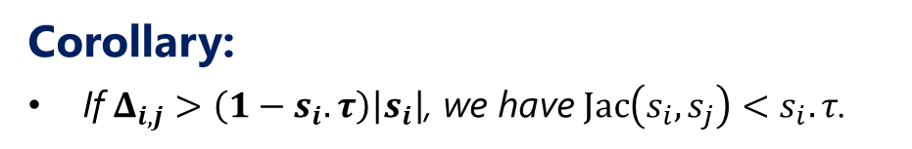


LI-DSN-Join: Cost model for determining $Δ_{i}^{d}$
Corollary:
If $Δ_{i,j}>\left(1−s_{i}.τ\right)\left|s_{i}\right|$, we have $Jac\left(s_{i},s_{j}\right)<s_{i}.τ$.
$Δ_{i}^{d}=\left(1−s_{i}.τ\right)\left|s_{i}\right|$ ?
Our solution:
$Δ_{i}^{d}=\left\lfloor \left(1−s_{i}.τ\right)\left|s_{i}\right|\right\rfloor +α$
If $α$ is large,
We have less situations that need IF-Scan (i.e., $\left(1−s_{i}.τ_{temp}\right)\left|s_{i}\right|>Δ_{i}^{d}$).
$Δ$-Scan needs more cost (the size of local-index becomes larger).
Cost of $Δ$-Scan:
$O\left(\left|s_{i}.D\right|\right)$
We want to avoid this operation as much as possible!
Cost of IF-Scan:
$O\left(\sum_{e^{′}∈s_{i}}{\left|I\left(e^{′}\right)\right|+\left(\left|S_{i}\right|−\left|s_{i}.D\right|\right)}\left|s_{i}\right|\right)$, where $S_{i}$ is a collection of sets $s_{j}$ s.t. $s_{i}∩s_{j}≠∅$
Obtain all $s_{j}$ s.t. $s_{i}∩s_{j}≠∅$.
Compute $Δ_{i,j}$ for all $s_{j}∈S_{i}$.
Notes:
Here I focus on how to set the threshold. This corollary tells a necessary difference size to guarantee the correctness. So one may consider this equation for determining the threshold. However, this is too strict in practice, so we allow some false positive, alpha. If alpha is large, we have less situation which need IF-Scan but the delta-Scan cost becomes larger. Now our challenge is how to set an well-balanced alpha. To get such alpha, we design a cost model. The cost of delta-Scan is derived from its scan cost, the size of a local-index. The cost of IF-Scan is derived from the cost of obtaining all sets with at least one common element and computing the difference for all of them. We can see this cost is very high, so we want to avoid this operation as much as possible.

Slide 15
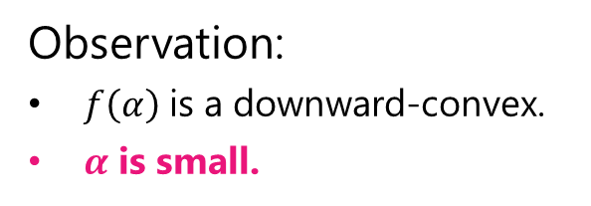
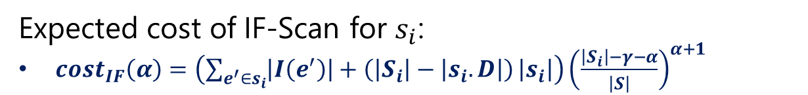
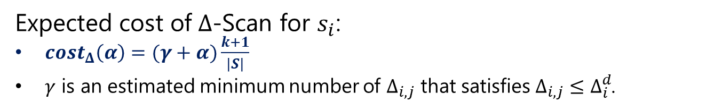
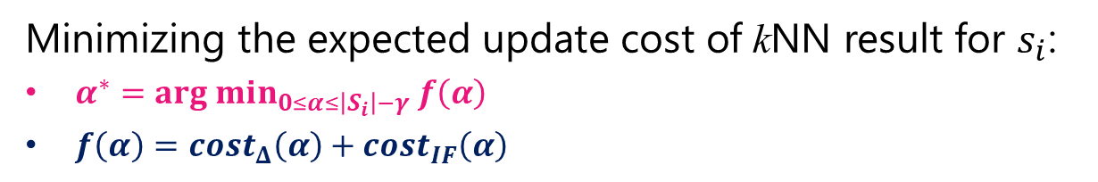
LI-DSN-Join: Determining an optimal $α$
Minimizing the expected update cost of kNN result for $s_{i}$:
$α^{∗}=arg min_{0≤α≤\left|S_{i}\right|−γ} f\left(α\right)$
$f\left(α\right)=cost_{Δ}\left(α\right)+cost_{IF}\left(α\right)$
Expected cost of $Δ$-Scan for $s_{i}$:
$cost_{Δ}\left(α\right)=(γ+α)\frac{k+1}{\left|S\right|}$
$γ$ is an estimated minimum number of $Δ_{i,j}$ that satisfies $Δ_{i,j}≤Δ_{i}^{d}$.
Expected cost of IF-Scan for $s_{i}$:
$cost_{IF}\left(α\right)=\left(\sum_{e^{′}∈s_{i}}{\left|I\left(e^{′}\right)\right|+\left(\left|S_{i}\right|−\left|s_{i}.D\right|\right)}\left|s_{i}\right|\right){\left(\frac{\left|S_{i}\right|−γ−α}{\left|S\right|}\right)}^{α+1}$
Observation:
$f\left(α\right)$ is a downward-convex.
$α$ is small.
Notes:
This problem is formulated so that the objective is to minimize the expected update cost of kNN result for s_i. The objective function is sum of the costs of delta-Scan and IF-Scan. They are also functions of alpha and derived from the costs in the previous slide. Actually, the objective function is a downward convex. We can easily obtain an optimal value. As can be seen from this figure, alpha is small in practice.

Slide 16
Summary of concrete challenges
Solve?
1. Identifying sets whose kNN results may change
2. Quick update of kNN results of the above sets
3. Quick similarity computation between two sets
Notes:
We have solved all challenges, so I’m going to report the performance of LI-DSN-Join.

Slide 17
Experiment: Setting
Competitors:
ALL: A state-of-the-art set similarity join algorithm with prefix- and length-filter [2]
Tree: A state-of-the-art set similarity search algorithm with a B-tree like index [3]
Parameters:
k: 2, 4, 8, 16, 32
Deletion rate: 0, 0.001, 0.002, 0.004, 0.008
Datasets:
Amazon (product), LiveJournal (social network), Netflix (rating), Orkut (social network) + additional 6 datasets (in the paper)
10,000,000 set updates (consisting of element insertions and deletions)
[2] Scaling up all pairs similarity search, In WWW 2007.
[3] An efficient framework for exact set similarity search using tree structure indexes, In ICDE 2017.
Notes:
We compared LI-DSN-Join with ALL and Tree. ALL is a state-of-the-art set similarity join algorithm, and tree is a state-of-the-art set similarity search algorithm. We extended them to deal with our algorithm. We used 10 real datasets, but I show the results on 4 datasets. The experiments terminated when the algorithms deal with 10 million set updates.

Slide 18
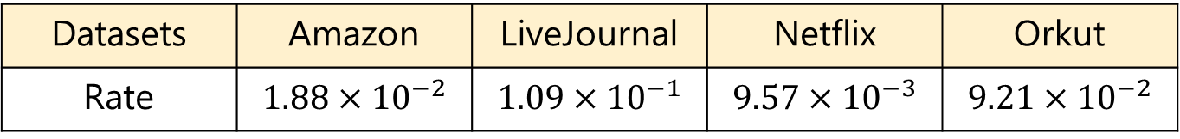
Experiment: Index update time
Table 1: Index update time / Total update time
Datasets | Amazon | LiveJournal | Netflix | Orkut
Rate | $$1.88×{10}^{−2}$$ | $$1.09×{10}^{−1}$$ | $$9.57×{10}^{−3}$$ | $$9.21×{10}^{−2}$$
Index update occupies only a very small part of join update.
Demonstrate that kNN results update is the dominant factor
Notes:
First, I show the index update time is very short. The table shows the ratio of index update time over total update time. We see (that) the index update is done quickly and kNN results update is the dominant factor.

Slide 19
Experiment: Comparison with existing techniques (Update time)
LI-DSN-Join
Updates the join result faster.
Scales well
Is much better particularly when sets are large.
Why?
Incremental update with local-indices
Notes:
Now we compare LI-DSN-Join with ALL and Tree. We can see LI-DSN-Join updates the join result much faster than ALL and Tree. Although ALL and Tree employ the fundamental properties to avoid unnecessary result updates, they cannot scale well. On the other hand, LI-DSN-Join incrementally updates the join result with local-indexes, so its update time is faster significantly.

Slide 20
Experiment: Comparison with existing techniques (Memory)
The memory cost of LI-DSN-Join is always worse than that of ALL.
This is due to local-indices.
The memory cost is still practical (#elements is 10 millions) for in-memory systems. (Our environment has 512GB RAM.)
Notes:
The figure shows the memory costs of ALL and LI-DSN-Join. The memory cost of LI-DSN-Join is worse than that of ALL. This is because ALL does not employ local-index. However, the memory cost of LI-DSN-Join is still practical for in-memory systems.

Slide 21
Experiment: Impact of k
Why increase and decrease?
Local-index size increases
When k is large, thresholds are often stable -> ALL incurs less result verification cost
Notes:
Finally, the figures show the impact of k. We can see (that) as k increases, the update time of LI-DSN-Join slightly increases. This is because local-index size increases. On the other hand, the update time of ALL decreases. This is because when k is large, thresholds tend to be stable, so it incurs less result verification costs.

Slide 22
Conclusion
Problem: Dynamic Set kNN Self-Join
Monitor kNN results for all dynamic sets
Solution: LI-DSN-Join
Incrementally update the join result with local-indices
Evaluation:
LI-DSN-Join updates the join result more efficiently than existing techniques for set similarity join.
Notes:
I conclude my presentation. We addressed the problem of dynamic set kNN self-join and proposed LI-DSN-Join. We empirically evaluated its efficiency.

Slide 23

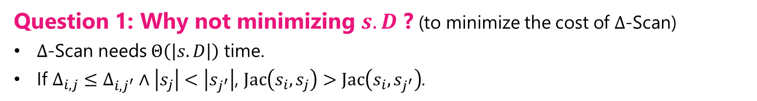


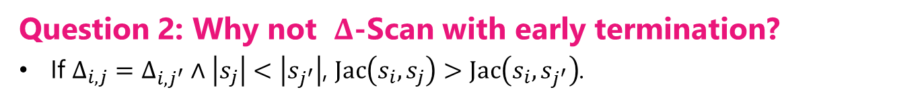
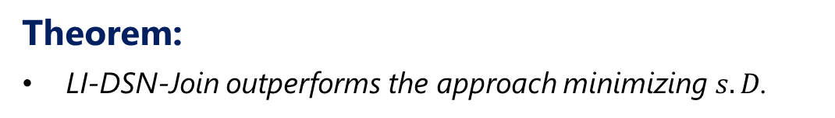

LI-DSN-Join: Analysis (see paper for detail)
Question 1: Why not minimizing $s.D$ ? (to minimize the cost of $Δ$-Scan)
$Δ$-Scan needs $Θ\left(\left|s.D\right|\right)$ time.
If $Δ_{i,j}≤Δ_{i,j^{′}}∧\left|s_{j}\right|<\left|s_{j^{′}}\right|$, $Jac\left(s_{i},s_{j}\right)>Jac\left(s_{i},s_{j^{′}}\right)$.
Theorem:
LI-DSN-Join outperforms the approach minimizing $s.D$.
Question 2: Why not $Δ$-Scan with early termination?
If $Δ_{i,j}=Δ_{i,j^{′}}∧\left|s_{j}\right|<\left|s_{j^{′}}\right|$, $Jac\left(s_{i},s_{j}\right)>Jac\left(s_{i},s_{j^{′}}\right)$.
$$≤$$
$$≤$$
$$Δ$$
$$s_{j}$$ | $$s_{j^{′}}$$ | …
Theorem:
LI-DSN-Join outperforms the early termination approach.

Slide 24
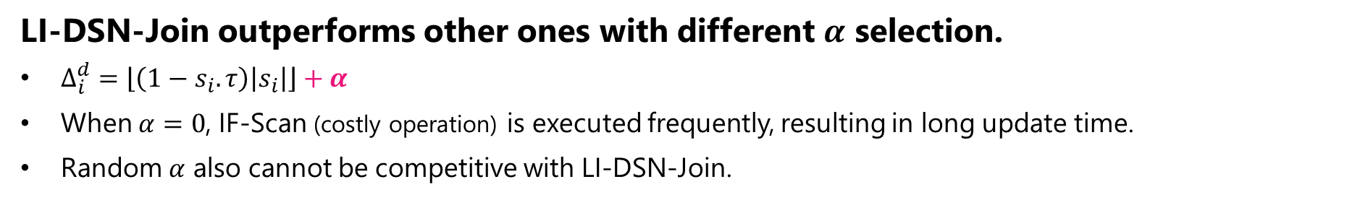
Experiment: Cost model evaluation
LI-DSN-Join outperforms other ones with different $α$ selection.
$Δ_{i}^{d}=\left\lfloor \left(1−s_{i}.τ\right)\left|s_{i}\right|\right\rfloor +α$
When $α=0$, IF-Scan (costly operation) is executed frequently, resulting in long update time.
Random $α$ also cannot be competitive with LI-DSN-Join.
Notes:
First, I validate our cost model. To do it, we compared LI-DSN-Join with zero-alpha and random-alpha. We can see from the figures (that) LI-DSN-Join is the best. When alpha is zero, IF-Scan is executed frequently, so its update time is long. Random alpha is also worse than LI-DSN-Join. This is because random alpha can provide too small alpha and too large alpha, both of which incur large update costs.

Slide 25
Experiment: Impact of deletion rate
ALL suffers from large deletion rate.
Many sets are affected by a single element deletion.
LI-DSN-Join is not sensitive to the rate.
Local-indices functions well.
Notes:
The figures show the impact of deletion rate.

