Slide 1


REVERSE MAXIMUM INNER PRODUCT SEARCH: HOW TO EFFICIENTLY FIND USERS WHO WOULD LIKE TO BUY MY ITEM?
Daichi Amagata^{1,2} and Takahiro Hara¹
1. Osaka University
2. JST PRESTO

Slide 2
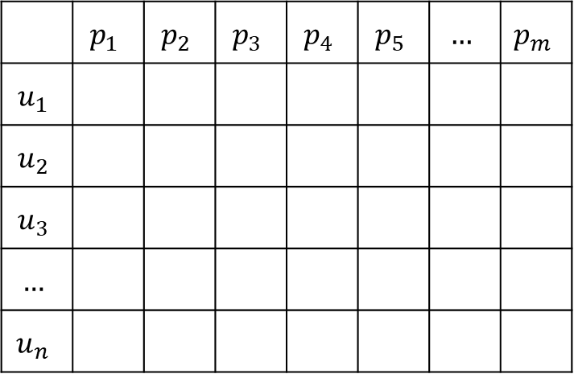




BACK GROUND: MATRIX FACTORIZATION
Rating Matrix:
User & Item Matrices <- we have these.
Items
$$d$$
 | $$p_{1}$$ | $$p_{2}$$ | $$p_{3}$$ | $$p_{4}$$ | $$p_{5}$$ | $$…$$ | $$p_{m}$$
$$u_{1}$$
$$u_{2}$$
$$u_{3}$$
$$…$$
$$u_{n}$$
$$m$$
Users
Items
x
$$d$$
Users
$$n$$
Motivation:
[1] empirically shows that MF-based recommender systems are better than Neural CF-based ones.
[1] Steffen Rendle, Walid Krichene, Li Zhang, and John Anderson, Neural Collaborative Filtering vs. Matrix Factorization Revisited, In RecSys, 2020.

Slide 3
BACK GROUND: MAXIMUM INNER PRODUCT SEARCH
Problem 1 (MIPS): Given a user vector $u$ and an item matrix $P$, MIPS finds $p^{∗}={arg max}_{p∈P} u⋅p$
 | $$p_{1}$$ | $$p_{2}$$ | $$p_{3}$$ | $$p_{4}$$ | $$p_{5}$$ | $$…$$ | $$p_{m}$$
$$u_{1}$$ | 4.1 | 5.0 | 2.5 | 1.8 | 3.0 |  | 0.2
$$u_{2}$$
$$u_{3}$$
$$…$$
$$u_{n}$$
$$m$$
$$d$$
P (item vectors)
$$u_{1}$$
x
$$d$$
$$p^{∗}=p_{2}$$
Note: This corresponds to
making a recommendation list for a given user. <- a “user-driven” service

Slide 4
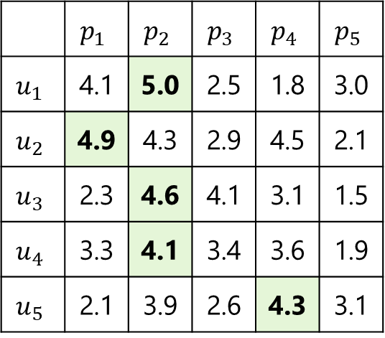
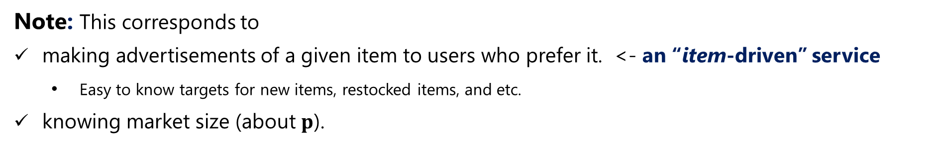
BACK GROUND: HOW TO FIND USERS WHO MAY BUY A GIVEN ITEM?
Question: For a given item $p$, which user vectors $u$ do satisfy $p={arg max}_{p^{′}∈P} u⋅p^{′}$ ?
$$d$$
 | $$p_{1}$$ | $$p_{2}$$ | $$p_{3}$$ | $$p_{4}$$ | $$p_{5}$$
$$u_{1}$$ | 4.1 | 5.0 | 2.5 | 1.8 | 3.0
$$u_{2}$$ | 4.9 | 4.3 | 2.9 | 4.5 | 2.1
$$u_{3}$$ | 2.3 | 4.6 | 4.1 | 3.1 | 1.5
$$u_{4}$$ | 3.3 | 4.1 | 3.4 | 3.6 | 1.9
$$u_{5}$$ | 2.1 | 3.9 | 2.6 | 4.3 | 3.1
$$m$$
Users
Items
x
$$d$$
$$n$$
Note: This corresponds to
making advertisements of a given item to users who prefer it. <- an “item-driven” service
Easy to know targets for new items, restocked items, and etc.
knowing market size (about $p$).

Slide 5
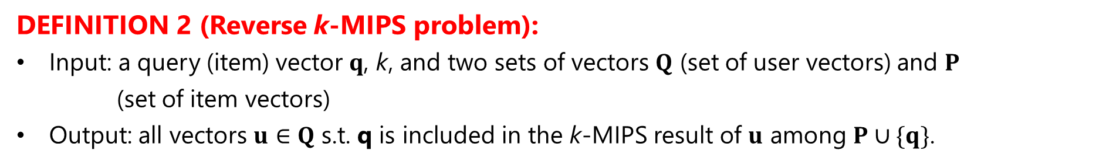
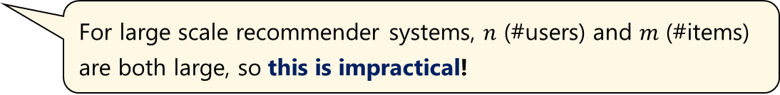
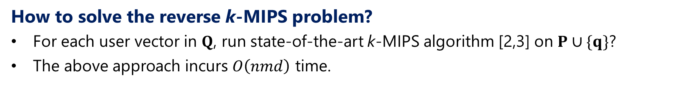
REVERSE MAXIMUM INNER PRODUCT SEARCH
DEFINITION 1 (k-MIPS problem):
Input: a set of vectors P, a query vector q, and k,
Output: k vectors in P that have the highest inner products with q.
DEFINITION 2 (Reverse k-MIPS problem):
Input: a query (item) vector $q$, k, and two sets of vectors $Q$ (set of user vectors) and $P$ (set of item vectors)
Output: all vectors $u∈Q$ s.t. q is included in the k-MIPS result of $u$ among $P∪\{q\}$.
How to solve the reverse k-MIPS problem?
For each user vector in $Q$, run state-of-the-art k-MIPS algorithm [2,3] on $P∪\{q\}$?
The above approach incurs $O\left(nmd\right)$ time.
For large scale recommender systems, $n$ (#users) and $m$ (#items) are both large, so this is impractical!
[2] Hui Li, Tsz Nam Chan, Man Lung Yiu, and Nikos Mamoulis, FEXIPRO: fast and exact inner product retrieval in recommender systems, In SIGMOD, 2017.
[3] Christina Teflioudi, Rainer Gemulla, and Olga Mykytiuk, LEMP: Fast retrieval of large entries in a matrix product, In SIGMOD, 2015.

Slide 6
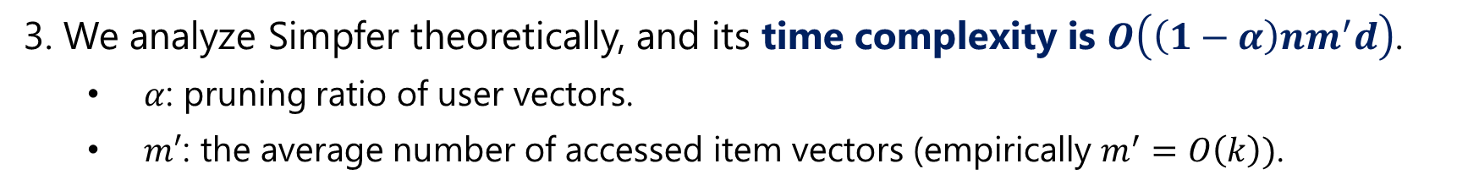
CONTRIBUTION
1. We propose the reverse k-MIPS problem.
2. We propose Simpfer, an simple, fast and exact algorithm for reverse k-MIPS.
Simpfer is easy to deploy, if you use a MF-based recommender system.
Source code is available at https://github.com/amgt-d1/Simpfer.
3. We analyze Simpfer theoretically, and its time complexity is $O\left(\left(1−α\right)nm^{′}d\right)$.
$α$: pruning ratio of user vectors.
$m′$: the average number of accessed item vectors (empirically $m^{′}=O\left(k\right))$.
4. We analyze Simpfer empirically on four real datasets.
Simpfer is two orders of magnitude faster than baseline algorithms.
For a dataset with 2 million users, Simpfer needs 0.5[sec], while the baselines need a half hour!

Slide 7





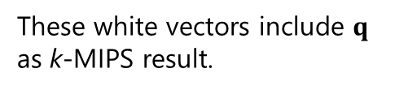
HOW TO SPEED-UP REVERSE k-MIPS PROCESSING?
Straightforward solution: for each $u∈Q$, run k-MIPS on $P∪\{q\}$
$$m$$
Strong points:
The result is correct.
Some item vectors can be skipped by using [2,3].
$Q$: users
$P$: items
$$q$$
x
$$n$$
Weak points:
All user vectors must be investigated.
Most user vectors are not included in the result.
These white vectors include $q$ as k-MIPS result.
Our Idea:
User vectors that are not included in the reverse k-MIPS result should be ignored.
We don’t need the k-MIPS result (i.e., vectors), and just Yes/No answer for the k-MIPS result is sufficient.
-> How to implement these ideas?
[2] Hui Li, Tsz Nam Chan, Man Lung Yiu, and Nikos Mamoulis, FEXIPRO: fast and exact inner product retrieval in recommender systems, In SIGMOD, 2017.
[3] Christina Teflioudi, Rainer Gemulla, and Olga Mykytiuk. LEMP: Fast retrieval of large entries in a matrix product, In SIGMOD, 2015.

Slide 8


















PRE-PROCESSING
Lines 1-6: General data structure
norm:
$$\left\|v\right\|$$
$$Q$$
$$u_{1}$$ | $$u_{2}$$ | $$u_{3}$$ | $$u_{4}$$ | $$u_{5}$$ | $$u_{6}$$ | $$u_{7}$$ | $$u_{8}$$ | … | $$u_{n}$$
$$P$$
$$p_{1}$$ | $$p_{2}$$ | $$p_{3}$$ | $$p_{4}$$ | $$p_{5}$$ | $$p_{6}$$ | $$p_{7}$$ | $$p_{8}$$ | … | $$p_{m}$$
$P^{′}$: the first $O\left(k_{max}\right)$ vectors in $P$
Lines 7-10: Lower-bound arrays ($k_{max}$ is the maximum $k$)
$$L_{1}$$
4.5 | 4.1 | 3.9 | … | 3.2
… | … | … | … | …
4.8 | 4.7 | 4.2 | … | 3.8
$←k_{max}$-MIP in $u_{1}×P^{′}$ ($≤p^{∗}$)
$$…$$
$$L_{n}$$
$←k_{max}$-MIP in $u_{n}×P^{′}$
Lines 11-18: Blocks (the block size is $O(log{n})$)
$$u_{1}$$ | $$u_{2}$$ | $$u_{3}$$ | $$u_{4}$$ | $$u_{5}$$ | $$u_{6}$$ | $$u_{7}$$ | $$u_{8}$$ | … | $$u_{n}$$
Only $O\left(n\left(d+\log{n}\right)\right)$ time & $O\left(n\right)$ space.
$$B_{1}$$
$$B_{2}$$
$$L\left(B_{1}\right)$$
4.3 | 4.1 | 3.5 | … | 2.9
… | … | … | … | …
$←L^{j}\left(B\right)=\min_{u_{i}∈B}{L_{i}^{j}}$

Slide 9
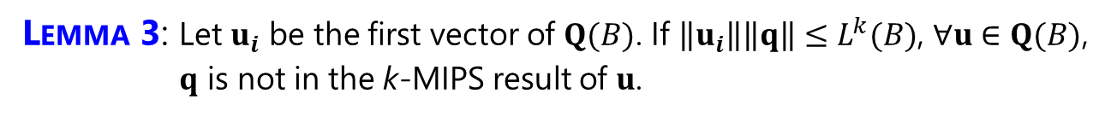




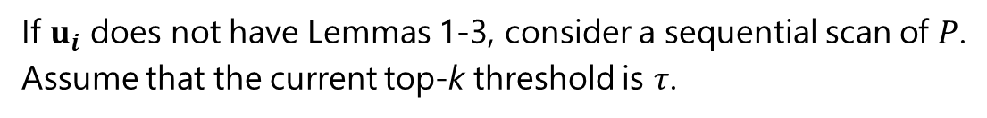
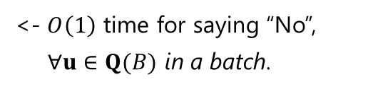
UPPER- & LOWER-BOUNDING
Assume that we have $u_{i}⋅q$.
LEMMA 1: If $u_{i}⋅q≤L_{i}^{k}$, $q$ is not in the k-MIPS result of $u_{i}$.
<- $O\left(1\right)$ time for saying “No”.
LEMMA 2: If $u_{i}⋅q≥\left\|u_{i}\right\|\left\|p_{k}\right\|$, $q$ is in the k-MIPS result of $u_{i}$.
<- $O\left(1\right)$ time for saying “Yes”.
LEMMA 3: Let $u_{i}$ be the first vector of $Q(B)$. If $\left\|u_{i}\right\|\left\|q\right\|≤L^{k}(B)$, $∀u∈Q(B)$, $q$ is not in the k-MIPS result of $u$.
<- $O\left(1\right)$ time for saying “No”, $∀u∈Q(B)$ in a batch.
If $u_{i}$ does not have Lemmas 1-3, consider a sequential scan of $P$.
Assume that the current top-k threshold is $τ$.
$$p_{1}$$ | $$p_{2}$$ | $$p_{3}$$ | $$p_{4}$$ | $$p_{5}$$ | $$p_{6}$$ | $$p_{7}$$ | $$p_{8}$$ | … | $$p_{m}$$
COROLLARY 1: Assume that $q$ is in an intermediate k-MIPS result of $u_{i}$, and we now evaluate $p_{j}$. If $u_{i}⋅q (≥τ)≥\left\|u_{i}\right\|\left\|p_{j}\right\|$, $q$ is in the k-MIPS result of $u_{i}$.
<- Early stop the scan
COROLLARY 2: If $u_{i}⋅q<τ$, $q$ is not in the k-MIPS result of $u_{i}$.
<- Early stop the scan

Slide 10
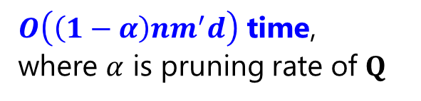
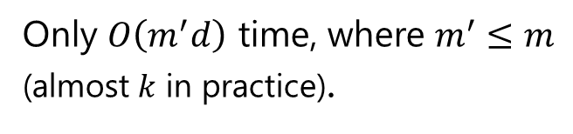
SIMPFER: SIMPLE, FAST, AND EXACT FOR REVERSE k-MIPS
<- Early stop (Corollary 1)
<- Batch pruning (Lemma 3)
<- Lower-bounding (Lemma 1)
<- Upper-bounding (Lemma 2)
<- Early stop (Corollary 2)
Only $O\left(m^{′}d\right)$ time, where $m^{′}≤m$ (almost $k$ in practice).
$O\left(\left(1−α\right)nm^{′}d\right)$ time, where $α$ is pruning rate of $Q$

Slide 11
EXPERIMENTAL RESULT 1: IMPACT OF $k$
MovieLens ($n=138,493,m=26,744)$, Netflix ($n=480,189,m=17,770)$, Yahoo! ($n=2,088,620,m=200,941)$, Amazon ($n=1,948,882,m=98,211)$

Slide 12
EXPERIMENTAL RESULT 2: IMPACT OF $n$ (#USERS)
MovieLens ($n=138,493,m=26,744)$, Netflix ($n=480,189,m=17,770)$, Yahoo! ($n=2,088,620,m=200,941)$, Amazon ($n=1,948,882,m=98,211)$

Slide 13
EXPERIMENTAL RESULT 3: IMPACT OF $m$ (#ITEMS)
MovieLens ($n=138,493,m=26,744)$, Netflix ($n=480,189,m=17,770)$, Yahoo! ($n=2,088,620,m=200,941)$, Amazon ($n=1,948,882,m=98,211)$

Slide 14
CONCLUSION
1. We proposed the reverse k-MIPS problem.
2. We proposed Simpfer for reverse k-MIPS.
Source code is available at https://github.com/amgt-d1/Simpfer.
3. We analyzed Simpfer theoretically, and its time complexity is $O\left(\left(1−α\right)nm^{′}d\right)$.
4. We analyzed the empirical efficiency of Simpfer on four real datasets.

