Slide 1

The Jungle Game
Chesshire Coders
Angélica Fallas
Taner King
Adam Gundem
Alexander Hennings
Cameron Ackerman
Image from: http://www.tattoodaze.com/tattoo-images/79/th_tiger-art-decor-mountain-tiger-tiger-hand-painting-original-bkLbwV.jpg

Slide 2
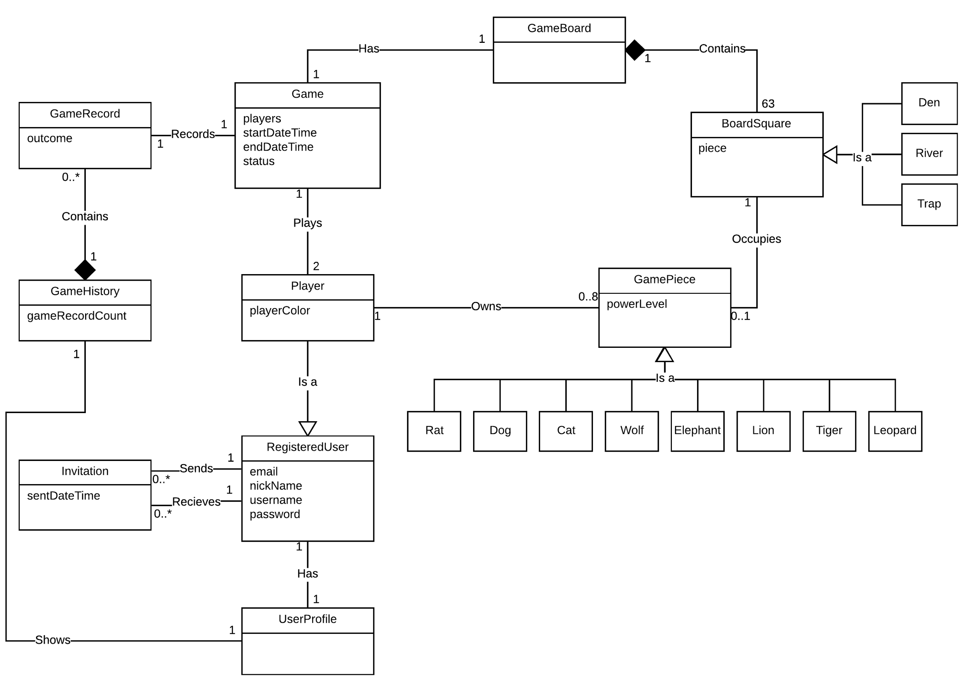
Domain Model

Slide 3
Domain Model - Glossary
Player: An extension of a registered user. They may make moves, capture pieces, and perform other actions that the registered user entity cannot. Each player may control up to eight game pieces. Each player also has a color indicating which team they are on.
Game: An instance of a game of Jungle. Each game has two players, a game board, sixteen pieces, start/end times, and a status (ongoing, completed, abandoned, etc.)
GameBoard: A representation of the Jungle board that contains the current state of a game. The game board contains the different squares of Jungle, and any uncaptured Jungle pieces.
BoardSquare: A representation of a single square on the Jungle board. A square can be one of four types: normal (no specialization), den, river, and trap.
UserProfile: The user profile is the collection of information for a single registered user that is visible to all other registered users.

Slide 4
Domain Model - Glossary - Continued
GamePiece: A representation of a single Jungle piece. It is required that a game piece must be one of its eight different specialization types (i.e. if GamePiece were a Java class, it would be abstract). And there may be no more than one of each piece type per player.
GameHistory: The game history is shown on each registered user’s profiles. It includes a brief synopsis of each game played by that user.
GameRecord: A game record is the outcome of a single game of jungle.
Invitation: An invitation is a request for another registered user to play a game with the sending user. Each invitation has one sender and one receiver.
RegisteredUser: A registered user is a person that has performed the registration process by providing a username, nick-name, email, and password. Each RegisteredUser has a user profile, can send Invitations to other users, and may become a Player in a Jungle game.

Slide 5
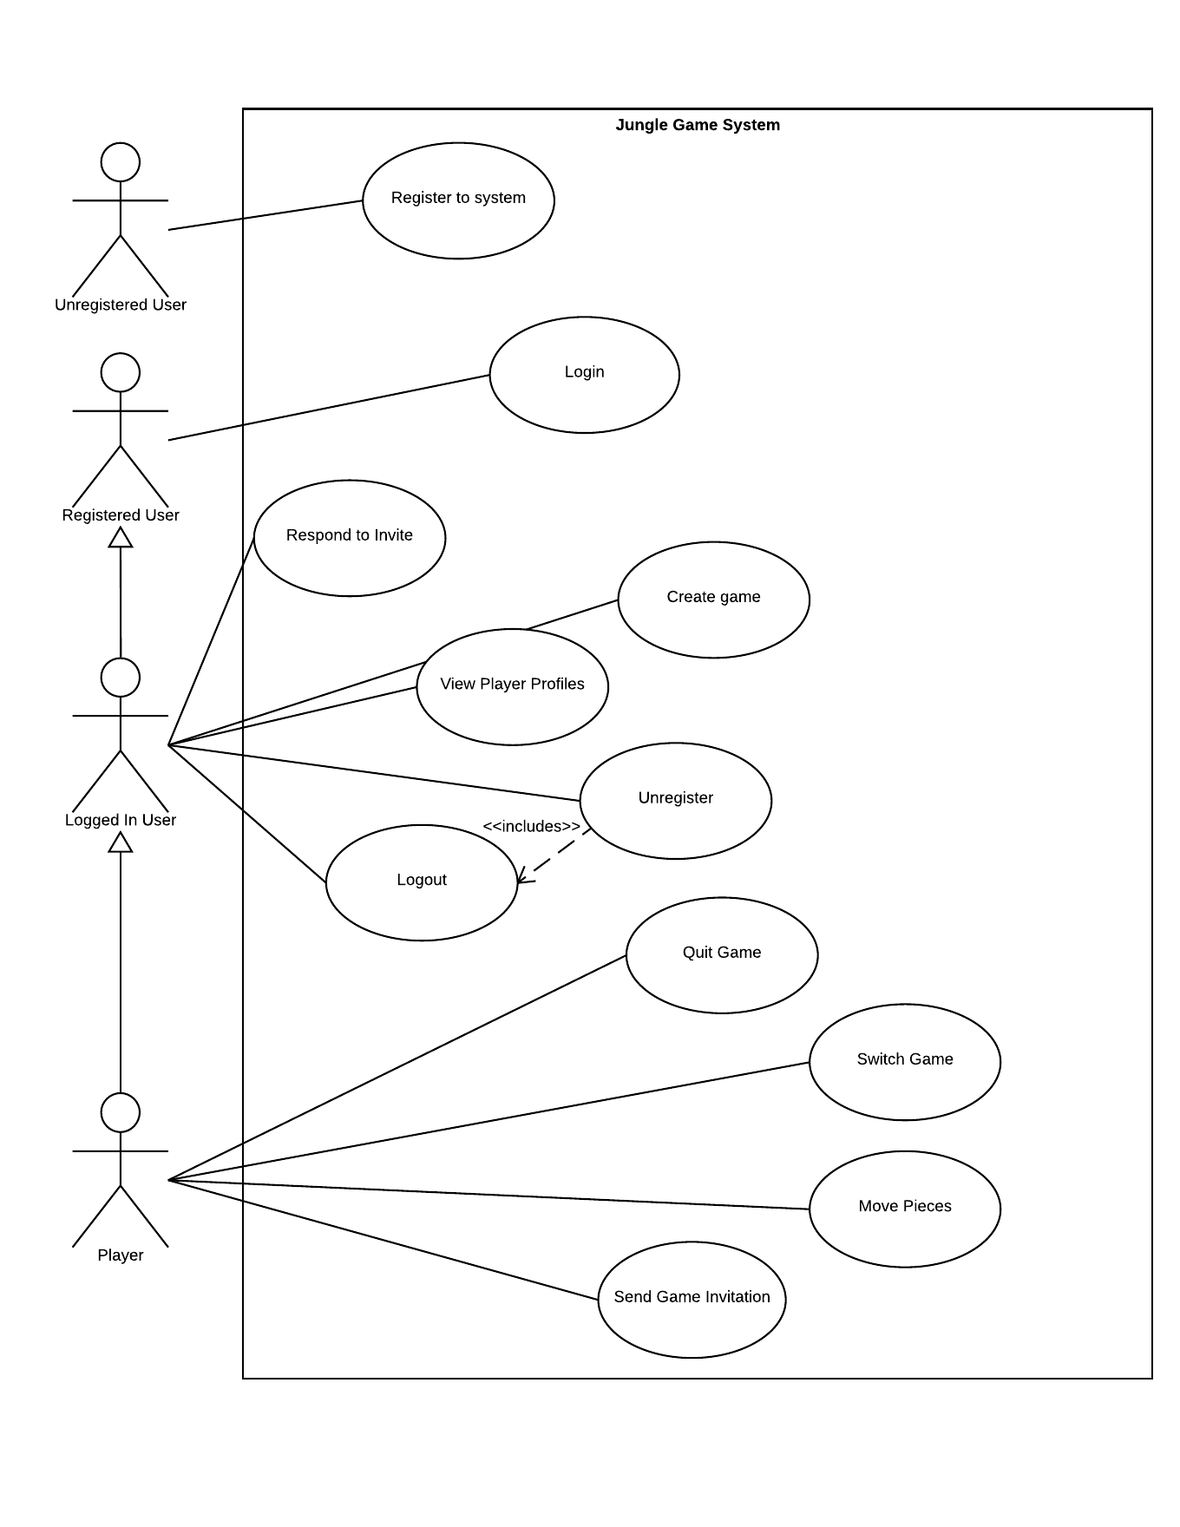
Updated Use
Case Diagram

Slide 6
Updated Use Case Diagram

Slide 7
Updated Use Case Diagram

Slide 8
Updated Use Case Diagram
Notes:
Changed <<extends>> to <<includes>>

Slide 9
Use Cases - Updates
Removed the Start Game use case
Game starts as soon as the second player accepts the invitation and is added to the game.
Removed the Join Game use case
Creating an account now states the requirement of a unique email
Creating an account now states the requirement of a unique nickname
Registered to System
now displays a success or failure message.
now states the requirement of a unique email
Accepting a game invitation now invalidates all other invitations if multiples were sent out for one game.
Accepting a game invitation now starts a new game if sent outside of a game.

Slide 10
Use Cases - Updates - Continued
Quit Game will not end the game if the game can not be found
Quit Game now directly records game information
Unregister from system now removes the login information instead of all information.
Move Game Piece now alerts the opposing player it is their turn
Added Failure conditions
Add notifications for users based on conditions
Login now requires the User to correctly enter the password within three tries.

Slide 11
Questions
And
Discussions

