Slide 1
Holt Visual Cryptography Tool
Allison Holt April 8, 2016

Slide 2
Problem Statement
Develop a tool such that…
Given a secret message and two innocent cover images, two new encoded images are created.
The encoded images need to
Have the same meaning as the cover image
Not reveal any information about the secret
Given two encoded images, a new image is created with the secret message revealed.

Slide 3
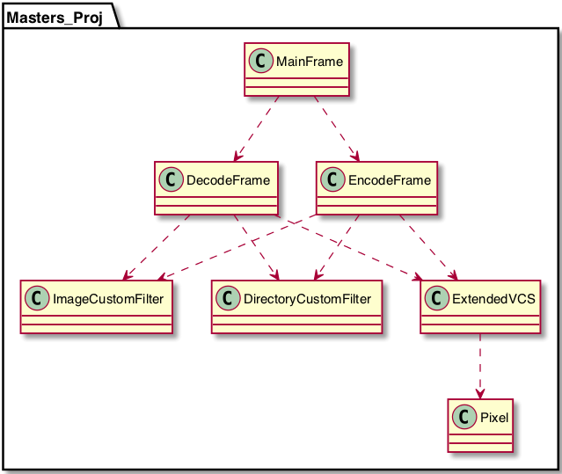
Solution ~ System Overview

Slide 4
Solution ~ Encryption
Error Diffuse Cover Images
Split Secret Message into Red, Green, and Blue Shares
Perform VIP Synchronization
Pixel Expansion in Random Order
Red share, Green share, Blue share, Cover pixel
Calculate Alpha Values
Store ARGB into Encoded Array
Error Diffuse Encoded Images

Slide 5
Solution ~ Decryption
Store the RGB Values of the Related Pixels (Related from Pixel Expansion)
Determine Which Pixels Most Likely Hold the Red, Green, and Blue Shares
Reverse the Encryption Process on a Specific Color in a VIP and Store
Create Color with the Concentrations and Store RGB in the Created Secret Image
Error Diffuse Secret Image

Slide 6
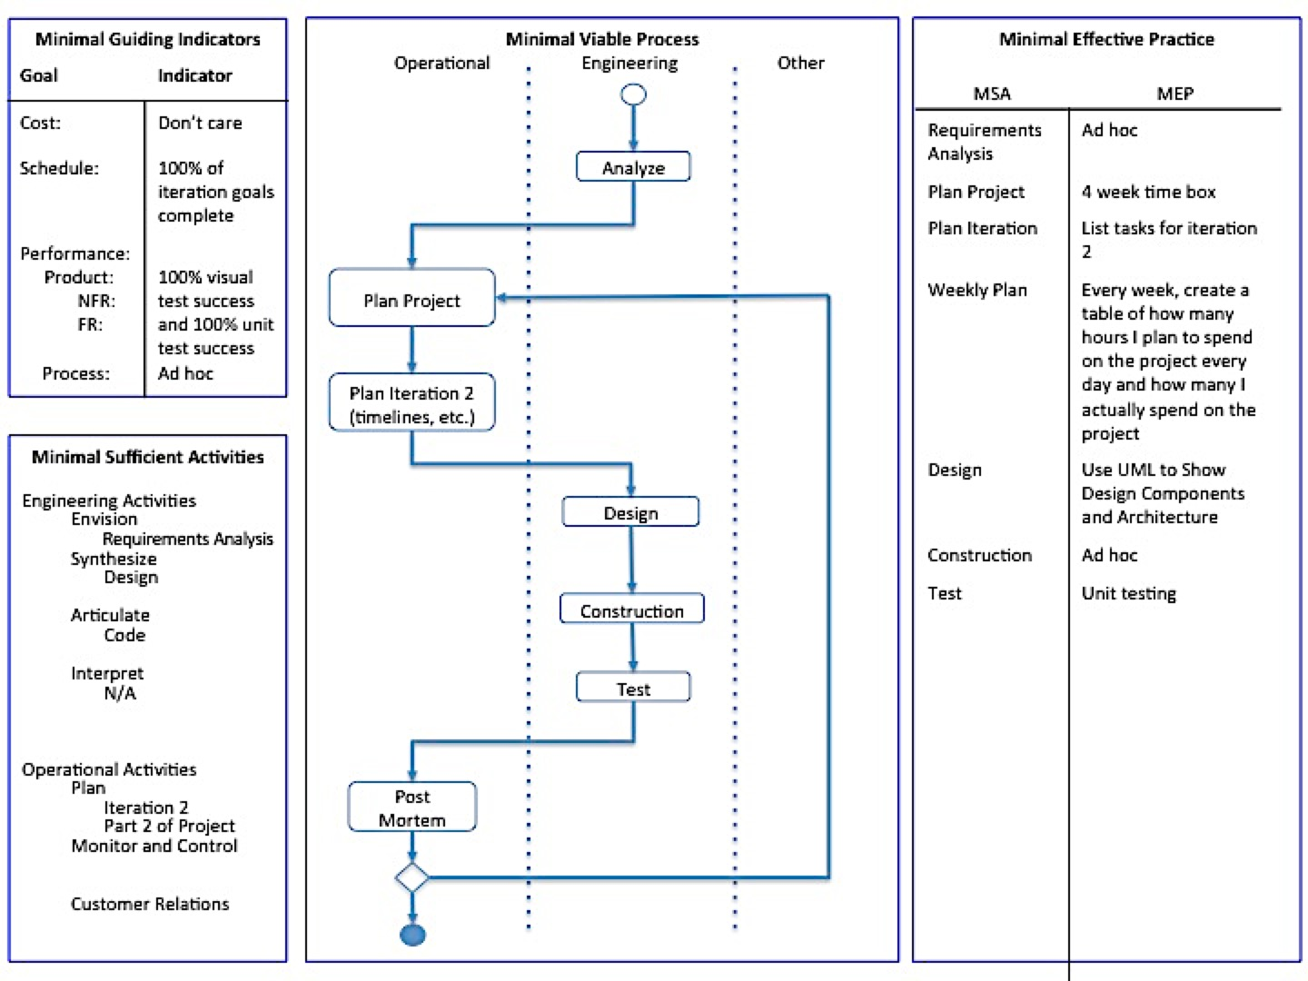
Process
Notes:
Add review of what happened over every iteration?

Slide 7
Iteration 0
Occurred over the summer before fully settling on a project
Dabbled with different visual cryptography schemes
Size Invariant
Extended
Notes:
Size Invariant
k, n where k is the minimum number of shares needed to reveal secret and n is the number of shares created
Shares looked like pictures of static
Extended
The shares are hidden in cover images so the encoded images have meanings
Only worked for strictly black and white images

Slide 8
Iteration 1
Created project package with NetBeans
Created GUI for program
Main/Welcome, Encode, and Decode Windows
Ported code from Iteration 0 into project
Tested GUI and ExtendedVCS class worked with black and white images

Slide 9
Iterations 2 & 3
Iteration 2
Researched halftone visual cryptography
Looked for strategies to combine extended with halftone
Iteration 3
Implemented gray scale encryption and decryption
Added success messages to improve user interaction
Notes:
Halftoning simulates a continuous tone through the use of dots, varying in either size or in spacing
Issue was secret was visible in the encoded images

Slide 10
Iterations 4 & 5
Iteration 4
Research methods of encoding and decoding colorful images
Selected VIP synchronization
Iteration 5
Implemented the Floyd-Steinberg dithering/error diffusion
Implemented VIP synchronization without pixel expansion
Notes:
Issue encoded images having the secret revealed in the gray scale images
With color images, the encoded images did not have the same meaning as the covers they inherited from
Also, the decryption did not reveal the secret

Slide 11
Iteration 6 & 7
Iteration 6
Added pixel expansion to encoding process
Randomized the order of the expanded pixels
Fixed the encoded shares so they weren’t too dark
Iteration 7
Updated the decryption technique (not worried about transparencies)
Added features to make tool more robust
Utilizedαto better blend the encoded images
Notes:
The decrypted messages were not too clear
After reversal of the encryption technique, decrypted image was awesome
Robustness: all required mores must be entered before button enabled, default values for optional fields, success messages tell where files were stored along with names
Alpha: based on averages of |cover – encoded color concentration|; had no impact on decryption

Slide 12
Lessons Learned
In terms of process
Necessary to have hard deadlines on construction
Adding weekly planning helped balance other commitments with project workload
In general
Should have researched better ways to test with images
Documenting as you make progress is a must
Using source control software like GitHub is also useful in terms of tracking changes

Slide 13
Demonstration

Slide 14
Any Questions?

