Slide 1
Holt Visual Cryptography Tool
Allison Holt April 8, 2016

Slide 2
Problem Statement
Develop a tool such that…
Given a secret message and two innocent cover images, two new encoded images are created.
The encoded images need to
Have the same meaning as the cover image
Not reveal any information about the secret
Given two encoded images, a new image is created with the secret message revealed.

Slide 3
Solution ~ Encryption
Error Diffuse Cover Images
Split Secret Message into Red, Green, and Blue Shares
Perform VIP Synchronization
Pixel Expansion in Random Order
Red share, Green share, Blue share, Cover pixel
Calculate Alpha Values
Store ARGB into Encoded Array
Error Diffuse Encoded Images

Slide 4
Solution ~ Decryption
Store the RGB Values of the Related Pixels (Related from Pixel Expansion)
Determine Which Pixels Most Likely Hold the Red, Green, and Blue Shares
Reverse the Encryption Process on a Specific Color in a VIP and Store
Create Color with the Concentrations and Store RGB in the Created Secret Image
Error Diffuse Secret Image

Slide 5
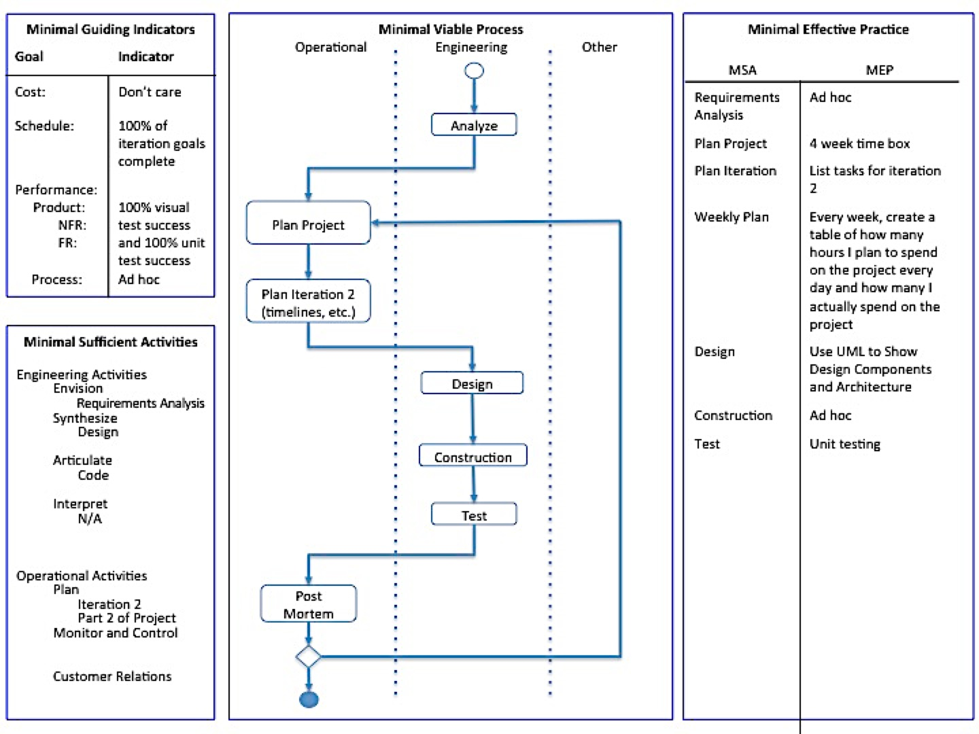
Process
Notes:
Add review of what happened over every iteration?

Slide 6
Lessons Learned
In terms of process
Necessary to have hard deadlines on construction
Adding weekly planning helped balance other commitments with project workload
In general
Should have researched better ways to test with images
Documenting as you make progress is a must
Using source control software like GitHub is also useful in terms of tracking changes

Slide 7
Demonstration

