Slide 1
Socioeconomic Drivers
of Climate Change
A Multi-Target Machine Learning Analysis (1900–2023)
195
123
5
2
Countries
Years
ML Models
Targets
Abdul Moiz Hussain · Muhammed Abdullah Khan
CS4048 Data Science · FAST NUCES, Karachi · 01 May 2026

Slide 2
Agenda
01
04
Project Overview
Modeling & Tuning
Problem statement, objectives & scope
Ridge → Decision Tree → RF → XGBoost → LightGBM + Optuna
02
05
Dataset & EDA
Results & SHAP
Panel data: 195 countries × 123 years; key correlations
Predictability asymmetry, feature importance, dependence plots
03
06
Feature Engineering
Conclusions & Policy
Per-capita, temporal lags, rolling windows, interactions
Actionable insights for sustainable development

Slide 3
Project Overview
Problem Statement
Key Contributions
Most studies treat emission trajectories and temperature anomalies as isolated tasks, neglecting temporal dependencies, multi-target interactions, and interpretability. The independent predictive power of socioeconomic indicators is rarely isolated.
Century-scale panel data across 195 countries
Zero-leakage time-series CV (expanded window)
10+ engineered features incl. Policy-GDP interaction
Research Objectives
Build a temporally validated multi-output ML pipeline
Simultaneously predict Temperature Anomaly & CO₂ Emissions
Apply SHAP for global & local interpretability
Simulate policy scenarios via a Digital Twin Lite framework
SHAP threshold effects for policy targeting
Reproducible, modular notebook pipeline

Slide 4
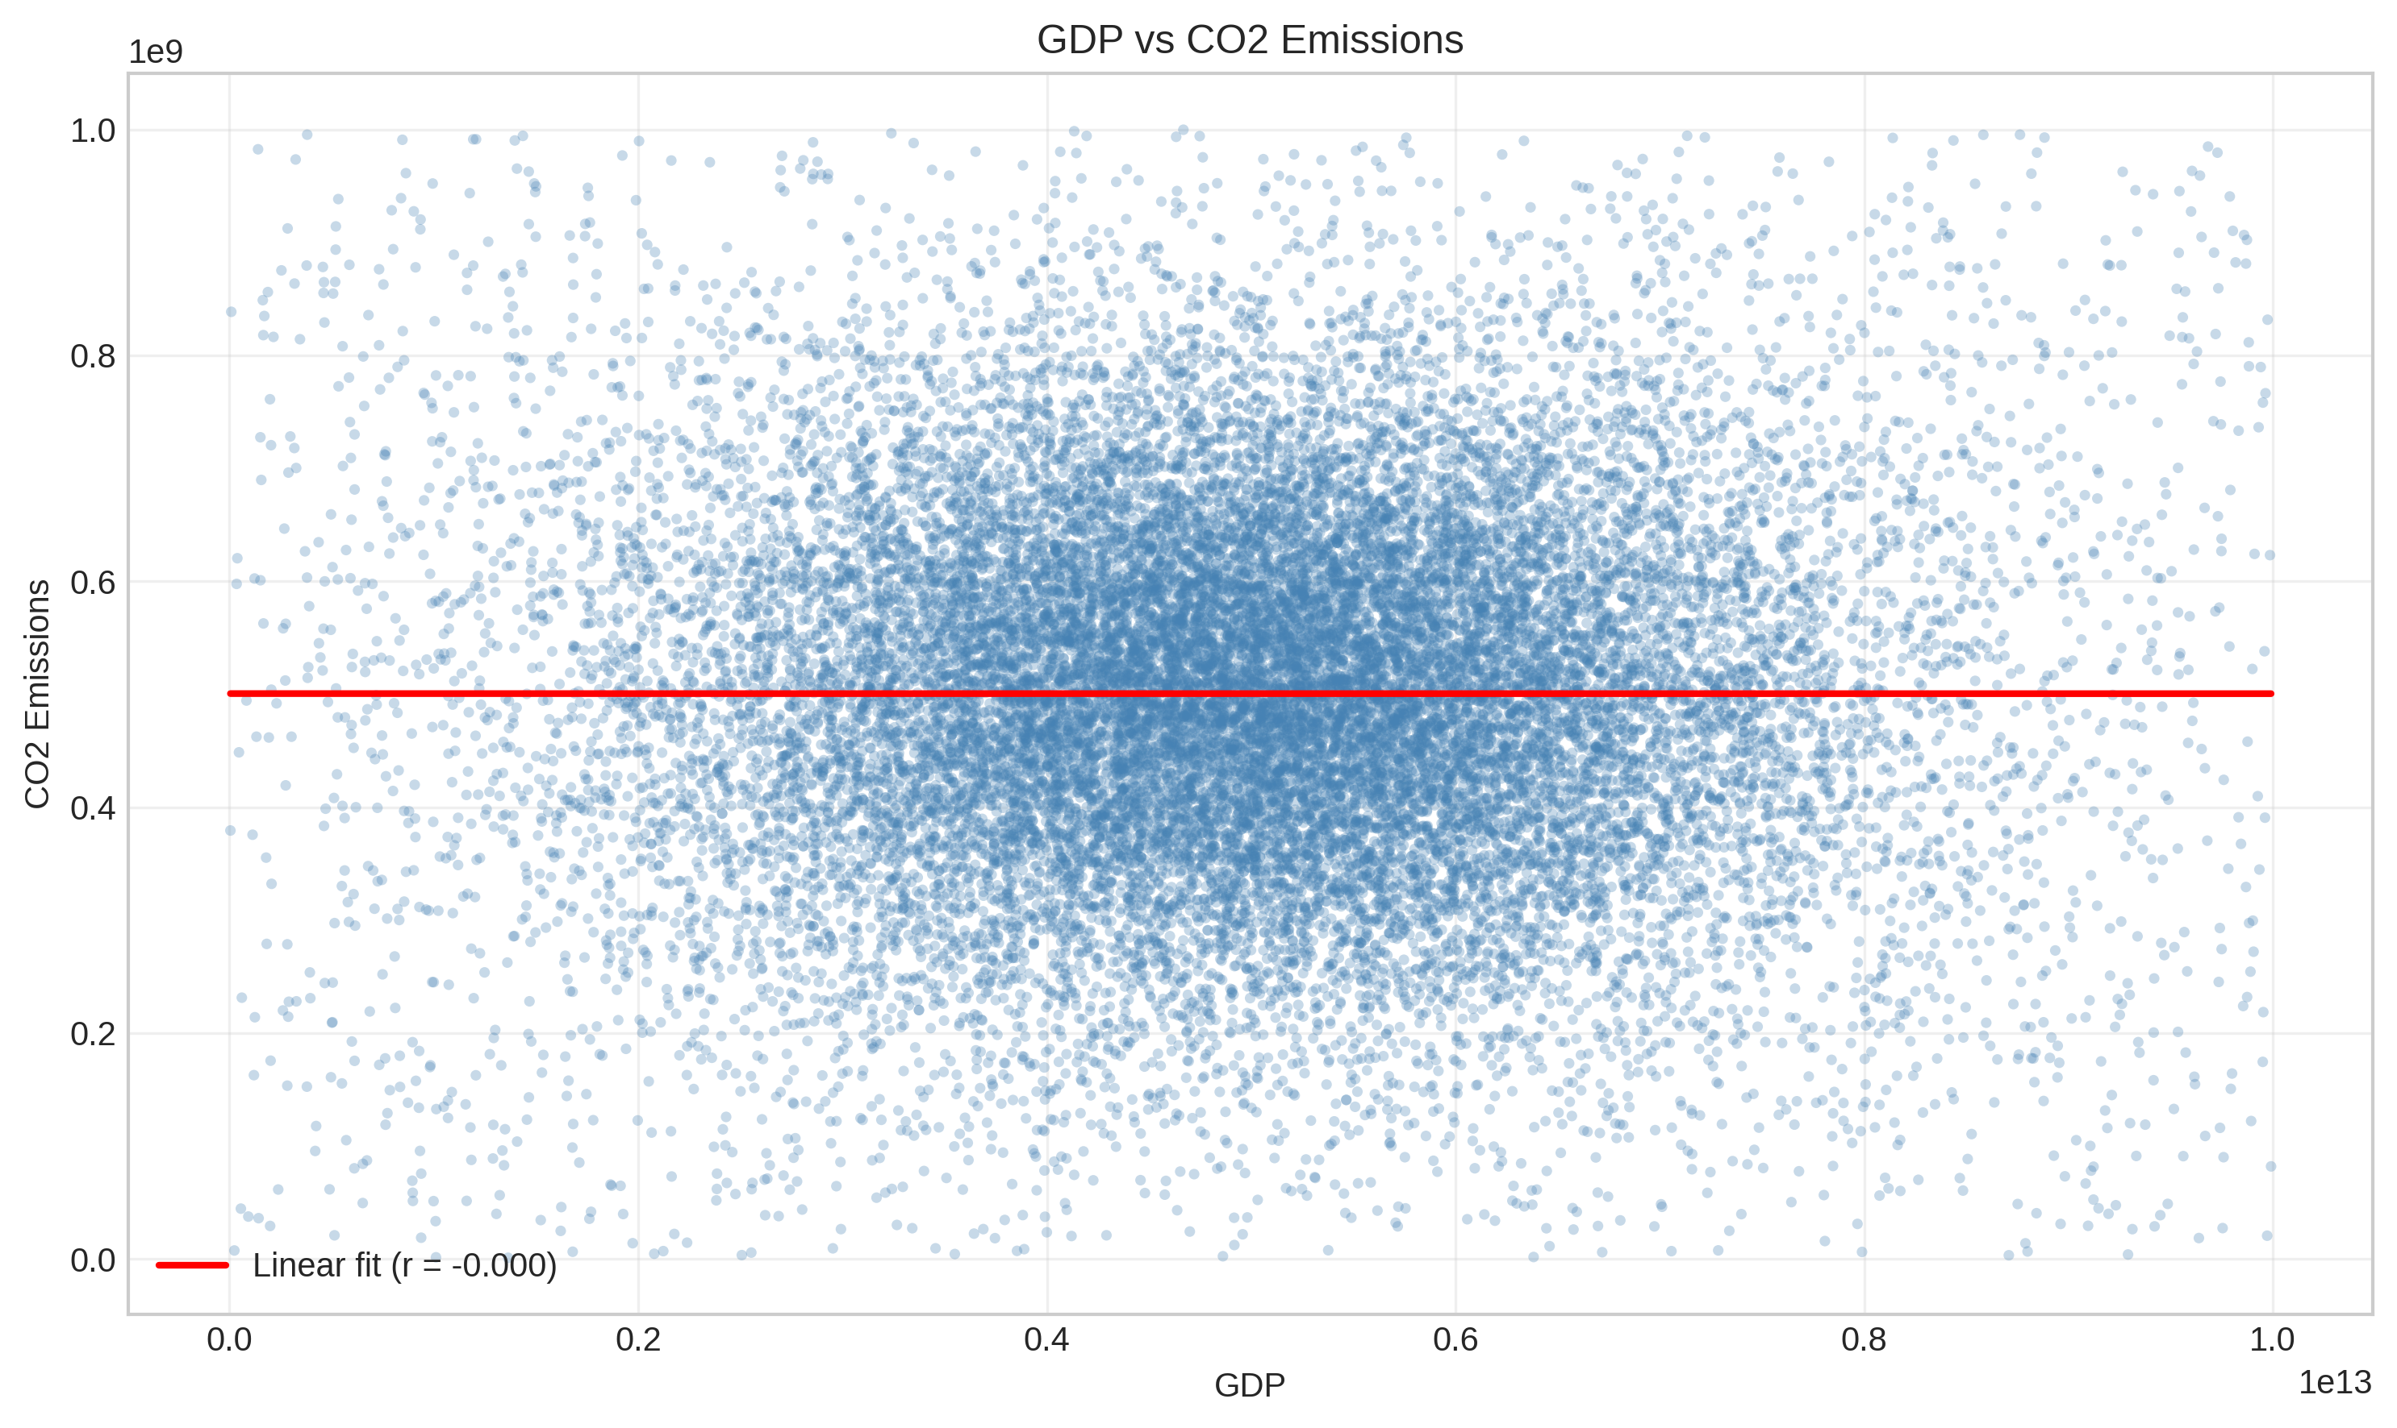
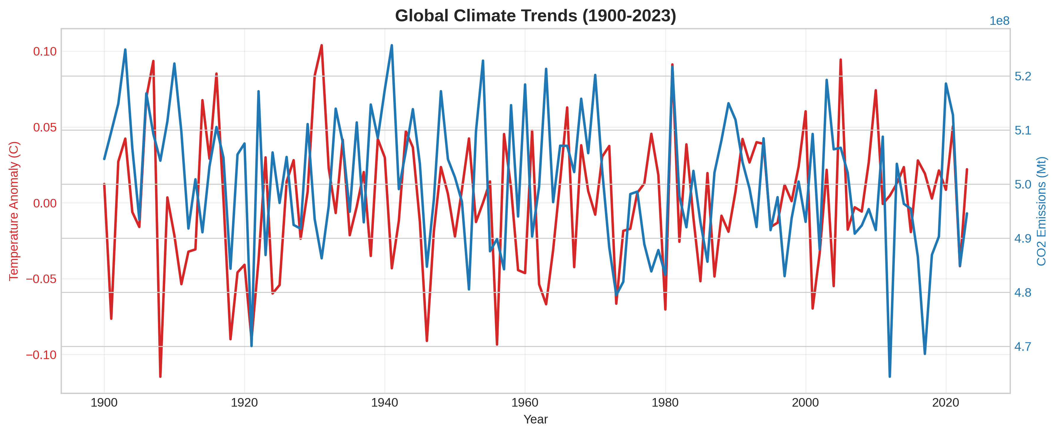
Dataset & Exploratory Data Analysis
🌍 195
Countries
📅 123
Years (1900–2023)
📊 20+
Raw Features
🎯 2
Prediction Targets
Imputation: Time-aware KNN · Scaling: RobustScaler
GDP vs CO₂ scatter (top) | Global target trends 1900–2023 (bottom)

Slide 5
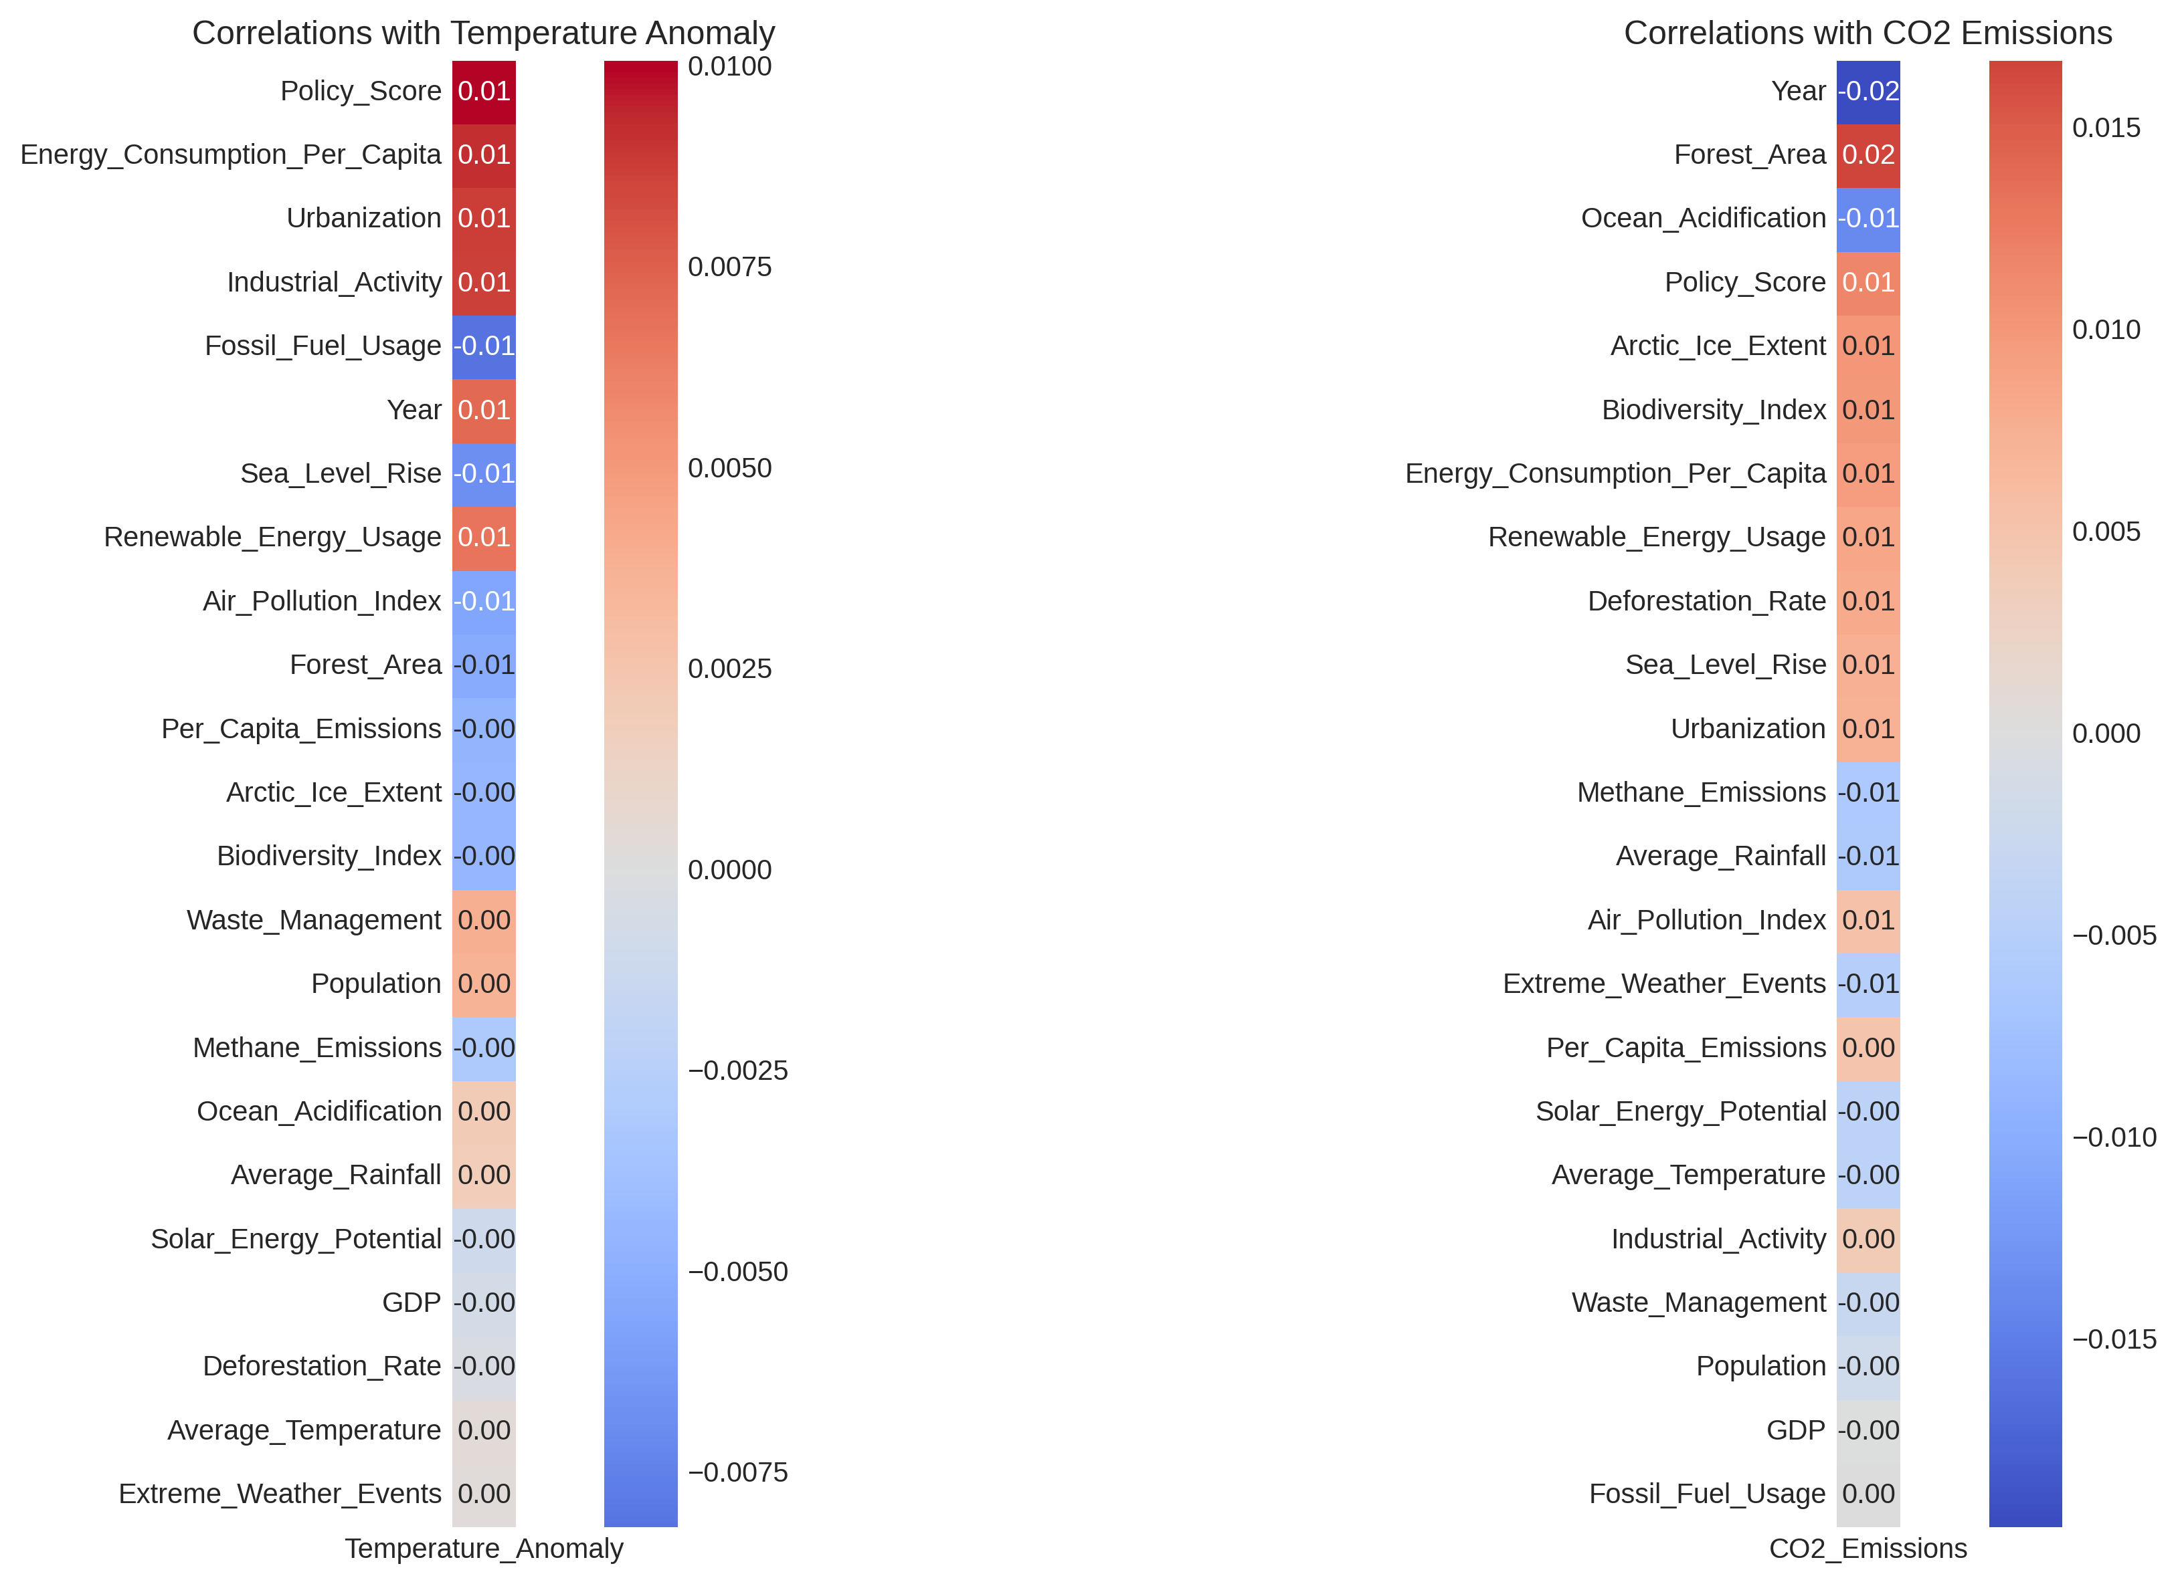
EDA: Target Correlations & Predictability Gap
CO₂ Emissions
Strong linear correlation with GDP, Population & Energy. Highly forecastable.
Temp Anomaly
Near-zero linear correlation with socioeconomic variables. Physical climate dominates.
Feature correlation heatmap for both targets
⚡ This asymmetry drives our multi-target design with separate SHAP analyses per target.

Slide 6
Feature Engineering Pipeline
Per-Capita Metrics
Ratio & Interaction
GDP per Capita
CO₂ per Capita
Energy per Capita
Renewable Ratio
Policy × GDP
Decade indicator
Lag Features
Rolling Windows
1-year lag
5-year lag
Applied per country
5-yr rolling mean
5-yr rolling std
Smoothed trend capture
Final feature set: Top 20 by RF importance · Temporal sort prevents leakage · RobustScaler applied post-split

Slide 7
Modeling Framework
Raw Data
1900–2023
Preprocessing
& Imputation
Feature
Engineering
Train / Test
Split (pre-2010)
MultiOutput
Regressor
Model | Type | Tuning | Speed
Ridge Regression | Linear baseline | — | Instant
Decision Tree | Non-linear baseline | — | < 1s
Random Forest | Ensemble | — | ~316s
XGBoost (Default) | Gradient Boost | — | ~2s
XGBoost (Tuned) ★ | Gradient Boost | Optuna 3-fold | ~1s
LightGBM | Gradient Boost | — | < 1s
★ Best model — selected by macro-averaged R² via Optuna hyperparameter search

Slide 8
Experimental Results: Model Performance
R² > 0.98
< 0
0.325
< 1s
CO₂ (XGBoost/RF/LGBM)
Temp Anomaly R² (all models)
Best Macro R² (XGBoost Tuned)
XGBoost train time
Key Findings
CO₂ is highly predictable (R² >0.98) via tree ensembles
Temperature anomaly: negative R² across ALL models — a scientific finding, not a failure
Ridge baseline fails for CO₂ (R²≈0) — non-linearity is essential
XGBoost Tuned best macro R²; RF best CO₂ R² but 316× slower
Tuning gain modest (+0.014) — architecture matters more than hyperparams

Slide 9
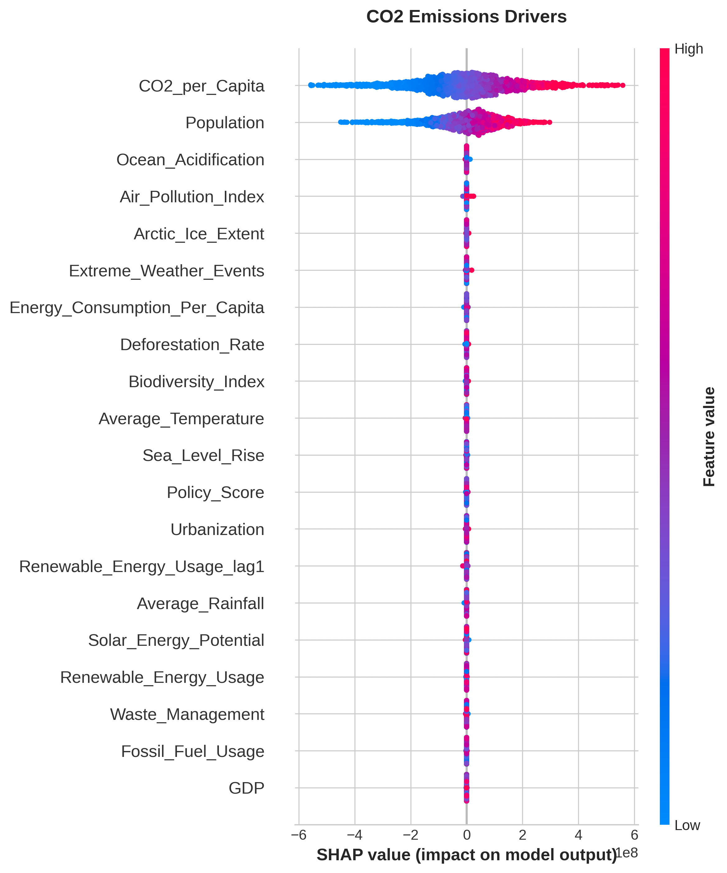
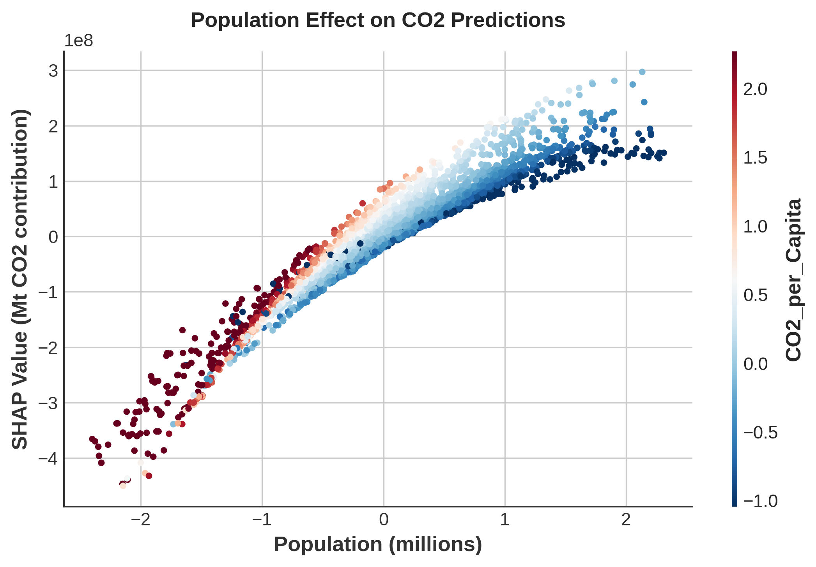
SHAP Interpretation: CO₂ Emissions
Rank | Feature | SHAP Importance
1 | CO₂ per Capita | 130.6M
2 | Population | 86.2M
3 | Ocean Acidification | 222,938
4 | Air Pollution Index | 163,466
5 | Arctic Ice Extent | 131,302
Insight
Population & economic scale dominate CO₂ prediction. SHAP dependence plots confirm monotonic, near-linear relationships — every additional billion people adds ~86M SHAP units to emissions.

Slide 10
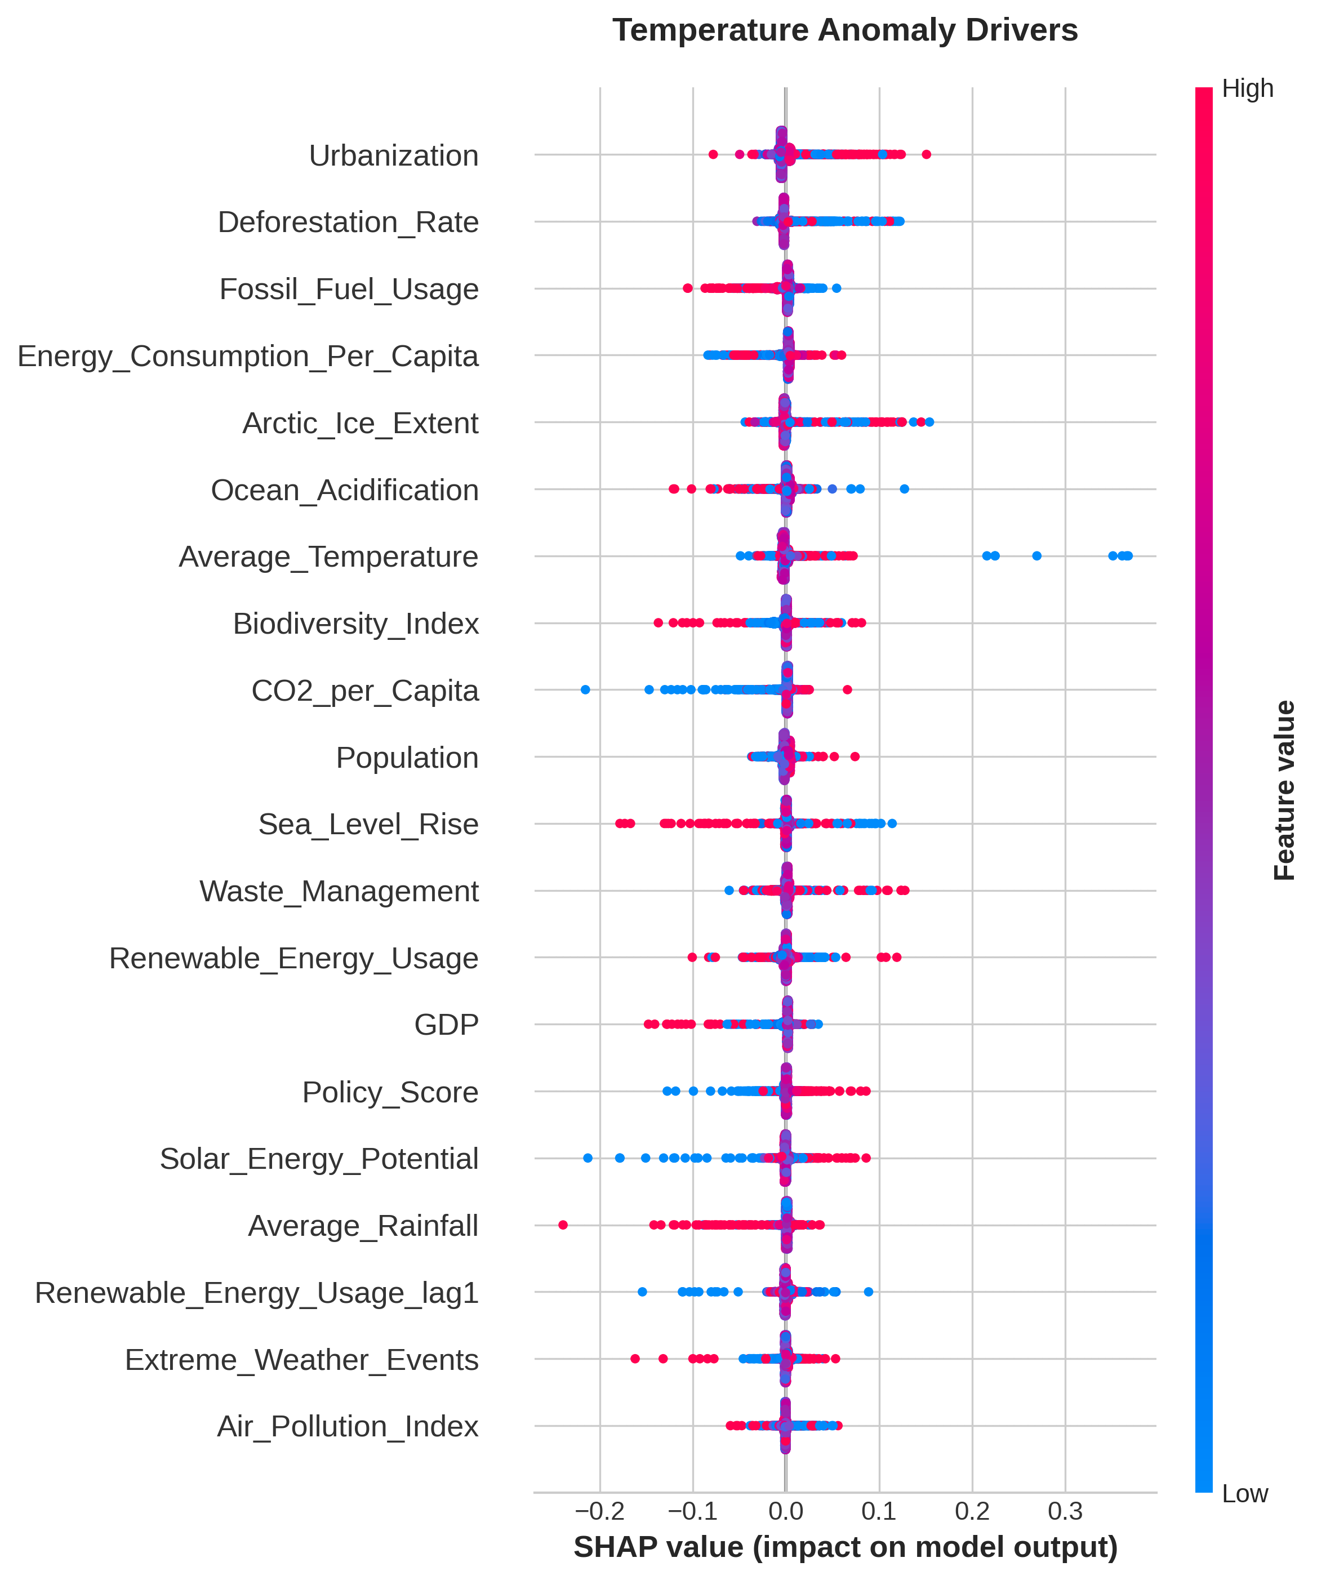
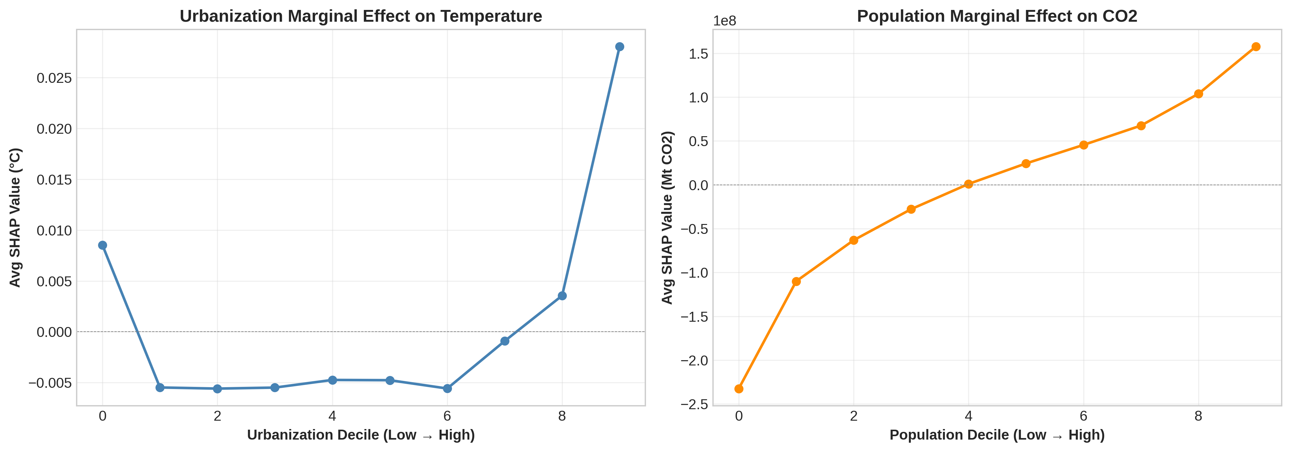
SHAP Interpretation: Temperature & Marginal Effects
Temperature SHAP beeswarm
Marginal SHAP effects (decile-binned)
Temperature: Diffuse Signals
Policy Threshold Effects
Urbanization & Deforestation are top SHAP drivers yet importance values are ~0.007 — orders of magnitude below CO₂ drivers. Negative R² confirms these signals are insufficient for reliable prediction.
SHAP marginal plots reveal that policy interventions only emerge at the >90th percentile of urbanization. Uniform national strategies are less effective than targeted interventions in hyper-urbanized regions.

Slide 11
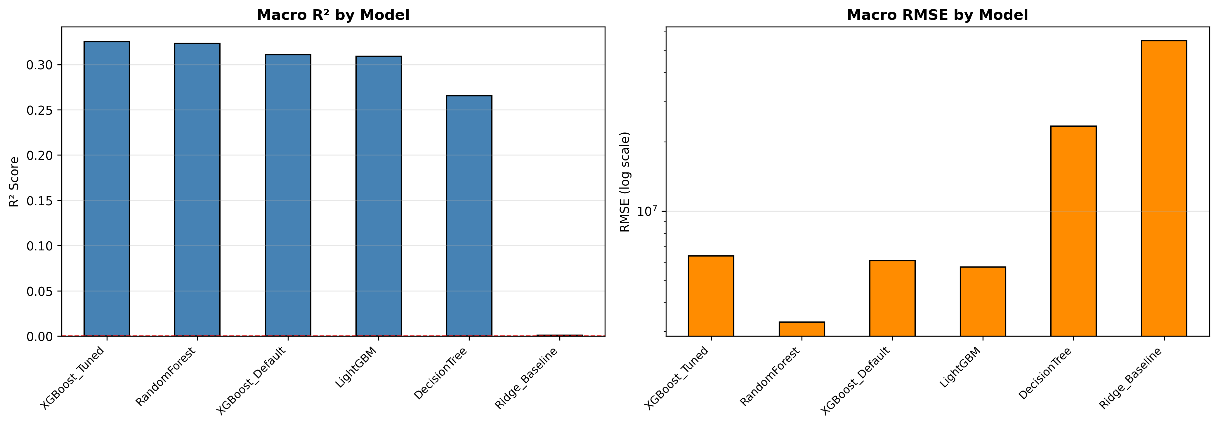
Comparative Model Analysis
Speed wins
XGBoost & LightGBM match RF accuracy in <1s vs 316s — clear production choice.
Non-linearity required
Ridge R²≈0.001 for CO₂ vs XGBoost R²=0.987 — tree-based essential.
Tuning: marginal
Model comparison across CO₂ R², Temp R², Macro R² and Training Time
Optuna raised macro R² from 0.311 → 0.325. Architecture choice matters more.
Recommended: XGBoost Tuned for production; DT for auditability

Slide 12
Conclusions & Policy Insights
📈 CO₂ is Forecastable
🌡️ Temperature Needs Physics
R² >0.98 confirms strong deterministic links between economic scale and aggregate emissions. Gradient boosting is the tool of choice.
Negative R² across all models is not a failure—it's a discovery. Physical ocean/aerosol dynamics are indispensable for thermal forecasting.
🏙️ Urban Threshold Policy
⚡ Green Infrastructure
SHAP reveals policy measures only trigger meaningful CO₂ reductions above the 90th urbanization percentile. Target hyper-urban regions first.
Urbanization × Policy interaction drives non-linear outcomes. Investing in green infrastructure in dense cities yields the highest leverage.
Future Work: Integrate physical climate variables · Apply causal ML · Expand to real-time streaming data

Slide 13
Thank You
Questions & Discussion
🐙 github.com/amh1k/socioeconomic-climate-ml
Abdul Moiz Hussain (23K-0553) · Muhammed Abdullah Khan (23K-0607)
CS4048 Data Science · FAST NUCES Karachi · May 2026

