Slide 1
Find Your Perfect Dog
BIS 15L Winter 2025 Group 14
By, Allyson Hafezi, Fiona Davoudi, Jenna Hussein

Slide 2



Agenda
Data Exploration
Shelter Dogs Shiny App
Dog Rankings Shiny App

Slide 3
Dataset Intro and Methods of Analysis
Shelter Dogs - basic characteristics of almost 3000 dogs in Hungarian shelters
Dog Rankings - 19 variables detailing characteristics, cost, and popularity scores of 87 dog breeds
Our Goal:
Create a quiz-style shiny app to take user preferences on characteristics to find an available dog for adoption or suggest a specific breed.

Slide 4
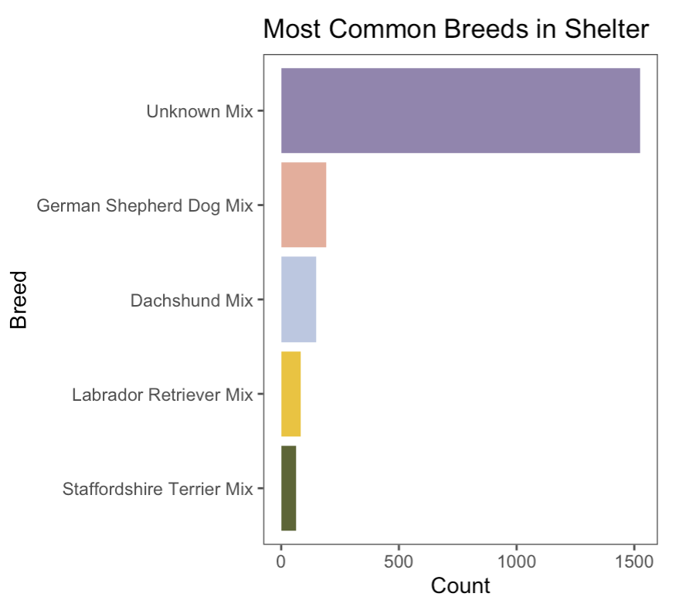
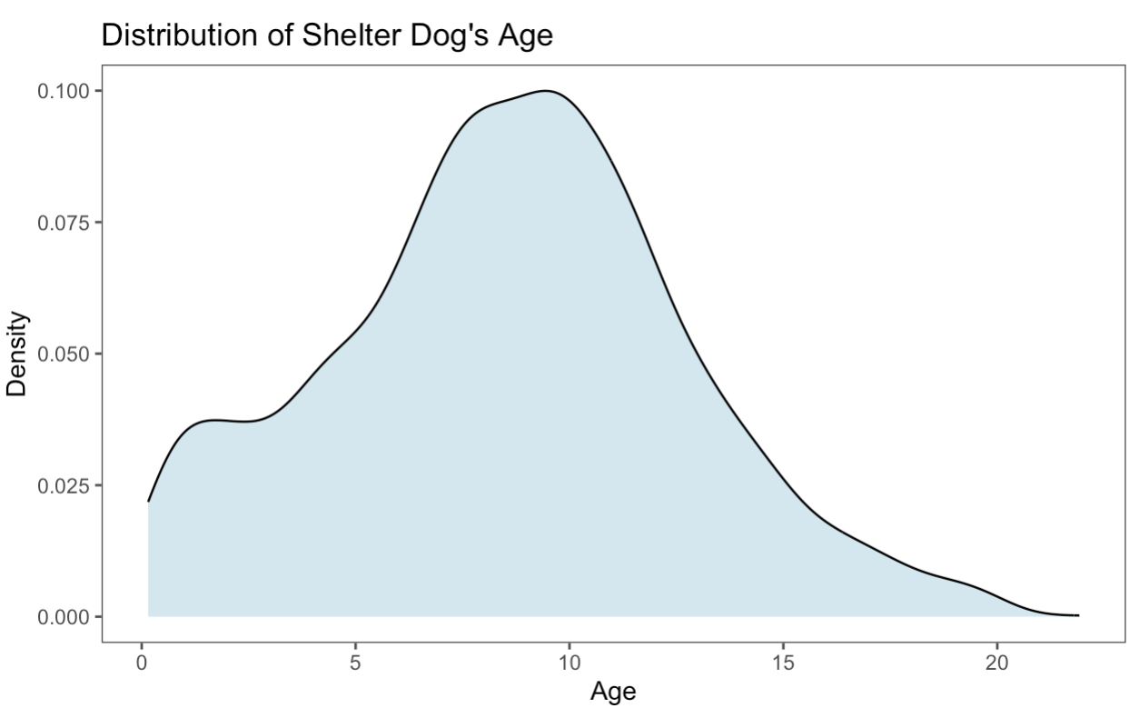
Key Variables - shelter Dogs

Slide 5
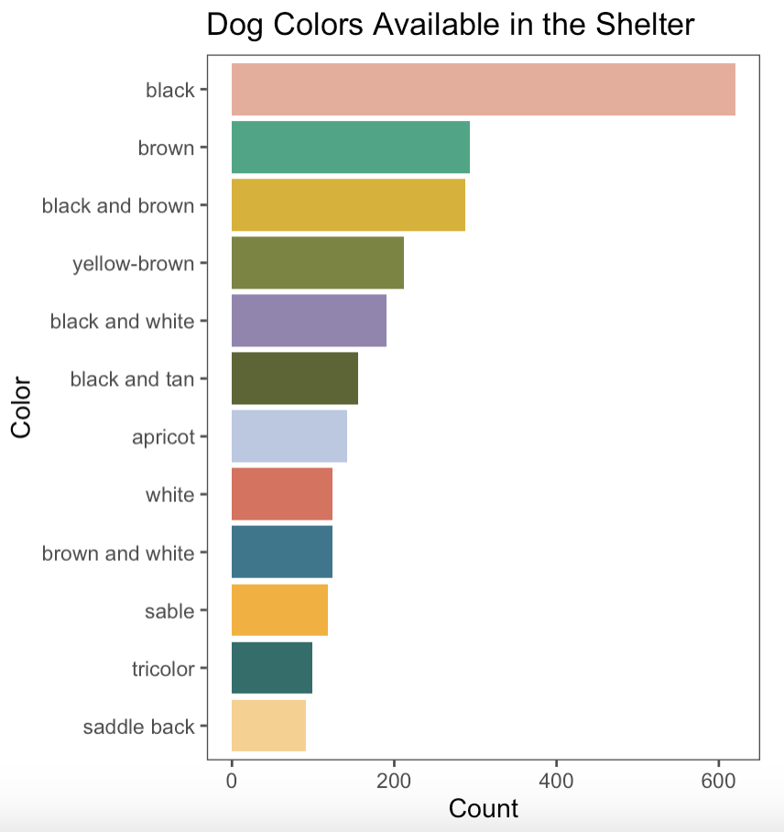
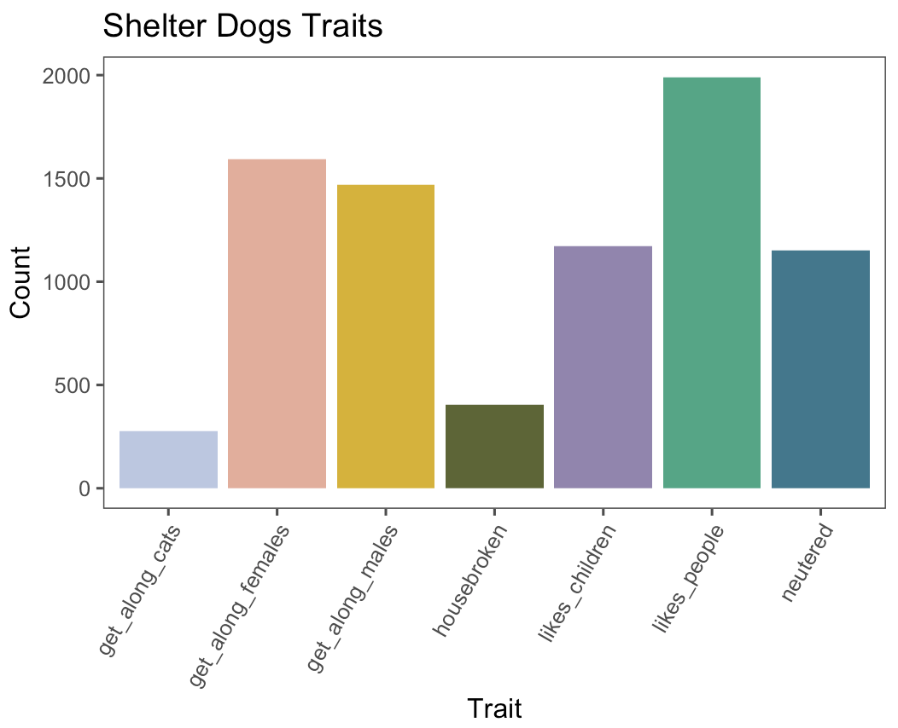

Slide 6
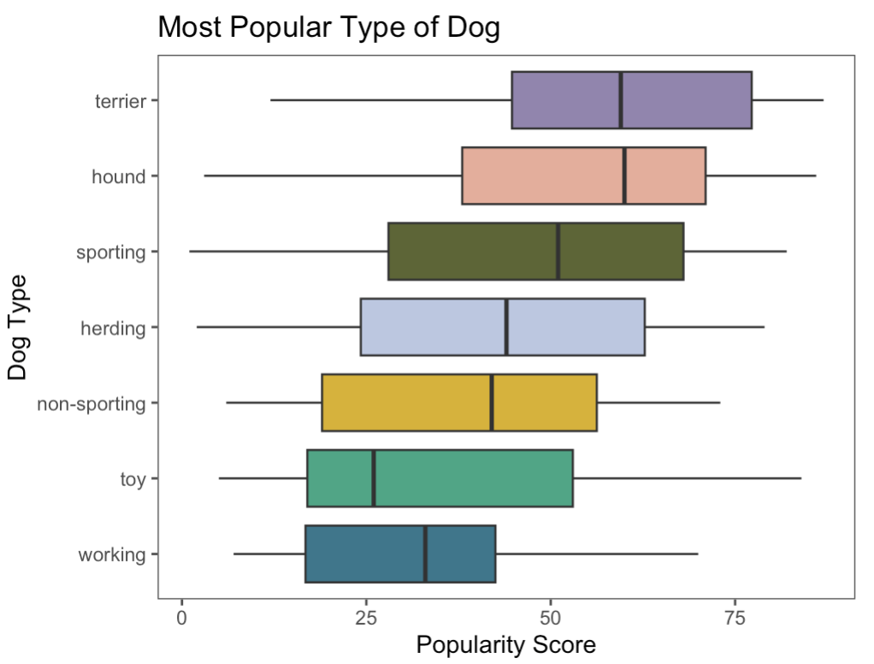
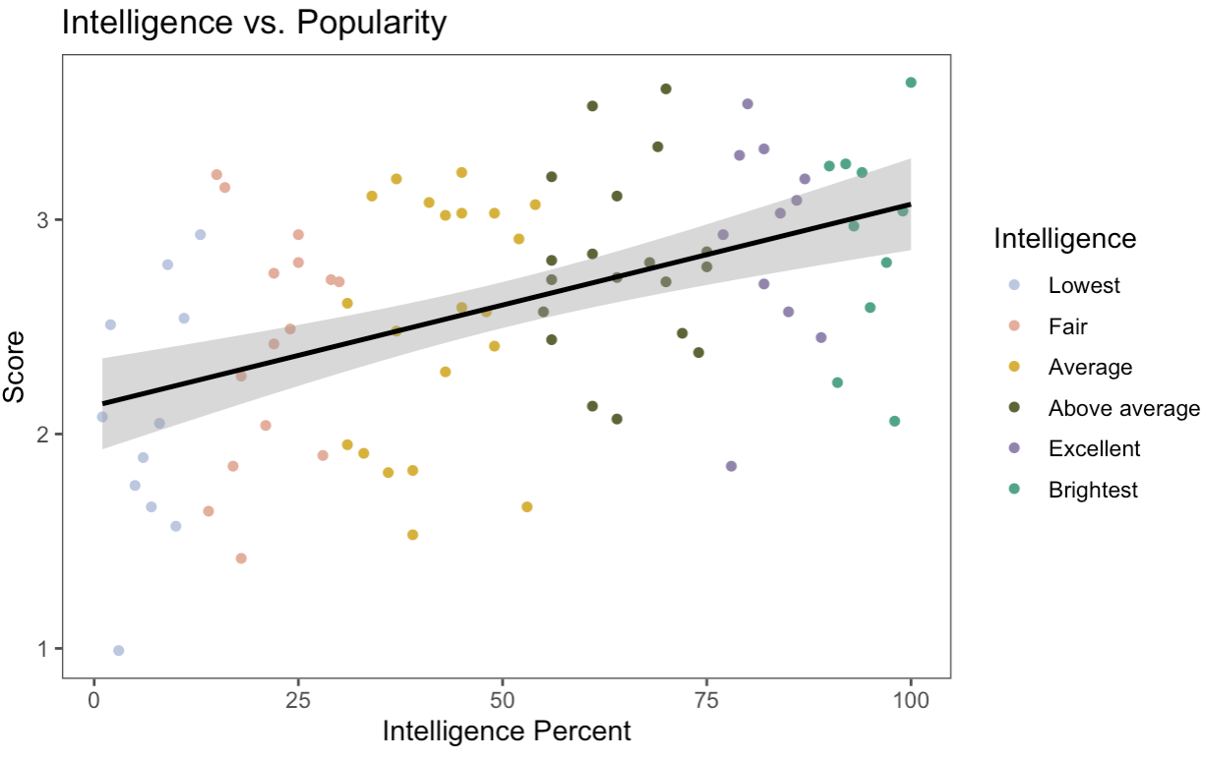
Key Variables - Dog Rankings

Slide 7
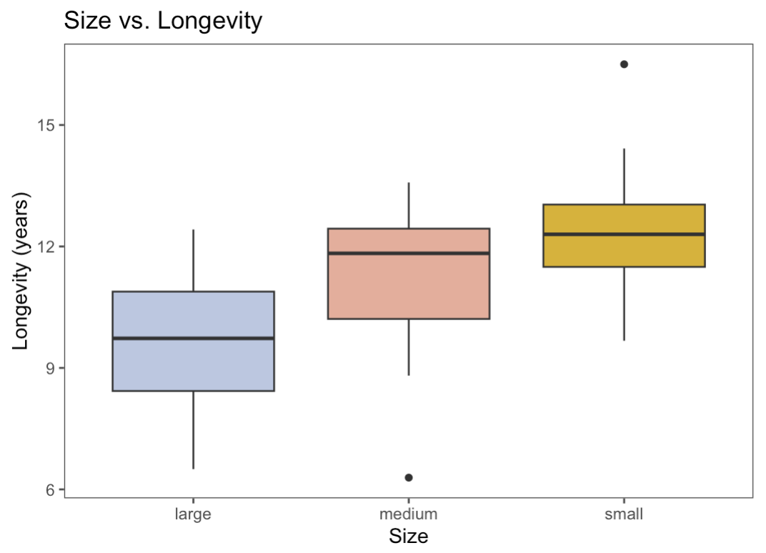
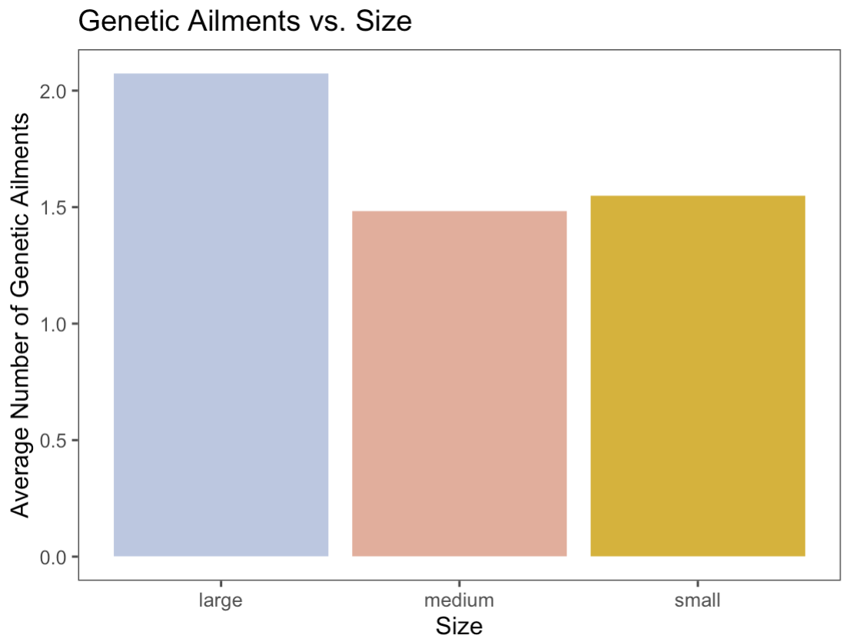

Slide 8
Shelter Dogs Shiny App

Slide 9
Dog Rankings Shiny App

Slide 10
Conclusion
Shelter Dogs
Unknown Breed Mix and Black Dogs are by far most common
Color and Traits can help narrow down options
Dog Rankings
Terrier’s are in general the most popular type of dog
Small dogs live longer and have few genetic ailments than large dogs
Having a list of desired characteristics while using our quiz can help narrow down the type of dog to for, but nothing can replace the in-person connection in choosing your furry friend!

Slide 11
Thanks !

Slide 12
Presentation template by
http://pptmon.com/ Click to follow link

