Slide 1
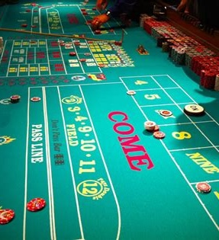

Quantum-Inspired Decision Strategies in Classical Craps
Adam Hasler
Spring 2025

Slide 2
Why explore quantum decision-making in a classical casino game?
Quantum mechanics challenges classical probability assumptions.
Subjective probability and belief updating (e.g., QBism) may inspire new decision strategies.
Craps: a clean, well-studied classical environment for experimentation.

Slide 3
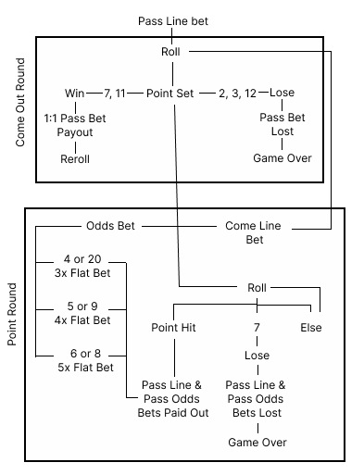
Classical Craps Overview
Dice game with fixed payout odds and well-known probabilities.
Pass Line bets, Come bets, Odds bets.
House edge: small but positive.

Slide 4
Quantum Mechanics and Decision Theory
Quantum Concepts Affecting Decision Strategies
Quantum probability: not just frequencies, but amplitudes.
Measurement: outcomes depend on belief and information.
SIC-POVMs: special measurements encoding subjective probabilities.

Slide 5
Agent Models
Three Types of Betting Agents
Classical Rational Agent (Objective probability, maximize expected value)
Quantum Rational Agent (Subjective quantum-inspired prior beliefs)
QBist Agent (Personal, experience-driven probability updates)

Slide 6
Simulation Design
Simulated craps games (following real rules)
Each agent bets over hundreds or thousands of sessions
Metrics collected:
Final bankroll
Probability of profit
Standard deviation/volatility
Survival rate
How quickly is a predetermined profit hit (walkaway strategy)

Slide 7

Current Progress and Next Steps
Craps simulator finished (Python)
Upcoming
Write agent models (Python)
Run simulation and collect results
Compare results and plot relevant data
Paper
Craps Overview
Mathematical foundations of quantum mechanics and QBism
Modeling Agents
Results and Discussion
https://github.com/amhasler/quantum_craps

