Slide 1

Open-MCT Based iCub Telemetry Data Visualization Tool
Nuno Guedelha, Silvio Traversaro, Stefano Dafarra
AMI Research Increment 05-10-2021

Slide 2
Motivation
Running an experiment…
Hard time constraints
Setup complexity
Stress
Requires…
Repeatability (automatized repetitive actions)
Centralized control and visualization
Flexibility (easy selection of telemetry data)
Robustness (survive robot interface reboot)

Slide 3

Motivation
Start YARP server
Run Yarpmanager
Load app config
Example $⟹$ walking demo
Reading YARP ports from terminal
Overhead effort
Running apps: yarpview, iCubGUI, WalkingModule
Run individual plotters
Monitoring
Control Inputs
Connecting ports
Battery status
Walking Coord.
Type RPC commands
External forces
Virtualizer
Reading YARP ports from terminal
cameras
VR + gloves
RobotViz.
Sensorised suit
RPC client on terminal
Organize workspace
Notes:
Yarpmanager tool
The command-line utility "yarpmanager-console" and its graphical companions "yarpmanager" are tools for running and managing multiple programs on a set of machines.
Create apps from third-party apps, yarp modules and/or devices (yarpdev <device>)
Define app resources
Connect/disconnect ports

Slide 4
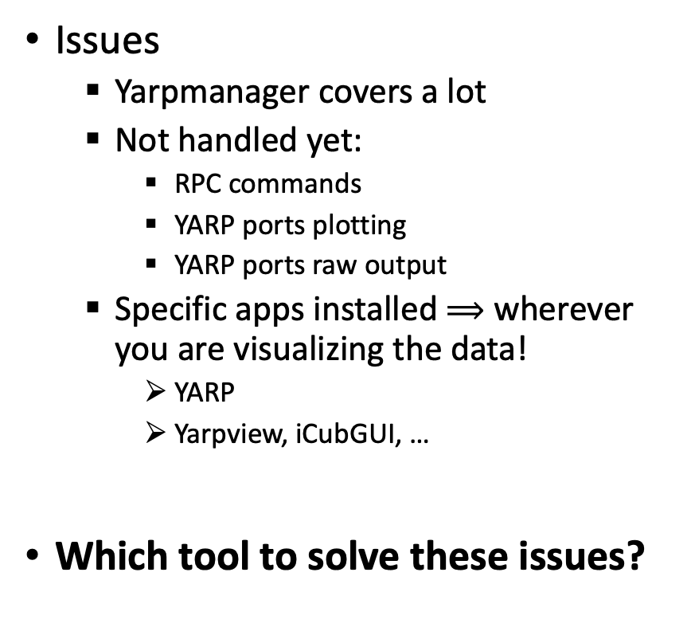
Motivation
Issues
Yarpmanager covers a lot
Not handled yet:
RPC commands
YARP ports plotting
YARP ports raw output
Specific apps installed $⟹$ wherever you are visualizing the data!
YARP
Yarpview, iCubGUI, …
Which tool to solve these issues?
Start YARP server
Run Yarpmanager
Load app config
Reading YARP ports from terminal
Overhead effort
Run individual plotters
Type RPC commands
Organize workspace
CTRL Console
Robot
Visualizer
4

Slide 5
Outline
why Open-MCT?
Open-MCT framework Overview: features and current limitations
Control Console Overview: a Remote RPC web interface
Architecture overview and protocols
Connecting YARP data output ports to the visualizer web client
Connecting the YARP RPC ports to the control console web client
Installation, parametrization and launching
Robust handling of resources, clients and fail recovery
Deployment and next steps

Slide 6
why Open-MCT?

Slide 7
Control Console Overview: a Remote RPC web interface

Slide 8
Architecture overview and protocols

Slide 9
Connecting YARP data output ports to the visualizer web client

Slide 10
Connecting the YARP RPC ports to the control console web client

Slide 11
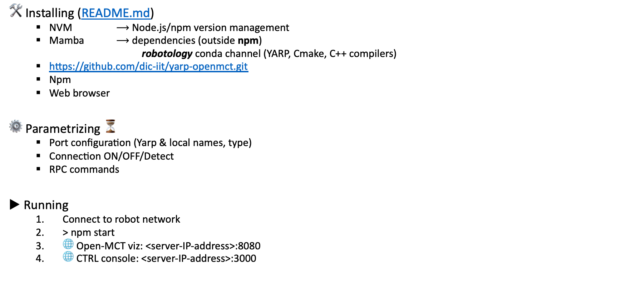
Installing, parametrizing and launching
🛠 Installing (README.md)
NVM $⟶$ Node.js/npm version management
Mamba $⟶$ dependencies (outside npm)
robotology conda channel (YARP, Cmake, C++ compilers)
https://github.com/dic-iit/yarp-openmct.git
Npm
Web browser
⚙️ Parametrizing ⏳
Port configuration (Yarp & local names, type)
Connection ON/OFF/Detect
RPC commands
▶︎ Running
Connect to robot network
> npm start
🌐 Open-MCT viz: <server-IP-address>:8080
🌐 CTRL console: <server-IP-address>:3000

Slide 12
Deployment and Next Steps
Tested on iCubGenova04
Running modules and app from terminal
Controle console
RPC commands
Network Ping
Open-MCT based visualizer
Individual iCub telemetry entry plots
CTRL console
Issues analysis in progress…
Next steps
Improve runtime stability
Stacked & overlay plots
Added 3D robot viz
Imporve the control GUI

