Slide 1
AppArmor in the Userspace
Security on the Ubuntu phone/converged device
Presentation by
John Johansen
john.johansen@canonical.com
www.canonical.com
September 2013

Slide 2
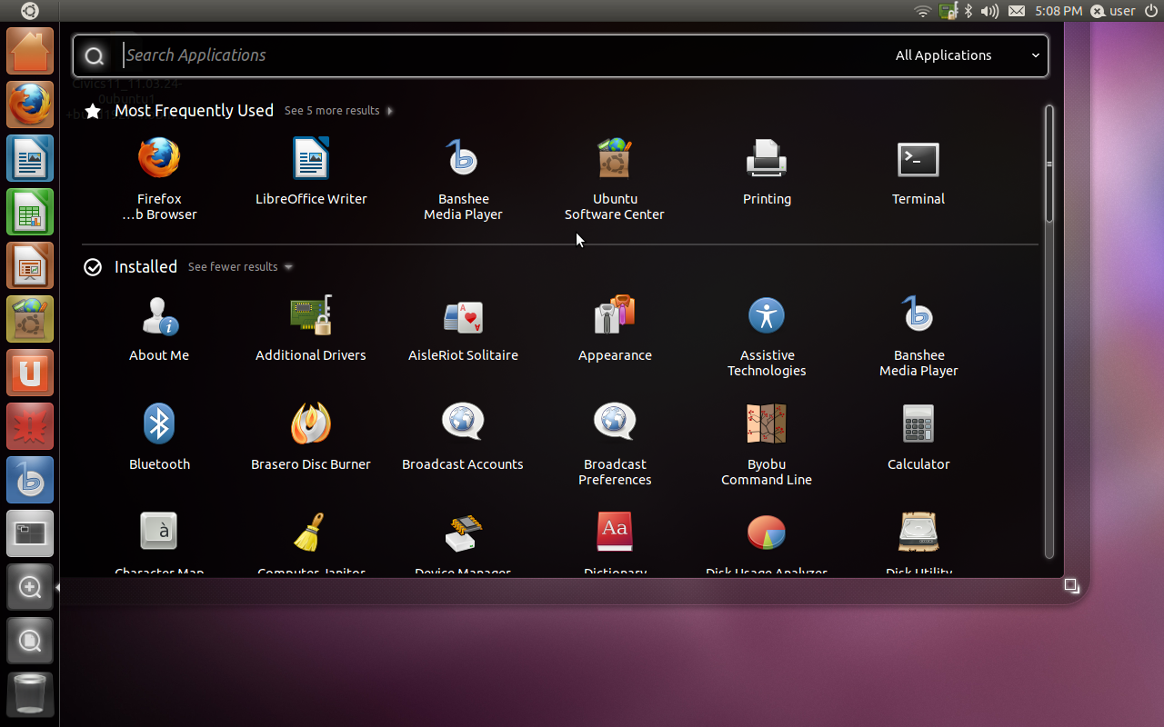
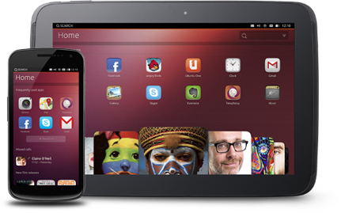
Security on the Desktop
Notoriously Hard
Notes:
Linux desktop has a lot of problems
No separation between users files, configs ...
work motivated by phone, tablet and converged dev
Archive vs. developers being able to deliver/update their own apps (click packages)
Manual review of applications doesn't scale
Automated checks
Application confinement
Must support traditional archive
Confinement must be done within “traditional” Desktop
Small changes are acceptable
Break everything changes are not
Designed with AA in mind but alternate LSM possible
Caveat much of this is phone only or still in dev atm

Slide 3
Desktop confinement challenges
Dbus
Gconf
Gsettings/dconf
Display Manager
Environment Variables
Keyring
Ubuntu online Accounts
HUD
Unity Dash
Installing/Updating Applications
Data/File Access
Resource usage
Process to get apps into the archive
Notes:
So what are the problems
- Just a list of some of the problems with the desktop
Settings/Data being stored in a single file
Env vars affecting how an app is launched
X has issues
Don't want to have to be root to install/update apps
What should an app be able to use, how much do I trust it
Ubuntu app review board slow, doesn't scale

Slide 4
What do we want?
Decoupling of Applications from the Core OS
Security
Reduce/remove the user from security decisions where possible/reasonable
Still have a full Linux desktop
Notes:
Nothing new here!
Want policy as centralized as possible

Slide 5
How to do it?
Extend AppArmor with userspace trusted helpers
New packaging
Replace/update some components
New APIs & Apps
Notes:
Sandboxing the desktop is hard so take a varienty of approaches
Some solutions may not even be the best, just expedient first passes
Nothing really new here, there have been several attempts at this
New packaging is nice – but we also want to work with the archive
Review
New packaging minimal
Archive security audit
Accept not everything in the archive can or will be locked down
New APIs needed for access to some features
Some linux APIs just busted from a security pov
New/updated applications
Not going mention this more
What can we replace?

Slide 6
Display Server
Notes:
X has issues (don't really need to elaborate)
- keyboard and mouse sniffing
- screen shots
- clip board
- drag and drop
- xsettings
- we have experimented with nested X servers
Xace and Xypher used in aa-sandbox
- have worked on an apparmor Xace plug-in
But the real solution is to replace it
- Mir/Wayland make life a lot easier
- Still evaluating what will be done for X apps

Slide 7
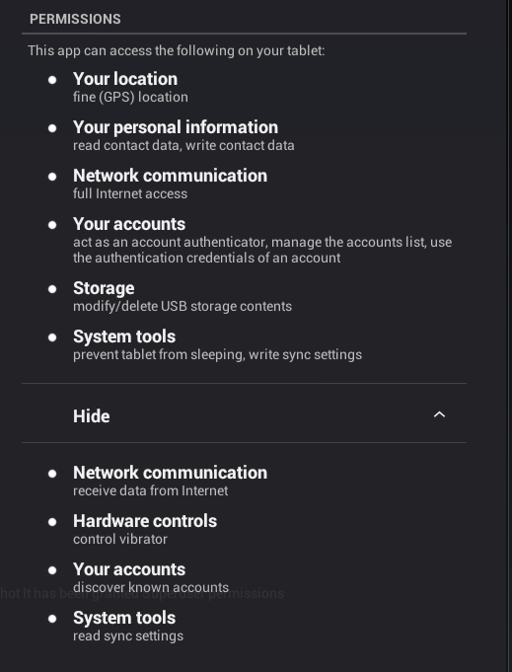
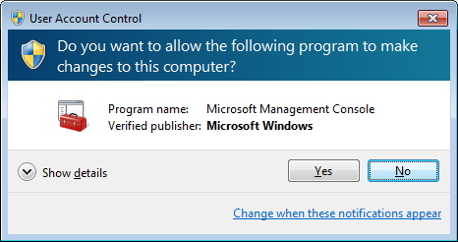
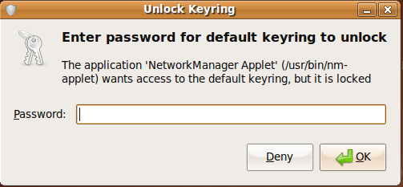
Design – Looking at what has been done
Notes:
Luxury to look at what has been done before
In general users are bad at making security decisions
User don't often really understand the permissions being asked for
Android model
Apps Ask for broad permissions
Having a permission list does help with review
Users want
The app
Want there what they just asked for to happen
Don't like password prompts
Reduce their use and they might have more meaning
Want security

Slide 8
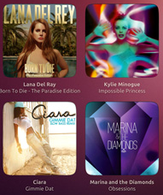
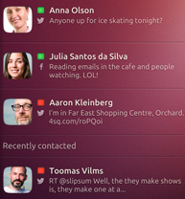
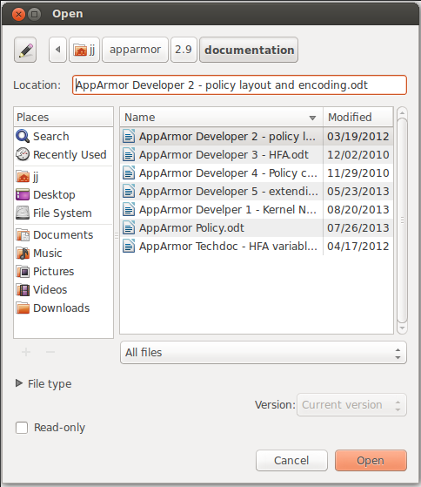
Make user actions be the security prompt
Trusted
Helper
Sandbox
Application
Notes:
Basic Idea (examples not actual pickers)
Applications are sandboxed
Have a preseeded permission set
Used to guide what kind of review is needed
Obviously would like to avoid human review
Applications talk to trusted helper(s)
Trusted helper provides the user dialog
Punches hole in sandbox
Lots of different ways
Communication directly back to app
Copy/link a file into the sand box
Delegate a file into the sand box
Extend the sand box

Slide 9
Extending AppArmor
Labeling work
Finish off mediation
Extend permissions
Make peer label
Delegation
Improved Templating
Extend library API to better support trusted helpers
Extend services to use AppArmor (Trusted helpers)
Integrate apparmor support into upstart
Native/Helper defined type policy extension
  dbus, audio, contact, …
  In the future make it so new types can be defined with out tool updates
Notes:
Lots of work, but building on the existing base
The intersting stuff from a desktop perspective
- trusted helpers
- native/helper defined policy extensions

Slide 10
AppArmor: helper based policy extension
Kernel object level often too coarse
  File, socket, ...
Kernel mediation can't handle intermediaries/middle men
  DBus
  Unity Dash
Services/Helpers need to be able to define what is important to them
  Contact X
  Picture Y
  Retains semantics
    Can map to underlying kernel policy that is needed + Helper
Notes:
Lots of work, but building on the existing base
The intersting stuff from a desktop perspective
- trusted helpers
- native policy extensions
Policy is compiled, and checked
Needs stubs in code to
- parse
- layout for compiler
- end goal is to extend language so compiler doesn't need to be extended

Slide 11
Trusted Helpers
Active
Policy
Backend
context
Application
context
Trusted
Backend
Application
Policy
Compiler
profile Backend {
allow file rw
allow ipc Intermediary
bind service address
…
}
profile Application {
allow ipc intermediary
ent=foo rw,
…
}
dbus, gsettings, keyring, pulse, online accounts, content picker, locations, sensors
Notes:
Basic pattern, some have different implementations
- trust store
Gsettings
- mmap read access
- deny write access
- set GSETTING_BACKEND env var
- new backend/daemon for confined apps that handles writing of settings

Slide 12
DBus
Active
Policy
Backend
context
DBus
context
Application
context
Trusted
Backend
DBus
Application
Policy
Compiler
profile Backend {
allow file rw
allow ipc Intermediary
bind service address
…
}
profile Application {
allow backend X,
#implied ipc interm...
…
}
profile DBus {
allow ipc Application
allow ipc Backend
...
}
Notes:
Kernel performs mediation of IPC between
- dbus and app
- dbus and back end
Dbus policy applies to communication between
- app and backend
Dbus policy does a cross check
Any of the entities can be unconfined
- Backend
- Dbus
- application
Use Dbus rules in some places so we don't have to modify backend server
- HUD

Slide 13
D-Bus Mediation Overview
AppArmor hooks in dbus-daemon perform checks when applications send or receive messages and bind to well-known connection names
The message hook can mediate based on any combination of the following:
    Bus name (system, session, accessibility, etc.)
    Object path (/org/freedesktop/DBus, /org/freedesktop/Accounts/User1000, etc.)
    Interface (org.freedesktop.DBus, com.ubuntu.Upstart, etc.)
    Member name (the name of a signal or method in an interface)
    Peer connection's name
    Peer connection's AppArmor label
The bind hook can makes decisions based on two variables:
    Bus name
    Requested well-known name

Slide 14
D-Bus Mediation Policy
D-Bus rules are specified in the AppArmor profiles
  Retains the design goal of having centralized security policy
  Dbus config does have a toggle to turn mediation off
Rules can be very simple or very restrictive, depending on the desires of the policy author
  Allow all D-Bus permissions:
    dbus,
  Allow specific D-Bus permissions:
    dbus send bus=session path=/org/freedesktop/DBus
    interface=org.freedesktop.DBus member=Hello,

Slide 15
D-Bus Mediation Performance
Measured total time it took to do the following:
  Start dbus-daemon and variable # of client/server pairs
  Client/server pairs have a 1:1 mapping during the test
  Clients make 50,000 method calls to servers
  Wait for dbus-daemon, clients, and servers to exit
Numbers below come from a Nexus 7 running Ubuntu Touch
Client server pairs | Time - unconfined clients (seconds) | Time - confined clients (seconds) | Added overhead (%)
1 | 28.5424 | 31.6576 | 10.91
2 | 56.6322 | 63.1622 | 11.53
3 | 85.3982 | 94.7406 | 10.94
4 | 114.112 | 127.690 | 11.90
5 | 143.325 | 160.319 | 11.86
8 | 238.590 | 268.871 | 12.69
Notes:
~50% over head before caching the label on the connection
Unconfined to unconfined shows no penalty
Still improvements to be made

Slide 16
D-Bus Mediation Performance Improvements
Each decision may result in:
  Get the label of the subject and peer
  Open, write to, read from, and close the .access file in apparmorfs to query the policy loaded into the kernel
    Per side of a connection
The labels are already being cached on the D-Bus connections
  This is why there's no noticeable overhead in unconfined applications
In the future
  Cache decisions in userspace
    Potentially avoids/reduces four syscalls that perform the query
  Have query do crosscheck
  Have userspace pull in policy not query the kernel
Notes:
not a priority atm because dbus % of actual app time is low

Slide 17
Click packaging
Simplified Debian Packaging
Direct update by developers
Human review doesn't scale
Automated tests
Sandboxed
AppArmor support contained in
Click hooks
Security Manifest File
Alternate LSM could be used
Notes:
Click packaging is the new packaging fomat that Ubuntu will use
- decouple apps from the base OS (archive)
Goal no human review needed
- however use the security manifest to flag when further review needed
Still have archive applications
- may not be confined
- needs to go through standard archive review
- can't just be updated by developer
- some applications will only talk to properly confined apps

Slide 18
Click packaging: Manifest files
#include <tunables/global>
# Specified profile variables
@{APP_ID_DBUS}="ar_2ecom_2ebeuno_2ehello_2dworld_5fhello_2dworld_5f0_2e1"
@{APP_PKGNAME}="ar.com.beuno.hello-world"
@{APP_VERSION}="0.1"
@{CLICK_DIR}="/opt/click.ubuntu.com"
profile "ar.com.beuno.hello-world_hello-world_0.1" {
#include <abstractions/base>
#include <abstractions/fonts>
#include <abstractions/freedesktop.org>
#include <abstractions/ibus>
#include <abstractions/X>
#
# DBus rules common for all apps
#
# Allow connecting to session bus and where to connect to services
dbus (send)
bus=session
path=/org/freedesktop/DBus
interface=org.freedesktop.DBus
member=Hello
peer=(name=org.freedesktop.DBus),
dbus (send)
bus=session
...
{
"framework": "ubuntu-sdk-13.10",
"maintainer": "Martin Albisetti <martin.albisetti@canonical.com>",
"name": "ar.com.beuno.hello-world",
"hooks": {
"hello-world": {
"apparmor": "apparmor/hello_world.json",
"desktop": "hello_world.desktop"
}
},
"title": "Hello World",
"version": "0.1"
}
{
"policy_groups": [
"networking"
],
"policy_version": 1.0
}
Notes:
Click packages include a click manifest and a security manifest
Combined, contains the package name, the application name, the application version, and AppArmor policy groups
The security manifest file is used to generate an AppArmor profile
Package name, application name and version (collectively used to from the APP_ID) are used to create rules based on a versioned install path
Package name is used to generate rules for configuration, data, runtime, and cache directories (XDG based)
Policy groups map to sets of rules granting access to a certain feature
Examples are camera, location, networking

Slide 19
Click: Launching Applications
In Ubuntu, upstart will be used to launch click applications in a clean, sandboxed environment
    The application is launched under its own AppArmor profile via the 'application' upstart job.
    The profile name is the same as the APP_ID and the job derives the profile name by consulting the click manifest.
    To support other desktop environments, traditional .desktop files are modified to use aa-exec-click before being installed in XDG_DATA_HOME/applications
Upstart will set up environment variables such as TMPDIR, XDG variables, etc., as required for confinement
  aa-exec click from desktop file - for alternate desktop environments
The appropriate AppArmor profile will be attached and the application will be spawned

Slide 20
Click: Launching other Apps
In general, click packages should not depend on external applications
However, click packages may need to launch a browser when a user clicks on a URL
In Ubuntu Touch, url-dispatcher will be used to safely handle URL clicks
            It implements a D-Bus service that can launch the browser while providing isolation between the app and browser
Notes:
Click packaging is the new packaging fomat that Ubuntu will use
- decouple apps from the base OS (archive)
Goal no human review needed
- however use the security manifest to flag when further review needed
Still have archive applications
- may not be confined
- needs to go through standard archive review
- can't just be updated by developer
- some applications will only talk to properly confined apps

Slide 21
Questions please
Thank you
John Johansen
john.johansen@canonical.com
www.canonical.com

