Slide 1
AppArmor Update
2014 Linux Security Summit
Presentation by
Tyler Hicks
tyhicks@canonical.com
www.canonical.com
August 2014

Slide 2
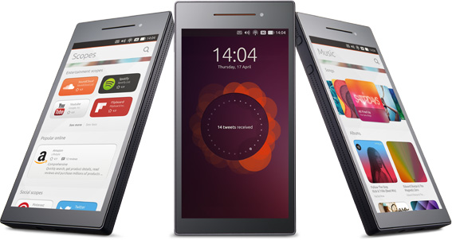
What's driving AppArmor development at Canonical?
Securing container workloads with the ability to place the container in its own AppArmor policy namespace
Application isolation for Ubuntu phone and tablet images
  wiki.ubuntu.com/SecurityTeam/Specifications/ApplicationConfinement

Slide 3
Recent improvements

Slide 4
Confining the container and the processes inside
Rework of AppArmor labeling is underway to gain the ability to cache more than one label on an object, ??? better caching of perms too (so can skip path lookup more often, etc.)
Compound labels and policy namespaces allow containers to be confined as a whole by one AppArmor profile in the “host” and then an entirely new set of AppArmor profiles can be used to confine the individual processes inside the container
  Potential for users to load their own AppArmor policy inside their user namespaces
For more information, see the presentation from LSS 2013
  selinuxproject.org/~jmorris/lss2013_slides/jj_apparmor-labeling-2013.odp

Slide 5
Fine-grained mediation in dbus-daemon
Sending and receiving of messages can be filtered on bus name, path, interface, member name, peer name, and peer label
    dbus (receive, send)
          bus=session
          path=/com/ubuntu/connectivity1/NetworkingStatus,
Bind rules can enforce a specific well-known name and a bus name
    dbus bind name=org.gnome.keyring,
Eavesdropping rules can specify the bus name
    dbus eavesdrop bus=system,
dbus-daemon patches have been submitted upstream
  https://bugs.freedesktop.org/show_bug.cgi?id=75113

Slide 6
Mediation of signals and ptrace
Signal mediation allows for rules to specify the signal(s) and the peer
    # Send SIGHUP and SIGINT to any process
    signal (send) set=(hup, int),
    # Allow libvirtd to send us signals
    signal (receive) peer=/usr/sbin/libvirtd,
Ptrace trace and tracedby permissions govern ptrace(2)
Ptrace read and readby govern certain /proc accesses, kcmp(2), futexes (get_robust_list(2)) and perf trace events
    # Allow unconfined processes (eg, a debugger) to ptrace us
    ptrace (readby, tracedby) peer=unconfined,
penguindroppings.wordpress.com/2014/06/06/application-isolation-with-apparmor-part-iv/

Slide 7
Other notable changes
Userspace utilities were rewritten from Perl to Python3
  aa-status, aa-enforce, aa-genprof, etc.
  Google Summer of Code project
  ??? Actually done by last lss but lots of bug fixes and integration done
systemd unit config file support for specifying the name of an AppArmor profile to switch to when starting a new process
Parser/?????Compiler improvements
  Minimization changes provided an average of 40% to 50% improvement in compilation times
  Differential compression provides a 50% smaller binary policy and a 30% to 40% improvement in compilation times for large profiles
  Atomic loading of cache files that contain multiple profiles decreases load times

Slide 8
Looking forward

Slide 9
Network mediation
UNIX domain sockets will soon have fine-grained mediation
  Can specify socket type, path, and socket label
    # Allow communication with D-Bus session bus
    unix (connect, send, receive) type=stream path=”@/tmp/dbus-*”,
??? embedded \0 in address names are not a problem
Additional address families will follow
??? still a coarse control over af that don't have a fine grained extension
  INET
  INET6
  NETLINK
  ??? Be flexible on what is used,
  - simple finer grained better basic controls at send etc. (no cipso, xfrm, secmark)
  - leverage cipso, xfrm, secmark as extension to provide full mediation

Slide 10
Smarter binary policy caching
Multiple, versioned binary policy caches
  Each policy cache will be tied to a unique feature set advertised by AppArmor in securityfs
  ??? better support of different policy version so kernels can be used as backport kernels to older releases
Ubuntu will soon generate the policy cache during kernel install instead of doing it at boot
Some cached policies for the Ubuntu phone images are already being generated server side to avoid having to compile them on the phone

Slide 11
Additional important pieces
Provide library interface for policy compiler and loader
  Needed for full systemd support
More parser/???compiler performance enhancements
Support/expose a wider permission set ??? in policy, the kernel has these separate
  For example, the write permission currently expands to setattr, create, delete, chmod, chown, open, and delete but it may be useful to expose more of these permissions
Finish labeling and profile stacking work to provide full container confinement

Slide 12
Questions please
Thank you
Tyler Hicks
tyhicks@canonical.com
www.canonical.com

