Slide 1




Mid Term Presentation for
IE 506 Machine Learning: Principles and Techniques Course Project
Paper: Harnessing Side Information for Classification Under Label Noise
Team Name: Optimistic Learners
Bundeliya Harsh Jitendrakumar (23N0452)
Tanmay Nath (23N0457)
Instructor: Prof. P. Balamurugan
IEOR,IIT Bombay

Slide 2
overview of the contents
IE 506 Machine Learning: Principles and Techniques
overview of the contents
Motivation for The Problem
Background of The Problem
Model Optimization
Aalgorithm flowchart
Computational Complexity
Experiments
Result
Contributions of each Team Member
Feature Works
References
Team Name: Optimistic Learners
2 / 20

Slide 3
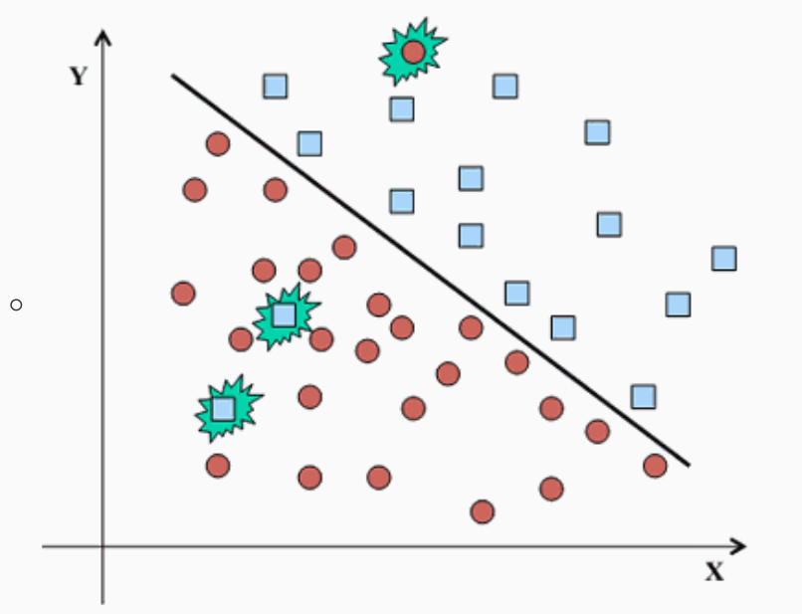
Motivation for The Problem
IE 506 Machine Learning: Principles and Techniques
Motivation for The Problem
supervised classifiers like SVMs or CNNs require correctly labeled data for training.
Labeling errors in real-world datasets, caused by factors such as human fatigue during manual annotation, introduce noise in the label space, impacting classifier performance.
For Ex:
Disease diagnosis, where doctors' experience matters a lot, often has label mistakes.
These errors can mess up training the classifier and make it bad at classifying.
Source: https://mlwiki.org/index.php/Noise_Handling_%28Data_Mining%29
Team Name: Optimistic Learners
3 / 20

Slide 4

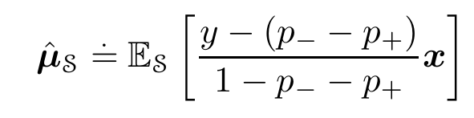
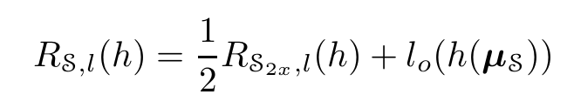
Background of The Problem
IE 506 Machine Learning: Principles and Techniques
Background of The Problem
Loss factorization, weakly supervised learning and label noise robustness by Giorgio Patrini:
For each instance ($X_{i}$, $Y_{i}$) in $S_{2x}$ , with a constant determined by the choice of λ and η, the learning rate, we obtain:
learning with asymmetric label noise, characterized by noise rates (p+, p−),
We extend existing methods by devising an unbiased estimator of μ:
Team Name: Optimistic Learners
4 / 20
Notes:
where p+, p− is the rate at which the +1 label data is hampered and -1 label data is hampered repectively,

Slide 5
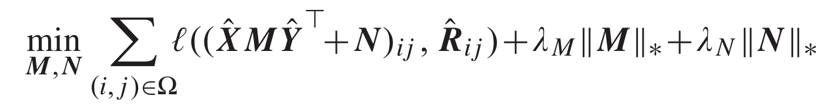
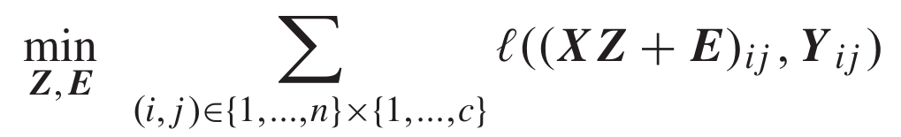

Background of The Problem
IE 506 Machine Learning: Principles and Techniques
“Matrix completion with noisy side information” by Chiang et al
$\text{Supp}\text{o}\text{se} \hat{R} \text{∈}R_{n_{1}×n_{2}} \text{is} \text{a} \text{matrix} \text{with} \text{rank} \text{r} \text{that} \text{should} \text{be} \text{recovered}\text{, }\text{and} \hat{X} \text{∈ }R_{n_{1}×d_{1}}\text{and} \hat{Y} \text{∈}R_{n_{2}×d_{2}} \text{(}\text{d}\text{1 }\text{and} \text{d}\text{2 }\text{denote} \text{feature} \text{dimensionality}\text{)}$
The matrices $\hat{X}$ (row feature) and $\hat{Y} (\text{column} \text{feature}$) serve as the side information for recovering $\hat{R}$.
Proposed model for recover $\hat{R}$ :
“Ω” is the index set containing all observed entries of $\hat{R}$
Inspired by this work Our paper treats the noisy label removal problem as a label matrix recovery problem:
Team Name: Optimistic Learners
5 / 20
Notes:
Our paper treats the noisy label removal problem as a label matrix recovery problem

Slide 6
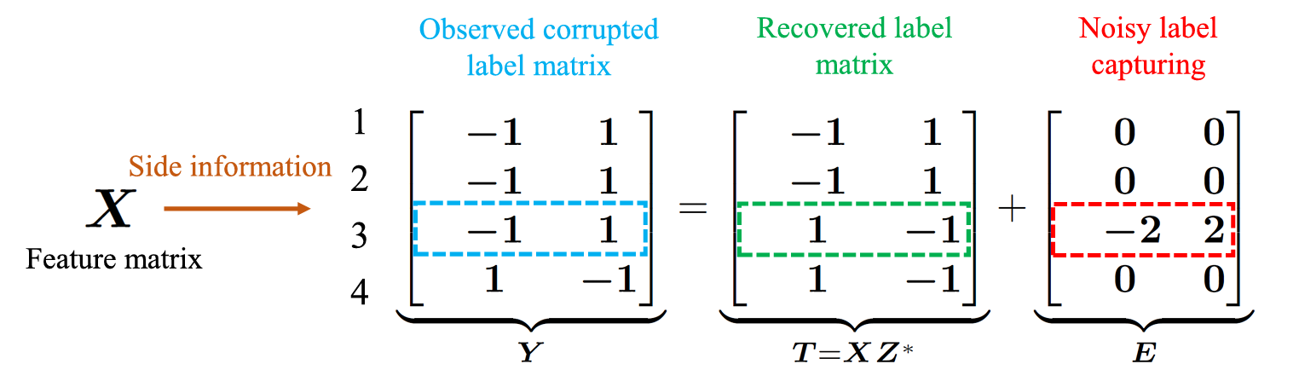
Model
IE 506 Machine Learning: Principles and Techniques
Over Main Objective:
our method tries to learn a proper mapping Z from feature space to label space in presence of the label noise encoded by E.
By taking the feature matrix X as side information,
the observed label matrix Y can be ideally decomposed as the sum of a low-rank recovered label matrix T = XZ* and
a row-sparse matrix E.
Note: that the nonzero row in E exactly corresponds to the 3rd example with noisy label
Source: https://ieeexplore.ieee.org/document/8848850
Team Name: Optimistic Learners
6 / 20
Notes:
where the first one is the low-rank groundtruth label matrix XZ estimated by the projection Z on the feature matrix X, and the second part is E ∈ Rn×c describing the difference between the observed labels and accurate labels.

Slide 7
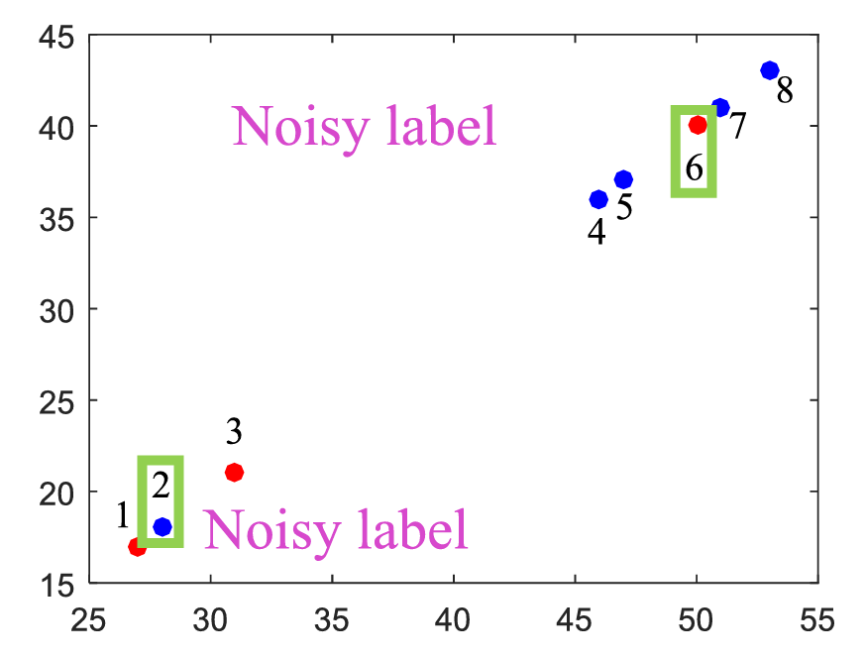
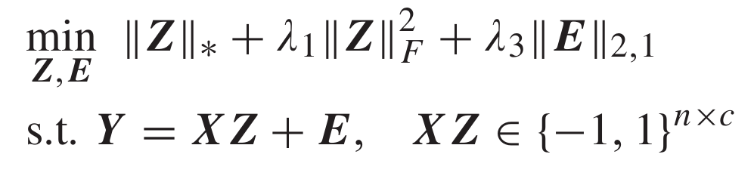
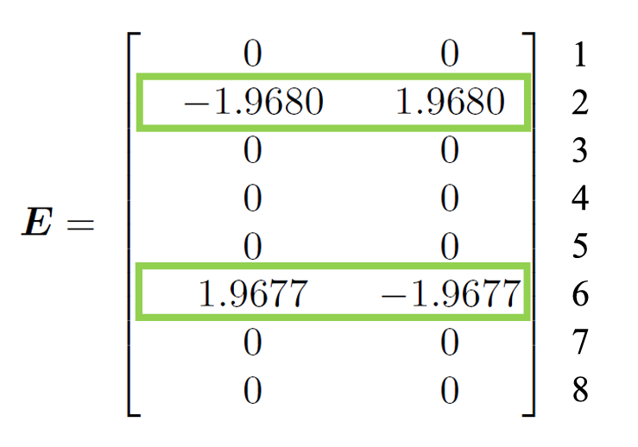

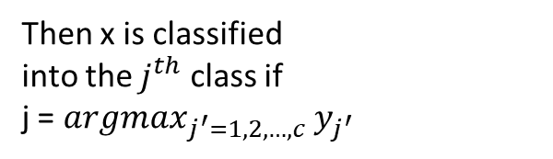
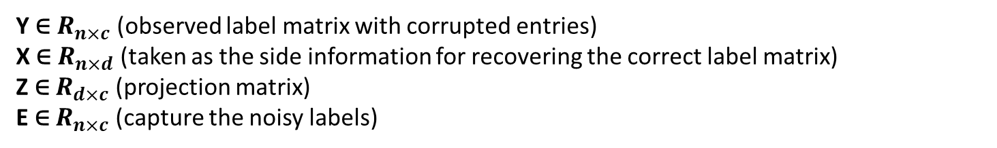
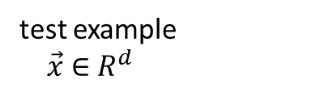
Model
IE 506 Machine Learning: Principles and Techniques
Objective Function:
Y ∈ $R_{n×c}$ (observed label matrix with corrupted entries)
X ∈ $R_{n×d}$ (taken as the side information for recovering the correct label matrix)
Z ∈ $R_{d×c}$ (projection matrix)
E ∈ $R_{n×c}$ (capture the noisy labels)
Inference:
test example
$\vec{x}$ ∈ $R^{d}$
Then x is classified
into the $j^{th}$ class if
j = ${argmax}_{j^{′}=1,2,…,c}$ $y_{j^{′}}$
$\vec{y}$= $Z^{∗}\vec{x}$
Team Name: Optimistic Learners
7 / 20
Notes:
Frobenius norm is imposed to Z to avoid overfitting
nuclear norm is employed to achieve low-rank effect
ℓ2,1 norm is utilized to realize row sparsity
λ1 and λ3 are the nonnegative tradeoff parameters.

Slide 8
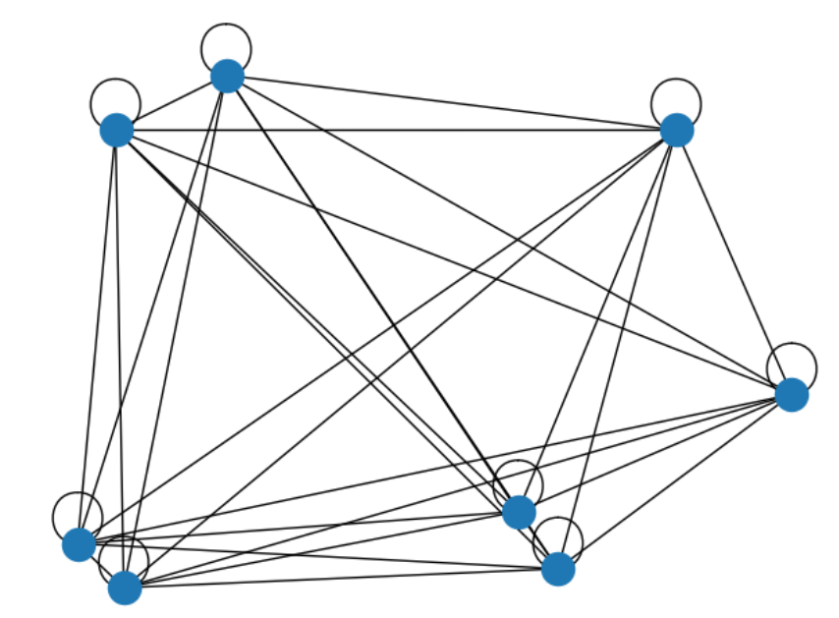
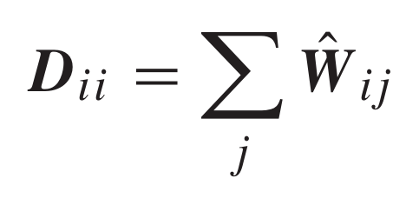
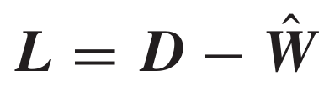
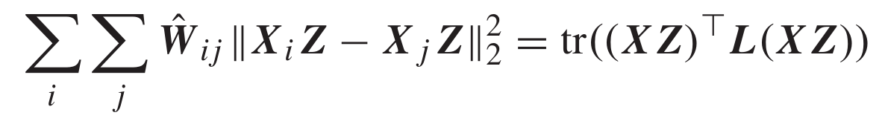
Model
IE 506 Machine Learning: Principles and Techniques
Let G ={V,E} be an undirected weighted graph with vertex set V consisting of all n examples and E is the edge set encoding the similarity between these examples.
The symmetric adjacency matrix W ∈ Rn×n is utilized to quantify the graph G
(σk is the kernel width)
The diagonal matrix D and the Laplacian matrix L of the graph G are
Team Name: Optimistic Learners
8 / 20
Notes:
similar examples revealed by G obtain similar clean labels, and the labels of dissimilar examples can be quite different. Therefore, we have the Laplacian regularizer

Slide 9
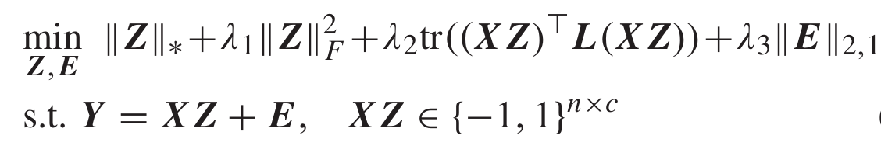
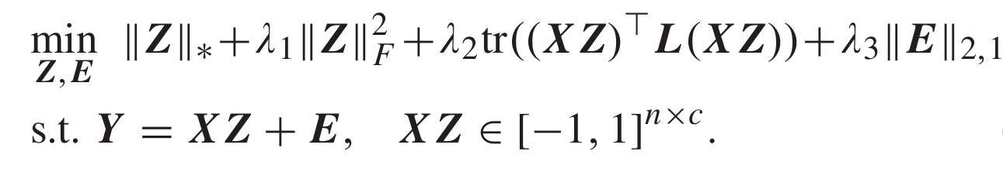

Model
IE 506 Machine Learning: Principles and Techniques
λ1, λ2,andλ3 are the non-negative tradeoff parameters.
we relax the discrete constraint XZ ∈ ${\{−1,1\text{\}}}_{\text{n}\text{×}\text{c}}$ to a continuous convex set XZ ∈ ${[−1,1\text{]}}_{\text{n}\text{×}\text{c}}$
Final Optimazation Problem:
Directly solving the problem is difficult due to the existence of coupled variables,
which will make its optimization not have a closed-form solution.
Team Name: Optimistic Learners
9 / 20

Slide 10
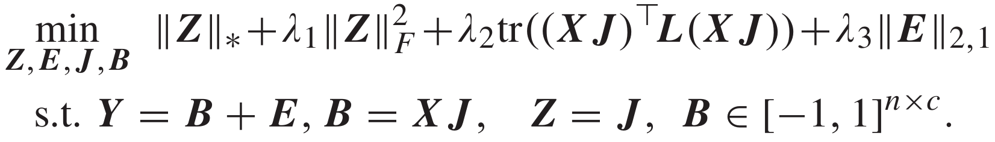
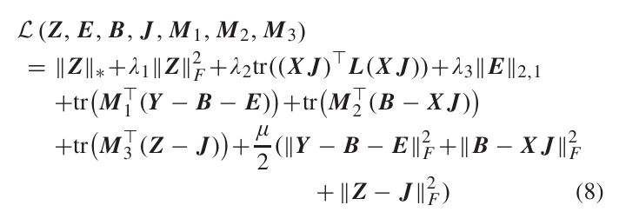

Model Optimization
IE 506 Machine Learning: Principles and Techniques
Optimization:
So we introduce two auxiliary variables J and B
For efficiency, here we use the alternating direction method of multipliers (ADMMs)
which alternatively optimizes the related variables in an iterative manner.
The augmented Lagrangian function :
where M1, M2, and M3 are the Lagrangian multipliers, and μ>0 is the penalty coefficient.
We can sequentially minimize each of the variables Z, E, B, and J by fixing the others in every iteration(ADMM).
Team Name: Optimistic Learners
10 / 20

Slide 11
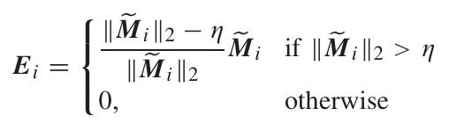
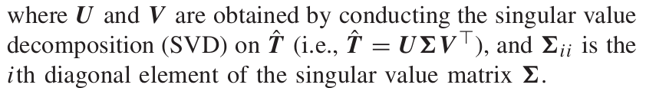

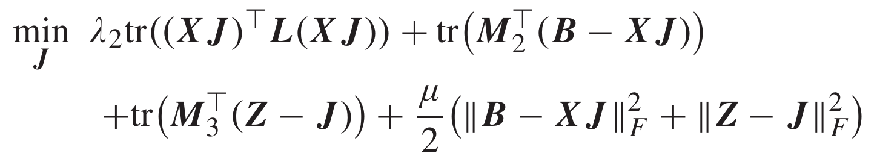
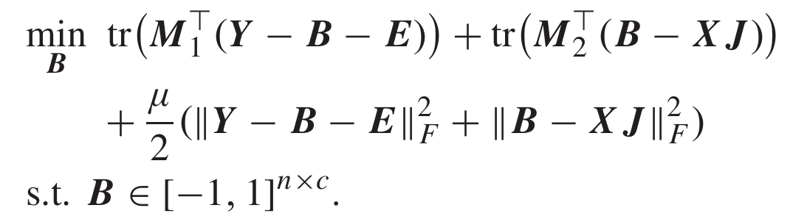
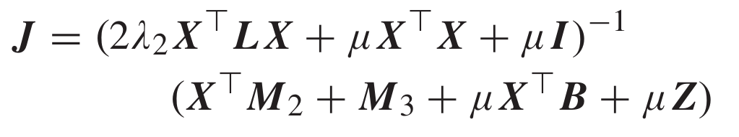
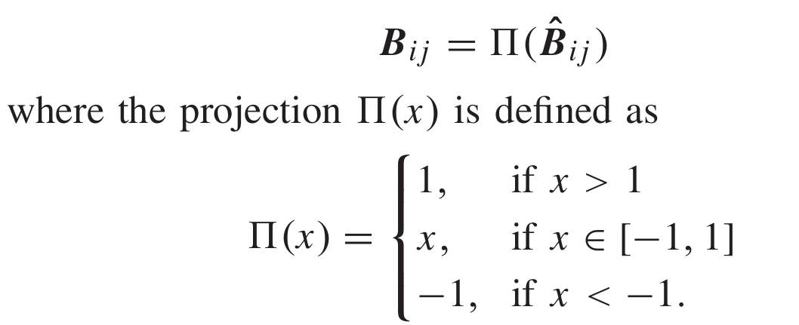
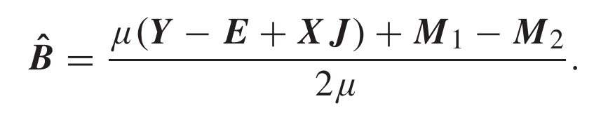
Model Optimization
IE 506 Machine Learning: Principles and Techniques
Update Z: The subproblem related to Z is
Update E: By dropping the unrelated terms to E, the subproblem of E is
Update J : The subproblem regarding J is
Team Name: Optimistic Learners
11 / 20

Slide 12



Aalgorithm flowchart
IE 506 Machine Learning: Principles and Techniques
Initialize: Z = 0, J = Z, E = 0, B = 0, $M_{1}=0, M_{2}$ = 0, $M_{3}$ = 0 ; $µ={10}^{−3}$, $µ_{max}$ = ${10}^{6}$, $ρ$ = 1.2, $ε$ = ${10}^{−6}$, iter_max = 1000; iter =0;
Construct graph G and calculate the Laplacian matrix L
While iter > iter_max :
X Y
Update Z (1)
Update E (2)
Update J (3)
Update B (4)
Update $M_{1}$(5)
Update $M_{2}$(6)
Update $M_{3}$(7)
Team Name: Optimistic Learners
12 / 20

Slide 13
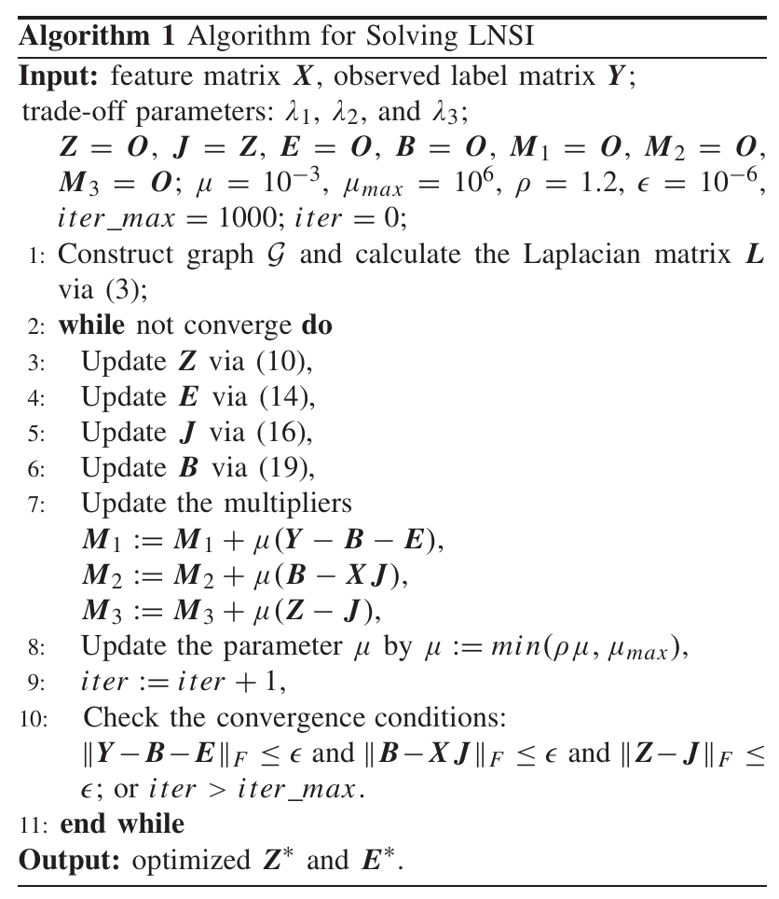
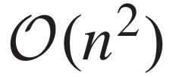
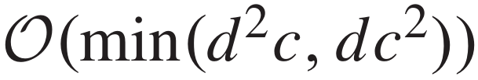

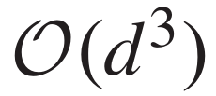
Computational Complexity
IE 506 Machine Learning: Principles and Techniques
Computational Complexity:
For graph construction (Line 1) :
For compute the SVD (Line 3 ):
For compute the l2-norm of
each row of a n × c matrix E (Line4):
For computing Invese
of a d × d matrix (Line 5):
Note: the complexity of Algorithm is squared to the number of training examples (n).
Team Name: Optimistic Learners
13 / 20

Slide 14
Experiments
IE 506 Machine Learning: Principles and Techniques
Experiments
numpy, pandas, matplotlib, seaborn, math, tensorflow computational framework considered
Python programming language considered
Data Sets: subset of MNIST
200 Train data points (from each category 0-9) and 2000 test data points
Pre-Processing:
resizes the input images,
prepares them for input into the VGG16 model,
loads the VGG16 model without its top layers,
and then extracts features from the images using the VGG16 model.
Shuffle the data
Adding Noise
Encoding of Noise label
Thus, the feature matrix X is of size 2000 × 4096 and the label matrix Y is of size 2000 × 10
Team Name: Optimistic Learners
14 / 20

Slide 15
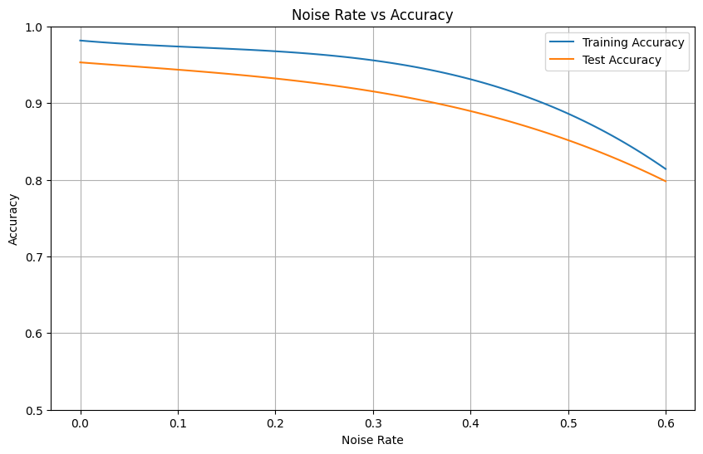
Result
IE 506 Machine Learning: Principles and Techniques
Implemented model(LNSI)
Additionally, we enforced a 10-nearest-neighbor condition for the adjacency matrix and determined the optimal values for the hyperparameters through grid search, with λ1 = 10000, λ2 = 1000, λ3 = 1, and a kernel width of 1.
We investigated noise levels of 0.0, 0.2, 0.4, and 0.6 and compared the accuracy for the test and training sets for the LNSI algorithm.
Team Name: Optimistic Learners
15 / 20

Slide 16
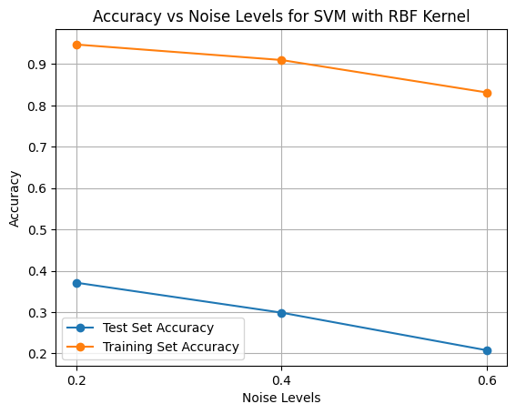
Result
IE 506 Machine Learning: Principles and Techniques
Furthermore, we evaluated the accuracy of SVM with an ”rbf” kernel versus LNSI
Team Name: Optimistic Learners
16 / 20

Slide 17
Contributions of each Team Member
IE 506 Machine Learning: Principles and Techniques
Contributions of each Team Member:
Paper Understanding by both
Implementation by both
“Loss factorization, weakly supervised learning and label noise robustness” by Tanmay
“Matrix completion with noisy side information” by Harsh
Report made by Tanmay
presentation slides made by Harsh
Team Name: Optimistic Learners
17 / 20

Slide 18
Overview of paper
IE 506 Machine Learning: Principles and Techniques
Feature Works:
we will change the various norms used in the overall project and try to look out for better results.
In our paper, we used the Laplacian regularizer. We want to try out other regularizer to make our model better.
we will try to update the current code and get better results and compared with the μSGD model.
Team Name: Optimistic Learners
18 / 20

Slide 19
References
IE 506 Machine Learning: Principles and Techniques
References
[1] Giorgio Patrini, Frank Nielsen, Richard Nock, Marcello Carioni. Loss Factorization, Weakly Supervised Learning and Label Noise Robustness. The 33rd International Conference on Machine Learning, in Proceedings of Machine Learning Research, 2016 (chrome-extension://efaidnbmnnnibpcajpcglclefindmkaj/https://proceedings.mlr.press/v48/patrini16.pdf) [2] K.-Y. Chiang, C.-J. Hsieh, and I. S. Dhillon. Matrix completion with noisy side information. In Proc Adv. Neural Inf. Process. Syst., 2015 (https://proceedings.neurips.cc/paper/2015/file/0609154fa35b3194026346c9cac2a248-Paper.pdf) [3] R. Wang, T. Liu, and D. Tao. Multiclass learning with partially corrupted labels. IEEE Trans. Neural Net w. Learn. Syst., 2018 (https://ieeexplore.ieee.org/abstract/document/7929355) [4] Kuan - Min Huang, Hooman samani, chang-yun yang yang and Jie - shengchen. Alternating Direction Method of Multipliers for Convex optimization in Machine Learning - interpretation and Implementation ,2nd International Conference on Image processing and Robotics,2022.(https://ieeexplore.ieee.org/document/9798720) [5] Prof won Math ( https : //youtu.be/M 9F 7zT 9Gg − k?si = BQIkRM 2batjP Y V mc) Accessed on 11th Feb,2024 [6] datacamp (https://www.datacamp.com/blog/classification-machine-learning) Accessed on 11th Feb,2024 [7] iMerit (https://imerit.net/blog/how-noisy-labels-impact-machine-learning-models/) Accessed on 11th Feb,2024 [8] Prof. Yi Ma (https://people.eecs.berkeley.edu/ yima/matrix-rank/home.html) Accessed on 12th Feb,2024 [9] Sciencedirect (https://www.sciencedirect.com/topics/mathematics/frobenius-norm) Accessed on 12th Feb,2024 [10] Wikipedia (https://en.wikipedia.org/wiki/Laplacian matrix) Accessed on 13th Feb,2024 [11] Yang Liu, Assistant Professor, Computer Science and Engineering UC Santa Cruz (https://www.youtube.com/watch?v=6tAHaO5GGqI) Accessed on 14th march,2024
Team Name: Optimistic Learners
19 / 20

Slide 20

IE 506 Machine Learning: Principles and Techniques

