Slide 1



Wishyoulization-Tassels-Slicer-Custom-Visual-Demo
View in Power BI
Last data refresh:
8/18/2019 9:15:47 PM India Standard Time
Downloaded at:
8/18/2019 9:17:30 PM India Standard Time

Slide 2
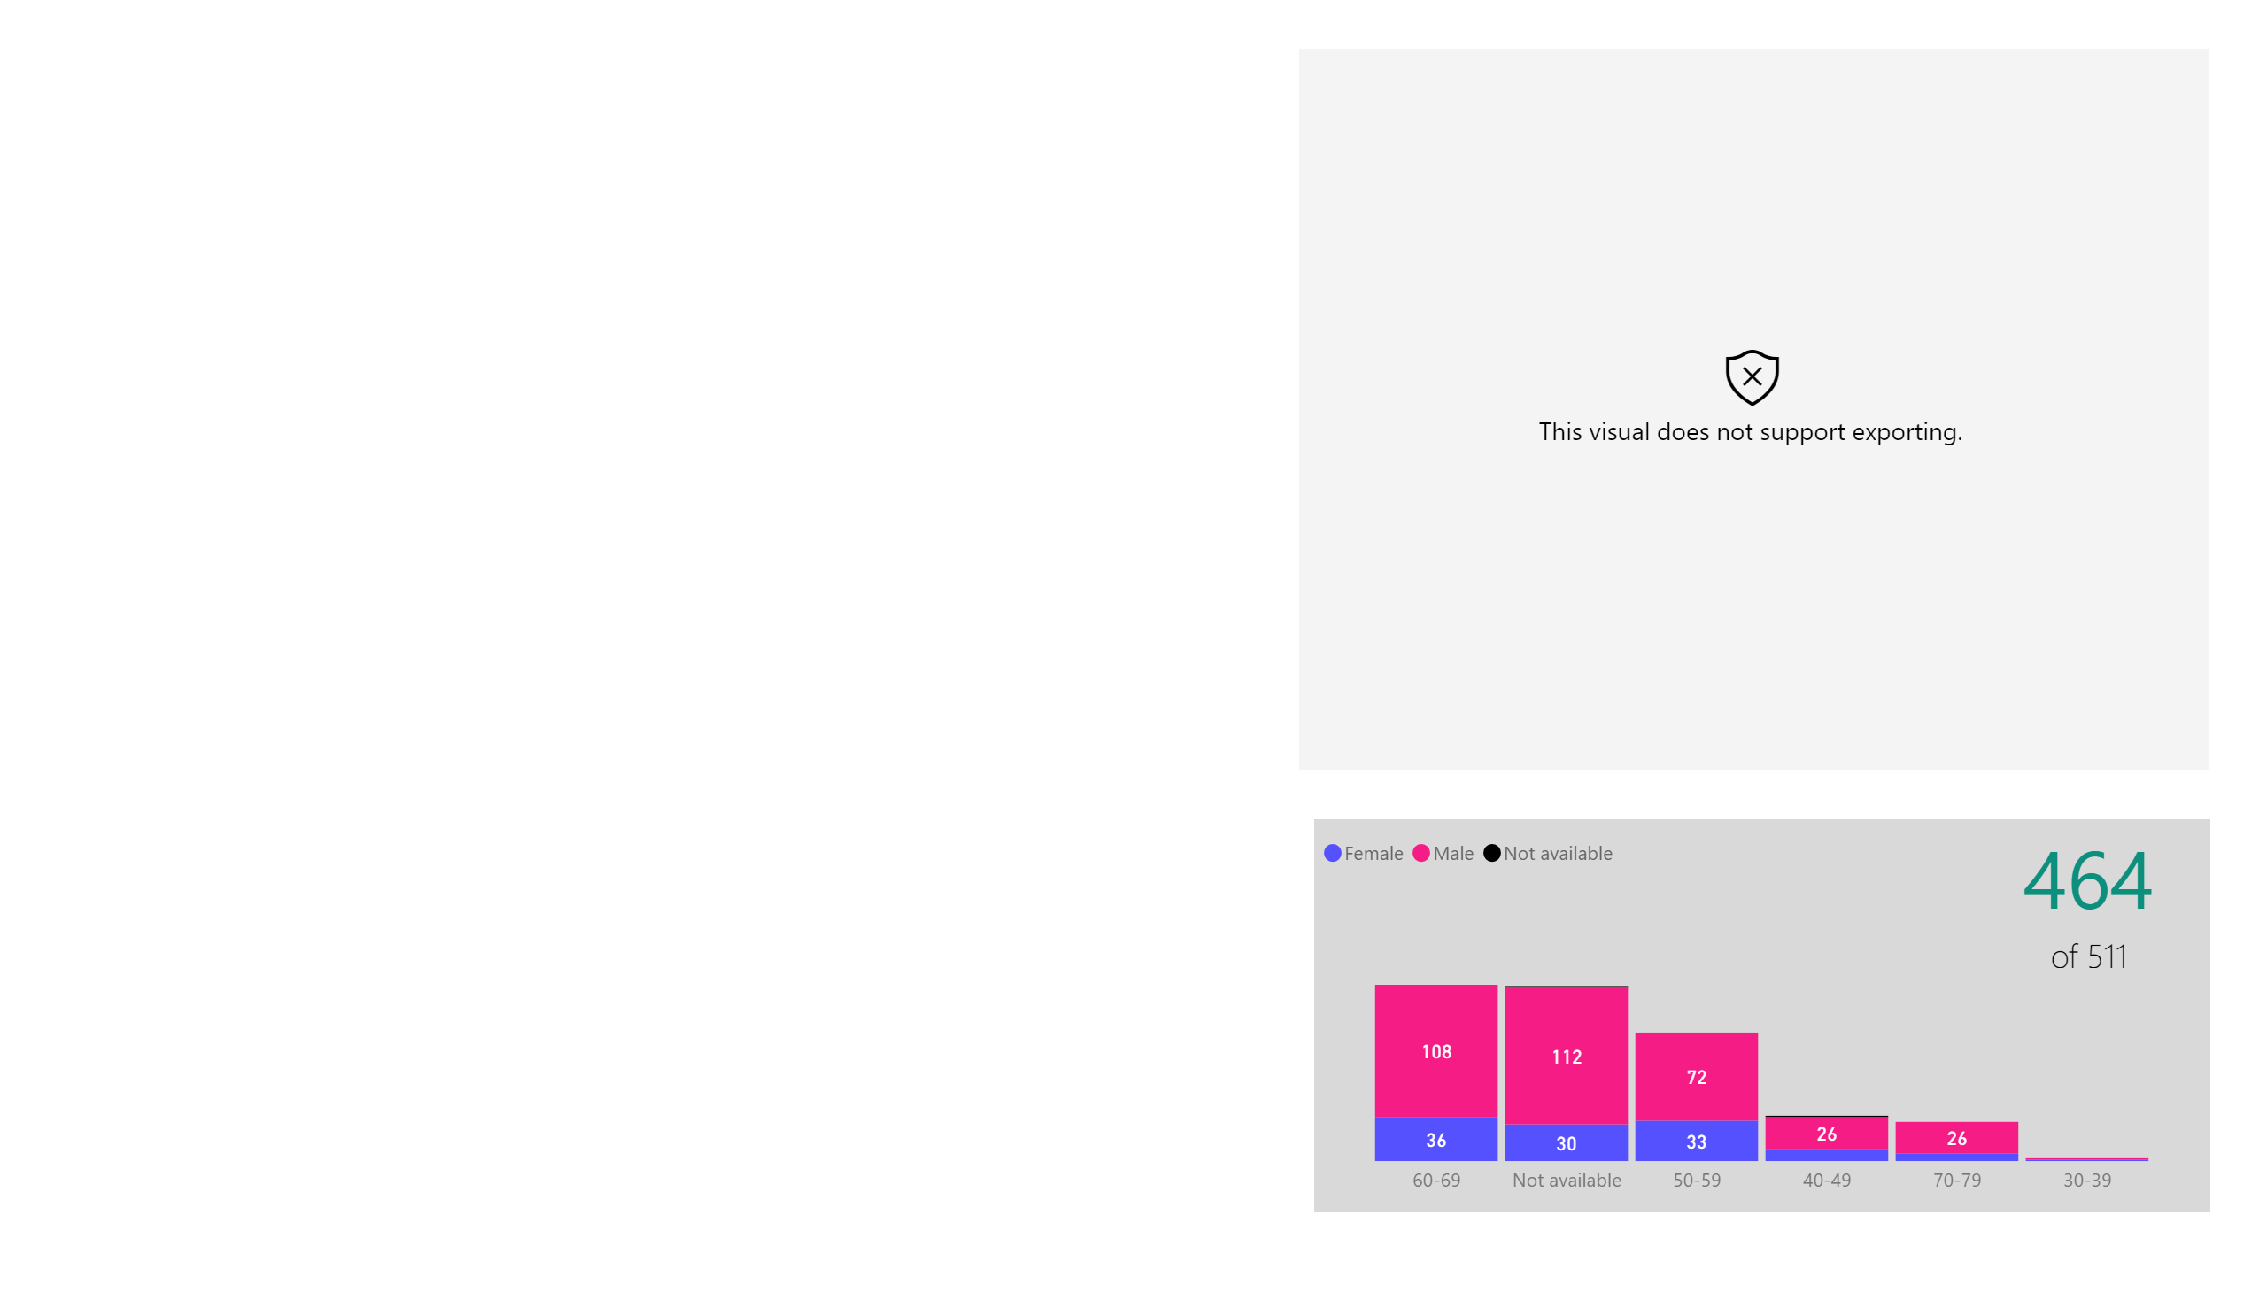

Slide 3
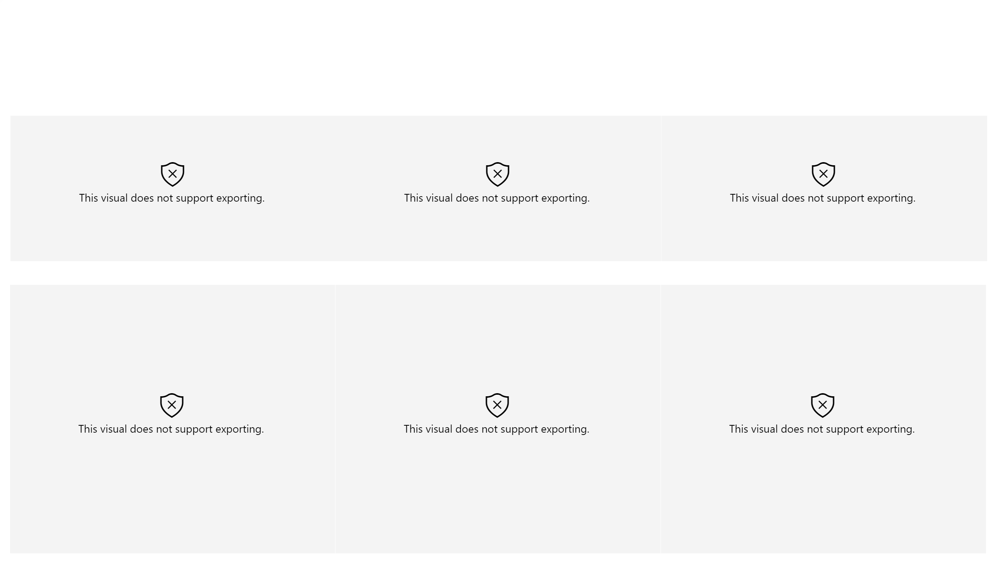

Slide 4
