Slide 1

start
Please interact via mouse.

Slide 2
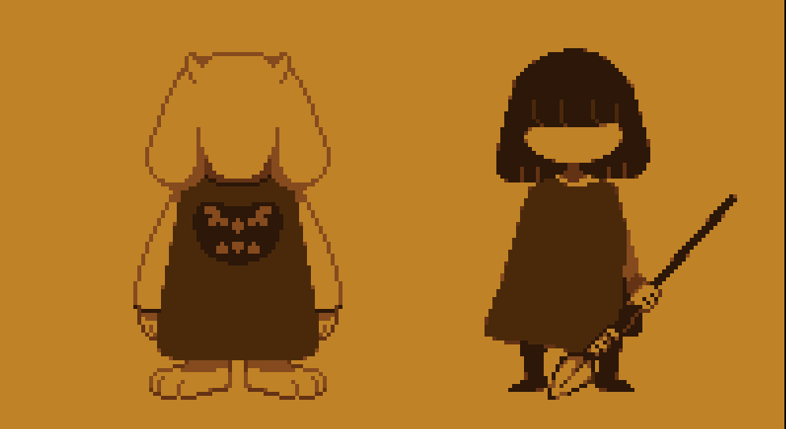
predefines
strypgrss
starttimer
rsttxtstp
stoptimer
clrdlgbox
stryrst
For a time, HUMANS and MONSTERS spreaded though the earth.

