Slide 1
Evaluating Federal Funding on Broadband Equity
Amal Michael
Regis University
MSDS696_Data_Science_Practicum II
Final Presentation
Apr 30 2026

Slide 2
About the project
Analyze the Impact of Federal Funding
RDOF ( Rural Digital Opportunity Fund ) Allocation in Oct 2020
FCC Broadband data as of Dec 2024
Census Data as of 2023
Was the Federal Funding Effective ?

Slide 3
Data
Geography key : State > County > Census Tracts > Census Block Groups > Census Block
Source | Data | Raw data | Data Prep | Final Data Points
Fcc.Gov | Internet providers and speeds | ~8 mil | Consolidation, Summarization | ~240,000
Census.gov | Median Income, Population, Minority Population | ~240,000 | Calculate Minority Population % | ~240,000
Census.gov | Census Block Group Shape files | ~240,000 | - | ~240,000
Fcc.Gov | RDOF (Rural Digital Opportunity Fund ) Allocation | 61767 | - | 61767

Slide 4
Approach
Integrate RDOF, Census & FCC data to a Pandas Data frame.
Calculate New Metric : WAS ( Weighted Internet Availability Score )
Plot EDAs – WAS, RDOF, Income, Population
Calculate Funding Efficiency Index
Supervised Machine Learning. Predict Funding Efficiency Index
Unsupervised Machine Learning. K-Means Clustering
Develop Interactive dashboard ( Tableau ) for Policy Recommendations

Slide 5
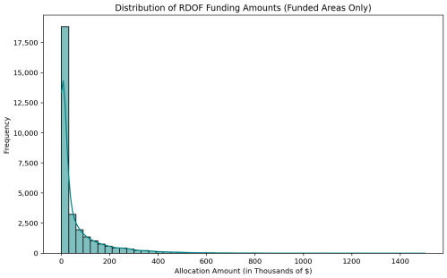
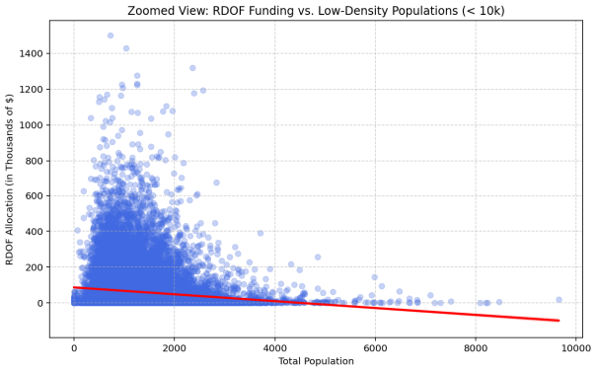
EDA
80% funding received < $200,000
Underserved areas got up to $1.5 mil
Funding Targets geographies with < 2000 residents
Funding tapers of when population moves 6000+

Slide 6
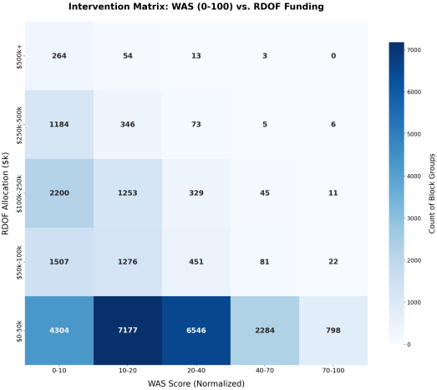
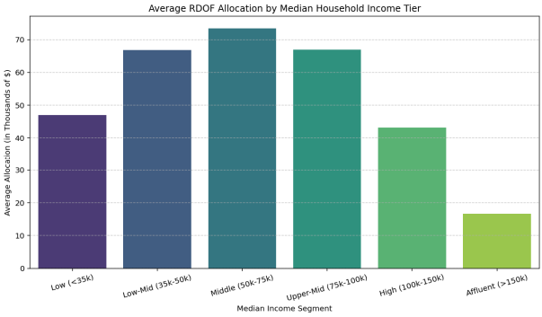
EDA
Middle Class focus – suburban to Rural
Funding reduces for Low income / Affluent
Result Matrix indicating where the funds went
Most funding went to underserved market censusblock groups

Slide 7
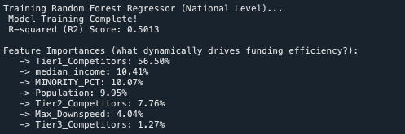
Supervised Machine Learning Random Forest Regressor
Target : Funding Efficiency Index
Features:
Tier1_Competitors
Tier2_Competitors
Tier3_Competitors
Max_down_speed
Median Income
Total Population
Minority percentage
Hyper Parameters:
n_estimators = 100
random_state = 42
n_jobs = -1
train size = 20%

Slide 8
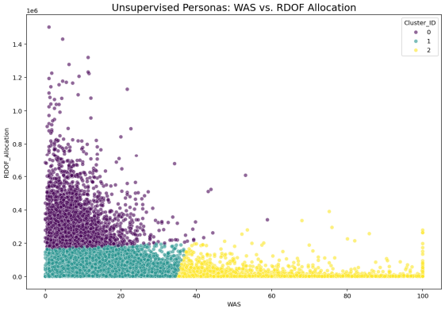
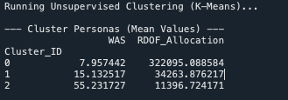
Unsupervised Machine Learning K-means Clustering
Cluster Features = WAS, RDOF
Hyper Parameters :
n_clusters = 3,
random_state = 42,
n_init = 10

Slide 9
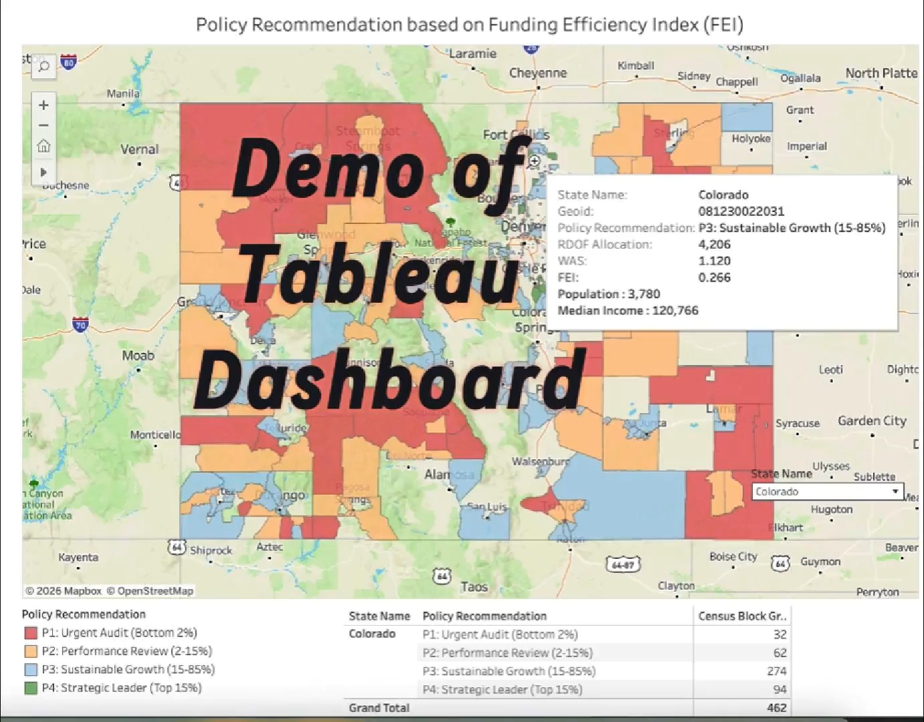
Interactive Dashboard
Interactive
Dashboard
Demo
https://public.tableau.com/app/profile/amal.rozario/viz/RDOFPolicyRecommendations/Dashboard1

Slide 10
References
[1] Michael,Amal. (2025) Amal michaels data science practicum 1. Accessed: Mar. 17, 2026.
https://amalsdatascience.blogspot.com/2025/10/wrapping-up-geospatial-dive-into-us.html
[2] Federal Communications Commission. (2024) National broadband map: Broadband serviceable location fabric. Accessed: Mar. 17,
2026. : https://broadbandmap.fcc.gov/
[3] U.S. Department of the Treasury. (2024) USASpending.gov api database. : https://www.usaspending.gov/
[4] U.S. Census Bureau. (2023) American community survey 5-year estimates (2018-2022). : https://data.census.gov/
[5] Federal Communications Commission. (2020) Auction 904: Rural digital opportunity fund (rdof). Accessed: Mar. 17, 2026.
: https://www.fcc.gov/auction/904
[6] U. Paul, V. Gunasekaran, J. Liu, T. N. Narechania, A. Gupta, and E. Belding, “Decoding the divide: Analyzing disparities in broadband
plans offered by major us isps,” in Proceedings of the ACM SIGCOMM 2023 Conference, ser. SIGCOMM ’23. New York, NY, USA:
Association for Computing Machinery, 2023, pp. 1–14. [Online]. Available: https://doi.org/10.1145/3603269.3604831

Slide 11
Appendix
WAS Calculation
Tier1 Competitor : Speed > = 1000
Tier2 Competitor : Speed > = 100 and < 1000
Tier3 Competitor : Speed >=25 and < 100
WAS = Tier1_Competitor_count*5
+ Tier2_Competitor_count*3
+ Tier3_Competitor_count*1
* Normalized to 100
FEI Calculation
FEI = WAS / RDOF / 1000
National Policy Calculation
# 1. Scaling the variables
df_core['WAS_scaled'] = (df_core['WAS'] - df_core['WAS'].min()) / (df_core['WAS'].max() - df_core['WAS'].min())
df_core['FEI_scaled'] = (df_core['FEI'] - df_core['FEI'].min()) / (df_core['FEI'].max() - df_core['FEI'].min())
df_core['RDOF_scaled'] = (df_core['RDOF_Allocation'] - df_core['RDOF_Allocation'].min()) / (df_core['RDOF_Allocation'].max() - df_core['RDOF_Allocation'].min())
# 2. Score Calculation (Lower = More Urgent)
df_core['Policy_Score'] = (df_core['FEI_scaled'] * 0.4) + (df_core['WAS_scaled'] * 0.4) - (df_core['RDOF_scaled'] * 0.2)
# 3. Dynamic Thresholds for 2%, 15% and cumulative 85%)
q02, q15, q85 = df_core['Policy_Score'].quantile([0.02, 0.15, 0.85])
def assign_policy(score):
if score <= q02: return "P1: Urgent Audit (Bottom 2%)"
if score <= q15: return "P2: Performance Review (2-15%)"
if score <= q85: return "P3: Sustainable Growth (15-85%)"
return "P4: Strategic Leader (Top 15%)"

