Slide 1

Oogway UART Tile
Chris Shakkour
Shahar Dror

Slide 2
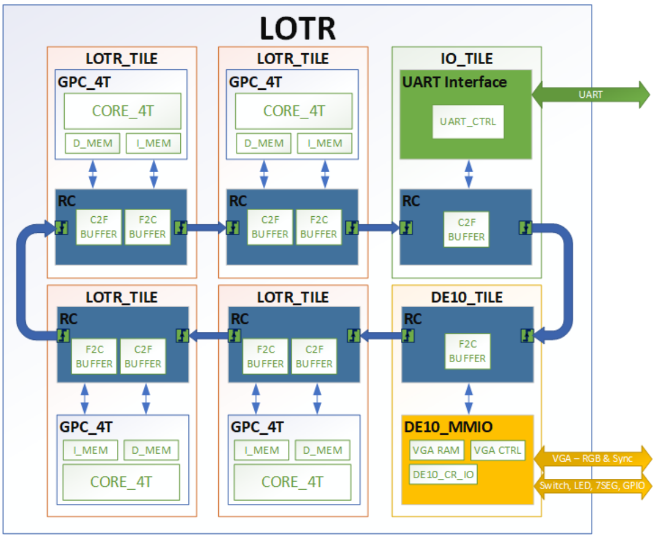
Introduction
The UART tile project is a part of a bigger project called the LOTR
A multi-core design project featuring a ring-like architecture to connect all the cores/tiles in a ring
the UART tile is here to provide communication from host devices to the LOTR

Slide 3
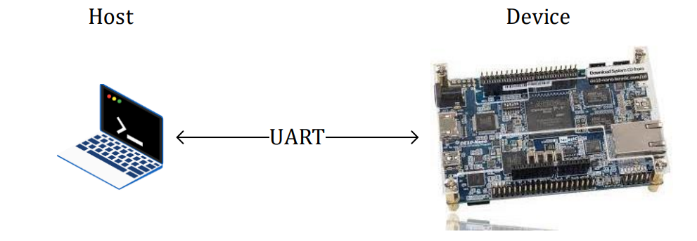
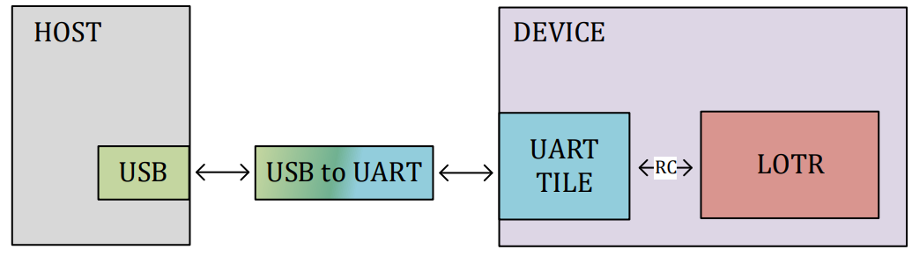
System level Connection
The HW interface of the project serves as the blue part in this diagram and the SW interface serves as the green part

Slide 4
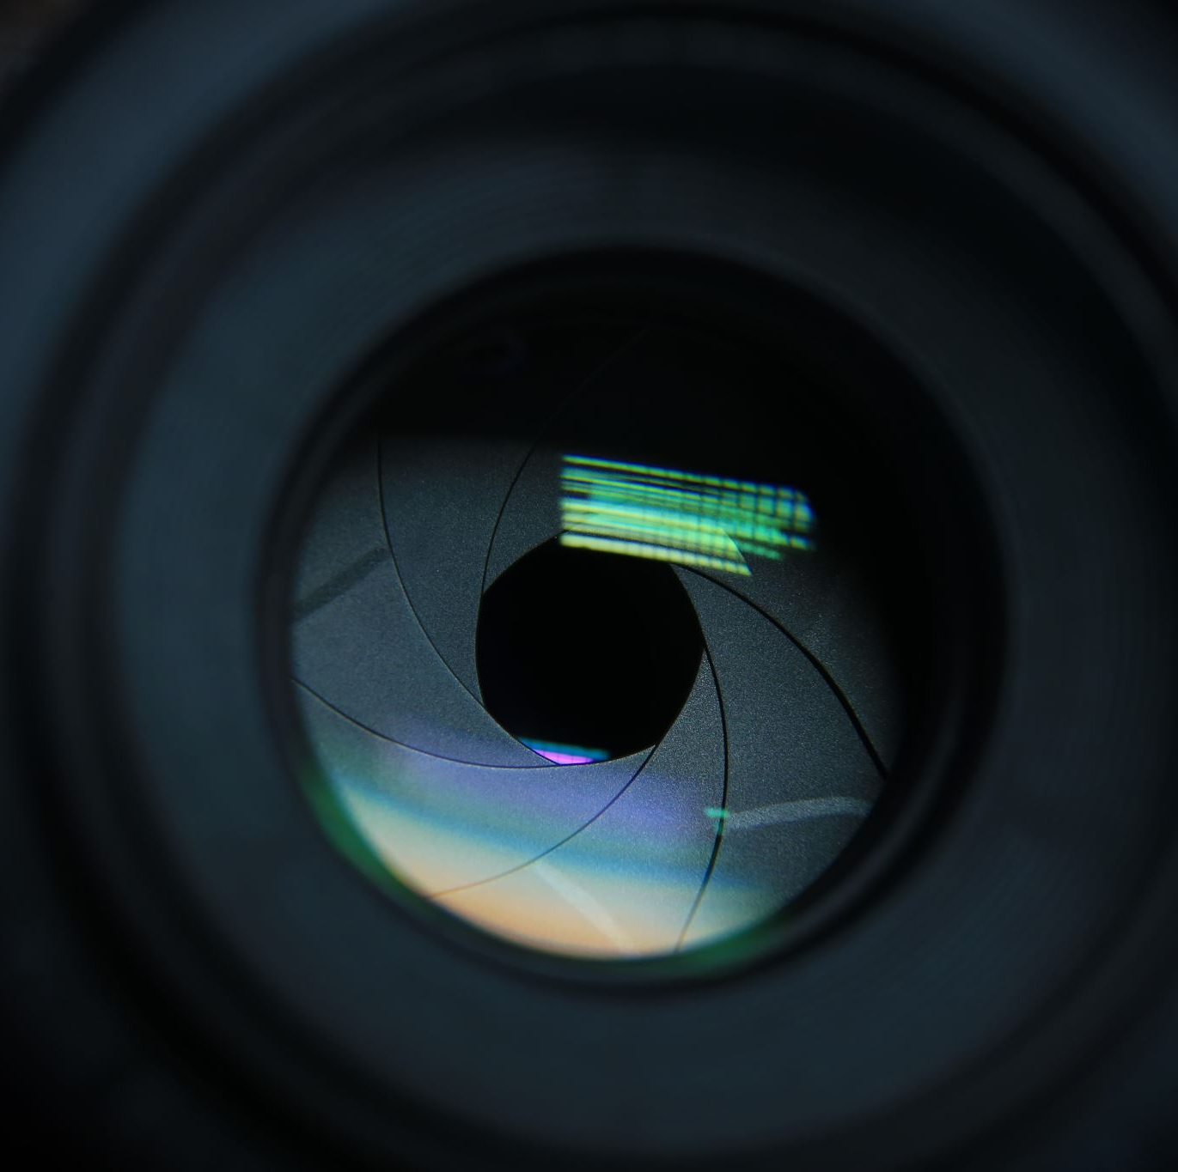
Demo

Slide 5
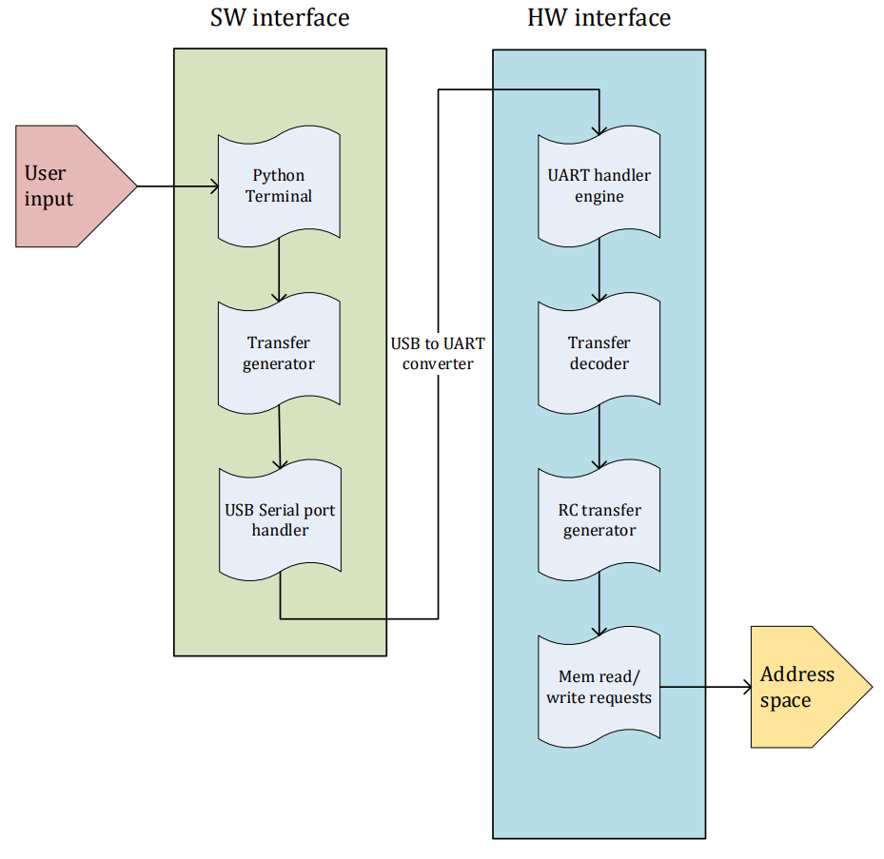
HW-SW interface
The following diagram shows the different abstraction levels within each interface, both interfaces SW, and HW have multiple abstraction levels as seen below.

Slide 6
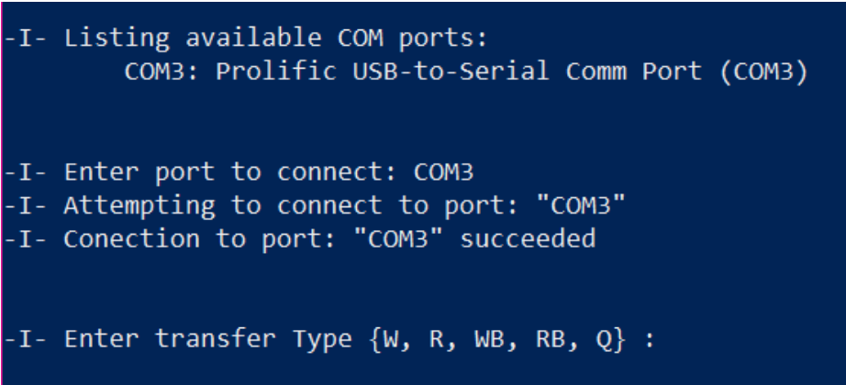
SW Interface
The software interface is the code running on a Host device
The software does two main functions:
Decode user input.
Generate “Host to Device” transfers.

Slide 7
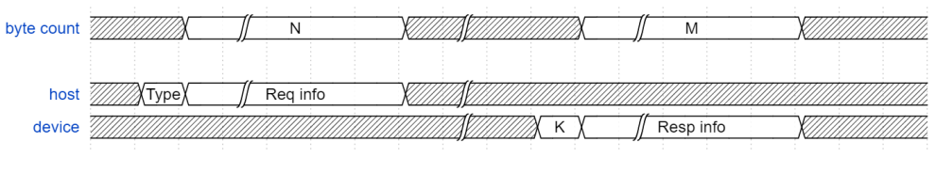
Host to Device Transfers
All transfers are initiated by the Host only.
The Host starts the transfer and waits for a response from the Device or expire upon timeout.
Each transfer starts with one byte indicating the transfer type followed by ‘N’ bytes with the required information:
transfer address
data from Host to Device
For each transfer, a series of bytes is responded from the Device starting with ‘K’ followed by “M” bytes of response information.

Slide 8
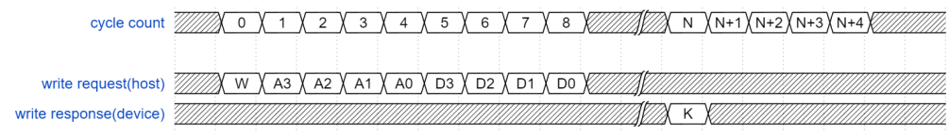
Write transfer
Initiated by the Host with a starting byte ‘W’, Followed by 8 bytes consisting of, 4 bytes representing the transfer Address, and 4 bytes of transfer data. After a successful transfer, the Device responds with a byte of “K” in ascii indicating transfer completion.

Slide 9
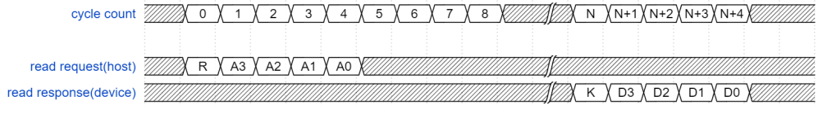
Read transfer
Initiated by the Host with a starting byte ‘R’, Followed by 4 bytes representing the transfer Address. After a successful transfer, the Device responds with a byte of “K” in ascii indicating transfer completion, followed by 4 bytes of response Data.

Slide 10
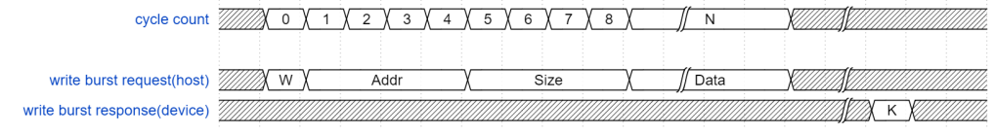
Write burst transfer
Initiated by the Host with a starting byte ‘W’, Followed by Many bytes consisting of, 4 bytes representing the transfer Address, 4 bytes representing the transfer Size and 4*Size bytes of transfer data. After a successful transfer, the Device responds with a byte of “K” in ascii indicating transfer completion.

Slide 11
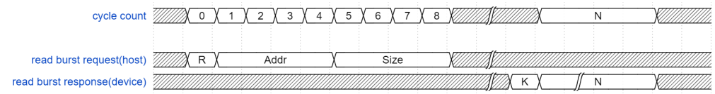
Read burst transfer
Initiated by the Host with a starting byte ‘W’, Followed by Many bytes consisting of, 4 bytes representing the transfer Address, 4 bytes representing the transfer Size. After a successful transfer, the Device responds with a byte of “K” in ascii indicating transfer completion, followed by 4*Size bytes of response data.

Slide 12
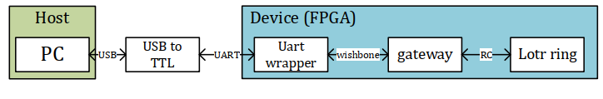
Low-level communication diagram
The transfers are sent in asynchronous serial communication protocols from the host via the USB line and the UART line
Then translated to reg access transfers passing through the wishbone
After that the gateway communicates with the RC interfaces
The way back to the HOST in the opposite direction

Slide 13
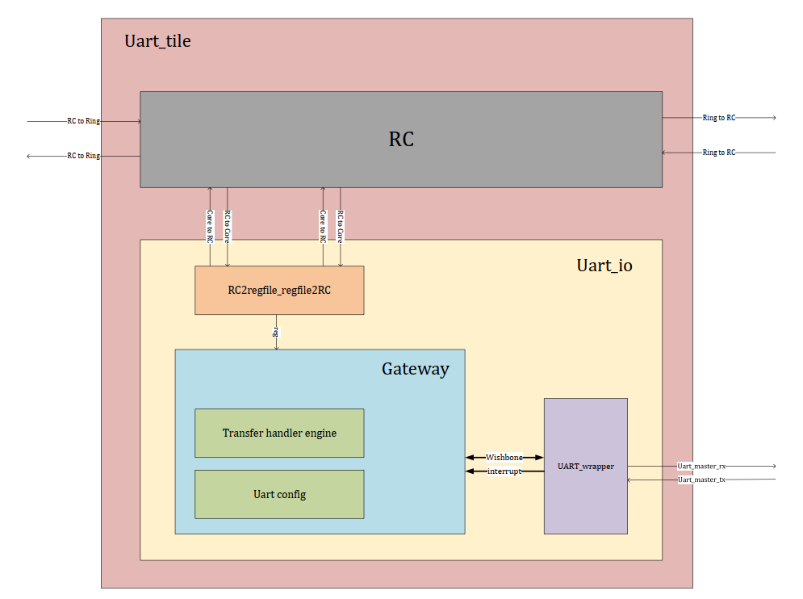
Hardware interface
The UART tile connects to the Ring using the RC block, the RC block communicates with the Gateway module that acts as a conversion bridge between the UART transfers and the RC transfers.

Slide 14
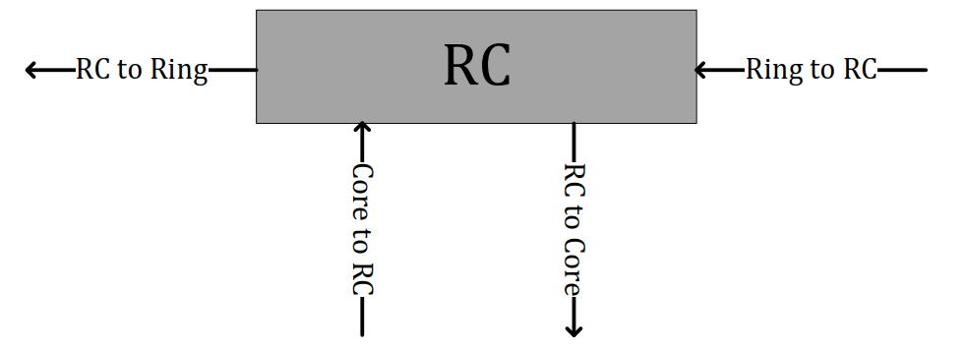
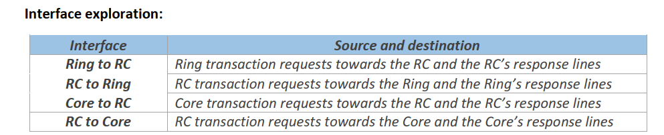
Ring controller (IP)

Slide 15
Configuration FSM
An FSM that handles the configuration flow and goes to sleep after config flow is done.
configuring the UART IP via a series of wishbone reads and writes to set the configuration registers with the desired values:
Baudrate
word length
Interrupt configuration

Slide 16
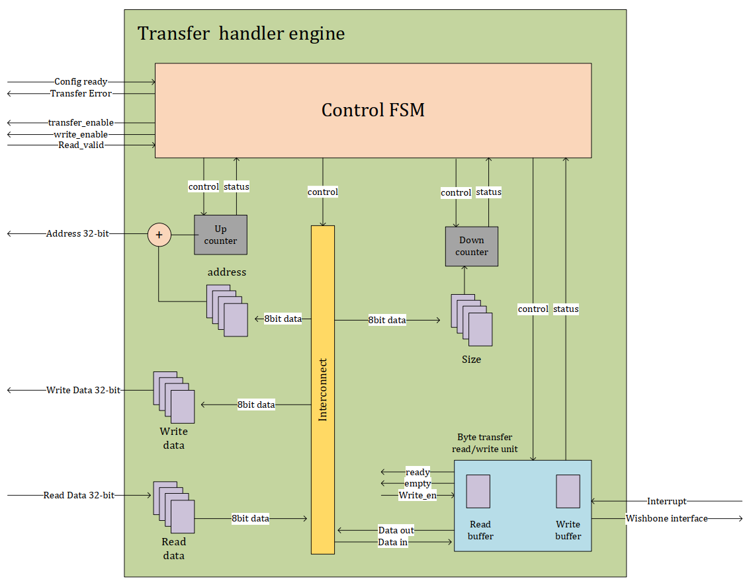
Transfer handler engine
This unit is responsible for decoding the transfers sent by the Host after the translation to wishebone
The FSM to convert them to direct access register transfers.
The address and data information are sent in parallel in a single cycle to the Reg2rc conversion unit that then moves this transfer forward to the RC controller

Slide 17
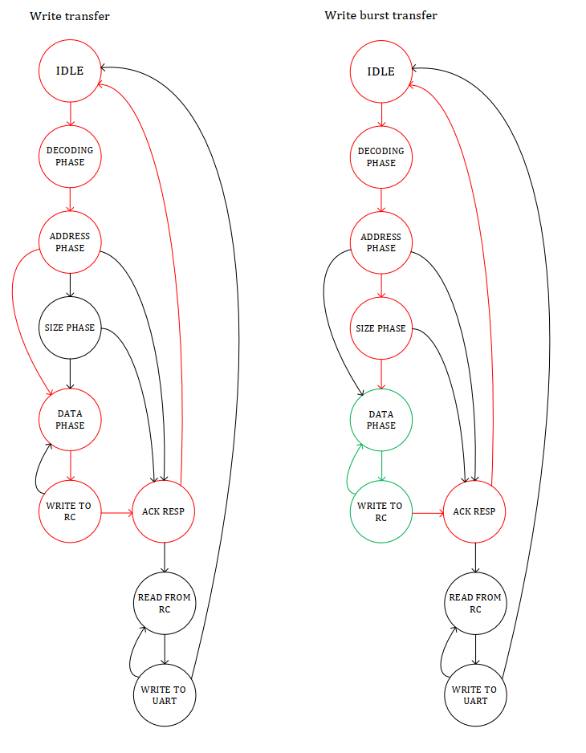
FSM examples write

Slide 18
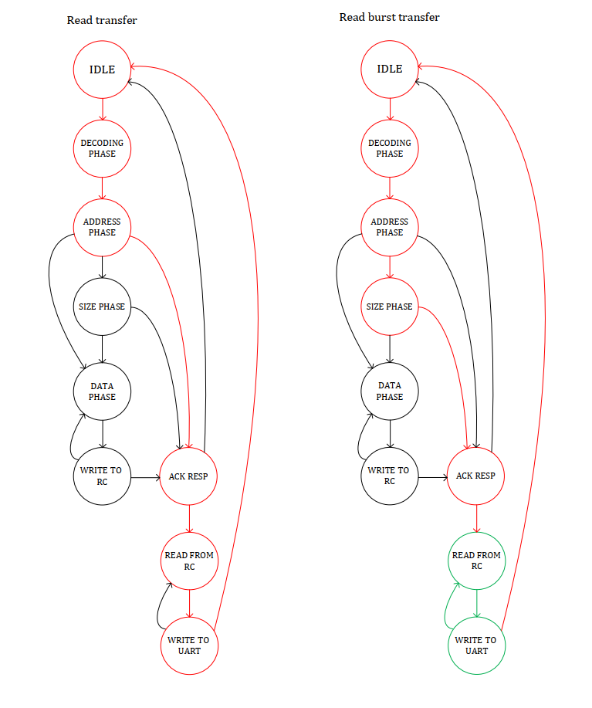
FSM examples read

Slide 19
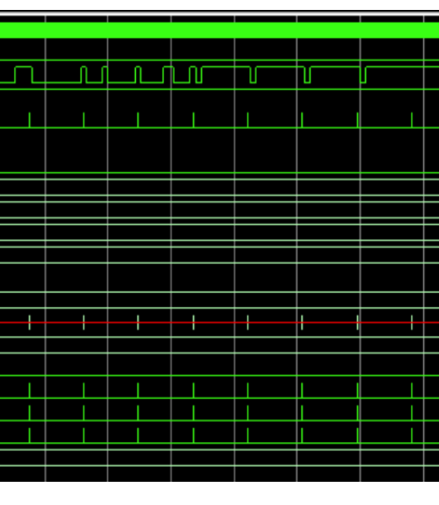
Verification and Validation
Block-level RTL simulations.
System-level RTL simulations.
SW Emulators using Arduino and other platforms.
Realtime system validation.

Slide 20
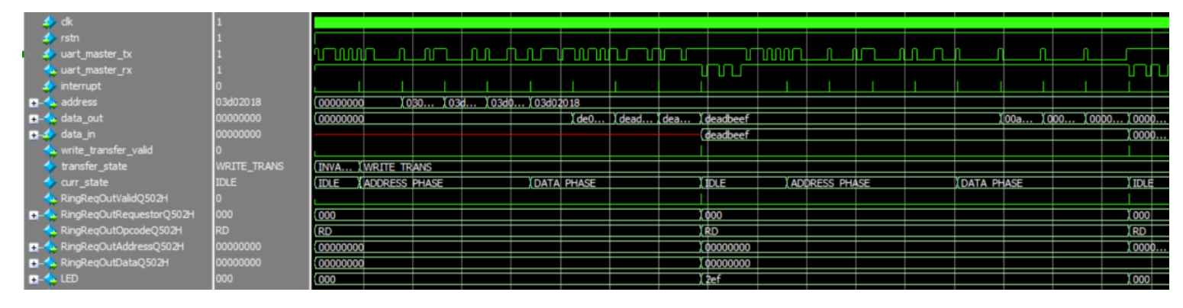
Verification and Validation
System level simulations

Slide 21
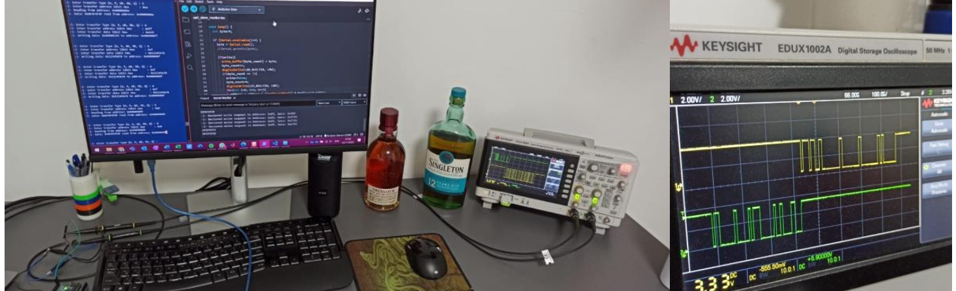
Functional validation
The functional validation has been done using an Oscilloscope to monitor the UART RX and TX lines using these two lines one can observe the transactions being sent to and from the device.

Slide 22
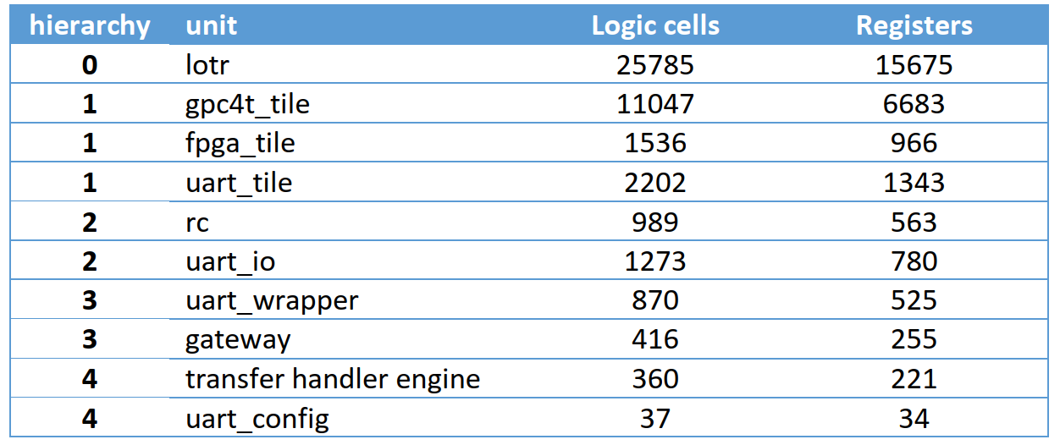
FPGA AREA REPORTS
The area reports have been done on a 50Mhz clock while using the INTEL Quartus prime software

