Slide 1
RVC_ASAP RISCV Core As-Fast-As-Possible
Amichai Ben-David

Slide 2
Agenda
Content | Duration
Review the RISCV GCC guide. Compile a simple program to RISCV Machine Code
Review the Modelsim Systemveilog guide. Compile & test a simple RTL program.
Design/Understand the RVC_ASAP Block Diagram.
Write the Systemverilog (RTL) code that describes the block diagram.
Design a

Slide 3
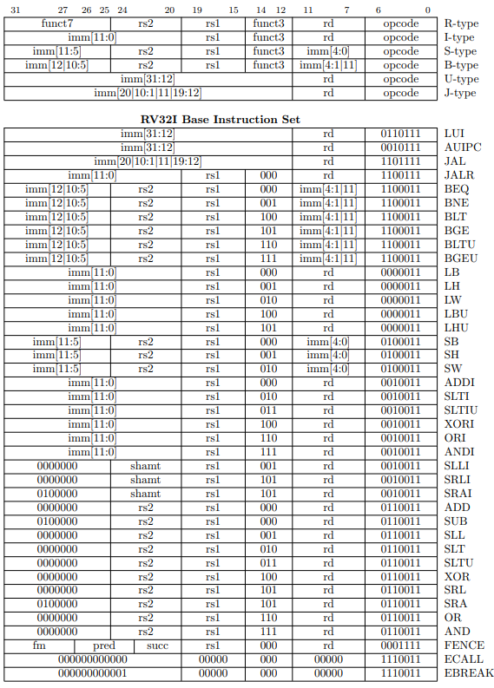
RISCV ISA: Format & Instructions

Slide 4
RISCV ISA: R-Type

Slide 5
RISCV ISA: I-Type

Slide 6
RISCV ISA: S-Type

Slide 7
RISCV ISA: B-Type

Slide 8
RISCV ISA: U-Type

Slide 9
RISCV ISA: J-Type

Slide 10
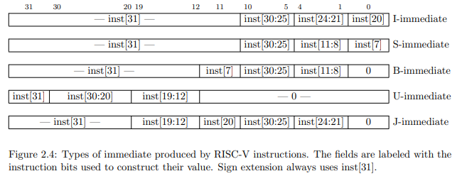
RISCV ISA – Format & Instructions

Slide 11
RISCV ISA – Format & Instructions

Slide 12
RISCV ISA – Format & Instructions
unique casez (SelImmType)
U_TYPE : Immediate = { Instruction[31:12], 12'b0 } ;
I_TYPE : Immediate = { {20{Instruction[31]}} , Instruction[31:20] };
S_TYPE : Immediate = { {20{Instruction[31]}} , Instruction[31:25] , Instruction[11:7] };
B_TYPE : Immediate = { {20{Instruction[31]}} , Instruction[7] , Instruction[30:25] , Instruction[11:8] , 1'b0};
J_TYPE : Immediate = { {12{Instruction[31]}} , Instruction[19:12] , Instruction[20] , Instruction[30:21] , 1'b0};
default: Immediate = { Instruction[31:12], 12'b0 };
endcase

Slide 13
Core Stages - Description
//===========================================================================
Instruction fetch
// 1. Send the PC (Program Counter) to the I_MEM.
// 2. Set the Next Pc -> Pc+4 or Calculated Address.
//===========================================================================
//===========================================================================
Decode
// 1. Get the instruction from I_MEM and use the "decoder" to set the Ctrl Bits.
// 2. Construct the Immediate types.
// 3. Use the RS1 & RS2 (RegSrc) to read the Register file data.
//===========================================================================
//===========================================================================
Execute
// 1. Compute Data to write back to register.
// 2. Compute Address for load/store
// 3. Compute Branch/Jump address target. (set PC)
// 4. Check branch condition
//===========================================================================
//===========================================================================
Memory Access
// Acceess D_MEM for Write (STORE) and Reads (LOAD). – use Byte Enable and Sign-Extend indications.
//===========================================================================
//===========================================================================
Write-Back
// Select data write back to register file -> AluOut vs DMemRdData
//===========================================================================

Slide 14
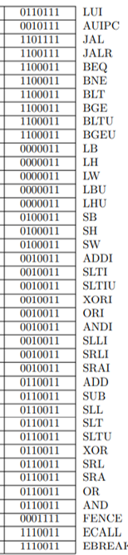
Core Stages - Building blocks

Slide 15
RegReg-Type

Slide 16
RegReg-Type
CtrlBits
CtrlBits
RegDst
RegSrc1/2
RegData1
PC
AluOut
RegData2
Instruction
Instruction

Slide 17
ImmReg-type

Slide 18
STORE

Slide 19
LOAD

Slide 20
LUI

Slide 21
AUIPC

Slide 22
JAL

Slide 23
JALR

Slide 24
BRANCH

Slide 25
Full Connectivity

Slide 26
Data Path
//Data Path
logic [31:0] Pc;
logic [31:0] NextPc;
logic [31:0] PcPlus4;
logic [31:0] Instruction;
logic [31:1][31:0] Register;
logic [31:0] Immediate;
logic [4:0] Shamt;
logic [31:0] PreDMemRdDatal
logic [31:0] DMemRdData;
logic [31:0] AluIn1;
logic [31:0] AluIn2;
logic [31:0] AluOut;
logic [31:0] RegRdData1;
logic [31:0] RegRdData2;
logic [31:0] RegWrData;
logic [31:0] WrBackData;
//Behavrial Memory
logic [7:0]IMem[I_MEM_MSB:0];
logic [7:0]Dmem[D_MEM_MSB:I_MEM_MSB+1];

Slide 27
Control Bits
//Ctrl Bits
logic SelNextPcAluOut;
logic SelRegWrPc;
logic SelDMemWb;
logic SelAluPc ;
logic SelAluImm;
t_immediate SelImmType;
logic BranchCondMet;
t_branch_type CtrlBranchOp;
logic [3:0] CtrlDMemByteEn;
logic CtrlDMemWrEn;
t_alu_op CtrlAluOp;
//mean terms
t_opcode Opcode;
logic [2:0] Funct3;
logic [6:0] Funct7;
logic [4:0] RegSrc1, RegSrc2, RegDst;

Slide 28
Coding Style Parameters , Enumerate
//Ctrl Bits
logic SelNextPcAluOut;
logic SelRegWrPc;
logic SelDMemWb;
logic SelAluPc ;
logic SelAluImm;
t_immediate SelImmType;
logic BranchCondMet;
t_branch_type CtrlBranchOp;
logic [3:0] CtrlDMemByteEn;
logic CtrlDMemWrEn;
t_alu_op CtrlAluOp;
//mean terms
t_opcode Opcode;
logic [2:0] Funct3;
logic [6:0] Funct7;
logic [4:0] RegSrc1, RegSrc2, RegDst;
parameter I_MEM_MSB = 'h1000-1;
parameter D_MEM_MSB = 'h2000-1;
typedef enum logic [2:0] {
U_TYPE = 3'b000 ,
I_TYPE = 3'b001 ,
S_TYPE = 3'b010 ,
B_TYPE = 3'b011 ,
J_TYPE = 3'b100
} t_immediate ;
typedef enum logic [3:0] {
ADD = 4'b0000 ,
SUB = 4'b1000 ,
SLT = 4'b0010 ,
SLTU = 4'b0011 ,
SLL = 4'b0001 ,
SRL = 4'b0101 ,
SRA = 4'b1101 ,
XOR = 4'b0100 ,
OR = 4'b0110 ,
AND = 4'b0111
} t_alu_op ;
typedef enum logic [2:0] {
BEQ = 3'b000 ,
BNE = 3'b001 ,
BLT = 3'b100 ,
BGE = 3'b101 ,
BLTU = 3'b110 ,
BGEU = 3'b111
} t_branch_type ;
typedef enum logic [6:0] {
LUI = 7'b0110111 ,
AUIPC = 7'b0010111 ,
JAL = 7'b1101111 ,
JALR = 7'b1100111 ,
BRANCH = 7'b1100011 ,
LOAD = 7'b0000011 ,
STORE = 7'b0100011 ,
I_OP = 7'b0010011 ,
R_OP = 7'b0110011 ,
FENCE = 7'b0001111 ,
SYSCAL = 7'b1110011
} t_opcode ;

Slide 29
Coding Style Parameters , Enumerate
//Ctrl Bits
logic SelNextPcAluOut;
logic SelRegWrPc;
logic SelDMemWb;
logic SelAluPc ;
logic SelAluImm;
t_immediate SelImmType;
logic BranchCondMet;
t_branch_type CtrlBranchOp;
logic [3:0] CtrlDMemByteEn;
logic CtrlDMemWrEn;
t_alu_op CtrlAluOp;
//mean terms
t_opcode Opcode;
logic [2:0] Funct3;
logic [6:0] Funct7;
logic [4:0] RegSrc1, RegSrc2, RegDst;
parameter I_MEM_MSB = 'h1000-1;
parameter D_MEM_MSB = 'h2000-1;
typedef enum logic [2:0] {
U_TYPE = 3'b000 ,
I_TYPE = 3'b001 ,
S_TYPE = 3'b010 ,
B_TYPE = 3'b011 ,
J_TYPE = 3'b100
} t_immediate ;
typedef enum logic [3:0] {
ADD = 4'b0000 ,
SUB = 4'b1000 ,
SLT = 4'b0010 ,
SLTU = 4'b0011 ,
SLL = 4'b0001 ,
SRL = 4'b0101 ,
SRA = 4'b1101 ,
XOR = 4'b0100 ,
OR = 4'b0110 ,
AND = 4'b0111
} t_alu_op ;
typedef enum logic [2:0] {
BEQ = 3'b000 ,
BNE = 3'b001 ,
BLT = 3'b100 ,
BGE = 3'b101 ,
BLTU = 3'b110 ,
BGEU = 3'b111
} t_branch_type ;
typedef enum logic [6:0] {
LUI = 7'b0110111 ,
AUIPC = 7'b0010111 ,
JAL = 7'b1101111 ,
JALR = 7'b1100111 ,
BRANCH = 7'b1100011 ,
LOAD = 7'b0000011 ,
STORE = 7'b0100011 ,
I_OP = 7'b0010011 ,
R_OP = 7'b0110011 ,
FENCE = 7'b0001111 ,
SYSCAL = 7'b1110011
} t_opcode ;

Slide 30
Coding Style - Macros
`define RVC_MSFF(q,i,clk) \
always_ff @(posedge clk) \
q<=i;
`define RVC_EN_MSFF(q,i,clk,en) \
always_ff @(posedge clk) \
if(en) q<=i;
`define RVC_RST_MSFF(q,i,clk,rst) \
always_ff @(posedge clk) begin \
if (rst) q <='0; \
else q <= i; \
end
`define RVC_EN_RST_MSFF(q,i,clk,en,rst)\
always_ff @(posedge clk) \
if (rst) q <='0; \
else if(en) q <= i;
For sequential assignment we will use a macro.
This will allow us to design a combinatoric design, and every sequential logic will be marked with the “MSFF” macro. (Master-Slave-Flip-Flop)

Slide 31
File Header
//-----------------------------------------------------------------------------
// Title : riscv as-fast-as-possible
// Project : rvc_asap
//-----------------------------------------------------------------------------
// File : <TODO>
// Original Author : Amichai Ben-David
// Code Owner :
// Created : 11/2021
//-----------------------------------------------------------------------------
// Description :
//
//
//-----------------------------------------------------------------------------

Slide 32
Git & Model Structure
| LICENSE
| README.md
+---apps
| alive_asap.s
| crt0.s
| link.common.ld
| README.md
+---doc
| HOW_TO.md
| riscv-spec-20191213.pdf
| rvc_asap.pptx
| single_cycle_RVC.png
+---modelsim_run
| README.md
| rvc_asap_list.f
+---source
| README.md
| rvc_asap.sv
| rvc_asap_macros.sv
| rvc_asap_pkg.sv
+---verif
| README.md
| rvc_asap_tb.sv

Slide 33
Let’s Get Started!

Slide 34
Backup
unique casez (Opcode) //mux
JALR, I_OP, LOAD : SelImmType = I_TYPE;
LUI, AUIPC : SelImmType = U_TYPE;
JAL : SelImmType = J_TYPE;
BRANCH : SelImmType = B_TYPE;
STORE : SelImmType = S_TYPE;
default : SelImmType = I_TYPE;
endcase
always_comb begin : branch_comp
//for branch condition.
unique casez ({CtrlBranchOp})
BEQ : BranchCondMet = (AluIn1==AluIn2) ;// BEQ
BNE : BranchCondMet = ~(AluIn1==AluIn2) ;// BNE
BLT : BranchCondMet = ($signed(AluIn1)<$signed(AluIn2)) ;// BLT
BGE : BranchCondMet = ~($signed(AluIn1)<$signed(AluIn2)) ;// BGE
BLTU : BranchCondMet = (AluIn1<AluIn2) ;// BLTU
BGEU : BranchCondMet = ~(AluIn1<AluIn2) ;// BGEU
default : BranchCondMet = 1'b0 ;
endcase
end

Slide 35
Backup
always_comb begin
unique casez ({Funct3, Funct7, Opcode})
//-----R type-------
{3'b000, 7'b0000000, R_OP} : CtrlAluOp = ADD; //ADD
{3'b000, 7'b0100000, R_OP} : CtrlAluOp = SUB; //SUB
{3'b001, 7'b0000000, R_OP} : CtrlAluOp = SLL; //SLL
{3'b010, 7'b0000000, R_OP} : CtrlAluOp = SLT; //SLT
{3'b011, 7'b0000000, R_OP} : CtrlAluOp = SLTU;//SLTU
{3'b100, 7'b0000000, R_OP} : CtrlAluOp = XOR; //XOR
{3'b101, 7'b0000000, R_OP} : CtrlAluOp = SRL; //SRL
{3'b101, 7'b0100000, R_OP} : CtrlAluOp = SRA; //SRA
{3'b110, 7'b0000000, R_OP} : CtrlAluOp = OR; //OR
{3'b111, 7'b0000000, R_OP} : CtrlAluOp = AND; //AND
//-----I type-------
{3'b000, 7'b???????, I_OP} : CtrlAluOp = ADD; //ADDI
{3'b010, 7'b???????, I_OP} : CtrlAluOp = SLT; //SLTI
{3'b011, 7'b???????, I_OP} : CtrlAluOp = SLTU;//SLTUI
{3'b100, 7'b???????, I_OP} : CtrlAluOp = XOR; //XORI
{3'b110, 7'b???????, I_OP} : CtrlAluOp = OR; //ORI
{3'b111, 7'b???????, I_OP} : CtrlAluOp = AND; //ANDI
{3'b001, 7'b0000000, I_OP} : CtrlAluOp = SLL; //SLLI
{3'b101, 7'b0000000, I_OP} : CtrlAluOp = SRL; //SRLI
{3'b101, 7'b0100000, I_OP} : CtrlAluOp = SRA; //SRAI
//-----Other-------
default : CtrlAluOp = ADD; //LUI || AUIPC || JAL || JALR || BRANCH || LOAD || STORE
endcase
end

Slide 36
Backup
assign Opcode = t_opcode'(Instruction[6:0]);
assign Funct3 = Instruction[14:12];
assign Funct7 = Instruction[31:25];
assign SelNextPcAluOut = (Opcode == JAL) || (Opcode == JALR) || ((Opcode == BRANCH) && BranchCondMet);
assign SelRegWrPc = (Opcode == JAL) || (Opcode == JALR);
assign SelAluPc = (Opcode == JAL) || (Opcode == JALR) || (Opcode == BRANCH) || (Opcode == AUIPC);
assign SelAluImm =!(Opcode == R_OP);// In case of RegReg Operation the Imm Selector is deasserted - defualt is asserted
assign SelDMemWb = (Opcode == LOAD);
assign CtrlLui = (Opcode == LUI);
assign CtrlRegWrEn = (Opcode == LUI ) || (Opcode == AUIPC) || (Opcode == JAL) || (Opcode == JALR) ||
(Opcode == LOAD) || (Opcode == I_OP) || (Opcode == R_OP) || (Opcode == FENCE);
assign CtrlDMemWrEn = (Opcode == STORE);
assign CtrlSignExt = (Opcode == LOAD) && (!Funct3[2]);//Sign extend the LOAD from memory read.
assign CtrlDMemByteEn = ((Opcode == LOAD) || (Opcode == STORE)) && (Funct3[1:0] == 2'b00) ? 4'b0001 :// LB || SB
((Opcode == LOAD) || (Opcode == STORE)) && (Funct3[1:0] == 2'b01) ? 4'b0011 :// LH || SH
((Opcode == LOAD) || (Opcode == STORE)) && (Funct3[1:0] == 2'b10) ? 4'b1111 :// LW || SW
4'b0000 ;

