Slide 1
FPGA-LAB Overview

Slide 2
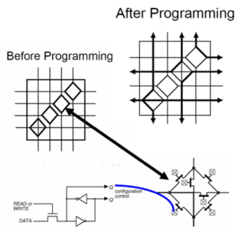
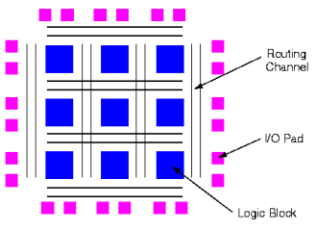
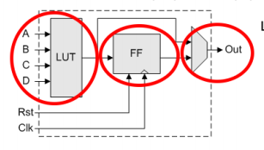
FPGA - Field Programmable Gate Array
Programmable Routing
Logical Element

Slide 3
FPGA market target
FPGA main use cases
Low Volumes
Prototyping
Emulation
Unit cost
per performance
at production
Software
FPGA
FPGA VS ASIC
ASIC
Feature | FPGA | ASIC
Time to Market | Fast | Slow
NRE | Low | High
Design Flow | Simple | Complex
Unit Cost | High | Low
Performance | Low | High
Power consumption | High | Low
Unit Size | High | Low
Custom
Chip
Initial development and manufacturing Cost
NRE - Non-recurring engineering

Slide 4
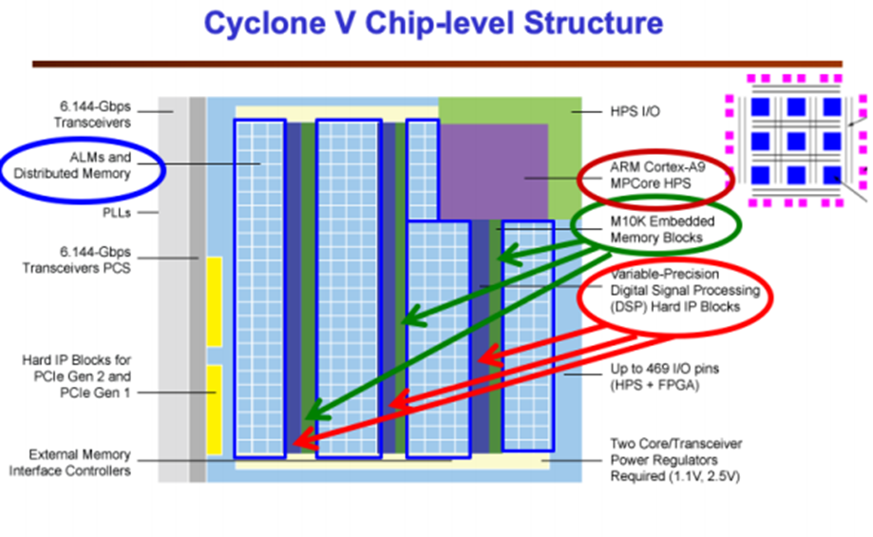
Advance FPGA with embedded commonly used hard-macros

Slide 5
Development Flow
Requirement
Architecture
Design
HDL Design
(Verilog etc.)
Test Environment
Behavioral
Simulation
Synthesis
Analysis
Bitstream

Slide 6

Enics FPGA-Lab configuration
FPGA DEVICE
tx
UART
ACCESS
ACCESS REGISTERS
REMOTE Terminal
/ Python Interface
rx
USB-UART Cable
8x32b output regs
8x32b input regs
Design specific
port assignment
My output ports
My input ports
My Design
MY DESIGN INTERFACE WRAP

