Slide 1
Dynamic Documents
Aleksandr Michuda

Slide 2
1 Before We Begin
Take-home Exam
We will start presentation soon!

Slide 3
2 Why Dynamic Documents?
Dynamic Documents are a part of the bigger picture of Reproducible Science. Sure, there is a fixed cost; BUT, they make my life easier in these ways:
Short term: Easier to document fresh out of the oven results
Medium term: Fast, reliable and tractable new results
Long term: You can see how everything was created

Slide 4
3 What are Dynamic Documents?
Based on principles of literate programming, we aim at combining code and paper in one single document
Best framework to achieve the holy grail of one-click reproducible workflow
Best implementations: Quarto.

Slide 5
4 The State of Things Now
Currently, the code and the narrative components live in separate universes

Slide 6
5 Part of Larger Workflow
Dynamic documents are best used as part of a larger organized workflow
Structuring folders: Data, analysis, output
Documenting code
Combining both into a final document: Pre analysis or final paper
We have already been using jupyter notebooks, but what if you want to turn that notebook into a publishable format for sharing or even submission?

Slide 7
6 Using Markdown
In terms of writing the “paper”/documentation part of dynamic documents, there are many solutions
Latex, HTML, RST (ReStructured Text)
But most have honed in on using Markdown
Markdown is an easy way to write formatted text in a plain text format
But without as verbose and difficult of a syntax like latex/HTML
Although basic markdown has the basics for formatting, creating tables, adding figures
We will use Pandoc, which is used in both the Stata and R sessions

Slide 8
7 What is Pandoc?
Pandoc is sort of what it says: pan (all), doc (document)
It’s a way to convert between and across different file formats
Word -> HTML
Latex -> Markdown
HTML -> XML
Anything to anything
See Pandoc’s website for all input and output filetypes

Slide 9
8 The Magic of Pandoc
Pandoc and Markdown allows you to create one file that can then be used in many different places
Example:
You’re writing your CV and want to put it up in various places.
Your website needs HTML
One job posting allows PDF
One job posting only allows Word
Ordinarily, you would need to have three versions, Word, HTML, PDF
This might get unruly as you change one but forget to change the other
What if there’s another file format you might need?
With Pandoc and markdown, you would:
write your CV in markdown
convert to PDF, Word and PDF with pandoc

Slide 10
9 Quarto
Quarto is the successor or RMarkdown, a very powerful dynamic document software developed for RStudio
Now it also applies to jupyter notebooks and allows for creating nice documents from the notebooks you create!
Dynamic documents usually have a yaml header at the top, that defines global options
We will talk about three special types of yaml options in Quarto:
output type
hiding code or output
execution options

Slide 11
10 What is YAML?
YAML is a very basic language created by Ansible (I think?) to define options for its software in a way that didn’t require lots of coding.
--- title: "Toward a Unified Theory of High-Energy Metaphysics: Silly String Theory" date: 2008-02-29 author: - name: Josiah Carberry id: jc orcid: 0000-0002-1825-0097 email: josiah@psychoceramics.org affiliation: - name: Brown University city: Providence state: RI url: www.brown.edu abstract: > The characteristic theme of the works of Stone is the bridge between culture and society. ... keywords: - Metaphysics - String Theory license: "CC BY" copyright: holder: Josiah Carberry year: 2008 citation: container-title: Journal of Psychoceramics volume: 1 issue: 1 doi: 10.5555/12345678 funding: "The author received no specific funding for this work." ---

Slide 12
11 YAML
But the basic thing you need in order to get the paper is:
--- title: My paper author: Aleksandr Michuda ---

Slide 13
12 Preview of what we will talk about
Quarto is VERY expansive, you can write websites, books or dissertations with it
All with jupyter notebooks
Today, we will focus on the basics that you will need if you wanted to write paper using a jupyter notebooks:
Tables
Figures
Cross-references
Citations

Slide 14
13 Tables
Default | Left | Right | Center
12 | 12 | 12 | 12
123 | 123 | 123 | 123
1 | 1 | 1 | 1
You can create tables easily in three ways:
Create your own markdown table (Not dynamic)
Put in a latex table directly (Not dynamic)
Generate a table from code (Dynamic)
Demonstration of pipe table syntax

Slide 15
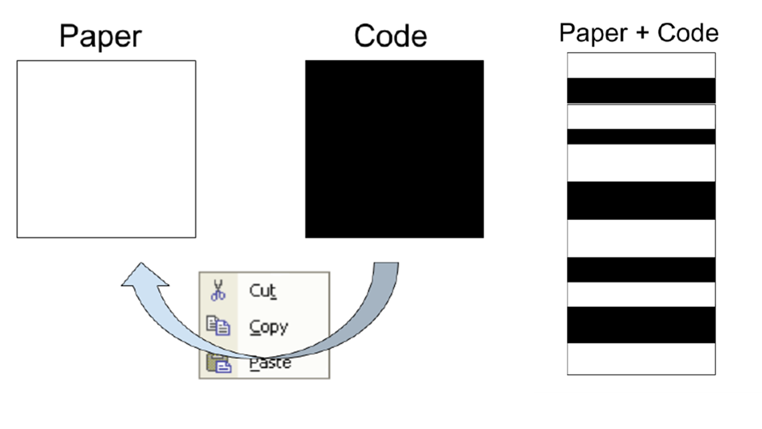
14 Figures
You can add figures that are generated or from a folder
It’s like figures markdown but with more options
Figure 1: My figure 1, width 300

Slide 16
My figure width 80

Slide 17
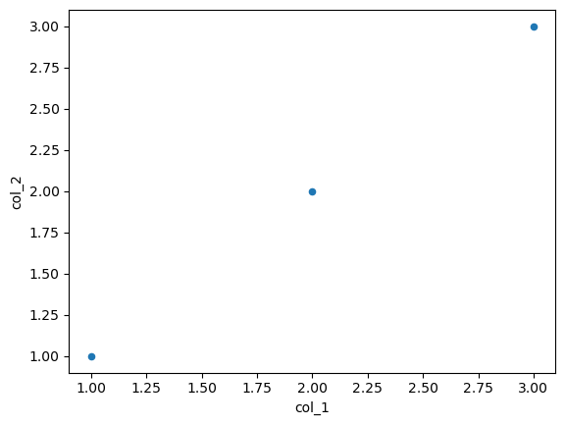
Figure 2: A scatter plot

Slide 18
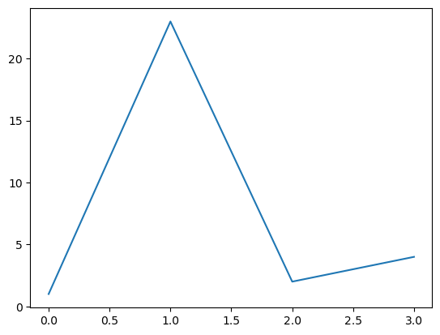
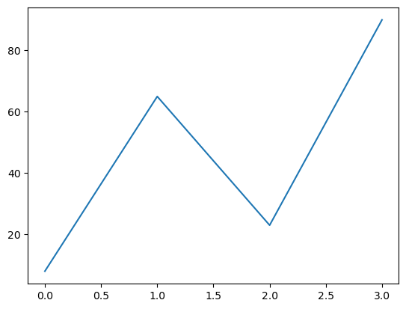
(a) First
(b) Second

Slide 19
#tbl-something #fig-something

Slide 20
15 Cross References
To reference a figure, table or section, just use its label!
See Table 1
See Figure 3
See Section 15

Slide 21
16 Citations and Footnotes
For citations, You can use a standard bibtex file, just specify it in the YAML
--- bibliography: references.bib ---
See Gupta et al. (2021) ¹
This is true (Gupta et al. 2021).

Slide 22
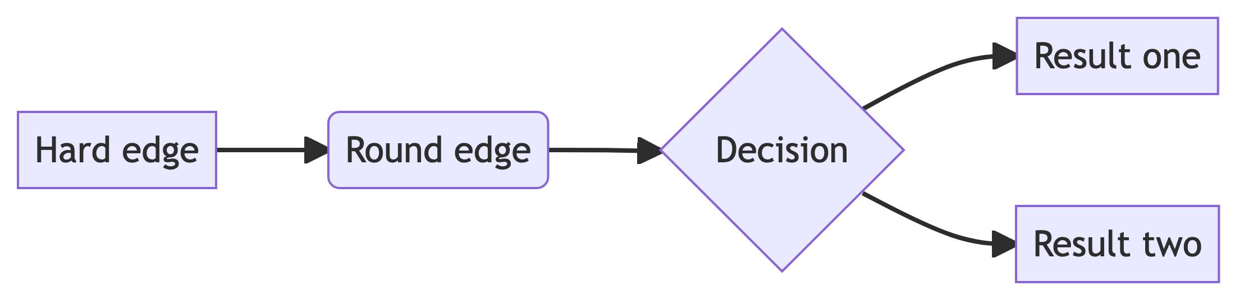
17 Mermaid

Slide 23
18 References
Gupta, Anubhab, Heng Zhu, Miki Khanh Doan, Aleksandr Michuda, and Binoy Majumder. 2021. “Economic Impacts of the COVID- 19 Lockdown in a Remittance-Dependent Region.” American Journal of Agricultural Economics 103 (2): 466–85.

Slide 24
Notes
1. This is footnote.dkfng

