Slide 1

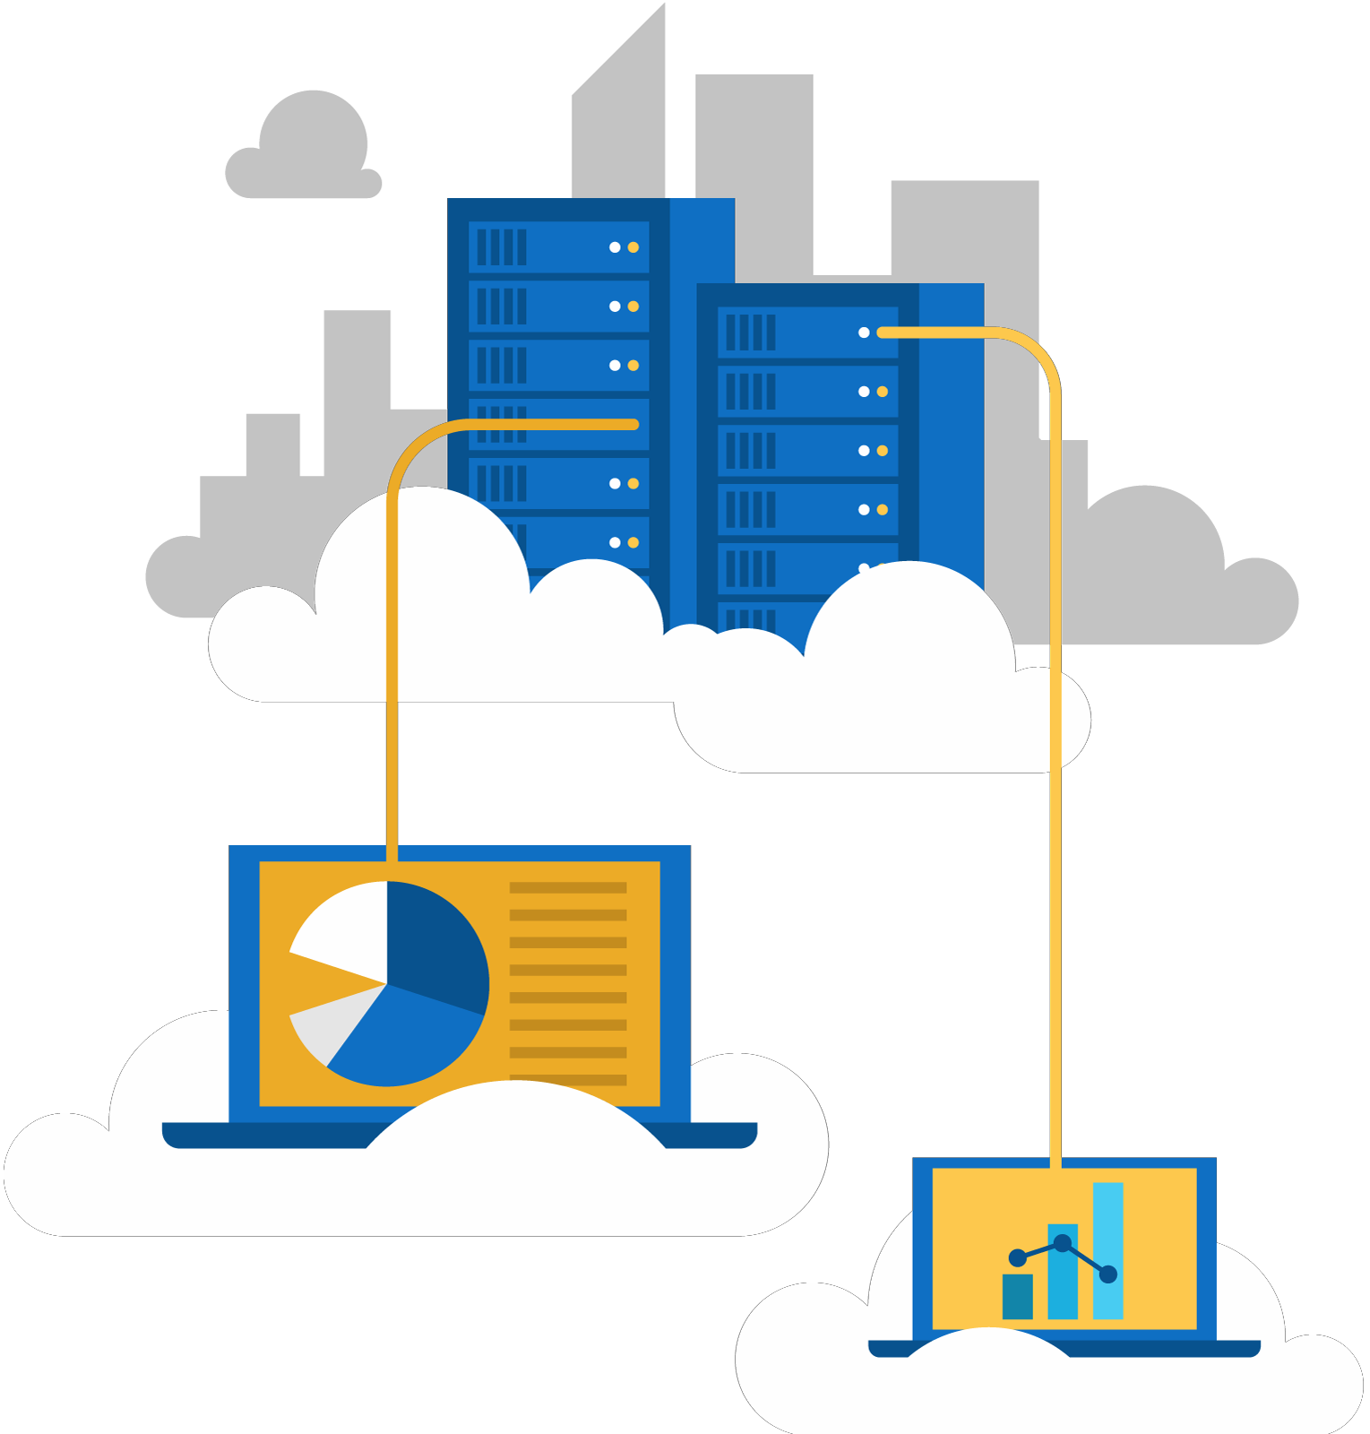




Jordan Radkov
Cloud Solution Architect

Slide 2

Week 1
Determine Workload Requirements (10-15%)

Slide 3
Series Agenda
1 | Determine Workload Requirements (10-15%)
2 | Design for Identity and Security (20-25%)
3 | Design a Data Platform Solution (15-20%)
4 | Design a Business Continuity Strategy (15-20%)
5 | Design for Deployment, Migration, and Integration (10-15%)
6 | Design an Infrastructure Strategy (15-20%)

Slide 4
Series Agenda
1 | Determine Workload Requirements (10-15%)
2 | Design for Identity and Security (20-25%)
3 | Design a Data Platform Solution (15-20%)
4 | Design a Business Continuity Strategy (15-20%)
5 | Design for Deployment, Migration, and Integration (10-15%)
6 | Design an Infrastructure Strategy (15-20%)

Slide 5

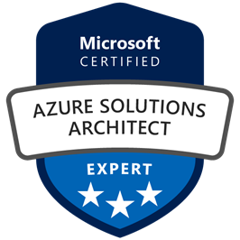
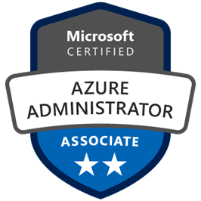
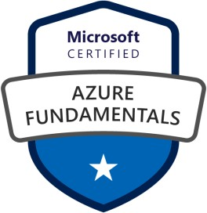



Jordan Radkov
Cloud Solution Architect based in the Munich
10+years in the industry in infrastructure administration , automation and now cloud
Constant learner - Ancora Imparo

Slide 6
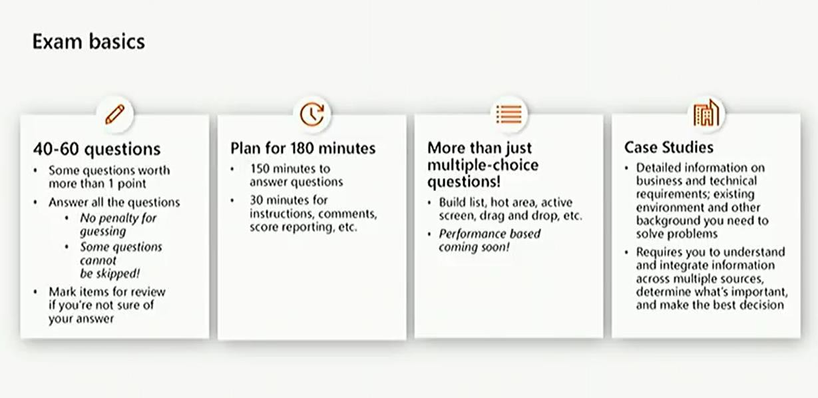

Slide 7
To prep – go through exam objectives
Carefully read the questions, look for key words
Write anything that might be helpful to organize thoughts
docs.Microsoft.com – all exam questions have some type of authoritative answer, typically documentation

Slide 8





Slide 9
Objective Review – Determine workload requirement (10-15%)
Gather Information and Requirements
May include but not limited to: Identify compliance requirements, identity and access management infrastructure, and service-oriented architectures (e.g., integration patterns, service design, service discoverability); identify accessibility (e.g. Web Content Accessibility Guidelines), availability (e.g. Service Level Agreement), capacity planning and scalability, deploy-ability (e.g., repositories, failback, slot-based deployment), configurability, governance, maintainability (e.g. logging, debugging, troubleshooting, recovery, training), security (e.g. authentication, authorization, attacks), and sizing (e.g. support costs, optimization) requirements; recommend changes during project execution (ongoing); evaluate products and services to align with solution; create testing scenarios
Optimize Consumption Strategy
May include but not limited to: Optimize app service, compute, identity, network, and storage costs
Design an Auditing and Monitoring Strategy
May include but not limited to: Define logical groupings (tags) for resources to be monitored; determine levels and storage locations for logs; plan for integration with monitoring tools; recommend appropriate monitoring tool(s) for a solution; specify mechanism for event routing and escalation; design auditing for compliance requirements; design auditing policies and traceability requirements

Slide 10
Objective Review - #1
Gather Information and Requirements
Identify compliance requirements
Identity and access management infrastructure, and service-oriented architectures (e.g.,
integration patterns, service design, service discoverability)
Identify accessibility (e.g. Web Content Accessibility Guidelines), availability (e.g. Service Level Agreement)
Capacity planning and scalability, deploy-ability (e.g., repositories, failback, slot-based deployment), configurability, governance, maintainability (e.g. logging, debugging, troubleshooting, recovery, training)
Security (e.g. authentication, authorization, attacks)
Sizing (e.g. support costs, optimization) requirements; recommend changes during project
execution (ongoing)
Evaluate products and services to align with solution
Create testing scenarios

Slide 11

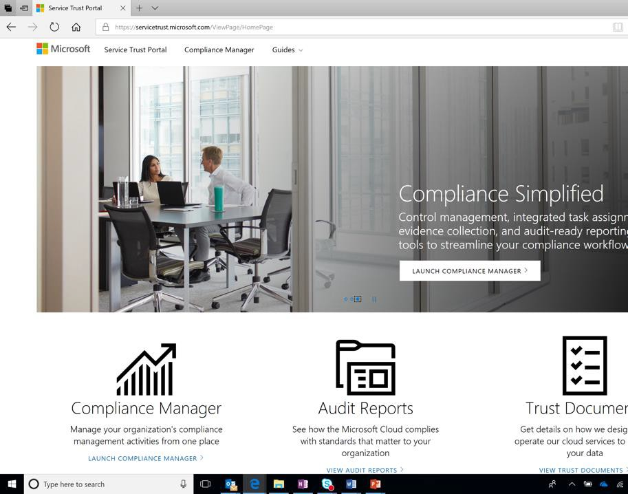


Service Trust Portal
Assess Microsoft Cloud with rich resources around security, compliance, and privacy
In-depth information
Access to FedRAMP, ISO, SOC audit reports, data protection white papers, security assessment reports, and more
Powerful assessment tools
Easy navigation
Centralized resources around security, compliance, and privacy for all Microsoft Cloud services

Slide 12


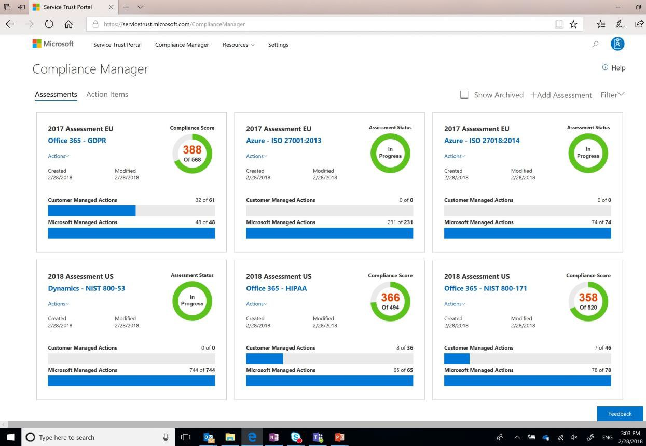

Ongoing risk assessment
Actionable insights
Simplified compliance
Compliance Manager is a dashboardthat provides the Compliance Scoreanda summary of your data protection andcompliancestatureas well as recommendationstoimprovedata protection andcompliance. This is a recommendation, it is uptoyou toevaluateandvalidate theeffectivenessof customer controls as per your regulatory environment. Recommendations from Compliance Manager and Compliance Scoreshouldnot be interpretedas a guaranteeof compliance.

Slide 13
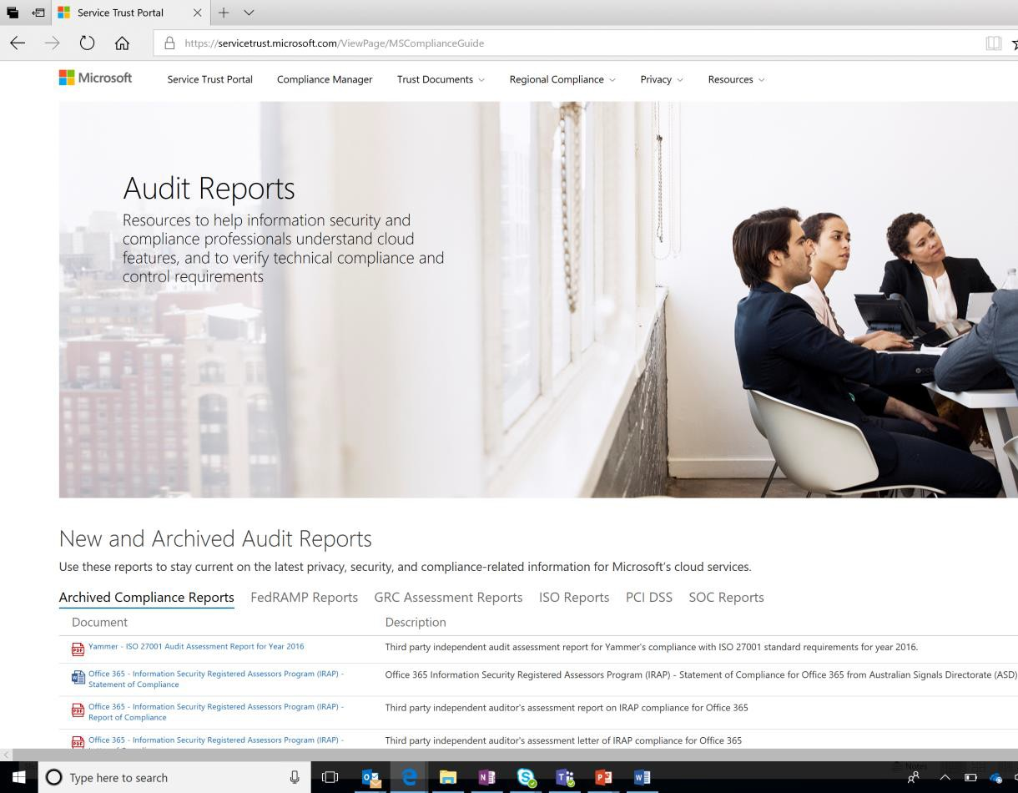
Trust Documents
Build trust with transparency and empowerment
Audit reports
FedRAMP, ISO, SOC, PCI-DSS audit reports and global GRC assessment reports
Data protection documents
Azure blueprints
Resources to assist you in building and launching cloud-powered applications that help you comply with stringent regulations and standards.

Slide 14
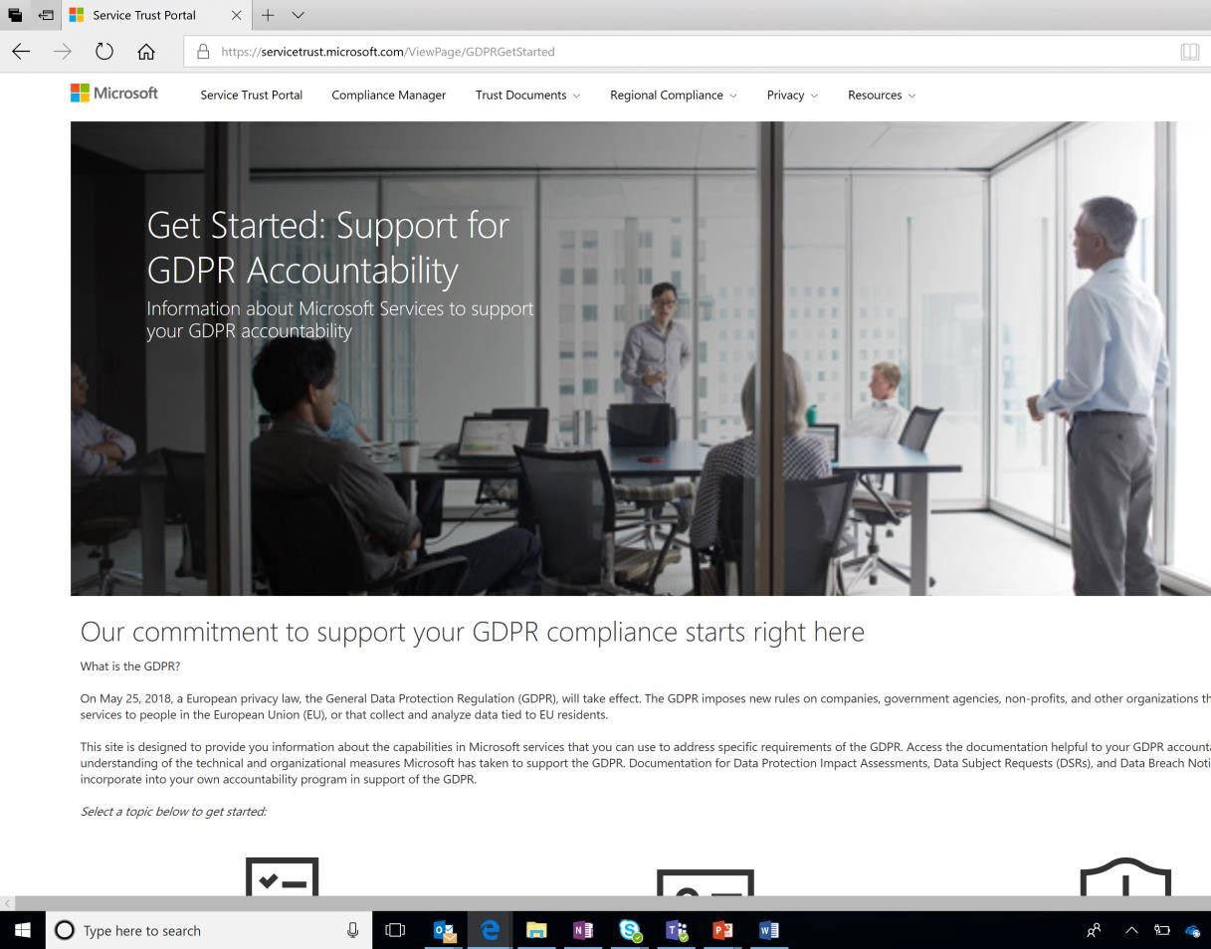

Privacy resources
Information about Microsoft services to support your GDPR accountability
Data Subject Requests
How Microsoft enable you to respond to Data Subject Requests (DSRs)
Data breach notifications
Data Protection Impact Assessments
How Microsoft helps controllers complete GDPR Data Protection Impact Assessments (DPIAs)

Slide 15
Identity
Azure Identity Management and access control security best practices
Identity as primary security perimeter
Centralize ID management
Enable single sign-on
Conditional Access – device standards
Enable password management (SSPR – self service password reset)
Enforce MFA
RBAC – subscription, resource group, or resource
Lower exposure of privileged accounts
Control locations where resources are created
Actively monitor for suspicious activity

Slide 16
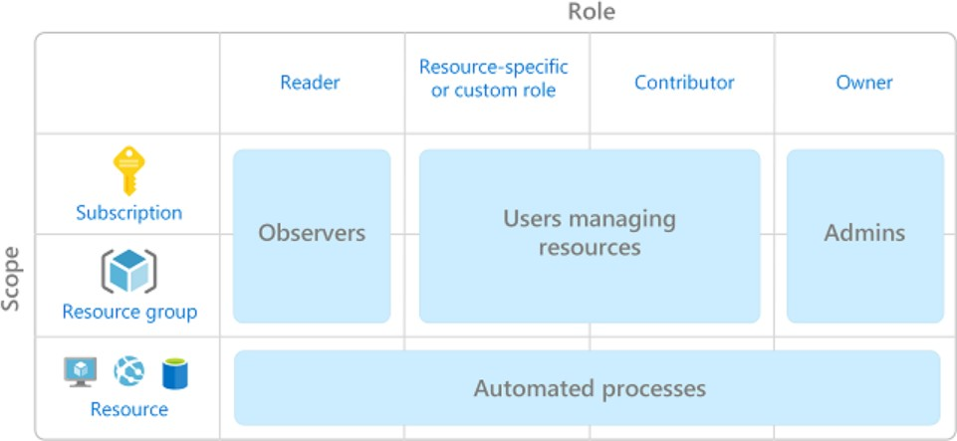
RBAC
Who has access to Azure resources, what they can do with those resources, and what areas they have access to

Slide 17
RBAC
•
Owner - Has full access to all resources including the right to delegate access to others.
Contributor - Can create and manage all types of Azure resources but can’t grant
access to others.
Reader - Can view existing Azure resources.
User Access Administrator - Lets you manage user access to Azure resources.
•
•
•

Slide 18
Security
Authentication – Identity
Azure Active Directory (Azure AD)
Microsoft account (MSA)
Active Directory (AD)
Authorization – Permissions
Once we know who you are, do you have permission to access the resource?

Slide 19
Service Level Agreement
Define SLA’s for each workload
Dependency mapping – include internal/external dependencies
Identify single point of failure
Example – workload requires 99.99% but depends on a service that is only 99.9%
Mean Time To Recover (MTTR) – avg time it takes to restore
Mean Time Between Failures (MTBF) – time it will last between outages
Composite SLA’s – SQL SLA 99.99% * Web App 99.5% = 99.94%

Slide 20
Objective Review - #2
Optimize Consumption Strategy
Configure network access to the storage account
Optimize app service
Compute, identity, network, and storage costs

Slide 21
Configure Azure Storage firewalls and virtual networks
Storage – layered security model
Network rules – only apps requesting data from over specified networks can access
Requires authorization – AD, valid access key or token
Deny all traffic and then grant access to specific VNets

Slide 22
Azure App Service
PaaS Offering
Service for hosting web applications, REST APIs, and mobile back ends
Scalability

Slide 23
Compute Options
Virtual Machines are an IaaS service, allowing you to deploy and manage VMs inside a virtual network (VNet).
App Service is a managed PaaS offering for hosting web apps, mobile app back
ends, RESTful APIs, or automated business processes.
Service Fabric is a distributed systems platform that can run in many environments, including Azure or on premises. Service Fabric is an orchestrator of microservices across a cluster of machines.
Azure Container Service lets you create, configure, and manage a cluster of VMs that are preconfigured to run containerized applications.
Azure Container Instances offer the fastest and simplest way to run a container in Azure, without having to provision any virtual machines and without having to adopt a higher-level service.
Azure Functions is a managed FaaS service.
Azure Batch is a managed service for running large-scale parallel and high-
performance computing (HPC) applications.
Cloud Services is a managed service for running cloud applications. It uses a PaaS hosting model.

Slide 24
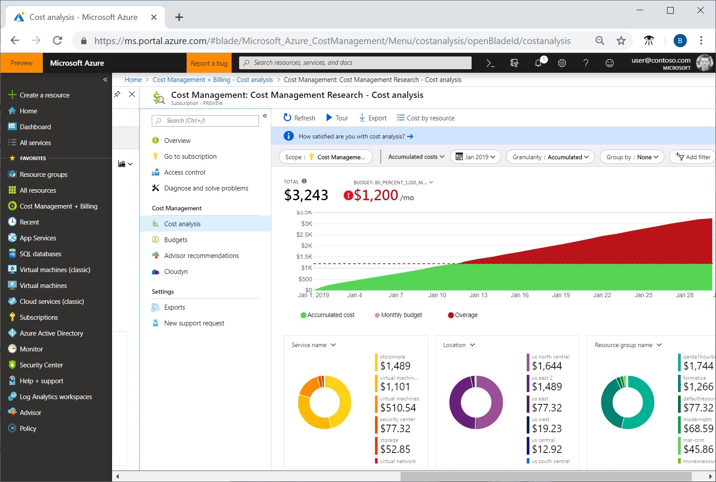
Azure Cost Management

Slide 25
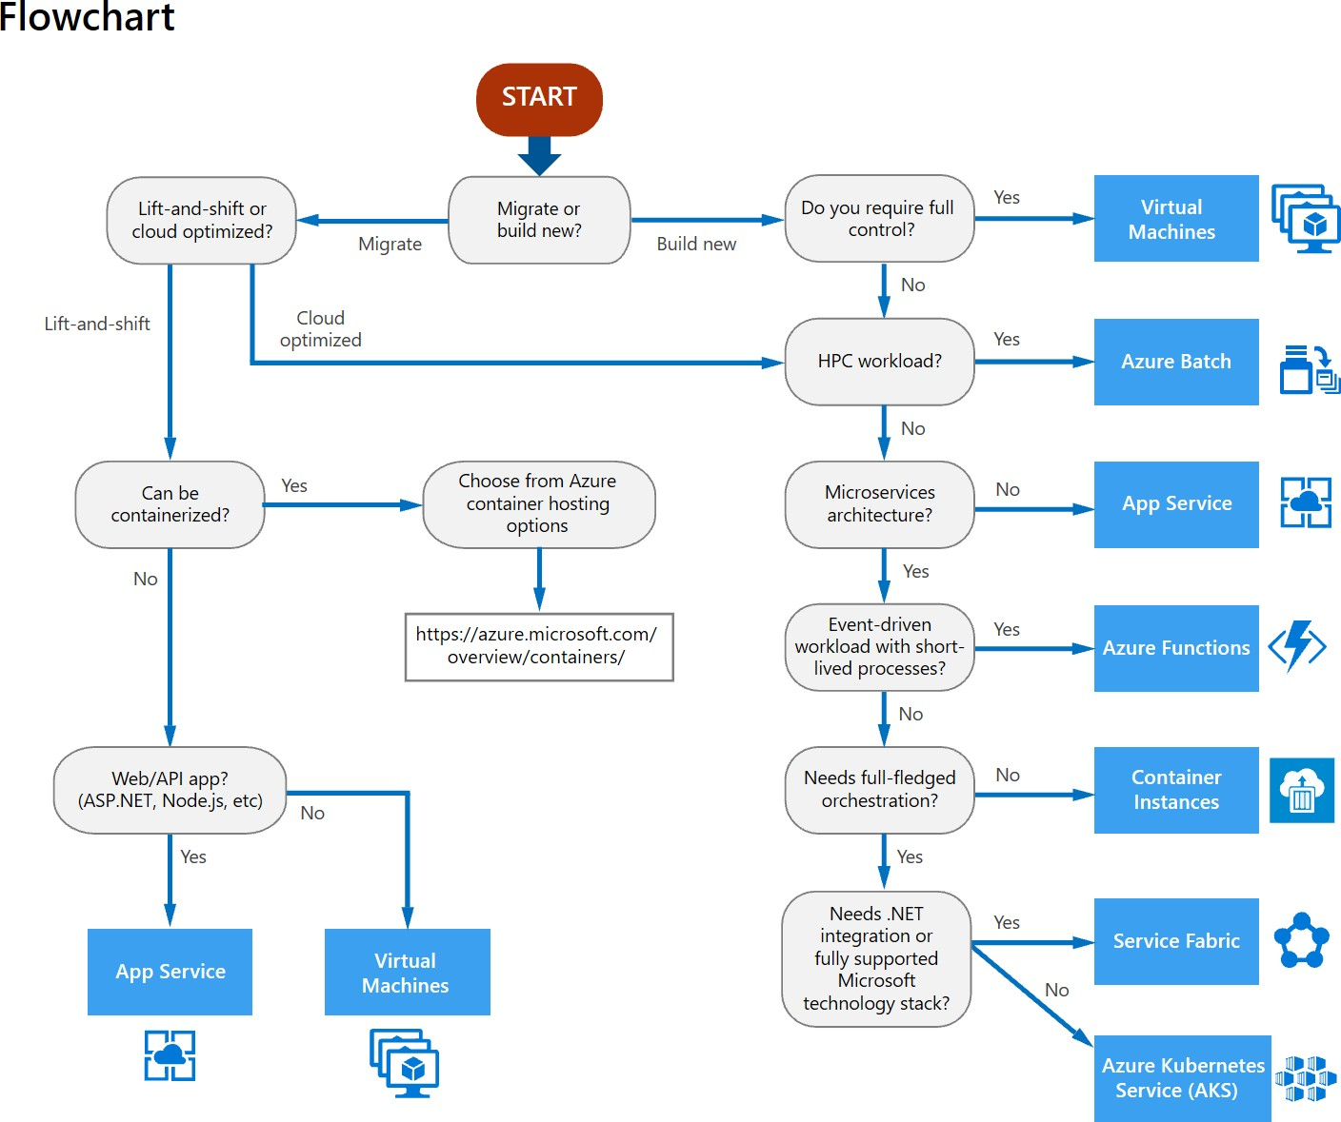

Slide 26
Choose the right data store
RDMS – Azure DB, Managed Instances
Key/value stores – Redis Cache
Document databases – Cosmos DB
Graph Databases – Cosmos DB
Column-family databases – Cosmos DB
Data Analytics
Search engine databases
Time Series databases
Object storage
Shared Files

Slide 27
Design Principles
Design for self healing. In a distributed system, failures happen. Design your application to be self healing when failures occur.
Make all things redundant. Build redundancy into your application, to avoid having single points of failure.
Minimize coordination. Minimize coordination between application services to achieve scalability. Design to scale out. Design your application so that it can scale horizontally, adding or removing new instances as demand requires.
Partition around limits. Use partitioning to work around database, network, and compute limits. Design for operations. Design your application so that the operations team has the tools they need. Use managed services. When possible, use platform as a service (PaaS) rather than infrastructure as a service (IaaS).
Use the best data store for the job. Pick the storage technology that is the best fit for your data and how it will be used.
Design for evolution. All successful applications change over time. An evolutionary design is key for
continuous innovation.
Build for the needs of business. Every design decision must be justified by a business requirement.

Slide 28
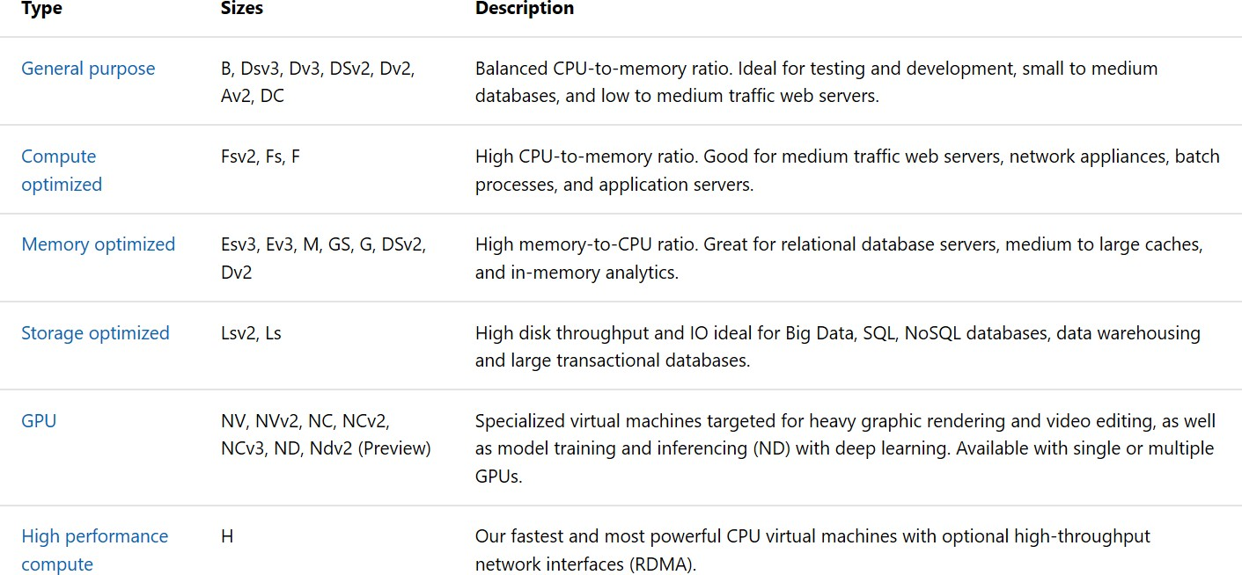
Sizes for VM Windows Virtual Machine in Azure

Slide 29
Objective Review - #3
Design an Auditing and Monitoring Strategy
Define logical groupings (tags) for resources to be monitored
Determine levels and storage locations for logs
Plan for integration with monitoring tools
Recommend appropriate monitoring tool(s) for a solution
Specify mechanism for event routing and escalation
Design auditing for compliance requirements
Design auditing policies and traceability requirements

Slide 30
Logical Groupings (tags)
Tags – name/value pairs
Allows to retrieve related resources
Billing/Management
Develop a self-service metadata tagging strategy
User must have write access

Slide 31
Storage Levels and locations
Blob
Premium (preview) – high performance hardware
Hot – frequent access
Cool – 30 days, infrequent access, lower availability but high durability and time to access/throughput as hot
Archive – 180 days, offline, highest access costs but most cost effective for
infrequently accessed data

Slide 32
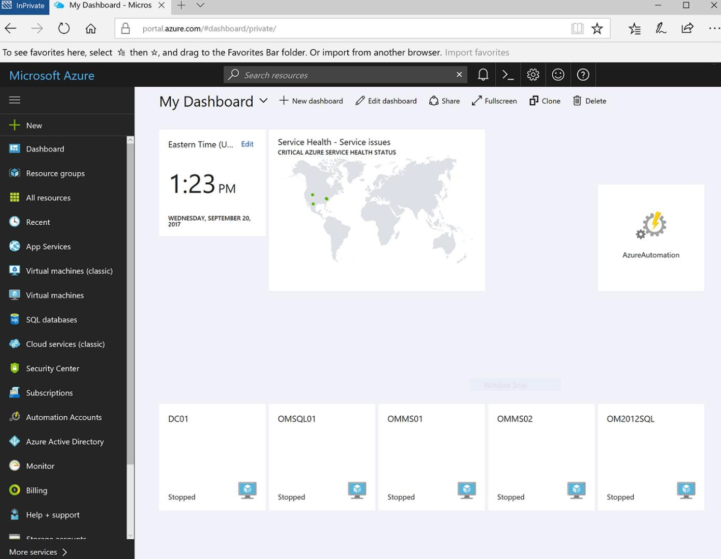
Metrics and Logs
Metrics – numerical, lightweight, point in time Logs – analyze with queries
Azure Monitor uses Kusto query language. Can do aggregations, joins, etc.
Shared dashboard

Slide 33
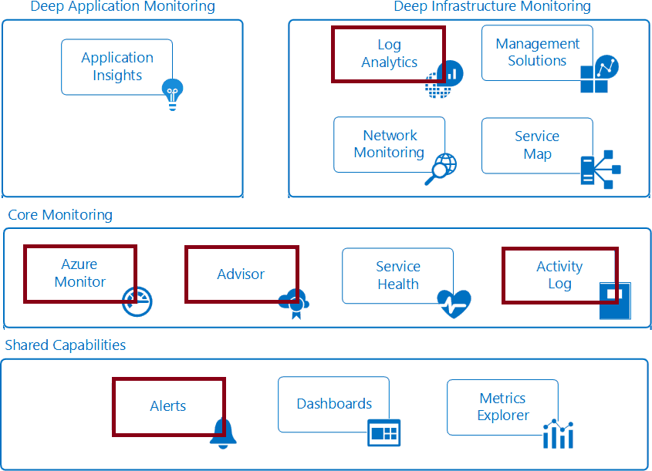
Azure Monitor Service

Slide 34
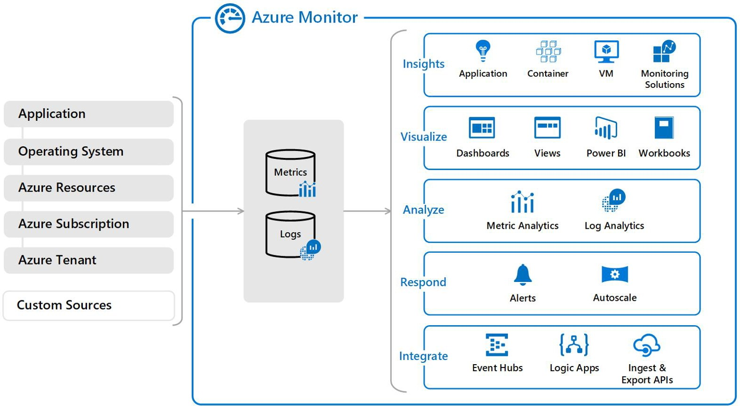

Slide 35
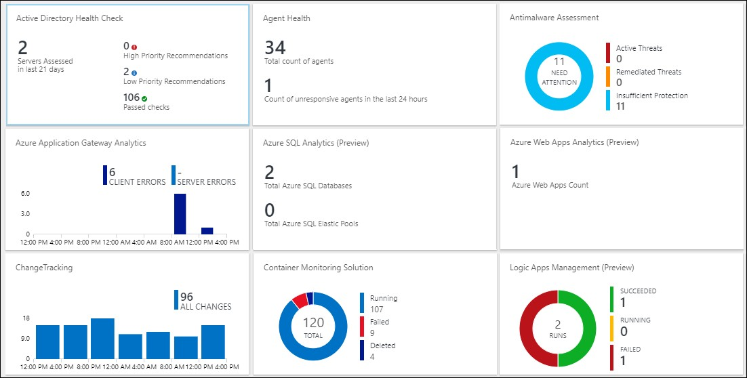
Video: Log Analytics

Slide 36
Log Analytics Scenarios
Example 1 - Assessing updates
IT Administrators assess systems update requirements
Must be able to accurately schedule updates
OMS/Log Analytics collects data from all customers performing updates
Uses "Crowd-sourced" data to provide an average time to help meet strict SLAs
Example 2 - Change tracking
Troubleshooting operational incidents is a complex process
OMS/Log Analytics let you perform analysis from multiple angles, using a variety of sources
Everything correlated through a single interface
Track issues such as unexpected system reboots or shutdowns

Slide 37
Practice: Collect and Analyze Data
Part 1
Collect data about virtual machines
Create a workspace
Enable Log Analytics on virtual machines Collect event and performance data View the data collected
Part 2
View or analyze data collected with Log Analytics search
Search, modify, and filter event data Work with performance data

Slide 38
Practice: Analysis with Log Analytics
Microsoft Online Labs has a self-paced Deep Analysis with Microsoft Azure Log Analytics exercise.
Focus on the basics of Azure Insight and Analytics
Explore Log Analytics, log searches, analysis of Service Map and Network Performance Monitor solutions

Slide 39
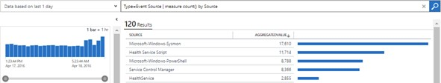
Log Analytics Querying
Log Analytics provides a query syntax
Quickly retrieve and consolidate data in the repository
Save or have log searches run automatically to create an alert Export the data to Power BI or Excel

Slide 40
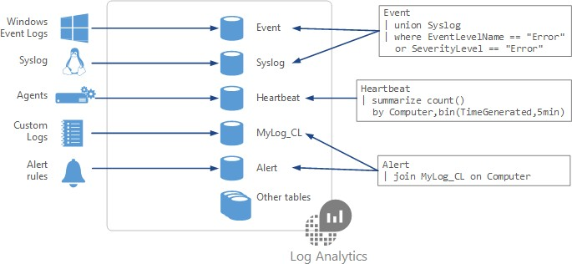
Query Language Syntax
Event
| where (EventLevelName == "Error")
| where (TimeGenerated > ago(1days))
| summarize ErrorCount = count() by Computer
| top 10 by ErrorCount desc

Slide 41
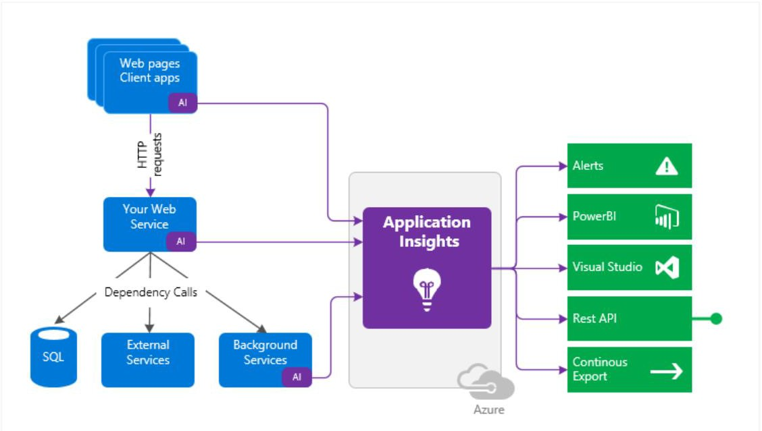
Application Insights - instrumentation monitors your app and sends telemetry data to the portal

Slide 42
Application Insights
Smart detection and manual alerts
Application Maps – bottlenecks/failure spots for distributed apps (triage)
Profiles
Usage analysis
Diagnostic search for instance data
Metrics explorer for aggregated data
Dashboards
Live Metrics stream
Analytics
Visual Studio
Snapshot Debugger

Slide 43
Azure Policies
Focus on deployment & existing resources
Controls properties likes types or locations of resources
Examples –
Require SQL Server 12.0 (denies servers that don’t) Allowed VM SKU’s
Enforce required tag and value on a resource
Can use PowerShell, Azure CLI or Portal
Enforced during policy assignment or policy update & more
Scope – resource groups, subscription or management groups

Slide 44

Questions?

